Slide 1
Turning Data Into Action A Webinar Series for SOHPs
Presenting by the ASTDD Data Committee

Slide 2
General Reminders
This webinar will be recorded and archived on the ASTDD website
We would like to hold any questions until the end, so if you have questions, please make a note of them. When we are ready for questions, if you wish to ask one, please click on the Set Status icon which is the little man with his arm raised on either the upper left or the top of your screen. Click on “raise hand.” We will then call on you to ask your question over the phone
Please respond to the polling questions at the conclusion of the webinar

Slide 3
This presentation was supported by Cooperative Agreement NU58DP004919-05-00 from CDC, Division of Oral Health. Its contents are solely the responsibility of the authors and do not necessarily represent the official views of CDC.

Slide 4
7-Part Series
Date | Topic | Presenter
May 18 | Turning data into action: the importance of data dissemination | Kathy Phipps, ASTDD
June 1 | Developing and using state oral health data reports | Hawaii & Vermont
June 15 | Using the CDC oral health data portal to visually depict oral health data | Valerie Robison, CDC
June 29 | Infographics – a practical tool for data dissemination | Carole Stampfel, AMCHP
July 13 | Oral health infographics – state examples | Arizona & New Hampshire
July 27 | Web-based oral health data systems – state examples | Colorado, Minnesota, Wisconsin
August 10 | Using coalitions and partners to spread the message | Children’s Health Alliance of Wisconsin , Washington Dental Service Foundation
All webinars are Thursday from 3:00-4:00 Eastern Time

Slide 5
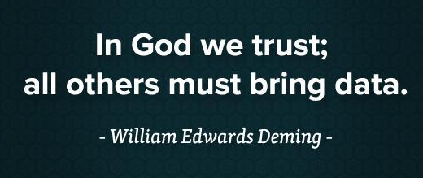
Today’s Session
THE IMPORTANCE OF DATA AND
DATA DISSEMINATION
Kathy Phipps, DrPH
Data & Surveillance Coordinator
Association of State & Territorial Dental Directors

Slide 6
The Importance of Data
William Thomson, 1st Baron of Kelvin, 1824-1907
Mathematical Physicist

Slide 7
The Importance of Data
Peter Drucker, 1909-2005
Management Consultant

Slide 8
Data Serve Many Purposes
To describe
To inform
To educate
To persuade

Slide 9
The Power of Data
When clearly presented and appropriately interpreted, data can be a powerful tool to …
Educate decision makers about issues
Empower them to enact good policy

Slide 10
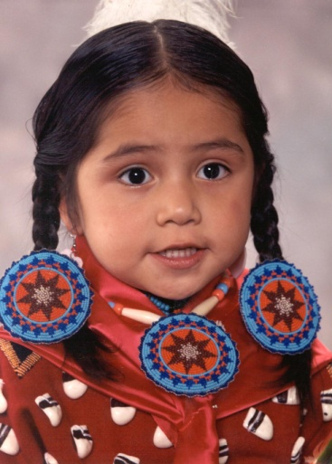
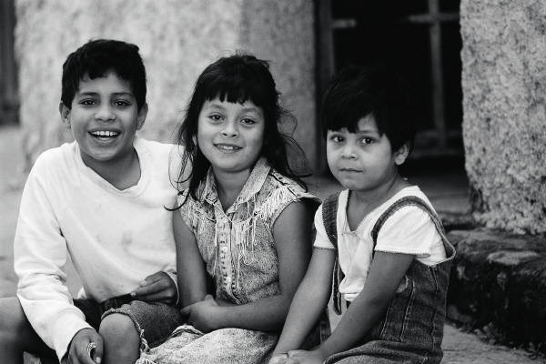
Measuring Oral Health

Slide 11
Oral Health Surveillance
Monitors the status of oral disease in a state’s population
Provides data for …
Setting achievable objectives
Planning & implementing public health programs
Evaluating public health programs
Also important for documenting burden of disease and gaining support and funding

Slide 12
Surveillance Process
Planning &
system design
Data
collection
Data
analysis
Interpretation
of results
Dissemination
&
communication
Application to
public health
programs

Slide 13
Resources Available

Slide 14
Planning & System Design
Available at: www.astdd.org

Slide 15
Data Collection
Available at: www.astdd.org

Slide 16
Data Collection
Available at: www.astdd.org

Slide 17
Data Collection
Available at: www.astdd.org

Slide 18
Data Analysis & Sample Selection
Available at: www.astdd.org

Slide 19
Interpretation of Results
ASTDD Surveillance Consultants
Kathy Phipps, kathyphipps1234@gmail.com
Mike Manz, mmanz@umich.edu

Slide 20
You Have Data – Now What?

Slide 21
Dissemination & Communication
Health Communications Committee
www.astdd.org/health-communications-committee/

Slide 22
Data Dissemination
Who do you tell?
Everyone!

Slide 23
Who Do You Tell?
Public officials – state, county, local
Tell a compelling, but true, story
Tell them over & over again
Greet them by name & introduce yourself

Slide 24
Who Do You Tell?
Public officials – state, county, local
Tell a compelling, but true, story
Tell them over & over again
Greet them by name & introduce yourself
Potential funders
Invite foundation staff to the table
Keep foundations engaged

Slide 25
Who Do You Tell?
Professional associations
Medical & dental professionals

Slide 26
Who Do You Tell?
Professional associations
Medical & dental professionals
Service organizations
Rotary, Kiwanis
Small local organizations – Women Aid

Slide 27
Who Do You Tell?
Professional associations
Medical & dental professionals
Service organizations
Rotary, Kiwanis
Small local organizations – Women Aid
Members of the public
Public service announcements

Slide 28
Who Do You Tell?
Professional associations
Medical & dental professionals
Service organizations
Rotary, Kiwanis
Small local organizations – Women Aid
Members of the public
Public service announcements
Others …

Slide 29
How Do You Tell the Story?
Tailor the “how” to the audience you want to reach
Reports
Fact sheets & data briefs
Infographics
On-line data platforms

Slide 30
Reports

Slide 31
Fact Sheets & Data Briefs

Slide 32
Infographics

Slide 33
Online Data Platforms

Slide 34
Getting the Message to the Audience

Slide 35
Press Conference – Hawaii

Slide 36
Stakeholder Meetings – West Virginia

Slide 37
Other Ways to Get Out the Message?

Slide 38
Use Your Oral Health Coalition
Successful messaging requires efforts beyond that of a single individual, group or organization
A coalition is essential

Slide 39
What Can Coalitions Do?
Carry the “banner”
Develop communications tools that will ensure common messaging across the state
Together we
can prevent
tooth decay!!

Slide 40
What Can Coalitions Do?
Keep legislators & their staff informed

Slide 41
What Can Coalitions Do?
Keep legislators & their staff informed
Contact stakeholders – encourage them to participate

Slide 42
What Can Coalitions Do?
Keep legislators & their staff informed
Contact stakeholders – encourage them to participate
Attend events to promote key oral health messages

Slide 43
What Can Coalitions Do?
Keep legislators & their staff informed
Contact stakeholders – encourage them to participate
Attend events to promote key oral health messages
Use data to enhance oral health messaging efforts

Slide 44
What Can Coalitions Do?
Keep legislators & their staff informed
Contact stakeholders – encourage them to participate
Attend events to promote key oral health messages
Use data to enhance oral health messaging efforts
Work with media

Slide 45
Coalitions & Working with Legislators

Slide 46
Working with Legislators
Do your homework
Identify your legislators
www.congress.gov
www.congress.org
State legislative websites

Slide 47
Working with Legislators
Do your homework
Identify your legislators
www.congress.gov
www.congress.org
State legislative websites
Know the issues and interests of your legislators
Visit their websites

Slide 48
Working with Legislators
Do your homework
Identify your legislators
www.congress.gov
www.congress.org
State legislative websites
Know the issues and interests of your legislators
Visit their websites
You won't agree on all of the issues, but a legislator needs to know if constituents support their issues

Slide 49
Working with Legislators
Make it personal
Schedule a face-to-face meeting

Slide 50
Working with Legislators
Make it personal
Schedule a face-to-face meeting
Write a letter

Slide 51
Working with Legislators
Make it personal
Schedule a face-to-face meeting
Write a letter
Send an email

Slide 52
Working with Legislators
Make it personal
Schedule a face-to-face meeting
Write a letter
Send an email
Call your legislator’s office

Slide 53
Working with Legislators
Make it personal
Schedule a face-to-face meeting
Write a letter
Send an email
Call your legislator’s office
Follow the legislator on Facebook & other social media

Slide 54
Working with Legislators
Make it personal
Schedule a face-to-face meeting
Write a letter
Send an email
Call your legislator’s office
Follow the legislator on Facebook & other social media
Attend a town hall meeting or in district coffee hour

Slide 55
Working with Legislators
Make it personal
Schedule a face-to-face meeting
Write a letter
Send an email
Call your legislator’s office
Follow the legislator on Facebook & other social media
Attend a town hall meeting or in district coffee hour
Use Coalition messaging plus personal stories

Slide 56
Working with Legislators
Give credit where credit is due
Give public recognition to deserving legislators
A public thank you, an award, etc.

Slide 57
Working with Legislators
Give credit where credit is due
Give public recognition to deserving legislators
A public thank you, an award, etc.
Be a player
Attend events where legislators will be present
Get acquainted and make them aware of you as an active member of the community

Slide 58
Working with Legislators
Remember, your issue is one of many
Legislative staff handle a bewildering array of issues
They do not know everything related to your issue
The purpose of any meeting with legislators/staff should be to share with them your views
If they aren’t familiar with the issue, take that as a perfect opportunity to bring them up to speed!

Slide 59
Working with Legislators
Staff, over legislator, contact has advantages
Staff can take more time to delve into an issue & gain a greater understanding of why your ideas are great
With a little work, staff can become advocates
A great deal of what gets done is due to the initiative of the staff

Slide 60
Working with Legislators
Expect and appreciate youth
Most legislative staffers are young
Staffers are bright and capable individuals who will respond appropriately to your requests

Slide 61
Working with Legislators
Make sure to follow up
Most advocates do not follow up then wonder why legislators don’t do what they were asked to do
This usually happens for the following reasons:
The legislator forgot about the request
The legislator hasn’t had time to form an opinion
The legislator is waiting to see how much you really want what you’re asking for

Slide 62
Tips for Effective Follow-Up
Ask staff which method of communication they prefer
Most appreciate being asked whether it’s best to update them via phone, fax, email or face-to-face meeting

Slide 63
Tips for Effective Follow-Up
Ask staff which method of communication they prefer
Most appreciate being asked whether it’s best to update them via phone, fax, email or face-to-face meeting
Be patient and considerate
Send a thank-you card to the person you met with

Slide 64
Tips for Effective Follow-Up
Ask staff which method of communication they prefer
Most appreciate being asked whether it’s best to update them via phone, fax, email or face-to-face meeting
Be patient and considerate
Send a thank-you card to the person you met with
Keep in touch
Keep the momentum rolling by sending small communications throughout the year and interacting with your legislators via their social media sites
Don’t be a pest – keep your communications short and purposeful and you’ll be looked at as a resource

Slide 65
Dissemination & Communication

Slide 66
Miscellaneous Tips & Tricks
Try to report data within 6-12 months of data collection
Advocates and legislators want current information

Slide 67
Miscellaneous Tips & Tricks
Try to report data within 6-12 months of data collection
Advocates and legislators want current information
Develop a written communication plan

Slide 68
Miscellaneous Tips & Tricks
Try to report data within 6-12 months of data collection
Advocates and legislators want current information
Develop a written communication plan
Humanize the story

Slide 69
Miscellaneous Tips & Tricks
Try to report data within 6-12 months of data collection
Advocates and legislators want current information
Develop a written communication plan
Humanize the story
Consider a state-wide media push

Slide 70
Miscellaneous Tips & Tricks
Try to report data within 6-12 months of data collection
Advocates and legislators want current information
Develop a written communication plan
Humanize the story
Consider a state-wide media push
Be aware of when your legislature is in session and release the information at a time when key legislators will take note of the results

Slide 71
Miscellaneous Tips & Tricks
Mail or email the report to key stakeholders and acknowledge their contribution

Slide 72
Miscellaneous Tips & Tricks
Mail or email the report to key stakeholders and acknowledge their contribution
In-person presentations are more powerful than a mailed report

Slide 73
Miscellaneous Tips & Tricks
Mail or email the report to key stakeholders and acknowledge their contribution
In-person presentations are more powerful than a mailed report
Consider publishing two different reports, a full report and a 1-3 page summary

Slide 74
Miscellaneous Tips & Tricks
Mail or email the report to key stakeholders and acknowledge their contribution
In-person presentations are more powerful than a mailed report
Consider publishing two different reports, a full report and a 1-3 page summary
Make sure to use plain English
www.plainlanguage.gov

Slide 75
12 offenders most likely to weaken your work
INSTEAD OF… | TRY…
addressees | you
assist, assistance | aid, help
commence | begin, start
implement | carry out, start
in accordance with | by, following, per, under
in order that | for, so
in the amount of | for
in the event of | if
it is | (omit)
promulgate | issue, publish
this activity, command | us, we
utilize, utilization | use
Available at: www.plainlanguage.gov

Slide 76
Miscellaneous Tips & Tricks
Create a document that is...
Visually inviting
Logically organized
Understandable on the first reading

Slide 77
Miscellaneous Tips & Tricks
Create a document that is...
Visually inviting
Logically organized
Understandable on the first reading
Use these tools to write clearly...
Active voice with strong verbs
Short sentences
Personal pronouns
Concrete, familiar words

Slide 78
Miscellaneous Tips & Tricks
Highlight the positive and the negative

Slide 79
Miscellaneous Tips & Tricks
Highlight the positive and the negative
Emphasize next steps and recommendations

Slide 80
Miscellaneous Tips & Tricks
Highlight the positive and the negative
Emphasize next steps and recommendations
Use pictures and graphs – avoid complex data tables

Slide 81
Miscellaneous Tips & Tricks

Slide 82
Example: Short & Sweet
There is no escaping the fact that it is considered very important to note that a number of various available applicable studies have generally identified the fact that additional appropriate nocturnal employment could usually keep juvenile adolescents off thoroughfares during the night hours, including but not limited to the time prior to midnight on weeknights and/or 2 a.m. on weekends.

Slide 83
Example: Short & Sweet
More night jobs would keep youths off the streets.

Slide 84
Conclusion
Turn
Data
Into
Doing

Slide 85
Success Story
San Luis Obispo (SLO) County, California

Slide 86
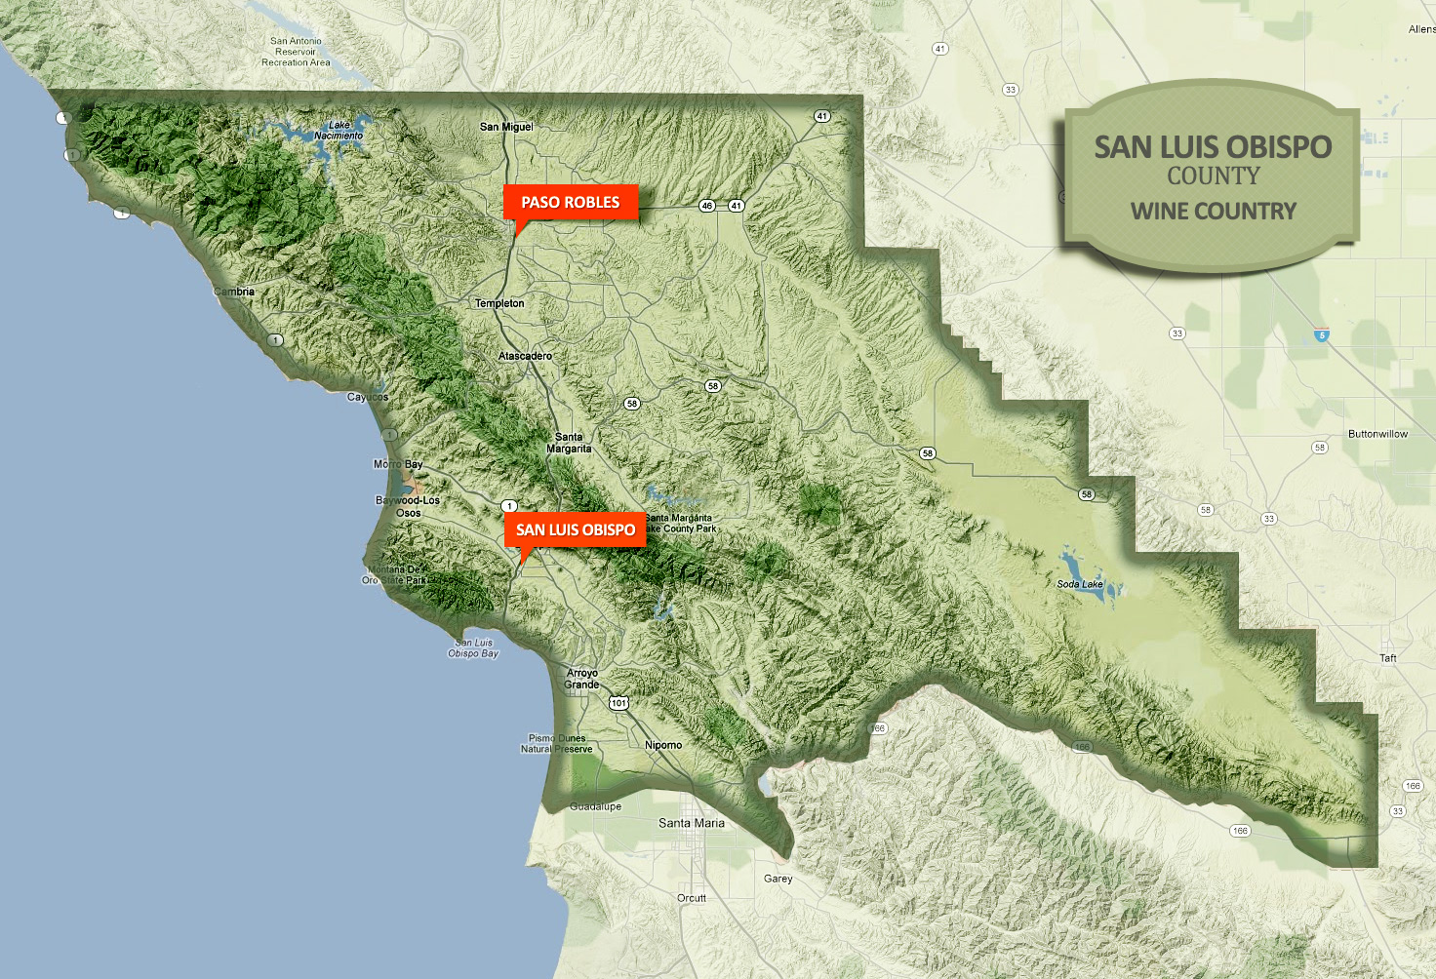
3 Distinct Regions
NORTH
CENTRAL
SOUTH

Slide 87
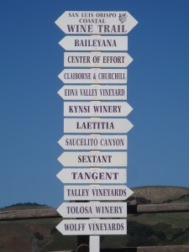
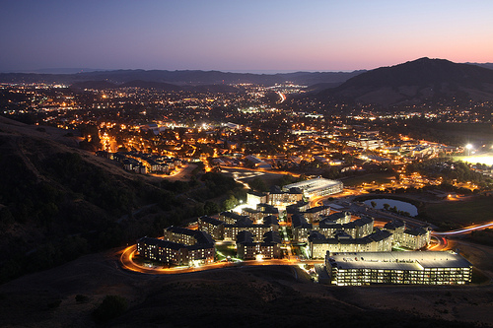
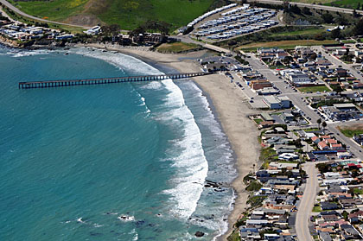
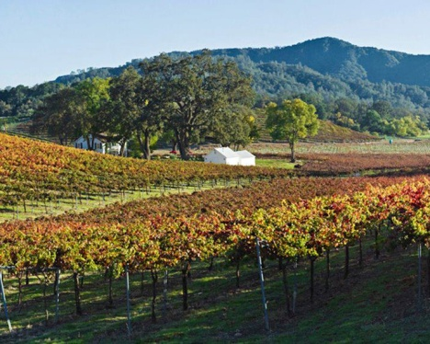
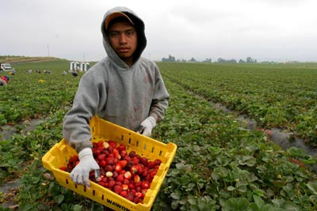
3 Distinct Regions
NORTH
CENTRAL
SOUTH

Slide 88
SLO Oral Health
2008 – County Oral Health Summit
Collectively identified problem areas
No county-wide prevention programs
Limited access to dental care for low-income children
Lack of coordination of oral health activities
Lack of local data

Slide 89
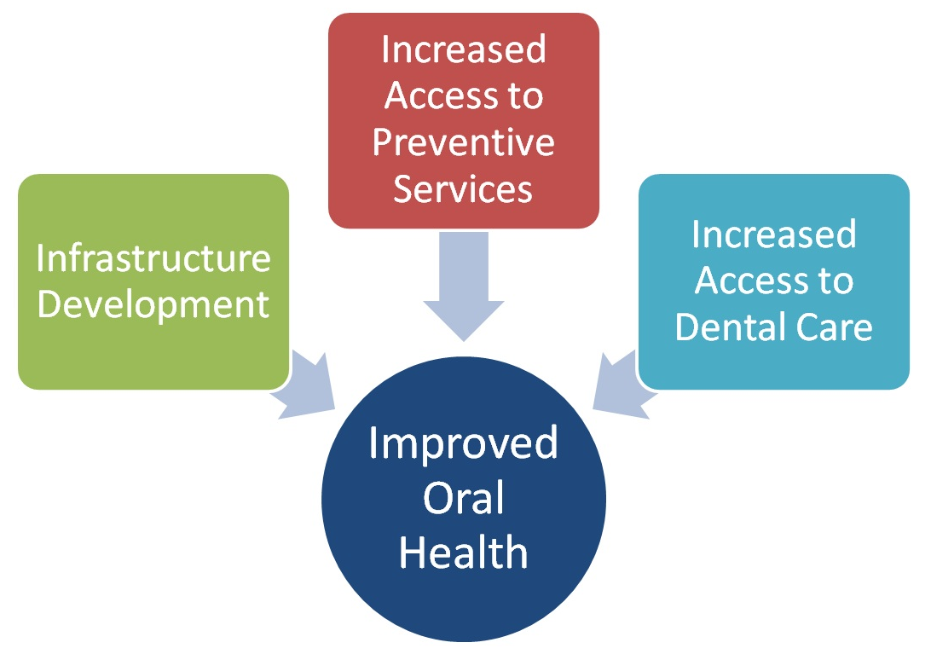
SLO Oral Health
2009 – Oral Health Initiative funded by First 5 SLO
SLO County Oral Health Coalition developed plan with a 3-prong approach

Slide 90
Fluoride Varnish Program
Head Start, Preschools, WIC
FQHC hired pediatric dentist
Give Kids a Smile
More dentists taking Medicaid
County hired Oral Health Program Manager

Slide 91
In the Beginning …

Slide 92
North: Significant Change

Slide 93
Central: Significant Change

Slide 94
South: Change not Significant

Slide 95
Conclusion
Small Investment by First 5 & County Government
Substantial Change in Oral Health
Maintain by Continuing to Provide Ongoing Support

Slide 96
Questions or Comments?

