Slide 1
Turning Data Into Action A Webinar Series for SOHPs
Presenting by the ASTDD Data Committee

Slide 2
7-Part Series
Date | Topic | Presenter
May 18 | Turning data into action: the importance of data dissemination | Kathy Phipps, ASTDD
June 1 | Developing and using state oral health data reports | Hawaii & Vermont
June 15 | Using the CDC oral health data portal to visually depict oral health data | Valerie Robison, CDC
June 29 | Infographics – a practical tool for data dissemination | Carole Stampfel, AMCHP
July 13 | Oral health infographics – state examples | Arizona & New Hampshire
July 27 | Web-based oral health data systems – state examples | Colorado, Minnesota, Wisconsin
August 10 | Using coalitions and partners to spread the message | Children’s Health Alliance of Wisconsin , Washington Dental Service Foundation
All webinars are Thursday from 3:00-4:00 Eastern Time

Slide 3
General Reminders
This webinar will be recorded & archived (www.astdd.org)
Please hold questions until the end
If you have questions, please make a note of them
If you want to ask a question at the end, click on the Set Status icon
The little man with his arm raised on either the upper left or the top of your screen. Click on “raise hand.”
We will then call on you to ask your question.
Please respond to the polling questions

Slide 4
Acknowledgements
This presentation was supported by Cooperative Agreement NU58DP004919-05-00 from CDC, Division of Oral Health. Its contents are solely the responsibility of the authors and do not necessarily represent the official views of CDC.

Slide 5
Today’s Session
Developing and Using State Oral Health Reports
Gavin Uchida and Annette Mente – Hawaii
Robin Miller – Vermont
Fun with Flags

Slide 6
Development & Use Hawaii State Oral Health Data Reports
Annette Mente, Planner
Gavin Uchida, DDS, MBA
State Dental Director
Family Health Services Division
Department of Health
State of Hawaii

Slide 7
Take home points
The role of Partnerships
ASTDD guidance/resources
Graphic Design
Communications expertise
Use the data

Slide 8
About us:
Family Health Services Division
Rebuilding, after elimination of the Oral Health Program in 2009
Last 7 years, oral health managed by core staff
Annette Mente and Gregg Kishaba (both non-dental),
and Andrew Tseu, DDS, JD
5 DOH dental clinics servicing I/DD population
Virtual Dental Home Project
Production of 2 data reports discussed today
CDC Component 1 State Infrastructure Grant
Recent hiring of a DOH Dental Director
Rebuilding the department role as statewide leadership

Slide 9
2 Data Reports
http://health.Hawaii.gov/about/publications/

Slide 10
Importance of Partnership
Local Partnerships were critical to collection of GOOD DATA
Our collaborative experience with Medicaid data
We received access to potentially sensitive data
We responded by vetting our results
Our being welcomed in community settings
Content vetted also with key oral health stakeholders
Oral Health Data Advisory Committee
Notes:
Also had Bev Isman at ASTDD & CDC review report

Slide 11
Importance of Partnership
ASTDD teamwork and guidance
Was CRITICAL for these reports
Hands on advice and assistance
Data collection and analysis
Results and report creation
Thank you
Notes:
Also had Bev Isman at ASTDD & CDC review report

Slide 12
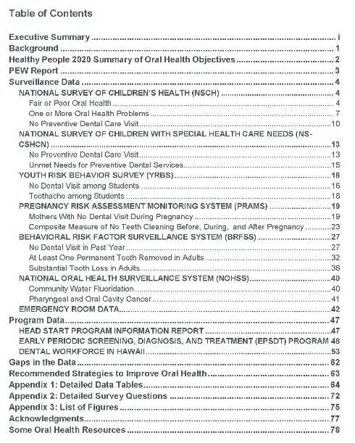
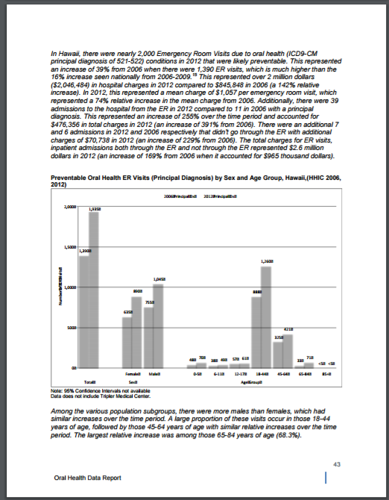
Report #1: Oral Health Key Findings
Developed as burden report
Derived from compilation of data sources
Input from oral health stakeholders
Solid, strong DATA
Very “Epi focused”
Over 100 pages in length
No summary findings or recommendations
Goal: provide a context for future conversation and stakeholder planning
Notes:
The original data report was developed for Epi/research users
The report was organized by data sources, thus not very user friendly
Over 100 pages in length
No summary of findings or recommendations

Slide 13
Report #2: Hawaii Smiles 2015
Developed using ASTDD BSS guidelines
Goal: add community-gathered data to the Hawaii Oral Health Report data
Goal: facilitate stakeholder planning and direction - User friendly

Slide 14
“Tell a Story with the Data” Department of Health Deputy Director, Danette Wong Tomiyasu MBA
“Tell a story” This data is about people.
Partnered closely with ASTDD
Reviewed reports from other states
Know your target audience(s)
Our Goals: Empower our community partners
Showcase key findings
Present clear recommendations for legislation
Notes:
While the data compilation was an important first step
The SOHP wanted the data to “tell a story” since data does not speak for itself
Worked with Kathy Phipps who asked important questions like, “Who is your audience?”
Together we outlined some report parameters including key findings & recommendations
Kathy also advised us to look at other state burden reports which was very helpful

Slide 15
The role of :

Slide 16
http://health.Hawaii.gov/about/publications/

Slide 17
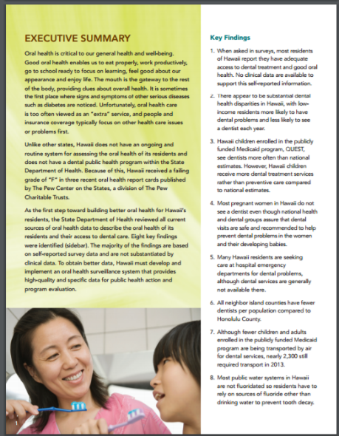
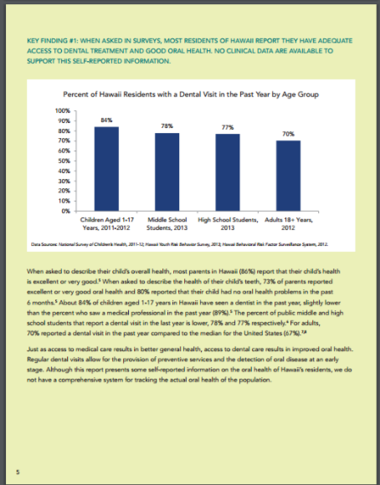
Hawaii Oral Health Key Findings
Notes:
The Key Findings report serves as an effective format the SOHP is now using for all oral health reports.
Originally, the Key Findings report was developed to fulfill the need for a burden document
Was derived from a longer report - compilation of existing data sources
Developed in partnership with oral health stakeholders

Slide 18
Printed Report Format Thank you to Kathy Phipps
Visually appealing
Logically organized
Easy to understand
Include both positive & negative findings
Direct recommendations & prescriptions
Short ‘n sweet: 18 pages each
5 pages of detailed tables, references in the back
Notes:
Took over a year to develop a format
Kathy did about 4 different drafts, but was very patient
Incorporated many of the tips promoted by ASTDD

Slide 19
Choosing a Graphic Designer
Graphic Designer familiar with Department
Understood DOH Design Approach
Able to work with Data/Charts
Provided choices of backgrounds, color schemes, photos
Notes:
Worked with Graphic Designer who had designed a number of DOH reports including for Chronic Disease Prevention Program, Immunization so understood the “look & feel” of an agency report.
Very affordable, relative to other design services
Very flexible, patient, easy to work with
Provided the program with a number of 3 background choices, several color schemes for graphs, went through series of photos till we found the final choices.

Slide 20
Concise
Organized
Visual
Relevant

Slide 22
Partnerships: Broad Dissemination of Report
All state legislators received electronic copies
Governor's office, policy staff
State agency heads
State OH coalition
Electronic copy posted on DOH website
http://health.Hawaii.gov/about/publications/
Notes:
The weakness for the SOHP was not having a communication plan to disseminate the report.
Dissemination was determined incrementally based on lists used for other Division data reports. Printed 100 copies of Key Findings Report.

Slide 23
Partnerships: Impact
Used in legislation
Governor’s State Health Transformation Office
Favorable response from stakeholders
Increase DOH credibility as data source
HDS assessment survey
Notes:
What surprised the Department was how the data and recommendations were adopted and used verbatim in a number of key policy documents and legislation
Data & recommendations were quoted in preamble to oral health legislation – for expansion of Medicaid adult dental benefits
The Governor’s State Health Transformation Office used the data in a State Innovation Model report to identify oral health as a key health issue for the state
Hawaii Dental Service also used the report recommendations to assess oral health stakeholder priorities & inform its Foundation funding priorities.

Slide 24
Hawaii Smiles Report
First 3rd grade BSS in Hawaii
Highest prevalence of tooth decay in US
Major partnerships
Agencies
Professional organizations
Funders
Volunteers
Notes:
From the Oral Health key findings we knew we had a winning format
Used same graphic designer
Worked again with Kathy Phipps & amazing public health dental resident, Jennifer Domagalski who sheparded the report through many hands.
Compelling story the highest prevalence of tooth decay among 3rd graders in the U.S.
First time HI conducted the BSS using a representative sample
Although, the SOHP still did not have a dissemination plan there was a distribution list from the Key Findings report.
It was through the partnerships developed during the BSS project that would help with communications

Slide 25
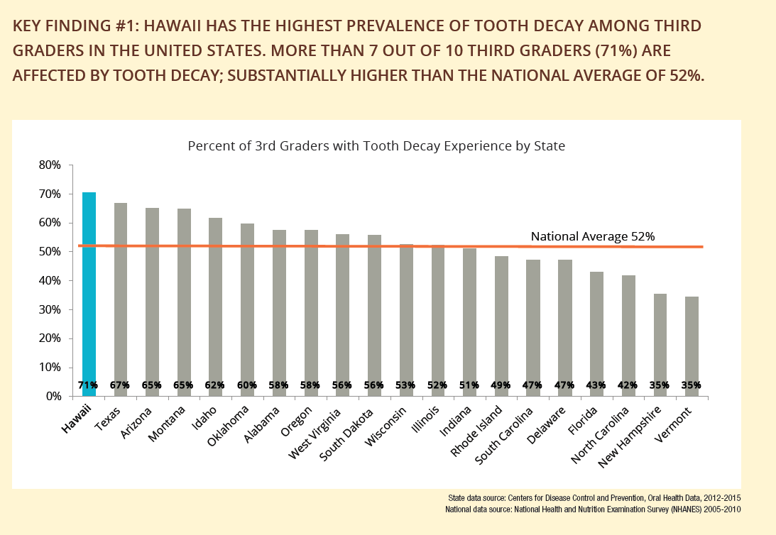
Finding #1: Tooth Decay Prevalence
Hawaii has the highest prevalence of tooth decay among third grade children in the U.S. with 70.6%, compared to the national average of 52%
Notes:
Here’s the Key Finding on prevalence & the report graph.
Hawaii has the highest rate of tooth decay, 70.6%, compared to the national average of 52%.

Slide 26
Partnerships: The role of a Communications Specialist

Slide 27
Communication Specialist Thank you, Nathan Hokama
HDS Foundation partnership
Department Public Information Officer
Press conference when Foundation award made
Notes:
The SOHP was very lucky to access a communication specialist through one of the key funders for the BSS Hawaii Dental Service Foundation, the delta dental affiliate
Hawaii is a very small state and the HDS communications consultant, Nathan Hokama, was also on contract with the DOH Public Information officer, Janice Okubo
The Department only has one PIO for the entire Department, so having addition assistance was extremely valuable to Janice.
Nathan working in partnership with Janice was critical to identify press opportunities for BSS even before it started.
They closely followed the progress of the report intent on doing a press conference when published.
Here’s a photo of the press conference held during Children’s Oral Health Month at an HDS sponsored event at the Children’s Discovery Museum. The HDS foundation check was presented to the DOH. The contractor for the BSS, the HPCA, was also present.
In the photo you see:

Slide 28
Communication Objectives
Heighten Focus on Children’s Oral Health
Public Health Leadership
Oral Health Disparities
Acknowledge Partners
Notes:
What follows are the communications objectives, strategies, tactics development by Nathan in consultation with the SOHP
Heighten Focus on Children’s Oral Health Increase public awareness of the state of oral health of children in the State of Hawaii to inspire a stronger focus on early intervention and more collaboration within the oral health community.
Leadership
Demonstrate the importance of Department of Health’s leadership in tackling the state’s tough oral health challenges
Oral Health Disparities Identify trends and highlight oral health disparities by income, ethnicity and geography across the islands of Hawaii
Acknowledge Partners Acknowledge the collaborative effort involved to conduct the BSS and recognize it is through partnerships across the community that oral health issues will be addressed. The Department cannot do this alone.

Slide 29
Communication Strategies
Change Narrative to a Hopeful Message
Facilitative Leadership Position
Action Orientation
Notes:
Change Narrative to a Hopeful Message [Note: might change this] Shift narrative away from the Pew Charitable Trust national survey findings, which consistently ranked Hawaii’s children at the bottom of the nation with a grade of “F” because of the inability to meet the eight of the policy benchmarks that include fluoridation of drinking water.
Facilitative Leadership Position Position the Hawaii Department of Health as a facilitative leader, bringing the community together to create the Hawaii Smiles report, an important milestone in providing baseline data to serve as a springboard for collective action to improve the oral health of Hawaii’s children
Action Orientation
Highlight actionable results in response to the surveillance report (e.g., create a platform to discuss pilot programs underway such as the Virtual Dental Home (teledentistry) program, greater access to dental health care. Also discuss look toward state planning & pilot dental sealant project.

Slide 30
Communication Tactics
News Conference
Media Advisory
News Release
Media Talking Points
Post-News Conference Media Coverage
Notes:
News Conference
Invite key stakeholders to serve as panelists to announce the Hawaii Smiles report findings and to explain the launch of the Virtual Dental Home program
Media Advisory
Invite media to the news conference; facilitate interviews for in-depth coverage
News Release Draft news release for distribution at the news conference
Media Talking Points Develop talking points for news conference panelists to harmonize messaging for consistent and unified communications
Post-News Conference Media Coverage

Slide 31
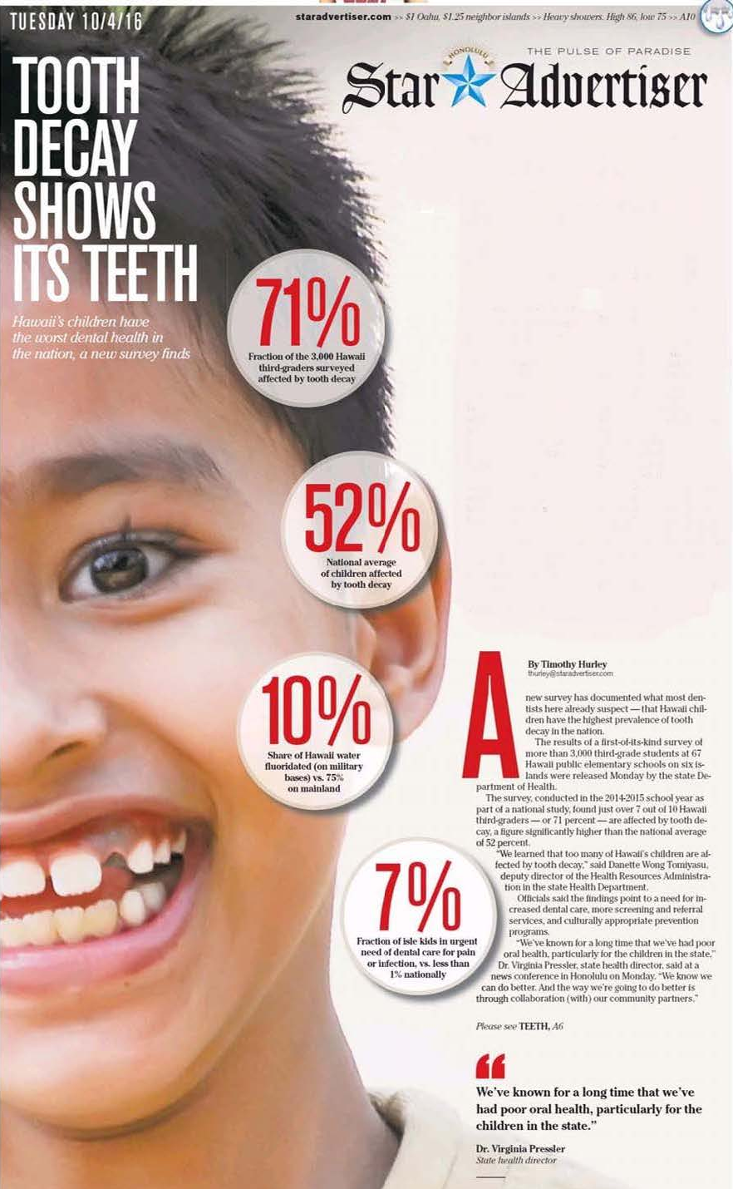
“Tell EVERYONE”
Press conference
led to next day full front page in the state’s largest newspaper
stories in neighbor island newspapers.
TV and radio media
22 TV “news stories”
22:35 minutes of TV news runtime over 5 TV stations
four radio stations broadcasted story
An estimated 539,896 residents were exposed to the news story on October 3, 2016.
Stakeholder Partnerships:
HDA and HDS conducted additional TV and radio interviews about the report.
Notes:
Front page coverage from the State major daily newspaper on the press conference
We had a couple of challenges:
Time of the press conference was Monday morning at 10:30am. Only time we could get Dr. Pressler & Mark Yamakawa together.
Department secretaries moved mountains to find us a room in the Dept for the press conference.
We asked Nathan why he thought the press responded so well to a Monday morning press conference:
The Department rarely calls press conferences
Dr. Pressler was going to be at the conference, so the press knew it was serious
Having the partners identified in the press advisory also showed the serious nature of the conference.

Slide 32
Followup: Broad Dissemination of Report
Copies sent to Department of Education
Printed 4-page executive summary
Disseminated at State Health Workforce Summit
State Dental Hygiene Association meeting
Hawaiian Island Oral Health Task Force meeting
State Health Planning Development Agency meeting
Notes:
400 copies of full Hawaii Smiles Report
1,100 copies of 4-page executive summary

Slide 33
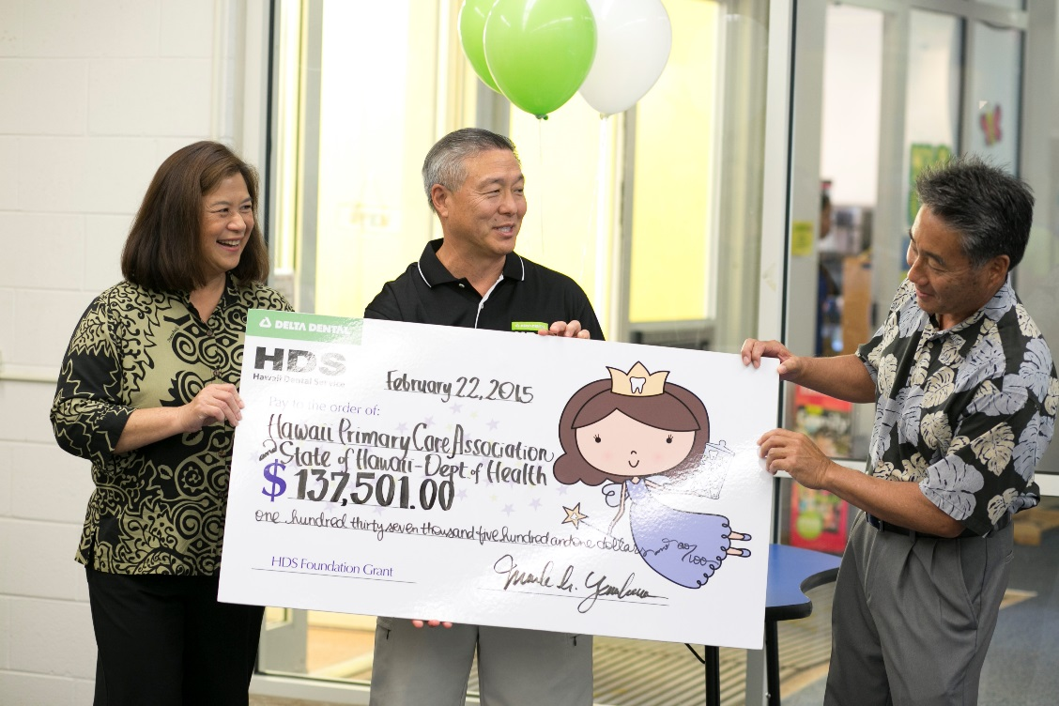
Impact
Funding
Notes:
In addition to statewide news coverage again the report was used in drafting oral health legislation
The data and recommendations we used in a 2nd state SIM report to CMS
The report sparked HPHA to apply for DQF grant on oral health disparities & moved HCAN, the lead children’s advocacy organization, to approach DOH to partner in an effort to convene stakeholders to develop a children’s oral health plan.

Slide 34
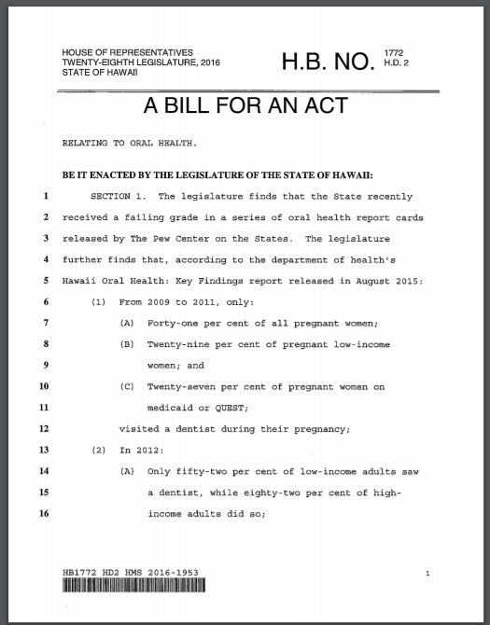
Impact
Used in legislation
2nd State Innovation Model report
Future focused projects
Notes:
In addition to statewide news coverage again the report was used in drafting oral health legislation
The data and recommendations we used in a 2nd state SIM report to CMS
The report sparked HPHA to apply for DQF grant on oral health disparities & moved HCAN, the lead children’s advocacy organization, to approach DOH to partner in an effort to convene stakeholders to develop a children’s oral health plan.

Slide 35
Take home points
The role of Partnerships
ASTDD guidance/resources
Graphic Design
Communications expertise
Use the data

Slide 36
Contact Info
Annette Mente Planner, Family Health Services Division Hawaii State Department of Health Email: annette.mente@doh.hawaii.gov
Gavin Uchida, DDS, MBA
State Dental Director, Family Health Services Division Hawaii State Department of Health
Email: gavin.uchida@doh.hawaii.gov

Slide 37
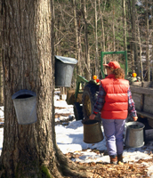
Use of reports and data to gain progress on dental public health issues in Vermont
Act I: Stuck in Vermont

Slide 38
Stuck in Vermont
The Vermont Oral Health Coalition was formed in 2011, the same year the Dental Therapist bill was introduced into the legislature
The bill started to gained traction in 2013, but did not pass until 2016
Some members of the coalition were very much in favor of the DT legislation; some were adamantly opposed.

Slide 39
Stuck in Vermont
We knew there was a lot that we agreed on, but we always got stuck on this issue.

Slide 40
Stuck in Vermont
From the outside our meetings looked like this:

Slide 41
Stuck in Vermont
… but on the inside, many of us felt like this:

Slide 42
Stuck in Vermont
Green Mountain Care Board Dental Policy Recommendations
Vermont Dental Society’s Action Plan for Dental Health
Department of Vermont Health Access’ (Medicaid) Dental Action Plan
State Oral Health Plan
VT Agency of Human Services Oral Health Recommendations

Slide 43
Stuck in Vermont
Common Themes in the reports:
Community water fluoridation
Prenatal and Infant oral health
Oral health access for Medicaid beneficiaries
Medical/dental integration
Dental sealants

Slide 44
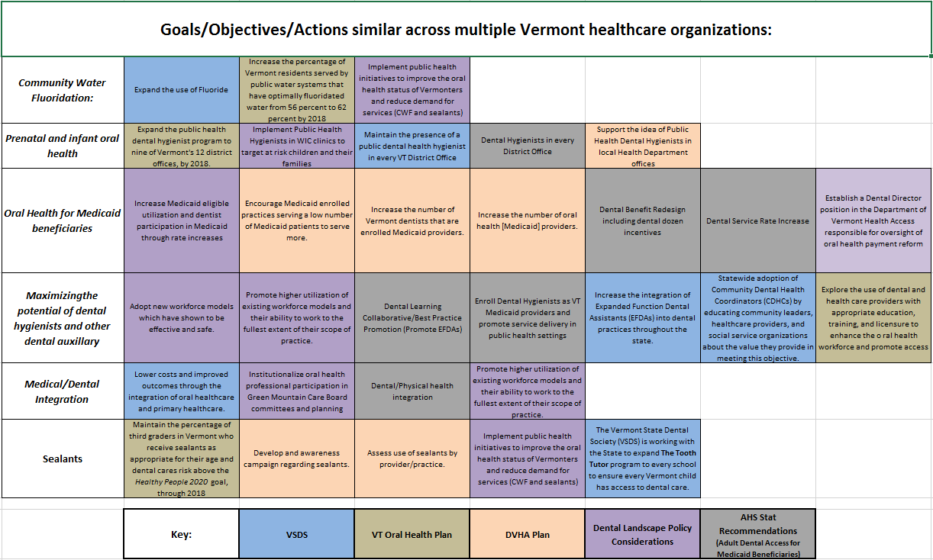
Stuck in Vermont

Slide 45
Stuck in Vermont

Slide 46
Stuck in Vermont
Based on these common themes we updated the structure of our coalition to focus on four subcommittees:
Pregnant women/young children
Medical/dental collaboration opportunities
Community water fluoridation
Promoting the use of Expanded Functions Dental Auxiliary

Slide 47
Stuck in Vermont
We surveyed dental practices in Vermont to identify gaps in access to care for pregnant women and children beginning at age one who are insured by Medicaid
We held our first statewide medical/dental integration conference
We worked together to maintain fluoridation in Rutland, Vermont’s 4th largest city
We produced a video to promote Vermont’s EFDA program and conducted a survey to better understand the EFDA landscape

Slide 48
Stuck in Vermont
In May of 2016 Governor Shumlin signed the dental therapist bill into law.
Dental therapy is now a subcommittee of the workforce development committee.
We continue to use the structure we developed in 2015.
Although our four focus areas have evolved, we remain focused on community water fluoridation, medical/dental integration, perinatal oral health, and workforce

Slide 49
Stuck in Vermont

Slide 50
Act II: Patience Pays Off

Slide 51
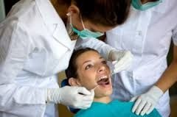
Patience Pays Off
Using data and reports to enroll hygienists as Medicaid providers in Vermont

Slide 52
Patience Pays Off
AHS leadership meeting, no traction on strategies
Change in Leadership at DVHA in 2015

Slide 53
Patience Pays Off
Developed comprehensive list of questions

Slide 54
Patience Pays Off
Developed Information packet including:
Fiscal impact statement
FAQ
List of 16 states where hygienists can enroll as Medicaid providers
General Supervision Agreement
Literature review
CMS informational Bulletin

Slide 55
FAQ Examples
What is the benefit of enrolling hygienists as Medicaid providers in VT?
How much is this going to cost the Medicaid program?
How will they be regulated and monitored?
What about liability?
Where will they get their equipment?
Where would they refer patients who need restorative dental care?

Slide 56
Literature Review Examples
Buchmueller, T., Miller, S., & Vujicic, M. (2014). How do providers respond to public health insurance expansions? Evidence from adult Medicaid dental benefits. National Bureau of Economic Research. Retrieved from http://www.nber.org/papers/w20053
Centers for Medicare and Medicaid Services (CMS). (2011). CMS oral health strategy. Retrieved on 8/29/14. Retrieved from https://www.medicaid.gov/medicaid/quality-of-care/downloads/cms-oral-health-strategy.pdf
Centers for Medicare and Medicaid Services (CMS). (2013). Keep kids smiling: Promoting oral health through the Medicaid benefit for children and adolescents. Retrieved from https://www.medicaid.gov/medicaid/benefits/downloads/keep-kids-smiling.pdf
National Governors Association (NGA). (n.d.). The role of dental hygienists in providing access to oral health care. Retrieved on 8/29/14 from http://www.nga.org/files/live/sites/NGA/files/pdf/2014/1401DentalHealthCare.pdf

Slide 57
Patience Pays Off
July of 2016 Vermont became the 17th state to enroll dental hygienists as Medicaid providers. This may increase access to preventive care for Medicaid beneficiaries

Slide 58
Act III
Lessons Learned

Slide 59
Lessons Learned
Other states are valuable sources of information
The ASTDD is a great source of information
Organizations have committed to what they have put in writing
Sometimes even if a report is not being used, it may contain data or recommendations that can further your cause
There is power in presentation

Slide 60
Thank you!
Robin Miller, RDH, MPH
Robin.n.miller@Vermont.gov
802-863-7272

Slide 61
Presenter Contact Info
Gavin Uchida, DDS, MBA
Hawaii State Department of Health
gavin.uchida@doh.hawaii.gov
Annette Mente Hawaii State Department of Health annette.mente@doh.hawaii.gov
Robin Miller, RDH, MPH
Vermont Department of Health
Robin.n.miller@Vermont.gov

Slide 62
Questions?
If you have a question, please click on the little man with his arm raised icon on either the upper left or the top of your screen. Click on “raise hand.” We will then call on you to ask your question over the phone.

