Slide 1
Promoting Key Oral Health Messages in Head Start and Child Care Programs
DHL Webinar
Presented by:
Michelle Landrum, R.D.H., M.Ed., and Beth Lowe, B.S.D.H., M.P.H.
July 13, 2018

Slide 2

General Reminders
This webinar will be recorded and archived on the ASTDD DHL webpage.
Questions will be addressed after the speakers are finished. Please click on the icon at the top of your screen that looks like a person with their hand in the air. The moderator will recognize and “un-mute” you so you can ask your question.

Slide 3
Objectives
Recognize NCECHW activities that support year 3 DHL project strategies
Understand the requirements for using NCECHW-approved oral health presentations
Learn how to access NCECHW-approved oral health presentations and handouts
Participate in an open question and answer session regarding your role as the state DHL

Slide 4
Update on NCECHW Activities that Support Year 3 DHL Project Strategies

Slide 5
NCECHW Activities that Support Year 3 DHL Project Strategies
The DHL workplan can be found on the DHL webpage
Letter of introduction sent to DHLs and the American Academy of Pediatrics' Chapter Oral Health Advocates
  Sent via DHL listserv in February 2018
Video on toothbrushing at the table will be released July or August 2018
Annual regional DHL coordinators’ meeting will be held at ADHA headquarters in Chicago, IL on August 13, 2018
  Year 4 DHL workplan will be finalized

Slide 6

NCECHW Activities that Support Year 3 DHL Project Strategies
Promoting the Oral Health of Young Children by Working in Dental Public Health
Presented by Michelle Landrum, Michelle Martin, and Gina Sharps
ADHA Annual Conference, June 22, 2018, Columbus, OH
  Approximately 130 attendees
  Increased visibility of DHLs among ADHA members
  Exploring opportunity to present at ADHA annual conference in 2019

Slide 7
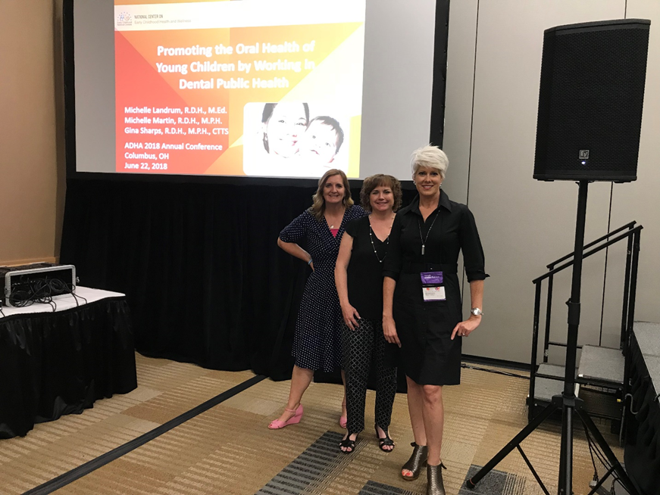
ADHA Annual Conference

Slide 8

NCECHW Activities that Support Year 3 DHL Project Strategies
ADHA Access magazine article
  September/October 2018 issue will feature the DHL project and highlight the following 5 DHLs:
    Heather K. Blair, Vermont DHL
    Kathy Hunt, Kansas DHL
    Michelle Martin, Utah DHL
    Beth Stewart, Texas DHL
    Celeste Terry, Louisiana DHL

Slide 9
NCECHW Activities that Support Year 3 DHL Project Strategies
NCECHW Health Care Institute
  Held April 25, 2018 in Albuquerque, NM
  Provided training on oral heath for Head Start and child care staff
  Participants included:
    67 Head Start staff representing 33 grantees
    2 child care staff representing 1 program
    4 Head Start regional health specialists
    9 regional DHL coordinators
  Regional DHLs coordinators presented Oral Health Messages to Share with Parents
  Staff to host training for parents

Slide 10
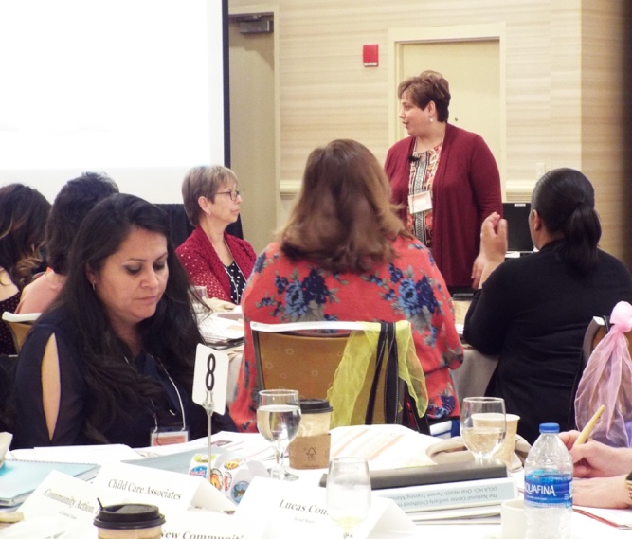
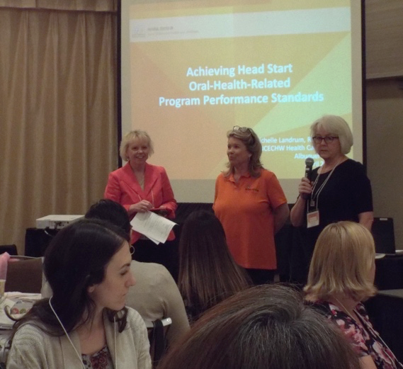
NCECHW Health Care Institute
Overview of Oral Health Training and NCECHW’s Oral Health Team
Oral Health Messages to Share with Parents
Achieving Head Start Oral Health-Related Program Performance Standards

Slide 11
NCECHW-Approved Oral Health
Presentations and Handouts

Slide 12
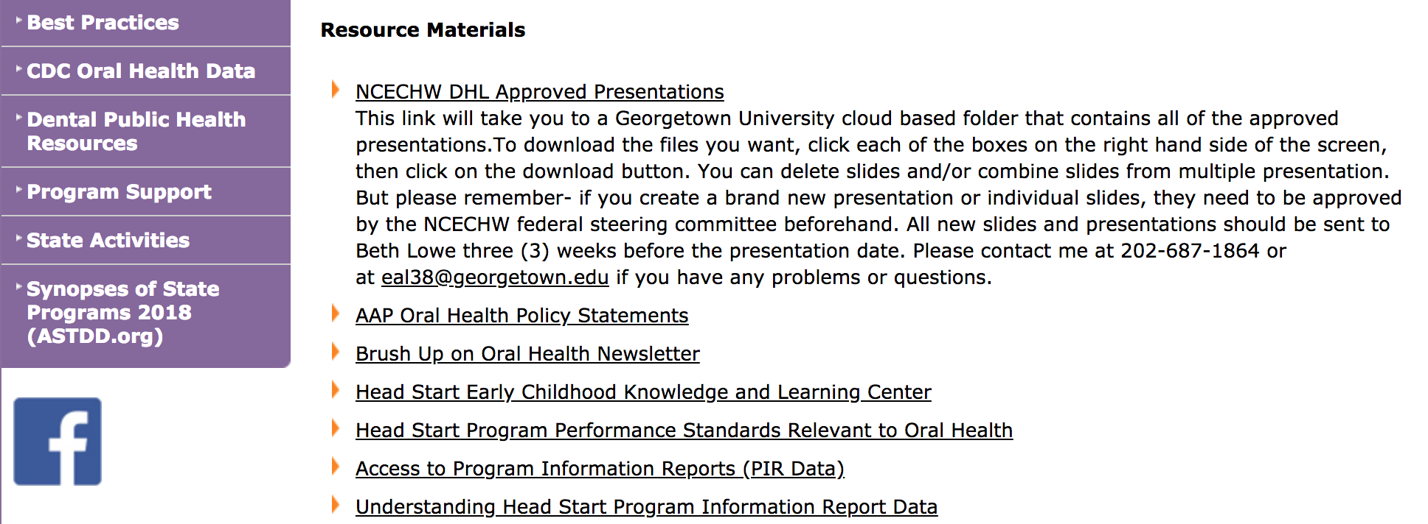
Accessing NCECHW Oral Health Presentations
Go to the ASTDD DHL webpage: https://www.astdd.org/head-start-state-dental-hygienist-liaisons-information
Under ‘Resource Materials’ Click on NCECHW DHL Approved Presentations

Slide 13
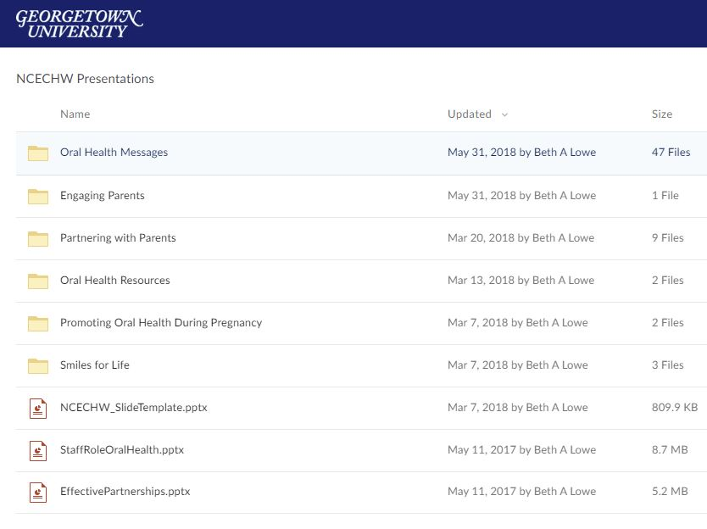
Accessing NCECHW Oral Health Presentations
The link will go to Georgetown University’s cloud-based folder that contains all oral health presentations
Click on presentation title to view contents of the folder

Slide 14
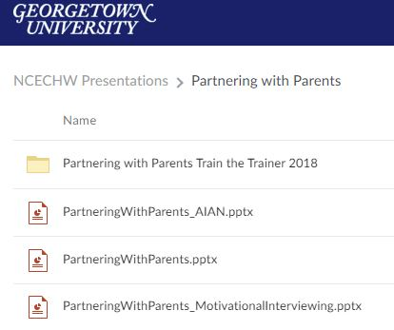
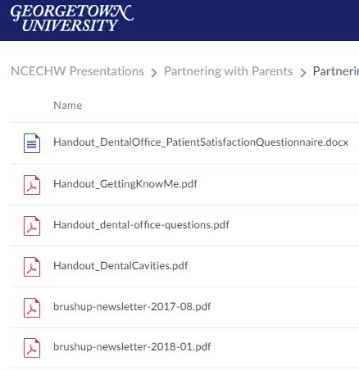
Accessing NCECHW Oral Health Presentations
Some presentations have handouts for different audiences that can be downloaded

Slide 15
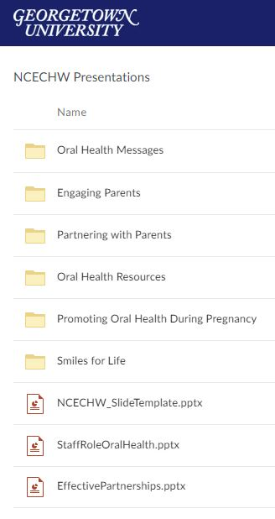
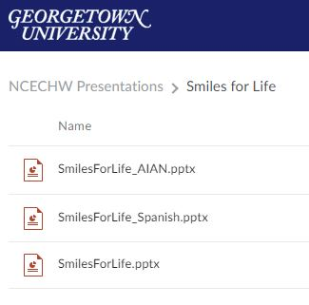
Accessing NCECHW Oral Health Presentations

Slide 16
Viewing Presentation Content
Click on presentation file name

Slide 17
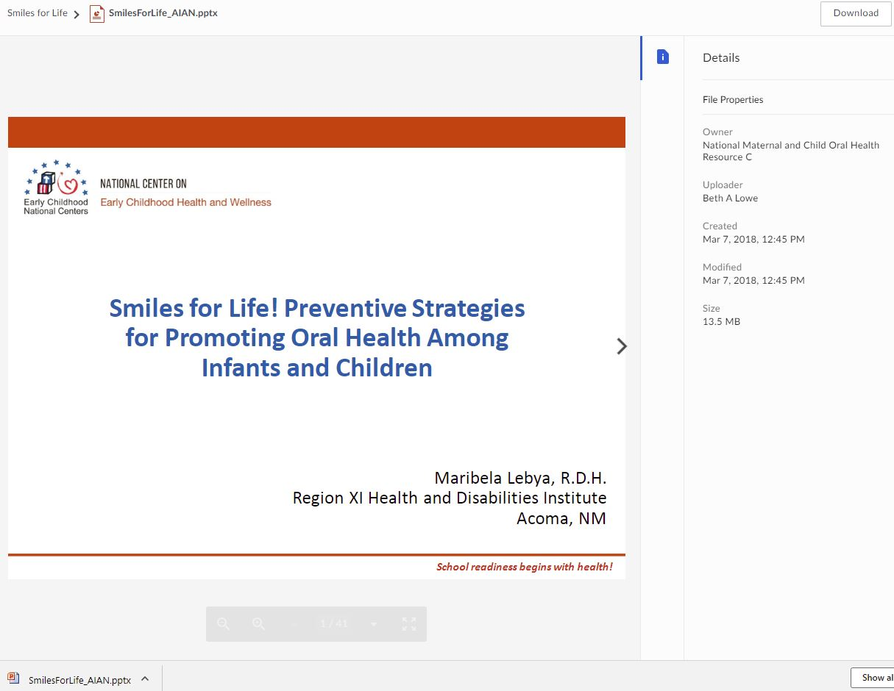

Viewing Presentation Content
Click to download file
Check for most current date
Click arrow to preview slides
Click to open downloaded file

Slide 18

National and Regional Meetings
Presentations at national and regional meetings
  Advanced permission required
  Abstracts must be approved by the NCECHW federal steering committee
  Submit request and abstract no later than 5 weeks before the abstract due date to Beth Lowe at eal38@georgetown.edu

Slide 19
State and Local Meetings
Presentations at state and local meeting
  Permission is not required
Presentation slides
  Must use NCECHW-approved slides for all presentations
  Submit new slides at least 3 weeks before the presentation to Beth at eal38@georgetown.edu

Slide 20
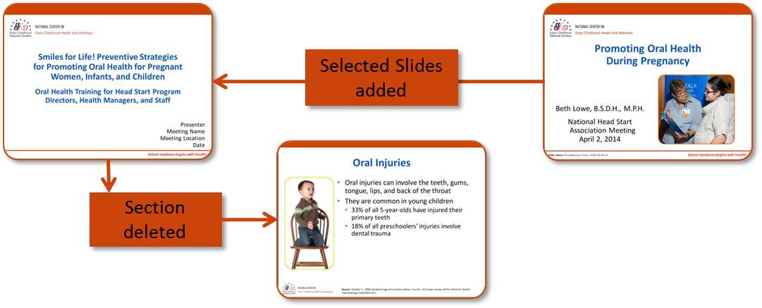
Adapting NCECHW-Approved Presentations
Remember that NCECHW-approved slides cannot be changed, but …
Approved slides can be removed, reordered, or mixed to meet presentation needs

Slide 21

Adapting NCECHW-Approved Presentations
Don’t forget to change the presenter name, meeting name, location, and date on the title slide

Slide 22
Key Oral Health Messages
Notes:
Added video hyperlink

Slide 23

Oral Health Messages to Share With Parents
Five Key Messages
Limit foods and drinks with added sugar
Drink water throughout the day
Brush twice a day with fluoride toothpaste
Get a dental visit by age 1
Practice good oral health during pregnancy

Slide 24
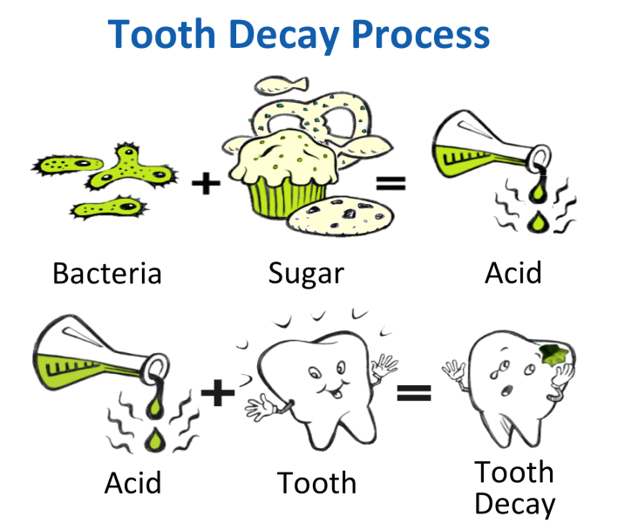
Oral Health Messages to Share With Parents
Limit Foods and Drinks with Added Sugar
Cavity equation
Frequency of consuming foods and drinks with added sugar
Bedtime routines
Juice recommendations

Slide 25
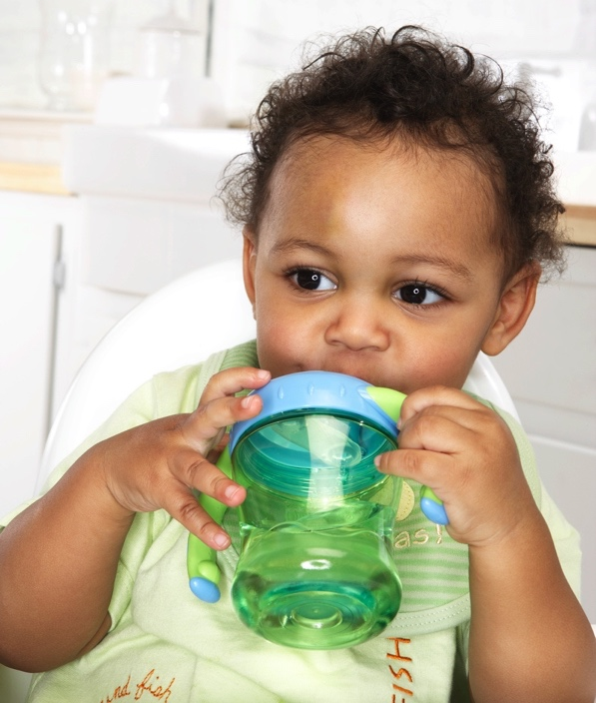
Oral Health Messages to Share With Parents
Drink Water Throughout the Day
Benefits of water
Sippy cup use
Strategies to encourage drinking water
Brush with Fluoride Toothpaste Twice a Day
Recommended amount of toothpaste for young children
Toothbrushing positions and patterns

Slide 26
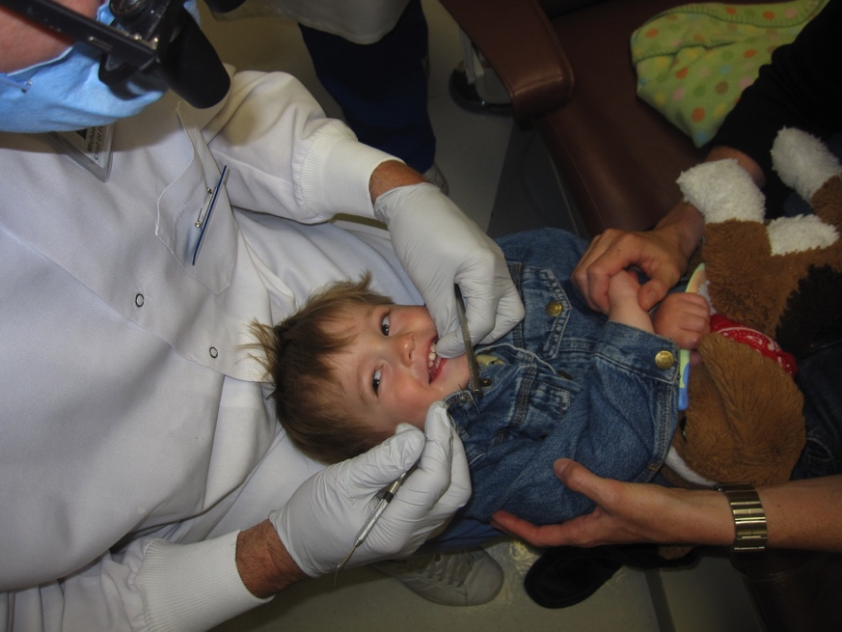
Oral Health Messages to Share With Parents
Get a Dental Visit by Age 1
Benefits of age 1 visit
What to expect during visit
Locating oral health professionals
Practice Good Oral Health During Pregnancy
Impact of mother’s oral health on baby’s oral health
Oral health conditions during pregnancy
Receiving oral health care is safe

Slide 27
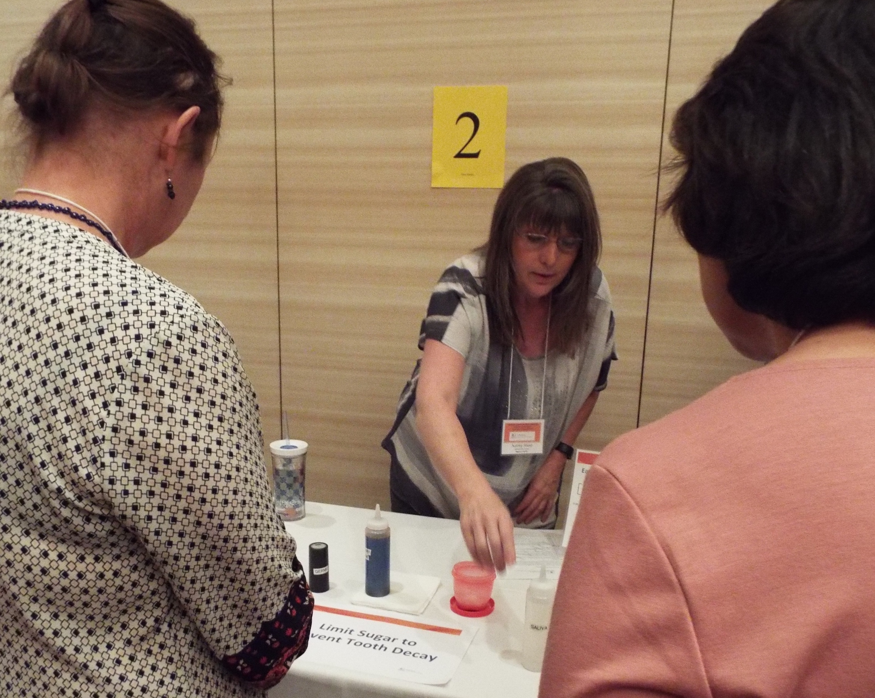
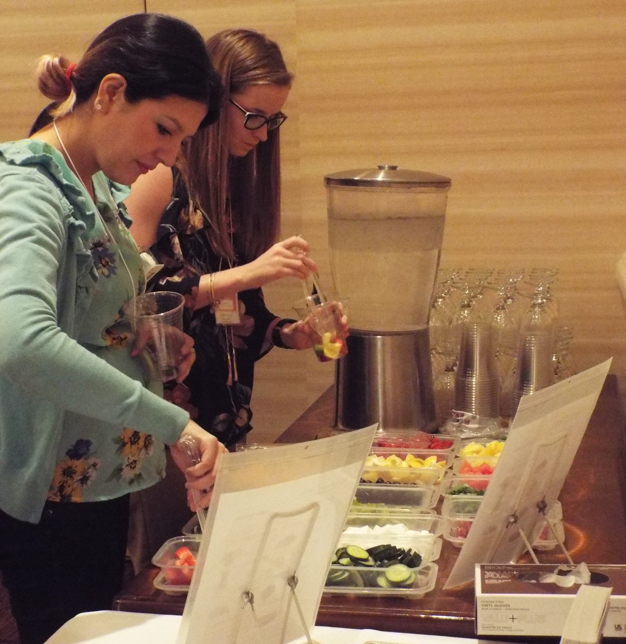
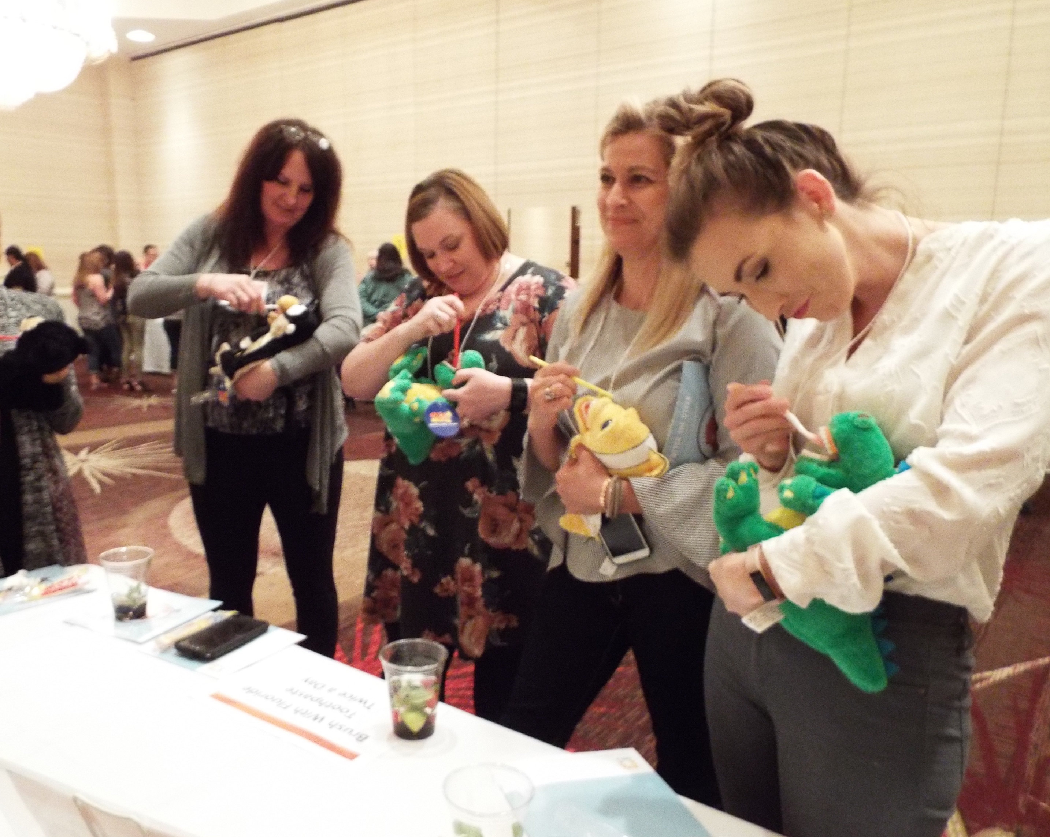
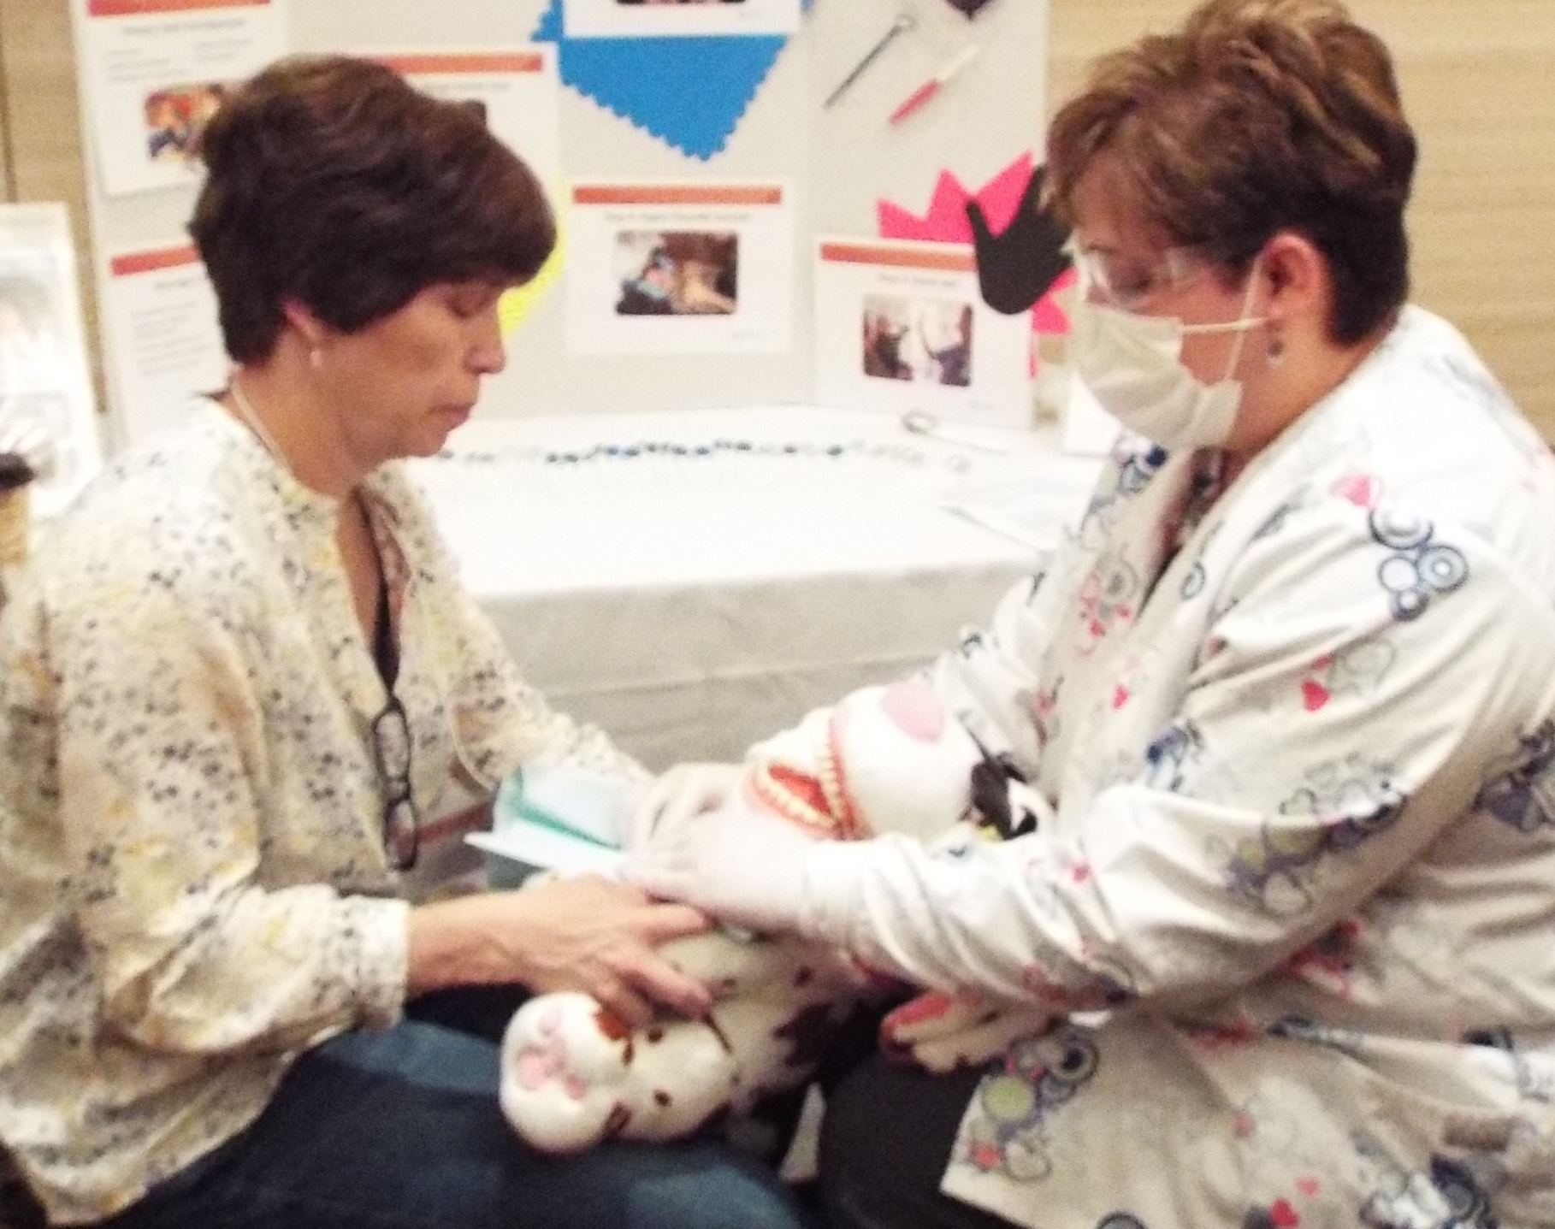
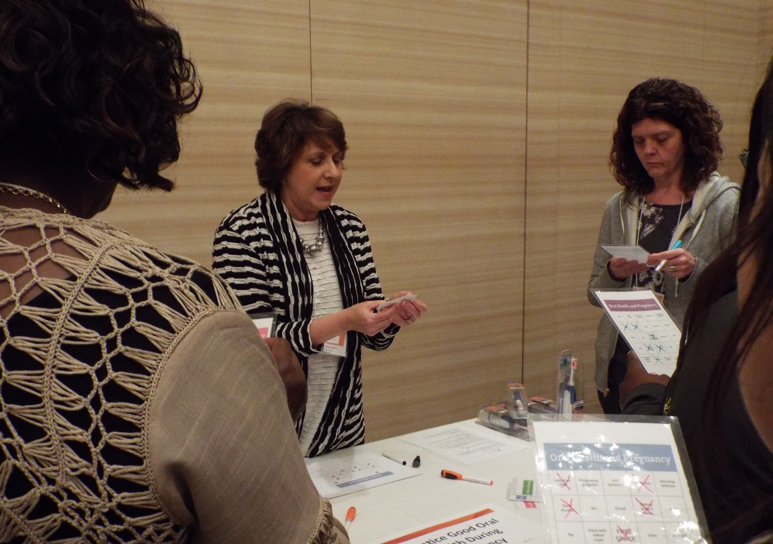
Key Message Stations
Limit sugar to prevent tooth decay
Drink water throughout the day
Brush with fluoride toothpaste twice a day
Get a dental visit
by age 1
Practice good oral health during pregnancy

Slide 28
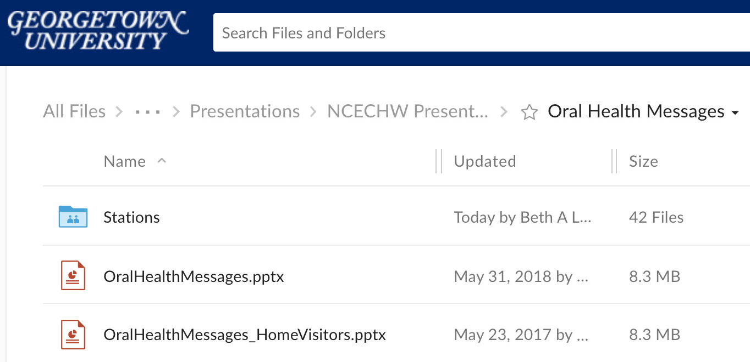
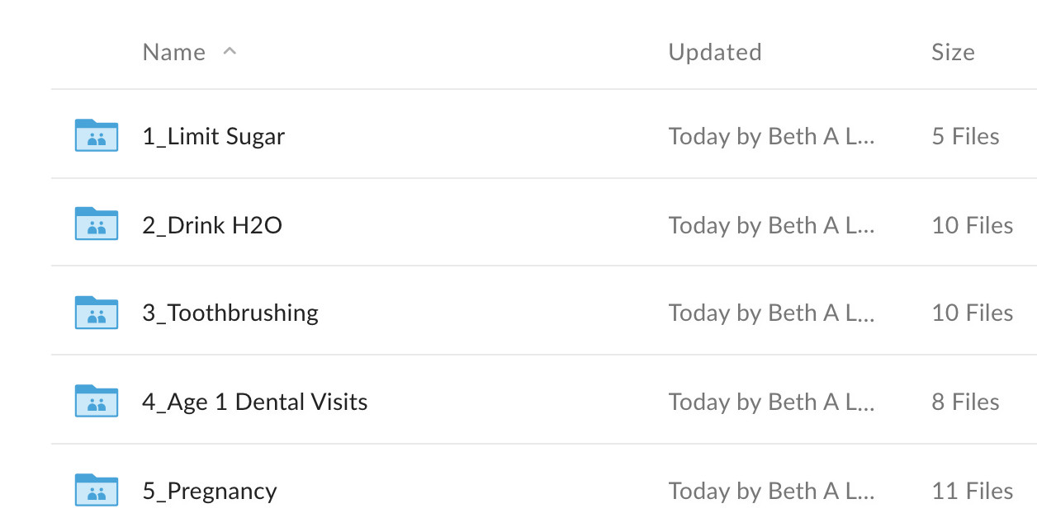
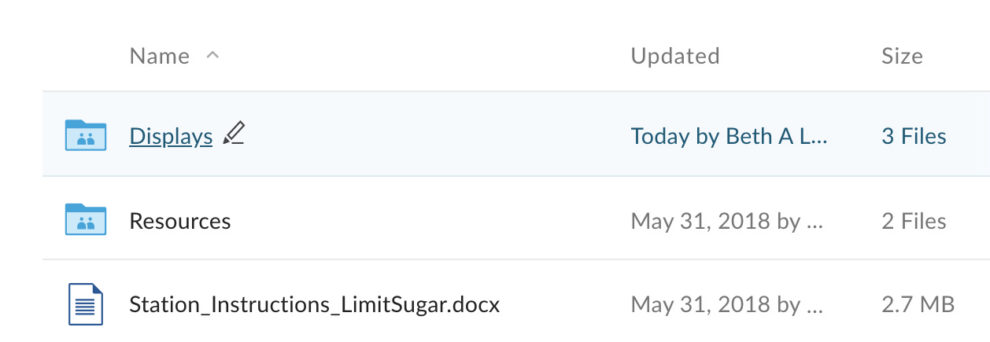
Oral Health Messages to Share With Parents
Five Key Messages
Instruction sheets
Displays
Handouts
Background materials

Slide 29
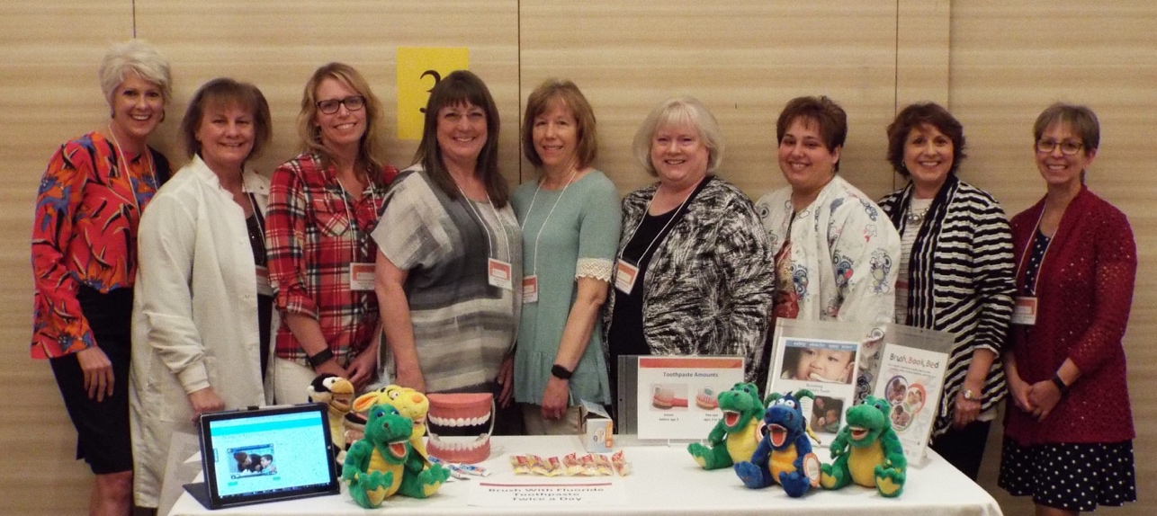
Station Instructions
Description
Materials needed
Instructions
Resources

Slide 30

Questions?

Slide 31
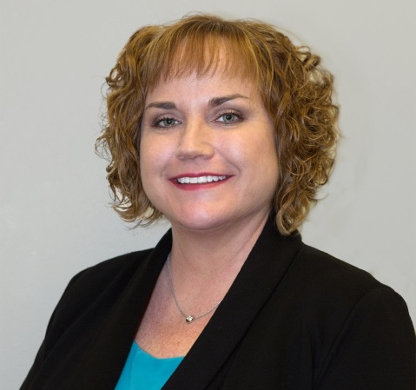
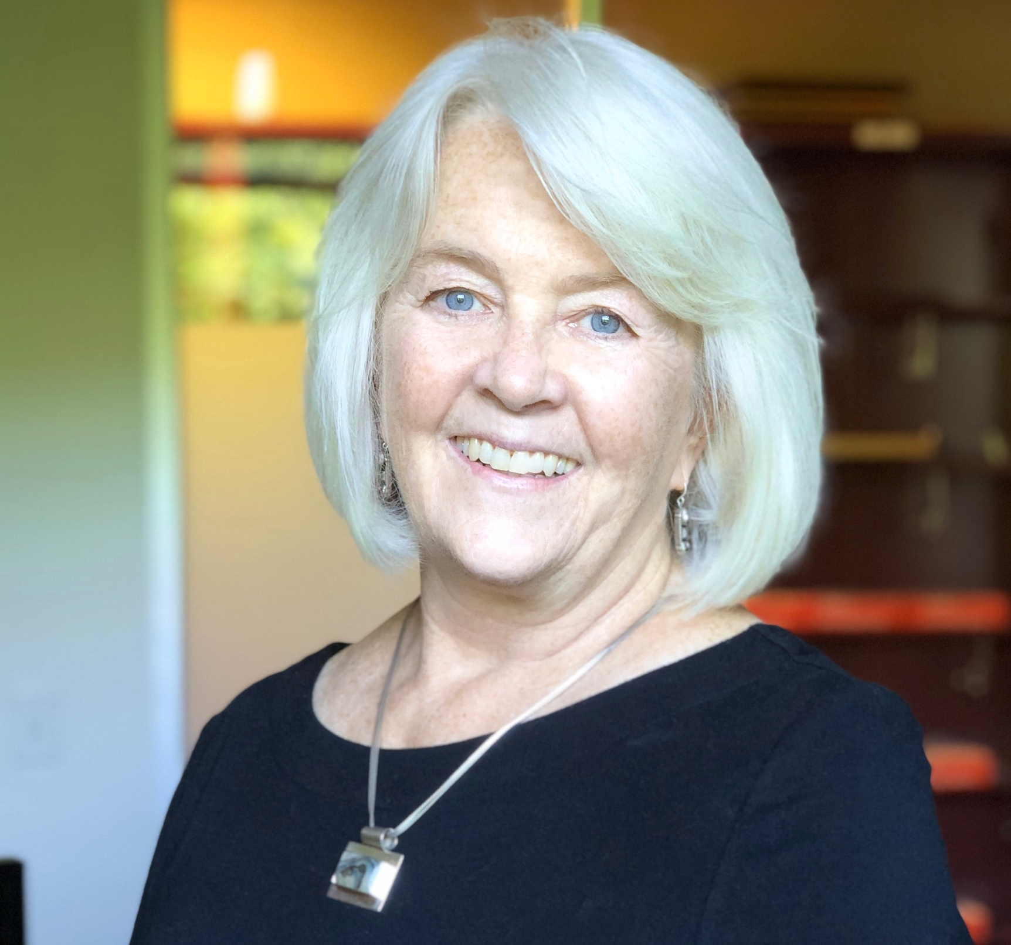
Contact Information
Michelle Landrum, R.D.H., M.Ed. michellelandrum@yahoo.com
Beth Lowe, B.S.D.H., M.P.H.
eal38@Georgetown.edu
National Center on Early Childhood Health and Wellness
Phone: (866) 763-6481
E-mail: health@ecetta.info
Website: https://eclkc.ohs.acf.hhs.gov/health

