Slide 1
Engaging Head Start Families
Using social media
to encourage good
oral health habits
during the pandemic

Slide 2
A disruption of oral health activities
The pandemic has disrupted Head Start and Early Head Start programs across the country.
The impact:
Toothbrushing in Head Start settings has stopped due to concerns about the potential for aerosolized transmission of COVID-19.
Head Start educators have discontinued in-person interactions with parents during the pandemic.

Slide 3
Use social media to overcome this disruption
Brief tips on oral health
Fun and engaging tips
Evidence-based tips
Share these videos and graphics on three social media platforms that many in our target audience use: Facebook, Instagram and Twitter
Notes:
To change icon, right click on icon and select “Change Graphic” then select “from icons”, select a new icon and click “insert” it will be placed in same color and size.

Slide 4
Three key educational messages
Children’s teeth should be brushed twice daily with fluoride toothpaste:
A rice-sized amount for children below age 3
A pea-sized amount for children ages 3 through 6
Children’s toothbrushes should be stored in separate, uncovered containers
Children’s toothbrushes should be replaced every 3 months

Slide 5
The platforms we have targeted
Facebook
Instagram
Twitter

Slide 6
Where to find everything
The Social Media Toolkit and all the video and graphics are accessible at http://bit.ly/HeadStartASTDD
Each video or graphic was designed for a particular social media platform(s)
The toolkit indicates which video or graphic should be used for each sample message
All messages can be sent without attaching a video or graphic
Many messages are ideally complemented by a video or graphic

Slide 7
Making it easy to participate
Download the Social Media Toolkit document:
It gives instructions on using the toolkit
It contains dozens of sample messages that make it easy for stakeholders to participate
The messages are grouped into categories based on the social media platform for which they are intended
Hashtags have been incorporated into each message to eliminate that task for users

Slide 8
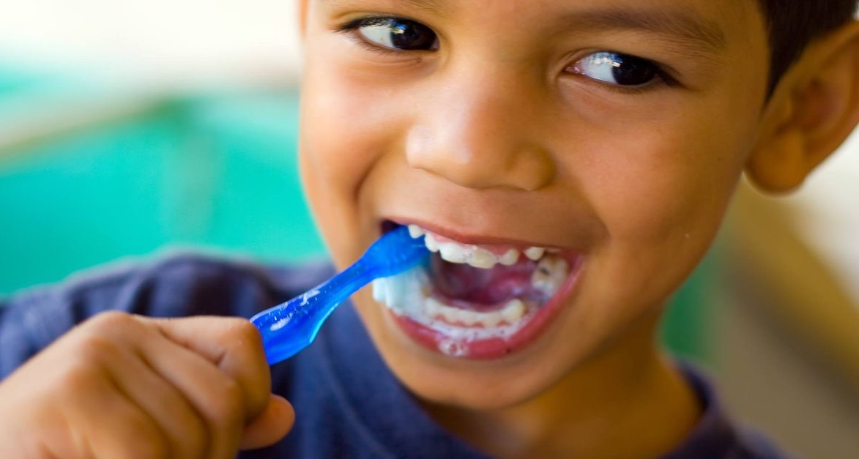
Step 1: Choose the topic you desire
In Section II of the Social Media Toolkit:
Messages are separated into three topics —
Brushing children’s teeth twice each day with fluoride toothpaste and using the right amount
Replacing a toothbrush every 3 months
The proper way to store toothbrushes

Slide 9
Step 2: Decide on the platform you will use
In Section II of the Social Media Toolkit:
Facebook Instagram Twitter

Slide 10
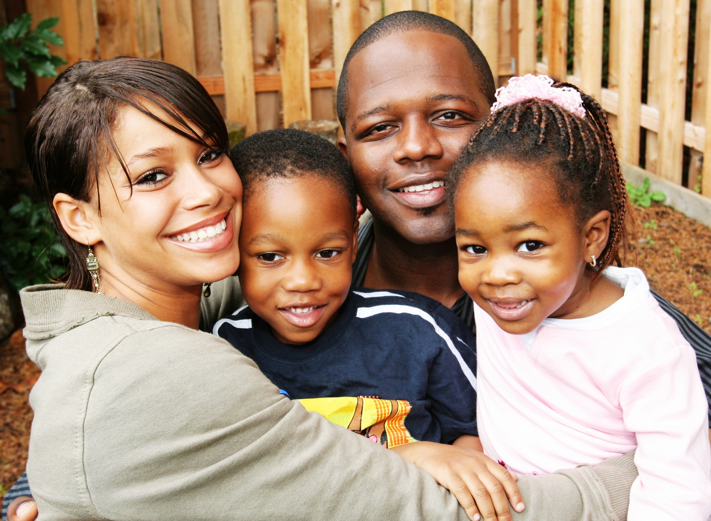
Step 3: Select your message
In Section II of the Social Media Toolkit:
Within your chosen topic, find the group of messages for your social media platform — then select the message you want to post.

Slide 11
Step 4: Consider adding a video or graphic
In Section III of the Social Media Toolkit:
Check the list of digital files: graphics and videos. Choose one that: a) fits your message and b) is compatible with the social media platform you plan to use
Go to the web page http://bit.ly/HeadStartASTDD and download the digital file you intend to use
Copy and paste the message you have chosen and add the digital file to your message before hitting “send”

Slide 12
Other uses for these graphics and videos
Upload them to your web pages
Insert or embed them in your slides and presentations

Slide 13
No expiration date for use
These messages can be used well into the future — unless or until the evidence-based guidance changes.

Slide 14
A brief comment on the use of hashtags
The messages in the Social Media Toolkit include hashtags, but the number of hashtags varies based on the social media platform.
Why? We wanted the number of hashtags to fit the culture of each platform.
For this reason, please think twice before adding or deleting any hashtags.

Slide 15
Help us reach families with helpful messages
Join us in March
Each week
Whenever possible
Saturday 3/20 is World Oral Health Day. The Friday before, a social media event is planned to promote healthy oral health habits at home.
Email me for more info: mattlivesindc@gmail.com
Try to post at least one message from the Social Media Toolkit each week.
Share or retweet others who post these messages on social media.
Notes:
To change icon, right click on icon and select “Change Graphic” then select “from icons”, select a new icon and click “insert” it will be placed in same color and size.

Slide 18
National Center on Health, Behavioral Health, and Safety

