Slide 1

HPV & Oropharyngeal Cancer
Mahnaz Fatahzadeh, DMD MSD
Professor, Division of Oral Medicine
fatahza@sdm.rutgers.edu
Notes:
Good afternoon and thank you for attending this webinar. Today’s presentation provides an update on the relationship between HPV and oropharyngeal cancer.

Slide 2
Objectives
To describe differences in epidemiology and clinical presentation between HPV+ and HPV- oropharyngeal cancers
To describe potential impact of HPV vaccination of the incidence of oropharyngeal cancer
To discuss the emerging strategies for prevention and early detection of oropharyngeal cancer

Slide 3
2015 Estimated US Cancer Cases*
Men
848,200
Women
810,170
Prostate 26%
Lung & bronchus 14%
Colon & rectum 8%
Urinary bladder 7%
Melanoma of skin 5%
Kidney & renal pelvis 5%
Non-Hodgkin 5%
lymphoma
Oral Cavity/Pharynx 4%
Leukemia 4%
Liver & bile duct 3%
29% Breast
13% Lung & bronchus
8% Colon & rectum
7% Uterine corpus
6% Thyroid
4% Melanoma
of skin
4% Non-Hodgkin
lymphoma
3% Kidney & renal pelvis
3% Leukemia
3% Pancreas
*Excludes basal and squamous cell skin cancers and in situ carcinomas except urinary bladder. American Cancer Society, 2015.
Notes:
This slide summarizes estimated incidence rates for different types of cancer among males & females. Prostate and breast cancers have the highest incidence rates in males and females, respectively. Cancers affecting the oral cavity and pharynx account for about 4% of malignancies in males.

Slide 4
JADA 2011;142(8):915-924
Notes:
This slide essentially illustrates the boundaries of oral cavity and oropharynx , the two anatomical regions accounting for oral cancer.

Slide 5
Oropharyngeal cancer
(OPC)
Risk factors
Traditional- tobacco & alcohol
Emerging- HPV infection
Alarming rise in oropharyngeal ca in middle aged (40-50) males without traditional risk factors
70% of oropharyngeal cancers in the US are HPV-related squamous cell carcinomas
An epidemic of HPV-mediated malignancy projected to surpass the incidence rate of cervical cancer by 2020 in US
The New Face of Head and Neck Cancer: The HPV Epidemic Oncology Sep2015
Notes:
Considering the risk factors for OPC, we note two different profiles. Although traditional risk factors, namely tobacco and alcohol abuse are still valid, 70% of oropharyngeal cancers in the US are related to HPV infection. This is a cause for alarm as incidence of HPV-associated oropharyngeal cancers is thought to surpass that of cervical cancer by 2020.

Slide 6
HPV infection
Small DNA viruses with predilection for mucocut-aneous keratinocytes in humans, > 100 subtypes
Most common sexually transmitted infection
> than 50% of sexually active will have genital infection at some time during their lives
A Small percent will have oral infection at any given time of which only 1% are oncogenic subtypes
The New Face of Head and Neck Cancer: The HPV Epidemic Oncology Sep2015
Notes:
Human papilloma viruses are small DNA viruses with predilection for mucocutaneous epithelium. HPV infection is the most common sexually transmitted infection particularly in the context of multiple sexual encounters. There are numerous HPV subtypes a few of which are oncogenic.
HPV may also infect oral region. In majority of individuals, oral infection is asymptomatic and transient. We don’t know why in some people, infection persists and progress to oropharyngeal cancer.

Slide 7
Oral HPV infection
No associated signs or symptoms
No treatment for active oral HPV infection
Majority clear the virus within 2 years
Smoking increases the risk of oral HPV infection
In some people infection may persist & progress to OPC
HPV+ tumors are biologically and clinically distinct cancers
The New Face of Head and Neck Cancer: The HPV Epidemic Oncology Sep2015

Slide 8
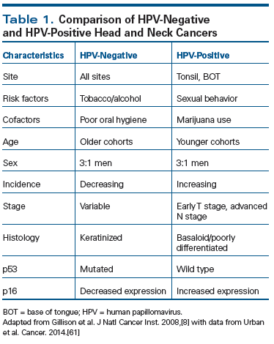
The New Face of Head and Neck Cancer: The HPV Epidemic Oncology Sep2015

Slide 9
HPV+ Oropharyngeal Ca
Palatine & lingual tonsils are uniquely susceptible to HPV infection (immune-privileged sites)
Primary tumors are often small and hidden in depth of tonsillar crypts
Lack of signs & symptoms in early OPC
Most frequent presentation is asymptomatic metastatic cervical swelling
The New Face of Head and Neck Cancer: The HPV Epidemic Oncology Sep2015

Slide 10
HPV+ Oropharyngeal Ca
Prognosis & Prevention
Better prognosis with current therapies than tobacco-related OPC (treatment implications!)
Difficult to inspect oropharynx for precancerous lesions without specialized instruments
Tonsillar crypts are inaccessible for sampling
No validated screening test available
The New Face of Head and Neck Cancer: The HPV Epidemic Oncology Sep2015

Slide 11
Oral HPV Infection
Natural history
Majority of virally-mediated OPC are caused by HPV16 (main subtype involved in cervical cancer).(1)
Our knowledge about the natural history (incidence & clearance) of oral HPV infection is limited.(1)
Need prospective studies to examine temporal relationship between oral HPV detection and risk of OPC.(1)
Recent study analyzed 132 HNSCC and 396 controls nested within 2 prospective cohorts & found presence of HPV-16 in the oral cavity precedes the development of oropharyngeal cancers. Individuals with oral HPV-16 infection were 22 times more likely to develop oropharyngeal cancer compared with those without HPV infection.(2)
Takes R, et al. HPV vaccination to prevent oropharyngeal carcinoma: What can be learned from anogenital vaccination programs. Oral Oncology 2015; 51: 1057–60.
Agalliu I, et al. Associations of Oral α-, β-, and γ-Human Papillomavirus Types With Risk of Incident Head and Neck CancerJAMA Oncol. Jan 2016

Slide 12
Oral HPV Infection
Role of immune response
Risk of oral HPV infection or cancer in mouth or throat from oral sex is lower in women with a greater # of vaginal sex partners
Men are twice likely to suffer from cancer related to HPV from oral sex compared to women (ie. risk of HPV infection & cancer increases with the number of oral sex partners)
HPV exposure via vaginal sex elicits an immune response protective against oral HPV infection and subsequent cancer
Men are less likely to clear oral HPV infection (less effective immune response)
Oral retention of HPV promotes cellular alterations which may result in oral malignancy
Presentation at annual meeting of AAAS by Gypsyamber D'Souza from Johns Hopkins University Feb 2016

Slide 13
HPV vaccination
Impact on OPC
Currently approved HPV vaccines protect against oncogenic HPV implicated in cervical and anal cancer as well as strains causing anogenital warts. (1)
Although not evaluated in RCT, HPV vaccination may also prevent oral HPV infection & HPV-induced oropharyngeal malignancy. (1)
2014 CDC study suggests currently available HPV vaccines could prevent most oropharyngeal cancers in the U.S. (2)
Costa Rica Vaccine Trial (CVT) shows vaccine efficacy against HPV16 and HPV18 (HPV16/18) infections at the cervical, anal, and oral regions among naive women. (3)
1) Takes R, et al. HPV vaccination to prevent oropharyngeal carcinoma: What can be learned from anogenital vaccination programs. Oral Oncology 2015; 51: 1057
2) Steinau M, et al. Human Papillomavirus Prevalence in Oropharyngeal Cancer before Vaccine Introduction, United States Emerging Infectious Diseases, 2014; 20:5, pp. 822-828
3) Beachler D, et al. Multisite HPV16/18 Vaccine Efficacy Against Cervical, Anal, and Oral HPV Infection.J Natl Can Ins. Oct 2015

Slide 14
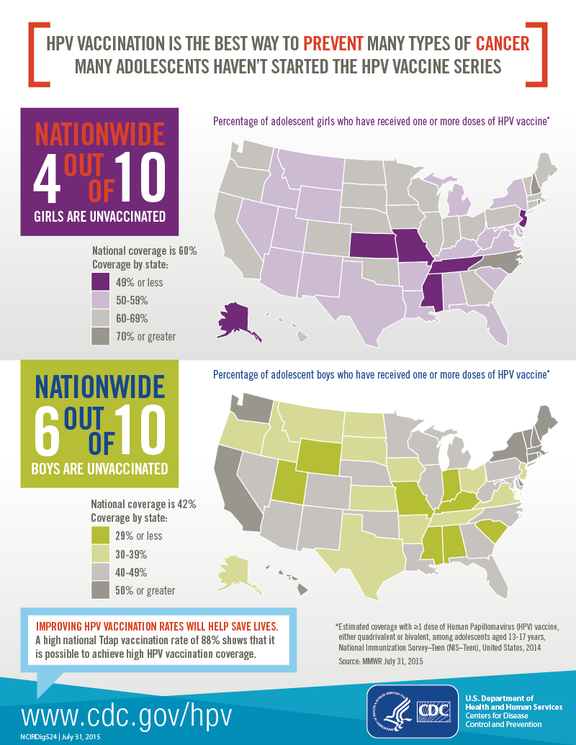
Source: MMWR July 31, 2015
U.S. Department of Health and Human Services, Centers for Disease Control and Prevention

Slide 15
Vaccine Financing
Private insurance
Public financing
Vaccines for Children (VFC) Program
Federal funding for Medicaid-eligible, uninsured, American Indian or Alaska
Native, or underinsured
Immunization Grant Program
Through a federal grant, CDC awards federal grants to state, local, and
territorial public health agencies to aid with vaccine costs.
Medicaid
State Children’s Health Insurance Program (CHIP)
Merck and GlaxoSmithKline assistance program for uninsured low income adults
HPV Vaccine: Access and Use in the U.S The Henry Kaiser Family Foundation The Sep 2015

Slide 16
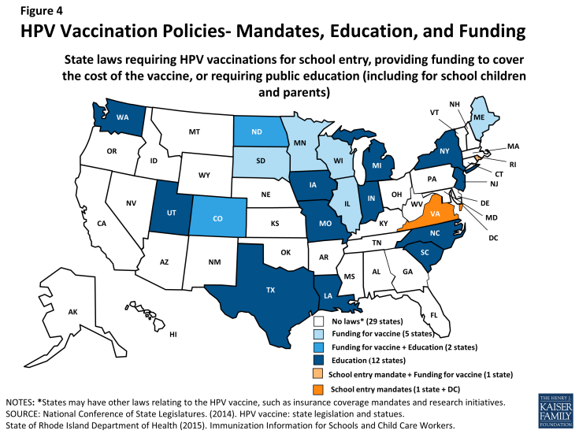
HPV Vaccine: Access and Use in the U.S The Henry Kaiser Family Foundation The Sep 2015
Notes:
This slide summarizes HPV vaccination policies across United States. Twenty nine states have no laws regarding HPV vaccination. Five states provide funding, 12 states require public education and 2 states require education and provide funding for HPV vaccine. One state including DC require HPV vaccination for school entry while 1 state not only mandate the vaccine for school entry but also covers the cost of vaccination.

Slide 17
Emerging Best Practices
Communication
Raising public awareness about signs, symptoms, risk factors & change in demographic of oral cancer
Evaluating risk profile of patients through a questionnaire and direct conversation
Assessing readiness to quit smoking/alcohol & refer as indicated
Inquiring parents about HPV vaccination of their children
Asking patients about voice changes (hoarseness), lump in throat/neck, swallowing difficulty
Repeating patient education at every visit

Slide 18
Emerging Best Practices
Examination
Screening every patient starting at age 15
Performing regular & thorough inspection of head, neck & oral tissues
Informing patients when you are screening for oral cancer
Documenting all signs/symptoms
Having a low threshold for referral if signs or symptoms persist
Instructing patients how to perform self exam between visits

Slide 19
References
Lewis A, Kang R, Levine A, Maghami E. The New Face of Head and Neck Cancer: The HPV Epidemic. Oncology J, Head & Neck Ca Sep 2015
Agalliu I, Gapstur S, Chen Z, Wan T, Andersen R, Teras L, et al. Associations of Oral α-, β-, and γ-Human Papillomavirus Types With Risk of Incident Head and Neck Cancer. JAMA Oncol. Jan 2016
Beachler D, Kreimer A, Schiffman M, Herrero R, Wacholder S. Rodriguez A. Multisite HPV16/18 Vaccine Efficacy Against Cervical, Anal, and Oral HPV Infection. J Natl Can Ins. Oct 2015
Steinau M, et al. Human Papillomavirus Prevalence in Oropharyngeal Cancer before Vaccine Introduction, United States Emerging Infectious Diseases, 2014;20:5, pp. 822-8.
Takes R, et al. HPV vaccination to prevent oropharyngeal carcinoma: What can be learned from anogenital vaccination programs. Oral Oncology 2015; 51: 1057–60.
The HPV Vaccine: Access and Use in the US. The Henry Kaiser Family Foundation
Fact sheet. September 2015.

Slide 20
Thank you fatahza@sdm.rutgers.edu

