Slide 1
My Water’s Fluoride v2.0

Slide 2
MWF Updates
MWF Incompatible with WFRS v2.0, relied on June 2011 archive
MWF 2.0 implementation April 2015
  Compatible with WFRS v2.x, pulls most recent data
  Enhanced user heuristic interface
  Improved messages and messaging for consumers
  Better documentation
MWF v2.1 implementation 2016…?
  Census tool
  Responsive design
  Downloadable WFRS database vintages

Slide 3
A popular site
39 States participating
Over 700,000 annual visits

Slide 4
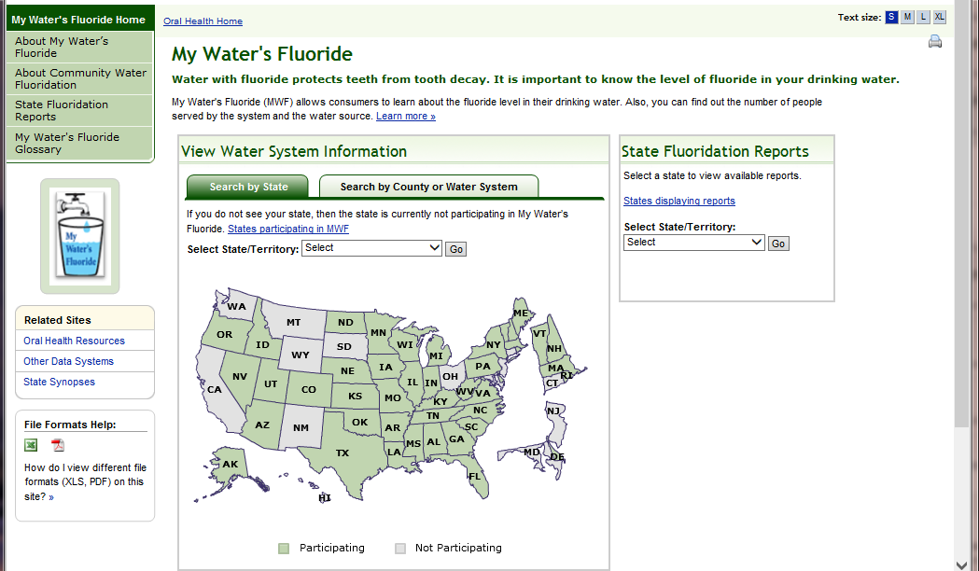
Search by State or if you know the PWS ID, you can enter that identifier
Click on a State or select from field

Slide 5
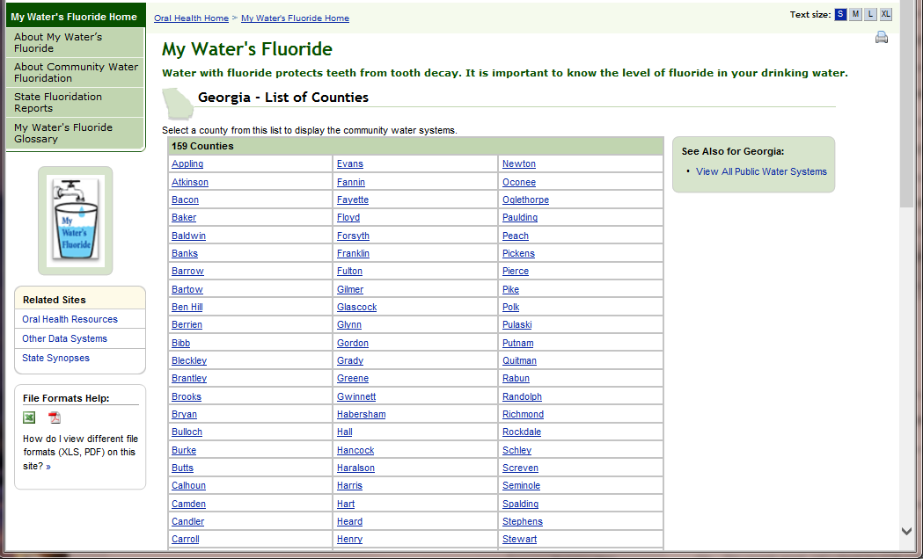

Slide 6
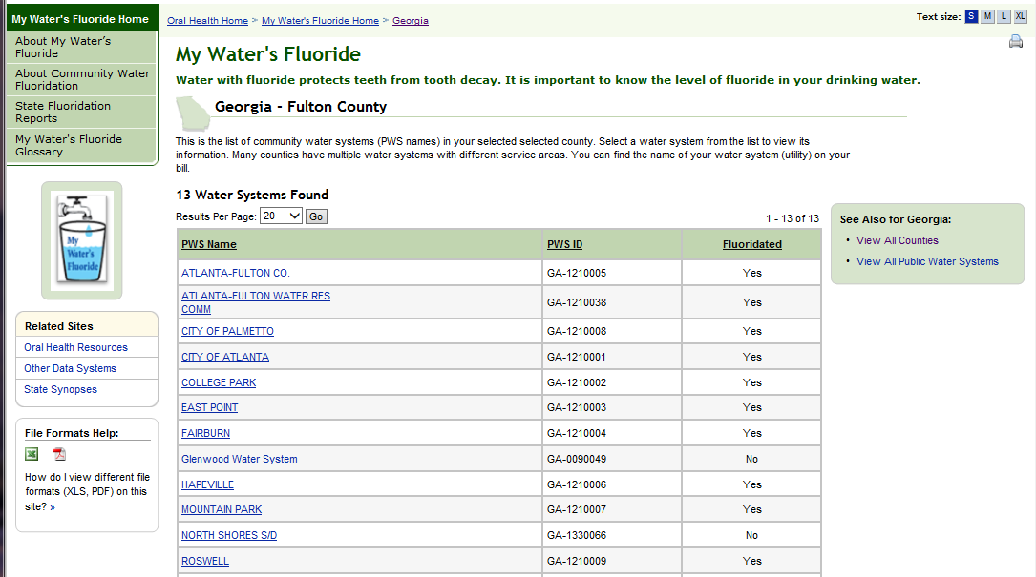

Slide 7
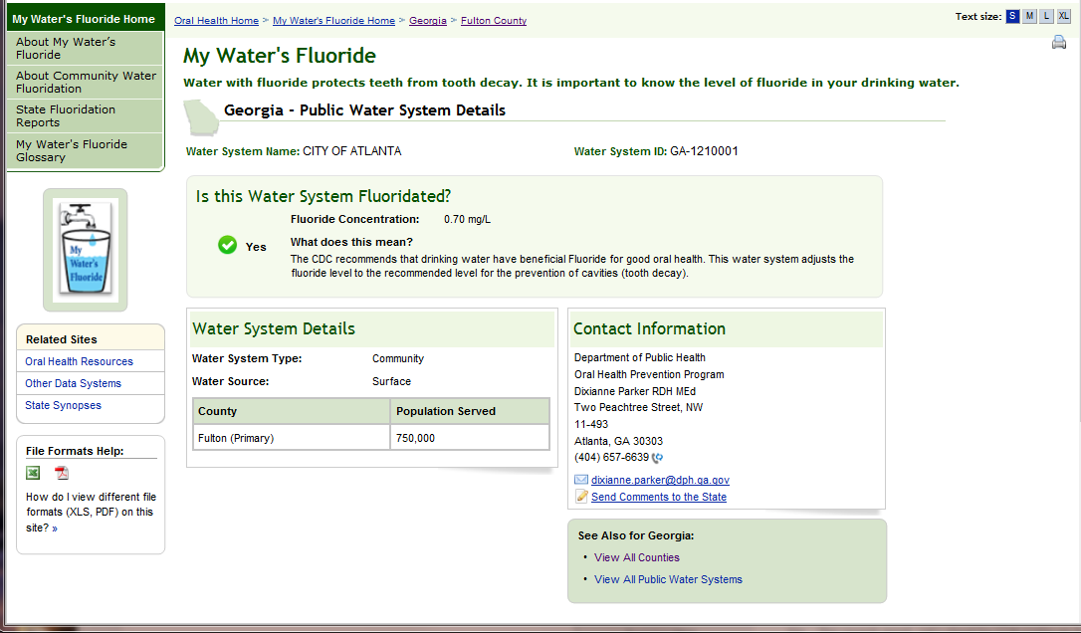
Time to update information

Slide 8
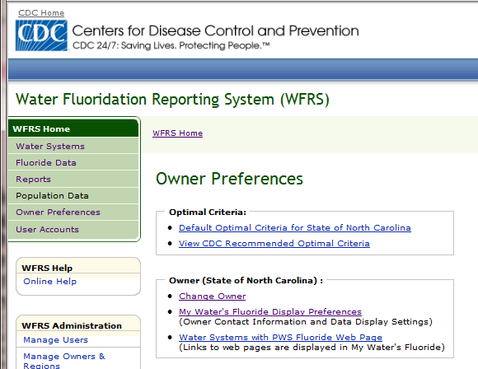
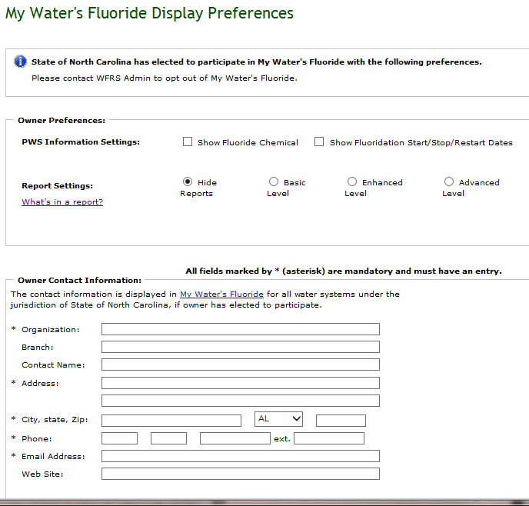
Update MWF preferences within WFRS
Reports
Contact information

Slide 9
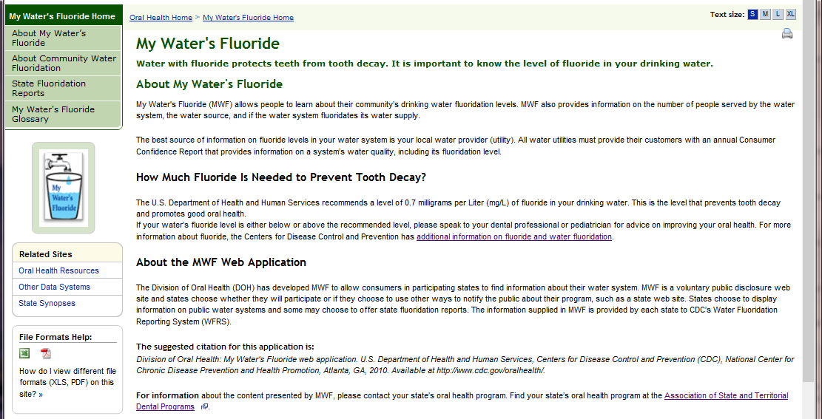

Slide 10
Questions?
Kip Duchon
cfx3@cdc.gov
770-488-6076

