Slide 1
Association of State and Territorial Dental Directors (ASTDD) Older Adult Basic Screening Survey (BSS) Tips for Success

Slide 2
Why Do We Need An Older Adult BSS?
Population is aging—10,000 people each day turn 65 years old!
Oral health is integral to overall health across the lifespan.
Data are needed to show the burden of disease in this population.
Data support efforts to increase funding for access to care.
We need data to “tell the story.”
Notes:
As we have seen with children’s oral health, the more information/data we have to share the more likely hat funders will take notice of the older adult population and their oral health needs. The older adult population is lagging in oral health data to document their oral health status and trends over time.

Slide 3
http://www.astdd.org/healthy-aging-committee/
Notes:
This graphic is also available on the ASTDD Healthy Aging Committee webpage: http://www.astdd.org/healthy-aging-committee/ Scroll down to: Talking Points- Why Oral Health in Older Adults is Important. This information is something that could be shared with potential screening sites to raise their awareness of the link between oral health and overall health.

Slide 4
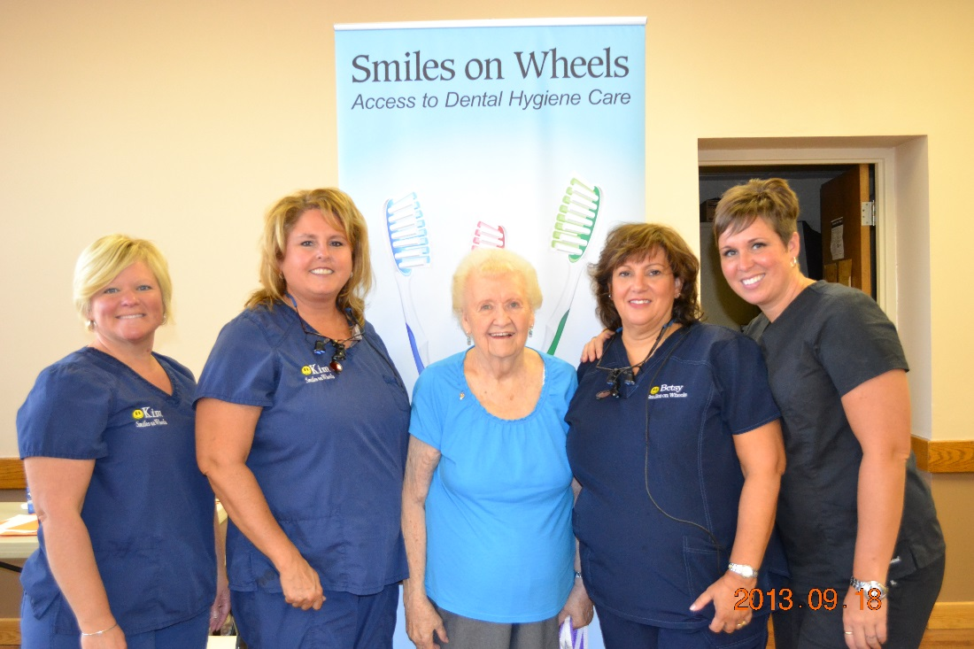
Older Adult BSS Tips for Success
Purpose: The ASTDD Healthy Aging Committee received input from states saying they would like information from other states that have completed the Older Adult BSS.
The Older Adult BSS Tips for Success asks states to share:
Funding resources
Documents/forms
Lessons learned
Flyers
Marketing tools
Notes:
If your state has completed an older adult BSS and you have items you would like to share, please send them to Lori Cofano: lkcofano@gmail.com

Slide 5
States that have completed an older adult BSS as of 12/2016
Alaska
Arkansas
California
Connecticut
Florida
Georgia
Kansas
Maryland
Massachusetts
Michigan
Missouri
Nevada
New Hampshire
North Carolina
North Dakota
Oregon
Rhode Island
Vermont
Virginia
*Washington (phone survey only)
West Virginia
Wisconsin
Notes:
List of states that have completed some sort of older adult BSS as of 2016. For the most recent list and links to Older Adult BSS reports, please visit the ASTDD Data Committee webpage: http://www.astdd.org/data-collection-assessment-and-surveillance-committee/
Has your state recently completed an older BSS? Please share with the information with the ASTDD Healthy Aging Committee and the ASTDD Data Committee.
Data Committee Consultant: Dr. Kathy Phipps- kathyphipps1234@gmail.com
Healthy Aging Committee Consultant: Lori Kepler-Cofano lkcofano@gmail.com

Slide 6
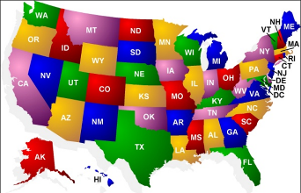
States with Published Reports
ASTDD’s Data Committee keeps an updated list of states that have completed an Older Adult BSS and has links to reports on the ASTDD website:
http://www.astdd.org/data-collection-assessment-and-surveillance-committee/
Scroll down the page to: States with Oral Health BSS Data
Notes:
Older adult BSS reports are available on the ASTDD website on the Data Committee webpage: http://www.astdd.org/data-collection-assessment-and-surveillance-committee/
Scroll down to: States with Oral Health BSS Data.

Slide 7
Funding Sources
States reported receiving funding for an Older Adult BSS from:
Centers for Disease Control and Prevention ( CDC)
National Association of Chronic Disease Directors (NACDD)
Delta Dental Foundation
DentaQuest Foundation
Private community foundations
State Department of Aging
Notes:
These are some of the resources states have used to fund their Older Adult BSS. This list changes frequently so watch for additional funding opportunities! States also note the use of volunteers or students from either dental or dental hygiene programs to assist with various aspects of the BSS.

Slide 8
Where to Start?
Select a person to oversee coordination of the BSS project.
Review ASTDD BSS Toolkit
Toolkit is FREE to ASTDD members! Log on to the ASTDD Members Only page.
Not a member of ASTDD? Fee is $10 including shipping: http://www.astdd.org/basic-screening-survey-tool
Notes:
We highly recommend that all states begin their planning by ordering the BSS Toolkit. It was designed and developed for states to learn how to do the BSS and includes: a training video, sample screening forms, examiner .PPT, and many tips on the best way to plan and implement a BSS for older adults. Go to: http://www.astdd.org/basic-screening-survey-tool

Slide 9
Where to Start?
Review past data collected in your state.
Select a population group and work with an epidemiologist on how to sample that population; ASTDD can assist you. Contact:
Dr. Mike Manz: mmanz@umich.edu
Dr. Kathy Phipps: kathyphippps1234@gmail.com
Potential sample population locations:
Congregate Meal Sites
Long-Term Care Facilities
Assisted Living Facilities
Seek funding or in-kind and volunteer resources.
Notes:
1) Review the ASTDD Toolkit first!
2) Review what your state has done, list any gaps and list what information you want to know.
Determine the population that you need data for and how best to access that group: congregate meal sites, long-term care, or assisted living. Only one population should be selected. The data cannot be mixed.
Always work with an epidemiologist to determine sampling. The ASTDD contracts with Dr. Mike Manz and Dr. Kathy Phipps to assist states with the
BSS.

Slide 10
Next Steps
Who can help make this project successful?
Partners
Screeners
Funders
Others?
Contact an ASTDD Older Adult BSS Coach, if needed, at any point in the process:
Lori Cofano: lkcofano@gmail.com
Jill Moore: moorej14@michigan.gov
Notes:
Who else do you need to work with to make your older adult BSS successful? Do you have partners that can help you access meal sites, long-term care or assisted living facilities? Who will screen and who will be in charge of logistics such as scheduling, transportation, ordering supplies, completing data collection forms, etc? Depending on your source of funding, are there any opportunities to have the funder or others assist with any other aspects of the project? Are you wondering how other states have completed their older adult BSS? Most are more than willing to share their lessons learned; both positive and negative. We hope you will too!

Slide 11
Review Existing Resources
Don’t reinvent the wheel!
ASTDD Older Adult BSS Toolkit
Evaluations
Reports
Data collection documents
Patient surveys
Marketing posters
Ask ASTDD members for resources via ASTDD listserv: members@groups.astdd.org
Notes:
Feel free to use the resources available in Tips for Success. Use the ASTDD listserv (members@groups.astdd.org) to ask for assistance from states that have completed an Older Adult BSS; contact Mike Manz or Kathy Phipps; contact a BSS coach; look at existing reports from other states. ASTDD has many helpful resources so no need to reinvent the wheel.

Slide 12
The BSS Process *Courtesy of Eli Schwartz, NOHC presentation 2015
Identification of existing data and policy documents with relation to seniors’ oral health care
Contact state and county agencies on aging to seek support
Identification of funding source
Application and approval from Institutional Review Board (IRB)
*Note: States should look into applying for IRB
exemption or waiver first
5. Development of invitation letters, oral health screening
forms and surveys
Notes:
This is an overview of the BSS Process. For more detailed information review the ASTDD BSS Toolkit. The first step is to identify what types of data and policies related to older adult oral health exist in your state. You may find it useful to review reports from other states to see who they partnered with, the source of funding for the older adult BSS, and lessons learned.

Slide 13
The BSS Process (Continued)
6. Sampling (with assistance from ASTDD)
7. Organizing screening instruments, equipment, and oral health
items such as toothbrushes, floss, denture brushes, etc.
8. Conduct trainings or calibrations; screening; and
questionnaire surveys
9. Follow-up
10. Analysis and reporting
Adapted from “Implementation Steps of a County-wide Oral Health Basic Screening Survey of Seniors” roundtable presentation, NOHC 2015, Eli Schwarz, DDS, MPH, PhD, Oregon Health Science University, Dept. of Community Dentistry
Notes:
The majority of states conduct, at a minimum, a standardization session prior to starting a BSS project. Some do a formal calibration session, although that is a more involved process. Contact Kathy Phipps or Lori Cofano for more information regarding standardization vs. calibration.

Slide 14
Lessons Learned: Planning
Start planning EARLY! (ASTDD Older Adult BSS Manual suggests 9-12 months.)
For seniors who are homebound, collaborate with the agency that serves Meals on Wheels and include oral health messages and information about the screenings on the back of their menu cards; they are usually printed ahead of time, so that will take planning. With enough notice even most homebound residents can get transportation.
Assisted living facility—nice because you could spend the day there, but success will be directly linked to the director, especially going to get residents from their rooms
Notes:
Lessons learned have been collected from states that have completed an older adult BSS. Please be sure to share your lessons learned, both positive and negative, once you have completed the project. We all learn from each other!

Slide 15
Lessons Learned: Planning
At senior centers, announce the screening for a longer period of time than you think you need to in newsletters, on their website, at each meal that is served. Unfortunately (or fortunately) seniors have a lot going on and unless its kept on their radar, they will do something else that day and not show up.
Faith-based locations are positive because people know each other, are friends, and will encourage each other to participate.
Realize that staff turnover in long-term care facilities is fairly high; you may deal with several different individuals throughout the approval and scheduling process.

Slide 16
Lessons Learned: Planning
Let the location know in advance what type of space you will
need to set up for the screening and if you will need tables,
chairs, power, etc.
If your target population is those age 65 and older, you may
encounter younger individuals at the screening location. If
they insist on being included, data cleaning and analysis can
compensate .
Prepare a list of possible dental offices/clinics for referrals if they aren’t already receiving care.

Slide 17
Lessons Learned: Planning
Activities at sites—good to get people there, hard to pull them away. Good to make “time” for screening so that they do not feel like they are missing out on the activities
An engaged congregate meal site coordinator is invaluable —knows seniors by name, speaks of the event in a positive tone, encourages them to participate, explains why this is important for them (cancer screen) and their peers who may not have access to oral care (data collection); rely on coordinator to help identify best day to hold event.
Try to schedule screening when bingo, the hairstylist/manicurist or preacher are not there. Dental screening cannot successfully compete with any of these.
Notes:
Continuing themes: 1) Give plenty of advance notice, 2) Staff at the location have an impact on the success of your BSS, 3) Find out about daily activities so you can plan appropriately.

Slide 18
Lessons Learned: Planning
Consider having a sign-up list for specific times in advance so they aren’t frustrated waiting around. One state allowed 15 minutes per person; remember they want to talk!
Be mindful of conducting the screening in long-term care facilities during winter months – flu season can hamper access to facilities.
Long-term care facilities may want a consent form for their records; they usually have generic forms that can be easily modified.
Consider how data will be collected (real time vs. paper.) Depending on how “tech savvy” the screeners are, paper forms may be the best route.

Slide 19
Lessons Learned: Planning
Type of screening site impacts data. Do you want moderate risk older adults? Select meal sites. Do you want data on vulnerable older adults? Select long-term care sites.
Congregate meal sites are more likely to participate than long-term care facilities.
Long-term care facilities may view the screenings as an “audit” and may refuse or ignore your attempt to contact them.

Slide 20
Lessons Learned: Supplies
Need nice freebies (incentives)!
Bring enough toothbrushes, toothpaste, etc. to distribute to personnel, nursing staff, janitorial crew, etc.
Bring a few sippy cups; persons with hand tremors or weakness may spill the water from a regular cup.
Complete two assessment forms, one with the senior’s screening number for the oral health program to use/keep and a second form that includes the senior’s name so that any needed dental care, oral lesions, poor oral hygiene, etc. may be documented and the form given to the nursing director for follow-up. The facility form should use understandable , non-dental terms.

Slide 21
Lessons Learned- Supplies
Privacy screens are useful at congregate meal sites and assisted living facilities.
Privacy screens can serve a dual purpose by displaying oral health messages (see next slide).

Slide 22
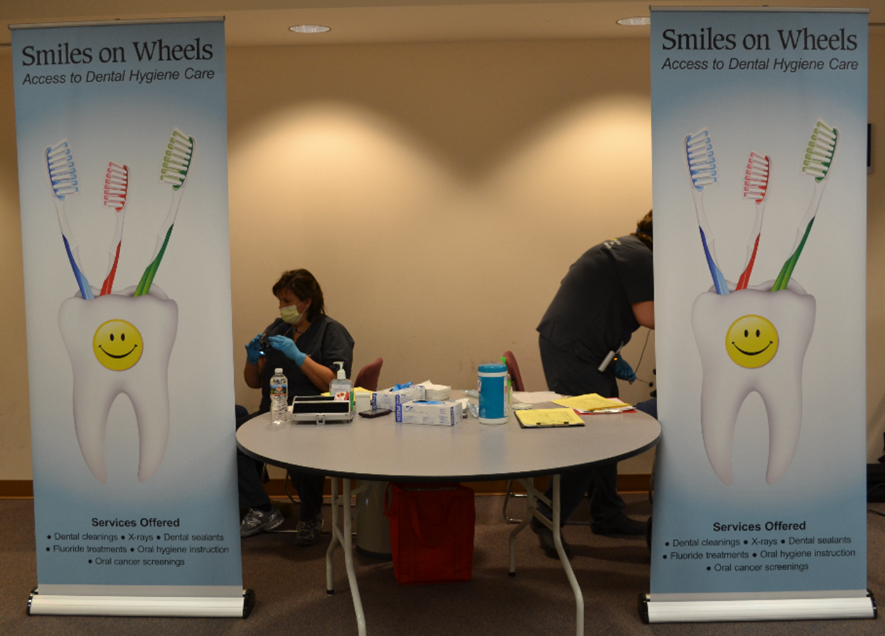
Notes:
Thank you to Michigan for sharing a photo of their privacy screens, incentives and organized supplies.

Slide 23
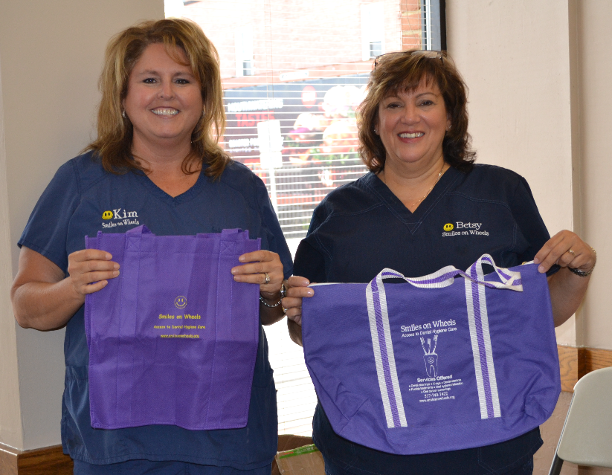
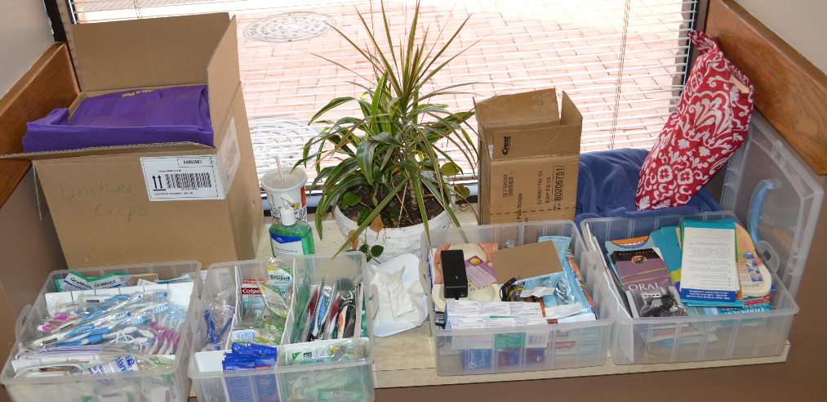
Everyone loves incentives!
Being organized makes things go more smoothly.
Notes:
Kids aren’t the only ones who love getting incentives! Be creative. Think of things that may be useful for older adults in their day to day life, toothbrushes, floss, denture brushes, toothbrush travel covers, etc. Is there a way to acknowledge your funder or your program? Talk with the staff of the congregate meal site, assisted living or long-term care facility to get their input on what people may find useful. Budget is always a consideration as well.
Having supplies organized is a must to keep things running smoothly. Will screeners be transporting items to locations or will supplies need to be shipped? If shipped, will the location have a place to store the items? Keep a checklist of items to ensure screeners have what they need.

Slide 24
Other Lessons Learned
Posters and marketing materials help.
More women usually consent than men.
If one person wants to do it then friends will.
Senior health fairs: large energetic crowd, need extra screeners and barriers such as ropes to keep people in line.
Senior health fairs — Create coupons so they can come back to get free incentives so they don’t miss them.

Slide 25
Other Lessons Learned
Offer staff in-service to increase likelihood that a facility will agree to participate.
Hold a debriefing with your primary contact at the facility at the conclusion of the survey to discuss seniors that need dental treatment, helpful hints for oral hygiene, etc.
Notes:
It is important to remember you will need the assistance of staff when doing the BSS in any facility. Be sure to engage them in the process as their “buy-in” can lead to better participation. Think about what you will do with the information you collect on seniors who need follow up care or assistance with oral hygiene. A list you can share with the nursing director or other primary contact at the conclusion of the survey is something to discuss during the planning process.

Slide 26
Resource Documents From Other States
Maryland FAQs brochure: https://www.astdd.org/www/docs/md-dr-des23013-older-adult-bpar-faq-2016.pdf
Maryland Health questionnaire: https://www.astdd.org/www/docs/md-dr-des23013-older-adult-bpar-health-questionaire.pdf
Maryland Screening form: https://www.astdd.org/www/docs/md-dr-des23013-older-adult-bpar-bss-screening-form.pdf
Georgia Oral Health Coalition –Older Adults and Oral Health flyer: http://www.astdd.org/docs/seniors-OH-flyer-georgia.docx
Notes:
Thank you to Maryland for the following resources:
FAQs brochure: https://www.astdd.org/www/docs/md-dr-des23013-older-adult-bpar-faq-2016.pdf
Health questionnaire: https://www.astdd.org/www/docs/md-dr-des23013-older-adult-bpar-health-questionaire.pdf
Screening form: https://www.astdd.org/www/docs/md-dr-des23013-older-adult-bpar-bss-screening-form.pdf
Thank you to Georgia for the older adults and oral health flyer. The section in the top right is designed for you to place your own information: http://www.astdd.org/docs/seniors-OH-flyer-georgia.docx

Slide 27
Older Adult BSS Coaches
Jill Moore RDH, BSDH, MHA
Dental Sealant Coordinator
Michigan Department of Health and Human Services
Email: MooreJ14@Michigan.gov
Phone: 517-373-4943
Lori Kepler Cofano, BSDH
Dental Public Health Consultant
Email: lkcofano@gmail.com
Phone: 775-781-1722
Notes:
Many states have the same issues when doing the Older Adult BSS, so ASTDD has Older Adult BSS coaches available by request. They are willing to share their own experiences and offer suggestions to deal with barriers that often arise. If they don’t have the answer to your question, they will try to find it using their contacts.

