Slide 1
Oral Health Data CDC’s open data website for oral health
cdc.gov/oralhealthdata
National Center for Chronic Disease Prevention and Health Promotion
Division of Oral Health

Slide 2
Oral Health Data CDC’s open data website for oral health
cdc.gov/oralhealthdata
National Center for Chronic Disease Prevention and Health Promotion
Division of Oral Health

Slide 3
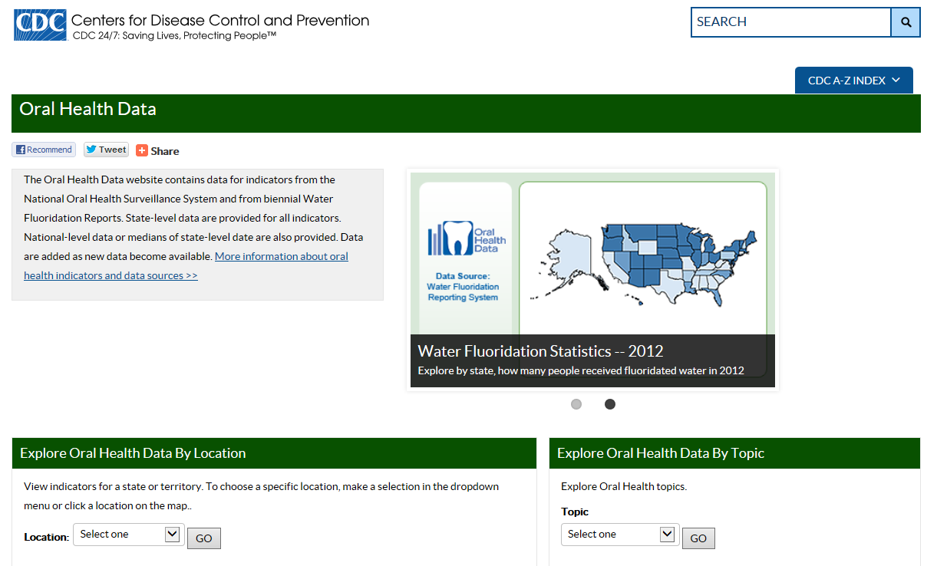
cdc.gov/oralhealthdata CDC’s open data website for oral health

Slide 4
cdc.gov/oralhealthdata Replaces data websites: NOHSS, Maps, Synopses

Slide 5
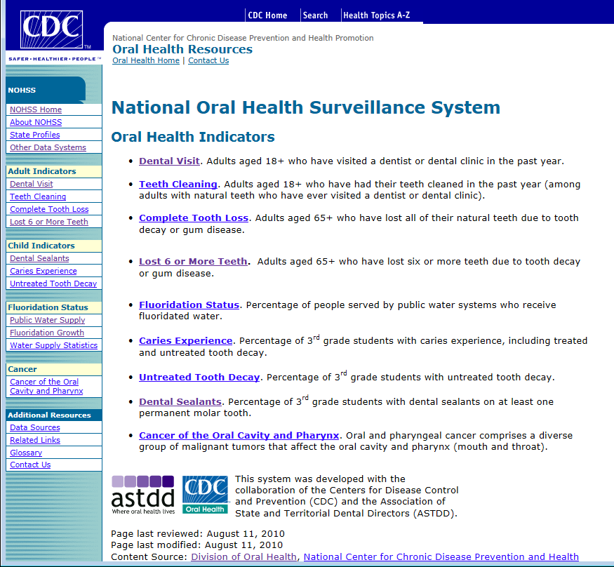
cdc.gov/oralhealthdata Replaces data websites: NOHSS, Maps, Synopses
http://www.cdc.gov/nohss
http://apps.nccd.cdc.gov/nohss

Slide 6
cdc.gov/oralhealthdata Replaces data websites: NOHSS, Maps, Synopses
http://www.cdc.gov/nohss
http://apps.nccd.cdc.gov/gisdoh
http://apps.nccd.cdc.gov/nohss

Slide 7
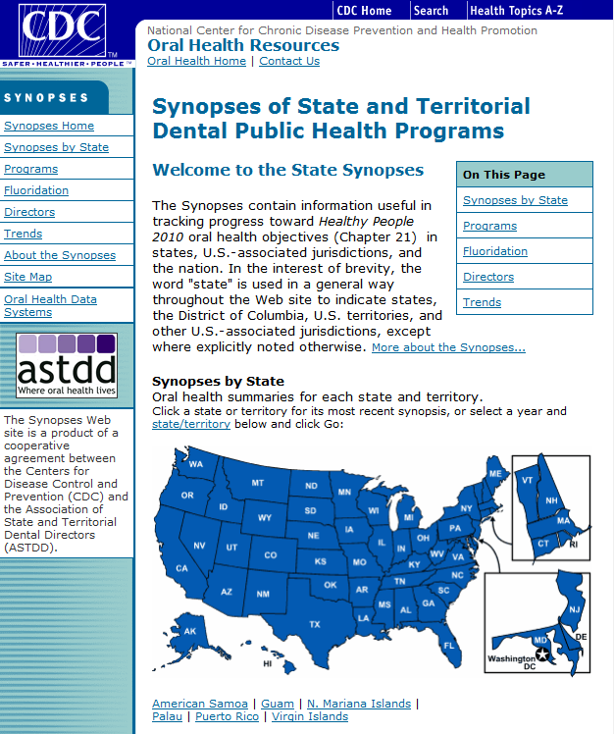
cdc.gov/oralhealthdata Replaces data websites: NOHSS, Maps, Synopses
http://www.cdc.gov/nohss
http://apps.nccd.cdc.gov/gisdoh
http://apps.nccd.cdc.gov/synopses
http://apps.nccd.cdc.gov/nohss

Slide 8
cdc.gov/oralhealthdata Replaces data websites: NOHSS, Maps, Synopses
http://www.cdc.gov/nohss
http://apps.nccd.cdc.gov/gisdoh
http://apps.nccd.cdc.gov/synopses
http://apps.nccd.cdc.gov/nohss

Slide 9
cdc.gov/oralhealthdata Replaces data websites: NOHSS, Maps, Synopses
http://www.cdc.gov/nohss
http://apps.nccd.cdc.gov/gisdoh
http://apps.nccd.cdc.gov/synopses
http://apps.nccd.cdc.gov/nohss

Slide 10
Two main sections: Two main audiences
High level view: Users in a hurry media, policy, program, partners
Image credit: US Department of Commerce, National Oceanic & Atmospheric Administration

Slide 11
Two main sections: Two main audiences
High level view: Users in a hurry media, policy, program, partners
Deep dive: Data Portal data analysts, developers
Image credit: US Department of Commerce, National Oceanic & Atmospheric Administration

Slide 12
Two main sections: Two main audiences
High level view:
Deep dive:
“Savvy in-between”
Image credit: US Department of Commerce, National Oceanic & Atmospheric Administration

Slide 13
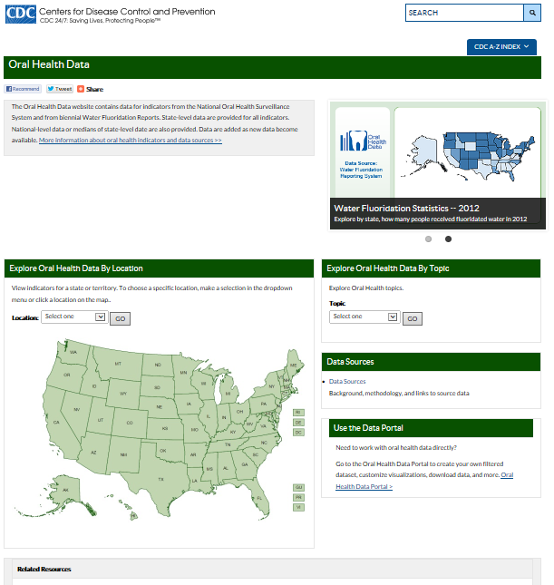
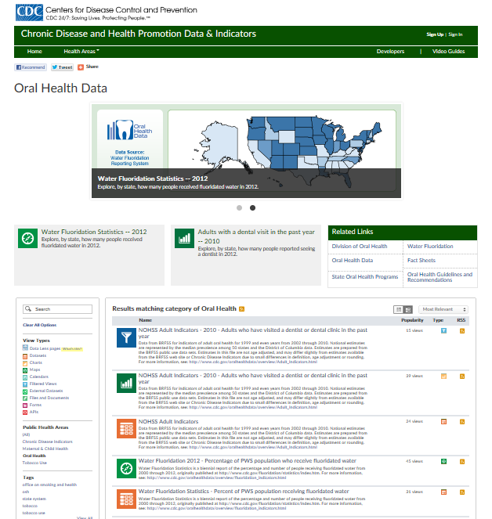
Two main sections: Two main audiences
High view: media, policy, programs, partners, public
Deep dive: Data Portal data analysts, developers

Slide 14
Let’s start with the high view
High level view: media, policy, programs, partners, public
Image credit: Department of Commerce, National Oceanic & Atmospheric Administration

Slide 15
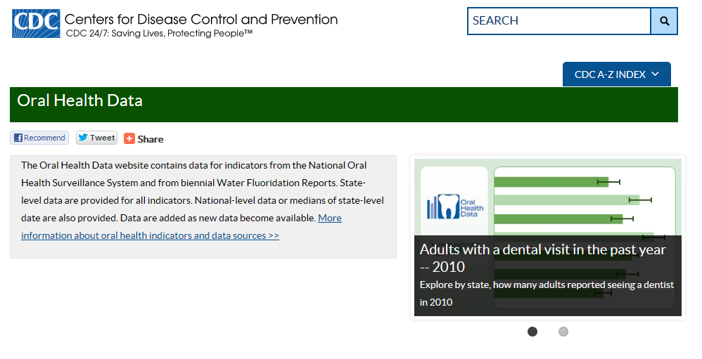
Oral Health Data: high level

Slide 16
Oral Health Data: high level
cdc.gov/oralhealthdata open data website for oral health

Slide 17
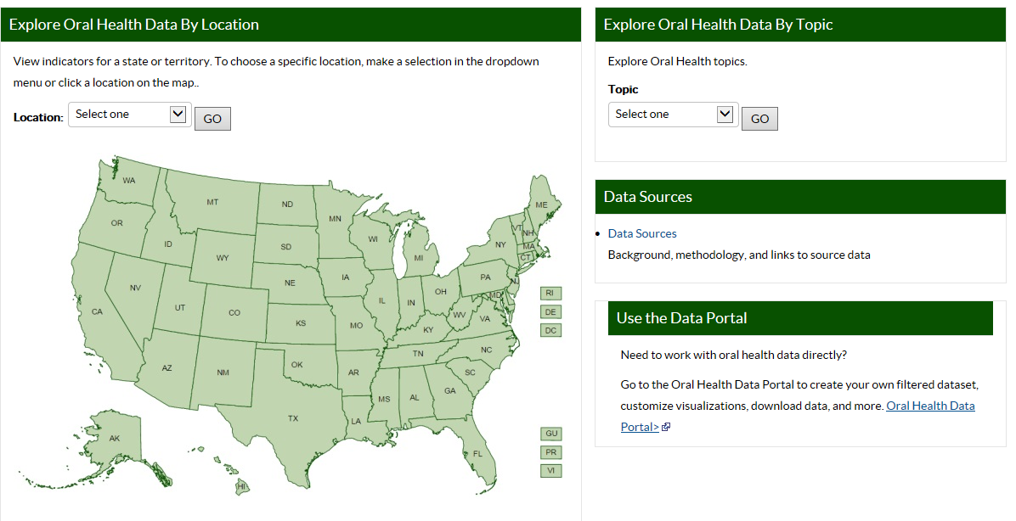
Oral Health Data: high level

Slide 18
Oral Health Data: high level
Access background and help pages

Slide 19
Oral Health Data: high level
View by topic

Slide 20
Oral Health Data: high level
View by state
View data by state

Slide 21
Oral Health Data: deep dive
cdc.gov/oralhealthdata open data website for oral health
Work directly with data
“deep dive”

Slide 22
Overview, Indicators, Data Sources

Slide 23
Overview, Indicators, Data Sources
Access background and help pages
Access background and help pages

Slide 24
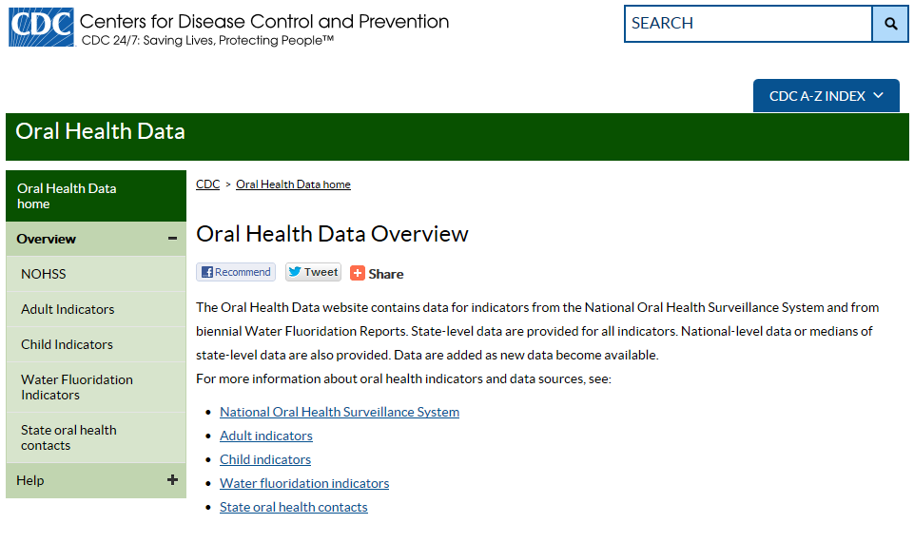
Overview, Indicators, Data Sources

Slide 25
Overview, Indicators, Data Sources

Slide 26
Overview, Indicators, Data Sources
Peruse background information on data sets

Slide 27
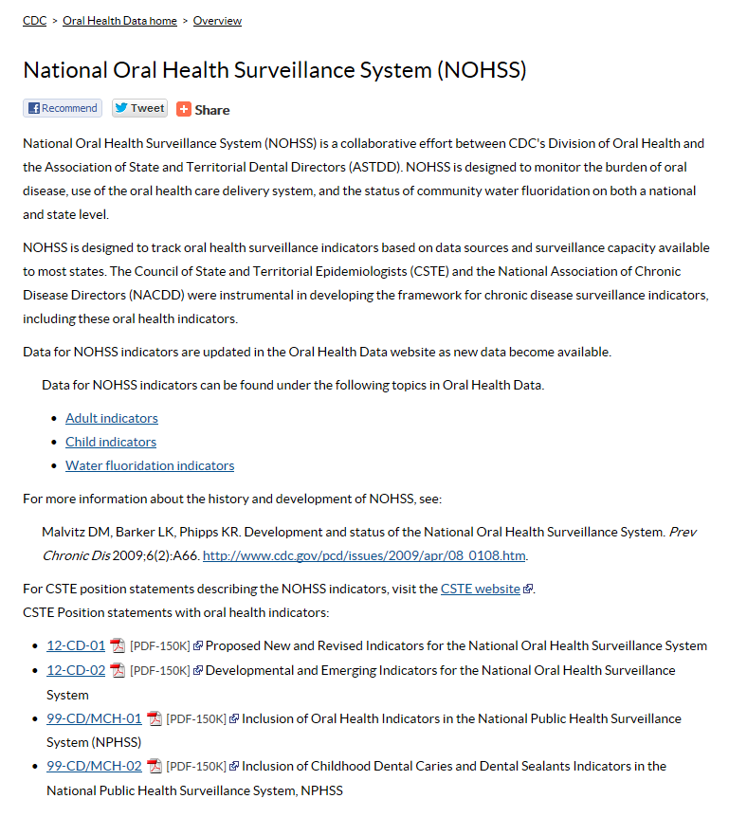
Overview, Indicators, Data Sources

Slide 28
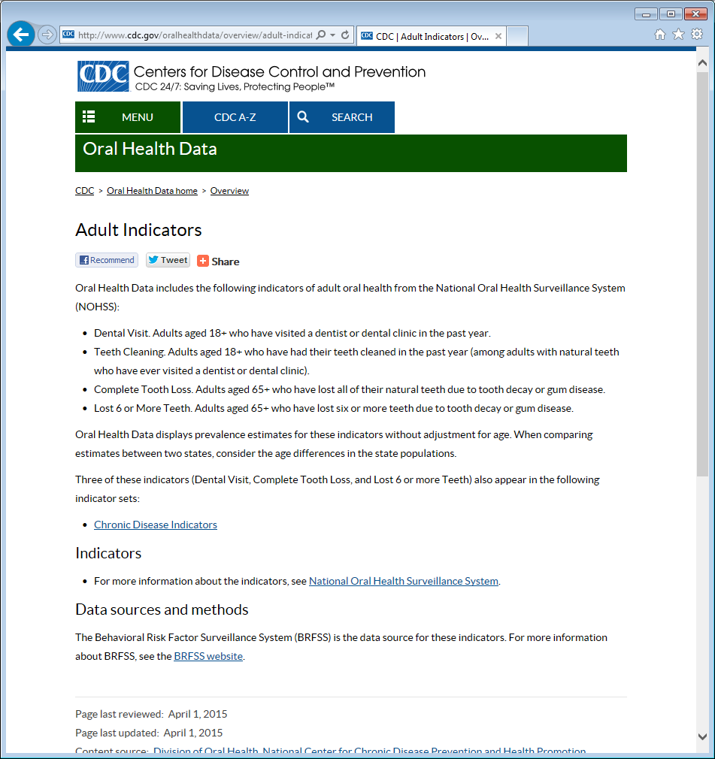
Overview, Indicators, Data Sources

Slide 29
Overview, Indicators, Data Sources

Slide 30
Overview, Indicators, Data Sources

Slide 31
Help: how to use the site
Access Help pages

Slide 32
Help: how to use the site

Slide 33
Help: how to use the site
Learn how to navigate the open data website

Slide 34
Help: how to use the site

Slide 35
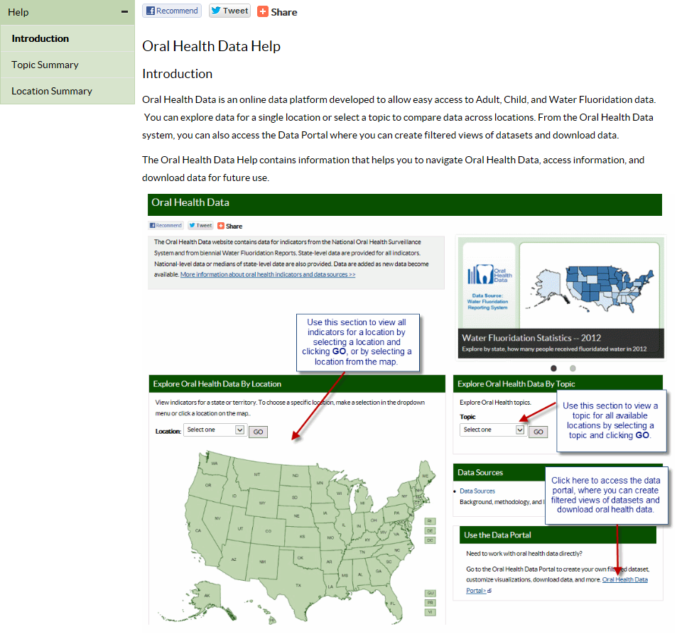
Help: how to use the site

Slide 36
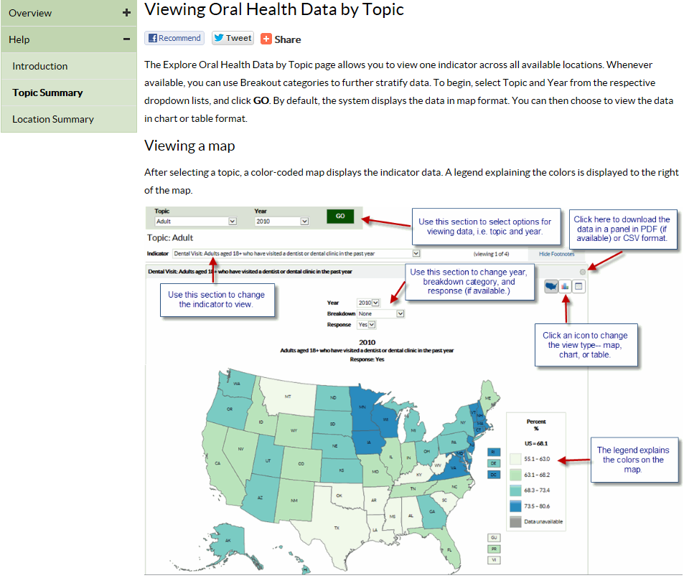
Help: how to use the site

Slide 37
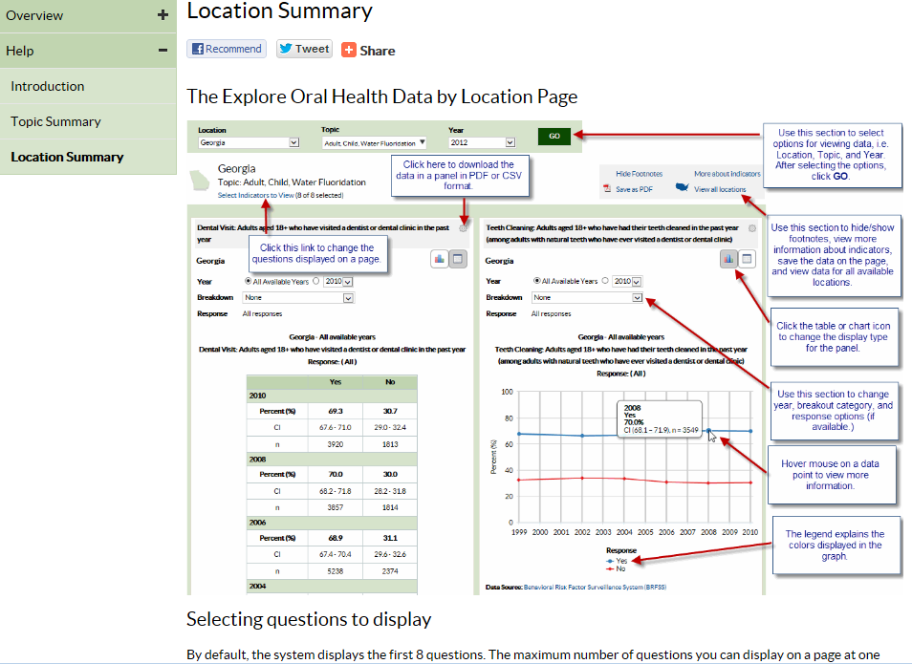
Help: how to use the site

Slide 38
Explore Oral Health Data By Topic: Fluoridation
Explore by topic

Slide 39
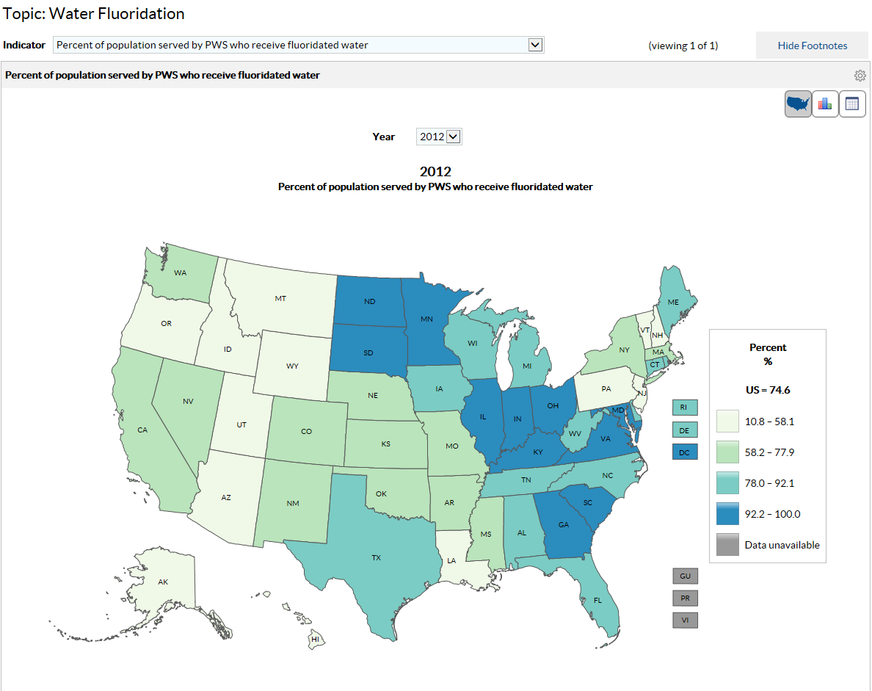
Explore Oral Health Data By Topic: Fluoridation

Slide 40
Explore Oral Health Data By Topic: Fluoridation
View data in a map

Slide 41
Explore Oral Health Data By Topic: Fluoridation
…and by year

Slide 42
Explore Oral Health Data By Topic: Fluoridation
… view bar graph or table

Slide 43
Explore Oral Health Data By Topic: Adult
Explore by topic

Slide 44
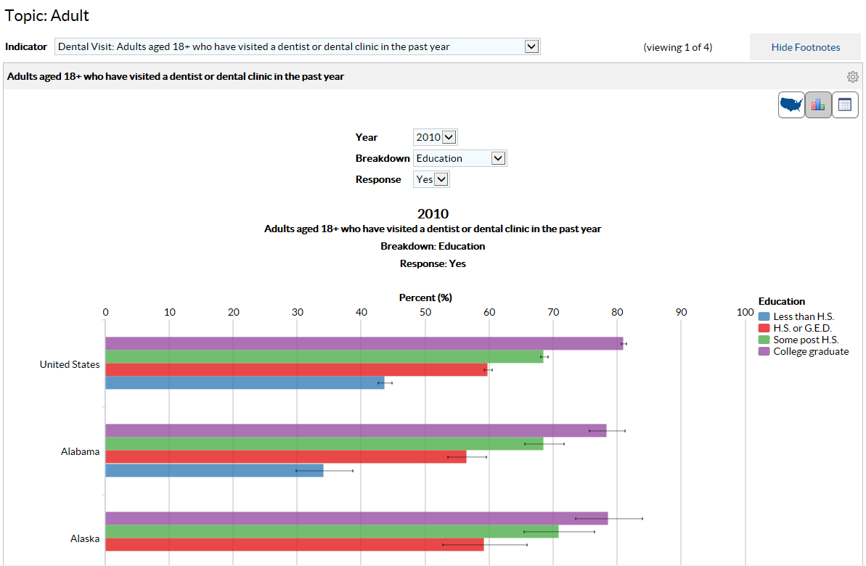
Explore Oral Health Data By Topic: Adult
… view bar graph

Slide 45
Explore Oral Health Data By Topic: Adult
… view by age, sex, education, income and race

Slide 46
Explore Oral Health Data By Topic: Child
Explore by topic

Slide 47
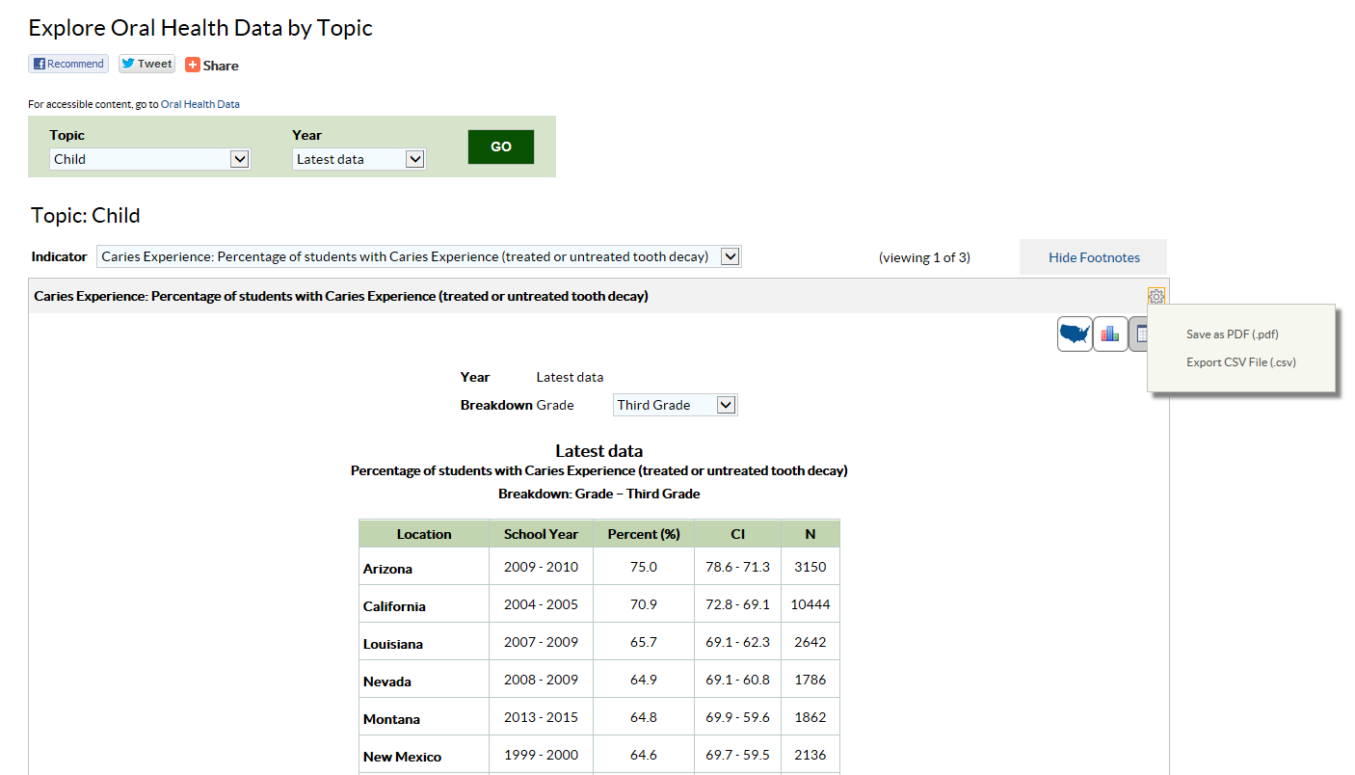
Explore Oral Health Data By Topic: Child

Slide 48
Explore Oral Health Data By Topic: Child
… and view by grade in school

Slide 49
Explore Oral Health Data By Topic: Child
… view table, save as a PDF, or export data to a CSV file

Slide 50
Explore Oral Health Data By Location
View all indicators for one state

Slide 51
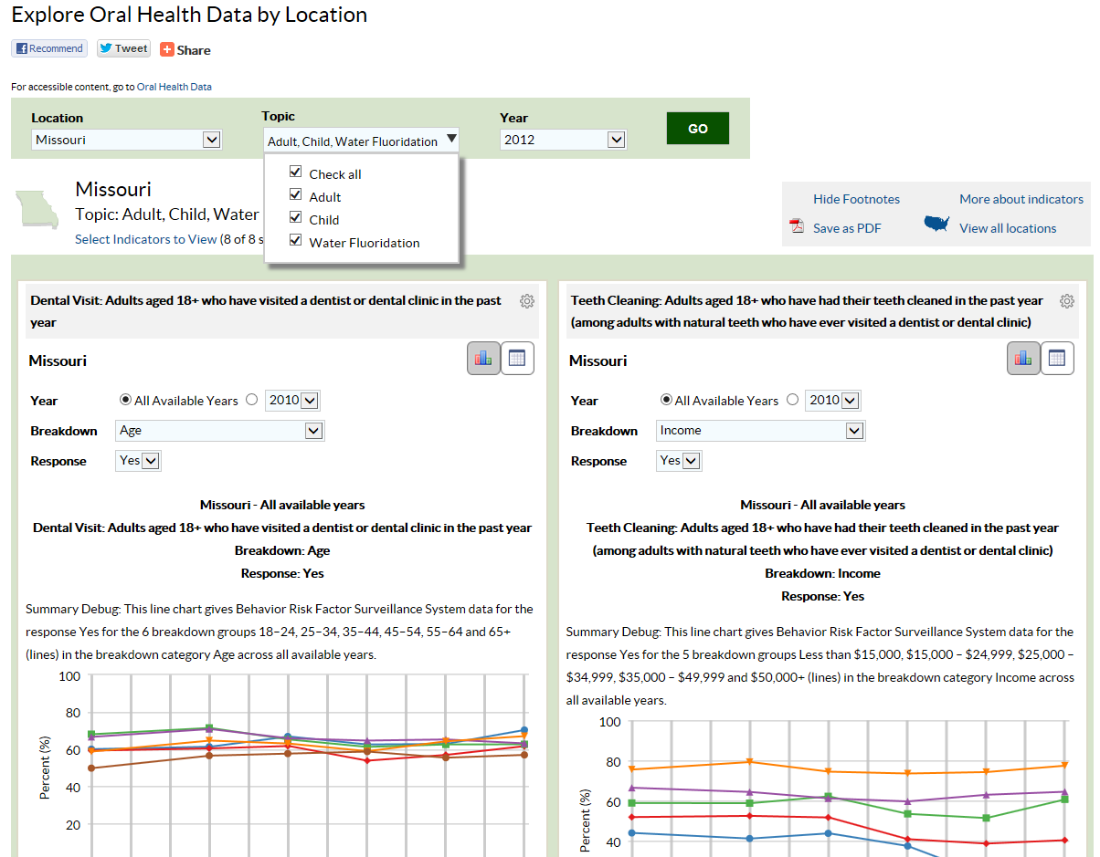
Explore Oral Health Data By Location
Select indicators for one state

Slide 52
Explore Oral Health Data By Location
User can select view for each indicator shown on page
Change view independently for each indicator shown on page

Slide 53
Use the Data Portal: deep dive
cdc.gov/oralhealthdata open data website for oral health
Work directly with data
“deep dive”

Slide 54
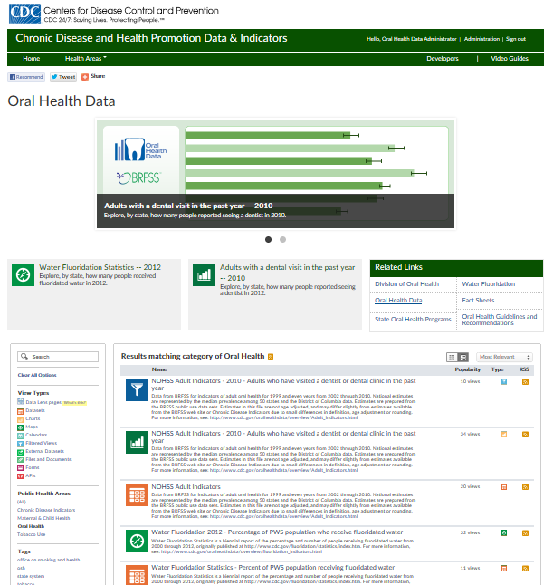
Now, for the deep dive: (well, maybe just a quick dip)
Deep dive: data analysts, developers
Image credit: Department of Commerce, National Oceanic & Atmospheric Administration

Slide 55
Use the Data Portal: deep dive
Work directly with data sets through the Data Portal

Slide 56
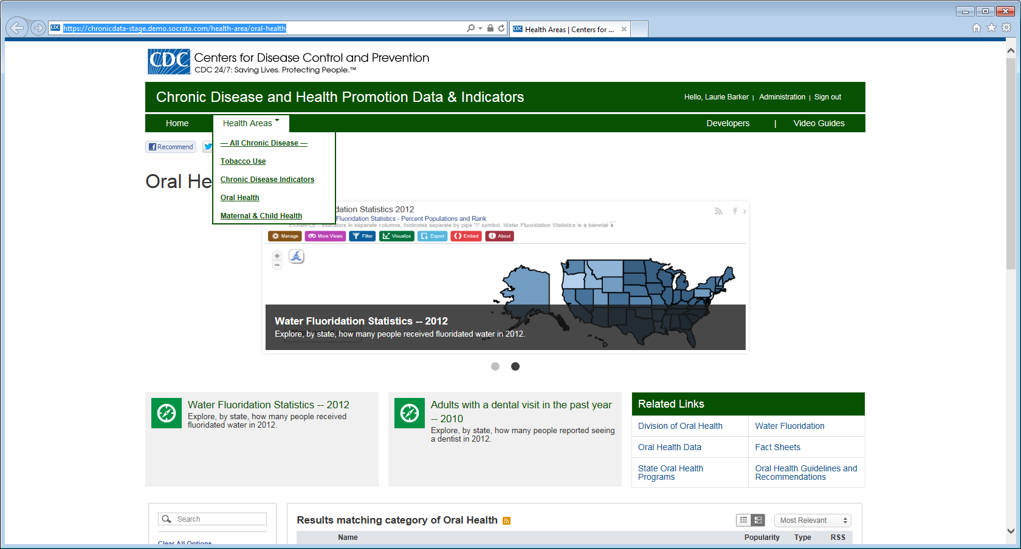
Use the Data Portal: deep dive
Select existing filtered views or visualizations

Slide 57
Use the Data Portal: deep dive
Interact with visualizations or create new ones

Slide 58
Use the Data Portal: deep dive
User can work directly with the data through the Data Portal

Slide 59
Use the Data Portal: deep dive
User can interact with a data set

Slide 60
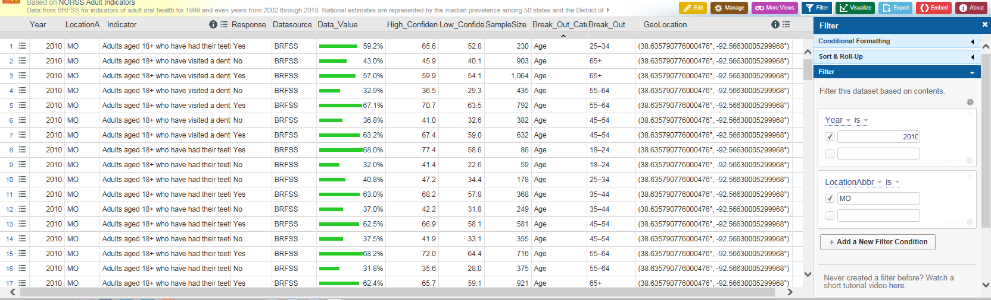
Use the Data Portal: deep dive
User can filter, graph, map or export data sets, or embed link to available views

Slide 61
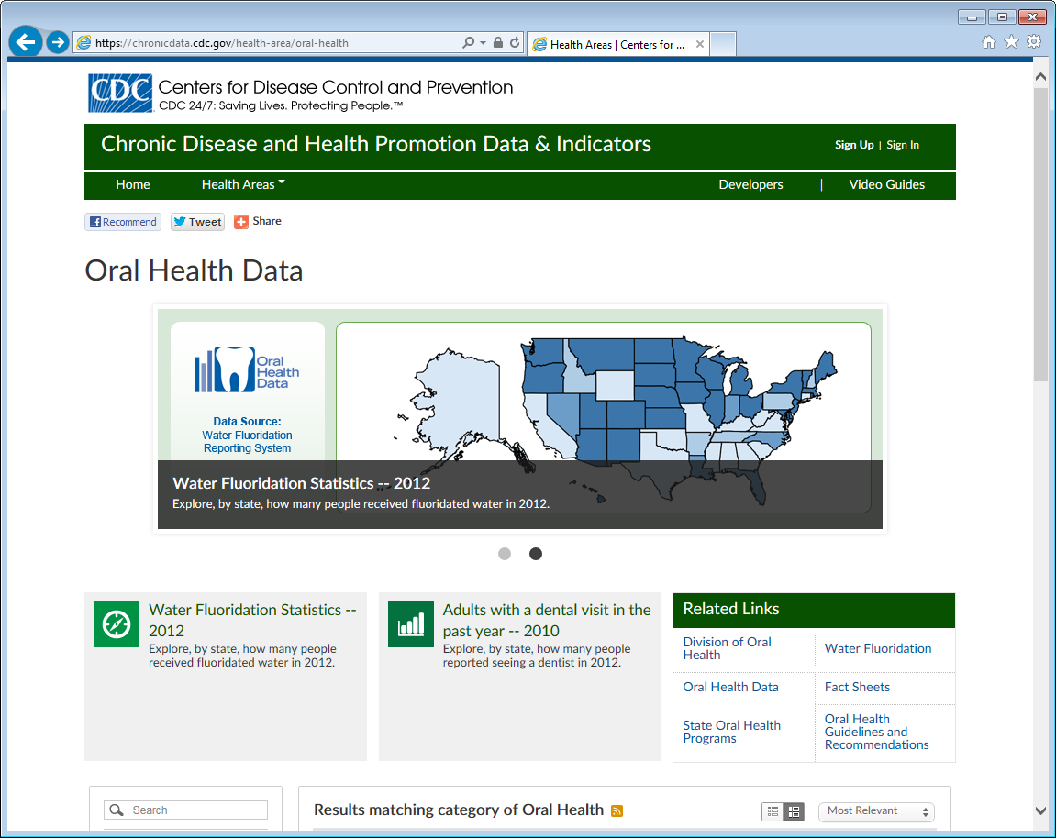
Use the Data Portal: deep dive

Slide 62
Use the Data Portal: deep dive

Slide 63
Use the Data Portal: deep dive

Slide 64
Use the Data Portal: for coders

Slide 65
oralhealth@cdc.gov
For more information please contact Centers for Disease Control and Prevention
1600 Clifton Road NE, Atlanta, GA 30333
Telephone: 1-800-CDC-INFO (232-4636)/TTY: 1-888-232-6348
Visit: www.cdc.gov | Contact CDC at: 1-800-CDC-INFO or www.cdc.gov/info
The findings and conclusions in this report are those of the authors and do not necessarily represent the official position of the Centers for Disease Control and Prevention.
National Center for Chronic Disease Prevention and Health Promotion
Division of Oral Health

