Slide 1

“Adopting Performance Management Strategies to Improve Oral Health in Your State”
April 12, 2017

Slide 2
General Reminders
This webinar will be recorded and archived on the ASTDD website
We would like to hold any questions until the end, so if you have questions, please make a note of them. When we are ready for questions, if you wish to ask one, please click on the Set Status icon which is the little man with his arm raised on either the upper left or the top of your screen. Click on “raise hand.” We will then call on you to ask your question over the phone
Please respond to the polling questions at the conclusion of the webinar

Slide 3
Funding Acknowledgement(s)
This presentation was supported by Cooperative Agreement NU58DP004919-05-00 from the CDC, Division of Oral Health and by the Health Resources and Services Administration (HRSA) of the U.S. Department of Health and Human Services (DHHS) under grant #H47MC00048. This information or content and conclusions are those of the authors and should not be considered as the official position or policy of the CDC, HRSA, DHHS, or the U.S. government, nor should any endorsements be inferred.

Slide 4
Moderator /Presenters
Harry Goodman, DMD, MPH
Ellen Volpe, MHA
Mary Davis, DrPH, MSPH
Erin Knoerl, MPH
Katy Battani, RDH, MS
Notes:
Harry
Read bios

Slide 5
Learning Objectives
At the end of this webinar, participants will be able to:
1. Explain how Performance Management and Quality Improvement can be used in state oral health programs.
2. Discuss examples of use of Performance Management and Quality Improvement in state oral health programs.
3. Identify resources for further information about Performance Management and Quality Improvement.

Slide 6
Title V National Performance Measure 13
Thirty-one states and jurisdictions selected NPM 13.
NPM 13A: Percent of women who had a dental visit during pregnancy.
NPM 13B: Percent of children, ages 1 through 17, who had a preventive dental visit in the past year.
On July 15 of each year, states and jurisdictions are required to submit an application/annual report.
As part of this annual application, a state may refine its action plan.
States may add new or revise existing program strategies, evidence-based or -informed strategy measures.

Slide 7
Title V National Performance Measure 13
Division of State and Community Health
Title V Block Grant National Performance Measure 13 Liaisons
Gor Yee Lum, M.P.H.
Regional MCH Consultant
NPM 13 Liaison-lead
Phone: (415) 437-8497
E-mail: Glum@hrsa.gov
Cherri Pruitt, M.P.A.
Regional MCH Consultant
NPM 13 Liaison Co-lead
Phone: (303) 844-7872
E-mail: CPruitt@hrsa.gov

Slide 8
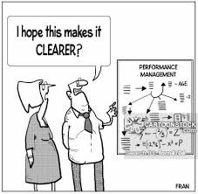
Performance Management Primer

Slide 9
Let’s Start with Definitions
“Performance management is the practice of actively using performance data to improve the public's health.
This practice involves the strategic use of performance measures and standards to establish performance targets and goals.”*
A systematic process by which an organization involves its employees in improving the effectiveness of the organization and achieving the organization’s mission and strategic goals.
*From Silos to Systems: Using Performance Management to Improve Public Health Systems – prepared by the Public Health Foundation for the Performance Management National Excellence Collaborative, 2003
Notes:
Performance management uses a set of management and analytic processes supported by technology that enables an organization to define strategic goals and then measure and manage performance against those goals.

Slide 10
What Can Performance Management Do for Public Health?
By improving performance and quality, public health systems can save lives, cut costs, and get better results.
Enables health departments to be more:
  Efficient
  Effective
  Transparent
  Accountable

Slide 11
Performance Management Can Result in:
Better return on dollars invested in health
Greater accountability for funding and increases in the public’s trust
Reduced duplication of efforts
Better understanding of public health accomplishments and priorities among employees, partners, and the public
Increased sense of cooperation and teamwork
Increased emphasis on quality, rather than quantity
Improved problem-solving

Slide 12
What Are Performance Management Practices?
  Goal setting
  Financial planning
  Operational planning
  Data collection
  Consolidation of data
  Data analysis
  Reporting of data
  Quality improvement
  Evaluation of results
  Monitoring of key performance indicators
  Others???

Slide 13
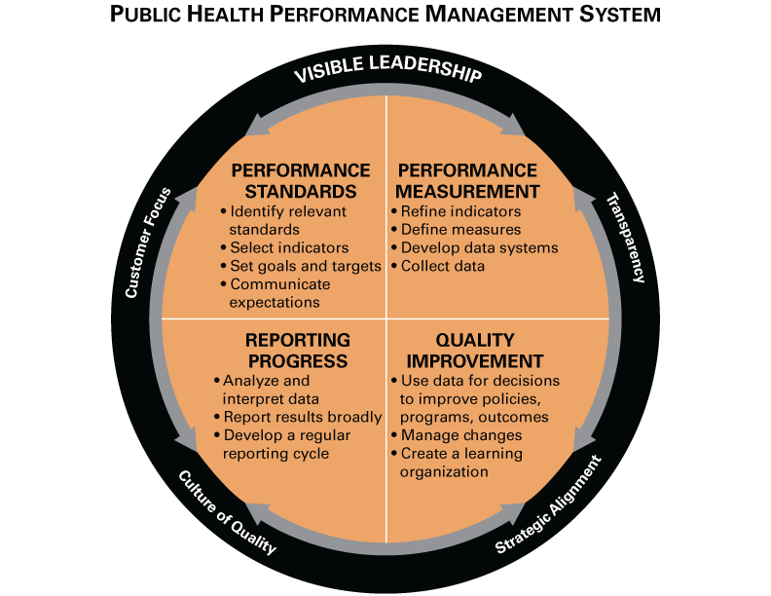
Developed in 2013, adapted from the 2003 Turning Point
Performance Management System Framework
www.phf.org
Notes:
Most have seen this Turning Point Model – the 30,000 foot view of what we’re talking about today.
Turning Point Performance Management National Excellence Collaborative convened about a decade ago. Four year collaborative funded by RWJF established in 2000.
Turning Point Performance Management Collaborative (PMC) – seven states (AK, IL, MO, MT, NH, NY, WV) and five national partners (ASTHO, NACCHO, CDC, HRSA, PHF) working to study and promote systems to manage public health performance
20+ years ago where we started seeing literature and observation about performance management working in other industries. We began asking questions, what does performance management look like in public health?
Managing performance is what you do at the program, organization (local/state), or system level to ensure you get results. It’s the opposite of leaving things to chance.

Slide 14
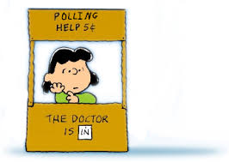
Poll
Have you seen the Performance Management Framework before?
Yes
No
Not Sure

Slide 15
Visible Leadership
Engage leadership in performance management
Align performance management with organizational priorities
Track and incentivize progress
Think about:
Does senior management take a visible role in performance management?
Is performance management emphasized as a priority and goal for your work?

Slide 16
Visible Leadership
Senior management commitment to a culture of quality that:
Aligns performance management practices with the organizational mission
Regularly takes into account customer feedback
Enables transparency about performance against targets between leadership and staff.
Key Resource: NACCHO Roadmap to a Culture of Quality Improvement. http://qiroadmap.org/

Slide 17

Leadership : Bob Russell, DDS
Public Health Dental Director, IA Department of Public Health
Increased state and federal fiscal allocations toward dental public health, $3 million over 3 years
Oral Health Bureau created IA Oral Health Strategic Plan 2016-2020
Initiated advocacy plan for “I-Smile”

Slide 19
Performance Standards
Identify relevant standards
Select indicators
Set goals and targets
Communicate expectations
Think about:
Do you set or use standards, targets or goals for your organization or program?
How do you communicate the expectations and strategic direction for your organization or program?

Slide 20
Performance Standards
Standards may be set based on national, state or scientific organizations, by benchmarking against similar organizations, or by other methods.
Example: Healthy People 2020* OH-1: Reduce the proportion of children and adolescents who have dental caries experience in their primary or permanent teeth.
*www.HealthlyPeople.gov

Slide 21
Performance Measurement
Refine indicators and define measures
Develop data systems
Collect data
Think about:
How do you measure capacity, process or outcomes?
What tools exist to support the efforts?

Slide 22
Performance Measurement
Sets criteria and establishes scope (programmatic vs. state)
HP 2020 OH-1.1: Reduce the proportion of children aged 3-5 years with dental caries experience in their primary teeth.
  Baseline 33%
  Target: 30%
  Target Setting Method: 10% Improvement
  Data Sources National Health and Nutrition Survey, CDC/NCHS
  Timeframe: Every 3 years (example)

Slide 23

How New Hampshire Uses Criteria to Select Measures
Data should be available for several years to show trends.
Data should be reliable, in that we are confident in the accuracy of the data and that it measures what is intended to measure.
The measures should reflect new and growing initiatives.
The measures should be a good indicator of whether or not a program or intervention is working.
Source: Improving the Public’s Health in New Hampshire, 2005. http://www.dhhs.nh.gov/dphs/iphnh/documents/report.pdf

Slide 24
Reporting Progress
Analyze and interpret data
Report results broadly
Develop a regular reporting cycle
Think about:
Do you document or report your unit / program’s progress?
Is this information regularly available? To whom?
What is the frequency of analysis and reporting?

Slide 25
Reporting Progress
Tracking and reporting progress depends on:
Purpose of performance management system
Intended users of performance data
A robust reporting system
Makes comparisons to national, state, or local standards or benchmarks
Show where gaps may exist within the system
Facilitates identifying areas for improvement

Slide 26

Reporting: SC Strategic Plan

Slide 27
Quality Improvement
Use data for decisions to improve policies, programs and outcomes
Manage changes
Create a learning organization
Think about:
Do you have a quality improvement process?
What do you do with information gathered through reports?
Do you have the capacity to take action for improvement when needed?

Slide 28
Quality Improvement
Quality Improvement (QI) is the establishment of a program or process to manage change and achieve quality improvement in public health policies, programs, or infrastructure based on performance standards, measures, and reports.
Most Commonly Used Tools
Brainstorming, Flow Chart, SIPOC+CM, Cause and Effect Diagram, Five Whys, Solution and Effect Diagram, Check Sheets, Pareto Charts, Pie Charts, Run Charts, Control Chart, Force Field Analysis, Nominal Group Technique

Slide 29
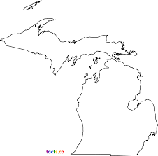

Slide 30

Polling
Have you heard of the Public Health Accreditation Board?
Yes
No
Not Sure
Is your state PHAB Accredited?
Yes
No
Don’t Know

Slide 31
PHAB: Driving Public Health Performance
PHAB Standard 9.1: Use a performance management system to monitor achievement of organizational objectives.*
For the health department to most effectively and efficiently improve the health of the population, it is important to monitor the performance of public health processes, programs, interventions, and other activities. A fully functioning performance management system that is completely integrated into health department daily practice at all levels includes:
setting organizational objectives across all levels of the department,
identifying indicators to measure progress toward achieving objectives on a regular basis,
identifying responsibility for monitoring progress and reporting,
identifying areas where achieving objectives requires focused quality improvement processes,
visible leadership for ongoing performance management. Department information systems and public health data support performance management. S
*www.phaboard.org

Slide 32
PHAB Status Update: April 2017
Distribution of Health Departments | Accredited | In Process | Total in e-PHAB
Local | 155 | 131 | 286
State | 22 | 16 | 38
Tribal | 1 | 3 | 4
Centralized States Integrated System* | 1/67 | — | 1/67
Multi-Jurisdictional | — | 8 | 8
Total Number of Health Departments | 178 + 1 system | 158 | 337
Population (Unduplicated) | 178,255,529 | 80,819,504 | 259,075,033

Slide 33

Putting it All Together:
CT Performance Management System

Slide 34
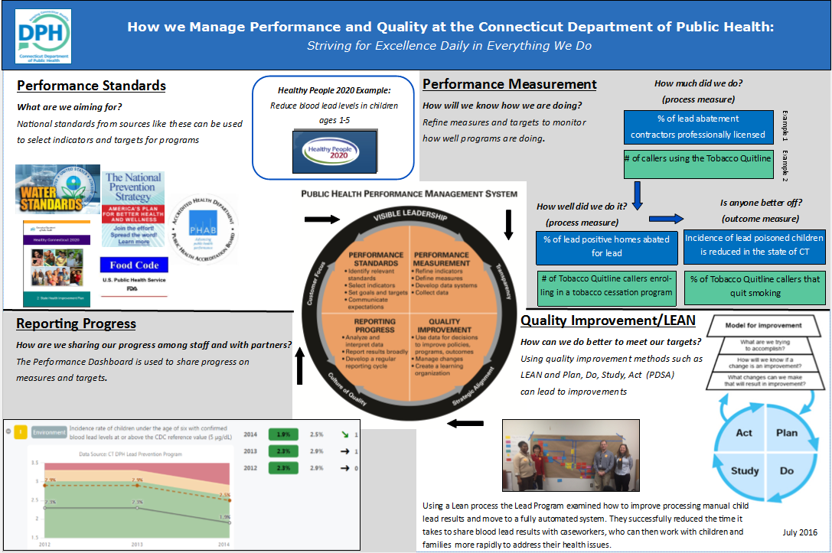

Slide 35
Community Water Fluoridation- Performance Management Initiative
Erin C. Knoerl, MPH
Public Health Specialist – Community Water Fluoridation and Oral Health Workforce
New York State Department of Health, Bureau of Child Health

Slide 36
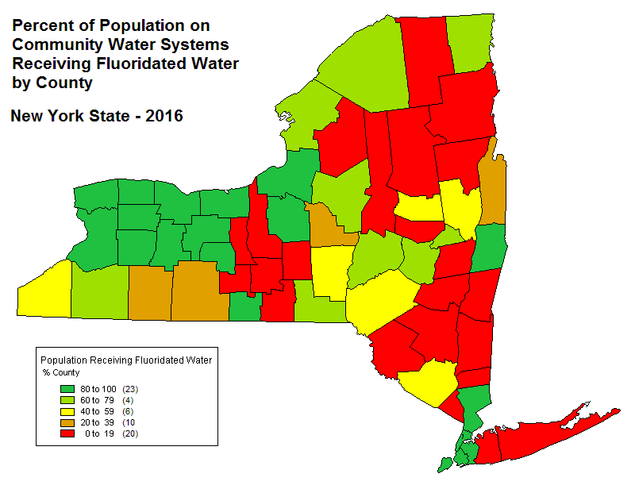
Community Water Fluoridation (CWF) Across NYS
Population served: 13 million
Fluoride adjusted water systems: 122 of 2,407 systems
Percentage of people on public water in NYS who receive optimally fluoridated water:
  With NYC- 71.7%
  Without NYC- 47.0%
Notes:
Another 290 purchase fluoridated water
38 are naturally fluoridated
If you have heard me present before then you may have noticed a change in the number of adjusted systems, fun fact, the Metropolitan Water Board consolidated with the Onondaga County Water Authority.

Slide 37
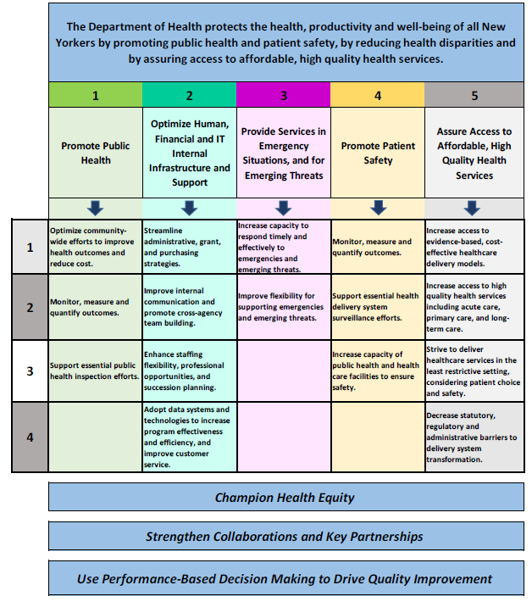
Performance Management is a Priority in NYS
2012 Strategic Plan
  Mission
  Vision
  Strategic Map
  Key priority: Become a model performance-based organization
Center for Community Health Initiative
  2013 – current
  Quarterly update meetings
2016 Governor’s Office Initiative
  Remodeled Agency Strategic Plan
  Annual performance plans
  Lean process improvement plans
Update to the Strategic Map
  Cross-cutting strategic priority: Use performance-based decision making in quality improvement
2016 New York State Department of Health Strategic Map as of November 17, 2016
Notes:
2012 Strategic Plan- mission, vision and map. The map lists the priorities and objectives, really the critical steps, that must be taken to successfully achieve the Department's mission of protecting the health and well being of New Yorkers.
7 priorities including: Become a model performance-based organization- related strategies include:
Implement a process for program-level performance measures
Engage internal/external stakeholders in developing and implementing metrics
Implement a quality improvement process
Implement practices that support being a performance-based organization
Use performance-based decision-making in aligning resources
An October 2016 assignment from the NYS Division of the Budget (DOB) called upon State agencies to submit strategic plans, annual performance plans, and Lean process improvement plans. In response, DOH used the assignment as an opportunity to build on its past work on strategic planning and performance management.
To facilitate implementation and support collaboration, DOH offices selected performance measures that align with specific strategic objectives associated with the priorities on the map. The offices provided one-year and three-year performance targets for each of their measures, and the Department is exploring how to develop a centralized performance management dashboard to track, monitor, and report on these measures on a regular basis.

Slide 38
Fluoridation is a Priority in NYS
2016-2020 Title V Maternal and Child Health Services Block Grant State Action Plan
  Objective LC-4: Increase the percentage of NYS residents served by community water systems that have optimally fluoridated water by 10% to 78.5%.
Prevention Agenda 2013-2018: New York State's Health Improvement Plan
  Objective 5-4: By December 31, 2018, increase the percentage of NYS population receiving fluoridated water by 10%. (Promoting Healthy Women, Infants and Children Action Plan)
  Objective 1a: Increase the percentage of NYS residents served by community water systems that receive optimally fluoridated water by 10% from 71.4% (2012) to 78.5%. (Promote a Healthy and Safe Environment Action Plan, Focus Area #2)
2014 New York State Oral Health Plan
  Objective 2.a: By 2017, increase the percentage of NYS population receiving fluoridated water by 10 percent.
Notes:
Fluoridation appears in three major State Health Plans

Slide 39
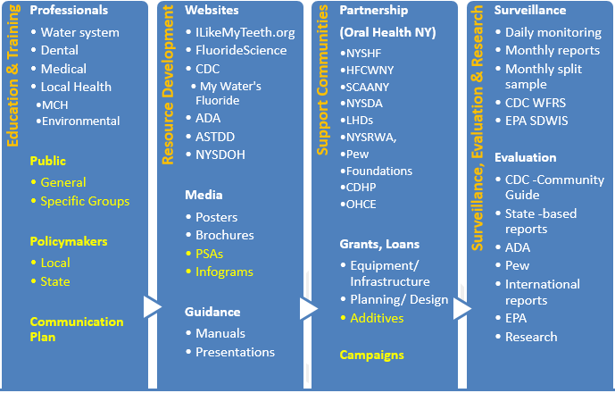
NYS’s CWF Program
Four programmatic focus areas
Performance management focus area: Surveillance
Program activities are accomplished through:
  Department of Health (DOH) staff and
  External contractors, partners and stakeholders
Yellow highlighted text shows the gaps being filled through a public-private partnership

Slide 40
Central Goal & Challenges
Year 1 Goal: Increase the percentage of NYS residents served by community water systems that receive optimally fluoridated water by 10% from 71% to 72% in 2017.
Challenge: In order to maintain existing fluoridating communities we (DOH) need to:
  Be able to identify public water systems (PWS) experiencing issues with CWF operation and equipment
  Provide technical and financial assistance to these PWS
Areas to Address:
  Consistent and timely access to CWF operation data from PWSs.
  Consistent delivery of optimally fluoridated water from PWSs to residents.
Notes:
Goal is based on achieving the goals outlined in the State Plans:
Objective LC-4 in the MCHSBG.
Objective 5-4 in the Prevention Agenda “Promote Health Women, Infants and Children Action Plan”
Water Quality Objective 1a in the Prevention Agenda “Promote Healthy and Safe Environment Action Plan”
Challenge: To reach our goal we would have to get an additional 1.23 million people on CWS access to fluoridated water. However, this number is contingent on our currently fluoridated CWS maintaining their fluoridation status.
Biggest barriers to this is:
attacks on safety and effectiveness
financial burden on communities
This was the uphill battle a few years ago; however, DOH has mechanisms in place to help but we need to know about the issues first.
Area to Address: DOH created two performance measures to address these area. Today I will just focus on one of these measures – the measure which addresses BCH’s access to CWF operation data

Slide 41
Model for
Improvement
PDSA Cycle
Change Idea
What are we trying to accomplish?
How will we know that a change is an improvement?
What change can we make that will result in improvement?
Act
Plan
What changes are to be made?
Next cycle?
Questions and predictions (why)
Plan to carry out the cycle (who, what, where, when)
Study
Do
Complete the analysis of the data
Compare data to predictions
Summarize what was learned
Carry out the plan
Document problems and unexpected observations
Begin analysis of data
Notes:
Model for Improvement
An approach to process improvement developed by Associates in Process Improvement, which helps t accelerate the adoption of proven and effective changes.
Four parts of the cycle:
Plan:
Decide what change you will make, who will do it, and when it will be done. Formulate an hypothesis about what you think will happen when you try the change. What do you expect will happen?
Identify data that you can collect (either quantitative or qualitative) that will allow you to evaluate the result of the test.
Do:
Carry out the change.
Study:
Make sure that you leave time for reflection about your test. Use the data and the experience of those carrying out the test to discuss what happened. Did you get the results you expected? If not, why not? Did anything unexpected happen during the test?
Act:
Given what you learned during the test, what will your next test be? Will you make refinements to the change? Abandon it? Keep the change and try it on a larger scale?

Slide 42
Performance Measure 1A: Percentage of NYS fluoride adjusted public water systems (PWS) that consistently submit monthly fluoride operating reports (MOR) to the NYSDOH
Operational Definition:
  Numerator: # of fluoride adjusted PWS that have a MOR on file at the BCH
  Denominator: # of fluoride adjusted PWS
Source: MORs and WFRS
Technical Notes: Consistently for Quarter- PWS must have all three MORs on file at BCH for a given quarter. Quarters are defined as the following: Q1- January-March; Q2- April-June; Q3- July-September; and Q4- October-December.
Notes:
State Sanitary Code Part 5.1 requires operation reports be submitted to local health by the 10th day of the following month
Report workflow: CWS → LHD/Field Office → BWSP → BCH
Numerator: # of fluoridating PWS that have MORs on file at BCH for a given time period
Denominator: total number of fluoride PWS
For 2015 and 2016= 123
For 2016= 122
Consistently refers to all reports for a given time period.
Quarterly = all 3 MORs for that given quarter
Yearly = all 12 MORs for that given year

Slide 43
Performance Measure 1A
Baseline: 85.4% of fluoride adjusted PWS have all 12 MORs on file at the NYSDOH for 2015
Target for Improvement: 100% of fluoride adjusted PWS will have all 12 MORs on file at the NYSDOH by April 2017. This is a 17% improvement from baseline.
Notes:
Numerator Denominator
Baseline 105 123
Target 123 123
100% seems lofty; however, submittal of MORs is required under the State Sanitary Code. Even if the PWS is offline for a month we want a report submitted.
Also, we achieved 100% reporting in 2013 so I know it can be done.

Slide 44
Internal Performance Management Process/Workflow
Track dates MORs are received in Excel
  by Local Health Department/District Field Office
  by the Bureau of Child Health (BCH)
Crosscheck against Water Fluoridation Reporting System (WFRS)
  Reports (Operational and Average Fluoride Levels by Month)
  “Fluoride Data” section
Verify missing MOR list with BWSP
Brief Bureau, Division and Center leadership on progress
Work with BWSP to implement tests of change to address measures

Slide 45
Percent of Fluoride Adjusted PWS with MORs on File by Quarter
Notes:
Complete Semi-Comp Incomplete Denominator
Numerator Numerator Numerator
2015- Q1 115 0 8 123
2015- Q2 105 10 8 123
2015- Q3 108 7 8 123
2015- Q4 113 2 8 123
2016- Q1 103 10 10 123
2016- Q2 103 7 13 123
2016- Q3 100 7 16 123
2016- Q4 94 10 19 123
This chart is by quarter and covers PWS receipt for all of 2015 and 2016
The trend is opposite of what we want; however, the data is reflective of a specific point in time. If I was to rerun the numbers today the percentages for completeness or semi-completeness may be higher due to receipt of MORs by BCH between last Thursday and today.
Still only 76.4% or 90 PWSs have a complete set of MORs for Q4 in 2016 or more importantly we do not have any reports for 19 PWS in Q4 in 2016

Slide 46
Percent of Fluoride Adjusted PWS with MORs on File for 2016
Notes:
Numerator Denominator
O Months: 10 123
1-11 Months: 23 123
12 Months: 90 123
This chart is for all of 2016- how many MORs does BCH have on file for each of the 123 PWS
73.2% or 90 PWS have ALL 12 reports on file
8.1% or 10 PWS have NO reports on file
Our baseline was 85.4% or 105 PWS in 2015
Our target was 100% or 123 PWS in 2016 – we did not meet it yet

Slide 47
The PDSA Cycle Approach to Address Missing MORs in 10 PWSs Missing full 2016 Dataset
Act
Plan
If successful, use another REHD call to target additional PWSs with delinquent reports from 2016
If not successful, modify approach to conduct individual outreach to REHD or targeted District Offices instead
Test of Change – alert Regional Environmental Health Directors (REHD) of the 10 PWSs with no 2016 MORs on file
Who- BWSP
What- Notify and ask for potential barriers
Where- REHD bi-weekly call
When- April 2017
Predictions- REHD will state they will follow-up with applicable LHDs
Study
Do
Track MORs received by BCH/BWSP from the 10 targeted PWSs
  Compare data to
predictions
    Summarize what
    was learned
Carry out the plan – BWSP holds the call
Problems, unexpected observations and feedback shared on the call by REHDs is documented by BWSP and shared with BCH
BWSP and BCH discuss internal feedback and observations
Notes:
We thought we would map out possible PDSAs to address our performance measures…
First PDSA would target the 10 PWSs that are missing a full set of 2016 MORs- these 10 systems fall within 2 LHDs or District Offices. Because they all fall within 2 LHDs we believe the breakdown may be at that level and not at the PWS level.
BWSP stated they have bi-weekly phone calls with Regional Environmental Health Directors and said they would be willing to talk about missing MORs on a call if given notice.
If successful we would target the LHDs/District Offices were we are missing other MORs.

Slide 48



Perinatal and Infant Oral Health Quality Improvement Program
PIOHQI
Katy Battani, RDH, MS
MD Office of Oral Health
Department of Health and Mental Hygiene

Slide 49
Quick Overview of PIOHQI
MD is one of 16 states nationwide with a PIOHQI grant
HRSA-funded program via the Maternal and Child Health Bureau
Strong focus on quality improvement methodology
Long-term outcome:
  Pregnant Women: By September 2019, increase by 15% over MD baseline the percent of women who have received prophylaxis, during pregnancy, as measured by the PRAMS data.
Three targeted aims that focus on:
  Outreach: *Home visiting; social marketing campaign
  Policy: Adult Medicaid dental benefit; dental hygiene curriculum
  Access and Utilization: Community Health Center oral health screening pilots prior to first prenatal visits

Slide 50


Integration of Oral Health into Home Visits for Pregnant Women
Components:
Provide training, both initial and ongoing
Collect oral health data
Provide resources and support to program
Notes:
In collaboration with Prevent Child Abuse America, Health Care Access Maryland and other health care providers, we are proud to offer this research-based home visitation service designed for expecting parents in southwest Baltimore City. It offers free support services that include pre-natal and peri-natal medical care, parenting education, skill building resources and connections to community based programs.
This program, which offers ongoing support up until the child is 3 years old, is recognized by the U.S. Department of HHS as one of seven proven home visiting models.

Slide 51
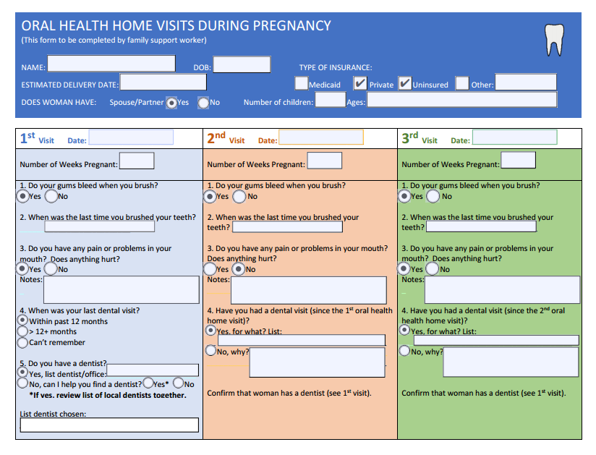

Slide 52
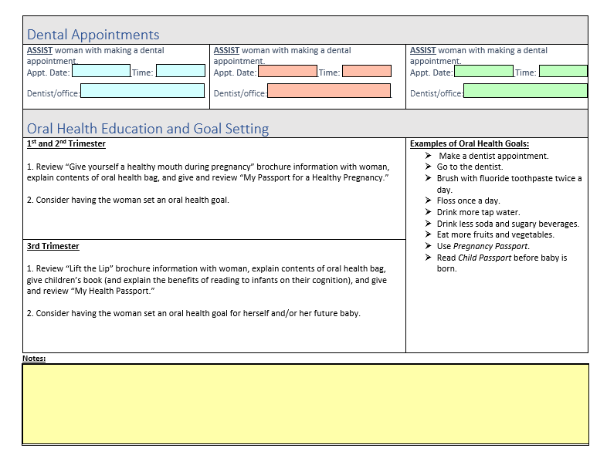

Slide 53
Quality Improvement Tools
Before Action Reviews/After Action Reviews (BAR/AAR)
  BAR: Helps enter into an event with a common understanding of the outcomes you’re seeking and potential pitfalls
  AAR: Helps capture what was learned from an event; provides opportunity to reflect and analyze; captures ideas to sustain or to improve upon
Process Mapping
  Visual picture of the sequence of steps in a process; helps to fully “think through” the various aspects of each step
Plan, Do, Study Act Cycles
National Improvement Partnership Network November 2016

Slide 54
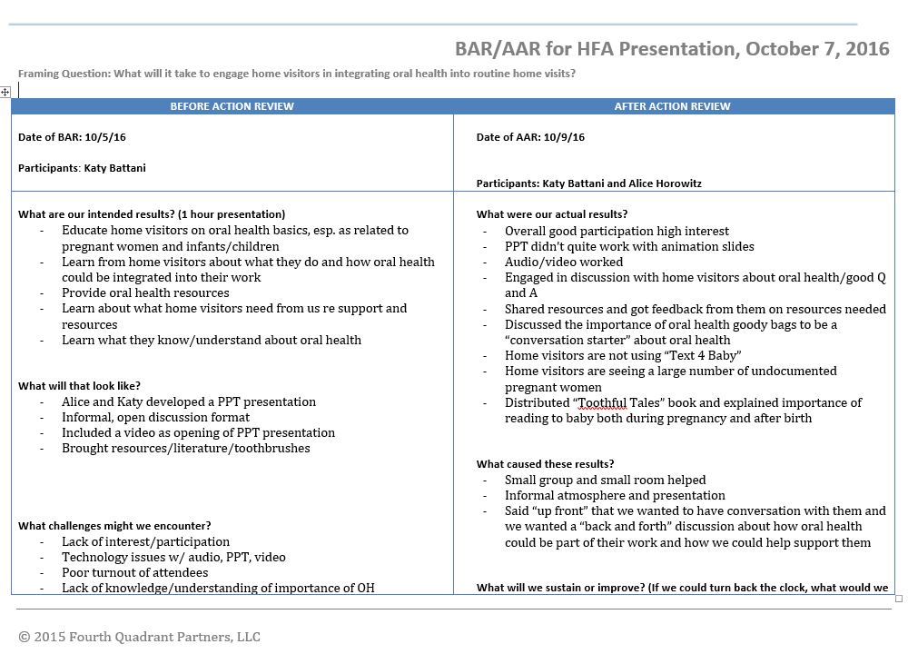

Slide 55
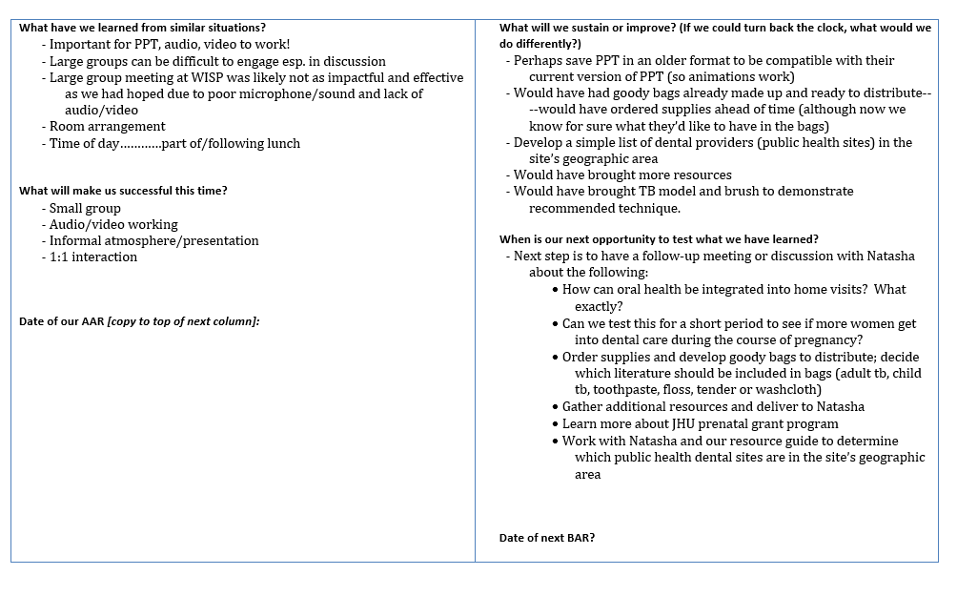

Slide 56
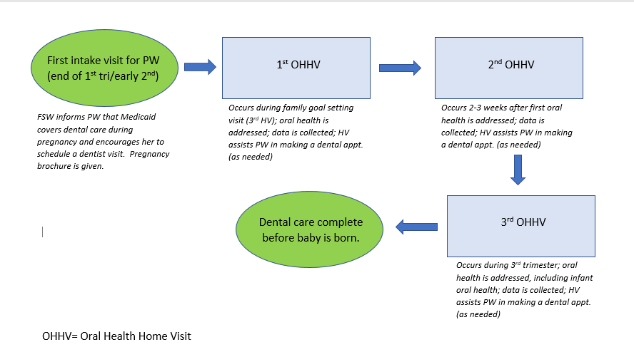
Process Mapping/Flow Chart for OHHVs for Pregnant Women

Slide 57
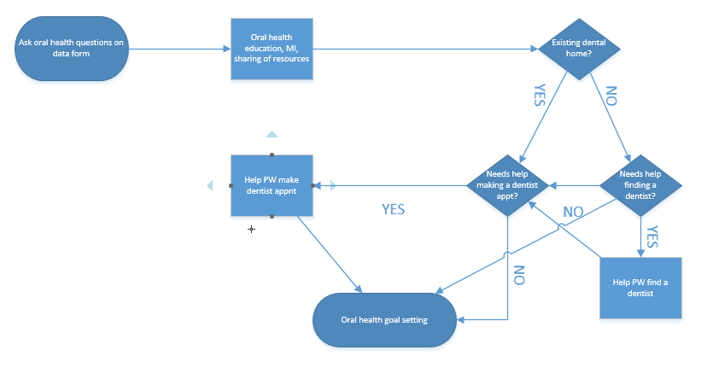
Process Mapping/Flow Chart for First OHHV
OHHV= Oral Health Home Visit

Slide 58
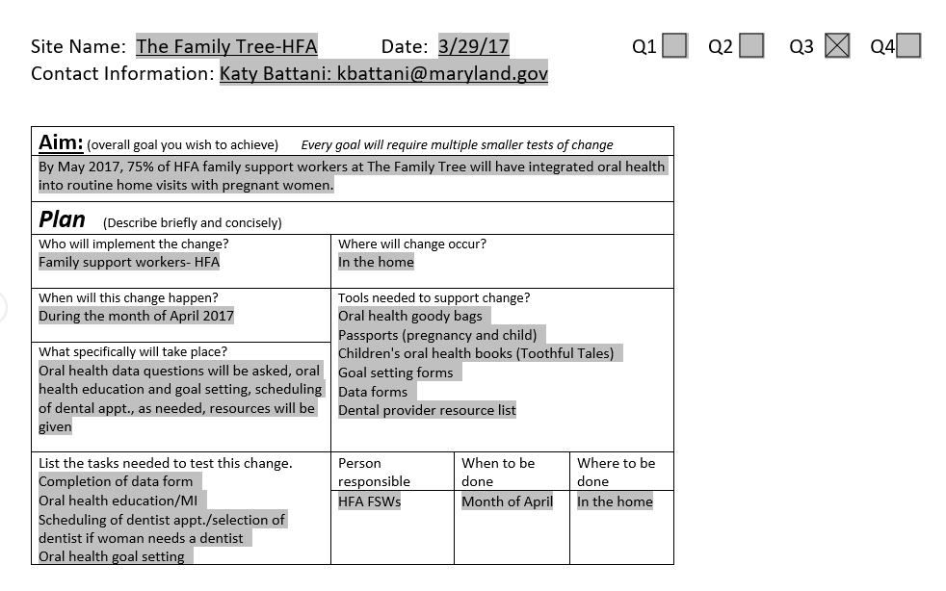

Slide 59
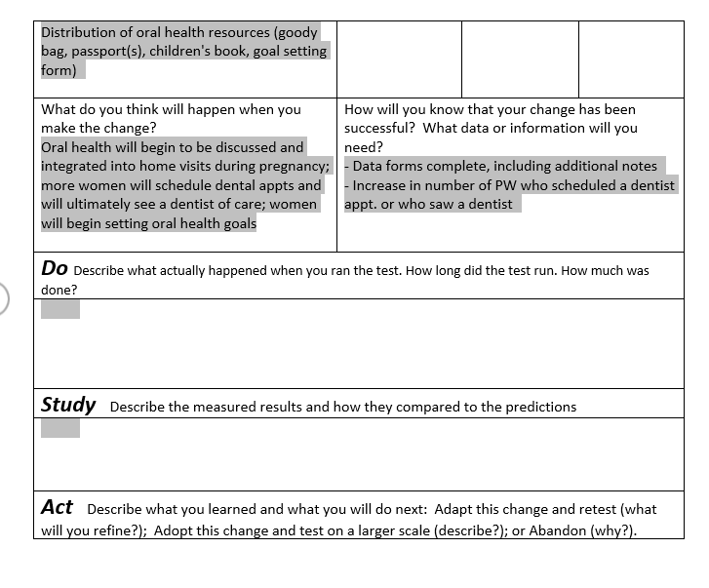

Slide 60

Getting Started
Create or review and revise existing performance plans in your department
Align those with agency performance management and other plans
  Review resources
  Discuss with colleagues
  Involve your teams
Try ideas out on a small scale
Seek technical assistance as needed

Slide 61

Resources
Journal of Public Health Management and Practice
QI Issues: 2010 and 2012
Accreditation Issue: 2014
Performance Management Articles
www.astho.org/Programs/Accreditation-and-Performance/
www.naccho.org/programs/public-health-infrastructure
https://nnphi.org/resource-directory/
Coming Soon:
ASTDD Performance Management Toolkit

Slide 62
Contact Information:
Harry Goodman, DMD, MPH
2307 Birmingham Court
Jarrettsville, Maryland 21084
Phone: (443) 243-7143
Email: harrygoodman2307@gmail.com
Ellen Volpe, MHA
Chief, Eastern Branch
HRSA MCHB, Division of State and Community Health
Phone: (301) 443-6320
E-mail: evolpe@hrsa.gov
Mary V. Davis, DrPH, MSPH
Evaluation Consultant
Project Y Evaluation Services, LLC
1108 Purple Glory Drive
Apex, NC 27502
Phone: (919) 451-0712
maryvwdavis@gmail.com
Erin Knoerl, MPH
Public Health Specialist – Community Water Fluoridation and Oral Health Workforce
Bureau of Child Health
New York State Department of Health
Empire State Plaza
878 Corning Tower
Albany, New York 12237
Phone (518) 474-1961
email: Erin.Knoerl@health.ny.gov
Katy Battani, RDH, MS
Project Manager
Perinatal and Infant Oral Health Quality Improvement Program (PIOHQI)
Office of Oral Health
Maryland Dep’t of Health and Mental Hygiene
201 West Preston Street
Baltimore, Maryland 21201
Phone: 410-767-7915
Email: kbattani@maryland.gov

Slide 63

Q and A
If you have a question, please click on the Set Status icon which is the little man with his arm raised on either the upper left or the top of your screen. Click on “raise hand.” We will then call on you to ask your question over the phone.

