Slide 1
Improving Oral Health Literacy
Through Social Marketing
Lessons learned from Healthy Teeth, Healthy Kids
Maryland receives federal funding (2011) for oral health social marketing initiative
  Purpose – Improve oral health literacy and reduce oral disease
Healthy Teeth, Healthy Kids – February 2012
  Reduce oral disease in children
  Reach women with young children at risk for oral disease
  Six-month social marketing campaign

Slide 2
Creating a Social Marketing Campaign
10 steps from idea to evaluation
Articulate vision and support with research
Create infrastructure to obtain input, guidance and commitment
Define audience and goals
Create comprehensive communication plan
Outline content and develop messaging
Develop creative approach and brand
Hold focus groups to test message, creative approach, and brand
Produce all marketing and support materials
Launch/implement and make adjustments as needed
Evaluate campaign and compile results

Slide 3
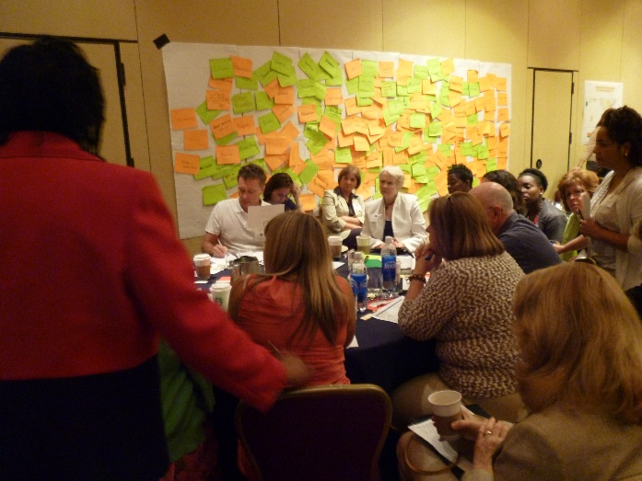
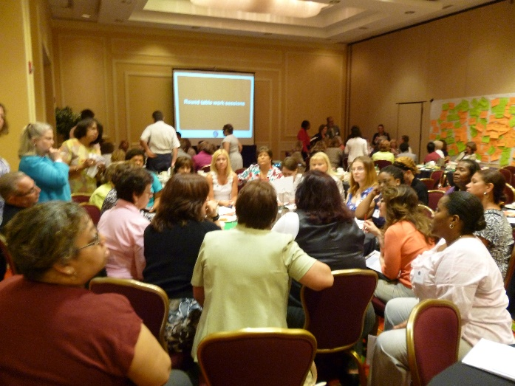
Create Infrastructure
Advisory committee
Work group
Strategic partnership council
Partnership with State Oral Health Coalition (Maryland Dental Action Coalition)

Slide 4

Define Audience and Goals
Audience:
  Mothers of at-risk children age 0 – 3 years
Goals:
  Improve oral health literacy
    Create awareness about the importance of oral heath and cavity prevention skills for children
  Improve preventative oral health behaviors
    Convince audience to adopt proper oral health and cavity prevention skills
  Drive access to care
    Providing a means to access a dentist that accepts Medicaid
Notes:
Convince audience to adopt proper oral health and cavity prevention skills

Slide 5
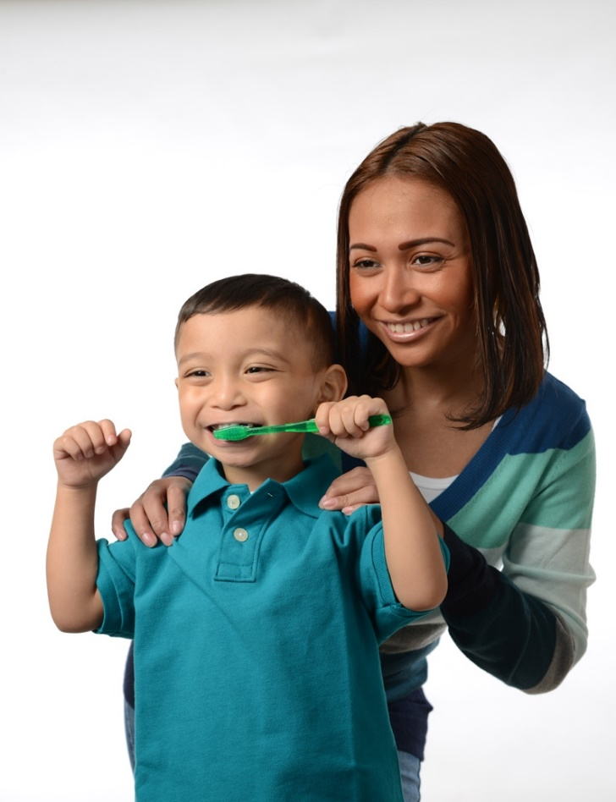
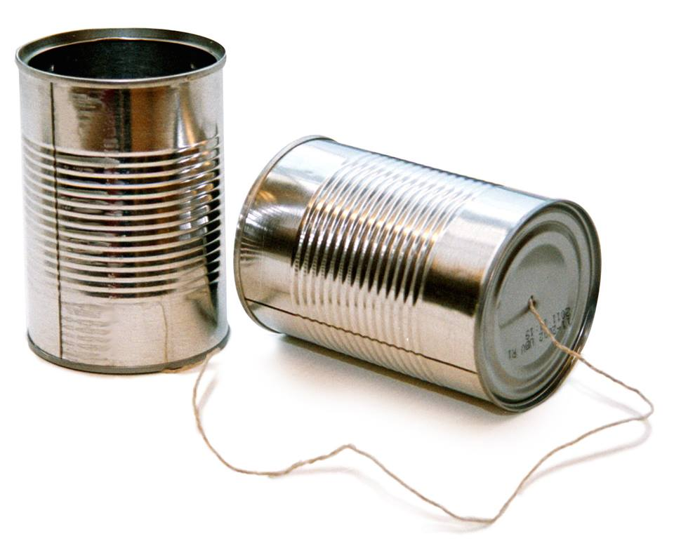
Communication Plan
A step-by-step explanation of how to achieve project goals by identifying strategies and tactics that are used to convey your message to a target audience over a distinct period of time.
Elements:
  Purpose
  Background
  Audience
  Goals and objectives
  Strategies
  Tactics
  Message
  Creative approach
  Production
  Implementation
  Evaluation
Notes:
A step-by-step explanation of how to achieve communication goals by identifying strategies and using media and tactics to communicate to a target audience over a distinct period of timeA step by step explanation of how to achieve communication goals by identifying achieving strategies using media and tactics to communicate messaging to a target audience over a determined period of time.

Slide 6

Strategies and Tactics
Create message and establish a call to action
  Message banks (outline all content)
  Offer tools + resources (website, call center, free oral health kits)
  Provide message saturation and sense of urgency
  Advertising campaign
  Earned media
  Social media
  Community engagement
Reach mothers at optimum learning moments
  Work with the community: health clinics, OB/GYN, prenatal classes, WIC, early head start, dentists, hygienists, etc.
Notes:
Create a favorable environment and sense of urgency
Advertising (diverse media mix with strong reach and frequency)
Develop a media partnership
Develop and utilize an earned media program
Develop a social media program
Engage in community events
Reach mothers during educateable moments
Develop produce and deliver an oral health kit
Evaluate the campaigns effectiveness
Provide a foundation for future work

Slide 7
Creating the Message – Message Bank
Mom Core Story: Good Oral Health is Necessary for Good Overall Health
You Need to Care for Your Mouth and Your Child’s Mouth Everyday
Message Bank
Mothering Begins Before Birth | Your Baby Needs Your Care | Visit Dentist by 1st Birthday
Taking care of yourself, especially your teeth and mouth, is one of the first ways you can care for your unborn child Brush twice a day with fluoride toothpaste; floss at least once Go to the dentist during your pregnancy, it is safe Caring for your own teeth during pregnancy is just as important as eating well and taking prenatal vitamins Your body is changing in many ways to support your pregnancy – these changes can cause dental problems if you do not brush with fluoride toothpaste and floss daily Gum disease, like pregnancy gingivitis, can be painful and unattractive, and is present in more than one third of pregnant women Studies show that gum diseases may contribute to triggering premature births or low birth-weight babies Eat healthy foods, including fresh fruits and vegetables and eliminate foods and beverages with added sugar, such as soda, cookies, candy, and juice drinks. | You have the power to prevent painful tooth decay that is expensive and time consuming to fix and hurts your child’s health Before teeth come in, after feedings and before bedtime, clean baby’s gums with a soft clean cloth In morning and before bedtime, gently brush teeth and gums with a smear of fluoride toothpaste and a small soft-bristled toothbrush Give baby milk or water, never give baby juice drinks (i.e., Kool-Aid, punch) or soft drinks Once your baby is off the bottle, serve milk or water in an open cup to limit teeth’s exposure time to potentially harmful sugars. Do not use a sippy cup Limit consumption of 100% fruit juice to 4 ounces a day served in an open cup, drank in one sitting Tooth decay is infectious. Do not share food or utensils with your baby to avoid spreading disease-causing bacteria Do not lay your baby down with a bottle Fluoride prevents cavities; drink fluoridated water and brush with fluoride toothpaste | Whether teeth have appeared or not, take baby to the dentist by his/her first birthday Choose a regular dentist or “dental home” for you and your family and visit twice a year Receive a free oral health kit and materials from your dentist or healthcare provider To find a dentist that accepts Medicaid, call 1-800-000-0000 or visit www.HealthyMouths4MD.org

Slide 8
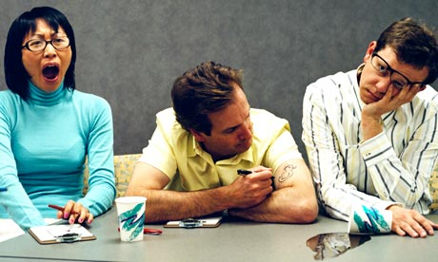
What if your audience is?
Not interested
Distracted
Not paying attention
Not motivated
Too busy
Considers your message unimportant

Slide 9

What Makes Marketing Work ?
Product must have value
  Must create a value proposition (Help them see the value your offer brings to them.)
  Simple: message must be short, understandable - easy to get from just a quick glance
  Impact: message must gain your attention, it must pull you in
  Engage: message must keep your attention and push all the right “buttons” that will make you respond
  Consistency: message and visual must be the same across various media and tactics
  Reach and Frequency: message must get to the target audience and be seen or heard numerous times
Notes:
Marketing 101
help them see the specific value your offer brings to them. And by doing so, you will grab their attention in such a way that they know: "Yes, that's right for me".In addition to having a product to market your must target the audience and the product must have value for the target audience and you must communicate the value in a way that will convince the target audience to obtain the product
Product must have value for the target audience
Must communicate the value in a way that will convince the target audience to obtain the product
Simple: message must be short, and understandable - easy to get from just a quick glance
Impact: message must gain your attention, it must pull you in
Engage: message must keep your attention and push all the right “buttons” that will make you respond
Consistency: message and visual must be the same across various media and tactics
Reach: message must reach the target audience
Frequency: message must be seen or heard numerous times

Slide 10
Campaign Testing
Focus Groups
  2 groups, women age 18 – 36, on Medicaid or Medicaid eligible
  Assessed awareness of oral health behaviors
  Tested clarity, appeal and impact of messaging
  Determined campaign brand
Pre-post campaign survey
  Created pre-post campaign surveys
  Surveyed target demographic (400)
  Provide baseline data on oral health awareness and behaviors
  Provided awareness of oral health communication materials and/or existing campaigns

Slide 11
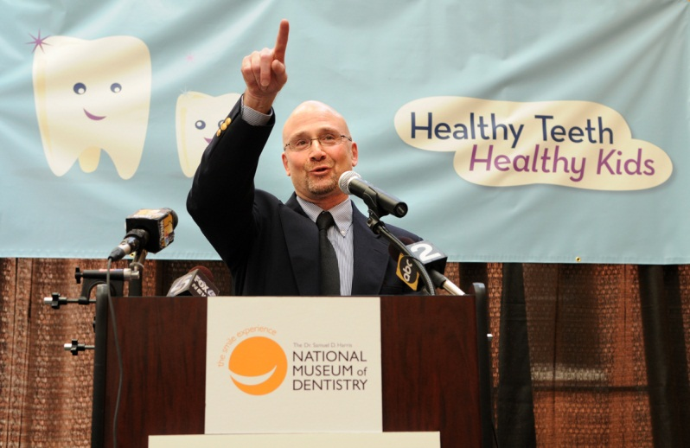
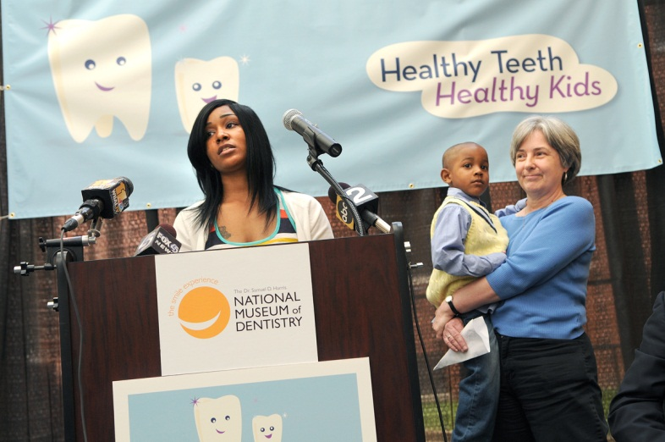
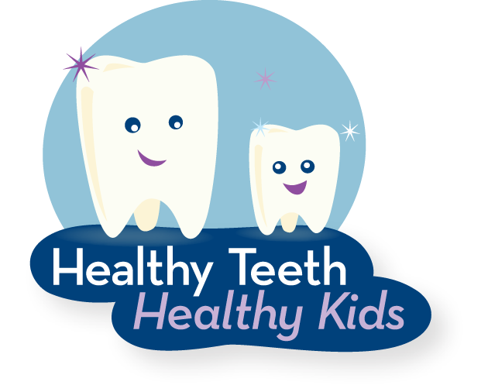
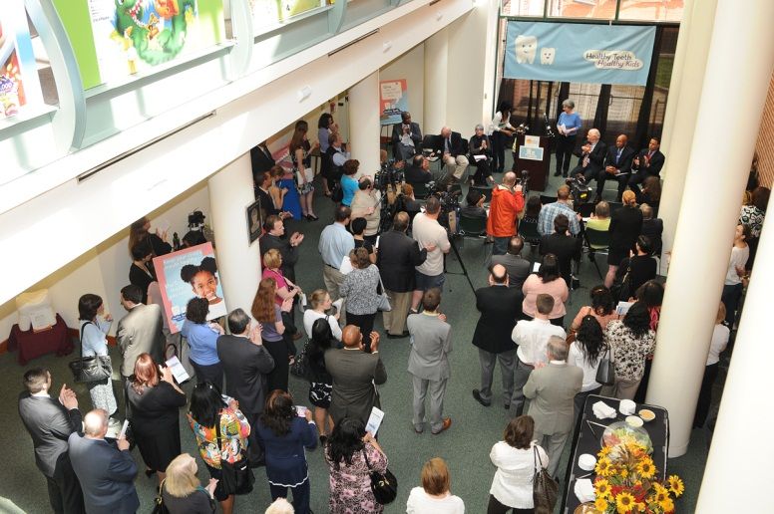
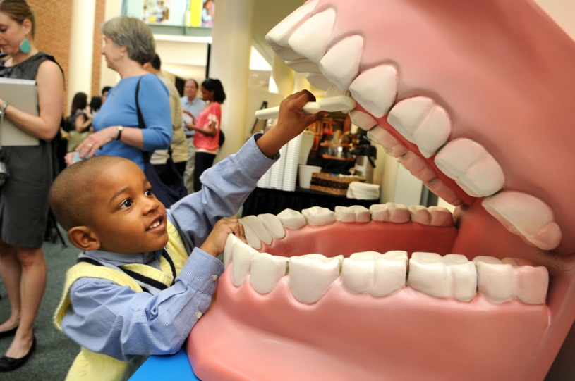
Campaign Launch

Slide 12
Campaign Timeline

Slide 13
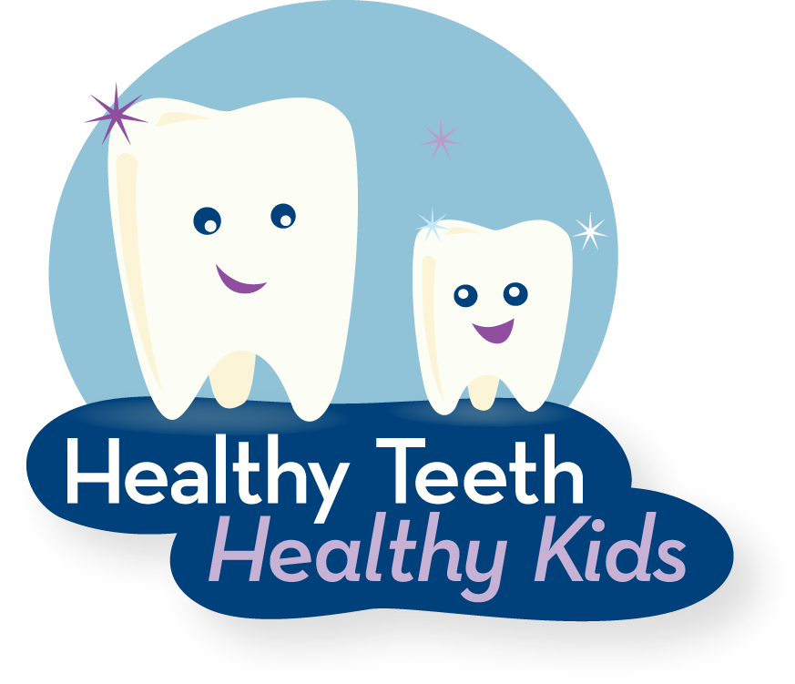
Campaign – by the numbers
Media impressions through advertising $8.8 million
Media coverage, 72 hits valued at $3.7 million
Distributed 82,000 brochures
Mailed 120,000 brochures
Distributed 80,000 oral health kits
Website visits – 2,500
Facebook likes – 260
Call center – 200

Slide 14
Post-campaign survey
Results
  Increase in the oral health literacy of the target audience (with statistically significant increases in awareness of campaign messaging and an increase in dental visits)
Conclusion
  The campaign was effective
  If sustained, we could build upon the campaign success
  Social marketing can work as an intervention to improve oral health
Notes:
There was a statistically significant increase in awareness of campaign messaging (up by 13%)
Self reported visits to the dentist increased by 7%
Two thirds reported having heard of the Healthy Teeth, Healthy Kids campaign
25% recall receiving the Healthy Teeth, Healthy Kids brochure
50% recall receiving a Healthy Teeth, Healthy Kids oral health kit from their health center
Of those receiving Healthy Teeth, Healthy Kids oral health kits 100% say they used the products in the kit

Slide 15

Lessons learned
Limit scope
Focus the audience
  Focus the message
Reinforce commitment of partners
Don’t bite off more than you can chew (Oral Health Kits)
Partner with your state coalition
Notes:
Moving the campaign process along was challenging. Multiple stakeholders with multiple expectations and multiple interests made it hard to reach consensus focusing as narrowly as possible. An example would include
focusing only parents and guardians of children in their first year, when brushing should
start. By narrowing the audience, the campaign can spend more resources on reaching
more of these individuals, more times.
• Poor oral health can cause your child to have problems eating, speaking, and
learning.
• Clean your baby’s gums before teeth come in.
• Brush your child’s teeth with fluoride toothpaste twice a day.
• Take your child to the dentist by age one.
• No Bottle in bed.
• Do not give drinks with added sugar, such as soda, juice, or punch.
• Do not share food, spoons, or forks.
• Next steps:
• To find a dentist call 1-855-45-TEETH
• Go to HealthyTeethHealthyKids.Org or call 1-855-45-TEETH

Slide 16

Dientes Sanos, Niños Sanos
Two 10-week campaigns Fall 2014/Spring 2015
Latinas with young children at-risk for oral disease
Goals: Same as HTHK
  Create awareness about the importance of oral heath and cavity prevention skills
  Convince Latinas to adopt proper oral health and cavity prevention skills for themselves and their children
  Drive to website
Main focus on radio advertising
  Transit advertising, community engagement and Spanish website
Pre and post campaign testing

Slide 17
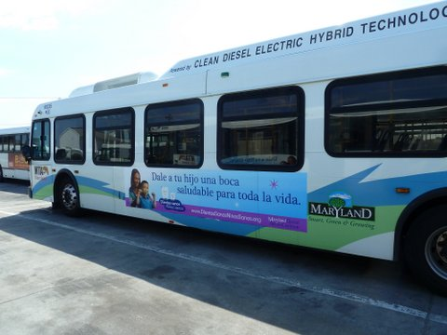
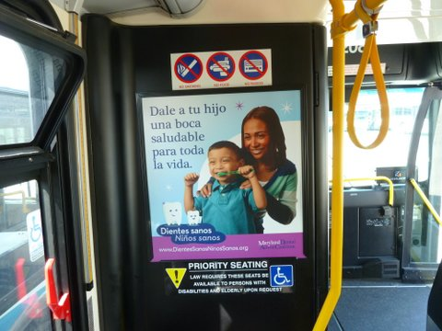

Dientes Sanos, Niños Sanos
Campaign Advertising

Slide 18
Dientes Sanos, Niños Sanos
Results
Significant improvements in awareness, knowledge, and behavior
  92% heard of the campaign
  91% recalled at least one campaign message (unaided)
  92% more believed children should go to the dentist by first birthday
  93% more believed that dental health is an important part of overall health
  19% more had heard of fluoride
  80% more drank fluoridated tap water
  Twice as many mothers heard of fluoride varnish
  210% increase in children receiving fluoride varnish

Slide 19
Conclusions
Latinas understood the importance of oral health and took action to practice preventative oral health behaviors for their children
Social marketing is an effective way to reach Latinas
  Create awareness and knowledge that can result in behavior change
  If used frequently and effectively, can create, reinforce, and sustain healthy behaviors

Slide 20

The Bottom Line
To achieve social marketing goals
  Follow the process
  Create partnerships
  Limit scope
  Focus message
  Create value
  Target, target, target!
  Sustain the effort

