Slide 1
NPM 13 Community of Learning Strengthening Title V Evidence-Based or –Informed Strategy Measures Webinar June 9, 2017
Notes:
Harry
Welcome

Slide 2
Funding
This project is supported by the Health Resources and Services Administration (HRSA) of the U.S. Department of Health and Human Services (DHHS) under grant #H47MC00048 in the amount of $3,000,000 over 5 years. This information or content and conclusions are those of the authors and should not be considered as the official position or policy of HRSA, DHHS, or the U.S. government, nor should any endorsements be inferred.
Notes:
Harry

Slide 3
General Reminders
This webinar will be recorded and archived on ASTDD’s website.
Questions will be addressed after the speakers are finished. When we are ready for questions, if you wish to ask one, please click on the Set Status icon, which is the little man with his arm raised on either the upper left or the top of your screen. Click on “raise hand.” We will then call on you to ask your question over the phone.
Please respond to the polling questions during the webinar.
Notes:
Harry
Review housekeeping announcement

Slide 4
Learning Objectives
To be aware of the opportunity for states to revise their Title V state action plans.
To understand evidence-based or -informed strategy measures (ESMs).
To learn tips for strengthening strategies.
To illustrate how two states are strategically addressing NPM 13A and 13B.
To be aware of next steps for the NPM 13 Community of Learning project.
Notes:
Harry

Slide 5
Agenda
Overview of Title V state action plans for addressing NPM 13A (dental visits for women during pregnancy) and NPM 13B (preventive dental visit for children and adolescents)
Tips for strengthen strategies
Examples of how states are addressing NPM 13
Alabama – NPM 13A
Iowa – NPM 13B
Next steps for the NPM 13 Community of Learning coordinated by OHRC and ASTDD
Questions and answers
Notes:
Harry

Slide 6
Presenters
Reginald Louie, D.D.S., M.P.H.
Sherry Goode, R.D.H.
Melissa Godwin, L.I.C.S.W.
Tracy Rodgers, B.S., C.P.H., R.D.H.
Katrina Holt, M.P.H., M.S., R.D., FAND
Notes:
Harry
Read bios

Slide 7
Title V State Action Plans
On July 15 of each year (July 17, 2017), states and jurisdictions are required to submit a Title V MCH Block Grant application/annual report.
As part of this annual application, a state may refine its action plan.
States may add new or revise existing program strategies and ESMs.
Notes:
Harry

Slide 8
Evidence-Based or –Informed Strategy Measures
ESMs assess the impact of the Title V program’s strategies contained in the state action plan.
ESMs should be measurable and meaningful (relate to NPM, based on or informed by evidence of effective practice).
“Evidence informed” is meant to convey that there is information suggesting that a strategy could be effective in addressing a NPM.
Evidence-informed strategies may include emerging practices and expert opinion.
Notes:
Harry

Slide 9
Tips for Strengthening Strategies
The Evidence Continuum
The purposeful and systematic use of the best available evidence to inform the assessment of various options and related decision making in practice, program development, and policy making.
Source: Strengthen the Evidence.
http://semch.org/rating-the-evidence.html
Notes:
Reg

Slide 10
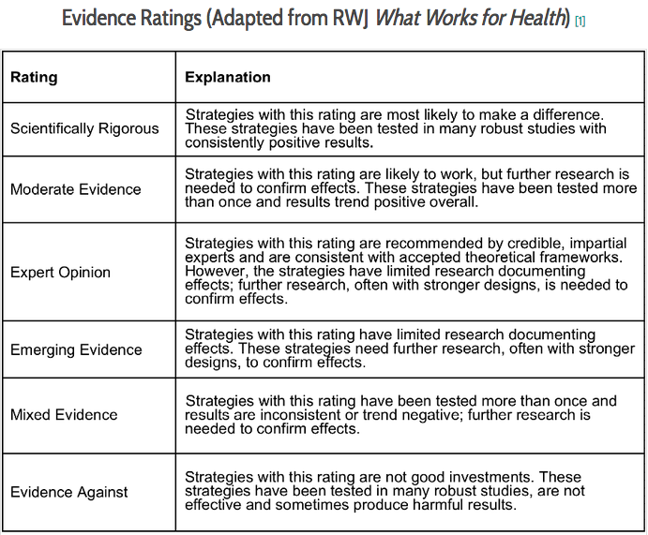
Source: Robert Wood Johnson Foundation. What Works for Health.
Notes:
Reg

Slide 11
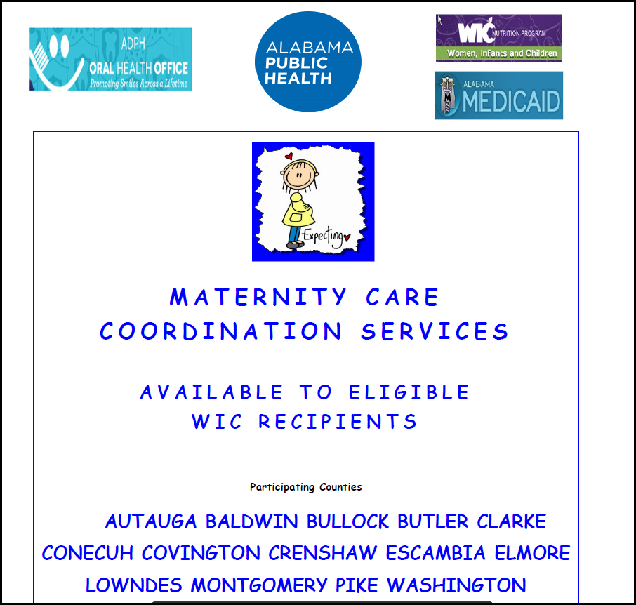
NPM 13A Example—Alabama
Strategy 13.2: Increase the percentage of women who had a dental visit during pregnancy.
ESM: Increase the proportion of at-risk pregnant women who report receiving a preventive dental visit during pregnancy by piloting the First Steps Program.
The success of this ESM is based upon:
Development and strengthening of relationships between state and local community partners.
Maternity patients “Buy in” to receiving dental and maternity care coordination services.
“Buy in” from the maternity patient, ADPH care coordinators, and community partners.
Ongoing evaluation of the program and its outcomes.
Notes:
Sherry and Melissa
Data Collection – Initially began collecting data on 2 elements that are related to dental access for the maternity patient – does the pregnant patient have a dental provider and has the patient had a preventive dental visit in the past 12 months and does the infant have a dental provider at time of discharge from services, does Mother want assistance in locating a dental provider for the child. This data was being manually collected and captured by the patients’ care coordinator. An electronic assessment of this document has been developed and being added to the current documentation system the Care Coordinator uses. We will collect data on the following questions: 1) Health Insurance, dental provider, preventive dental visit in the past 12 months for the maternity patients, date of the appointment, was a referral made to a dental provided for the child , provider name.
We are also tracking the number of educational brochures related to dental health that are provided to the patient, providing oral hygiene kits to the patient and all household members. The number of kits being provided is also being tracked.

Slide 12
NPM 13A Example—Alabama
Additional Strategies
Partnerships
Link to or create new partnerships at local, regional, state levels.
Identify and access data sources linked to prenatal care.
Identify new dental providers who will serve at risk pregnant women.
Increase statewide messaging to support this ESM.
Montgomery County Gift of Life Family Coaching Program
WIC program
Early Head Start and Head Start programs
Alabama Medicaid
March of Dimes
Pay It Forward
ADPH Perinatal
Alabama Dental Association
District dental societies
Non-profit dental programs
UAB School of Dentistry
Notes:
Sherry and Melissa

Slide 13
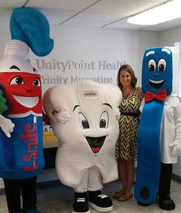
NPM 13B Example—Iowa
Strategies
ESMs
Provide targeted outreach for medical-dental integration.
Inform, educate, and disseminate scientific evidence about importance of prenatal dental screening and treatment.
Assure statewide care-coordination network that includes dental home referral, tracking, and follow-up for children.
Expand preventive school-based sealant programs.
Number of medical practices receiving an outreach visit from an I-Smile coordinator.
Notes:
Tracy

Slide 14
NPM 13B Example—Iowa
State
Local
Partnership with Medicaid
Quarterly I-Smile coordinator meetings
Contract management, technical assistance, & quality assurance (data, care coordination documentation)
Health promotion for birthing hospitals
Facebook page for Moms
Partnership with Delta Dental of Iowa Foundation
Hospital systems and fluoride varnish applications at well-child visits
School-based sealant program expansion
Complete a needs assessment and improvement plan
Face-to-face outreach to medical & dental offices
Develop new partnerships
Required services for infants, children, and pregnant women at WIC
Care coordination services for families to facilitate access to care
Statewide school-based sealant program
Participation in community events
Notes:
Tracy

Slide 15
Next Steps
Notes:
Katrina

Slide 16
NPM 13 Community of Learning
Activities
Webinars
Discussion list
Consultation
Resources: NPM 13 Evidence Review Brief and Review Full Report—available summer 2017http://semch.org/evidence-reviews.html
Notes:
Katrina

Slide 17
Contacts Questions Related to Revising State Action Plans Maternal and Child Health Bureau Division of State and Community Health
Gor Yee Lum, M.P.H.
Regional MCH Consultant NPM 13 Liaison-lead
Phone: (415) 437-8497
E-mail: Glum@hrsa.gov
Cherri Pruitt, M.P.A. Regional MCH Consultant
NPM 13 Liaison Co-lead
Phone: (303) 844-7872
E-mail: CPruitt@hrsa.gov
Notes:
Katrina

Slide 18
Contacts Questions Related to Oral Health Activities
Sherry Goode, R.D.H.
Acting Dental Director
Alabama Department of Public Health
Phone: (334) 206-2904
E-mail: sherry.goode@adph.state.al.us
Harry Goodman, D.M.D., M.P.H.
Consultant
Phone: (443) 243-7143
E-mail: harrygoodman2307@gmail.com
Melissa Godwin, L.I.C.S.W. CCRS Coordinator Bureau of Family Health Services Alabama Department of Public Health Phone: (334) 206-5943 Email: Melissa.Godwin@adph.state.al.us
Katrina Holt, M.P.H., M.S., R.D., FAND
Director
National Maternal and Child Oral
Health Resource Center
Phone: (202) 784-9551
E-mail: kholt@georgetown.edu
Reginald Louie, D.D.S., M.P.H.
Public Health Consultant
Phone: (510) 583-8120
E-mail: reglouie@sbcglobal.net
Tracy Rodgers, B.S., R.D.H., C.P.H.
Executive Officer
Iowa Department of Public Health
Phone: 515-782-6404
email: tracy.rodgers@idph.iowa.gov
Notes:
Katrina

Slide 19
Questions and Answers
If you wish to ask a question, please click on the Set Status icon which is the little man with his arm raised on either the upper left or the top of your screen. Click on “raise hand.” We will then call on you to ask your question over the phone.
Evaluation Questions
Notes:
Chris

