Slide 1
“Give You and Your Baby A Lifetime Of Healthy Teeth”
March 15, 2017

Slide 2
General Reminders
This webinar will be recorded and archived on the ASTDD website
We would like to hold any questions until the end, so if you have questions, please make a note of them. When we are ready for questions, if you wish to ask one, please click on the Set Status icon which is the little man with his arm raised on either the upper left or the top of your screen. Click on “raise hand.” We will then call on you to ask your question over the phone
Please respond to the polling questions at the conclusion of the webinar

Slide 3
Funding Acknowledgement(s)
This presentation was supported by Cooperative Agreement NU58DP004919-05-00 from CDC, Division of Oral Health. Its contents are solely the responsibility of the authors and do not necessarily represent the official views of CDC.

Slide 4
Moderator /Presenters
Reginald Louie, D.D.S., M.P.H.
Katrina Holt, M.P.H., M.S., R.D., FAND
Robert Bensley, PhD, MCHES - wichealth.org
Emily Norrix, MPH
Notes:
Harry
Read bios

Slide 5
Learning Objectives
Examine the new perinatal oral health module available to wichealth.org users
Discuss how to work with WIC to choose this free module for your state
Learn how this module is evaluated and what data is available to states who select it

Slide 6
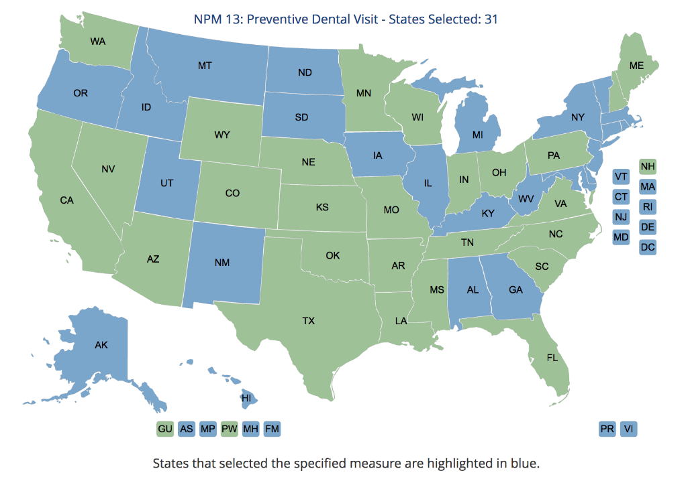
National Performance Measure 13
Thirty-one states and jurisdictions have chosen the national performance measure 13A&B:
NPM13A: Percent of women who had a dental visit during pregnancy.
NPM13B: Percent of children and adolescents ages 1–17 who had a preventive dental visit in the last year.

Slide 7
NPM13 Common Themes Among Strategies
Partnership
Build connections and strengthen collaboration opportunities
Education
Promote value of good oral health
Increase oral health literacy
Training
Provide training on improving oral health for MCH
Provide training on oral health for pregnant women
Access to Care
Ensure oral health care access and availability
Promote oral health screenings by non-oral-health professionals

Slide 8
NPM13 Community of Learning
A peer-to-peer network
Facilitate communication and learning
Share strategies and approaches
Share information about available resources
To learn more, contact:
OHRCinfo@georgetown.edu

Slide 12
over 3,800,000 lessons completed
98%
90%
86%
find wichealth helpful
believe they can make a change
prefer wichealth for nutrition ed

Slide 13
The Michigan Story: Perinatal Oral Health
Launched January 2013
Housed under Michigan’s Infant Mortality Reduction Plan
Goal: Develop Comprehensive Perinatal Oral Health System for the State of Michigan

Slide 14
Perinatal Oral Health Action Plan
5 Objectives
Develop and Promote Evidence-Based Perinatal Oral Health Guidelines
Integrate Oral Health into the Health Home for Women and Infants
Develop Interdisciplinary Professional Education to Improve Perinatal Oral Health
Increase Public Awareness of the Importance of Oral Health to the Overall Health of Pregnant Women and Infants
Ensure a Financing System to Support Perinatal Oral Health

Slide 15
Why work with WIC and wichealth.org?
Large majority of our target population are WIC clients
Nutrition and oral health are interconnected: perfect partners!
WIC is a trusted entity.
They have the infrastructure to deliver high quality education.
Some evaluation capabilities!

Slide 16
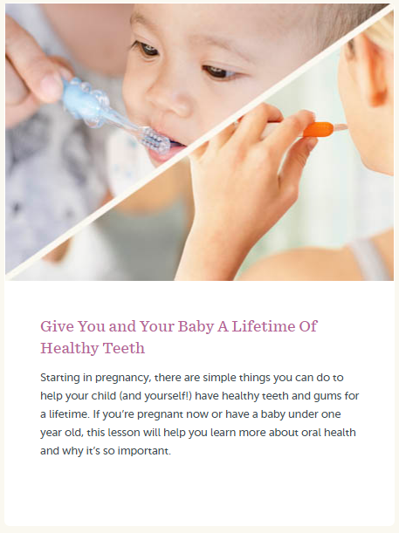
Module Demo
site: wichealth.org
username: oralhealthdemo
password: wichealth

Slide 17
Contact Information:
Reginald Louie, DDS, MPH
Public Health Consultant
Phone: (510) 583-8120
Email: reglouie@sbcglobal.net
Katrina Holt, M.P.H., M.S., R.D., FAND
Director
National Maternal and Child Oral Health Resource Center
Phone: (202) 784-9551
E-mail: kholt@georgetown.edu
Emily Norrix
Perinatal Oral Health Consultant
Phone: 517-241-0593
E-mail: norrixe@Michigan.gov
Robert Bensley, PhD, MCHES
Professor
Western Michigan University
Phone: (269) 716-2301
Email: bensley@wmich.edu
State WIC Contacts
http://www.fns.usda.gov/wic

Slide 18
Q and A
If you have a question, please click on the Set Status icon which is the little man with his arm raised on either the upper left or the top of your screen. Click on “raise hand.” We will then call on you to ask your question over the phone.

