Slide 1
Turning Data Into Action A Webinar Series for SOHPs
Presenting by the ASTDD Data Committee

Slide 2
7-Part Series
Date | Topic | Presenter
May 18 | Turning data into action | Kathy Phipps, ASTDD
June 1 | Developing and using state oral health data reports | Hawaii & Vermont
June 15 | Using the CDC Open Data Platform to visualize oral health data | Valerie Robison, CDC
June 29 | Data to Action: Making Better Infographics | Carole Stampfel, AMCHP
July 27 | Web-based oral health data systems – state examples | Colorado, Minnesota
August 3 | Oral health infographics – state examples | Arizona & New Hampshire
August 10 | Using coalitions and partners to spread the message | Children’s Health Alliance of Wisconsin, Washington Dental Service Foundation
All webinars are Thursday from 3:00-4:00 Eastern Time

Slide 3
General Reminders
This webinar will be recorded & archived (www.astdd.org)
Please hold questions until the end
If you have questions, please make a note of them
If you want to ask a question at the end, click on the Set Status icon
The little man with his arm raised on either the upper left or the top of your screen. Click on “raise hand”
We will then call on you to ask your question
Please respond to the polling questions

Slide 4
Acknowledgements
This presentation was supported by Cooperative Agreement NU58DP004919-05-00 from CDC, Division of Oral Health. Its contents are solely the responsibility of the authors and do not necessarily represent the official views of CDC.

Slide 5
Today’s Presenters
Colorado
Katya Mauritson, DMD
Gabrielle Elzinga-Marshall, MPA
Minnesota
Genelle Lamont

Slide 6
Word of Mouth
Disseminating and Using Oral Health Data
Katya Mauritson, DMD
State Dental Director
Gabrielle Elzinga-Marshall, MPA
Oral Health Evaluator, Epidemiologist

Slide 7
This presentation and products within the presentation were supported by the Grant or Cooperative Agreement Number, U58DP004904-05, funded by the Centers for Disease Control and Prevention and by the Children’s Oral Healthcare Access Program Agreement Number, H47MC28479, funded by the Health Resources and Services Administration. The contents are solely the responsibility of the authors and do not necessarily represent the official views of the Centers for Disease Control and Prevention or the Department of Health and Human Services.

Slide 8
Overview
What we did
History of data sharing and integration in oral health
Oral Health Data Dashboard in InstantAtlas
How we changed
Shifting to Tableau
What we do now
Shorter, focused fact sheets
VISION
Other Tableau dashboards
Marketing and training
Where we are going

Slide 9
A Brief History of Oral Health Data Dissemination
Full, detailed reports and stand alone data reports
Significant time investment
Long period of time from start to finish - need to elicit partner feedback
Issue area specific - creates “silo” for oral health
Not user-friendly

Slide 10
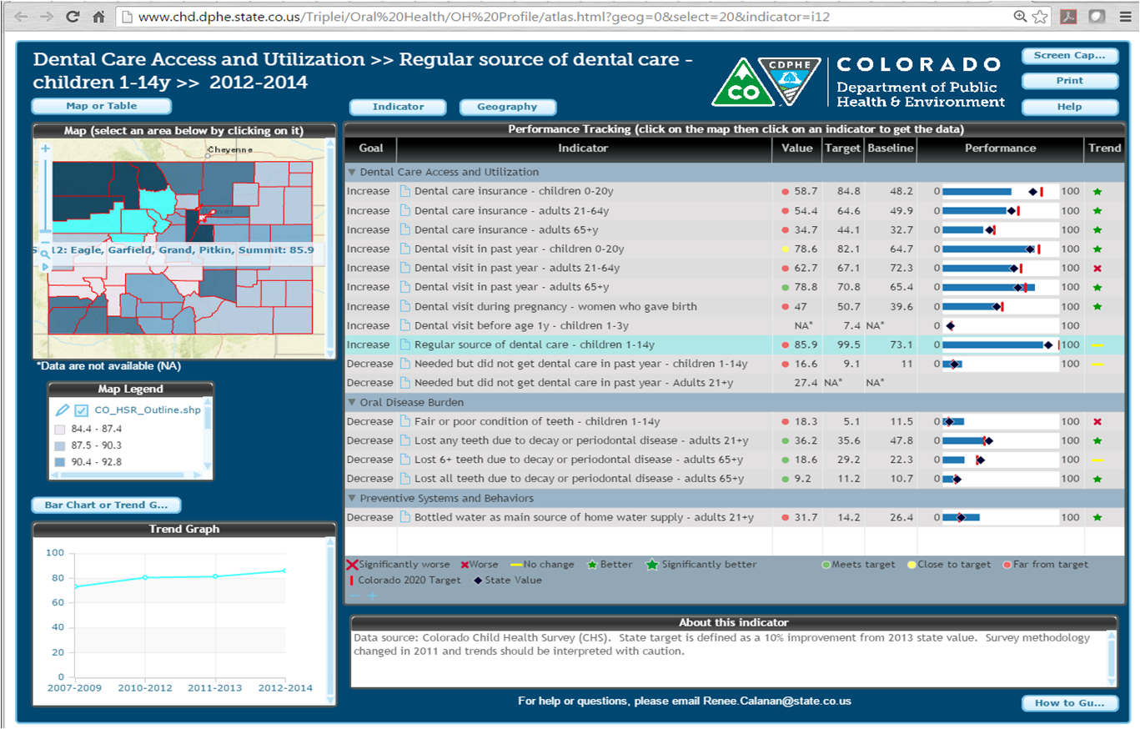
Oral Health Surveillance System in InstantAtlas

Slide 11
Shifting to Tableau
Tableau Benefits:
Relatively cost effective
Lots of options for visualizations, data sharing
CDPHE already had some licenses, some staff already knew how to use
Process/Timeline:
CDPHE starts using in 2015
OHU starts using for Cavity Free at Three in late 2015
CDPHE goes through competitive process, chooses Tableau as department-wide vendor in 2016
OHU decides to migrate InstantAtlas into Tableau in 2016

Slide 12
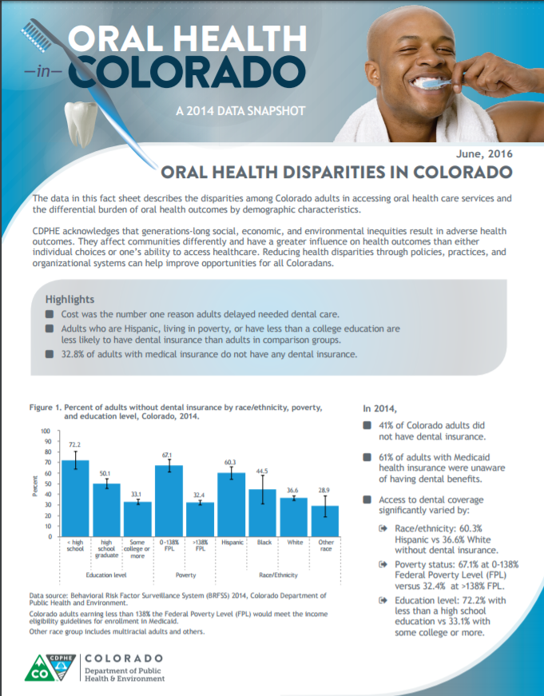
Revamping the OHU’s Data Dissemination
Shifted from long reports to short, single topic fact sheets and infographics
More user friendly
Easier to share
Simpler for data users to understand - limits questions, misinterpretation of data
Integrated OH Surveillance System into VISION
Wider audience
Gets OHU “on board” with other units in CDPHE
OHU is one of the first units outside of Chronic Disease to join VISION

Slide 13
What is VISION?
Visual
Information
System for
Identifying
Opportunities and
Needs
Objectives for VISION
To increase access to readily available Colorado data in a user-friendly format
To increase data-informed decision making
To enhance the integration of the chronic disease surveillance system with related topics - like oral health!
https://www.colorado.gov/pacific/cdphe/vision-data-tool

Slide 15
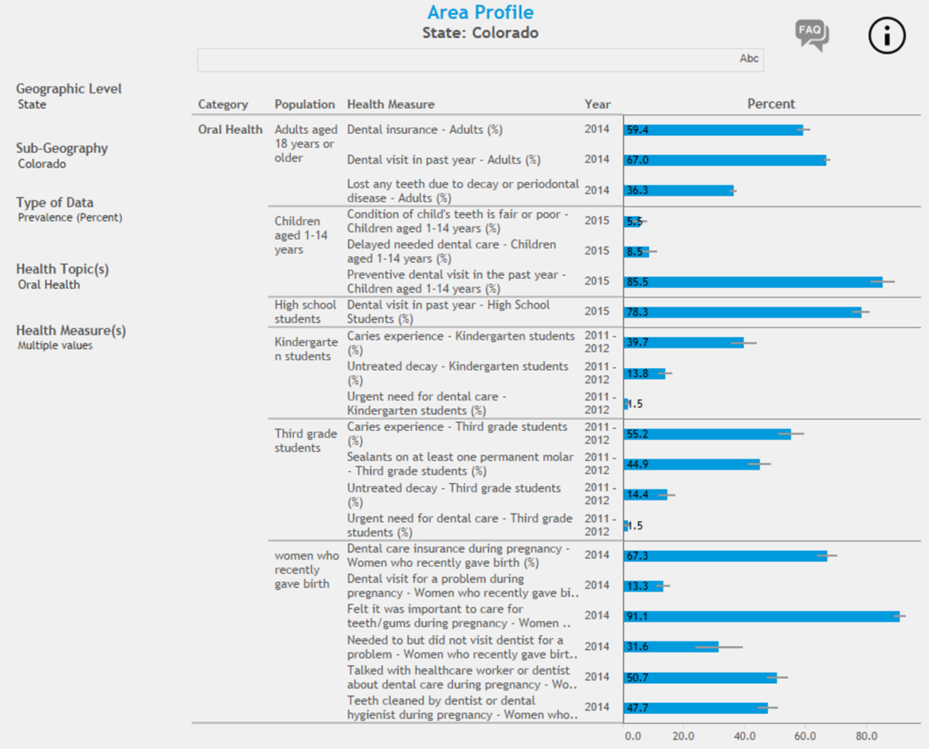
Oral Health Data in VISION

Slide 16
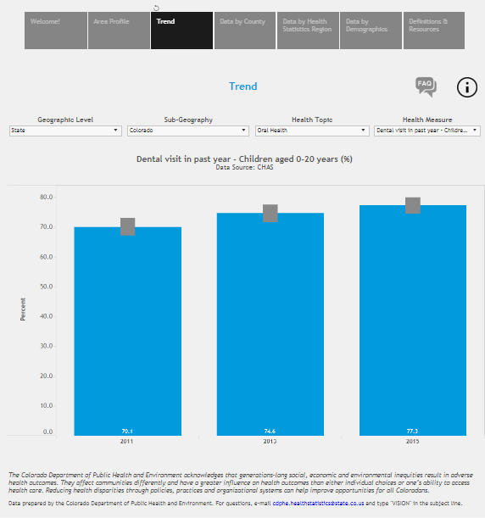

Slide 17
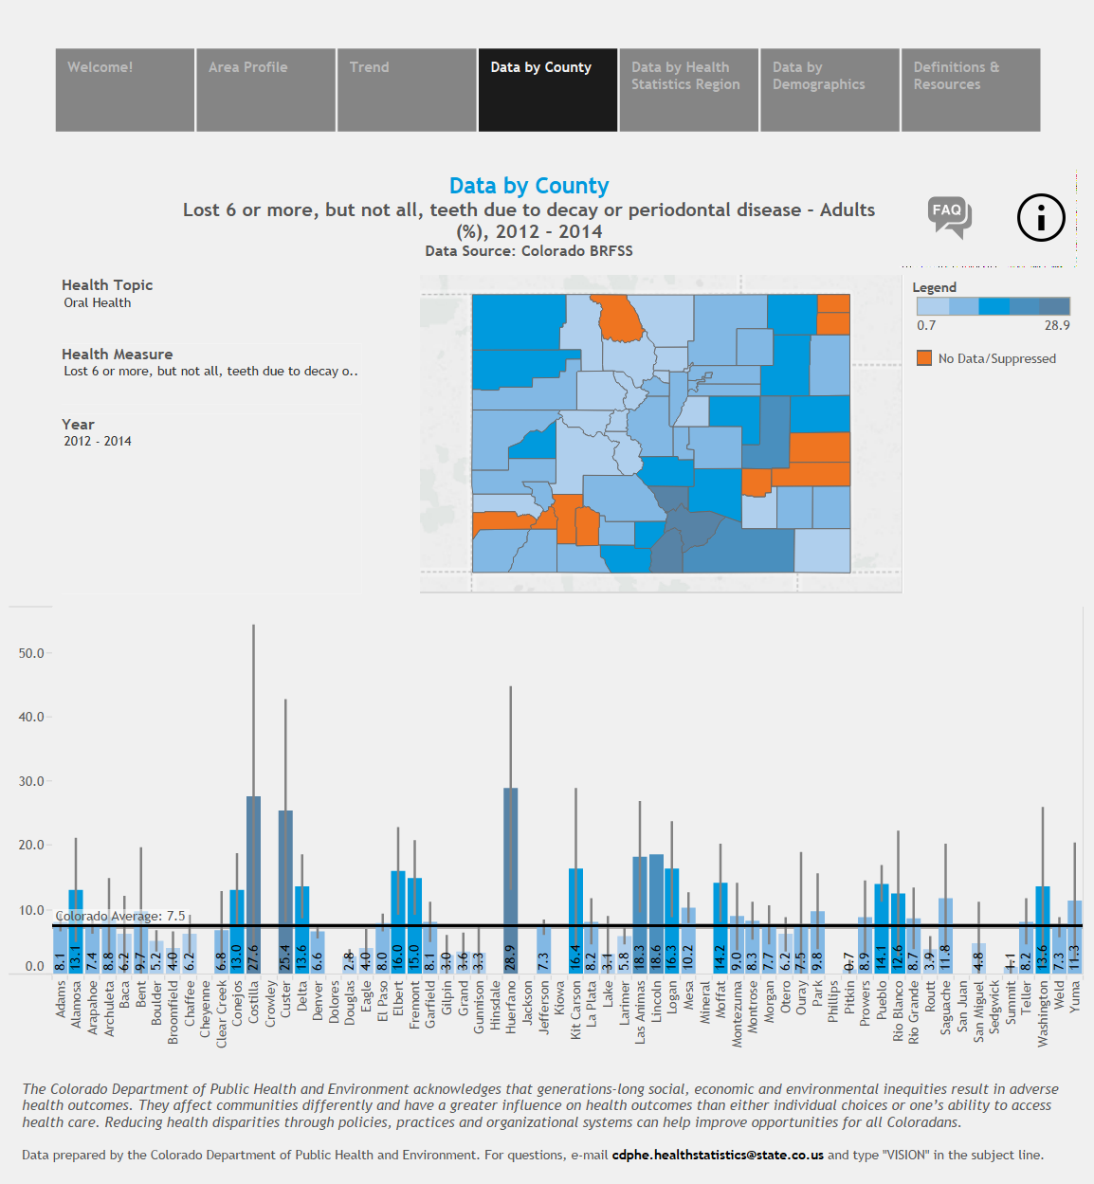
County/Regional Data in VISION
Almost all data available by Health Statistics Region
Many data points also available by county
Helps LPHAs with PHIPs
Dashboard images are easy to export for grant applications
LPHAs can compare their county to the state and other counties

Slide 18
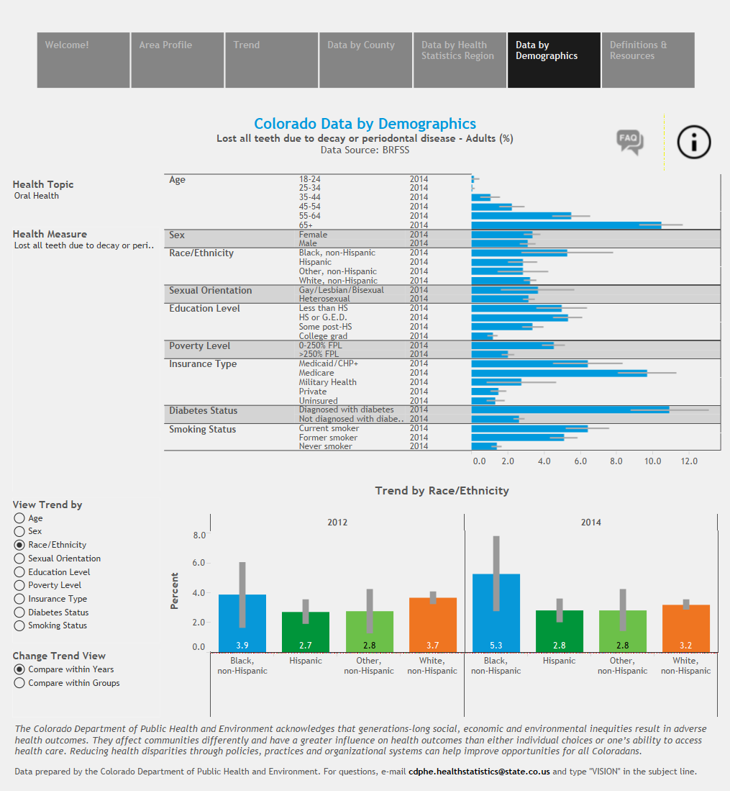
Demographic Data in VISION
Data points all presented by the following (when available):
Race/ethnicity
Poverty status
Education level
Age
Sex
Insurance type
Sexual orientation
Easy to visualize changes in health disparities over time
CDPHE statement of structural inequities included

Slide 19
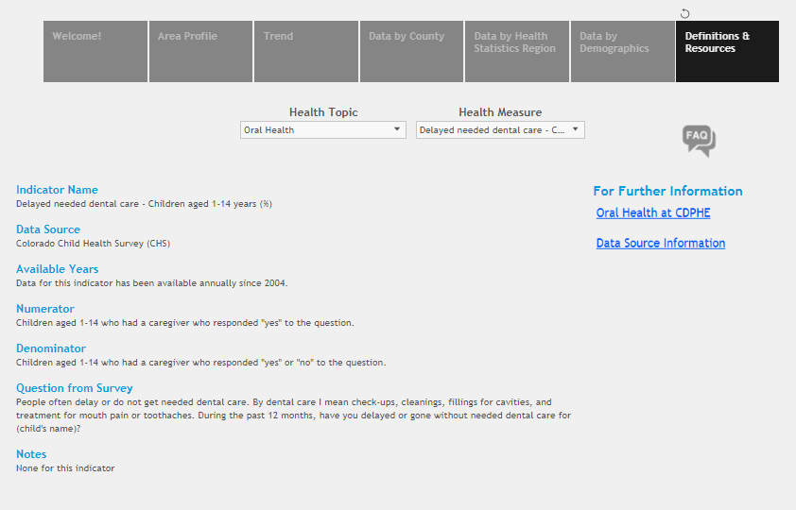

Slide 20
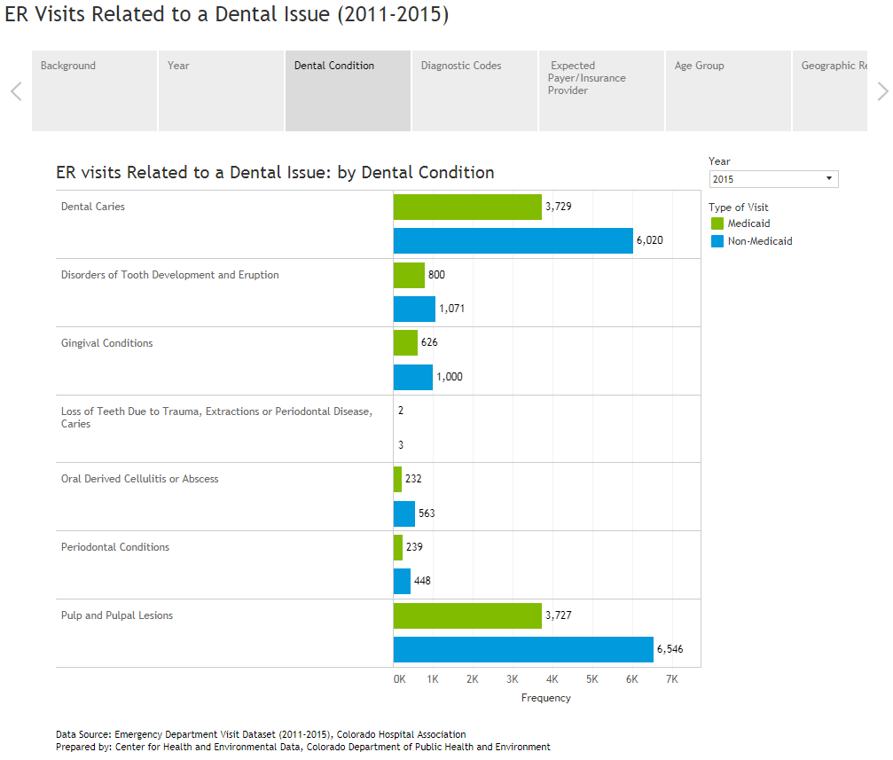
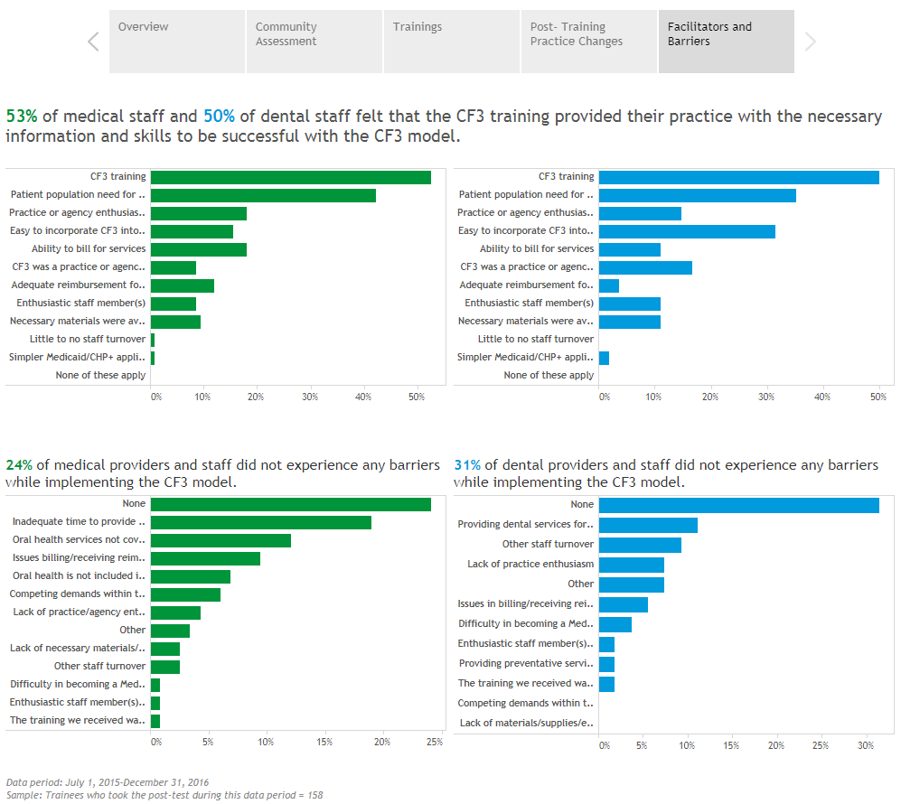
Other Examples of Tableau Work in Oral Health

Slide 21
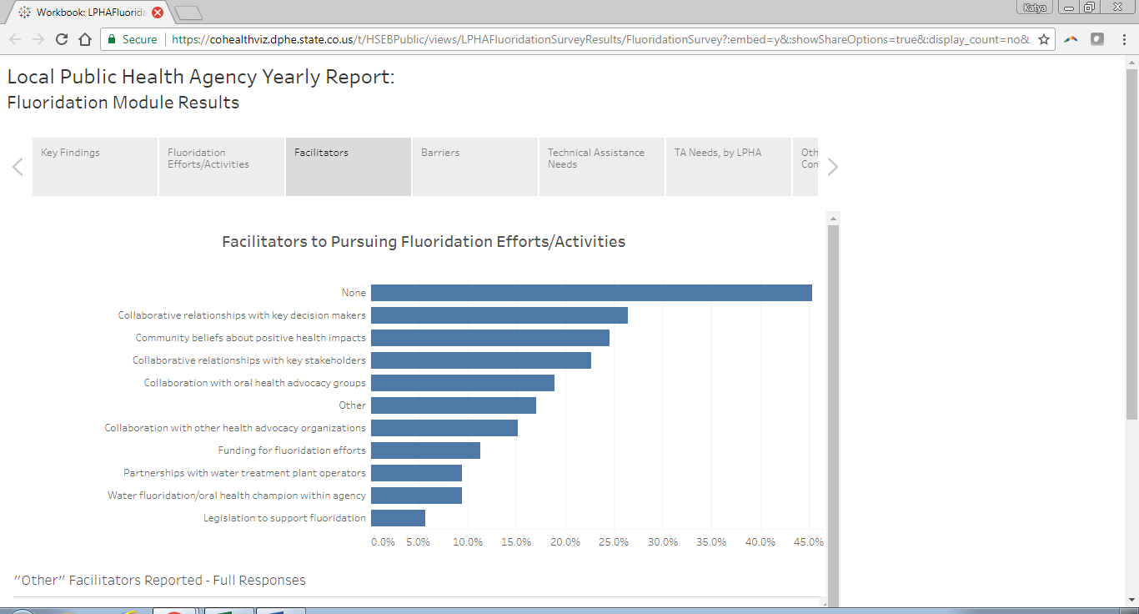

Slide 22
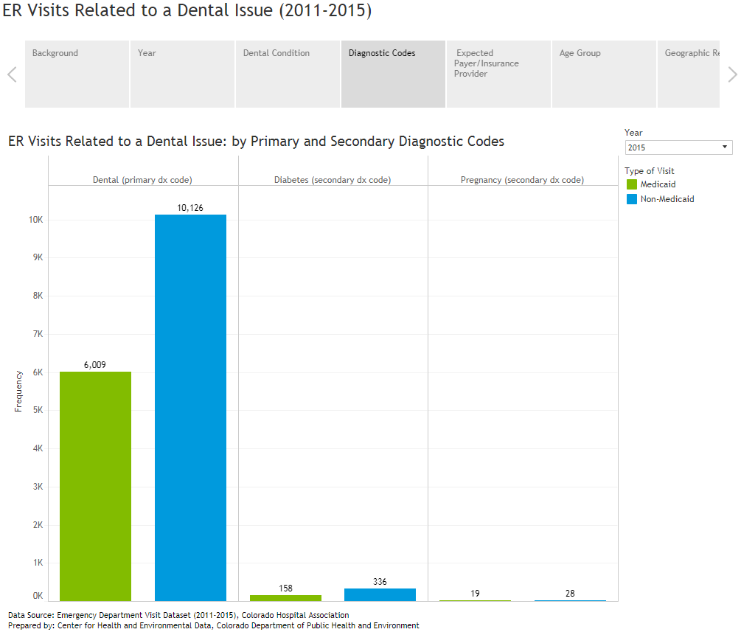

Slide 23
Future Directions
Continuous improvement on VISION and other OHU dashboards
Data updates - late summer, 2017
Continued integration/data streamlining
Social Determinants of Health data - continues to be added
VISION evaluation
Oral Health performance management dashboard?

Slide 24
Thank you!
Katya Mauritson, DMD
State Dental Director - Katya.Mauritson@state.co.us
Gabrielle Elzinga-Marshall, MPA
Evaluator - Gabrielle.elzinga@state.co.us

