Slide 1
Minnesota Oral Health Statistics System
Genelle R. S. Lamont, MPH, Ph.D.| Oral Health Surveillance Coordinator
July 27, 2017

Slide 2
Advancing Optimal Oral Health for all Minnesotans

Slide 3
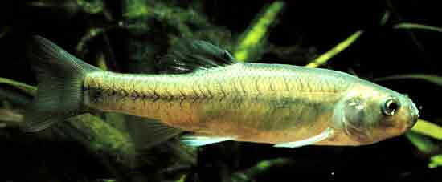
Minnesota Oral Health Statistics System (MNOHSS)
One-Stop Source for Oral Health Data
So you Don’t Have to Go Fishing!

Slide 4
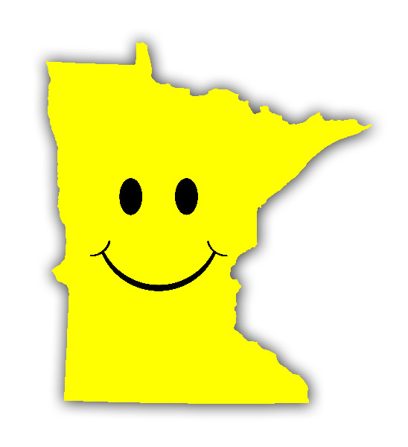
Collaborative team work
Notes:
National Environmental Public Health Tracking Program
Integrated system of environmental health, exposure and hazard data from national, state and city sources
21 content areas and 115 data indicators
25 states, New York City and 5 academic partners
Minnesota’s system is the MN Data Access Portal.
25 content areas including oral health with 120 data indicators.

Slide 5
Goals and objectives
Provide a scalable and sustainable state oral health surveillance system that:
Delivers timely, accurate, accessible, understandable and actionable oral health data.
Allows users to:
Track trends in dental and oral disease and service use.
Identify risk and protective factors, health disparities and high-need populations.
Ascertain unmet needs and target resources more efficiently.
Supports evidence-based state and local program planning, evaluation and policies.
Creates awareness of the importance of oral health.
Notes:
The goals and objectives of MNOHSS are to provide a scalable and sustainable state oral health surveillance system that:
Delivers timely, accurate, accessible, understandable and actionable oral health data.
Allows users to:
Track trends in disease and service use.
Identify risk and protective factors, health disparities and high-need populations.
Ascertain unmet needs and target resources more efficiently.
Supports evidence-based state and local planning, evaluation and policies.
Creates awareness of the importance of oral health, including the connection between oral health and overall health.

Slide 6
Audience
Oral health and public health professionals.
Government (state, county, local and tribal).
Researchers, educators and students.
Non-profit and advocacy organizations.
Foundations, entrepreneurs and charitable organizations.
Grant makers and writers.
Media/press.
Policymakers.
Public.

Slide 7
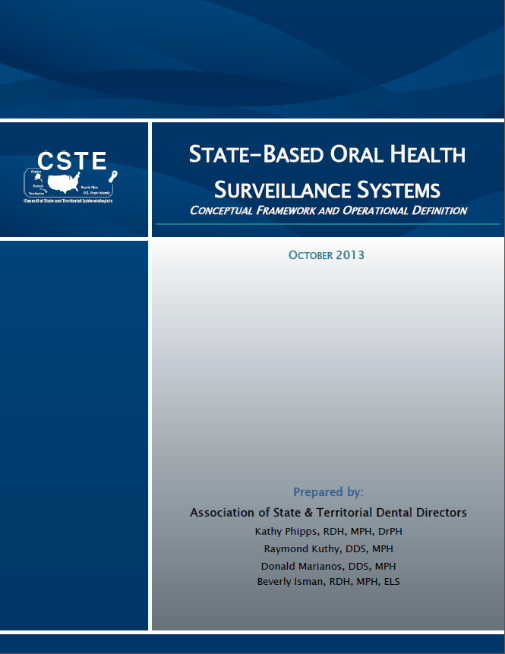
Select indicators

Slide 8
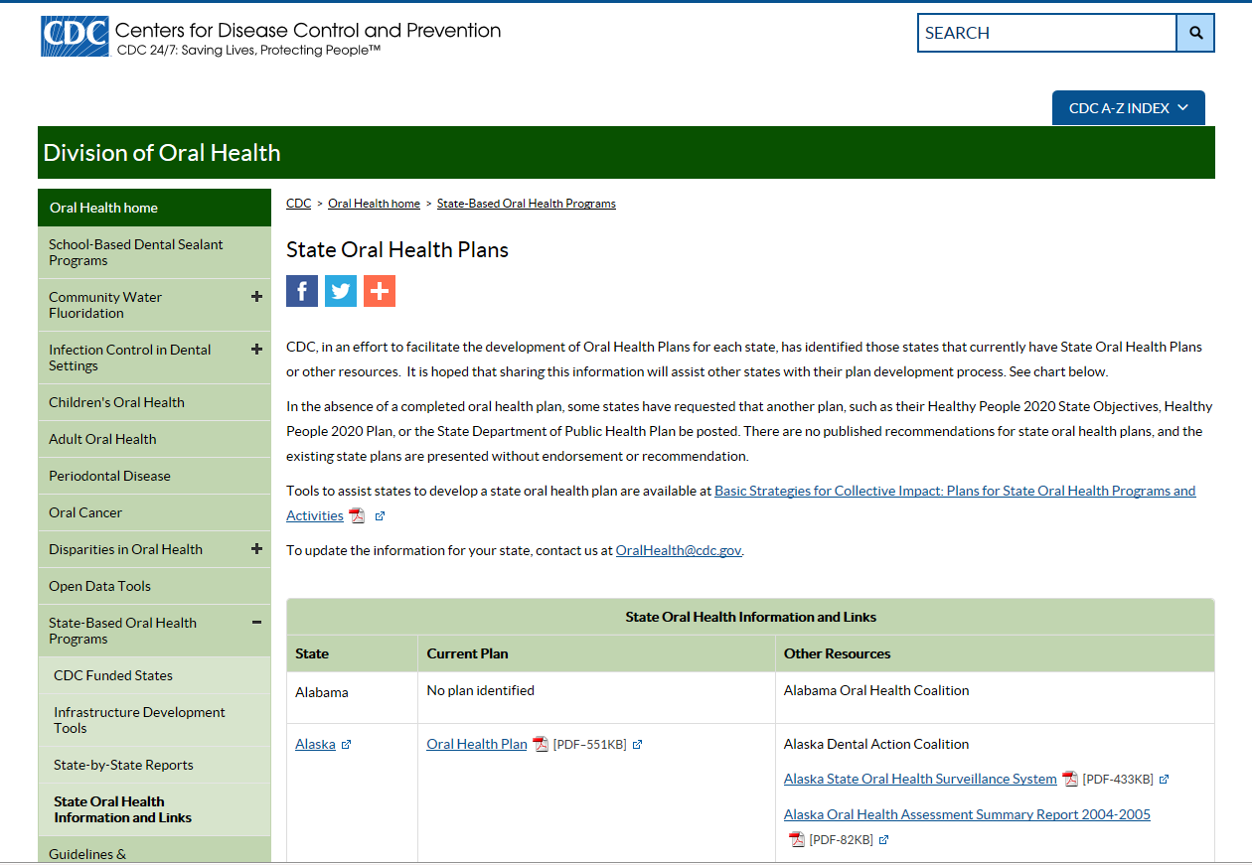
State surveillance plans

Slide 9
Datasets
Third Grade Basic Screening Survey.
Older Adult Basic Screening Survey.
Behavioral Risk Factor Surveillance System.
National Survey of Children’s Health.
Minnesota Department of Human Services.
Minnesota Health Access Survey.
Minnesota Department of Education.
Minnesota Cancer Surveillance System.
MDH Birth Defects Unit.
Notes:
MNOHSS has 6 data domains containing over 30 indicators. Data domains include: oral health status, dental disease prevention, oral health service use (total population), oral health service use (Medicaid enrollees), dental workforce and population characteristics.

Slide 10
Mobile-responsive technology

Slide 11
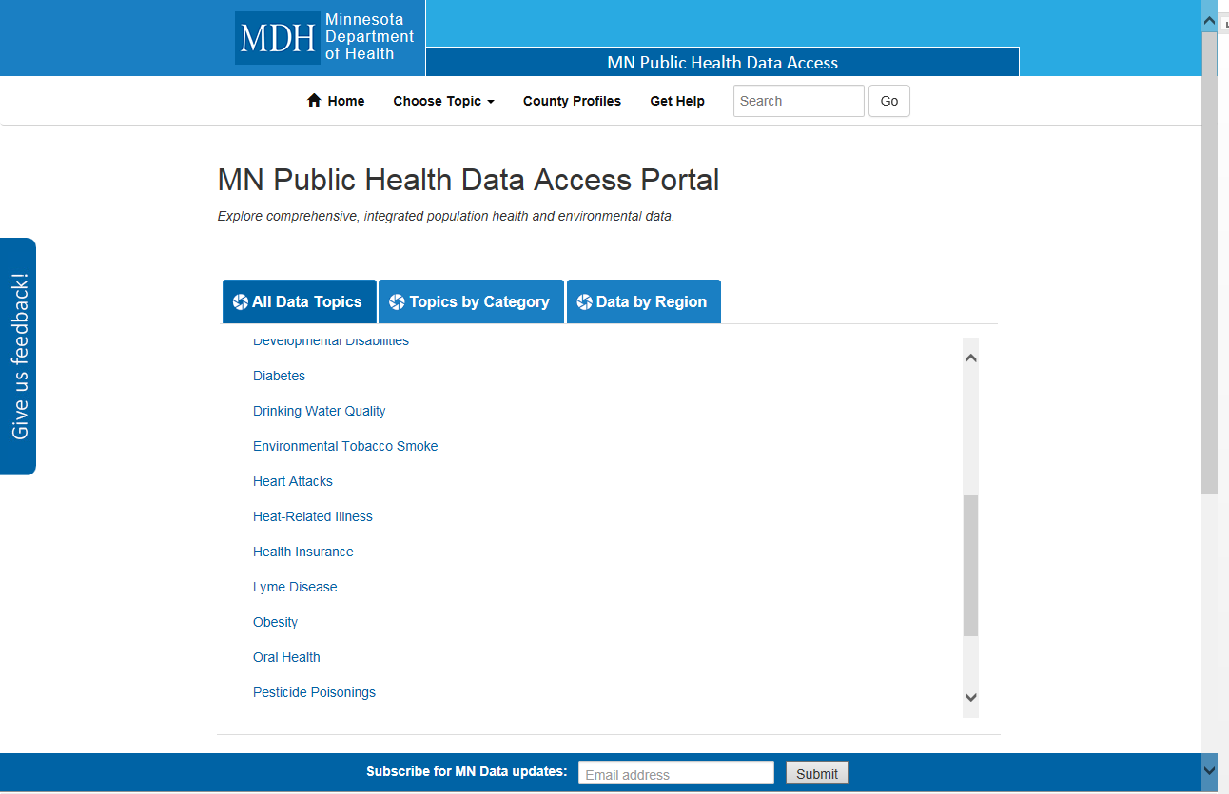
MN Public Health Data Access Portal
https://apps.health.state.mn.us/mndata

Slide 12
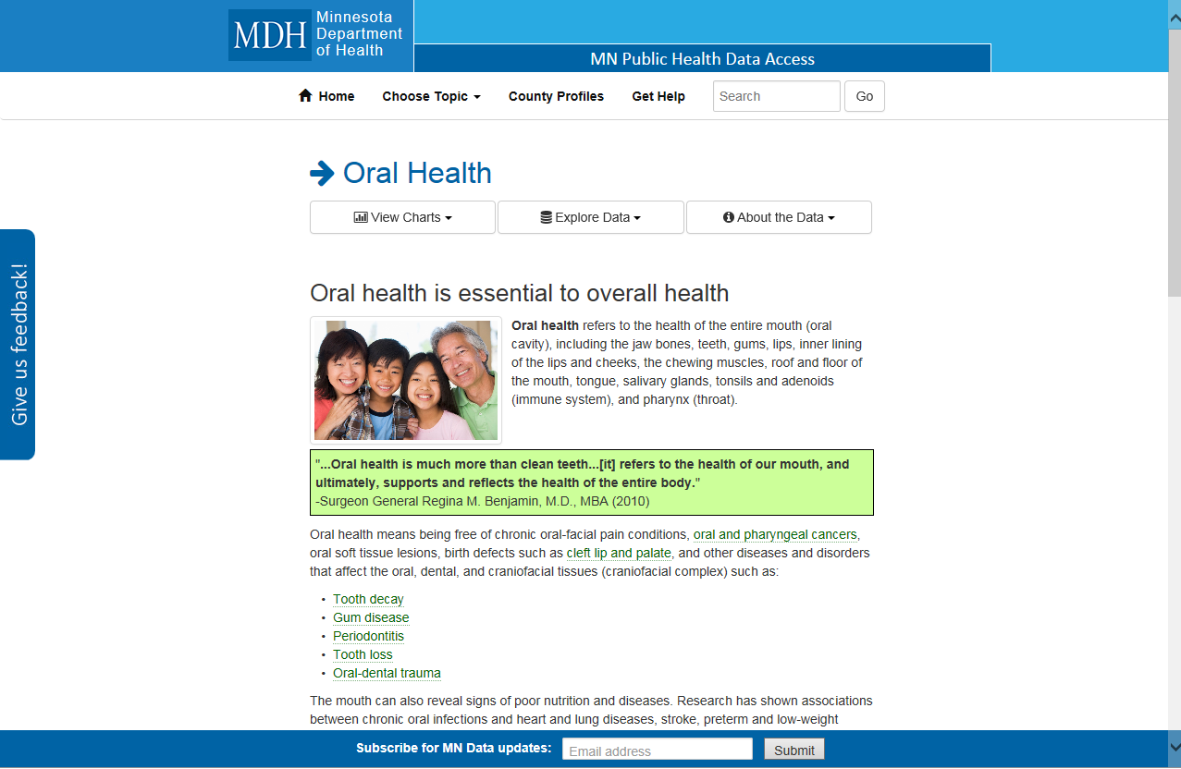
Landing page

Slide 13
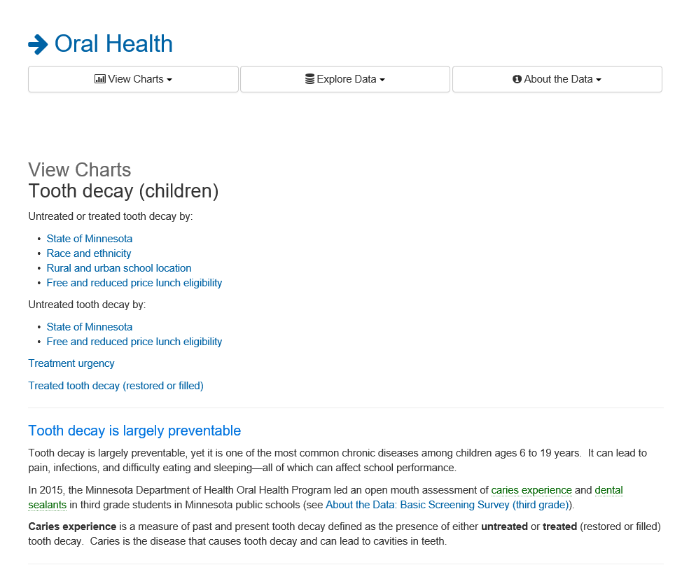
Example view charts page

Slide 14
Infographic example

Slide 15
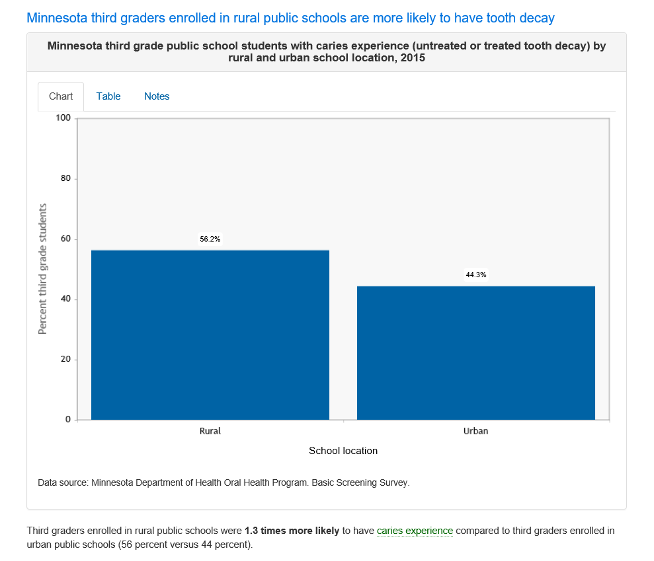
Example chart
Bite
Snack

Slide 16
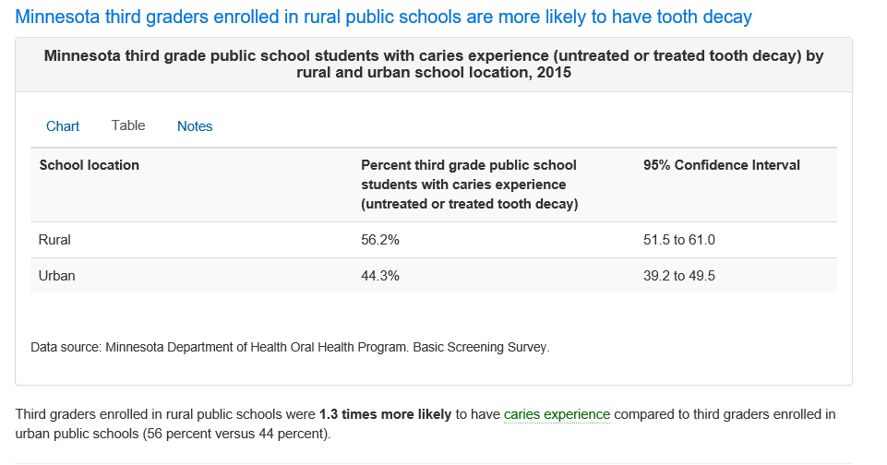
Example table
Meal

Slide 17
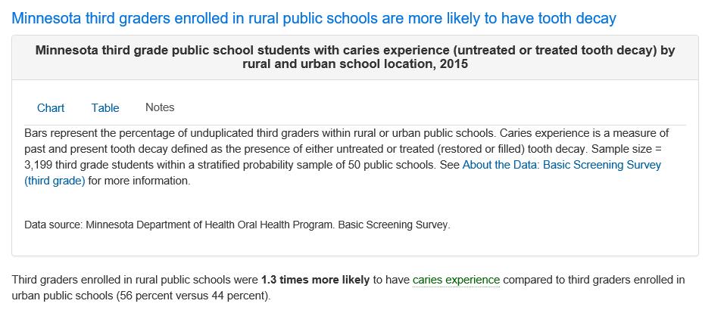
Notes tab

Slide 18
Explore data page

Slide 19
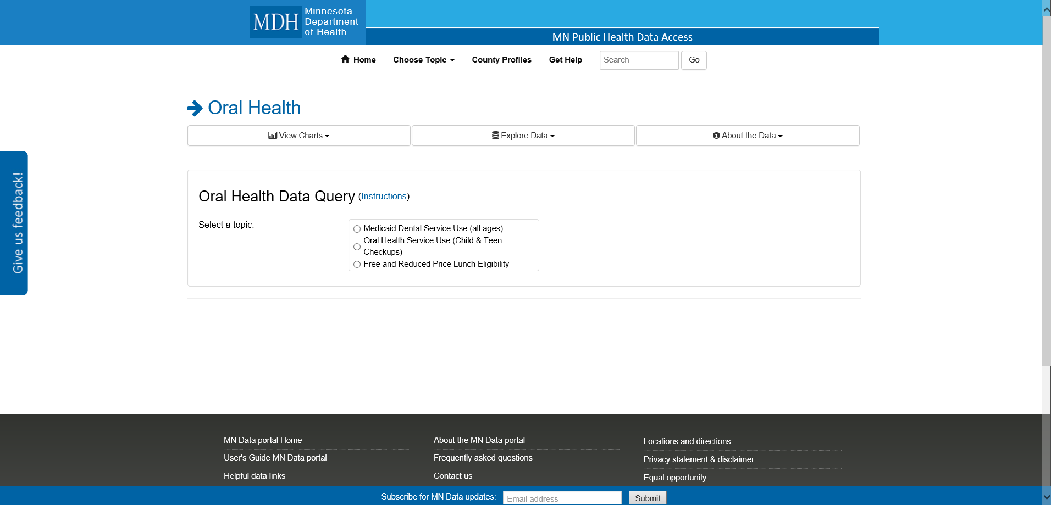
Data query

Slide 20
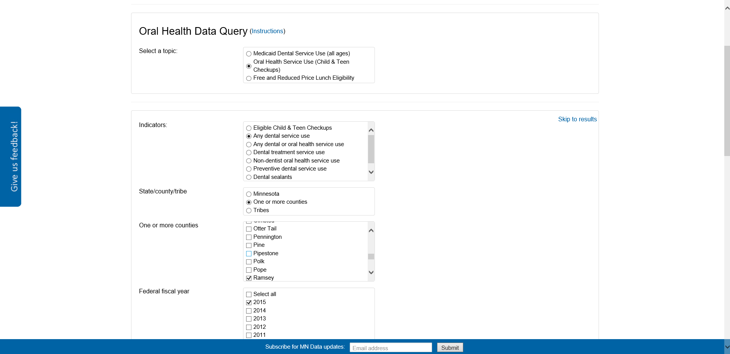
Child and Teen Checkups

Slide 21
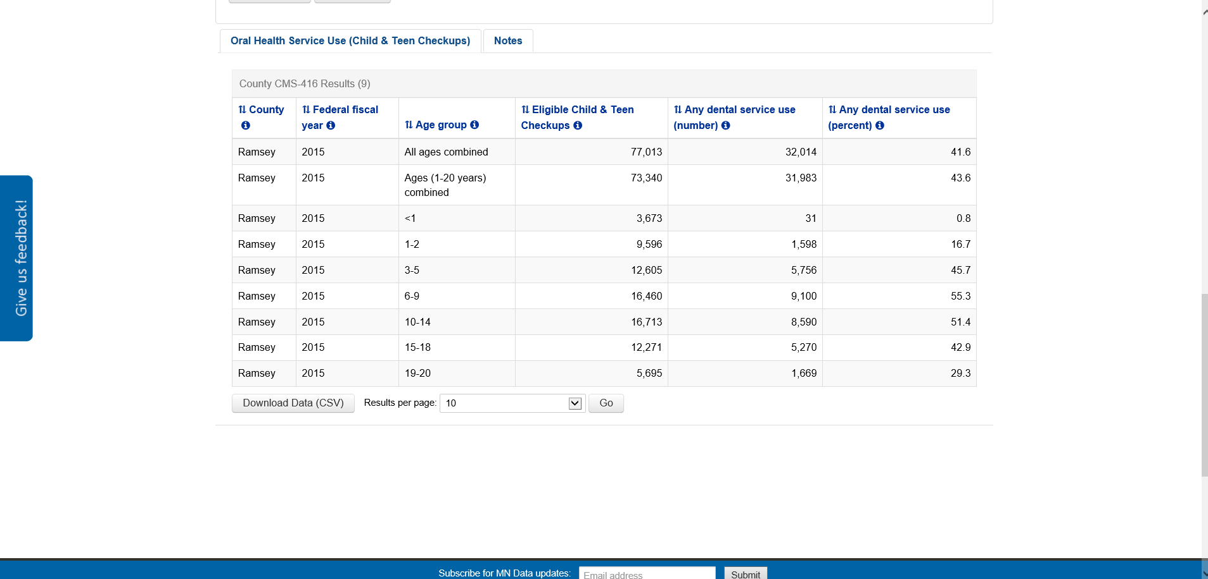
Query & download

Slide 22
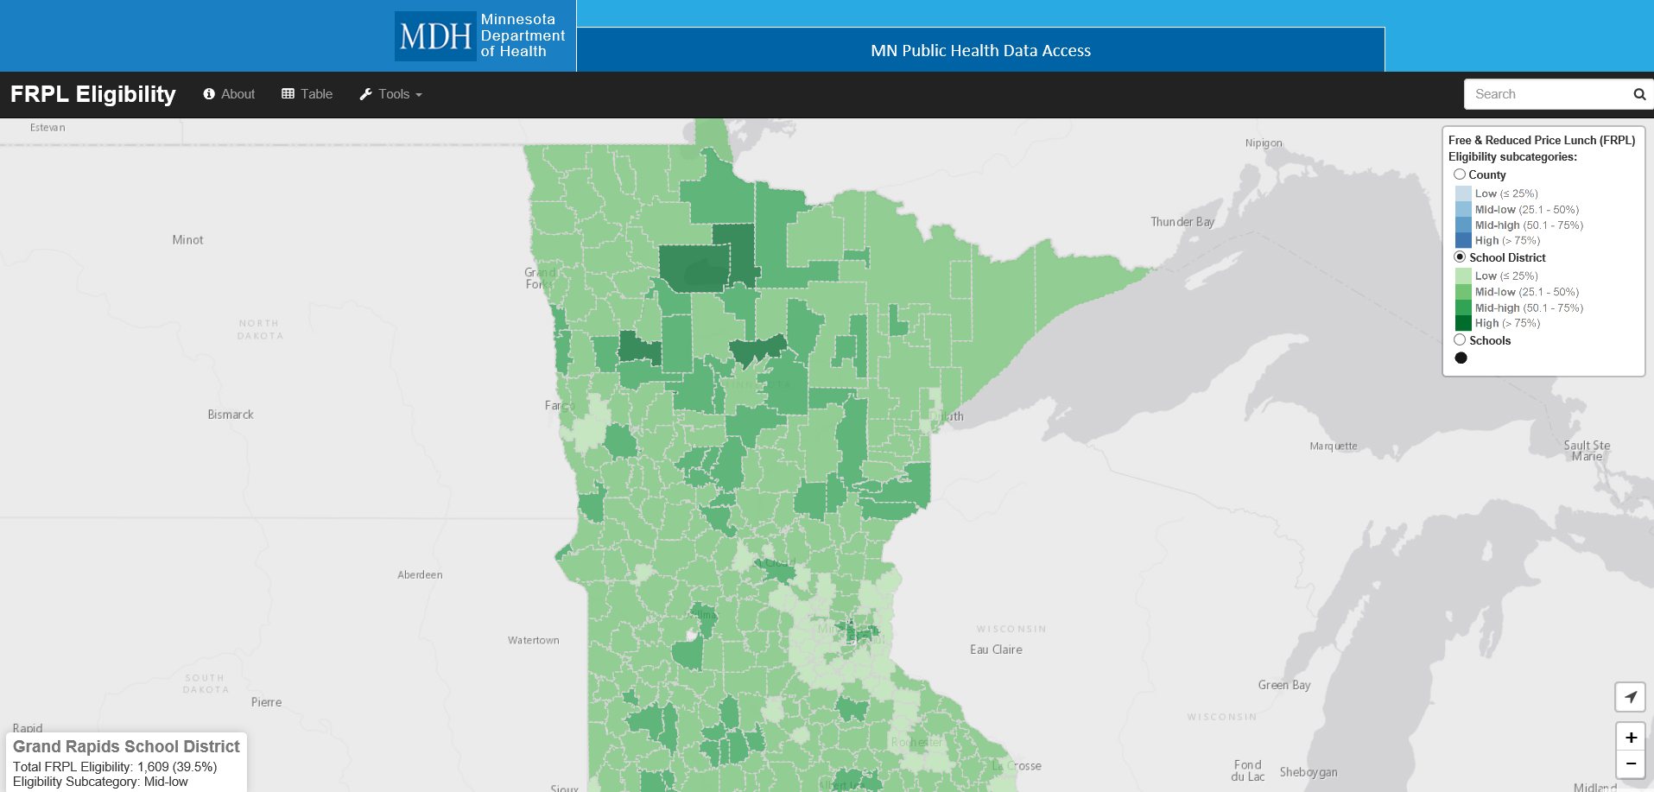
Interactive map school district

Slide 23
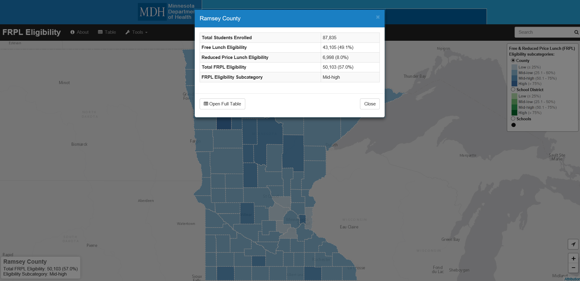
Interactive map

Slide 24
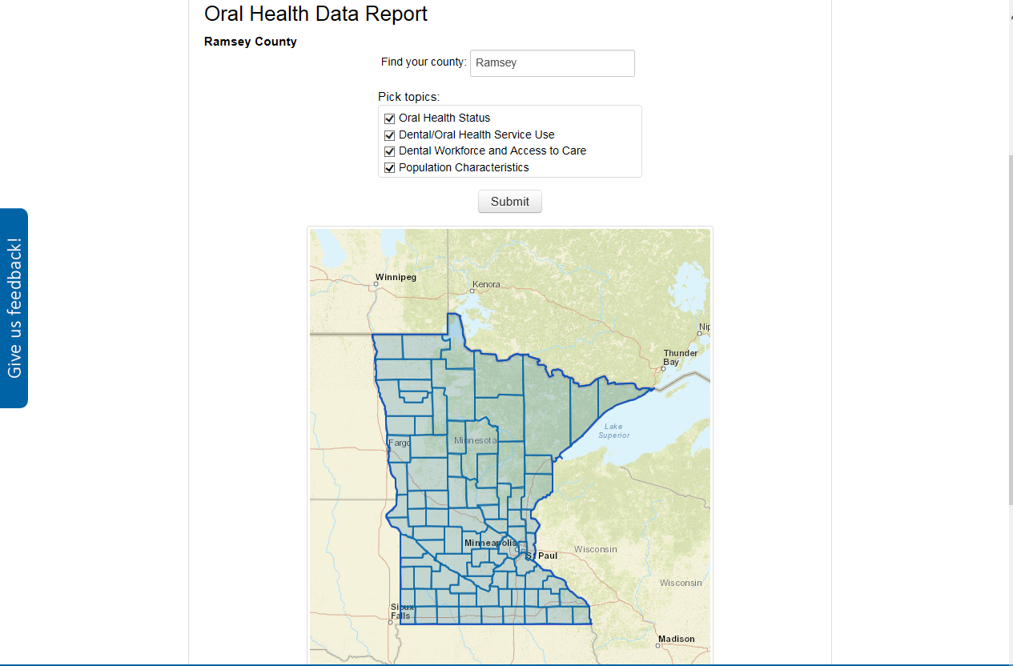
Oral health data report

Slide 25
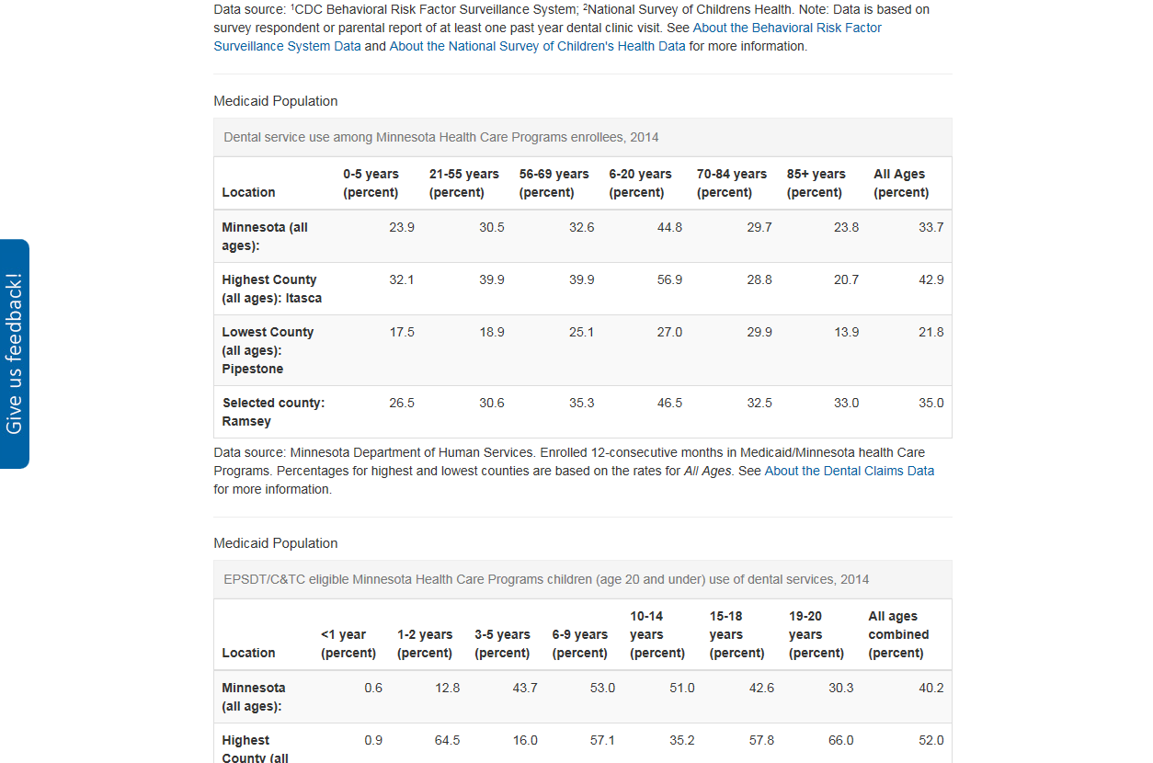
Oral health report read-out

Slide 26
About the data page

Slide 27
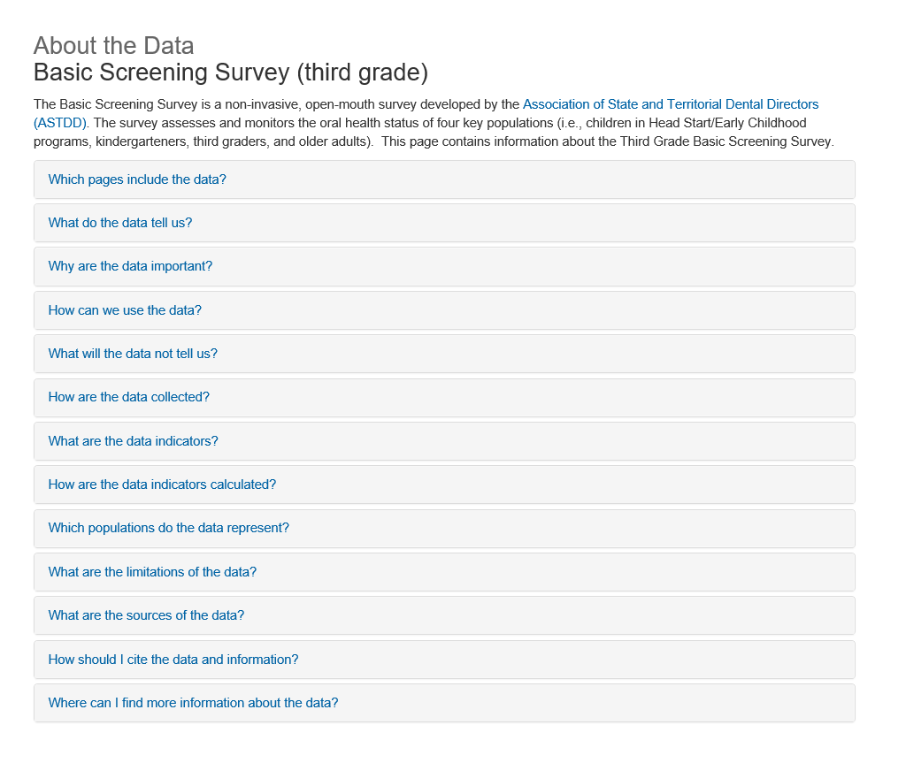
About the Data: Third grade BSS

Slide 28
Lessons learned
Build and foster partnerships.
Engage stakeholders early in the process.
Establish processes, standards and protocols.
Communicate, communicate, communicate.
Leverage resources, funding and opportunities.
Invest in and support diverse staff.

Slide 29
Acknowledgements
Delta Dental of Minnesota Foundation
Joe Lally, Executive Director
Dana L. Jensen, Program Officer & Senior Grants Manager
Sharon Oswald, Program Manager
Minnesota Environmental Public Health Tracking Program
Jean Johnson, Director
Jessie Shmool, Program Manager
Blair Sevcik, Epidemiologist
Lynn Treadwell, MN Data Portal Coordinator and Evaluator
MN.IT Services
Mary Ruth Harsha and Joyce Duclos, Project Managers
John Sonnek, Graeme St. Clare and Cassie Sass, Data Programmers
Mike Dolbow, GIS Supervisor
Kitty Hurley and Nick Kiminski, GIS Developers
MDH Oral Health Unit
Prasida Khanal, Director
Merry Jo Thoele (retired Director)
Barbara Hann (retired Data Coordinator)
Bilquis Khan (retired Evaluator)
Megan Clare Kuhn-Craig, Older Adult BSS Coordinator
Clare Larkin, Prevention Coordinator
Jon Roesler, Epidemiologist

Slide 30
Thank you!
Genelle R. S. Lamont, MPH, Ph.D.
genelle.lamont@state.mn.us
651-201-5974

Slide 31
Questions?
If you have a question, please click on the little man with his arm raised icon on either the upper left or the top of your screen. Click on “raise hand.” We will then call on you to ask your question over the phone.

