Slide 1
Turning Data Into Action A Webinar Series for SOHPs
Presenting by the ASTDD Data Committee

Slide 2
7-Part Series
Date | Topic | Presenter
May 18 | Turning data into action | Kathy Phipps, ASTDD
June 1 | Developing and using state oral health data reports | Hawaii & Vermont
June 15 | Using the CDC Open Data Platform to visualize oral health data | Valerie Robison, CDC
June 29 | Data to Action: Making Better Infographics | Carole Stampfel, AMCHP
July 27 | Web-based oral health data systems – state examples | Colorado, Minnesota
August 3 | Oral health infographics – state examples | Arizona & New Hampshire
August 10 | Using coalitions and partners to spread the message | Children’s Health Alliance of Wisconsin, Washington Dental Service Foundation
All webinars are Thursday from 3:00-4:00 Eastern Time

Slide 3
General Reminders
This webinar will be recorded & archived (www.astdd.org)
Please hold questions until the end
If you have questions, please make a note of them
If you want to ask a question at the end, click on the Set Status icon
The little man with his arm raised on either the upper left or the top of your screen. Click on “raise hand”
We will then call on you to ask your question
Please respond to the polling questions

Slide 4
Acknowledgements
This presentation was supported by Cooperative Agreement NU58DP004919-05-00 from CDC, Division of Oral Health. Its contents are solely the responsibility of the authors and do not necessarily represent the official views of CDC.

Slide 5
What is an Infographic?
A fun and quick way to learn about a topic without a lot of heavy reading!
A visual image such as a chart or diagram used to represent information or data
“a good infographic is worth a thousand words”

Slide 6
What is an Infographic?
Refer to June 29, 2017 archived webinar:
Data to Action: Making Better Infographics
Carole Stampfel, AMCHP
www.astdd.org

Slide 7
Today’s Presenters
Arizona
Julia Wacloff
New Hampshire
Jessica Morton
Laural Dillon

Slide 8
Arizona’s Infographic Journey
Oral health infographics – state examples
Association of State and Territorial Dental Directors Webinar

Slide 9
What will I talk about today?
Why
Process
Lessons learned

Slide 10
Background
Arizona BSS 2015
State Oral Health Plan

Slide 11
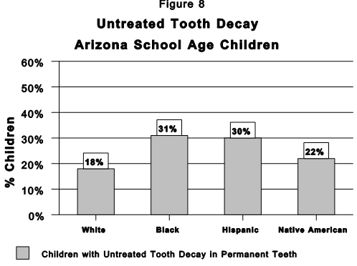
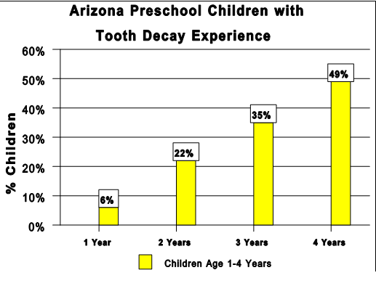
Story telling with data

Slide 12
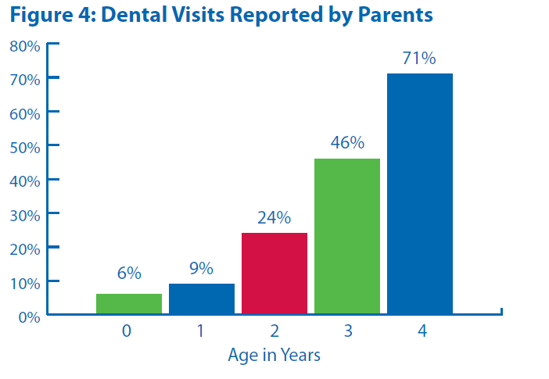
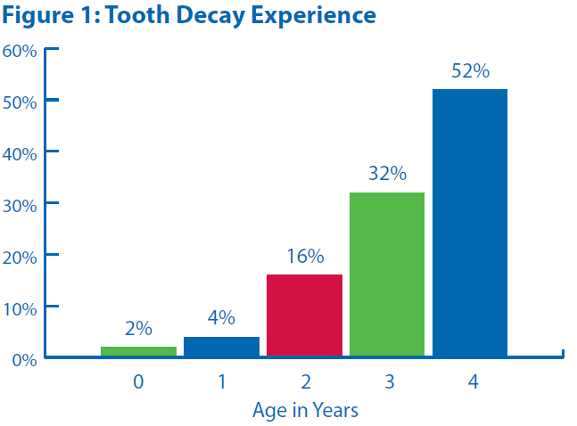
Infographics - Circa 2005

Slide 13
Maps

Slide 14
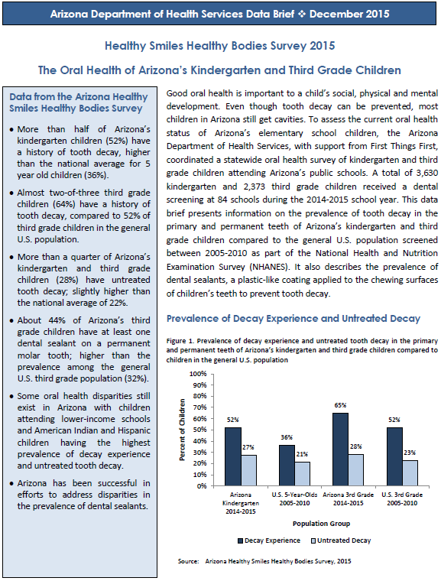
Arizona 2015 BSS Data Brief

Slide 15
Who did we work with?
Internal Bureaus

Slide 16
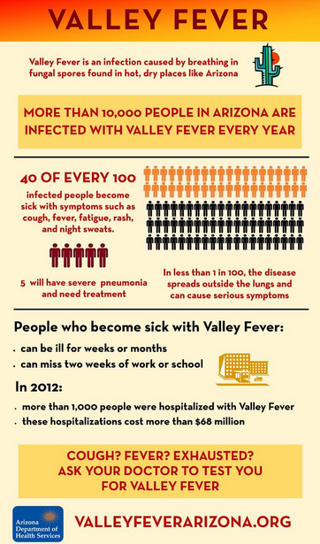
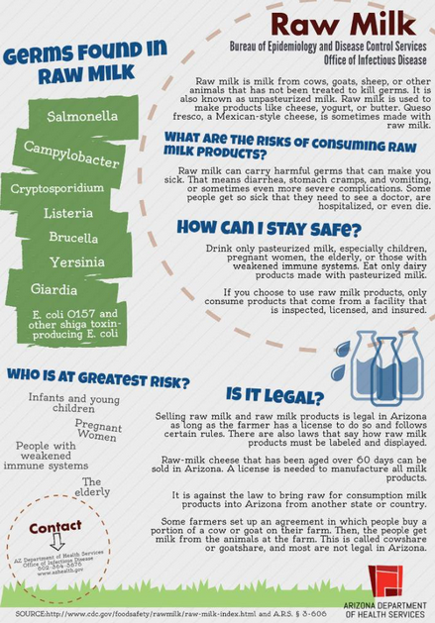

Slide 17
Who did we work with?
Internal Bureaus
Epidemiologist
Marketing Team and PIO
Visual graphic artist

Slide 18
What did we end up with?
Oral Health of Arizona 3rd Graders
Oral Health Disparities Among Arizona 3rd Graders

Slide 19
Title
Decay Experience
General Statement
Sealant Prevalence
Prevention Message
Cost & Consequences
Insurance
Link

Slide 20
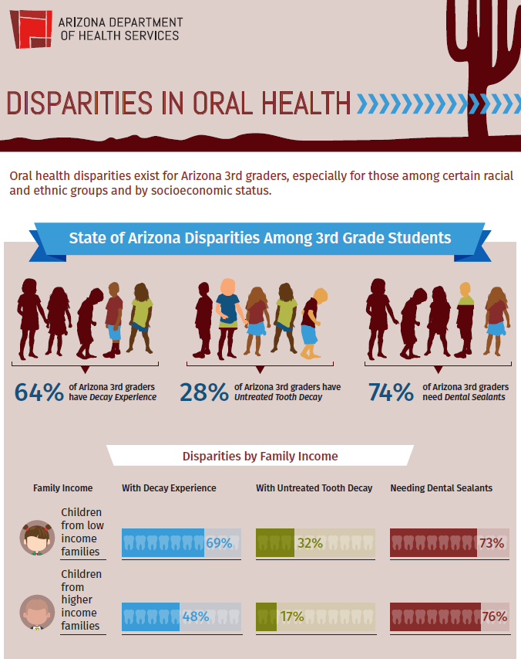

Slide 25
Lessons Learned
Epidemiology Involvement
TMI
Graphic Artists
Partner Use

Slide 26
Lessons Learned
Feedback from partners
Color palette
Add more about prevention recommendations
State maps
Word clouds – quotes from school nurses.
Notes:
Add recommendations for when and how often to go in for sealants
Add how many ahcccs parents do not know ahcccs covers dental care.
Maybe add number of kids that are eligible but do not have insurance (I don’t know where we would get this number)
County level in order from highest percent to lowest, but some said to keep it alphabetical so it doesn’t look like a trend and counties can find theirs easily.
Include a GIS map where the higher percentages are in a darker color.
Include absenteeism numbers for AZ (I mentioned we don’t have this avail. But could include national stats for impact of dental pain on absenteeism)
Word cloud for school nurse comments (I mentioned we surveyed school nurses when they asked about absenteeism)
Disparities infographic does not refer back to azsmiles.org or the main survey page at the bottom like the general infographic does.

Slide 27
For More Information…
Julia Wacloff
602-364-1474
Julia.wacloff@azdhs.gov

Slide 28
New Hampshire Oral Health Infographics for ASTDD
Laural Dillon, Program Coordinator
Jess Morton, Communication Specialist
New Hampshire Oral Health Program
Notes:
We both started working with the Oral Health Program in 2017. Neither of us were here when the infographics were developed, but we spoke to staff that did work on them and have been a set of fresh eyes for infographics that have been developed.
ADD Laural Intro.
JESS
I have been working for the State of New Hampshire for 16 years . The work that I have done has primarily been in outreach , education, and communications in the drinking water, indoor air quality, tobacco cessation, and oral health programs. Preparing for this webinar has made me excited about learning more about infographics and the possibilities they have for better communications on the programs that I work for.
8/3/2017 8:30 AM
28

Slide 29
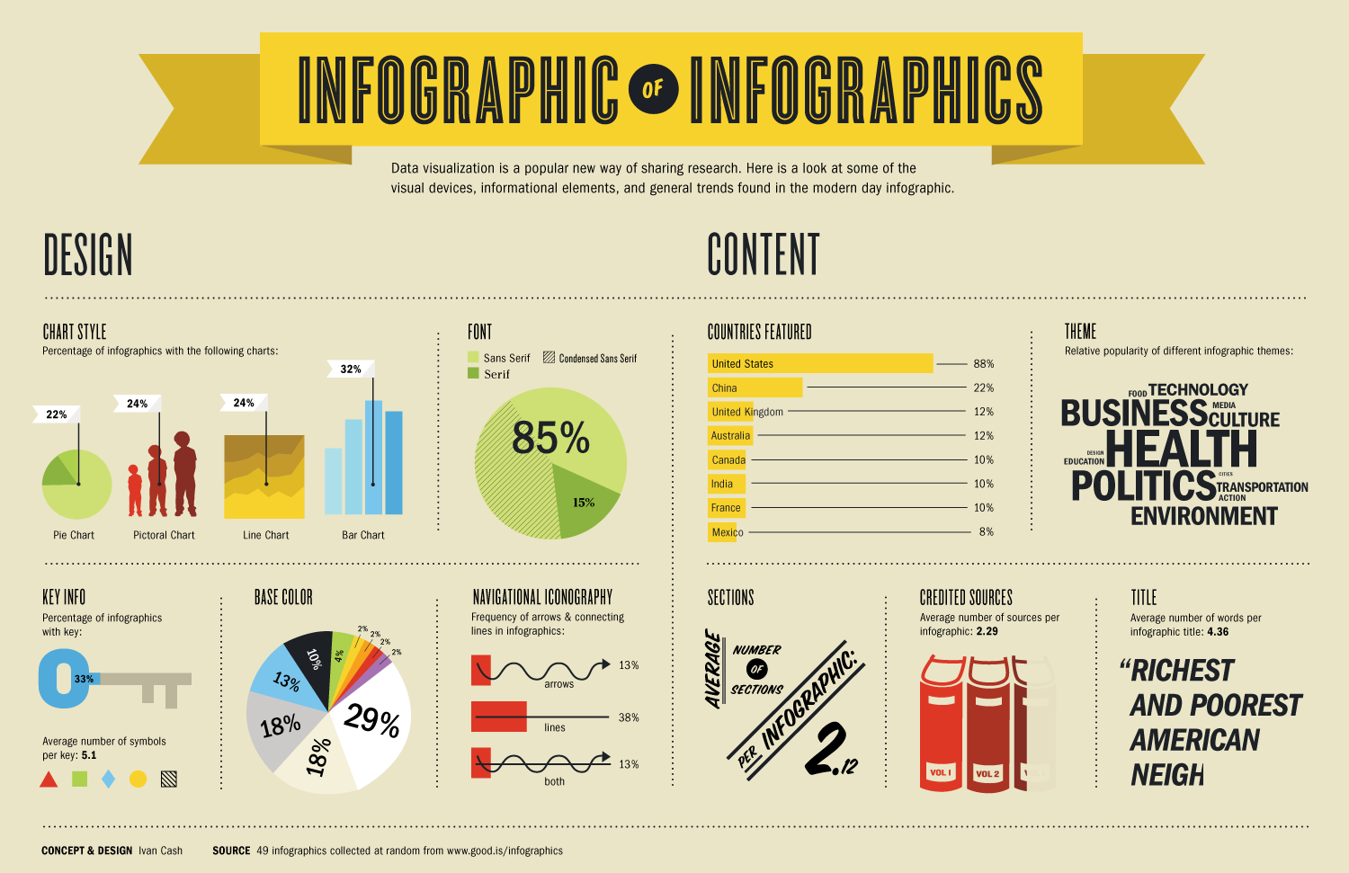
New Hampshire’s Experience
Why?
We had data and we wanted to communicate the information to our audiences.
We didn’t want another issue brief, fact sheet, or report.
We wanted something easy to read and understand.
However
We had limited financial resources
Notes:
The program’s evaluator had a lot of data and information that the program wanted to share to key partners, legislators, and our funders. Rather than just creating another fact sheet, issue brief, report, etc…we wanted something easy to read and to understand. CLICK
We came up with an infographic! This image shows you how people are designing their infographics, what content to use, theme, etc….. (You will notice HEALTH is a theme). CLICK
However, our financial resources were limited. The NH Oral Health Program could not hire a contractor, but instead had to rely on the expertise that was already in the program.
8/3/2017 8:30 AM
29

Slide 30
Infographic Software Used
Piktochart – www.piktochart.com
Minimal Cost – (FREE, $150 lite, $290 pro)
Easy to Use - User Friendly
Benefits of FREE membership
Create as many as you want
Limited templates for making
Piktochart watermark is added at the bottom
Store your uploaded images up to 40MB
Download in web resolution JPG or PNG
Limited Privacy options when publishing. Only available for public viewing
Notes:
DPHS gained access to Piktochart (web based) website that you pay to use. The cost was $40 a month (special deal). There are other options including a FREE membership.
FREE limits you n the templates etc…
We are going to share with you 3 infographics. The first and second infographics are about school based oral health programs and the third infographic is on our community based dental centers. We will tell you the good, the bad, and the ugly…as we walk through these infographics.
8/3/2017 8:30 AM
30

Slide 31
Notes:
Oral Health School Program
This is a top portion of the first school oral health program infographic – the next slide will show the bottom portion of the infographic.
This is showing the number of kids who received OH Education from 2010-2015.

Slide 32
Notes:
Second half of infographic.
Top icons – be specific – icons should be mean something
5 year accomplishments - Too much!
3rd grade survey - sealants and dental decay
Highlights – who the OH program funds vs the State of NH
Graphs are not user friendly.

Slide 33
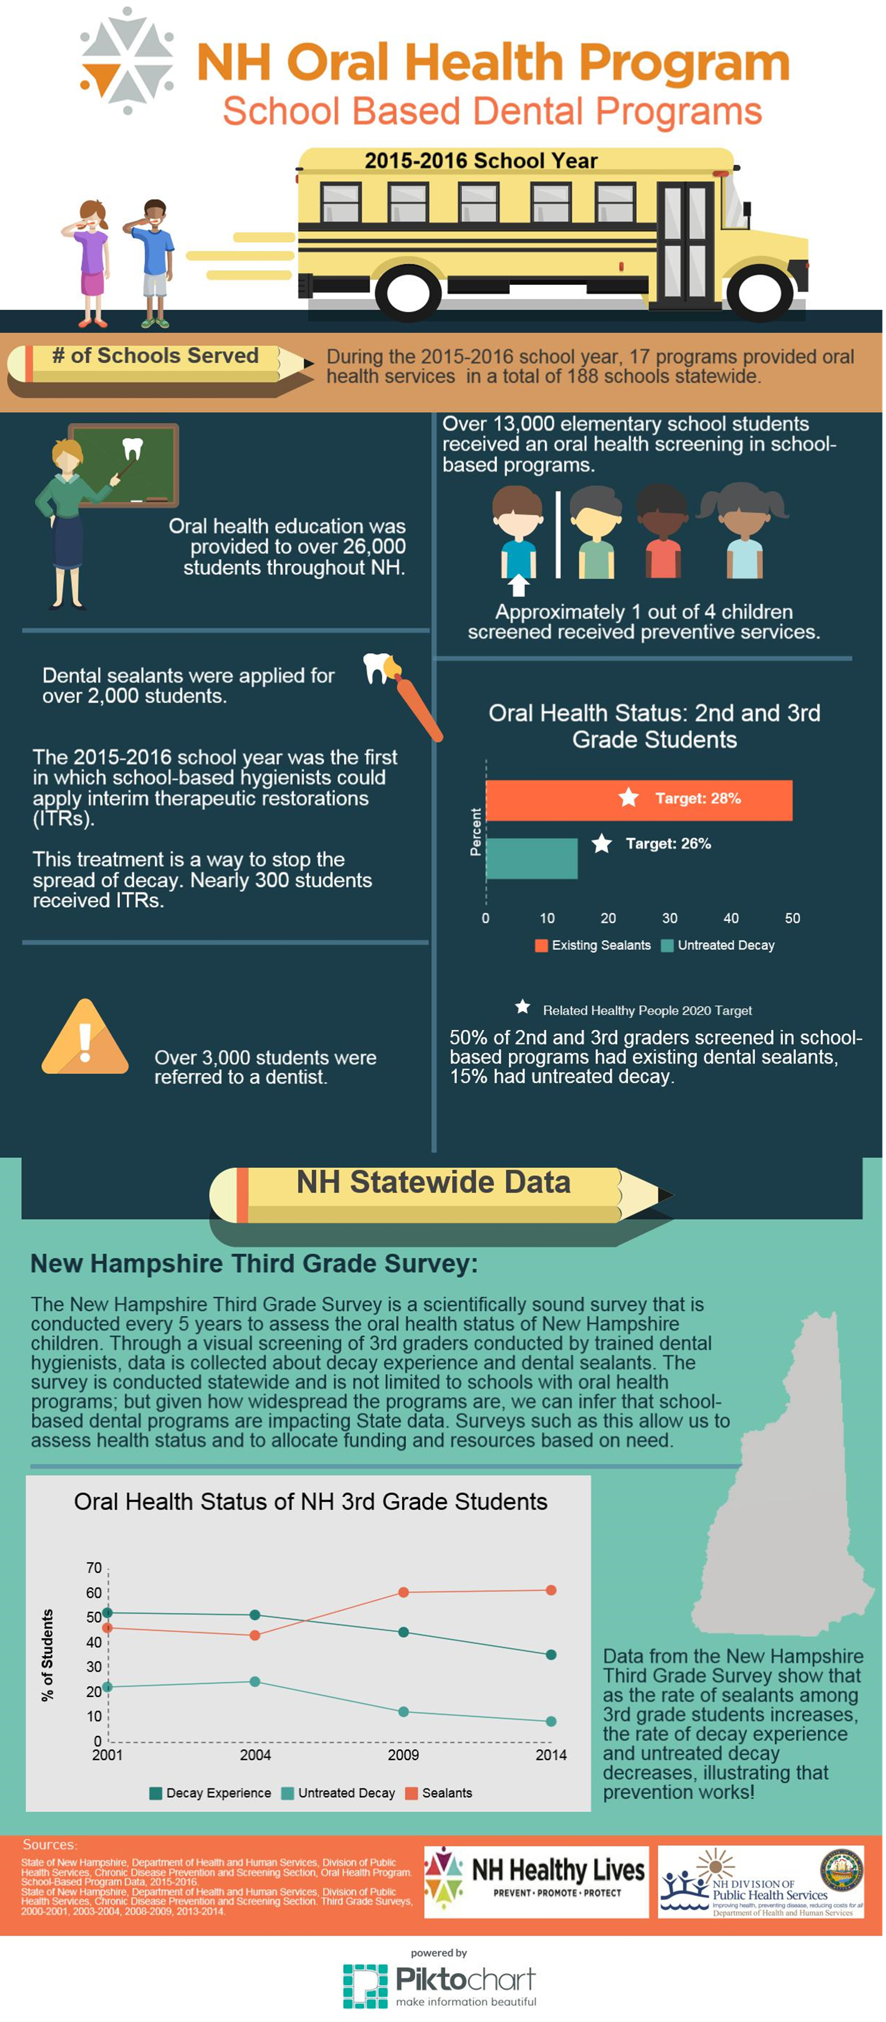
Notes:
Updated version of the previous infographic –
Top portion - # of programs, # of schools, # of education, # students received screening
Better layout, more engaging and easier to reach/understand

Slide 34
Notes:
2nd half of this infographic
# of dental sealants, Added ITRs,
Graph - ok

Slide 35
Notes:
Information on 3rd grade survey
Too much text
Graph clearly illustrates that as the # of sealants increases, # of tooth decay decreaes

Slide 36
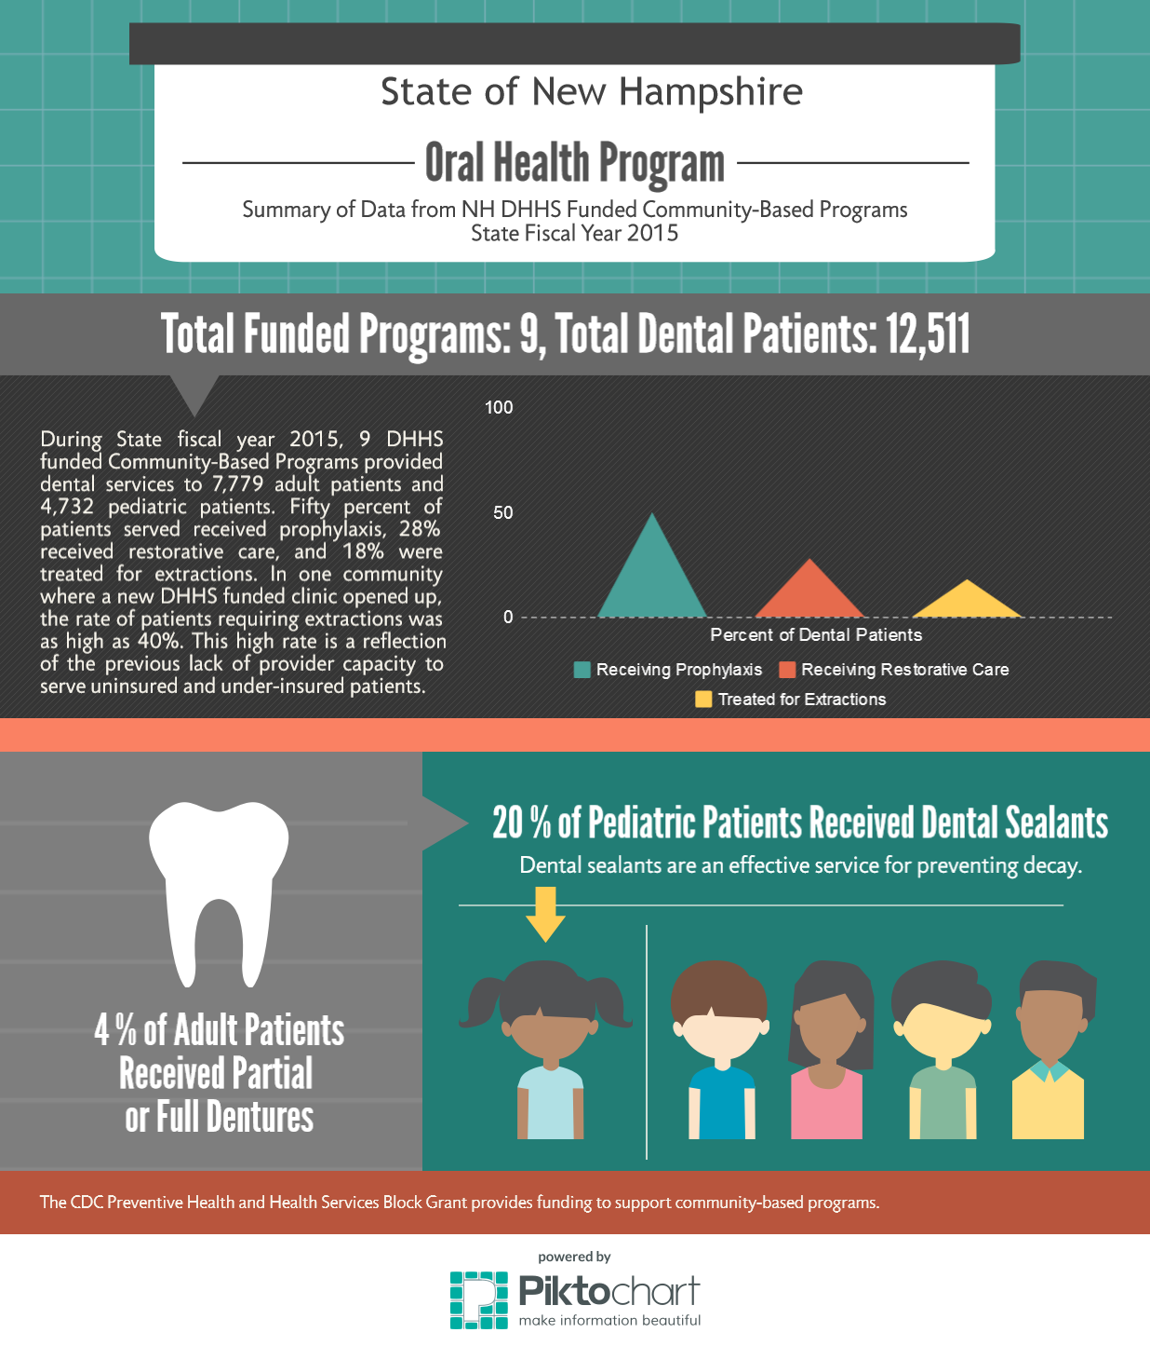
Notes:
3rd infographic on Community-Based Programs
Minimal
# Programs
# of patients
Percent of services performed.

Slide 37
Notes:
This is the bottom portion of the community based info.
Adults – dentures
Pediatric – dental sealants

Slide 38
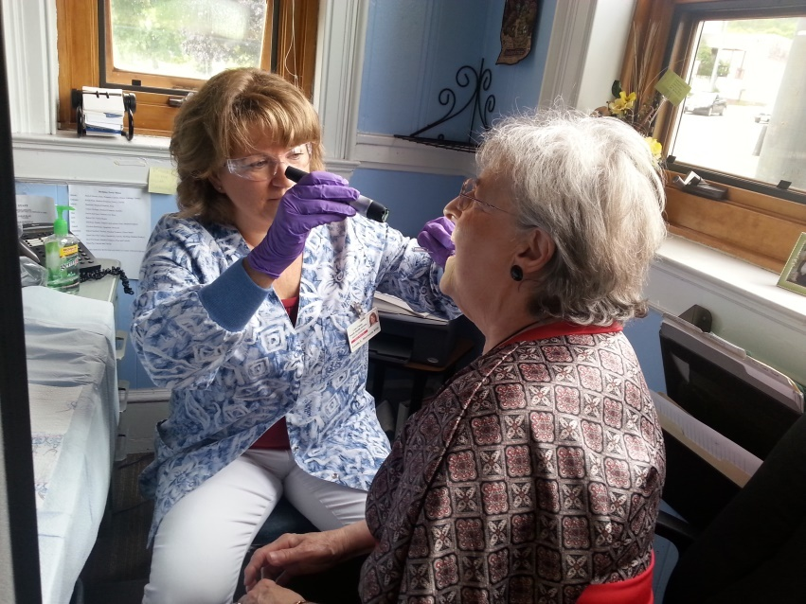
Audiences
School based health center program staff
Community based health center program staff
NH Legislators (400)
Funders (CDC)

Slide 39
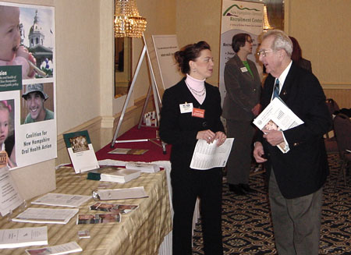
Dissemination
Calibration clinics
Legislative Breakfasts
CDC Grant Reports

Slide 40
Lessons Learned
Dissemination of the infographics could have been expanded.
Use a health promotion or communications person to help with design and layout.
Less is best. Keep it simple and short.
Watch your charts/graphs. Don’t use them if you don’t need too.
Notes:
Oral Health only handed out infographics at event. Should have considered posting to the website and asking partners to share information/data.
New DPHS Facebook and Twitter accounts
Oral Health now has a health communicator on its staff so we can review products more carefully. Also, share information with your public information or marketing staff.
Less is best. Even if you collect data it doesn’t mean the data is necessary to share. Consider only a few things at a time to share and make the infographic more meaningful.
Charts and Graphs…have their place..and it might not be in an infographic.
Since NH has new program staff and a new Commissioner and Division Chief
we will probably recraft some of our messages and tweak our infographics to improve them. It’s ok to go through multiple iterations to get it right.

Slide 41
For More Information
Laural Dillon
603-271-0460
Laural.Dillon@dhhs.nh.gov
Jess Morton
603-271-5928
Jessica.Morton@dhhs.nh.gov
www.dhhs.nh.gov

Slide 42
Questions?
If you have a question, please click on the little man with his arm raised icon on either the upper left or the top of your screen. Click on “raise hand.” We will then call on you to ask your question over the phone.

