Slide 1
Turning Data Into Action A Webinar Series for SOHPs
Presenting by the ASTDD Data Committee

Slide 2
7-Part Series
Date | Topic | Presenter
May 18 | Turning data into action | Kathy Phipps, ASTDD
June 1 | Developing and using state oral health data reports | Hawaii & Vermont
June 15 | Using the CDC Open Data Platform to visualize oral health data | Valerie Robison, CDC
June 29 | Data to Action: Making Better Infographics | Carole Stampfel, AMCHP
July 27 | Web-based oral health data systems – state examples | Colorado, Minnesota
August 3 | Oral health infographics – state examples | Arizona & New Hampshire
August 10 | Using coalitions and partners to spread the message | Children’s Health Alliance of Wisconsin, Washington Dental Service Foundation

Slide 3
General Reminders
This webinar will be recorded & archived (www.astdd.org)
Please hold questions until the end
If you have questions, please make a note of them
If you want to ask a question at the end, click on the Set Status icon
The little man with his arm raised on either the upper left or the top of your screen. Click on “raise hand”
We will then call on you to ask your question
Please respond to the polling questions

Slide 4
Acknowledgements
This presentation was supported by Cooperative Agreement NU58DP004919-05-00 from CDC, Division of Oral Health. Its contents are solely the responsibility of the authors and do not necessarily represent the official views of CDC.

Slide 5
Today’s Presenters
Washington State
Alia Katabi, MA
Alison Mondi, BA
Arcora Foundation
Wisconsin
Matt Crespin, MPH, RDH
Children’s Health Alliance of Wisconsin

Slide 6
Turning Data Into Action
Washington State Oral Health

Slide 7
Our Mission
To prevent oral disease and improve overall health

Slide 8
Arcora Foundation and Data
Arcora is…
Dedicated to prevent oral disease and improve overall health by partnering with communities and transforming systems
Relies on data to monitor disease trends, measure success and setbacks, inform strategies, plan programs, and influence policy and decision makers
Collaborate with WA State Department of Health’s Oral Health program to track progress made towards meeting Healthy People’s 2020 oral health targets.

Slide 9
WA State Oral Health Surveillance Data
Preschool Children
School Children
Adults
Older Adults
Head Start
Caries experience
Untreated tooth decay
Need for treatment
(Smile Survey)
Kindergarten & 3rd Grade
Caries experience
Untreated tooth decay
Rampant decay
Sealant prevalence (3rd grade only)
Need for treatment
(Smile Survey)
18+ Years
Tooth loss
Painful aching anywhere in your mouth
(BRFSS)
55+ Years
Tooth loss
Self-reported periodontal disease
(WA State Senior Telephone Survey)
65+ Years
Untreated tooth decay
Need for treatment
Periodontal disease
(WA State Elder Smiles: Senior Basic Screening Survey)
Oral Health Outcomes
1-17 Years
Parent’s self-report of child’s oral health, oral health problem in last year
(Data Resource Center for Child and Adolescent Health)
Grades: 6, 8, 10,12
Missing school because of toothache (Healthy Youth Survey)
Low-Income (Medicaid)
Utilization data:
Dental visit
Preventive service
Treatment service
(Medicaid Claims, CMS EPSDT)
Low-Income (Medicaid)
Dental visit
Preventive service
Treatment service
Sealant placement (6-9 & 10-14)
(Medicaid Claims, CMS EPSDT)
Grades 9-12
Dental visit (Healthy Youth Survey)
18+ Years
Dental visit
People with Diabetes
Dental visit
(BRFSS)
Pregnant Women
Teeth cleaning/dental visit
(PRAMS)
55+ Years
Dental visit
People with Diabetes
Dental visit
(WA State Senior Telephone Survey, WA State Elder Smiles: Senior Basic Screening Survey)
Access to Care
1-17 Years
Dental visit, Preventive dental visits
(Data Resource Center for Child and Adolescent Health)
Low-Income (FQHC patients)
Dental visit
(Medicaid Dental Claims Data, HRSA Health Center Program Grantee Data)
Risk Factors
0-5 Years
Poverty, race/ethnicity, & dental insurance
6-18 Years
Poverty/free reduced lunch, race/ethnicity, dental insurance, & disability
18+ Years
Diabetes, poverty, education, employment, race/ethnicity, & disability
Community water fluoridation
Intervention Strategies
School-based health centers that provide dental services
School dental sealant programs
Number of dental professionals; Number of dentists that serve Medicaid participants; Number of community-based oral health programs; Oral health program funding sources; Services provided by the state’s oral health program; Medicaid dental coverage for adults; Dental Health Professional Shortage Areas; Medicaid payment for preventive dental services provided by non-dental professionals
(Medicaid Claims Data, University of Washington State’s Oral Health Workforce Survey)
Workforce

Slide 10
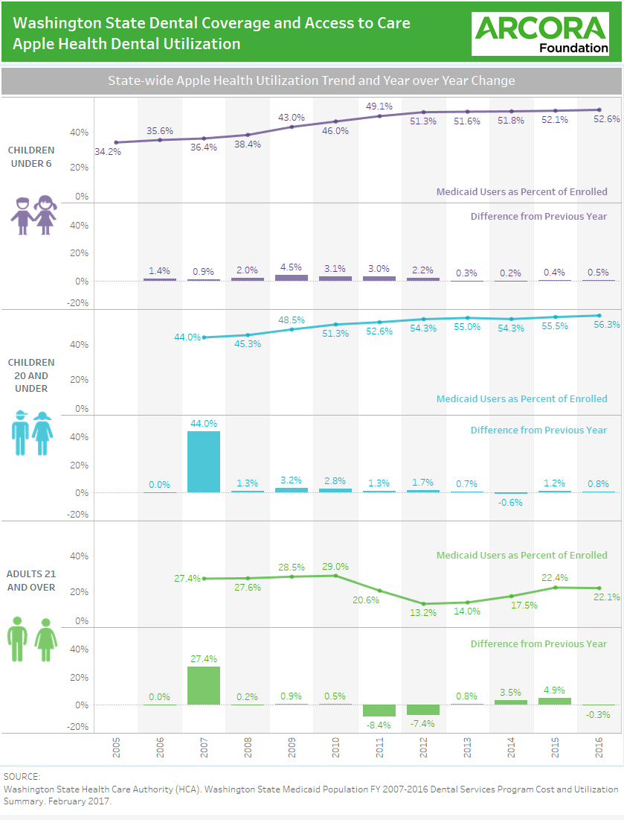
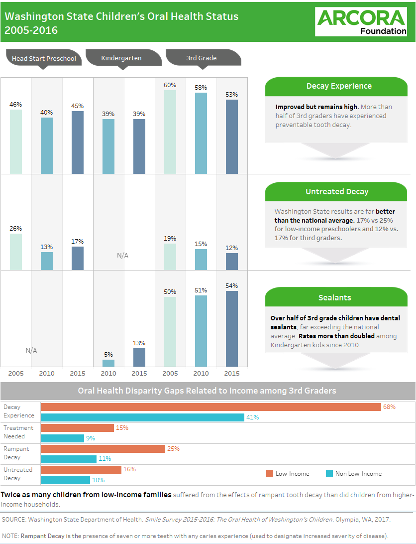
Oral Health Sample Reports
For additional oral health reports in Washington: https://www.arcorafoundation.org/resources/data-reports

Slide 11
Policy Implications: Turning Data into Action
Educate partners, media, and policy-makers
Engage partners, legislative champions
Advocate for policy change to support increased access to oral health care and better overall health for underserved communities
Restoration of the Medicaid Adult Dental Benefit
Oral Health Connections pilot funding

Slide 12
Audiences for our Messages
Partners with and without a specific oral health focus
Media
Legislators and other policy-makers (and their constituents)

Slide 13
Oral Health Connections Pilot: Secured Funding
Pilot to test an enhanced Medicaid dental benefit for pregnant women and people with diabetes
Data Used:
Apple Health Facts & Figures
United Concordia study on claims data
Diverse Advocacy Partners
Earned and Paid Media
Secured funding for the pilot in our state budget approved June 2017

Slide 14
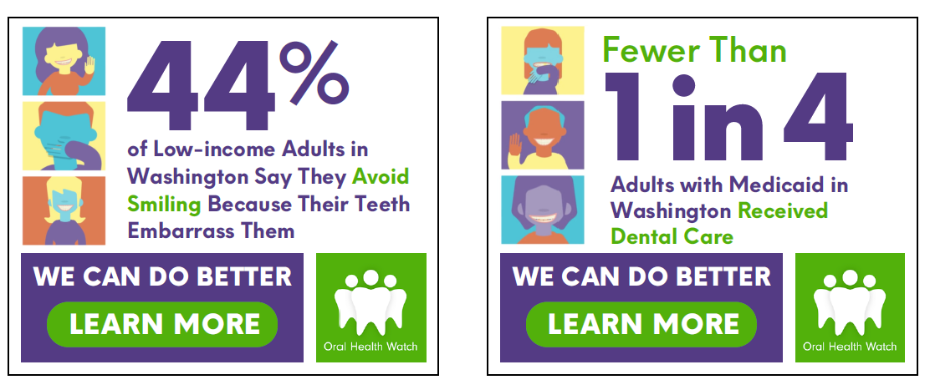
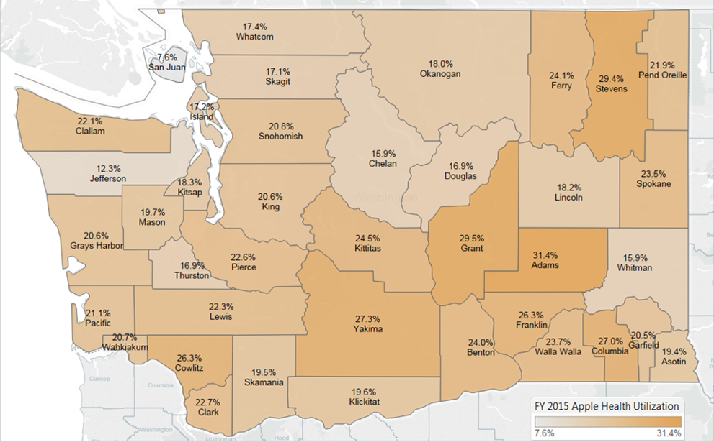
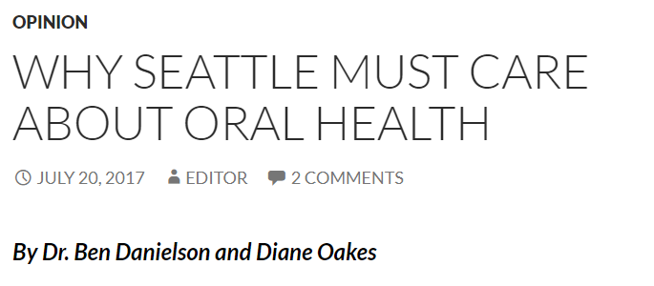
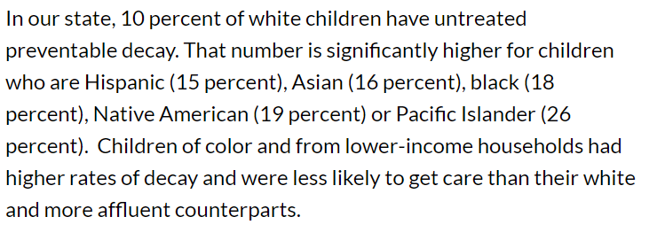
Utilizing Data for Action: Examples
Washington State Apple Health Dental Program Facts and Figures
Adult Enrollees with at Least One Dental Service, by County, FY 2015

Slide 15
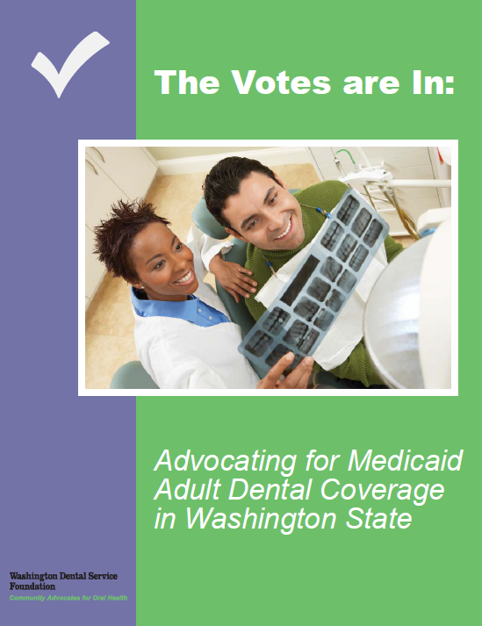
Restoration of the Medicaid Adult Dental Benefit
2013 Legislative Session
Data Used:
Apple Health Facts & Figures
Washington State Hospital Association Study on avoidable ER use
Diverse Advocacy Partners
Paid and Earned Media
Benefit Restored in 2014

Slide 16
Oral Health Connections Pilot: Secured Funding
Pilot to test an enhanced Medicaid dental benefit for pregnant women and people with diabetes
Data Used:
Apple Health Facts & Figures
United Concordia study on claims data
Diverse Advocacy Partners
Earned and Paid Media
Secured funding for the pilot in our state budget approved June 2017

Slide 17
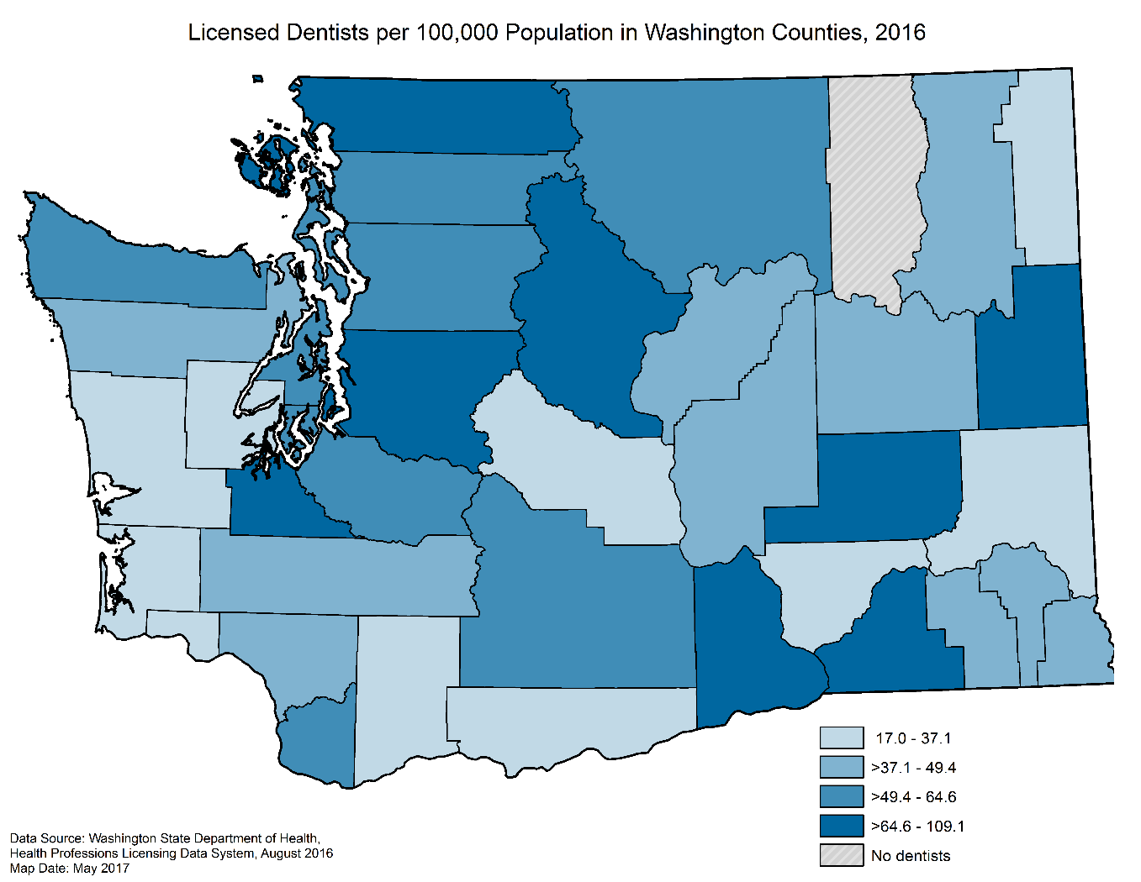
Coming Soon: Updated Washington State Oral Health Workforce Study

Slide 18
Questions

Slide 19
For Additional Information
Alia Katabi
Evaluation and Data Analyst
akatabi@arcorafoundation.org
Phone: (206) 729-5549
Alison Mondi
Policy Analyst
amondi@arcorafoundation.org
Phone: (206) 528-7327

Slide 21
Using Data to Drive Policy Change in Wisconsin
Matt Crespin, MPH, RDH
Associate Director
Children’s Health Alliance of Wisconsin

Slide 22
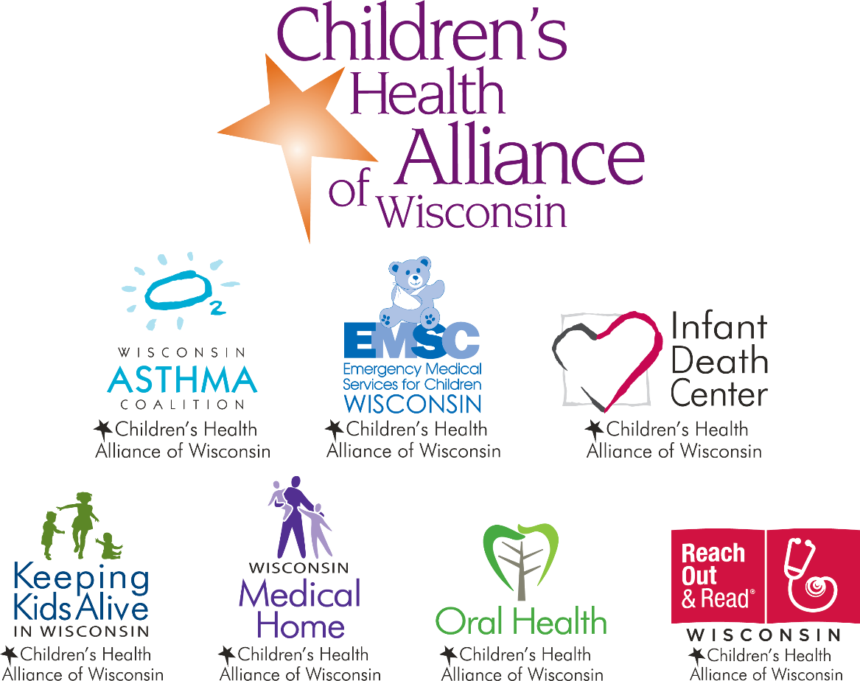

Slide 24
I wear many hats….
American Dental Hygienists’ Association (Vice President)
AAPHD (Council on Legislation)
ASTDD (School and Adolescent Oral Health Committee)
CDHP Sealant Workgroup (chair)
Washington Dental Services Foundation (consultant)
Children’s Health Alliance of Wisconsin
I’m here only as representative of Children’s Health Alliance of Wisconsin and not of any the other organizations I am affiliated with.

Slide 25
Desired outcomes
Understand how data can be used to identify a need for policy change
Understand how data can be used to build broad coalition support
Understand how data can be used to change policy

Slide 26
What success looks like

Slide 27
Supporting Organizations
CHW
CHAW
WOHC
WDA
WDHA
WHA
WPHCA
WI-AAP
WPHA
Delta Dental of WI
Assoc. of Health Insurers
Disability Rights Orgs.
Several Health Systems
and many more…
More than 75 legislators signed on as co-sponsors

Slide 28
Opponents

Slide 29
Background
Settings
Scope
Supervision

Slide 30
This change only addresses
Settings
Scope
Supervision

Slide 31
Initial practice settings
In a dental office.
For a school board, a governing body of a private school, as defined in s. 115.001 (3d), or a governing body of a tribal school, as defined in s. 115.001 (15m).
For a school for the education of dentists or dental hygienists.
For a facility, as defined in s. 50.01 (1m), a hospital, as defined in s. 50.33 (2), a state or federal prison, county jail or other federal, state, county or municipal correctional or detention facility, or a facility established to provide care for terminally ill patients.
For a local health department, as defined in s. 250.01 (4).
For a charitable institution open to the general public or to members of a religious sect or order.
For a nonprofit home health care agency.
For a nonprofit dental care program serving primarily indigent, economically disadvantaged or migrant worker populations.

Slide 32
RDH can practice unsupervised
In a dental office.
For a school board, a governing body of a private school, as defined in s. 115.001 (3d), or a governing body of a tribal school, as defined in s. 115.001 (15m).
For a school for the education of dentists or dental hygienists.
For a facility, as defined in s. 50.01 (1m), a hospital, as defined in s. 50.33 (2), a state or federal prison, county jail or other federal, state, county or municipal correctional or detention facility, or a facility established to provide care for terminally ill patients.
For a local health department, as defined in s. 250.01 (4).
For a charitable institution open to the general public or to members of a religious sect or order.
For a nonprofit home health care agency.
For a nonprofit dental care program serving primarily indigent, economically disadvantaged or migrant worker populations.

Slide 33
Proposed changes
In a dental office.
For a school board, a governing body of a private school, as defined in s. 115.001 (3d), or a governing body of a tribal school, as defined in s. 115.001 (15m).
For a school for the education of dentists or dental hygienists.
For a facility, as defined in s. 50.01 (1m), a hospital, as defined in s. 50.33 (2), a state or federal prison, county jail or other federal, state, county or municipal correctional or detention facility, or a facility established to provide care for terminally ill patients.
For a local health department, as defined in s. 250.01 (4).
For a charitable institution open to the general public or to members of a religious sect or order.
For a nonprofit home health care agency.
For a nonprofit dental care program serving primarily indigent, economically disadvantaged or migrant worker populations.
At a facility, as defined in s. 50.01 (1m), a hospital, as defined in s. 50.33 (2), or a facility that is primarily operated to provide outpatient medical services

Slide 34
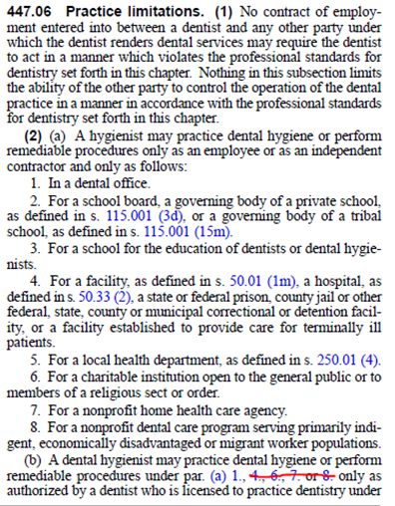
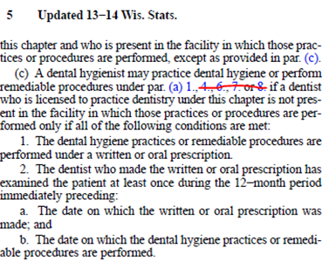
9. Outpatient medical facility

Slide 35
What we can agree on
Dental MA rates are some of the worst in the country.
Access to dental services for MA patients is poor
Dental disease continues to be an issue for young children, adults and the elderly with limited access to dental care
Improvements could be made to improve provider efficiency using existing models

Slide 36
Show me the data
Helps to support a generalized claim
Puts into perspective where you are and what you have/can accomplish
Highlights best practices

Slide 37
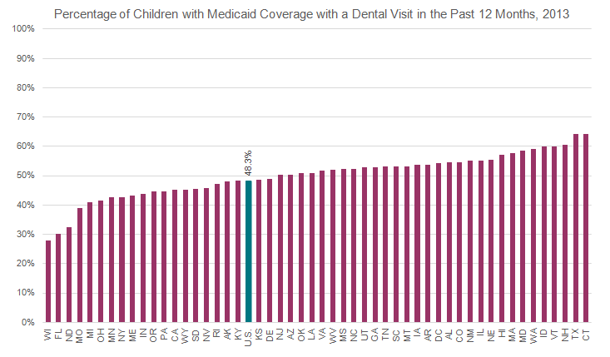
MA access
Source ADA Health Policy Institute

Slide 38
MA enrolled providers
Source: Wisconsin Medicaid Data -2014

Slide 39
Level of participation
Source: Wisconsin Medicaid Data -2014

Slide 40
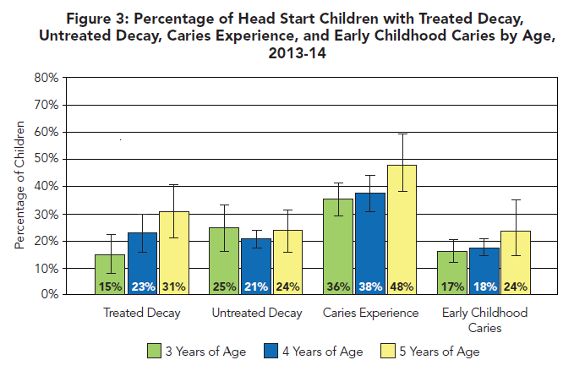
Source: Wisconsin Dept of Health Services - 2017

Slide 41
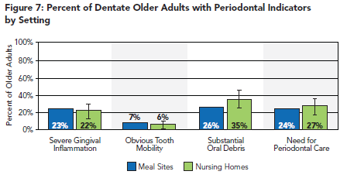
Source: Wisconsin Dept of Health Services - 2013

Slide 42
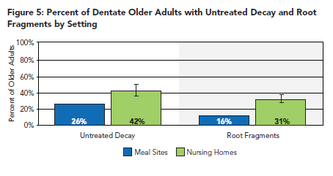
Source: Wisconsin Dept of Health Services - 2013

Slide 43
What we can agree on
Dental MA rates are some of the worst in the country.
Access to dental services for MA patients is poor
Dental disease continues to be an issue for young children, adults and the elderly with limited access to dental care
Improvements could be made to improve provider efficiency using existing models

Slide 44
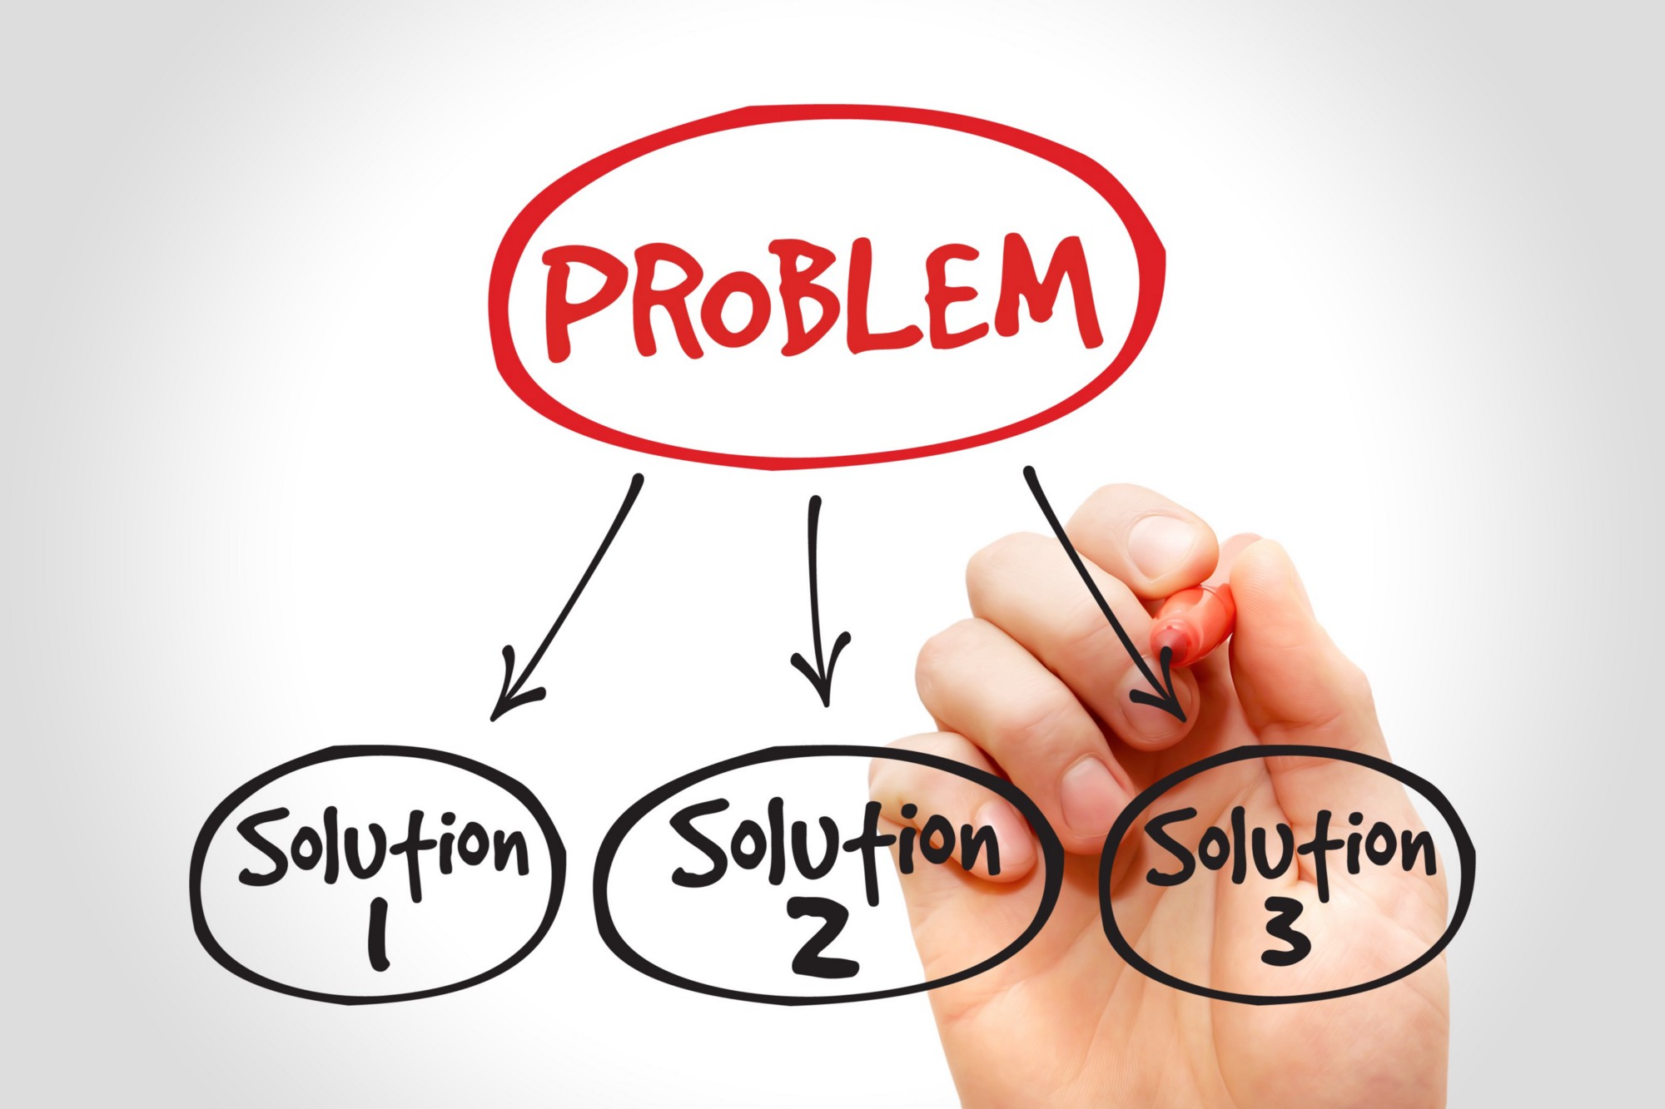

Slide 45
National Governors Association
As states face more demand for oral health, they should examine the role dental hygienists can play in increasing access to care by allowing them to practice to the full extent of their education and training.

Slide 46
Statewide Outcomes – Wisconsin 3rd Graders
Source: Wisconsin Dept of Health Services - 2013

Slide 48
Enhances existing systems
WDA Dental Home Initiative
Increased referrals to establish a dental home
Potential to reduce ECC
Increased medical/dental collaboration
Improves efficiency

Slide 49
MDs ability to provide FVT
NC study showed 17% decrease in referrals with caries when children 6-36 mo receive 4+ FVT
However
Wisconsin data shows fewer than 5% of MA children 12-24 mo received FVT by non-dental provider

Slide 50
Integration effect
Denver Health co-located RDH in pediatric medical office, more than 80% of children 6-36mo received FVT
Other potential integration points exist and improve efficiency.

Slide 51
Current business model
DDS provides exams at a physicians office which allows an RDH to see the patient at the next visit
Cost to provide exams = $750/day (labor and supplies)
MA revenue generated = $320
Lost production from the DDS = $3,700
Total loss of $4,000+ daily using this model or $1.05M annually

Slide 52
Financial viability
RDH integration would generate two billing codes
D0191 (assessment) and D1206 (FVT)
Estimated MA payment = $23/pt
RDH could see 4 pediatric patients/hr = $92
Average cost of consumables = $8/pt
Average cost of labor = $35/hour
ROI = $52K annually

Slide 53
Other potential examples
RDH practicing in pediatric/family physician/OBYGN offices
Nursing home hub and spoke model
RDH practicing in a daycare facility
RDH practicing in other medical settings
RDH practicing in home health care settings

Slide 54
Questions and thank you
Matt Crespin, MPH, RDH
mcespin@chw.org
Follow the Alliance on Facebook and Twitter: chawisconsin

Slide 55
Questions?
If you have a question, please click on the little man with his arm raised icon on either the upper left or the top of your screen. Click on “raise hand.” We will then call on you to ask your question over the phone.

