Slide 1
Strategies to Increase Impact of the Dental Hygienist Liaison
DHL Webinar
Michelle Landrum, R.D.H., M.Ed.
July 28, 2017

Slide 2
General Reminders
This webinar will be recorded and archived on the ASTDD DHL webpage.
Questions will be addressed throughout the webinar. Please click on the icon at the top of your screen that looks like a person with their hand in the air. The moderator will recognize and “un-mute” your phone line to allow you to ask your question.

Slide 3
Objectives
Describe the goal of the DHL project.
Identify and locate key state- and local-level contacts for oral health collaboration.
Implement strategies to build oral health collaboration in Head Start and child care settings throughout the state.
Differentiate between the EPSDT well-child schedule and the dental periodicity schedule.
Differentiate between an oral examination and an oral health screening.
Describe how dental hygienists can assist with monitoring and prevention activities in Head Start and child care settings.
Use NCECHW oral health resources and presentations.
Describe DHLs’ administrative responsibilities.

Slide 4
Overarching Goal of the DHL Project
To improve the oral health of pregnant women and children by providing a dental hygienist liaison (DHL) in each state to serve as a communication link between NCECHW, state-level stakeholders, and early childhood education (ECE) programs.
Primary target audience is ECE staff
State-level ECE stakeholders
HS regional health specialists
Health managers
Center directors
Home visitors

Slide 5
Strategies for Collaboration

Slide 6
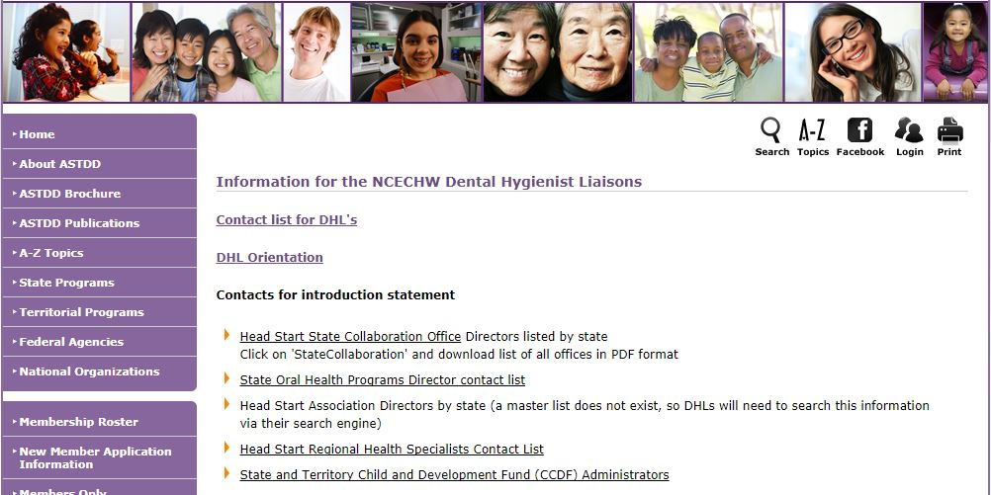
How to Connect with State-Level Contacts
The NCECHW DHL webpage provides stakeholder contact information.
Notes:
To increase visibility with ECE programs throughout the state, the DHL can connect and build relationships with key state-level stakeholders. These stakeholders can help share information and connect the DHL to local programs.

Slide 7
Key State-Level Contacts
Head Start State Collaboration Office Director
May provide a distribution list of Early Head Start/Head Start (EHS/HS) programs in the state
May contact DHL when an EHS/HS program has an oral health question or request
State Head Start Association Director
Convenes annual state conference, and may invite DHL to present
May share a distribution list of EHS/HS programs in the state
State Oral Health Coalition
Can assist with partnerships, resources and advocacy throughout the state

Slide 8
Key State-Level Contacts (Cont’d)
HS Regional Health Specialist
May contact DHL when a program has an oral health question or request
State Child Care and Development Fund Administrator(s)
May be able to link DHL to child care health consultants in the state
May invite DHL to present at state-level conferences
State Oral Health Program Director
May identify resources related to state’s oral health policies and systems to access oral health care

Slide 9
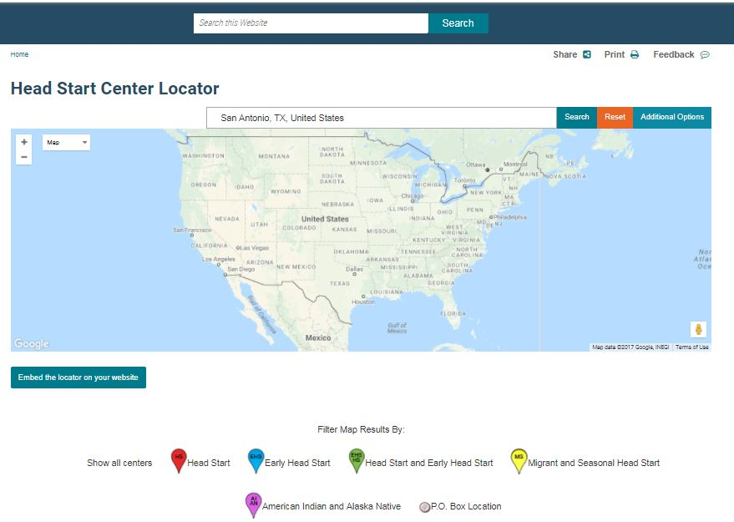
Key Local-Level Contacts
EHS/HS Program Directors and Health Managers
DHL webpage has link to EHS/HS Locator
Child Care Health Consultants

Slide 10
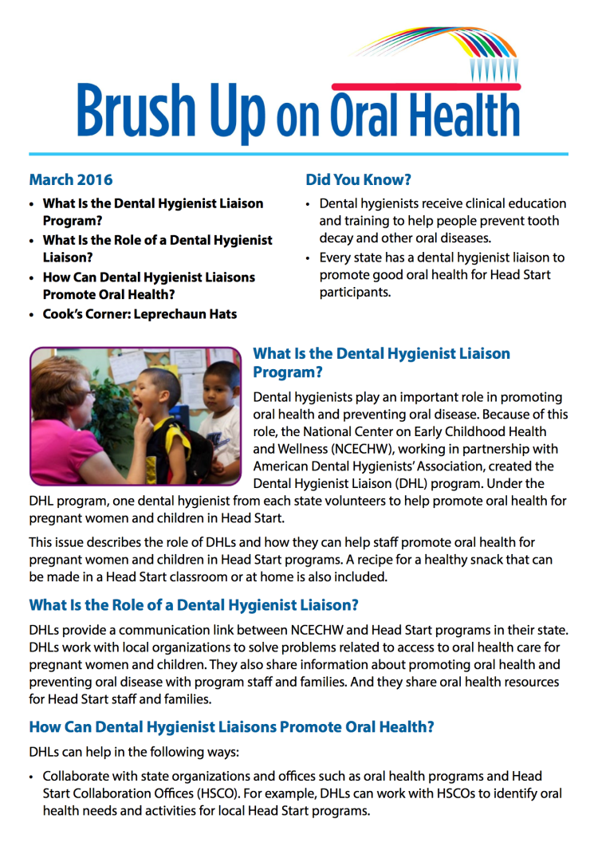
Building Relationships and Working in Collaboration
E-mail letter of introduction.
Attach Brush Up on Oral Health, March 2016
Forward Brush Up on Oral Health each month.
Forward NCECHW oral health-related announcements and new resources.
Submit articles for newsletters.

Slide 11
Building Relationships and Working in Collaboration (Cont’d)
Present (or coordinate a presentation) at state and/or local EHS/HS and child care-related meetings, as requested (reviewed in later slides).
Attend state and/or local EHS/HS and child care-related meetings (e.g., state HS association conference, local HS health services advisory meeting).
Learn individual program’s oral health needs and priorities before providing information and assistance.
Offer strategies to EHS/HS staff to help pregnant women and children access oral health care.

Slide 12
Head Start Program Performance Standards: EPSDT Dental Periodicity Schedule, Oral Examinations, and Monitoring and Prevention

Slide 13
HS Program Performance Standard 1302.42(b)(1)(i)
The revised standard indicate well-child visits and dental periodicity schedules.
Within 90 days calendar days after the child first attends the program or, for the home-based program option, received a home visit,… the program must “obtain determination from health care and oral health care professional as to whether or not the child is up-to-date on a schedule of age-appropriate preventive and primary medical and oral health care, based on the well-child visits and dental periodicity schedules as prescribed by the Early and Periodic Screening, Diagnosis, and Treatment (EPSDT) program of the Medicaid agency.”
Notes:
Rationale: To clarify that programs must determine whether or not the child is up to date on a schedule of both medical and oral health care.

Slide 14
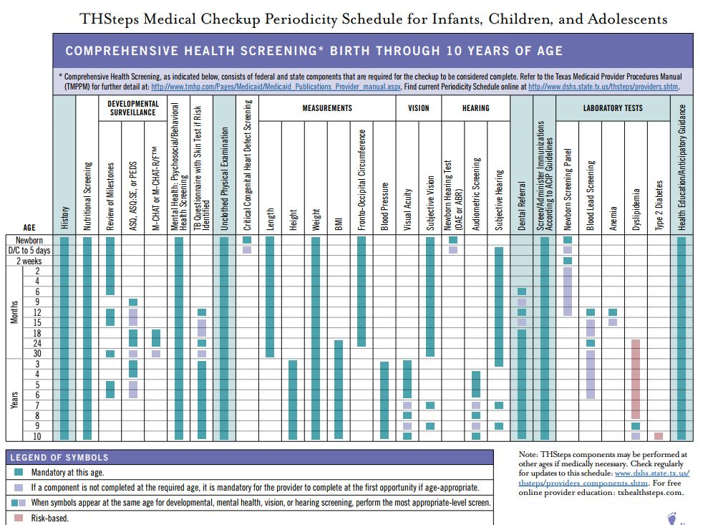
EPSDT Well Child Periodicity Schedule
The well-child periodicity schedule is for medical visits (checkups).
The well-child visit is performed by a primary care health professional (pediatrician, nurse practitioner, physician assistant).
Texas EPSDT Well-Child Periodicity Schedule

Slide 15
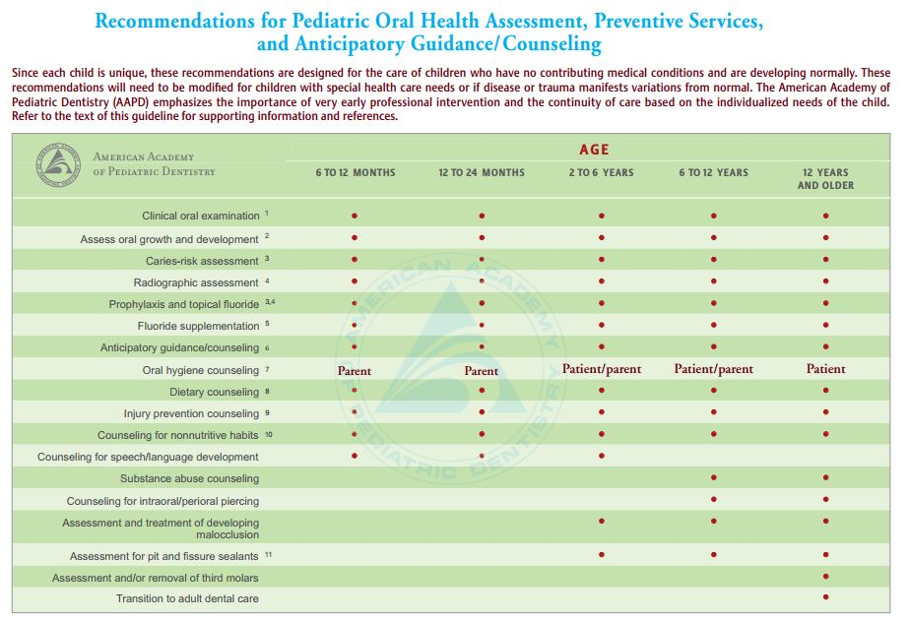
EPSDT Dental Periodicity Schedule
The dental periodicity schedule is for dental visits.
Performed by an oral health professional (see next slide).
Most states follow the American Academy of Pediatric Dentistry’s dental periodicity schedule, but some states have developed their own EPSDT dental periodicity schedules.

Slide 16
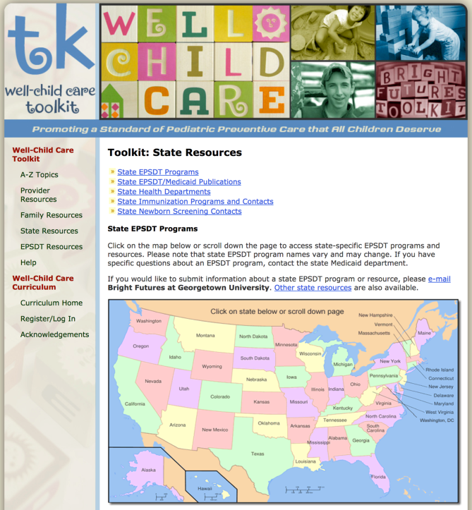
Oral Exam
Who can perform the clinical oral exam to meet EPSDT requirements?
Determined by each state’s Board of Dental Examiners and defined in the state’s dental practice act
In most states, a dentist must perform the oral exam. A dental therapist is able to perform an exam in ME, MN, and VT and in Indian country in AK, OR, and WA.
Link to EPSDT well-child and dental periodicity schedules by state: https://www.brightfutures.org/wellchildcare/toolkit/
states.html (link also found on the DHL webpage)

Slide 17
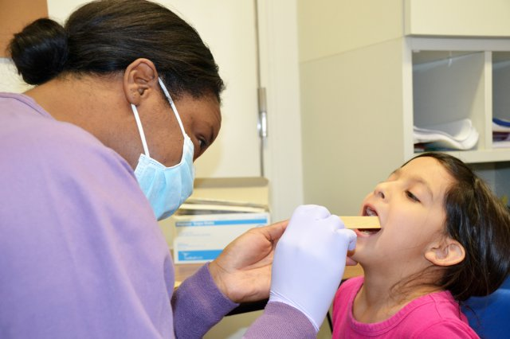
Oral Health Screening
There are no HS program performance standards that refer to an oral health (or dental) screening.
The only time a dental screening applies is if a state’s EPSDT dental periodicity schedule indicates an oral health screening before a child reaches a certain age (e.g., age 24 or 36 months)
The majority of states require an oral exam by age 12 months

Slide 18
Dental Hygienists Can Assist with Monitoring and Prevention
HS program performance standard 1302.42(c)(2) states: “A program must implement periodic observations or other appropriate strategies for program staff and parents to identify any new or recurring developmental, medical, oral, or mental health concerns.”
HS program performance standard 1302.42(c)(3) states: “A program must facilitate and monitor necessary oral health preventive care, treatment and follow-up, including topical fluoride treatments.”

Slide 19
Utilizing NCECHW Oral Health Resources and Presentations

Slide 20
NCECHW Oral Health Resources and Presentations
Guidelines
Having consistent messaging and sharing current, evidence-based, or evidence-informed information is extremely important to NCECHW
NCECHW asks that DHLs share only approved resources and use only approved presentations

Slide 21
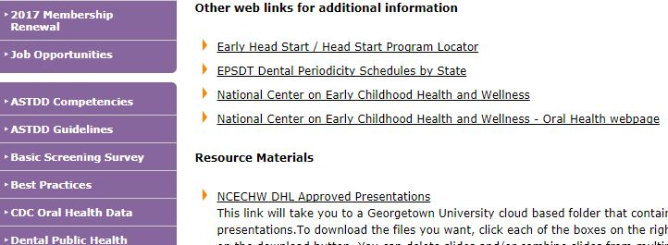
NCECHW Oral Health Resources and Presentations (Cont’d)
Approved resources can be found on the ECKLC oral health webpages (link on DHL webpage)
A link to the Dropbox folder for the approved presentations can be found on the DHL webpage

Slide 22
The DHL’s Administrative Responsibilities

Slide 23
Minimum Requirements for DHLs
Member of the American Dental Hygienists’ Association
Respond to NCECHW oral health-related requests in a timely manner
View DHL webinars
Webinars are archived on the DHL webpage or DHLs unable to attend live webcasts
Submit quarterly reports (see next slide)
Submit DHL stipend request- highly recommended but not required (see next slide)
Notes:
Notes:
The DHL does not have to fulfill all requests personally; however, it the DHL’s responsibility to connect the requestor to dental professionals and/or resources to ensure their needs are met.

Slide 24
Important Forms on DHL Webpage
DHL Quarterly Report of Activities Form
Extremely important to submit a report each quarter
Due by January 7, April 7, July 7, and October 7 each year
DHL Expense Reimbursement Form
Use for state, regional, or national meetings or presentations
DHL Meeting Report Form
Use for state, regional, or national meetings or presentations

Slide 25
Important Forms on DHL Webpage (Cont’d)
DHL Annual Stipend Request Form
$590 annual stipend (October – September)
Submit once you complete 1 activity in 2 of these categories
Stipends can be used to assist with:
Local travel or supplies to serve programs
Educational resources or oral health supplies for programs
Supplement travel expenses to a professional meeting (e.g., ADHA session, NOHC)
ADHA dues

Slide 26
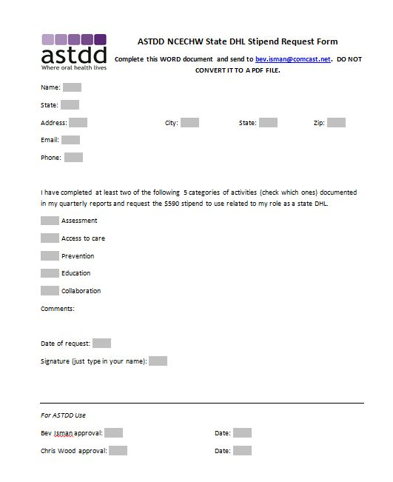
DHL Stipend Request Form
Email the request form to bev.isman@comcast.net as a Word document (not PDF)
Type “DHL stipend request- your name” in the subject line
Notes:
Email the request form to bev.isman@comcast.net as a Word document (not a PDF)
Type “DHL stipend request- your name” in the subject line

Slide 27
Contact Information
DHL Project Lead:
Michelle Landrum
E-mail: michellelandrum@yahoo.com
National Center on Early Childhood Health and Wellness
Phone: (866) 763-6481
E-mail: HeadStart@eclkc.info
Website: https://eclkc.ohs.acf.hhs.gov/health

Slide 28
Questions?
Click on the icon at the top of your screen that looks like a person with their hand in the air.
The moderator will recognize and “un-mute” you so you can ask your question.

