Slide 1
Spotlight

Slide 2
Don’t Bury the Lede
Matt Jacob and John Welby

Slide 3
Lead vs. Lede

Slide 4
Get to the point!

Slide 5
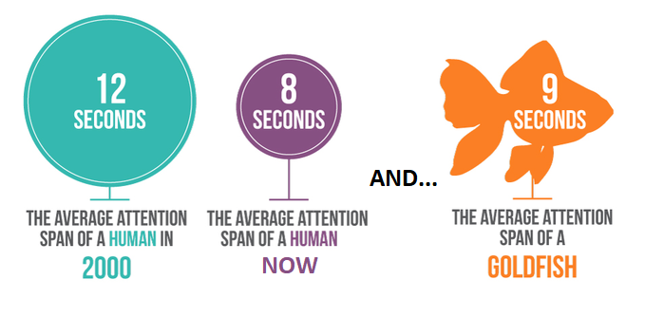
Our Attention Span is Dwindling

Slide 6
The lede is the heart of the story

Slide 7
A good lede covers the key points

Slide 8
A good lede is easy to understand
Short
Simple
Direct
Clear

Slide 9
A good lede should reach and be aligned with the target audience
Who is the target audience(s) for your content? (Age? Gender? Parental status? Geographic area? etc.)
What about this news or event is likely to interest them?
How much do they already know about this topic?

Slide 10
Maryland launches dental health campaign for Latinas
BALTIMORE, MD (September 30, 2014) – While doctor visits are top of mind for pregnant women, visits to the dentist are often neglected. A recent study finds that more than half (56%) of U.S. women did not visit a dentist during pregnancy. Moreover, 40 percent of pregnant women have some form of gum disease which has been linked to diabetes and heart disease. While experts agree that it's safe for pregnant women to receive dental care, a recent survey revealed that only 42% of women know that receiving dental care during pregnancy is safe.
Low income and minority women, primarily Hispanic, are disproportionately affected by poor oral health. When compared with other ethnicities in Maryland, Hispanic women rank lowest when asked if they knew that it was important to care for their mouth during pregnancy.
In an effort to improve upon these disproportionate findings, the Maryland Office of Oral Health, (OOH) is conducting a social marketing campaign to educate Latinas about the importance of oral health during pregnancy. The campaign will communicate that it is important and safe to visit a dentist during pregnancy and that dental care for pregnant women in Maryland is covered by Medicaid.

Slide 11
Maryland launches dental health campaign for Latinas
BALTIMORE, MD (September 30, 2014) – While doctor visits are top of mind for pregnant women, visits to the dentist are often neglected. A recent study finds that more than half (56%) of U.S. women did not visit a dentist during pregnancy. Moreover, 40 percent of pregnant women have some form of gum disease which has been linked to diabetes and heart disease. While experts agree that it's safe for pregnant women to receive dental care, a recent survey revealed that only 42% of women know that receiving dental care during pregnancy is safe.
Low income and minority women, primarily Hispanic, are disproportionately affected by poor oral health. When compared with other ethnicities in Maryland, Hispanic women rank lowest when asked if they knew that it was important to care for their mouth during pregnancy.
In an effort to improve upon these disproportionate findings, the Maryland Office of Oral Health, (OOH) is conducting a social marketing campaign to educate Latinas about the importance of oral health during pregnancy. The campaign will communicate that it is important and safe to visit a dentist during pregnancy and that dental care for pregnant women in Maryland is covered by Medicaid.

Slide 12
Maryland launches dental health campaign for Latinas
BALTIMORE, MD (September 30, 2014) – Today, the Maryland Office of Oral Health, (OOH) announced that it is conducting a social marketing campaign to educate Latinas about the importance of oral health during pregnancy. The campaign will communicate that it is important and safe to visit a dentist during pregnancy and that dental care for pregnant women in Maryland is covered by Medicaid.
While doctor visits are top of mind for pregnant women, visits to the dentist are often neglected. A recent study finds that more than half (56%) of U.S. women did not visit a dentist during pregnancy. Moreover, low income and minority women, primarily Hispanic, are disproportionately affected by poor oral health. When compared with other ethnicities in Maryland, Hispanic women rank lowest when asked if they knew that it was important to care for their mouth during pregnancy.
While experts agree that it's safe for pregnant women to receive dental care, a recent survey revealed that only 42% of women know that receiving dental care during pregnancy is safe.

Slide 13
Example 2: Burying the Lede
Coverage Counts
Today, federal Medicaid officials released the July 2021 monthly report on state Medicaid and Children’s Health Insurance (CHIP) enrollment data. These data reflect a range of indicators related to application, eligibility and enrollment processes. The new July 2021 report shows Medicaid and CHIP enrollment trends from August 2020 to July 2021.

Slide 14
Example 2: Burying the Lede
Coverage Counts
Today, new federal Medicaid report shows that enrollment in state Medicaid and Children’s Health Insurance (CHIP) programs rose by 17% over the past 14 months. Over this period, more than 12 million Americans enrolled —
a trend that officials attribute mostly to the impact of the COVID-19 pandemic.

Slide 15
Why do we bury the lede?

Slide 16
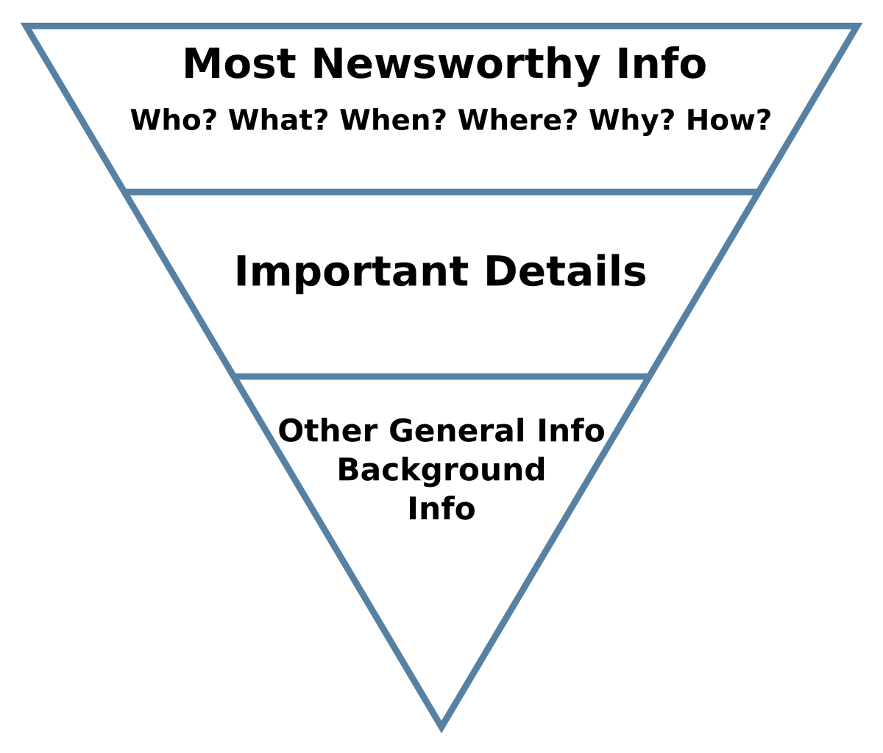
Inverted Pyramid

Slide 17
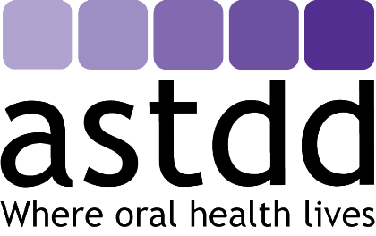

Slide 18
References
https://www.elegantthemes.com/blog/marketing/how-not-to-bury-the-lede-in-your-online-content
https://www.wyzowl.com/human-attention-span/#:~:text=According%20to%20research%2C%20our%20attention,or%20object%20for%209%20seconds
https://www.tempestamedia.com/2020/10/01/the-value-of-a-lede-oriented-to-your-target-audience/
https://www.elegantthemes.com/blog/marketing/how-not-to-bury-the-lede-in-your-online-content
https://slideplayer.com/slide/4955305/
https://www.textcrunch.sg/copywriting-5-rules-for-keeping-it-simple/
https://www.textcrunch.sg/

