Slide 1

Louisa Santos, BDS
National Oral Health Conference, Memphis, Tennessee
April 15, 2019
reikomega15@yahoo.com

Slide 2

ORAL HEALTH
A WINDOW TO OUR OVERALL HEALTH
“YOUR HEALTH BEGINS WITH YOU AND ENDS WITH YOU”!!!!

Slide 3

PBDA Objectives
To promote and support continuing education and human resource development in oral health
To promote and support oral and related health initiatives in the region
Strengthen capacity and infrastructure of dental programs in the Pacific
Encourage exchange of information between dental and health care professionals, individuals, groups and supporting organizations in the region and Pacific.

Slide 4
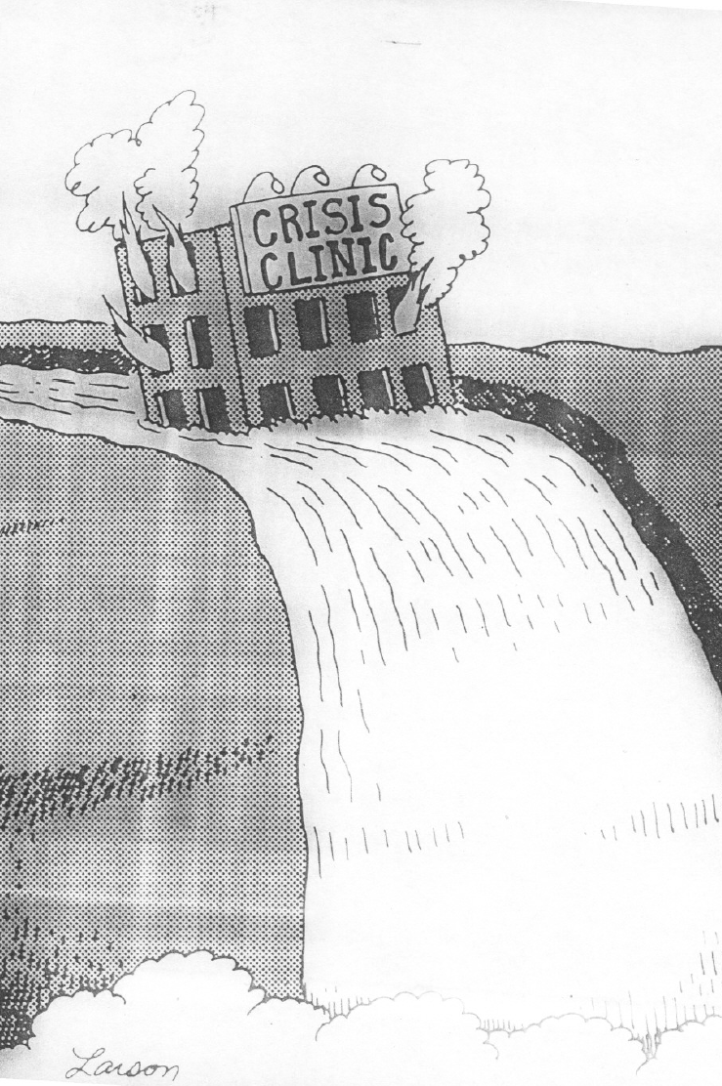
Human Resources for Health Challenges
1. Absolute shortages of trained health oral health professionals
2. Many of the current health workforce are under-trained
3. The educational systems charged with educating students to qualify for science-based health careers programs share the same problems as problems as the health sector
Notes:
Students are not entering health careers programs because they are not prepared. The few that do get scholarships to Fiji or other places often fail the basic sciences. We need to work on a multilevel solution: elementary and high schools and local community colleges to develop study skills, and math and science skills.

Slide 6
Dental Assistant Training in American Samoa – A Model for the Region
http://courses.polhncourses.org/course/category.php?id=39
Through this pilot program, POLHN is sponsoring 13 dental assistants in American Samoa to take Penn Foster Career School's Dental Assistant Diploma. While the Diploma can be delivered entirely online, through POLHN the dental assistants will also undergo in-country, face-to-face skills validation. The dental assistants will be actively supported through their studies by their supervisors and the POLHN Secretariat. The aim of the pilot is to assess the curriculum's appropriateness and relevance to Pacific contexts. The pilot is also part of POLHN's transition from focusing on online learning to a blended learning approach.
This pilot commenced in May 2013 and is due to conclude in April 2014.

Slide 7
PBDA SUCCES STORY AND ACHIEVEMENTS
  Oral Health continuing Education on Dentalcare.com
  Penn Foster training Program (American Samoa)
  Dental Hygienist Training Program (Palau)
  PBDA – member of the Medical Society
  EDDA TRAINING IN FSM (YAP AND POHNPEI)

Slide 8
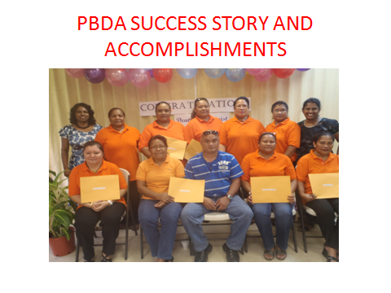

Slide 9
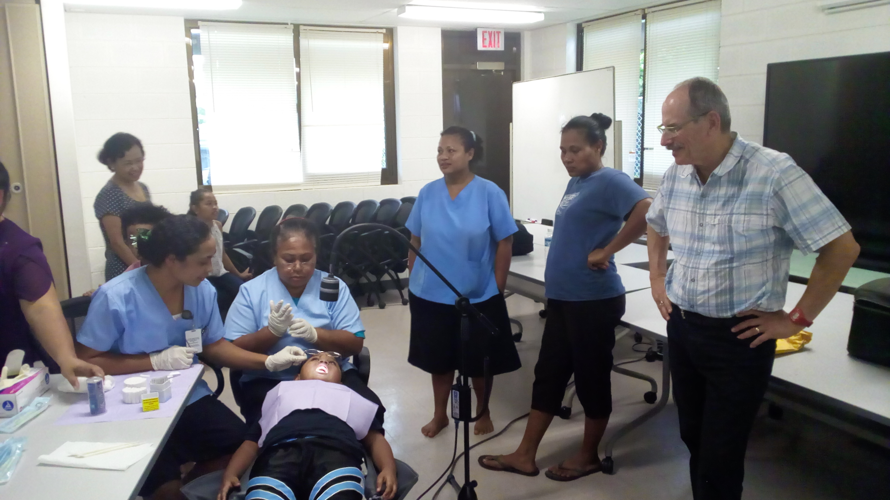
Notes:
EDDA Training in FSM.

Slide 10
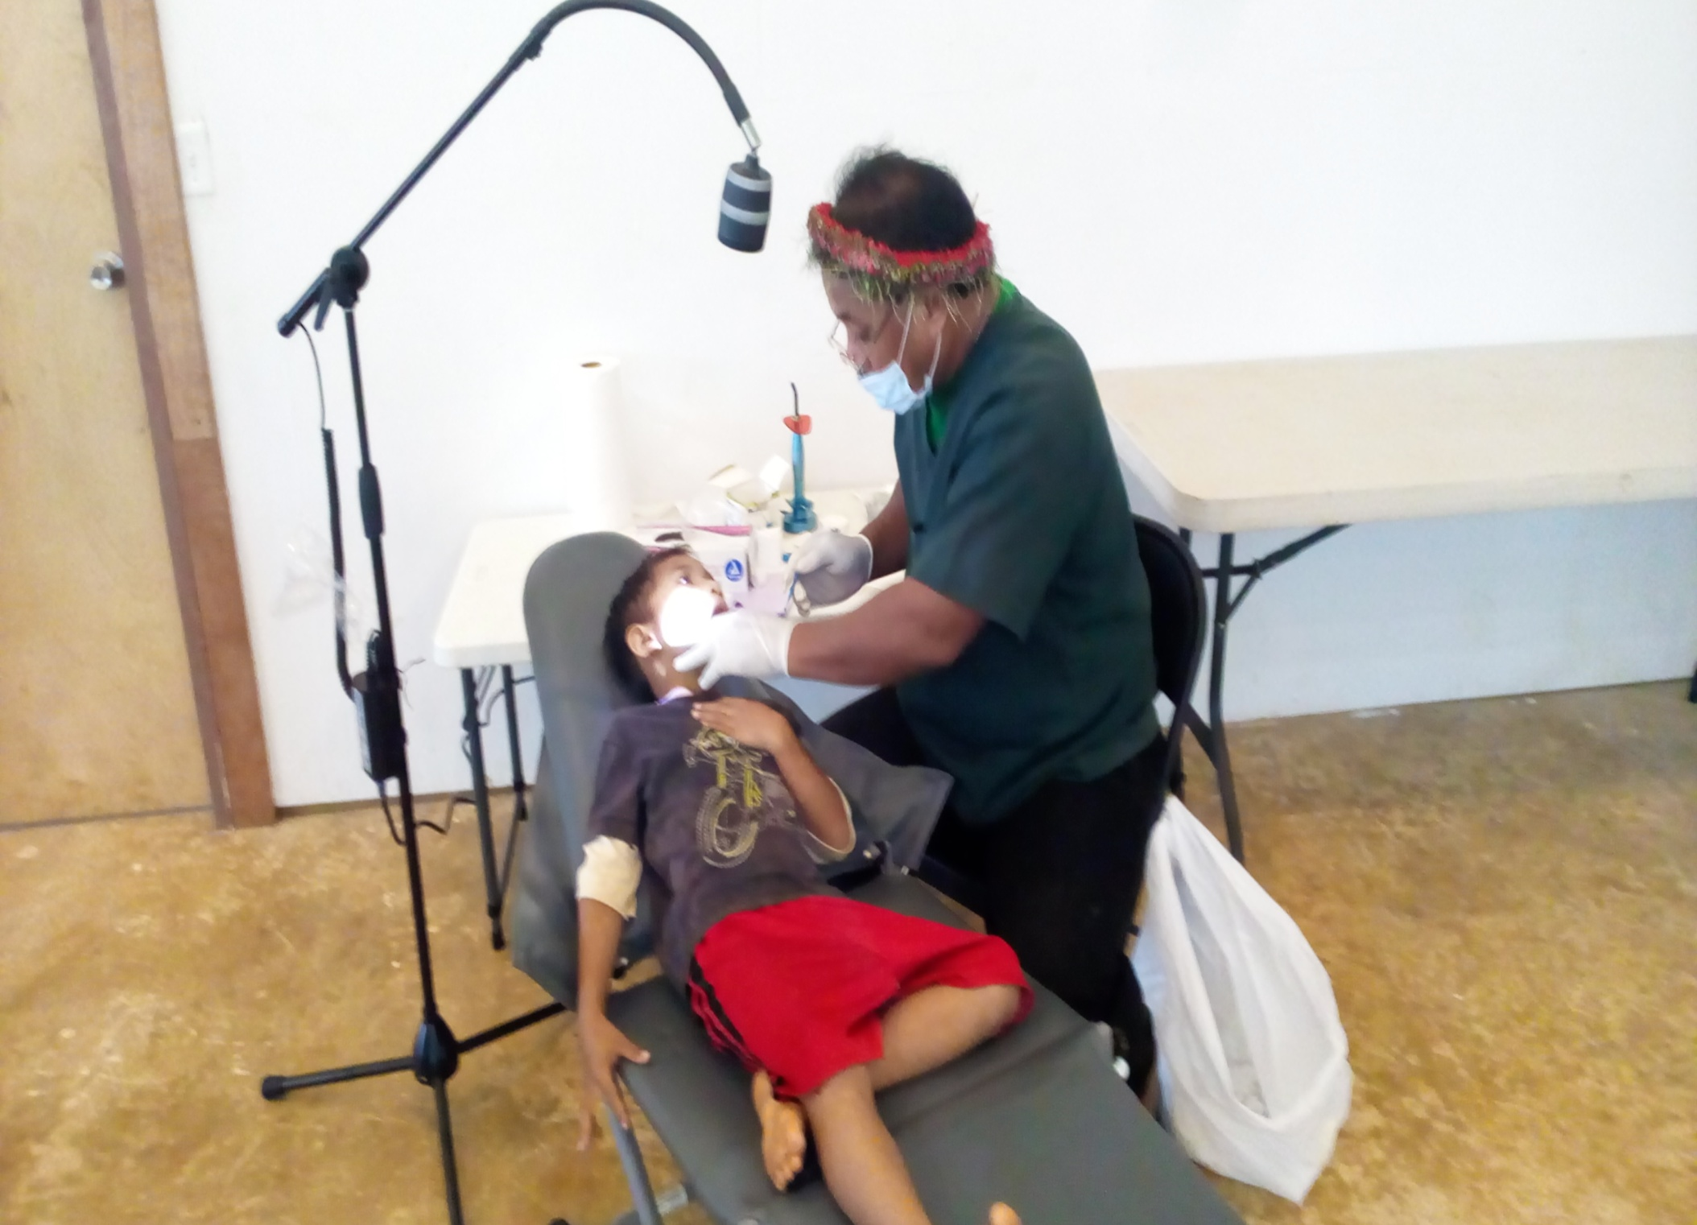

Slide 11
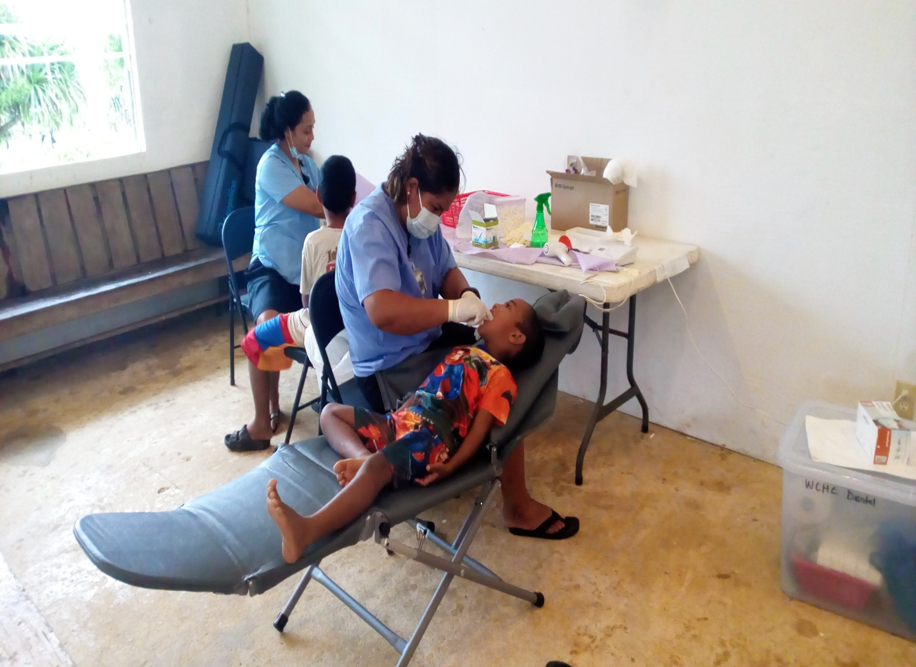

Slide 12
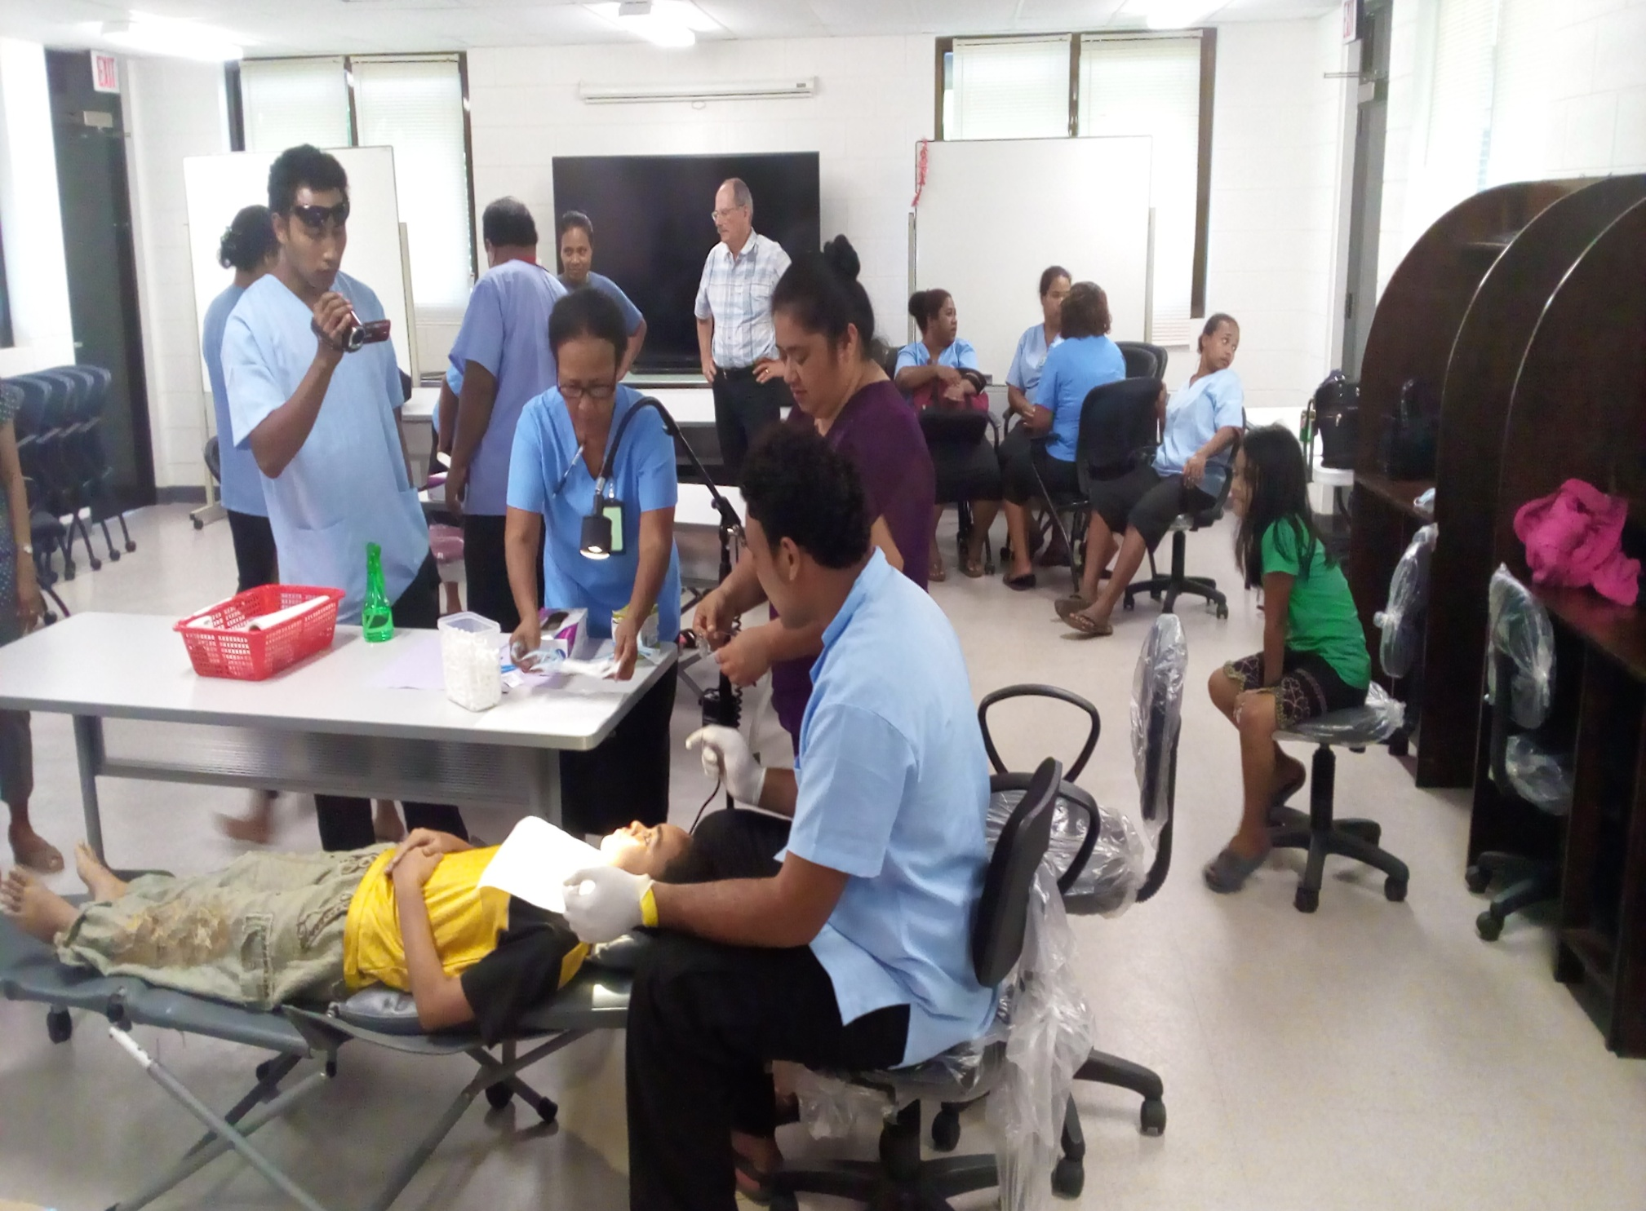

Slide 13
PBDA CHALLENGES
1. NO FUNDING
2.ORAL HEALTH WORKFORCE (DECREASING)
3. LACK OF CONTINUING EDUCATION
4. CLOSE COLLABORATION WITH OTHER HEALTH PROGRAMS.
5. LACK OF GOOD COMMUNICATIONS WITH MEMBERS OF ASSOCIATION.

Slide 14
RECOMMENDATIONS
ORAL HEALTH AS #1 PRIORITY in Health
FUNDING TO HIRE AND TRAIN AND SEND TO FNU
IMPROVE SALARY
SUPPORT PBDA’s ANNUAL MEETING AND GROW AS A VITAL ORAL HEALTH FOCUSED ORGANIZATION

Slide 15
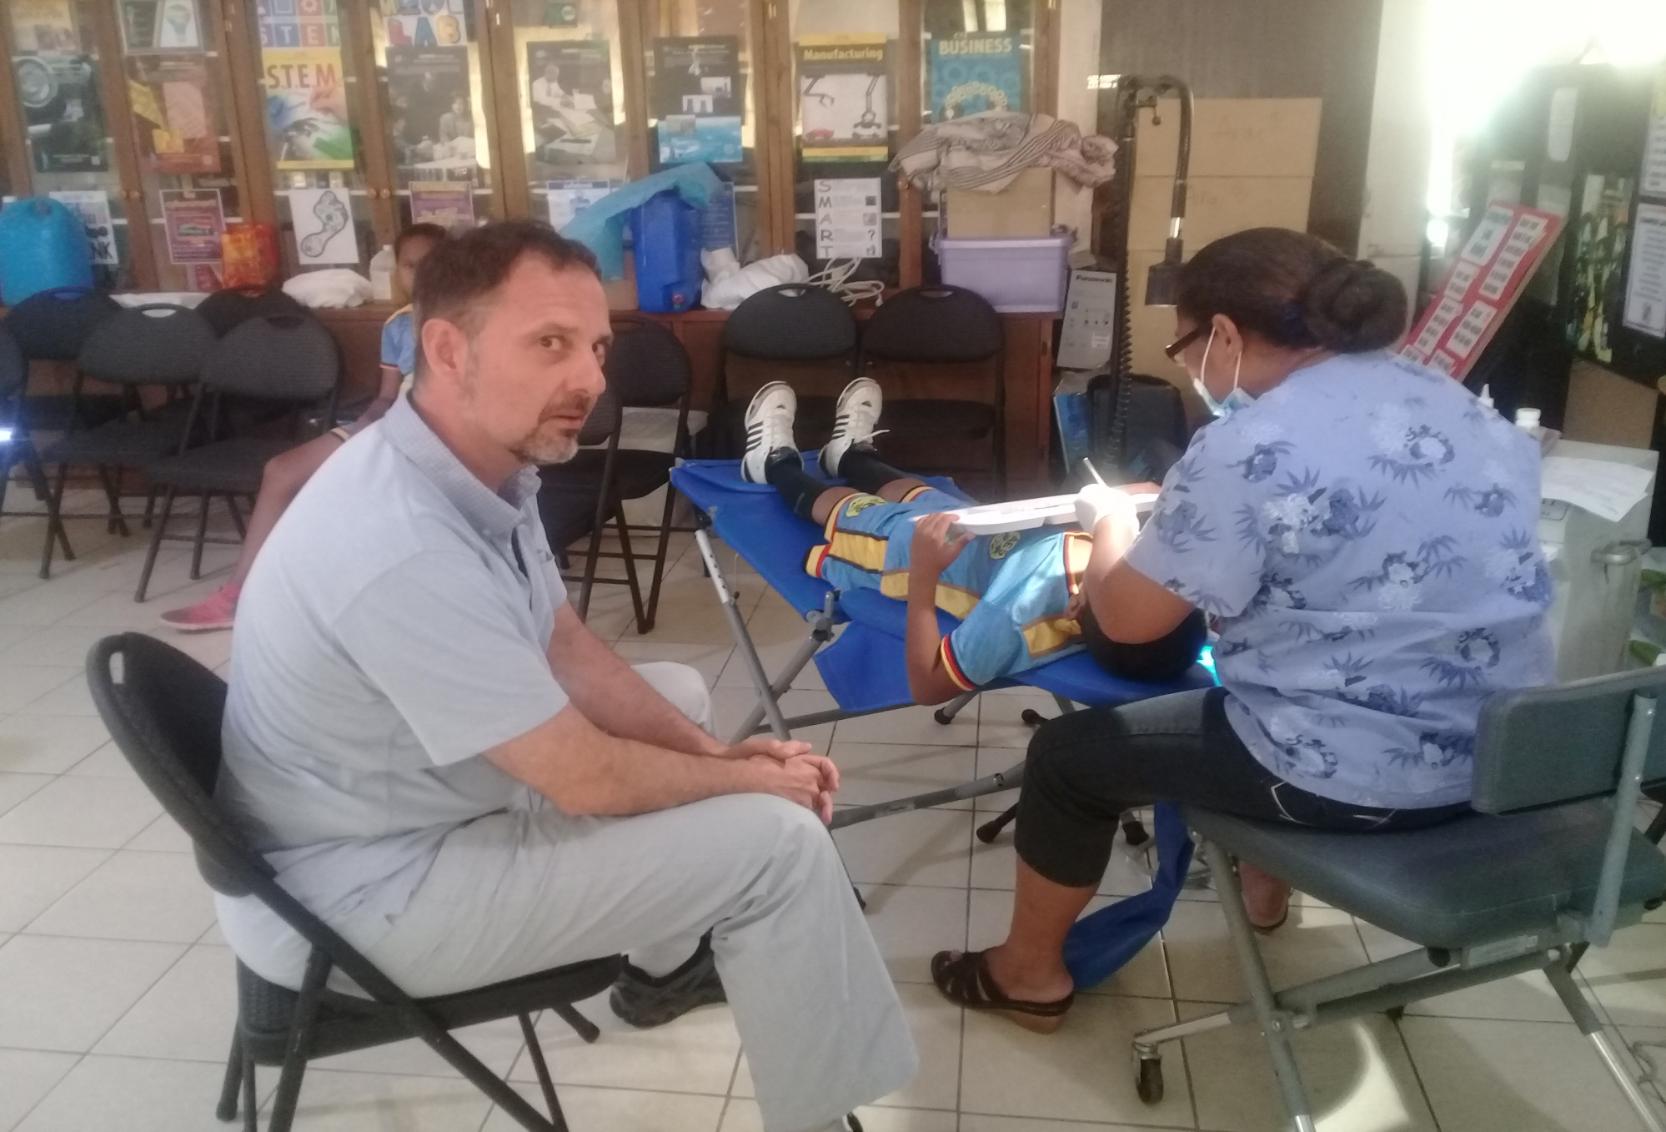

Slide 16
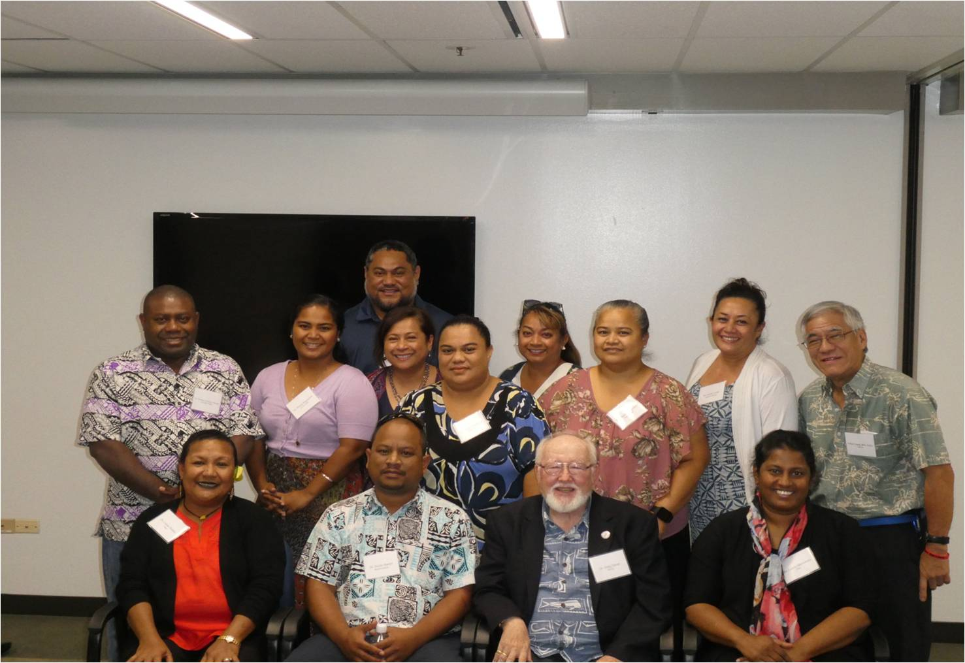
THANK YOU VERY MUCH

