Slide 1
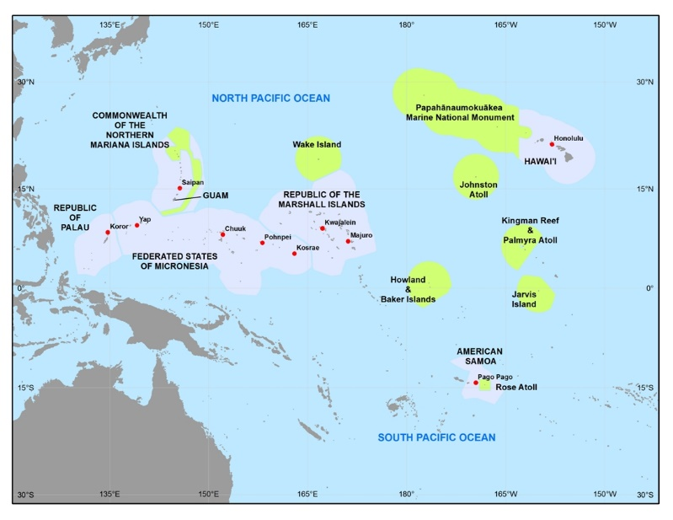
Oral Health Workforce in the USAPI
Angelica Sabino, DDS
National Oral Health Conference
Memphis, Tennessee
April 15, 2019

Slide 2
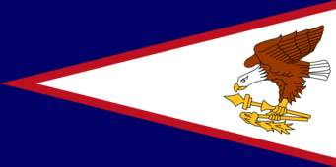
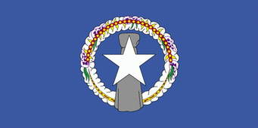
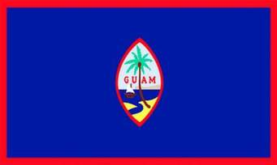
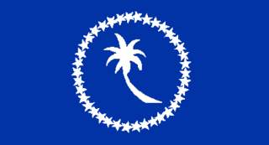

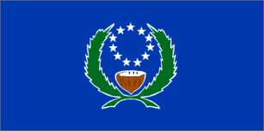

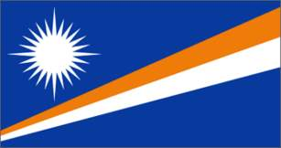
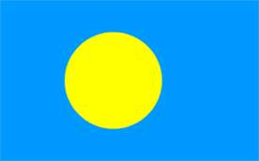
USAPI: United States Affiliated Pacific Islands (9)
1. American Samoa (US Commonwealth)
2. Commonwealth of the Northern Marianas (CNMI)
3. Guam (US Territory)
4. Federated States of Micronesia (Free Association with US)
  Chuuk State
  Kosrae State
  Pohnpei State
  Yap State
5. Republic of Marshall Islands (RMI)
6. Republic of Palau (ROP)

Slide 3
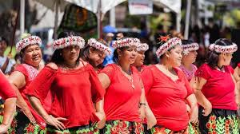
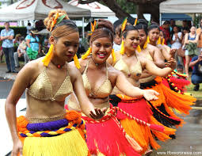
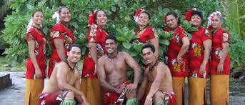
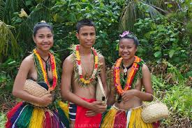
The United States Affiliated Pacific Islands (USAPI) are islands scattered across the vast Pacific Ocean spanning several million square miles; sharing similarity in socio-economic environment, culture, history and dependence on outside financial sources. However, they each have unique needs and challenges specific to their island.
The limited education, human resource development, physical isolation of the islands contributes to the large health disparity among the USAPI. The political affiliation of these islands to the United States allows for economic support and dependency on the United States to narrow the health disparities.

Slide 4
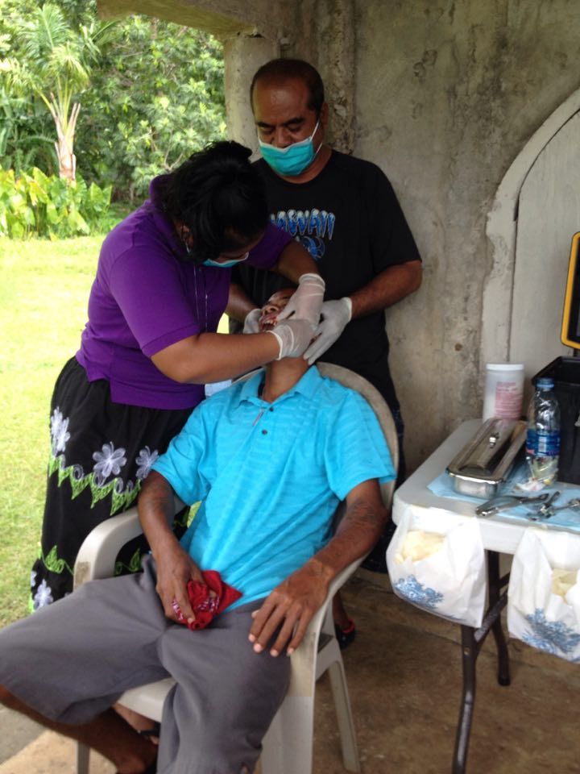
USAPI Workforce
Oral health workforce in the USAPI consists predominately of public health dentists, dental hygienists, dental nurses, expanded duty dental assistants, dental assistants and lab technicians.
In some islands like American Samoa, the public health dental clinic is situated in 2 distinct areas: the hospital and community health center and the workforce work independently of each other to help provide dental care to the whole community. However, this scenario causes the lack of unified data collection and surveillance.

Slide 5
Oral Health Workforce – one of many reasons of the health disparity in the USAPI
Number of workforce needed to care for a vast number of islands
  Islands scattered across the Pacific Ocean
    Usage of motorized boats
    Usage of small propelled aircrafts
Education limitation to create a healthy workforce
  In CNMI – board licensure requirements for a US educated dentist and hygienist.
Economic limitation to educate a workforce
  Scholarships needed to educate abroad
    US for CNMI
Increase in socio-economically poor population demands a larger public health workforce
Low wages for oral health workforce in economically poor island nations

Slide 6
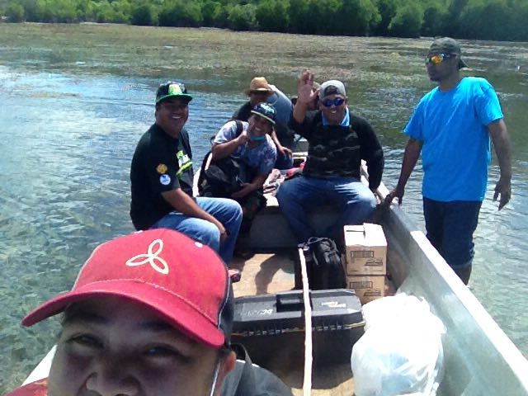
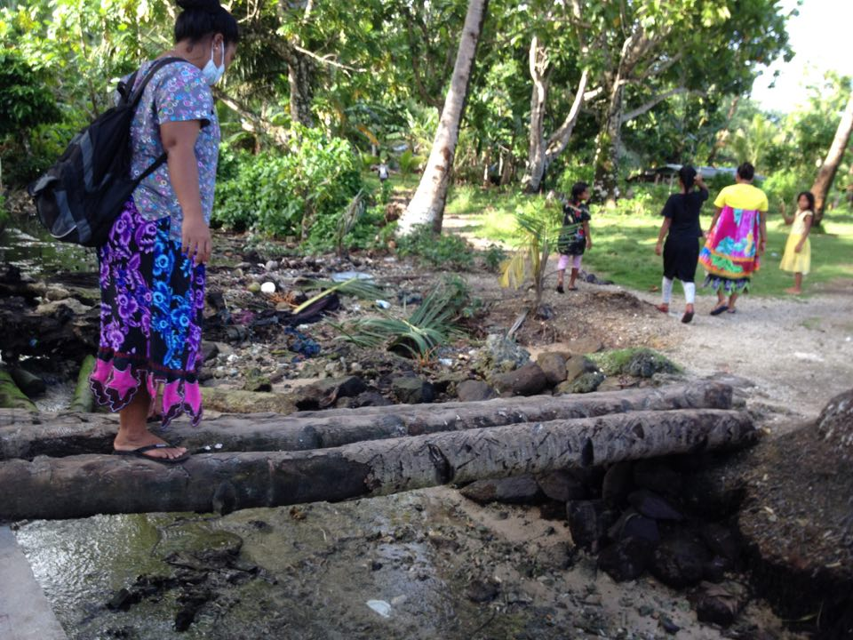
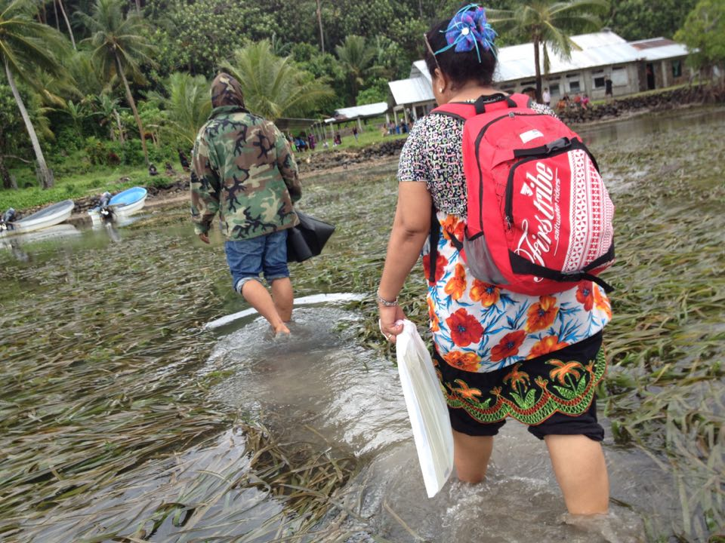
USAPI oral health workforce travel to outlaying islands to provide dental care

Slide 7
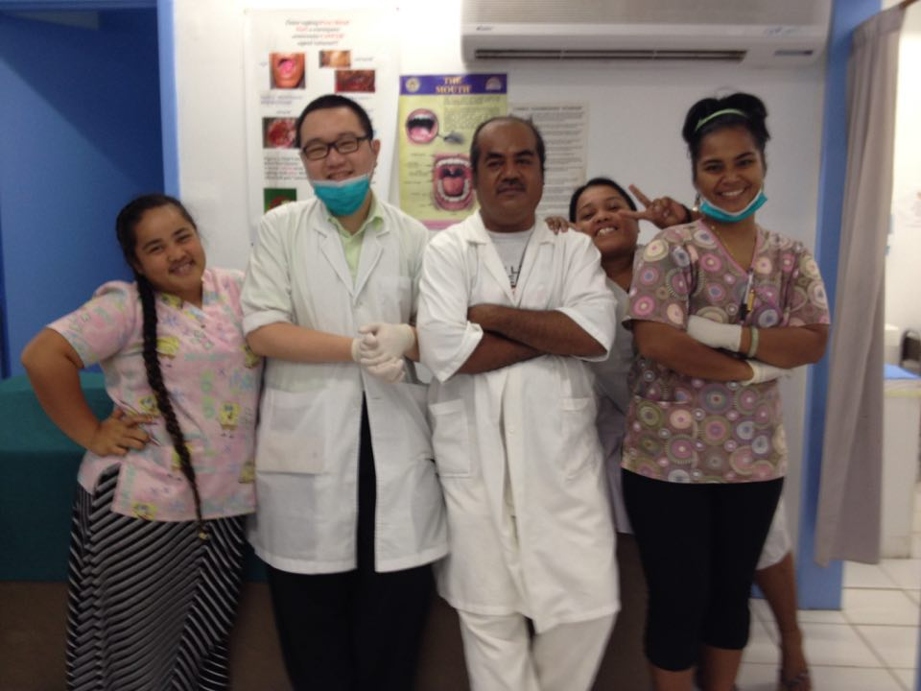
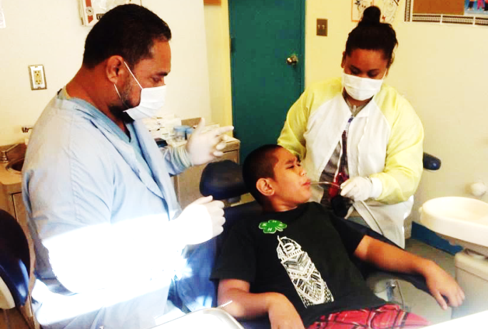
How can we resolve USAPI workforce shortage?
Educate and/or train NEW candidates to replenish workforce by forging partnership with universities/colleges such as Fiji National University (FNU) or other US based university
Train existing workforce to expand duties i.e. expanded duties dental assistants
  Fiji National University – curriculum available for EDDA
  Consultants – train on application of sealants, fluoride varnish and silver diamine fluoride, to name a few.
Increase number of funding opportunities for USAPI to increase workforce
Identify an individual willing to make a personal sacrifice and at a great expense to help improve the oral health of the island community

Slide 8
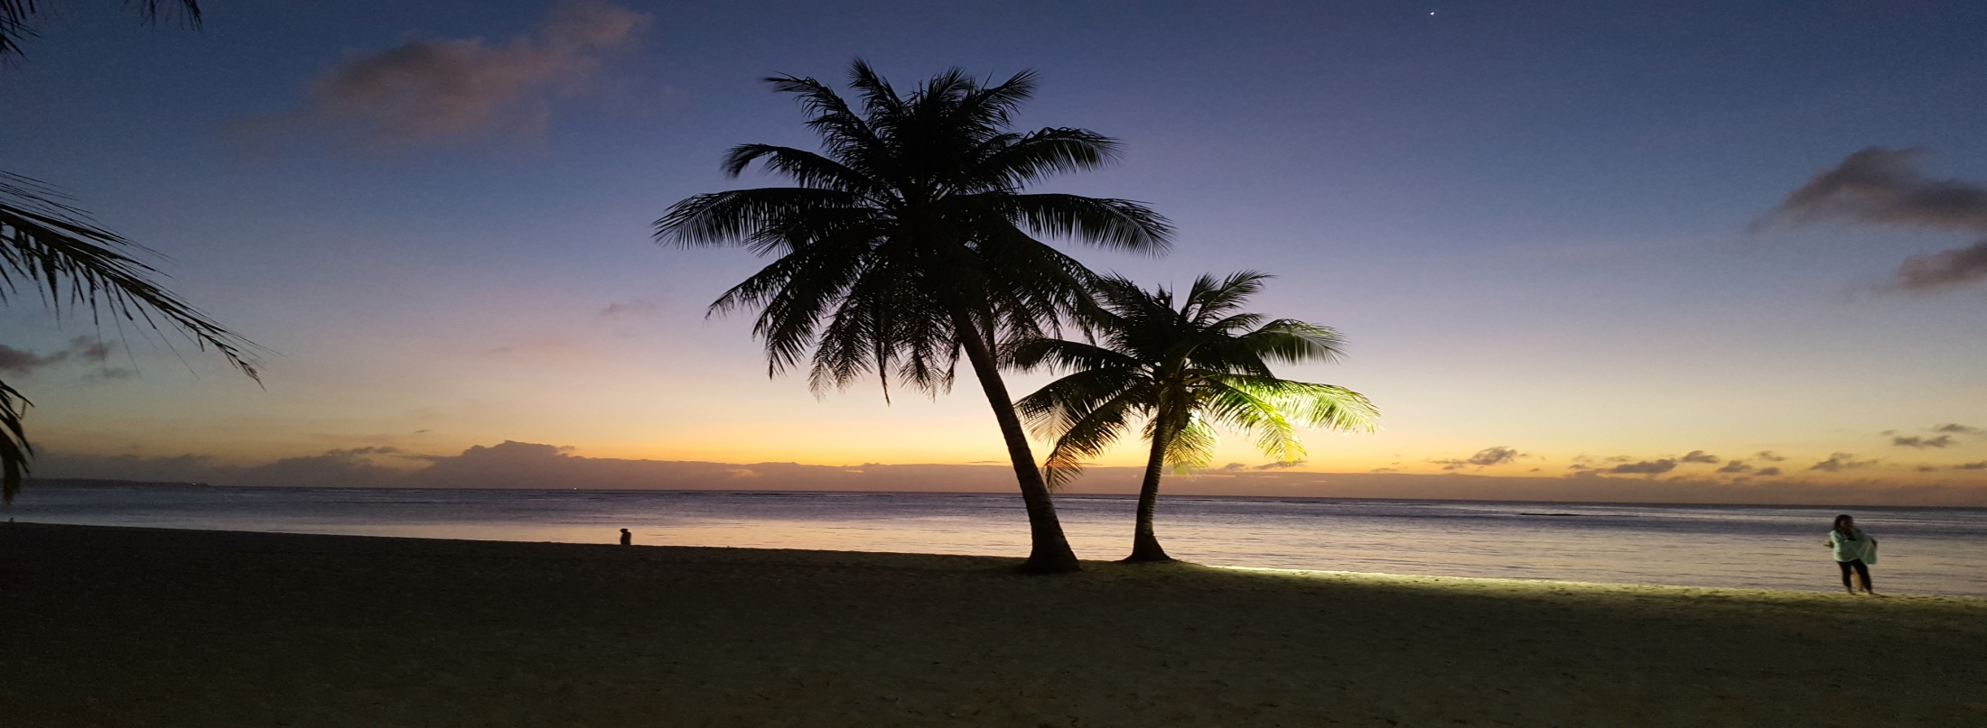
CNMI: Saipan, Rota, Tinian
Oral Health Program
Funded by local appropriated funds, Oral Health Workforce Grant (OHWF), MCH Title V grant

Slide 9
Demographics
The Commonwealth of the Northern Mariana Islands (CNMI) is a US Commonwealth that is composed of 14 islands in the northwestern part of the Pacific Ocean with only 3 inhabited islands: Saipan, Rota and Tinian. Saipan being the largest and the capital of the CNMI. 2010 census had 53,883 people living in the CNMI. Currency is US dollars.
There are 7 dental clinics on the island of Saipan; 6 private clinics and 1 public health dental clinic which is located within the only hospital in the CNMI, the Commonwealth Healthcare Corporation. The Commonwealth Healthcare Corporation has satellite health care centers in both Rota and Tinian. There is a dental clinic in each of the health care centers. The dental needs and care of the underserved population are mainly by the Public Health Dental Clinic. Therefore, the responsibility of dental care to Tinian and Rota lies on the Public Health Dental Clinic on Saipan.

Slide 10
Public Health Dental
Oral Health Program, a Division of the Maternal & Child Health Bureau
Oral Health Program (Focused primarily on children*)
  *targeting the children so as to have a healthier oral health population in the future. Not enough workforce to expand treatment to include the dental needs of the older population i.e. prosthodontics.
  1. Dental Clinic – Facility
    Preventative
    Curative
    Referral – primarily for oral cancer treatment
  2. Dental Outreach – (focused only on prevention; any restorative needs are done at the dental clinic facility)
    Schools
    Community
    Health Fair

Slide 11
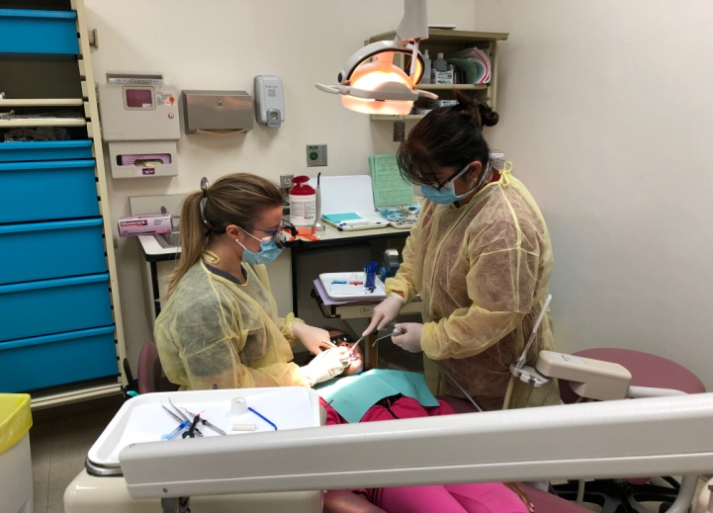
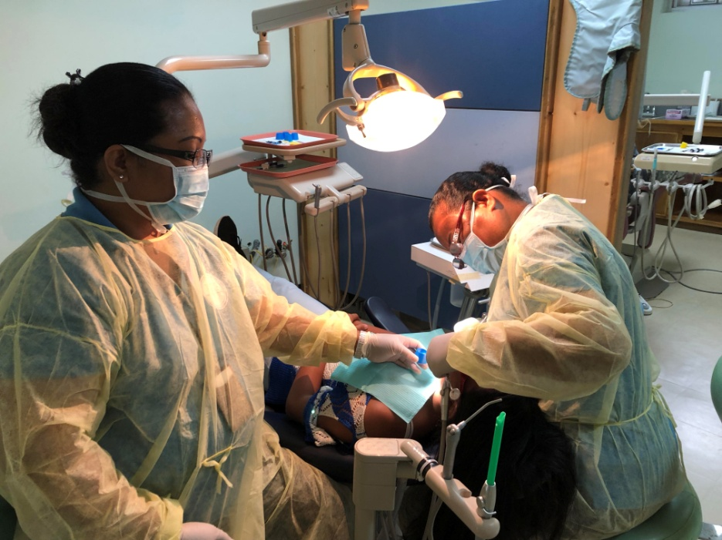
OHP – Dental Clinic
THE DENTAL CLINIC PROVIDES THE FOLLOWING SERVICES:
  Preventive Services
    Prophylaxis
    Fluoride: varnish & gel
    Sealants
    Silver Diamine Fluoride
  Curative Services
    Fillings
    Pulpotomy
    Stainless Steel Crown
    Extractions
    Root Canal Therapy
    Restorations under General Anesthesia
      Long wait list – only 2 locations: CHCC & SDA
      41 patients on wait list for 2018 – 18 treated

Slide 12
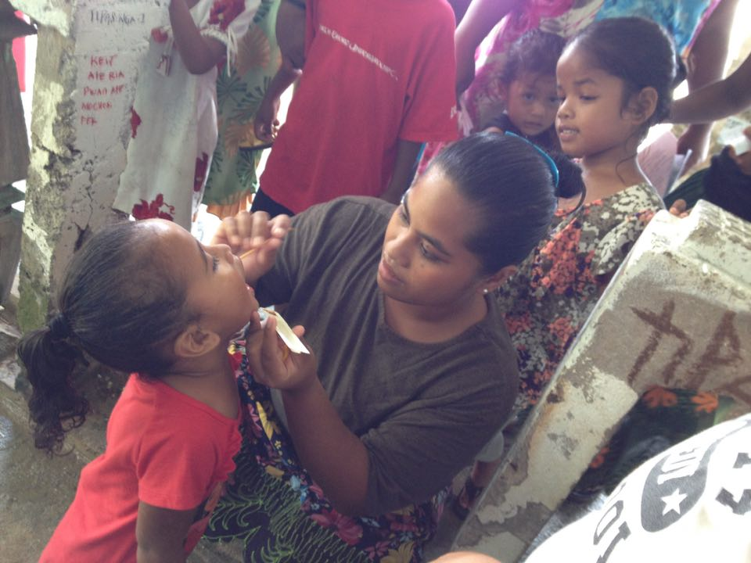
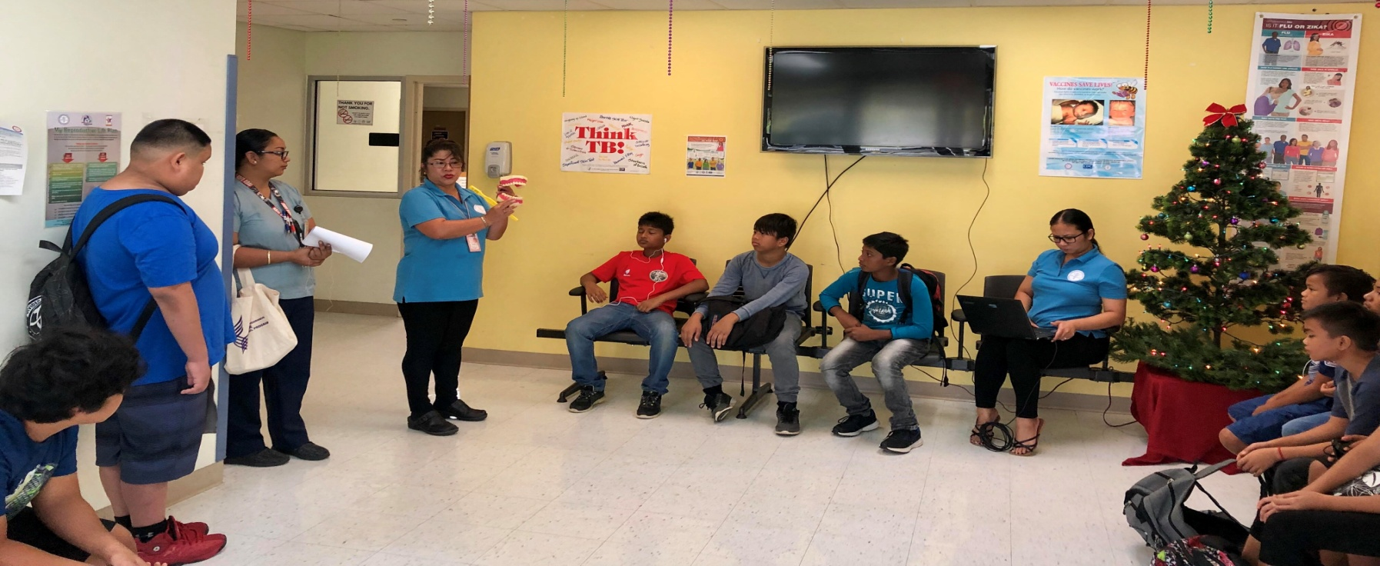
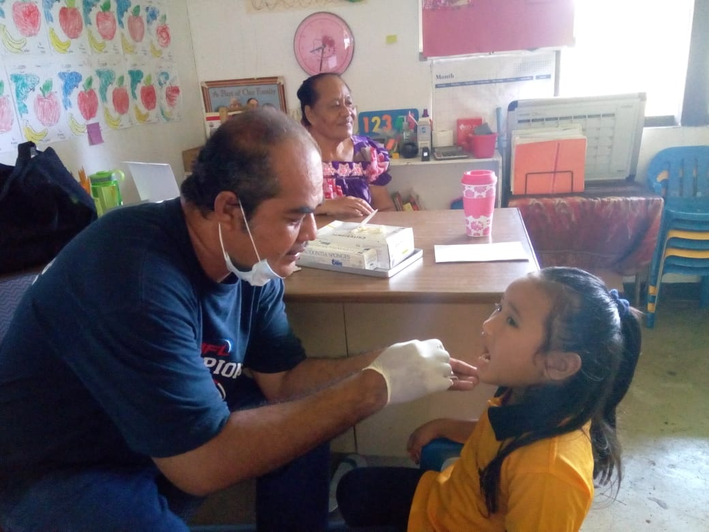
DENTAL OUTREACH PROGRAMS
School Sealant Program
Head Start Fluoride Varnish Program
Oral Cancer Outreach
  Schools
  Community
Oral Health & Pregnant Women

Slide 13
CNMI: Workforce
LOCAL FUNDING
WITH ORAL HEALTH WORKFORCE GRANT + LOCAL FUNDING
1 dentist
3 expanded dental assistants
1 hygienist
1 OHP preventative assistant
**ALL on Saipan ONLY
2 dentists
3 expanded dental assistants
3 dental assistants (1 on Saipan, 1 on Rota and 1 on Tinian)
2 hygienists (1 vacant position)*
1 OHP administrative assistant
1 OHP coordinator

Slide 14
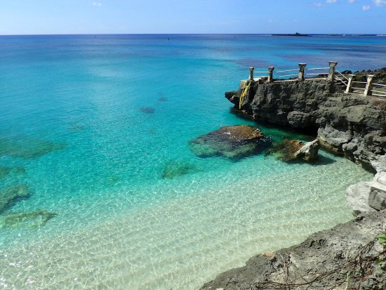
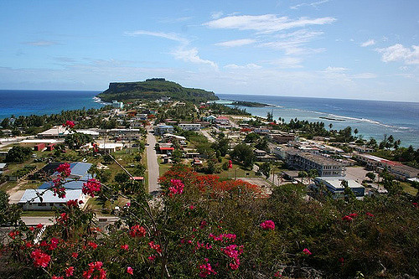
The OHWF grant provided dental access for Tinian and Rota which targets the unmet needs of the community
Expansion of the workforce
Increase supplies and equipment to serve 3 islands
Expansion of school sealant program to Rota and Tinian
(**there was no sealant program for 15 years)
Expansion of dental care to Rota and Tinian
(**no dentist on island for years)
Increase oral cancer early detection and intervention

Slide 15
Limitations of the OHWF
CNMI Professional Licensing Board
  Dentist – MUST be US educated
  Hygienist – MUST be US educated
  Dental Therapists – MUST be foreign educated dentists with the scope of work that is similar to an expanded duty dental assistants (EDDA)
Salary
  Dentist - $145K
  Hygienist - $45K
  Dental Therapists -$35K
  EDDA (w> 25 years experience) - $30K
  DA 1 - $20K
Cost for a higher education
  To be able to work in the OH field, must be US educated
Islands are physically isolated

Slide 16
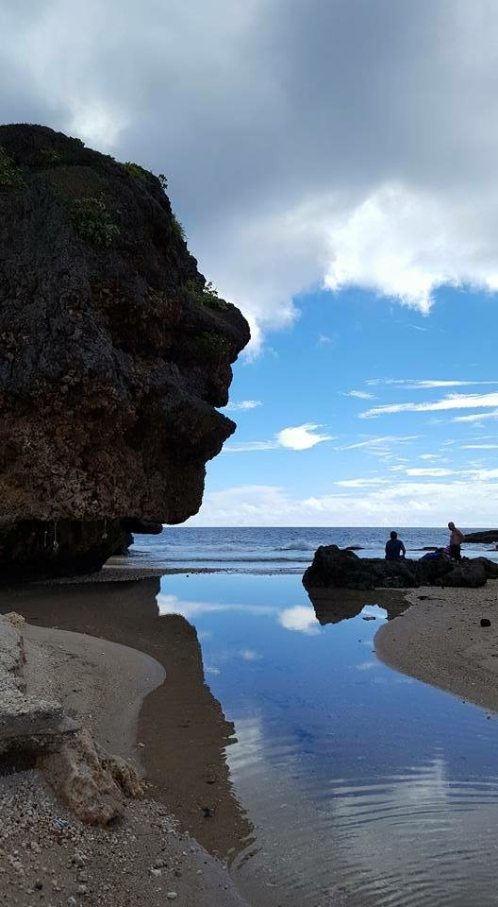
Innovative ways to increase workforce
Incentives
  Travel, Housing and Car allowances
Federal grants – OHWF
National Loan Repayment
  CNMI – HPSA score of 26 = $25K in loan repayment per year
National Health Service Corps
Partnership with a higher education entity to provide training and recruitment of interns
  Fiji National University – training program for EDDA, DA and possibly hygienists **
Teledentistry**
(NOTE ** - requires changes in the language for the CNMI professional licensure; changing the scope of work for dental therapists)

Slide 17
TELEDENTISTRY
Grant application to purchase equipment to support teledentistry in the CNMI
Changes to be made within the CNMI Dental Licensing Board as follows:
  Dental Therapist – to change the scope of practice. To function similar to the Minnesota model of the scope of practice for Dental Therapists.
  Hygienists – to allow to be foreign trained so as to increase # of schools student can attend
Dental Therapists with an expanded scope of work to provide continuous care to outlaying islands of Rota and Tinian and using teledentistry to communicate with dental staff on Saipan.

Slide 18
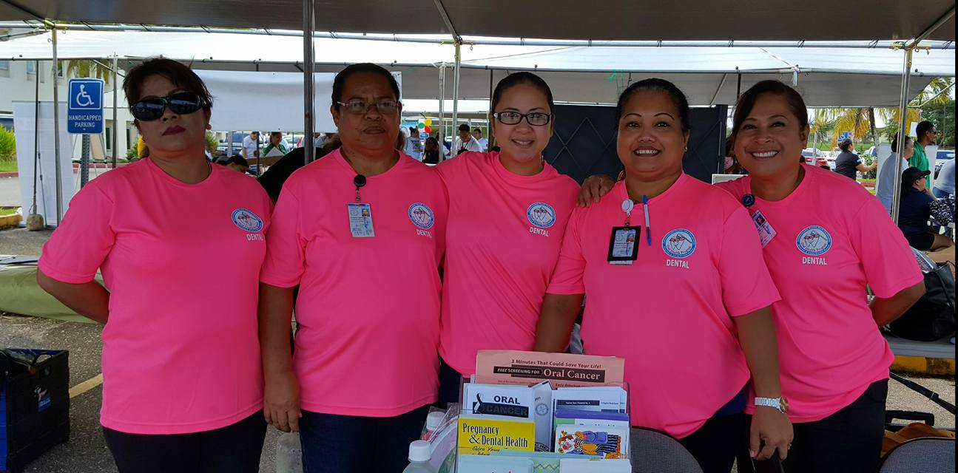
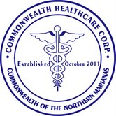
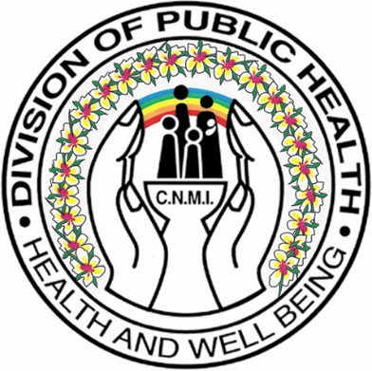
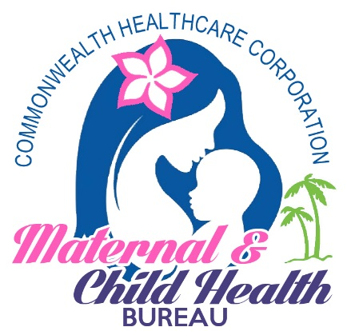
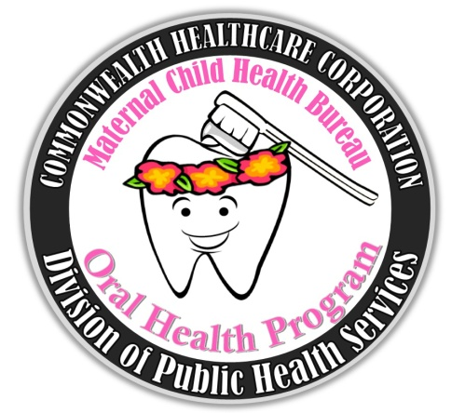
Thank You, Si Yu’us Ma’ase, Tirow, Kamager, Sulang, Salamat, Xie Xie, Arigato
Angelica C. Sabino, DDS
Chief Dentist, OHP
Commonwealth Healthcare Corporation
Email: asabinomch@gmail.com

