Slide 1

California Department of Public Health
Office of Oral Health
Addressing the
Social Determinants of
Oral Health
Lynn Walton-Haynes, DDS, MPH
Association of State and Territorial
Dental Directors Meeting
October 14, 2020

Slide 2
Panel Learning Objectives
Name three upstream social determinants (SD) of oral health
List 3 strategies for addressing SD
Addressing SD of oral health in CA communities

Slide 3
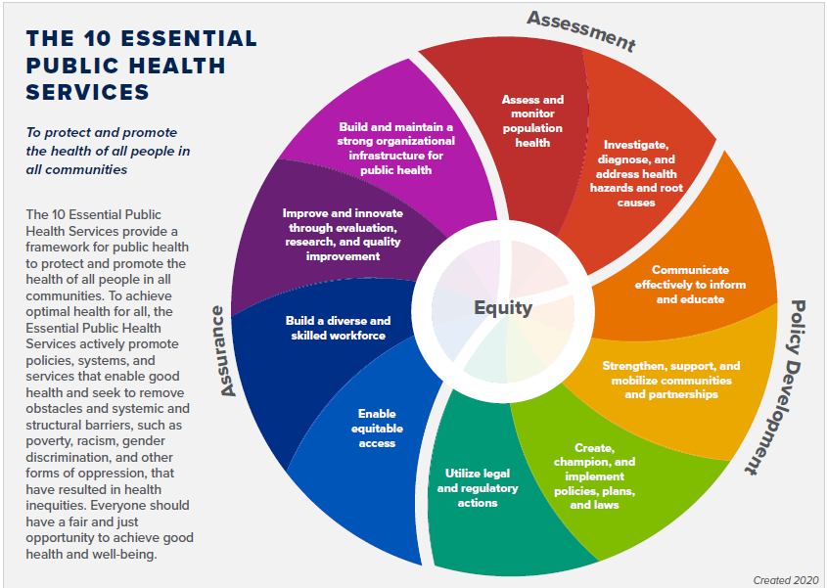
https://phnci.org/national-frameworks/10-ephs

Slide 4

Status of Oral Health in California
Oral diseases are highly prevalent
Disparities are persistent
Effective preventive measures are underutilized

Slide 5
California Oral Health Plan 2018 -2028
Goal 1:
Improve the oral health of Californians by addressing determinants of health and promote healthy habits and population-based prevention interventions to attain health status in communities.

Slide 6
Tooth Decay in Children
The California Smile Survey, 2006 and COHP 2028 Target

Slide 7
Receipt of dental visit during pregnancy among California women with a recent live birth, by race/ethnicity and insurance
Source: Maternal and Infant Health Assessment (MIHA) Survey, 2016-2017

Slide 8
Place Matters: Dental Indicators
Oakland, Alameda County by Census Tract
Visits to dentist or dental clinic among adults ages ≥ 18 years 2016
All teeth lost among adults ages ≥ 65 years 2016
Data Source: Centers for Disease Control (CDC), 500 Cities Project; CDC BRFSS 2016, US Census Bureau 2010, ACS 2012-2016

Slide 9
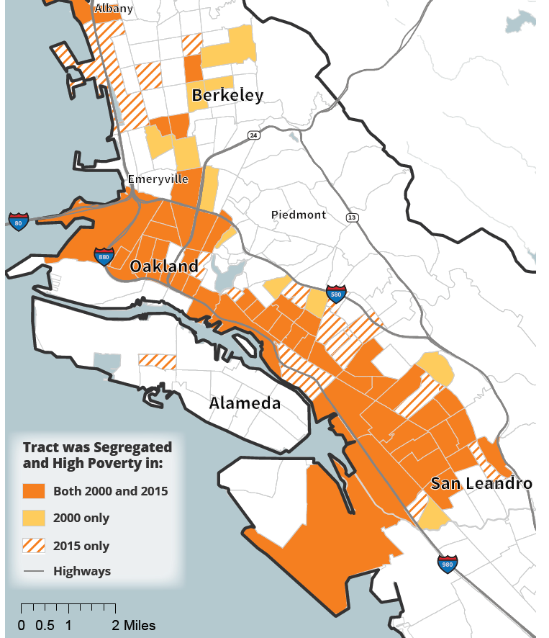
Place Matters
Alameda County by Census Tract
Source: “Rising Housing Costs and Re-Segregation in Alameda County”, UC Berkeley’s Urban Displacement Project and the
California Housing Partnership, https://www.urbandisplacement.org/sites/default/files/images/alamedafinal9_18.pdf

Slide 10
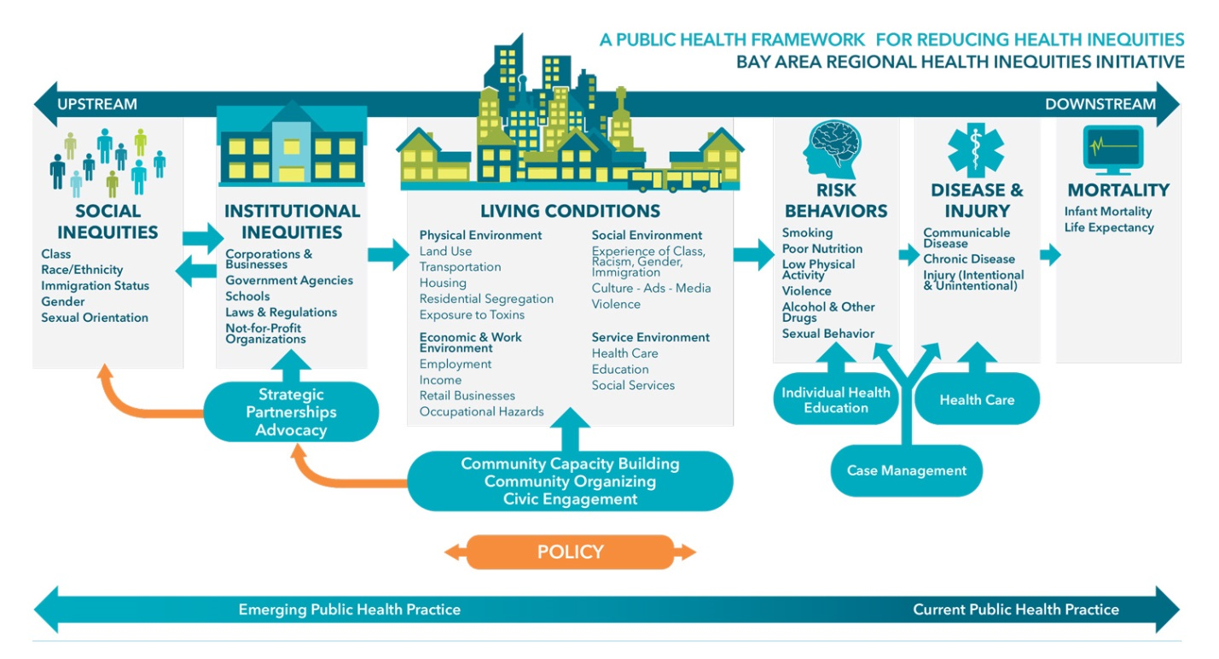
Bay Area Regional Health Inequities Initiative (BARHII) Framework
Source: https://www.barhii.org/barhii-framework

Slide 11
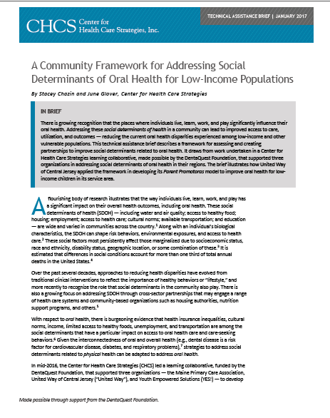
Steps to Developing a Plan to Address Social Determinants of Oral Health
Identify social determinants of oral health in a community
Map and mobilize community resources
Select approaches to take action
Evaluate implementation and impact
Source: CHCS Technical Assistance Brief, Jan 2017,
http://www.chcs.org/media/SDOH-OH-TA-Brief_012517.pdf

Slide 12
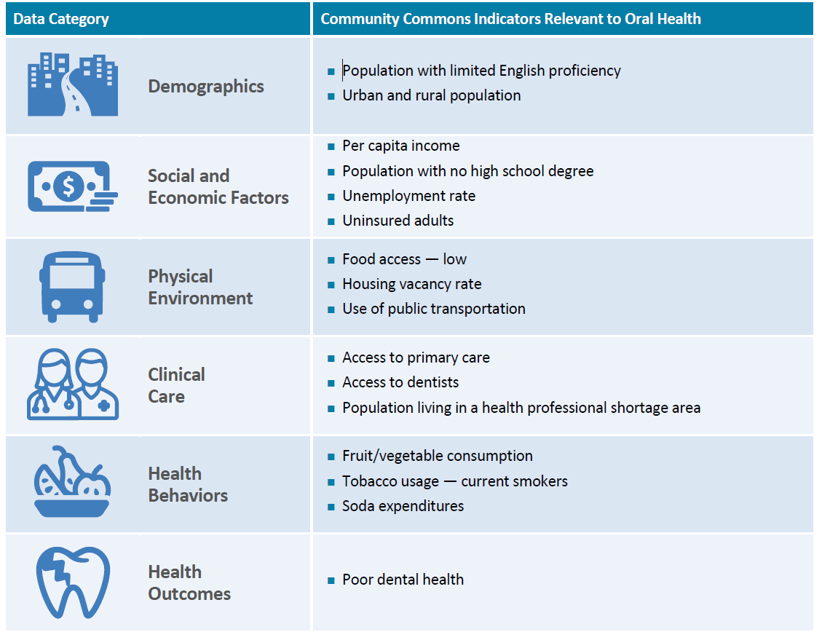
Indicators Potentially Related to Oral Health
Source: CHCS Technical Assistance Brief, Jan 2017,
http://www.chcs.org/media/SDOH-OH-TA-Brief_012517.pdf

Slide 13
Approaches to Take Action
Health Promotion
Rethink you Drink Campaign
Ex; Funding and technical assistance by health departments
Community Development
Capacity Building/ address cultural/language barriers
Ex: community health worker training by community based organizations
Consciousness raising
Health Literacy/
Community
engagement
Ex: CE courses on SDOH by provider organizations, institutions

Slide 14
California Priorities
Assessment
Community Engagement
Oral Health Literacy/Cultural Competency for Providers
Partnerships

Slide 15
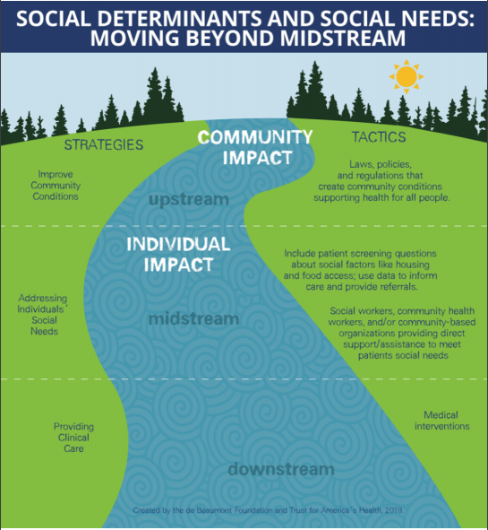
Graphic created by: de Beaumont Foundation and Trust for America’s Health
https://www.debeaumont.org/wp-content/uploads/2019/04/social-determinants-and-social-needs.pdf

Slide 16
Contact Information
Lynn Walton-Haynes, DDS, MPH
Dental Program Consultant
Office of Oral Health
California Department of Public Health
Lynn.Walton-Haynes@cdph.ca.gov
(916) 445-5474

Slide 17


Addressing Social Determinants of
Oral Health in San Diego County
Nancy Starr, R.D.H., M.P.H.
Association of State and Territorial
Dental Directors Meeting
October 14, 2020

Slide 18
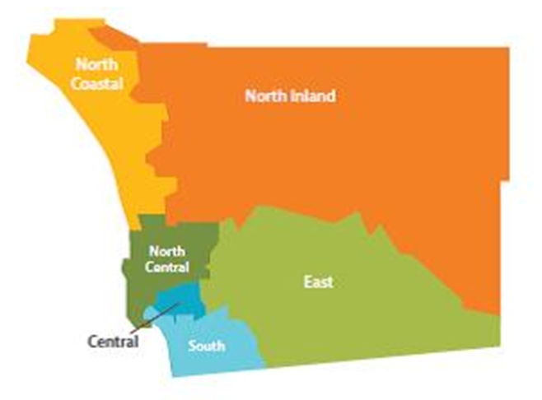
San Diego County
Population 3,338,330
5th largest county in the US
Busiest land border in the world (San Ysidro)
Race and Ethnicity
    45% Non-Hispanic White
    34% Hispanic
    5% Non-Hispanic Black
Living below poverty level
    7.8% Non-Hispanic White
    12.9% Hispanic
    18.6% Black (Hispanic and Non-Hispanic)
42 school districts – over 1,000 schools
US Census Bureau 2019 estimations: www.census.gov

Slide 19

the Past
Narrow Capacity and Partnership
  Community Oral Health Forum every 5 years
  San Diego County Oral Health Coalition established 1994
Engagement (Individual-focused)
  Grant-funded programs and health fairs
  Education and cross-threading messages
  Community events (dental sealant and fluoride varnish clinics)
  Fluoride rinse and education in schools
  Focused on children 0-5
Improve Community Conditions
  Emergency safety net for children
  Access to community dental clinics
  Water fluoridation
Notes:
Capacity
Dental society
Dental hygiene society

Slide 20
the Present
Broadened Capacity and Partnership
  Chief Dental Officer hired in July 2017 and expanded State funding (Proposition 56)
  Needs assessments and community oral health improvement plan in alignment with State funding
  Community Oral Health Forum every two years
  San Diego County Oral Health Coalition
    Action-oriented – focus on prevention
    Recruitment of nontraditional partners

Slide 21

the Present
Engagement (Community-focused)
  Oral health trainings for home visiting programs
  Schools
      Strengthen wellness policies for oral health
      Train nurses to improve Kindergarten Oral Health Assessment (KOHA) reporting
  Refugee train-the-trainer model

Slide 22
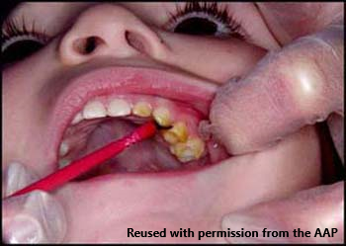
the present
  Engagement (Community-focused)
    Train pediatric providers to apply fluoride varnish
    Encourage general dentists to see children by first tooth eruption/age one
    Educate staff on oral health literacy including:
      Cross-threading messages
      Addressing racism

Slide 23

the Present
Improve Community Conditions
  Sustain water fluoridation
  Create policies promoting prevention in nontraditional settings
      Schools
      Medical facilities
  Expand services
    Medi-Cal Dental Program
    Increase the number of community dental clinics
    Annual event for children – free dental sealants and fluoride varnish

Slide 24
the future
Sustainability – Continue building capacity, strengthening partnerships, community engagement, and improving community conditions
Policy - Expanded oral health policy in schools and school-based programs
Prevention - Continued prevention efforts in the community (outside the dental office)
Data - Improved data with a focus on racial equity
Equity - Continued cross-threaded messages focusing on equity
    Media campaign to address implicit bias among providers
    www.blacklegacynowsd.com

Slide 25
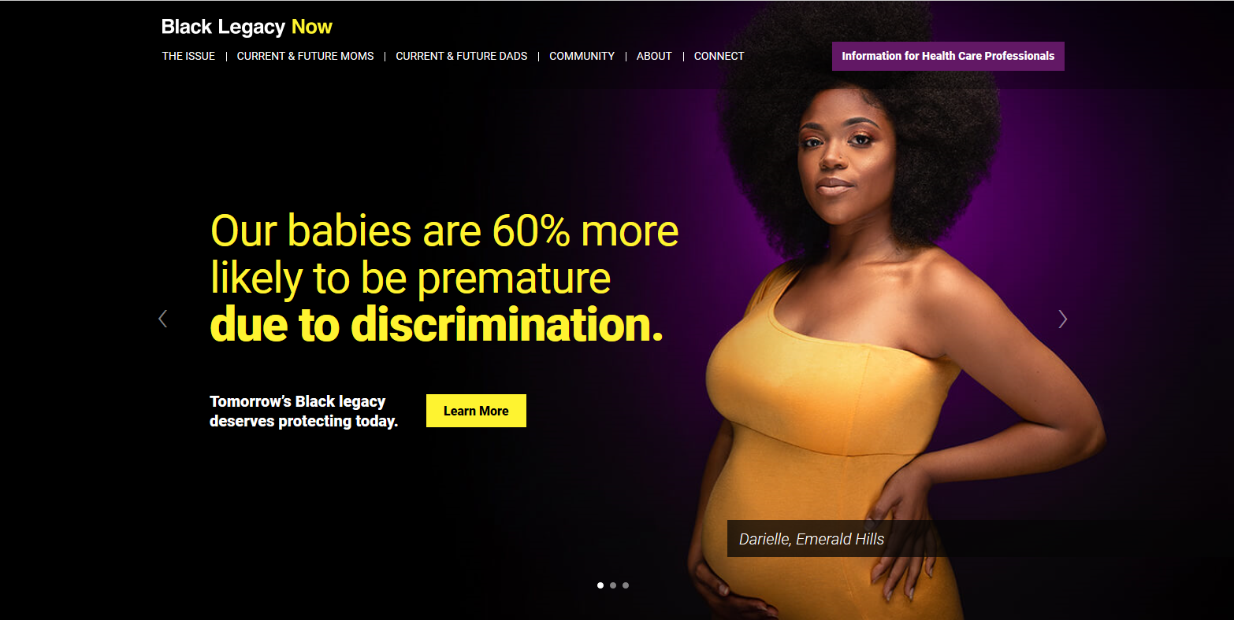
BlackLegacynowsd.com

Slide 26

CONTACT INFORMATION
Oral Health Programs
Family Health and Preventive Services Unit
Public Health Services – Maternal, Child, and Family Health Services Branch
County of San Diego
619-692-8858
Nancy Starr, RDH, MPH
Health Planning and Program Specialist
Office: 619-692-8657
Cell: 619-780-1281
www.mcfhs.org
  On May 17, 2016, the County of San Diego Health and Human Services Agency Division
  of Public Health Services received accreditation from the Public Health Accreditation Board.

Slide 27
Addressing the Social Determinants of Oral Health: Local Strategies for a National Discussion
Stephanie Thornton, MPP
October 14, 2020

Slide 28

The Children’s Partnership
The Children’s Partnership (TCP) is a California-based children’s advocacy organization committed to improving the lives of marginalized children where they live, learn, and play with breakthrough solutions at the intersection of research, policy, and community engagement

Slide 29

California’s Children
    9 million kids in CA
    Over half—close to 5 million—enrolled in Medi-Cal
    Of Medi-Cal enrolled children, more than 75% are Black or Latinx
Notes:
Source: Kidsdata.org (Lucile Packard Foundation for Children's Health)

Slide 30
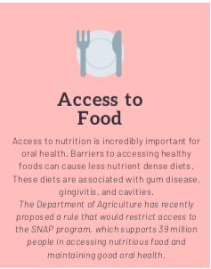
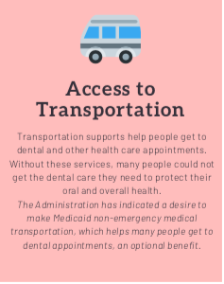
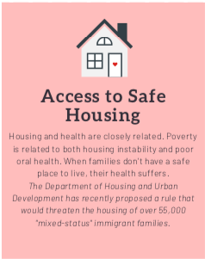
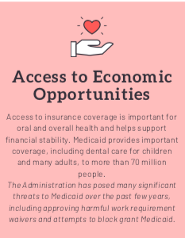
Social Determinants of Oral Health
“Create social, physical, and economic environments that promote attaining the full potential for health and well-being for all.” – Healthy People 2030
Notes:
Source: Kidsdata.org (Lucile Packard Foundation for Children's Health)
TCP advisory committee role
Immigrant Justice workgroup of OPEN

Slide 31
Adverse Childhood Experiences (ACEs)
  Dr. Nadine Burke-Harris appointed as CA’s first surgeon general in 2019 to lead a statewide response to toxic stress and the lifelong impact of ACEs
  Research-backed impacts: physical health (obesity, recurring infections, respiratory concerns), mental and behavioral health, academic performance, and others
  How does California’s growing emphasis on recognizing ACEs impact children’s wellbeing and how we respond?
Notes:
Source: “Pediatrics adverse childhood experiences and related life events screener (PEARLS) and health in a safety-net practice.” Dr. Nadine Burke Harris, et. Al. Child Abuse & Neglect 108 (2020) 104685 Available online 5 September 20200145-2134/© 2020.

Slide 32
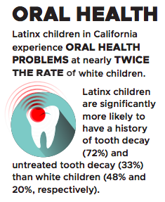

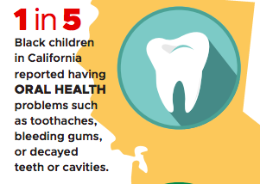
Racial Inequities in Oral Health

Slide 33
Supporting Community-Based Approaches:
California Strategies

Slide 34
The Role of Community Health Workers
  Individuals working in the community, who come from within the community and are closest to the people and to the issues
  Child health focus areas:
    Connecting families to dental and vision care, asthma, obesity prevention, mental health
  Social determinants of health focus areas:
    Health care navigation, food assistance, special education needs, distance learning support, warm hand-offs to legal experts on immigration, housing, etc

Slide 35
Early Childhood Oral Health Assessment (ECOHA)
  The ECOHA mobile application is administered by CHWs to families to address the oral health needs of children ages 0-5
  CHWs meet families at health fairs, libraries, WIC sites, elementary schools, churches, and clinics
  After completing the survey, CHWs are then able to provide tailored educational resources to families, and help them connect to a dental home

Slide 36
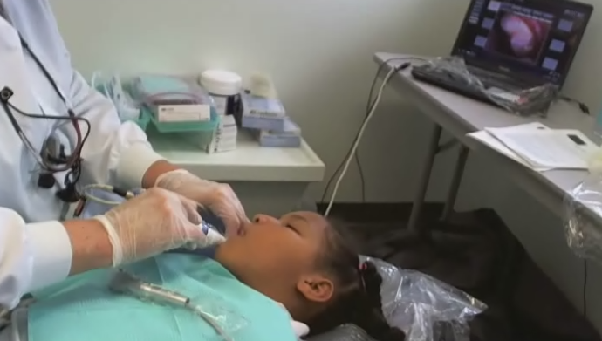
The Virtual Dental Home
  Creating telehealth-connected teams at schools
  Addressing social determinants of health
    Transportation
    Families work schedule
    Medi-cal provider deserts
    Fear and chilling effect
California Northstate University College of Dental Medicine
Notes:
*Define VDH

Slide 37
Policy and Administrative Advocacy

Slide 38
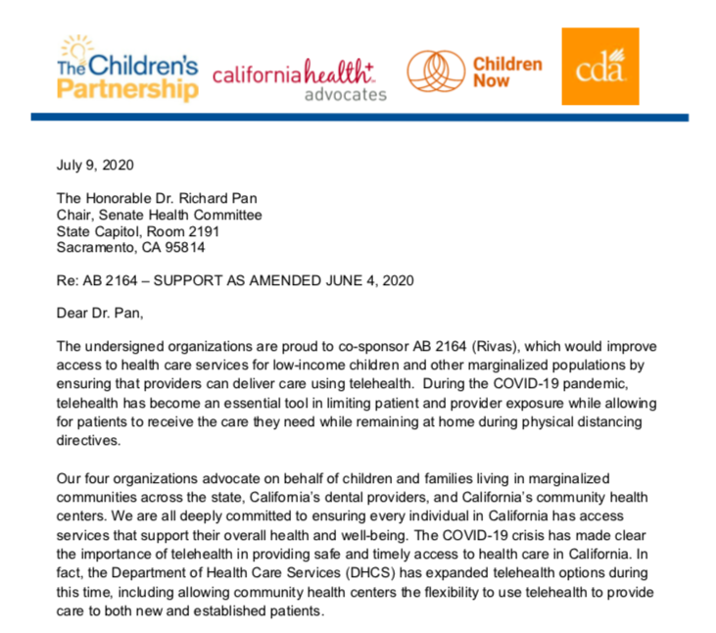
Legislation: Establishing a Patient at Community Sites
  Inability to “establish new patients” outside of FQHCs a key barrier to implementing the VDH
  Sponsored by coalition of advocates in CA
  Vetoed by Governor Newsom in September, but with intention of evaluating telehealth programs under COVID-19

Slide 39
Sustaining and Leveraging Local Pilot Projects
  California’s Dental Transformation Initiative 2015-2020 funded 13 Local Dental Pilot Projects (LDPPs) to end December 2020
  Lessons learned and best practices from pilot projects:
    Role of CHWs in bringing dental care to children where they are
    Increasing care coordination
    Equipping caregivers/parents to be oral health champions

Slide 40



Safe and Welcoming Communities
“Create social, physical, and economic environments that promote attaining the full potential for health and well-being for all.”
– Healthy People 2030
Notes:
Come back to the environment aspect of SDOH: not only about mitigating transportation barriers, providing food, etc but about recognizing that children and families don’t lead single-issue lives, their health concerns don’t exist in a vacuum. Addressing the SDOH means ensuring our children grow up in communities that are safe and welcoming for all

Slide 41
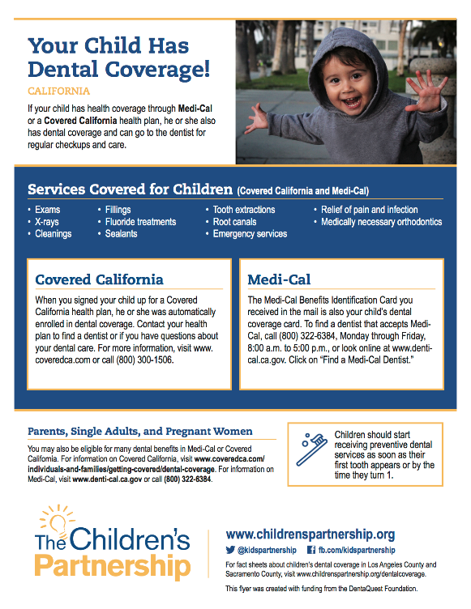



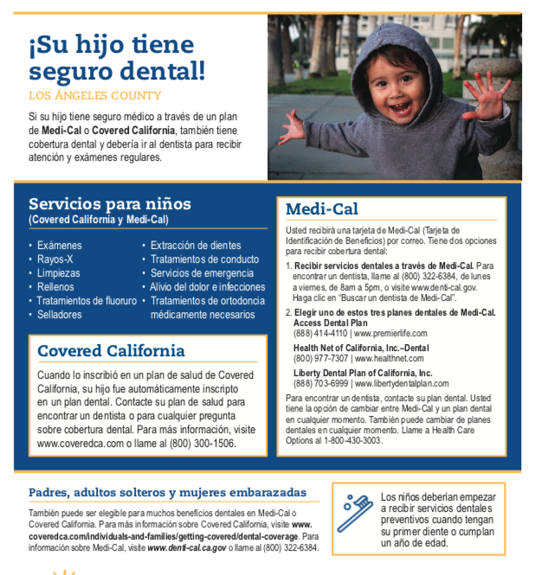
Resources

Slide 42
THANK YOU!
Stephanie Thornton
Email: sthornton@childrenspartnership.org

