Slide 1
Turning Data Into Action A Webinar Series for SOHPs
Presenting by the ASTDD Data Committee

Slide 2
7-Part Series
Date | Topic | Presenter
May 18 | Turning data into action | Kathy Phipps, ASTDD
June 1 | Developing and using state oral health data reports | Hawaii & Vermont
June 15 | Using the CDC Open Data Platform to visualize oral health data | Valerie Robison, CDC
June 29 | Data to Action: Making Better Infographics | Carole Stampfel, AMCHP
July 13 | CANCELLED - RESCHEDULED FOR AUGUST 3
July 27 | Web-based oral health data systems – state examples | Colorado, Minnesota, Wisconsin
August 3 | Oral health infographics – state examples | Arizona & New Hampshire
August 10 | Using coalitions and partners to spread the message | Children’s Health Alliance of Wisconsin, Washington Dental Service Foundation
All webinars are Thursday from 3:00-4:00 Eastern Time

Slide 3
General Reminders
This webinar will be recorded & archived (www.astdd.org)
Please hold questions until the end
If you have questions, please make a note of them
If you want to ask a question at the end, click on the Set Status icon
The little man with his arm raised on either the upper left or the top of your screen. Click on “raise hand”
We will then call on you to ask your question
Please respond to the polling questions

Slide 4
Acknowledgements
This presentation was supported by Cooperative Agreement NU58DP004919-05-00 from CDC, Division of Oral Health. Its contents are solely the responsibility of the authors and do not necessarily represent the official views of CDC.

Slide 5
Data to Action: Making Better Infographics
ASTDD Webinar
June 29, 2017
Caroline Stampfel, MPH
Direct of Programs, AMCHP
Notes:
Thank you so much for having me today. I’m the Director of Programs at AMCHP, but my background and training are in epidemiology, data, assessment and evaluation. My passion is to ensure that we make data driven decisions in our work, and in that spirit, I’m here today to talk about one of the ways we’ve been working to make data for decision-making more accessible – making better infographics.

Slide 6
Who is AMCHP?
AMCHP is a national resource, partner and advocate for state public health leaders and others working to improve the health of women, children, youth and families, including those with special health care needs.
Notes:
Before I jump into the nitty gritty, I wanted to tell you a little bit about AMCHP. (READ)
More practically speaking, we are a non-profit, membership association, and our core membership comes from MCH programs in state health departments.

Slide 7
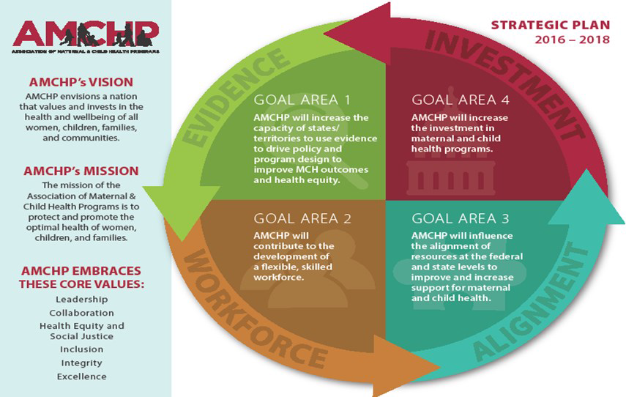
Notes:
As an organization, AMCHP is driven by our vision, mission, and strategic plan. I share these with you to underscore the importance of high quality information for decision-making - to realize our vision, to carry out our mission, and to accomplish our goals, we need the best possible information for action.
Vision: AMCHP envisions a nation that values and invests in the health and wellbeing of all women, children, families and communities.
Mission: to protect and promote the optimal health of women, children, and families.
AMCHP has a new 2016-2018 strategic plan centered around 4 goals:
Goal 1: AMCHP will increase the capacity of states/territories to use evidence to drive policy and program design to improve MCH outcomes and health equity
Goal 2: AMCHP will contribute to the development of a flexible, skilled workforce
Goal 3: AMCHP will increase the investment in maternal and child health programs
Goal 4: AMCHP will influence the alignment of resources at the federal and state levels to improve and increase support for maternal and child health

Slide 8
What Will I Talk About Today?
Why people use infographics
Some of the ways infographics can go wrong
Some of the ways we are trying to make better infographics
Iterations of infographics we’ve made
Lessons learned

Slide 9
What is an Infographic?
Graphic visual representation of information, data or other collections of knowledge¹
A chart, diagram, or illustration that uses graphic elements to present information in a visually striking way²
Data visualizations that present complex information quickly and clearly. Think of maps, signs, and charts used by statisticians or computer scientists: Wherever you have deep data presented in visual shorthand, you’ve got an infographic.³
¹https://en.wikipedia.org/wiki/Infographic
²https://www.merriam-webster.com/dictionary/infographic
³https://visual.ly/m/what-is-an-infographic/

Slide 10
Why Infographics?
Pictures rather than words
Shareable
Bring together a lot of information
Notes:
Infographics are everywhere you look – sometimes it seems like everyone is making them. Part of this is because they are so shareable on social media, and they allow the creator to share many pieces of information at once.
They usually use pictures rather than words or traditional data visualizations (tables / graphs) to convey information
They are visually appealing, and therefore incredibly shareable – when’s the last time you heard of a 100 page report going viral?
They are a snapshot of information that is often drawn from a number of different sources. The really good ones tell a story as you read through them.

Slide 11
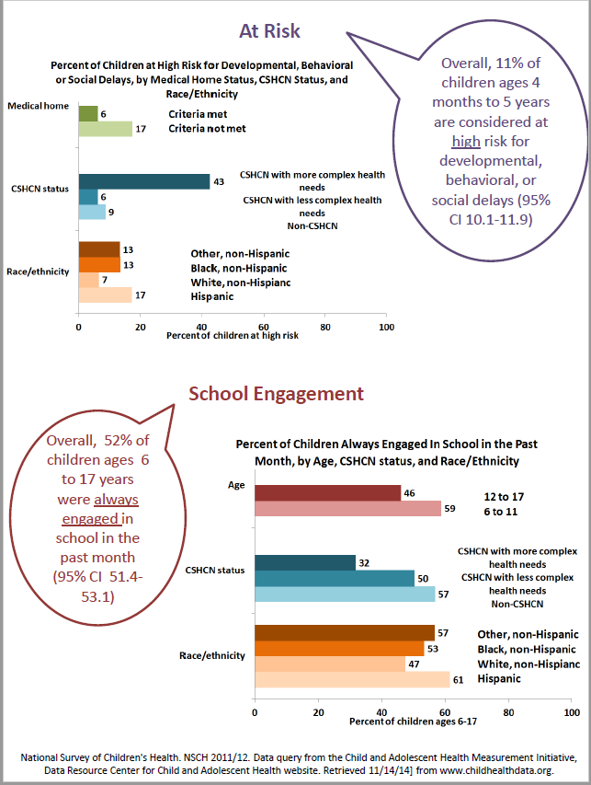
Where we came from – AMCHP Pulse Data and Trends
Notes:
This was our typical Data and Trends feature – pulling some data from a national survey, at least one bar graph. This one is slightly fancier since we included some thought bubbles.
So there’s nothing wrong with this – we have a topic (child health), and we shared some data, pulling out some important points, put more than one piece of data out there, used graphs and words.
But, by current standards, it’s really not an infographic.

Slide 12
Why BETTER Infographics?
Some infographics miss the mark, but why?
Too much information
Visualizations that not appropriate for the data
Clashing colors, fonts, hard to read
Notes:
Many infographics are not as effective as they could be. Although we know a good one when we see one, it’s sometimes hard to put your finger on what’s not right. When we reviewed infographics we felt missed the mark it was usually because of some key things that were happening with content and presentation of data and the design elements (READ).
At AMCHP we committed to making infographics to effectively communicate with our members and partners. To ensure that our infographics are effective,
we set out to identify characteristics of successful infographics, characteristics that should be avoided, and a process to critique and improve the infographics we create. We are coming from a perspective of doing these ourselves – we don’t have much graphic design support but we have a strong interest in moving data out;
We are still at the beginning of this journey, so what I’m sharing are things that are a part of our ongoing discussion, not necessarily universal truths

Slide 13
LOVED IT (We will try to…)
Put what’s newsworthy at the top
Rank our data (what’s most important)
Include white space
Dress up our charts
Use meaningful visuals
Keep visuals numerically accurate
Keep charts simple
Tell a story
Use complimentary color schemes (find good palettes)
Use images that we have purchased (avoid copyright infringement)
Include citations for data and images in some way
Use PDF as the final output
Come up with a catchy title
Notes:
We pulled resources from six websites with infographics best practices, design tips, and data visualization resources. We also collected numerous examples of infographics from public health and other sectors to examine their characteristics. A small group of epidemiologists, program staff, and graphic designers evaluated the tips and examples; we generated lists of characteristics and practices to avoid and design elements and data visualization to embrace when creating AMCHP infographics.
The left side of this table is our list of things we loved from everything we reviewed, and the right side is things we wanted to avoid because we felt it violated either content or design principles.
Put what’s newsworthy at the top – Use headlines to tell people what to pay attention to
Rank our data (what’s most important) – because you will have to eliminate stuff (epi)
Include white space
Dress up our charts
Using meaningful visuals (epi)
Keep visuals numerically accurate (epi)
Keep charts simple – no more than 1-2 series, easy interpretation (should be obvious to a lay person) (epi)
Tell a story
Use complimentary color schemes (Find good palettes)
Use images that we have purchased (avoid copyright infringement)
Include citations for data and images in some way (epi)
Use PDF as the final output
Come up with a catchy title

Slide 14
LOVED IT (We will try to…) | HATED IT (We will avoid…)
Put what’s newsworthy at the top | Pie charts
Rank our data (what’s most important) | Imagery in charts (not always appropriate)
Include white space | Too much information in one infographic
Dress up our charts | Too small (print and visuals)
Use meaningful visuals | Too many fonts
Keep visuals numerically accurate | Unlabeled / incorrectly labeled axis
Keep charts simple | Background images that are too busy
Tell a story | Images that might be divisive
Use complimentary color schemes (find good palettes) | Using people as “vessels” to show percent because they are not accurate
Use images that we have purchased (avoid copyright infringement)
Include citations for data and images in some way
Use PDF as the final output
Come up with a catchy title
Notes:
On the side of things we will avoid:
Pie charts, because of their potential for distortion (epi)
Imagery in charts (not always appropriate (epi)
Too much information in one infographic
Too small (print and visuals)
Too many fonts
Unlabeled / incorrectly labeled axis (epi)
Background images that are too busy
Images that might be divisive – we use flat icon to avoid having to choose representations of people by race/ethnicity; we are careful about gender stereotypes
Using people as “vessels” to show percent because they are not accurate (epi)

Slide 15
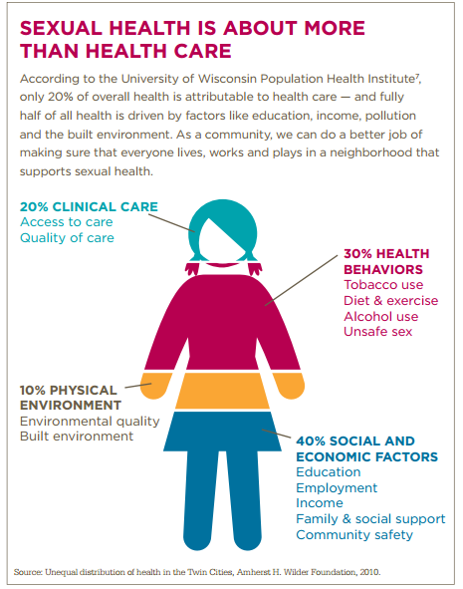
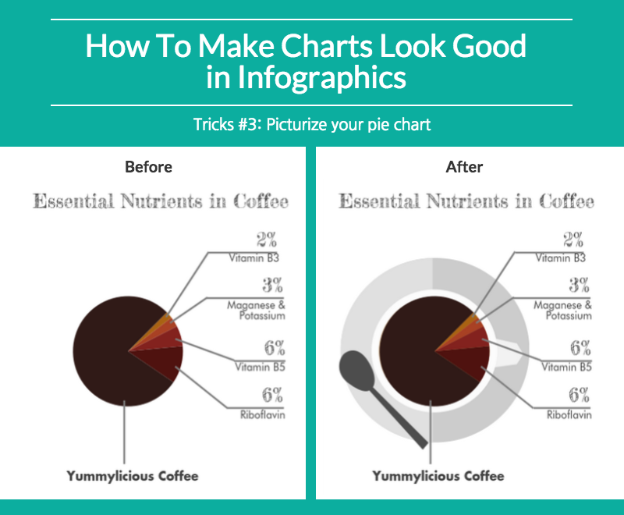
We will avoid…
Notes:
Here are some examples of things we wanted to avoid. Although the left side was actually from an article on how to improve your infographics, the epidemiologists in the room voted this down. Because pie charts can distort the visual representation of the data, we opt to avoid them if at all possible. We also did not like the gratuitous use of the coffee imagery – you might disagree, but one of our guiding principles is to keep charts simple, and our group felt the additional imagery did not contribute to the user’s understanding of the information.
On the right is another item we wanted to avoid – filling people as “vessels” to illustrate percents. Now this visual is from a friend’s publication, and I think it did what they wanted it to, but again, in a room with epis and data people, the ability to make this an accurate representation of the percentages shown was almost impossible. Is a head really 20% of the body?

Slide 16
How Do We Make Them Better? Iteration #1
Notes:
I want to share with you a series of iterations in the development of one our first infographics with our dos and don’ts. This infographic is sharing the results of an action learning collaborative around moving data from maternal mortality review to action. I’ve broken these into two pieces because the format doesn’t necessarily translate to slides.
Iteration 1 – we started with a map – does it add value? There were 6 participating states – it’s not easy to see, and the 31 refers to new committee members added over the life of the project.
We had a thermometer to show accumulated products. Does it work? We ended up dropping it because as an image, it was not directly related to the topic. The visual was numerically accurate and the things on the graph were all the same units, but we still didn’t like it.

Slide 17
Iteration #2
Notes:
Iteration 2 - Simplified the tagline
Added a headline about what ALCs do
Lost the map, instead used images that describe and relate to the numbers
Emphasized numbers by increasing the font size of them
We took the items from the thermometer and pulled them out with large numbers and images that related to the topic
We shifted the language in the headline at the bottom from “move data to action” to “Accelerate progress by advancing knowledge”. Why did we choose that language? Who was the audience? We decided that the primary audience for this type of infographic was not necessarily our members so much as our funders.

Slide 18
Iteration #3
Notes:
Iteration 3 – What’s the major difference here? With this iteration, we focused on getting more white space, moved the training of health workers to the center.

Slide 19
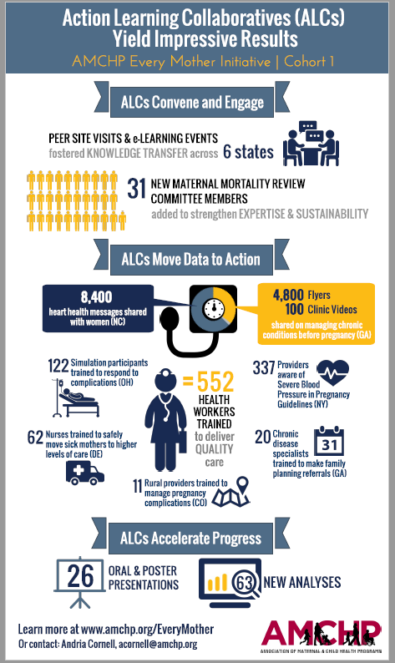
Iteration #4 The Final Version
Notes:
Iteration 4 –The Final Version
Format was even wider – more white space
Used people to show quantity without breaking our rule of filling people in.
Spreading out also allowed us to use a larger font throughout
Removed details that were not essential, allowed us to use less text, makes it feel cleaner

Slide 20
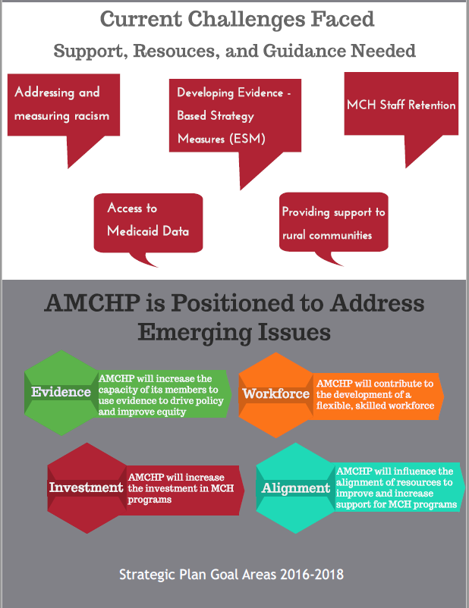
Notes:
Since then, we’ve experimented with a number of different styles. This example shows how we are trying to take information from our member assessment and summarize qualitative data from open-ended questions in an infographic. These are notoriously difficult to share in a cogent way; it always seems like a good idea to ask the members what the top emerging issues, challenges, and opportunities are, but when you have more than 400 answers to these questions, it’s hard to know what to do.
Emerging Issues: Here we took some of the key topics and summarized them in a word cloud – the relative size of the text indicates the relative frequency of the topic. This is one of the ways we can show a lot of themes and how some of them came up more than others. This is superimposed on a map to convey the message that this information comes from our members across the country.
We used word bubbles to convey that these are the words of our members.
We then tied the issues we heard to our strategic plan to provide a visual reminder that we are well-positioned to take on these issues and challenges because they align with specific objectives from goal areas in our strategic plan.

Slide 21
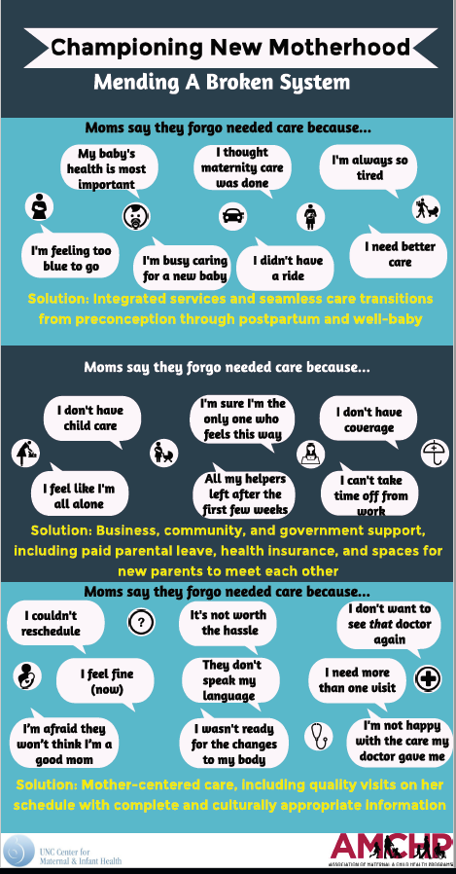
What if you don’t use numbers at all?
Notes:
This infographic accompanied a journal article on the postpartum visit – so this is our first peer-reviewed, published infographic. And it does not contain a single number. This information is the accumulation of information from journal articles, focus groups, and the solutions were proposed by a working group to address the challenges in the word bubbles.
We took a lot of care to choose images that resonated with the words, that showed mothers, infants, and the practical issues facing mothers when deciding to forgo needed care.
Originally we envisioned this infographic as a roadmap or pathway, but in the end, three simple bands with words from moms in the word bubbles and solutions from the working groups in yellow.

Slide 22
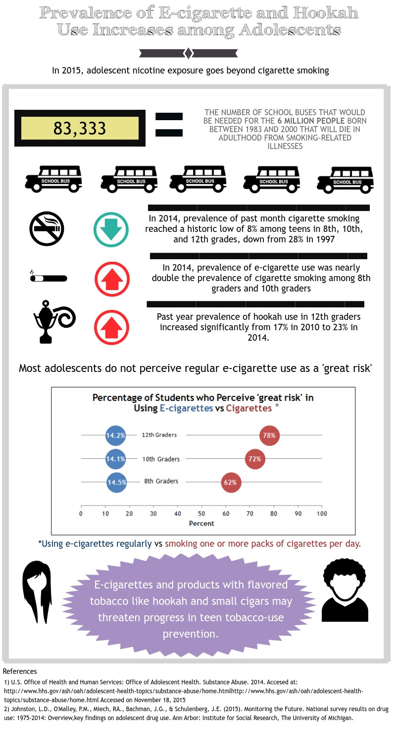
Experimenting with Social Math
Notes:
We started to experiment with the concept of social math. "Social math" is the practice of translating statistics and other data so that they become interesting to the journalist, meaningful to the audience, and helpful in advancing public policy. Mar 30, 2015 Berkeley Media Studies Group.
In this infographic, we use the concept of school buses to help bring home how many people will die in adulthood from smoking related illnesses – Most people understand roughly how big a school bus is, but it’s hard to fathom what 6 million people looks like. So in this case, social math takes the number 6 million and breaks it down to say – you would need more than 83 thousand school buses to hold all of the people who will die of cancer.

Slide 23
Where we are now: AMCHP Pulse Data and Trends
Notes:
Where are we now? Here’s a recent example of our Pulse Data and Trends AMCHP Infographic – this one highlights findings from our AMCHP Annual Conference Evaluation. We included our core evaluation questions and the bar chart on the right colors correspond with each of the key elements.
Again we use a good amount of real estate here to convey the findings from an open-ended question on what participants learned that they will apply. Why spend the space on this? Well, two reasons really – 1) people took the time to write these answers out, and by featuring them in our association newsletter, it is a way to give them their data back, and 2) we want people to know what attendees derived as benefits from the conference – being able to apply something from the conference back to their work is a key way we demonstrate the value of gatherings such as our conference.

Slide 24
We Still Struggle With…
Maps
Too much information in one infographic
Design aesthetics
Notes:
With all the work we’ve done, we still struggle with a few things. Maps – meaningful ones are hard to generate on an infographic, where space is a hot commodity.
TMI – since the content is driven by program and epi people rather than design people, we tend to want to put everything in that we think is important.
Design and communications pros know that the audience can only absorb so many pieces of information – 3 to 5 at most.
We still struggle with design aesthetics – color palettes, professional look/feel, “getting it right”

Slide 25
We Feel Good About…
Accurate data visualizations
Pushing the epi/data boundaries
Appropriate citations
Notes:
Because we’ve had so many data people looking at these, we feel good about accurate data visualizations. We feel like we are still pushing the boundaries of what “traditional” epi techniques.
We feel that we are giving proper credit for information – data sources, info sources, etc.

Slide 26
Our Favorite Resources
For making infographics:
Piktochart
https://piktochart.com/
Visme
https://www.visme.co/
Flat Icon
http://www.flaticon.com/

Slide 27
Our Favorite Resources
For making infographics better:
Making charts look cool: http://piktochart.com/how-to-make-charts-in-infographics-look-good/
Ten tips for designing better infographics: http://www.dotdash.ie/10-tips-for-designing-better-infographics
12 infographic tips: https://blog.kissmetrics.com/12-infographic-tips/
Do’s and Don’ts of infographic design: http://www.smashingmagazine.com/2011/10/14/the-dos-and-donts-of-infographic-design/

Slide 28
Is there a “How-To Guide”?
Decide what’s on your DO / DON’T list
Do you have access to a graphic designer?
Reach out to your PIO
If you have to do it yourself, get familiar with the programs
Who is your audience?
How many products do you need?
Consider how you will resolve tension between accuracy and style
Try it out!

Slide 29
Lessons Learned
Collaboration is essential
Agreement on design principles is a good starting point
Nobody gets it right the first time
Notes:
Collaboration between data people and design people is crucial to better quality infographics
We started making these without a lot of experience or guidance, and when we tried to hire experts, we had a hard time finding ones we could afford. So we built internal capacity with what we had, and used the expertise of each group member to come to some agreements on design principles, so that when it came time to critique, it was easier – it’s not a personal attack, it’s a critique based on our shared vision.
Peer review is tough – it’s hard to try something new, and even harder to give it to your colleagues and have them rip it apart. However, we feel it has made our work better quality. It’s important to remember that even the best first pass can still be improved.

Slide 30
Thank you!
Caroline Stampfel
Director of Programs
cstampfel@amchp.org

Slide 31
Questions?
If you have a question, please click on the little man with his arm raised icon on either the upper left or the top of your screen. Click on “raise hand.” We will then call on you to ask your question over the phone.

