Slide 1
Turning Data Into Action A Webinar Series for SOHPs
Presenting by the ASTDD Data Committee

Slide 2
7-Part Series
Date | Topic | Presenter
May 18 | Turning data into action: the importance of data dissemination | Kathy Phipps, ASTDD
June 1 | Developing and using state oral health data reports | Hawaii & Vermont
June 15 | Using the CDC Open Data Platform to visualize oral health data | Valerie Robison, CDC
June 29 | Data to Action: Making Better Infographics | Carole Stampfel, AMCHP
July 13 | Oral health infographics – state examples | Arizona & New Hampshire
July 27 | Web-based oral health data systems – state examples | Colorado, Minnesota, Wisconsin
August 10 | Using coalitions and partners to spread the message | Children’s Health Alliance of Wisconsin, Washington Dental Service Foundation
All webinars are Thursday from 3:00-4:00 Eastern Time

Slide 3
General Reminders
This webinar will be recorded & archived (www.astdd.org)
Please hold questions until the end
If you have questions, please make a note of them
If you want to ask a question at the end, click on the Set Status icon
The little man with his arm raised on either the upper left or the top of your screen. Click on “raise hand”
We will then call on you to ask your question
Please respond to the polling questions

Slide 4
Acknowledgements
This presentation was supported by Cooperative Agreement NU58DP004919-05-00 from CDC, Division of Oral Health. Its contents are solely the responsibility of the authors and do not necessarily represent the official views of CDC.

Slide 5
Using the CDC Open Data Platform to visualize oral health data
Valerie Robison DDS MPH PhD
Dental Officer, Division of Oral Health
National Center for Chronic Disease Prevention and Health Promotion
Centers for Disease Control and Prevention
Turning Data into Action: Webinar Series for SOHPs
June 15, 2017
National Center for Chronic Disease Prevention and Health Promotion
Division of Oral Heath

Slide 6
OBJECTIVES
Open Data Platform
Core Surveillance Indicators
Visualizations

Slide 7
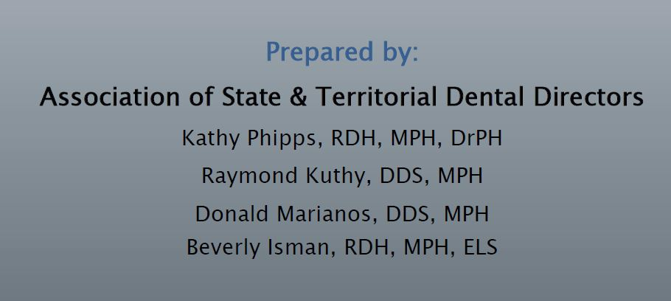
http://www.astdd.org/docs/state-based-oral-health-surveillance-systems-cste-whitepaper-oct-2013.pdf

Slide 8
http://www/astdd/prg/docs/state-based-oral-health-surveillance-systems-cste-whitepaper-oct-2013.pdf

Slide 9
Open Data Platform https://chronicdata.cdc.gov

Slide 11
https://www.cdc.gov/oralhealth/index.html

Slide 12
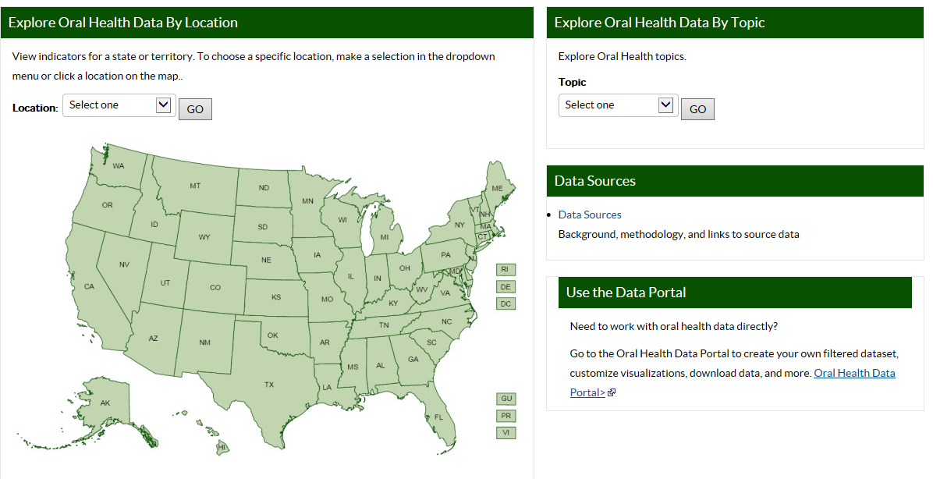
cdc.gov/oralhealthdata Home Page
View data by state
View by topic
Access background and help pages
Work directly with data

Slide 13
Oral Health Data – Data sets
Caries experience (3rd graders)
Untreated tooth decay (3rd graders)
Dental sealants (3rd graders)
Water fluoridation status
Dental visit (adults)
Teeth cleaning (adults)
Complete tooth loss (older adults)
Loss of 6 or more teeth (older adults)
Synopses 13 indicators
State Oral Health Survey, 3rd grade
(Basic Screening Survey protocol)
Water Fluoridation Reporting System (WFRS)
Behavioral Risk Factor Surveillance System (BRFSS)
ASTDD Synopses
Notes:
.
13

Slide 14
cdc.gov/oralhealthdata Home Page
View data by state
View by topic
Access background and help pages
Work directly with data

Slide 15
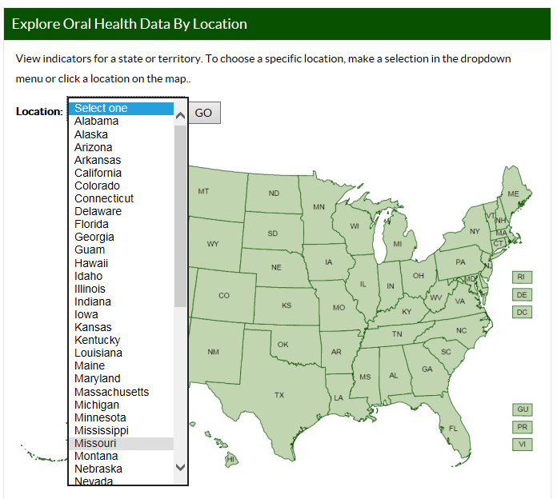
cdc.gov/oralhealthdata
View indicators
for one state

Slide 16
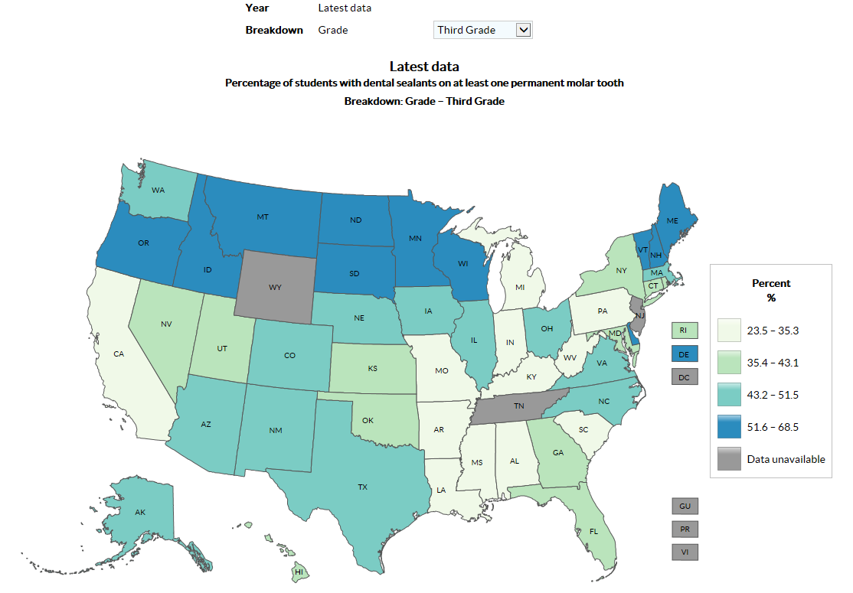
cdc.gov/oralhealthdata

Slide 17
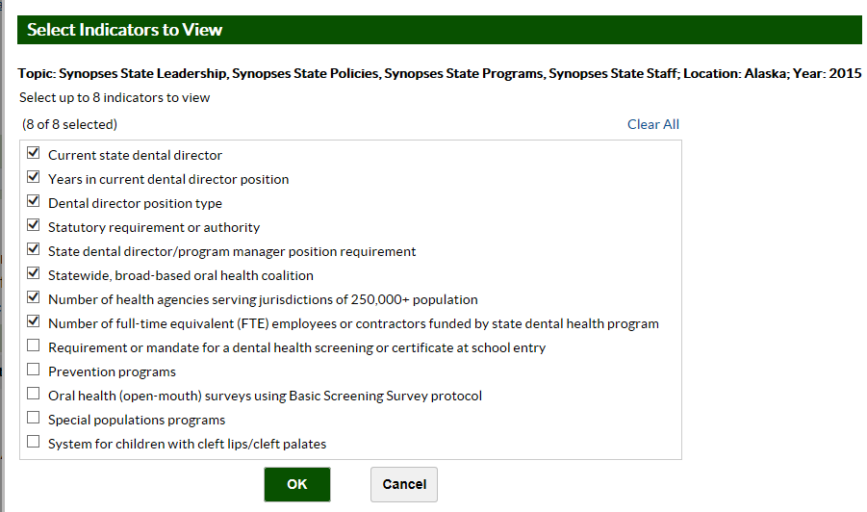

Slide 18
Future: County-level Water Fluoridation

Slide 19
cdc.gov/oralhealthdata Home Page
View data by state
View by topic
Access background and help pages
Work directly with data

Slide 20
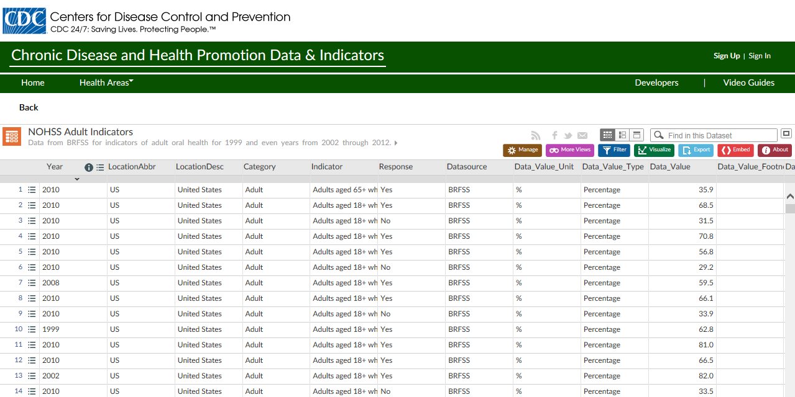
Interact with Views
Click to interact with a data view
To filter, graph, map or export data sets

Slide 21
Visualize Data
Charts
Many options to customize display
Color
Error bars
Labels (axes, data points, etc.)
Annotations
Legend (content and placement)
Flyout (details on mouse hover/click)

Slide 23
Open Data Platform https://chronicdata.cdc.gov

Slide 24
500 Cities Data

Slide 26
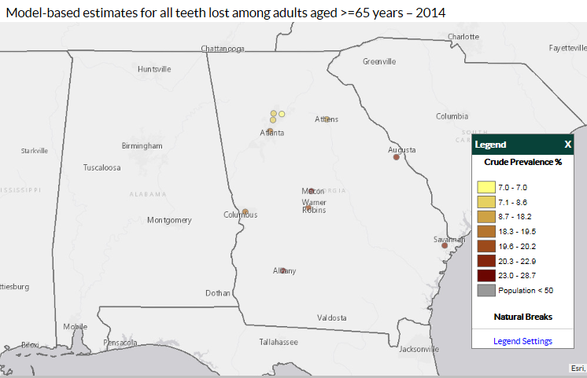

Slide 28
Dental Visits by Census Tract Atlanta, Georgia 2014

Slide 29
BRFSS

Slide 30
BRFSS MMSA

Slide 31
BRFSS WEAT Cross Tabulations

Slide 32
Chronic Disease Indicators

Slide 36
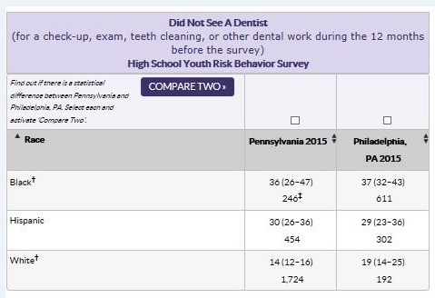

Slide 37
https://www.statecancerprofiles.cancer.gov

Slide 38
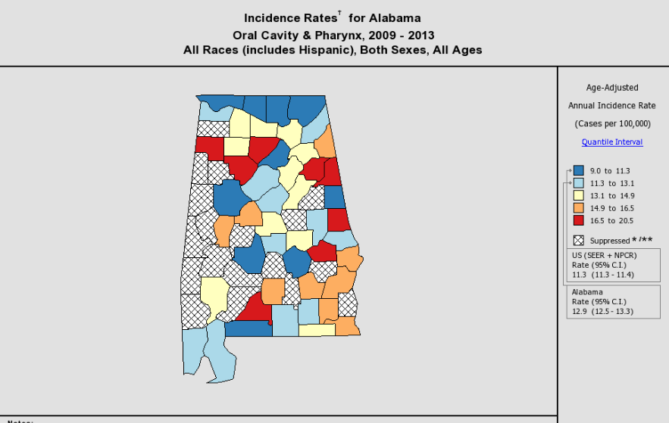

Slide 39
OBJECTIVES
Open Data Platform
Core Surveillance Indicators
Visualizations

Slide 41
RESOURCES
http://www.astdd.org/data-collection-assessment-and-surveillance-committee
Data Collection, Assessment and Surveillance Committee section which has links to all of the webcasts and other documents.

Slide 42
For more information please contact Centers for Disease Control and Prevention
1600 Clifton Road NE, Atlanta, GA 30333
Telephone: 1-800-CDC-INFO (232-4636)/TTY: 1-888-232-6348
Visit: www.cdc.gov | Contact CDC at: 1-800-CDC-INFO or www.cdc.gov/info
The findings and conclusions in this report are those of the authors and do not necessarily represent the official position of the Centers for Disease Control and Prevention.
National Center for Chronic Disease Prevention and Health Promotion
Division of Oral Health

Slide 43
Presenter Contact Info
Valerie Robison, DDS, MPH, PhD
Division of Oral Health
Centers for Disease Control and Prevention
vcr6@cdc.gov

Slide 44
Questions?
If you have a question, please click on the little man with his arm raised icon on either the upper left or the top of your screen. Click on “raise hand.” We will then call on you to ask your question over the phone.

