Slide 1

Dental Sealants
Evidence-Based Guidance
Standardization Training
This presentation was supported by Cooperative Agreement NU58DP006573-02-01
February 20, 2020
Notes:
How to use this PowerPoint Presentation?
This PowerPoint presentation is designed to train and/or assist dental providers with standardizing the process of selecting teeth for sealant placement.
Difference between “Standardization” vs “Calibration” training
“Standardization” training includes didactic presentation to assist with tooth selection criteria using clinical photographs for dental providers who place sealants. The PowerPoint training is meant to be used for information dissemination and to show clinical examples of sound, cavitated, and non-cavitated lesions on tooth surfaces. A pretest/ post test evaluation may also be used to assess the impact of the training on knowledge of tooth selection for sealant placement.
“Calibration” training includes didactic presentation and clinical calibration of screeners/sealant providers. (Didactic component must precede clinical component.) During the "hands on" calibration session, providers will individually conduct an in-mouth screening/exam on a human subject (child) and record clinical findings for each tooth. The purpose of the clinical training is to determine status of tooth surface (sound, cavitated, or non-cavitated) and build consensus on whether it is appropriate to place dental sealants. The goal of dental provider calibration is to obtain excellent inter-examiner reliability.
The NOTES within this PowerPoint presentation are solely for the purpose of additional information or references for the presenter and are not intended to be read verbally as part of the didactic presentation.

Slide 2
Presentation Overview
Review evidence-based guidance for sealant use
  Key questions
    1. What is the effectiveness of sealants in preventing caries initiation?
    2. What is the effectiveness of sealants in preventing caries progression?
    3. What is the effectiveness of sealants in reducing bacteria levels in caries lesions?
    4. Does four-handed technique improve sealant retention?
    5. Does the addition of mechanical preparation with a bur improve sealant retention?
    6. Does the use of bonding agent increases retention?
Notes:
Presentation will review evidence-based guidance for sealant use:
- Key questions
- Findings
- Current recommendations

Slide 3
Presentation Overview
Review evidence-based guidance for sealant use
  Key questions
    7. Does surface cleaning by toothbrush or dental handpiece result in similar retention rates?
    8. Are teeth that lose sealants at higher risk of tooth decay than teeth that were never sealed?
    9. Which caries assessment methods should be used in school programs to differentiate pit-and-fissure surfaces that are sound or non-cavitated from those that are cavitated?
  Findings
  Current recommendations

Slide 4
Why Evidence?
Constant or shrinking resources require that public health programs and publicly-funded healthcare delivery programs focus on effective and efficient practices
“Evidence-based” approaches incorporate the best available scientific information into decision-making*
Based on Sackett et al., BMJ 1996
Notes:
4
Why is Evidence important?
It is important that public health and publically-funded programs use evidence-based practices that have shown to be effective and efficient.
Evidence-based research uses available scientific information to help with decision-making.

Slide 5
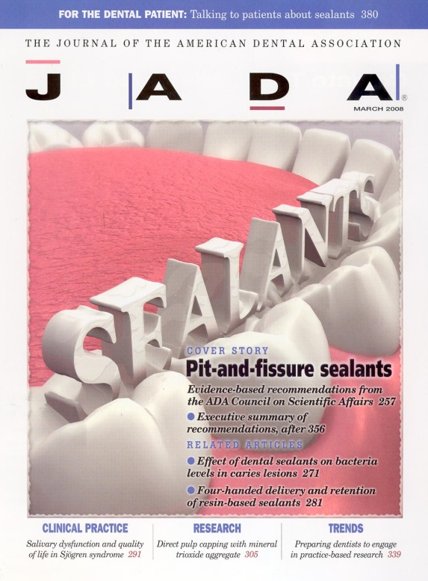
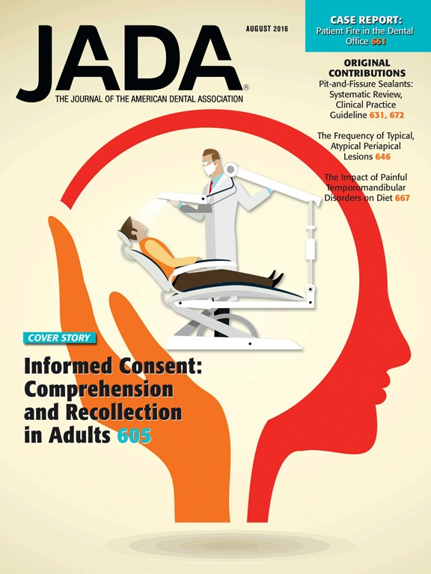
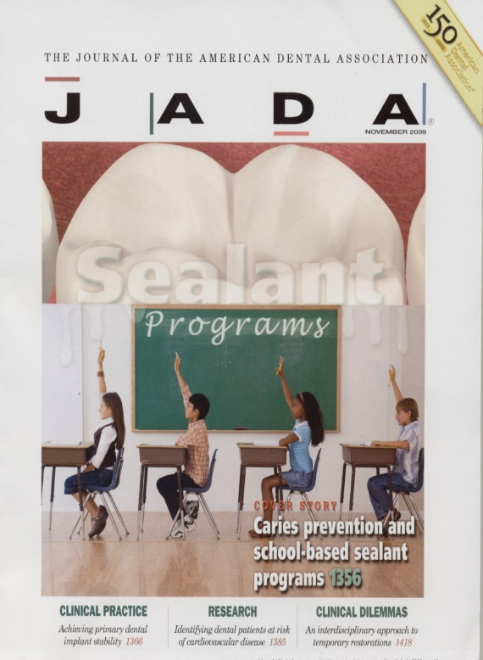
ASTDD Sealant Guidance
Clinical settings | School-based programs
Published 2008 and 2016 - JADA | Published 2009 - JADA
Expert panel | Expert panel
ADA | CDC-Supported
Notes:
Article Reference
Journal of the American Dental Association (JADA) 2016:147(8):672-682. Evidence-based clinical practice guideline for the use of pit-and-fissure sealants A report of the American Dental Association and the American Academy of Pediatric Dentistry. John T. Wright, DDS, MS; James J. Crall, DDS, MS, ScD; Margherita Fontana, DDS, PhD; E. Jane Gillette, DDS; Brian B. Nový, DDS; Vineet Dhar, BDS, MDS, PhD; Kevin Donly, DDS, MS; Edmond R. Hewlett, DDS; Rocio B. Quinonez, DMD, MS, MPH; Jeffrey Chaffin, DDS, MPH, MBA, MHA; Matt Crespin, MPH, RDH; Timothy Iafolla, DMD,MPH; Mark D. Siegal, DDS, MPH; Malavika P. Tampi, MPH; Laurel Graham, MLS; Cameron Estrich, MPH; Alonso Carrasco-Labra, DDS, MSc, PhD(c)
Abstract
Background: This article presents evidence-based clinical recommendations for the use of pit-and-fissure sealants on the occlusal surfaces of primary and permanent molars in children and adolescents. A guideline panel convened by the American Dental Association (ADA) Council on Scientific Affairs and the American Academy of Pediatric. Dentistry conducted a systematic review and formulated recommendations to address clinical questions in relation to the efficacy, retention, and potential side effects of sealants to prevent dental caries; their efficacy compared with fluoride varnishes; and a head-to-head comparison of the different types of sealant material used to prevent caries on pits and fissures of occlusal surfaces.
Types of Studies Reviewed. This is an update of the ADA 2008 recommendations on the use of pit-and-fissure sealants on the occlusal surfaces of primary and permanent molars. The authors conducted a systematic search in MEDLINE, Embase, Cochrane Central Register of Controlled Trials, and other sources to identify randomized controlled trials reporting on the effect of sealants (available on the US market) when applied to the occlusal surfaces of primary and permanent molars. The authors used the Grading of Recommendations Assessment, Development, and Evaluation approach to assess the quality of the evidence and to move from the evidence to the decisions.
Results. The guideline panel formulated 3 main recommendations. They concluded that sealants are effective in preventing and arresting pit-and-fissure occlusal carious lesions of primary and permanent molars in children and adolescents compared with the nonuse of sealants or use of fluoride varnishes. They also concluded that sealants could minimize the progression of non-cavitated occlusal carious lesions (also referred to as initial lesions) that receive a sealant. Finally, based on the available limited evidence, the panel was unable to provide specific recommendations on the relative merits of 1 type of sealant material over the others.
Conclusions and Practical Implications. These recommendations are designed to inform practitioners during the clinical decision-making process in relation to the prevention of occlusal carious lesions in children and adolescents. Clinicians are encouraged to discuss the information in this guideline with patients or the parents of patients. The authors recommend that clinicians reorient their efforts toward increasing the use of sealants on the occlusal surfaces of primary and permanent molars in children and adolescents.

Slide 6
Questions and Findings
1. What is the effectiveness of sealants in preventing caries initiation?
Systematic reviews confirm effectiveness
Ahovuo-Saloranta A, Cochrane (2017);
Wright JT, JADA (2016)
Notes:
6
Article References
Cochrane Library. 2017. Pit and fissure sealants for preventing dental decay in permanent teeth. Anneli Ahovuo-Saloranta, Helena Forss , Tanya Walsh, Anne Nordblad, Marjukka Mäkelä, Helen V Worthington
Version published: 31 July 2017.
Study characteristics: We included 38 studies that involved 7924 young people (aged 5 to 16 years) among whom a variety of dental sealants was used to prevent tooth decay. Young people in the studies represented the general population. The review includes studies available from a search of the literature up to 3 August 2016. We assessed all studies as being at high risk of bias because the dental professionals who are measuring the outcomes can see whether or not sealant has been used.
Key results: Fifteen studies compared resin-based sealants to no sealants and found that children who had sealant applied to their back teeth were less likely to have tooth decay in their back teeth than children with no sealant. We were able to combine data from seven of these studies (including two published since 2010), which involved children who were aged from 5 to 10 years when the sealants were applied. This showed that if 40% of back teeth develop decay over 24 months, using sealant reduces this to 6%. Similar benefits for resin-based sealants were shown up to four years. The effect appeared to persist when measured up to nine years, but there was less evidence. Results were inconclusive when glass ionomer-based sealant was compared with no sealant and when one type of sealant material was compared with another. Four studies assessed possible problems from using sealants; none were reported.
Quality of the evidence: We found moderate-quality evidence that resin-based sealant is more effective than no sealant for preventing tooth decay, reducing it by between 11% and 51% more than in children without sealant (measured two years after application). 'Moderate quality' means we are reasonably certain of this finding, although it is possible that future research could change it. Most of the studies included in this analysis were carried out in the 1970s. We are not able to draw conclusions about the other comparisons included in our review as the available evidence is very low quality. More studies with long follow-up times are needed.
**************************************************************************************************************************************************************************************************************************
JADA, 2016:147(8):631-645. Sealants for preventing and arresting pit-and-fissure occlusal caries in primary and permanent molars. A systematic review of randomized controlled trials—a report of the American Dental Association and the American Academy of Pediatric Dentistry. John T. Wright, DDS, MS; Malavika P. Tampi, MPH; Laurel Graham, MLS; Cameron Estrich, MPH; James J. Crall, DDS, MS, ScD; Margherita Fontana, DDS, PhD; E. Jane Gillette, DDS; Brian B. Nový, DDS; Vineet Dhar, BDS, MDS, PhD; Kevin Donly, DDS, MS; Edmond R. Hewlett, DDS; Rocio B. Quinonez, DMD, MS, MPH; Jeffrey Chaffin, DDS, MPH, MBA, MHA; Matt Crespin, MPH, RDH; Timothy Lafolla, DMD, MPH; Mark D. Siegal, DDS, MPH; Alonso Carrasco- Labra, DDS, MSc, PhD(c), Journal of the American Dental Association.
Abstract
Type of Studies Reviewed: The authors included parallel and split-mouth randomized controlled trials that included at least 2 years of follow-up, which they identified using MEDLINE (via PubMed), Embase, LILACS, the Cochrane Central Register of Controlled Trials, and registers of ongoing trials. Pairs of reviewers independently conducted the selection of studies, data extraction, risk of bias assessments, and quality of the evidence assessments by using the Grading of Recommendations Assessment, Development and Evaluation approach.
Results: Of 2,869 records screened, the authors determined that 24 articles (representing 23 studies) proved eligible. Moderate-quality evidence suggested that participants who received sealants had a reduced risk of developing carious lesions in occlusal surfaces of permanent molars compared with those who did not receive sealants after 7 or more years of follow-up. When the authors compared studies whose investigators had compared sealants with fluoride varnishes, they found that sealants reduced the incidence of carious lesions after 7 or more years of follow-up ; however, this finding was supported by low-quality evidence. On the basis of the evidence, the authors could not provide a hierarchy of effectiveness among the studies whose investigators had conducted head-to-head comparisons. The investigators of 2 trials provided information about adverse events, but they did not report any adverse events.
Conclusions and Practical Implications: Available evidence suggests that sealants are effective and safe to prevent or arrest the progression of non-cavitated carious lesions compared with a control without sealants or fluoride varnishes. Further research is needed to provide information about the relative merits of the different types of sealant materials.

Slide 7
Findings of Systematic Reviews
Strong evidence for sealant effectiveness for prevention of caries initiation on “sound” surfaces
  Effect of large magnitude
  Positive effect across included studies
Notes:
7

Slide 8
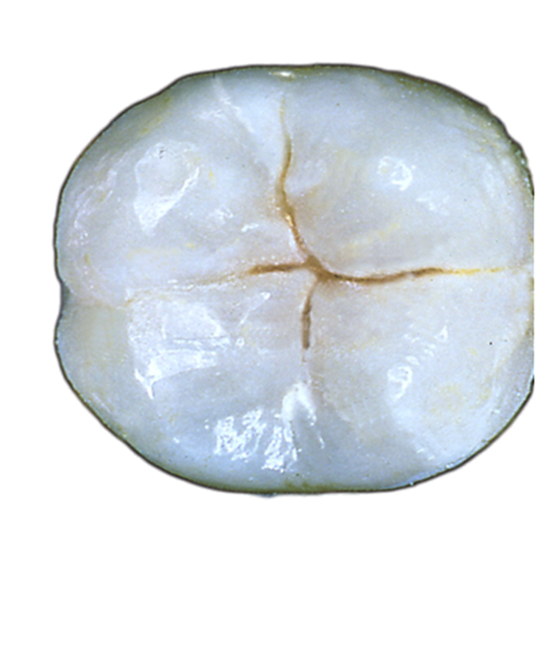
Questions and Findings
2. What is the effectiveness of sealants in preventing caries progression?
2008 systematic review found
that sealants are effective in
reducing the percent of non-
cavitated carious lesions that
progress to cavitation
Griffin SO, J Dent Res (2008)
Notes:
8
Article Reference
The effectiveness of sealants in managing caries lesions. Griffin SO¹, Oong E, Kohn W, Vidakovic B, Gooch BF; CDC Dental Sealant Systematic Review Work Group, Bader J, Clarkson J, Fontana MR, Meyer DM, Rozier RG, Weintraub JA, Zero DT. Journal of Dental Research 87(2):169-74 · March 2008

Slide 9
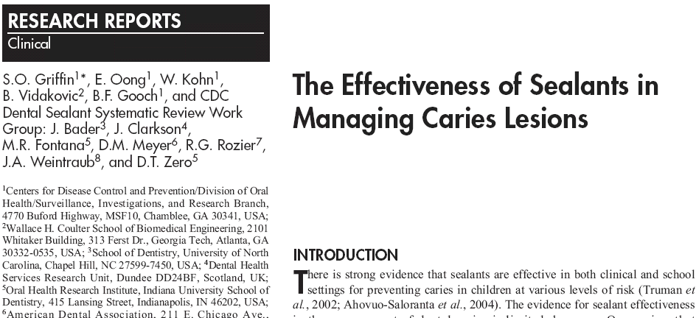
Journal of Dental Research 2008 87(2): 169-174
Sealants reduced the percentage of non-cavitated caries lesions that progressed by 71%.
Notes:
Abstract
A barrier to providing sealants is concern about inadvertently sealing over caries. This meta-analysis examined the effectiveness of sealants in preventing caries progression. We searched electronic databases for comparative studies examining caries progression in sealed permanent teeth. We used a random-effects model to estimate percentage reduction in the probability of caries progression in sealed vs. unsealed carious teeth. Six studies, including 4 randomized-controlled trials (RCT) judged to be of fair quality, were included in the analysis (384 persons, 840 teeth, and 1090 surfaces). The median annual percentage of non-cavitated lesions progressing was 2.6% for sealed and 12.6% for unsealed carious teeth. The summary prevented fraction for RCT was 71.3% (95% CI: 52.8%-82.5, no heterogeneity) up to 5 years after placement. Despite variation among studies in design and conduct, sensitivity analysis found the effect to be consistent in size and direction. Sealing non-cavitated caries in permanent teeth is effective in reducing caries progression.

Slide 10
Questions and Findings
3. What is the effectiveness of sealants in reducing bacteria levels in caries lesions?
A systematic review found
that sealants are effective in lowering
bacteria levels.
Oong E, JADA (2008)
Notes:
10
Article Reference
The Effect of Dental Sealants on Bacteria Levels in Caries Lesions. Oong, Ella M. et al. The Journal of the American Dental Association, Volume 139, Issue 3, 271 – 278.
http://jada.ada.org, March 2008

Slide 11
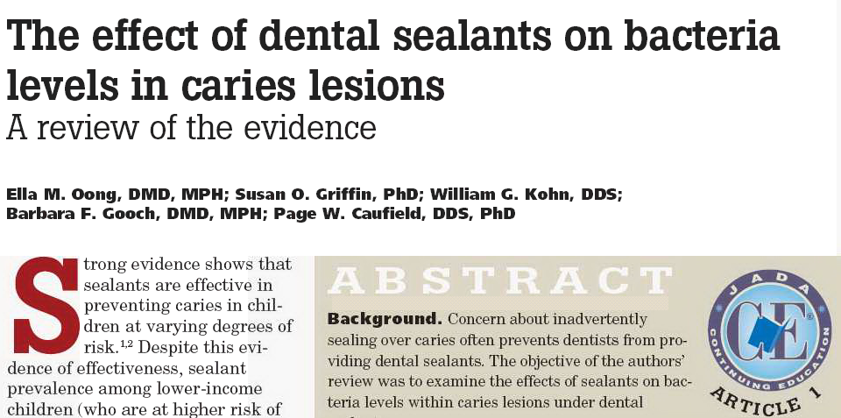
JADA 2008; 139(3):271-278
Sealants lowered bacteria levels by at least 100-fold.
Notes:
Abstract
Background: Concern about inadvertently sealing over caries often prevents dentists from providing dental sealants. The objective of the authors’ review was to
examine the effects of sealants on bacteria levels within caries lesions under dental sealants.
Methods: The authors searched electronic databases for comparative studies examining bacteria levels in sealed permanent teeth. To measure the effect of sealants on
Bacteria levels, they used the log10 reduction in mean total viable bacteria counts (VBC) between sealed and not-sealed caries and the percentage reduction in the
proportion of samples with viable bacteria.
Results: Six studies—three randomized controlled trials, two controlled trials and one before-and-after study—were included in the analysis. Although studies varied
considerably, there were no findings of significant increases in bacteria under sealants. Sealing caries was associated with a 100-fold reduction in mean total VBC (four
studies, 138 samples). Sealants reduced the probability of viable bacteria by about 50.0 percent (four studies, 117 samples).
Conclusions: The authors found that sealants reduced bacteria in carious lesions, but that in some studies, low levels of bacteria persisted. These findings do not support
Reported concerns about poorer outcomes associated with inadvertently sealing caries. Clinical Implications. Practitioners should not be reluctant to provide sealants
— an intervention proven to be highly effective in preventing caries—because of concerns about inadvertently sealing over caries.

Slide 12
ADA Clinical Recommendations
Sealants can be placed in pits and fissures of children’s primary teeth when it is determined that the tooth or patient is at risk of developing caries
Wright JT, JADA (2016)
Notes:
Article Reference
Evidence-based clinical practice guideline for the use of pit-and-fissure sealants A report of the American Dental Association and the American Academy of Pediatric Dentistry.
John T. Wright, DDS, MS; James J. Crall, DDS, MS, ScD; Margherita Fontana, DDS, PhD; E. Jane Gillette, DDS; Brian B. Nový, DDS; Vineet Dhar, BDS, MDS, PhD; Kevin Donly, DDS, MS; , Edmond R. Hewlett, DDS; Rocio B. Quinonez, DMD, MS, MPH; Jeffrey Chaffin, DDS, MPH, MBA, MHA; Matt Crespin, MPH, RDH; , Timothy Lafolla, DMD, MPH: Mark D. Siegal, DDS, MPH; Malavika P. Tampi, MPH; Laurel Graham, MLS; Cameron Estrich, MPH; Alonso Carrasco-Labra, DDS, MSc, PhD(c). Journal of the American Dental Association , 2016:147(8):672-682.
Abstract
Background: This article presents evidence-based clinical recommendations for the use of pit-and-fissure sealants on the occlusal surfaces of primary and permanent molars in children and adolescents. A guideline panel convened by the American Dental Association (ADA) Council on Scientific Affairs and the American Academy of Pediatric Dentistry conducted a systematic review and formulated recommendations to address clinical questions in relation to the efficacy, retention, and potential side effects of sealants to prevent dental caries; their efficacy compared with fluoride varnishes; and a head-to-head comparison of the different types of sealant material used to prevent caries on pits and fissures of occlusal surfaces.
Types of Studies Reviewed: This is an update of the ADA 2008 recommendations on the use of pit-and-fissure sealants on the occlusal surfaces of primary and permanent molars. The authors conducted a systematic search in MEDLINE, Embase, Cochrane Central Register of Controlled Trials, and other sources to identify randomized controlled trials reporting on the effect of sealants (available on the US market) when applied to the occlusal surfaces of primary and permanent molars. The authors used the Grading of Recommendations Assessment, Development, and Evaluation approach to assess the quality of the evidence and to move from the evidence to the decisions.
Results: The guideline panel formulated 3 main recommendations. They concluded that sealants are effective in preventing and arresting pit-and-fissure occlusal carious lesions of primary and permanent molars in children and adolescents compared with the nonuse of sealants or use of fluoride varnishes. They also concluded that sealants could minimize the progression of non-cavitated occlusal carious lesions (also referred to as initial lesions) that receive a sealant. Finally, based on the available limited evidence, the panel was unable to provide specific recommendations on the relative merits of 1 type of sealant material over the others.
Conclusions and Practical Implications: These recommendations are designed to inform practitioners during the clinical decision-making process in relation to the prevention of occlusal carious lesions in children and adolescents. Clinicians are encouraged to discuss the information in this guideline with patients or the parents of patients. The authors recommend that clinicians reorient their efforts toward increasing the use of sealants on the occlusal surfaces of primary and permanent molars in children and adolescents.

Slide 13
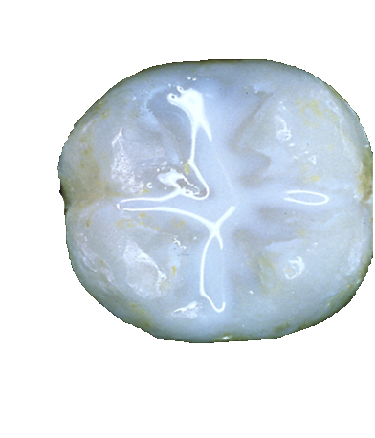
Guidance for School-Based
Sealant Programs
Seal sound pit and fissure surfaces
Seal non-cavitated pit-and-fissure surfaces
Gooch et al, JADA (2009)
Notes:
Article Reference
Preventing Dental Caries Through School-Based Sealant Programs. Gooch, Barbara F. et al. The Journal of the American Dental Association, Volume 140, Issue 11, 1356 – 1365.
Abstract
Background: School-based sealant programs (SBSPs) increase sealant use and reduce caries. Programs target schools that serve children from low-income families and focus on sealing newly erupted permanent molars. In 2004 and 2005, the Centers for Disease Control and Prevention (CDC), Atlanta, sponsored meetings of an expert work group to update recommendations for sealant use in SBSPs on the basis of available evidence regarding the effectiveness of sealants on sound and carious pit and fissure surfaces, caries assessment and selected sealant placement techniques, and the risk of caries’ developing in sealed teeth among children who might be lost to follow-up. The work group also identified topics for which additional evidence review was needed.
Types of Studies Reviewed: The work group used systematic reviews when available. Since 2005, staff members at CDC and subject matter experts conducted several independent analyses of topics for which no reviews existed. These reviews include a systematic review of the effectiveness of sealants in managing caries.
Results: The evidence supports recommendations to seal sound surfaces and non-cavitated lesions, to use visual assessment to detect surface cavitation, to use a toothbrush or handpiece prophylaxis to clean tooth surfaces, and to provide sealants to children even if follow-up cannot be ensured.
Clinical Implications: These recommendations are consistent with the current state of the science and provide appropriate guidance for sealant use in school-based sealant programs (SBSP).

Slide 14
Questions and Findings
4. Does four-handed technique improve sealant retention?
Using four-handed delivery to place resin based sealants may increase retention
Gooch et al, JADA (2009)
Notes:
Article Reference
Exploring four-handed delivery and retention of resin-based sealants. Susan O. Griffin, PhD; Kari Jones, PhD; Shellie Kolavic Gray, DMD, MPH; Dolores M. Malvitz, DrPH; Barbara F. Gooch, DMD, MPH
JADA 2008;139(3):281-289.

Slide 15
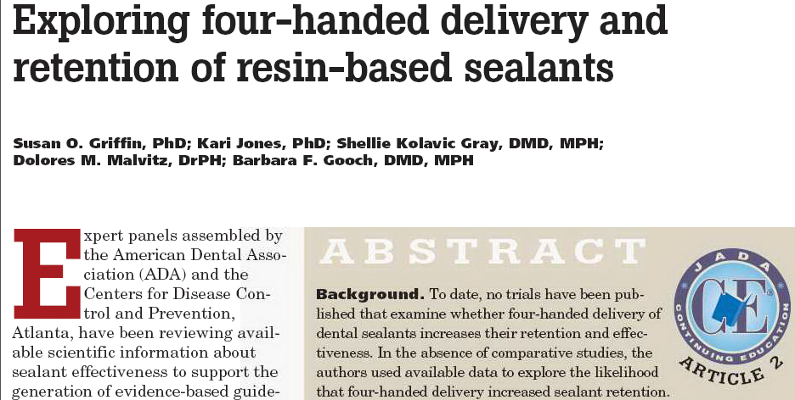
JADA 2008; 139(3): 281-289
Four-handed delivery is associated with higher sealant retention
Four-handed delivery is associated with higher sealant retention.
Notes:
Abstract
Background: To date, no trials have been published that examine whether four-handed delivery of dental sealants increases their retention and effectiveness. In the absence of comparative studies, the authors used available data to explore the likelihood that four-handed delivery increased sealant retention.
Methods: The authors examined data regarding the retention of autopolymerized resin-based sealants from studies included in systematic reviews of sealant effectiveness. The explanatory variable of primary interest was the presence of a second operator. To examine the unique contribution of four-handed delivery to sealant retention, the authors used linear regression models.
Results: Eleven of the 36 studies from systematic reviews met explicit criteria and were included in this analysis. The high level of heterogeneity among studies suggested that multivariate analysis was the correct approach. According to the regression model, the presence of a second operator increased retention by 9 percentage points.
Conclusions: For this group of studies, four-handed delivery of auto-polymerized sealants was associated with increased sealant retention. Clinical Implications. Using four-handed delivery to place resin based sealants may increase retention.

Slide 16
Questions and Findings
5. Does the addition of mechanical preparation with a bur improve sealant retention?
Limited evidence cannot determine effect (systematic review & clinical studies)
Beauchamp J, JADA 2008; Muller-Bolla M, CDOE (2006)
Notes:
16
Article Reference
Evidence-Based Clinical Recommendations for the Use of Pit-and-Fissure Sealants. Beauchamp, Jean et al. The Journal of the American Dental Association, Volume 139, Issue 3, 257 – 268
Abstract
Background: This article presents evidence-based clinical recommendations for use of pit-and-fissure sealants developed by an expert panel convened by the American Dental Association Council on Scientific Affairs. The panel addressed the following clinical questions: Under what circumstances should sealants be placed to prevent caries? Does placing sealants over early (non-cavitated) lesions prevent progression of the lesion? Are there conditions that favor the placement of resin-based versus. glass ionomer cement sealants in terms of retention or caries prevention? Are there any techniques that could improve sealants’ retention and effectiveness in caries prevention?
Types of Studies Reviewed: Staff of the ADA Division of Science conducted a MEDLINE search to identify systematic reviews and clinical studies published after the identified systematic reviews. At the panel’s request, the ADA Division of Science staff conducted additional searches for clinical studies related to specific topics. The Centers for Disease Control and Prevention also provided unpublished systematic reviews that since have been accepted for publication.
Results: The expert panel developed clinical recommendations for each clinical question. The panel concluded that sealants are effective in caries prevention and that sealants can prevent the progression of early non-cavitated carious lesions.
Clinical Implications: These recommendations are presented as a resource to be considered in the clinical decision-making process. As part of the evidence-based approach to care, these clinical recommendations should be integrated with the practitioner’s professional judgment and the patient’s needs and preferences. The evidence indicates that sealants can be used effectively to prevent the initiation and progression of dental caries.
**********************************************************************************************************************************************************************************************************************
Article Reference – Community Dentistry and Oral Epidemiology (CDOE)
Retention of resin‐based pit and fissure sealants: a systematic review. Michèle Muller‐Bolla; Laurence Lupi‐Pégurier; Corinne Tardieu; Ana Miriam Velly; Constance Antomarchi. Community Dentistry and Oral Epidemiology, Volume 34, Issue 5 First published: 01 September 2006.
Abstract
The aim of the present study was to perform a systematic review on the retention of resin‐based sealants (RBSs) according to the material used and the clinical procedure. An electronic search in MEDLINE, EMBASE, Cochrane library and SCOPUS was completed by a hand search in conference proceedings. One hundred and twenty‐four studies were identified, 31 of which were included. The retention rate of auto‐polymerized and light‐cured RBSs did not differ significantly. Light‐cured RBSs had a significantly higher retention rate than fluoride‐containing light‐cured RBSs at 48 months . Concerning the clinical procedure, the scarcity of well‐conducted studies made judgement difficult, except for the isolation stage. If using a rubber dam did not affect retention of auto‐polymerized RBSs, it did for fluoride‐containing light‐cured RBSs.

Slide 17
Questions and Findings
6. Does the use of bonding agent increases retention?
  ADA recommended use of a compatible one-bottle bonding agent (which contains both an adhesive and a primer) between the previously acid-etched enamel surface and the sealant material when, in the opinion of the dental professional, the bonding agent would enhance sealant retention in the clinical situation.
Beauchamp et al, JADA (2008)
Notes:
Article reference
Evidence-Based Clinical Recommendations for the Use of Pit-and-Fissure Sealants. Beauchamp, Jean et al. The Journal of the American Dental Association, Volume 139, Issue 3, 257 – 268.
Abstract
Background: This article presents evidence-based clinical recommendations for use of pit-and-fissure sealants developed by an expert panel convened by the American Dental Association Council on Scientific Affairs. The panel addressed the following clinical questions: Under what circumstances should sealants be placed to prevent caries? Does placing sealants over early (non-cavitated) lesions prevent progression of the lesion? Are there conditions that favor the placement of resin-based versus. glass ionomer cement sealants in terms of retention or caries prevention? Are there any techniques that could improve sealants’ retention and effectiveness in caries prevention?
Types of Studies Reviewed: Staff of the ADA Division of Science conducted a MEDLINE search to identify systematic reviews and clinical studies published after the identified systematic reviews. At the panel’s request, the ADA Division of Science staff conducted additional searches for clinical studies related to specific topics. The Centers for Disease Control and Prevention also provided unpublished systematic reviews that since have been accepted for publication.
Results: The expert panel developed clinical recommendations for each clinical question. The panel concluded that sealants are effective in caries prevention and that sealants can prevent the progression of early non-cavitated carious lesions.
Clinical Implications: These recommendations are presented as a resource to be considered in the clinical decision-making process. As part of the evidence-based approach to care, these clinical recommendations should be integrated with the practitioner’s professional judgment and the patient’s needs and preferences. The evidence indicates that sealants can be used effectively to prevent the initiation and progression of dental caries.

Slide 18
Questions and Findings
7. Does surface cleaning by toothbrush or dental handpiece prophylaxis result in similar retention rates?
Limited evidence cannot determine effect. (systematic review). One clinical study suggests no difference.
Gillcrist JA, JPHD (1998); Griffin SO, JADA (2008);
Gray, JADA (2009); Muller-Bolla M, CDOE (2006)
Notes:
18
Article References
Clinical Sealant Retention Following Two Different Tooth‐cleaning Techniques
James A. Gillcrist DDS, MPH; Michelle P. Vaughan DDS ; George N. Plumlee Jr. MS, MBA ; George Wade MA
Journal of Public Health Dentistry, Volume 58, Issue 3, September 1998, Pages 254-256. Wiley Online Library.
A comparison of the effects of toothbrushing and handpiece prophylaxis on retention of sealants
Gray, Shellie Kolavic et al. The Journal of the American Dental Association, Volume 140, Issue 1, 38 – 46, 2009.
Retention of resin‐based pit and fissure sealants: a systematic review. Michèle Muller‐Bolla; Laurence Lupi‐Pégurier; Corinne Tardieu; Ana Miriam Velly; Constance Antomarchi. Community Dentistry and Oral Epidemiology, Volume 34, Issue 5. First published: 01 September 2006.

Slide 19
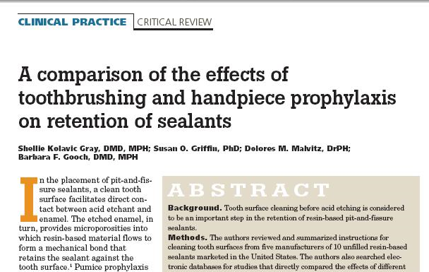
Toothbrushing was associated with similar, if not higher sealant retention than handpiece cleaning
JADA 2009; 140(1);38-46
Notes:
19
Abstract
Background: Tooth surface cleaning before acid etching is considered to be an important step in the retention of resin-based pit-and-fissure sealants.
Methods: The authors reviewed and summarized instructions for cleaning tooth surfaces from five manufacturers of 10 unfilled resin-based sealants marketed in the United States. The authors also searched electronic databases for studies that directly compared the effects of different surface-cleaning methods on sealant retention and for systematic reviews of the effectiveness of sealants. They explored the association between surface-cleaning methods and sealant retention in the studies included in the systematic reviews. They calculated the summary weighted retention rates for studies that used either a handpiece or toothbrush prophylaxis.
Results: All of the sealant manufacturers' instructions for use (IFU) recommended cleaning the tooth before acid etching. None of the IFU directly stated that a handpiece was required to perform the cleaning, but five IFU implied the use of handpiece prophylaxis. None of the IFU recommended surface-altering procedures in caries-free teeth. Direct evidence from two clinical trials showed no difference in complete sealant retention between surfaces cleaned mechanically with pumice or prophylaxis paste and those cleaned with air-water syringe or dry toothbrushing. Indirect evidence from 10 studies found that weighted summary retention by year after sealant placement in studies that used toothbrush prophylaxis was greater than or equivalent to values for studies that used handpiece prophylaxis.
Conclusions: Levels of sealant retention after surface cleaning with toothbrush prophylaxis were at least as high as those associated with hand-piece prophylaxis.
Clinical Implications: This finding may translate into lower resource costs for sealant placement.

Slide 20
Questions and Findings
8. Are teeth that lose sealants at higher risk of tooth decay than teeth that were never sealed?
A meta-analysis indicates that caries risk is similar.
Griffin et al, JADA (2009)
Notes:
20
Article Reference
Caries Risk in Formerly Sealed Teeth. Susan O. Griffin PhD; Shellie Kolavic Gray DMD; Dolores M.Malvitz DrPH; Barbara F.Gooch DMD, MPH;
Journal of the American Dental Association , Volume 140, Issue 4, April 2009, pages 415-423.

Slide 21
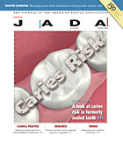
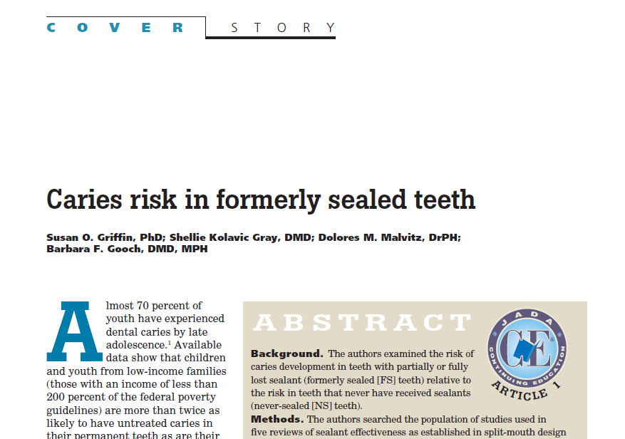
Caries Risk: Formerly vs. Never-Sealed Teeth
Notes:
Abstract
Background: The authors examined the risk of caries development in teeth with partially or fully lost sealant (formerly sealed [FS] teeth) relative to the risk in teeth that never have received sealants (never-sealed [NS] teeth).
Methods: The authors searched the population of studies used in five reviews of sealant effectiveness as established in split-mouth design studies involving resin-based sealants with no reapplication of lost sealant. They required included studies to contain sufficient data to estimate the risk of caries in FS teeth relative to that in NS teeth and its 95 percent confidence interval (CI). To estimate the mean RR by year since sealant placement, they used a weighted bivariate model and tested for heterogeneity using the quantity I².
Results: The weighted mean RR was 0.998 (95 percent CI, 0.817–1.220) one year after placement (four studies, 345 tooth pairs) and 0.936 (95 percent CI, 0.896–0.978) at four years (five studies, 1,423 tooth pairs).
Conclusions: Teeth with fully or partially lost sealant were not at a higher risk of developing caries than were teeth that had never been sealed.
Clinical Implications: Inability to provide a retention-check examination to all children participating in school sealant programs because of loss to follow-up should not disqualify a child from receiving sealants.

Slide 22
Questions and Findings
9. Which caries assessment methods should be used in school programs to differentiate pit-and-fissure surfaces that are sound or non-cavitated from those that are cavitated?
Visual assessment is appropriate to detect surface cavitation
Fontana M, JADA (2010)
Notes:
22
Article Reference
Techniques for assessing tooth surfaces in school-based sealant programs. Margherita Fontana, DDS, PhD; , Domenick T. Zero, DDS, MS; Eugenio D. Beltrán-Aguilar, DMD, MPH, MS, DrPH; Shellie Kolavic Gray, DMD, MPH. Journal of the American Dental Association, July 2010, Volume 141, Issue 7, Pages 854-860.
Abstract
Background: The authors reviewed the evidence supporting current guidelines for the detection of cavitated carious lesions. Currently, cavitation is the point at which sealants are not placed in school-based programs.
Types of Studies Reviewed: The authors did not perform a formal systematic review. However, they examined existing systematic reviews of caries detection and diagnosis, including those presented at the 2001 National Institutes of Health Consensus Conference on Management of Caries, published evidence related to the International Caries Detection and Assessment System criteria and other peer-reviewed publications. Where the authors found ambiguity or uncertainty in the evidence, they consulted with fellow members of an expert work group.
Results: Visual examination is appropriate and adequate for caries assessment before placing sealants. The clinician should not use an explorer under force. Radiographs are not indicated solely for the placement of sealants, and the use of magnification and caries detection devices is not necessary to determine cavitation.
Clinical Implications: This report focuses on tooth assessment, in particular the detection of carious lesion cavitation in school-based sealant programs. These recommendations must be balanced with the dentist's expertise, available treatment options, the patient's preferences and access to care.

Slide 23
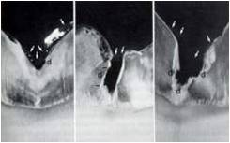
Do not Probe with a Sharp Explorer
Non-cavitated lesions can become cavitated
simply through pressure from the explorer during the typical examination.
Based on slide of M Fontana, DDS, PhD
Fontana, JADA 2010
Notes:
23
Do not probe with sharp explorer.
The use of explorers is not necessary for the detection of early lesions, and forceful use of a sharp explorer can damage tooth surfaces. The clinician should use recent radiographs, if available, in the decision-making process but should not obtain radiographs for the sole purpose of placing sealants. There are many technologies that detect caries. Recent reviews suggest that these devices should be used only as adjunctive devices to assist in caries diagnosis. These devices should serve primarily as a support tool for making preventive treatment plan decisions in conjunction with caries risk assessment, and sole reliance on these devices to detect caries may result in premature restorative intervention.

Slide 24
Clinical Examples
The following are clinical photos of permanent molars at different stages of lesion development, from sound to cavitated lesions. Each photo includes in the title the status (sound, non-cavitated, and cavitated), and the treatment indicated. Also, photos include a clinical description of the lesion(s).

Slide 25
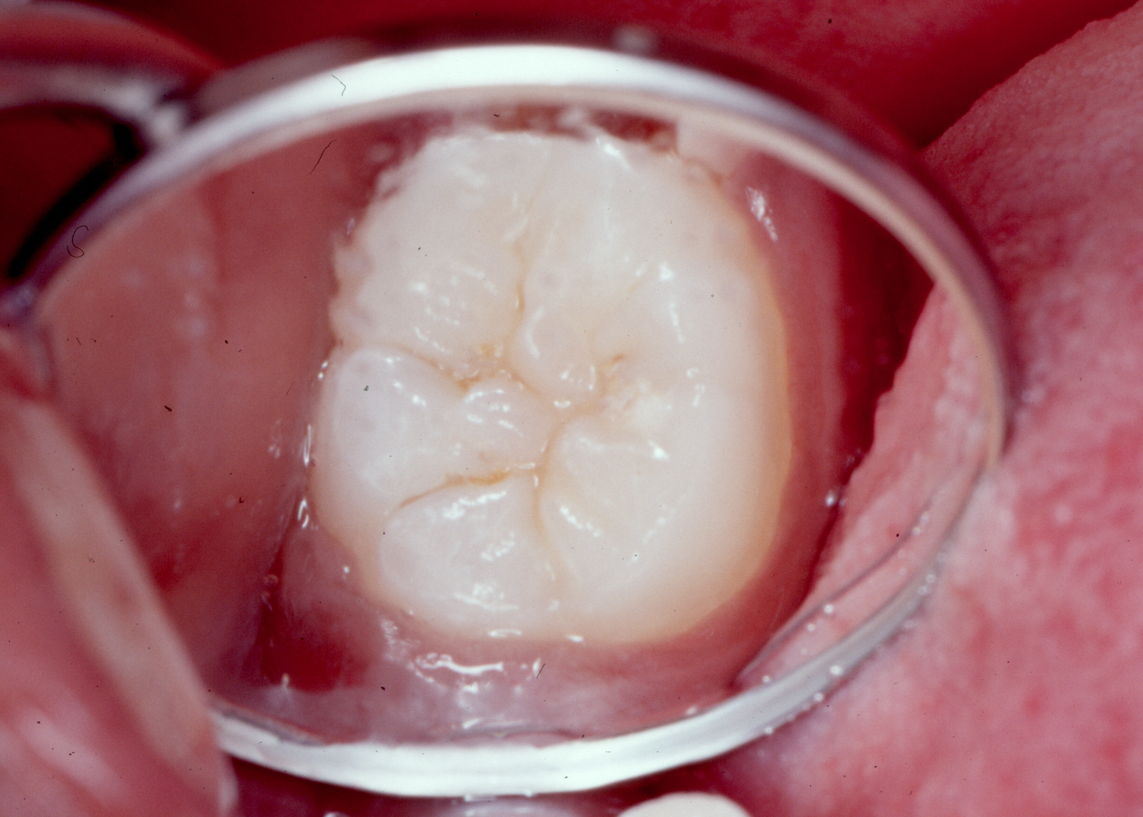
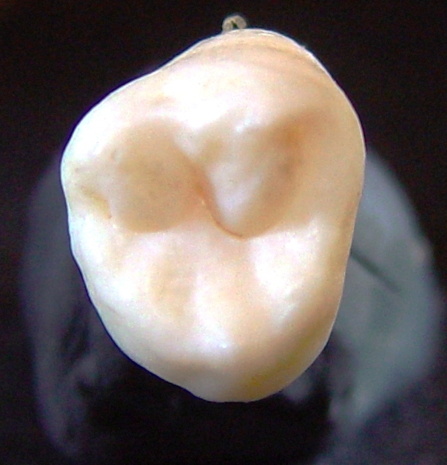
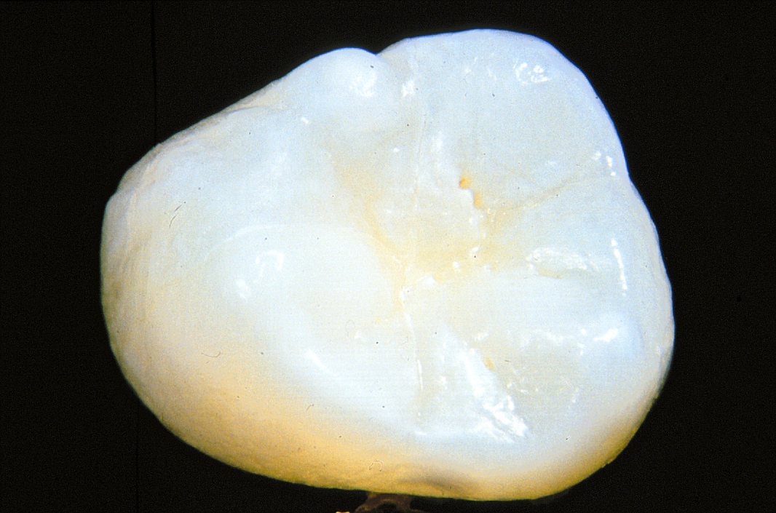
Sound Surfaces - Seal
Two molars that show no changes in color in the enamel’s pits and fissures.
Notes:
25

Slide 26
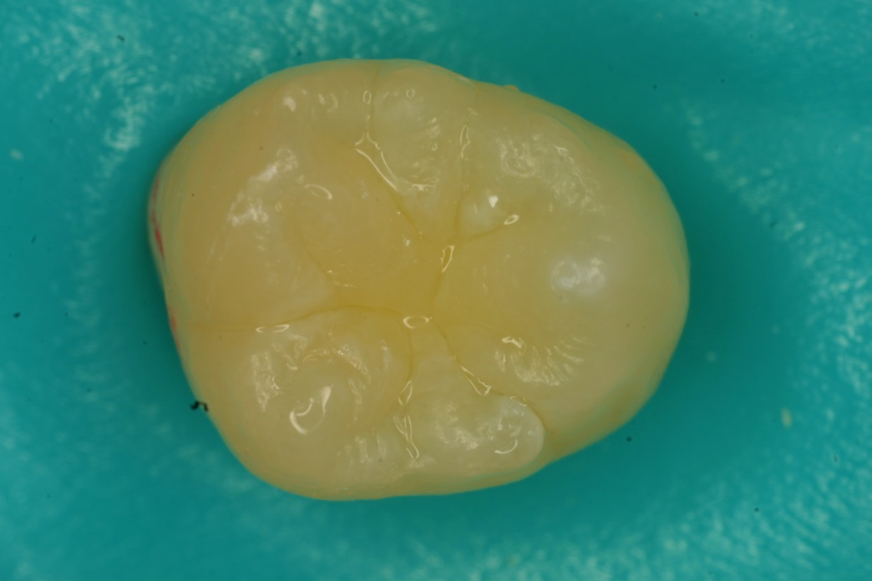
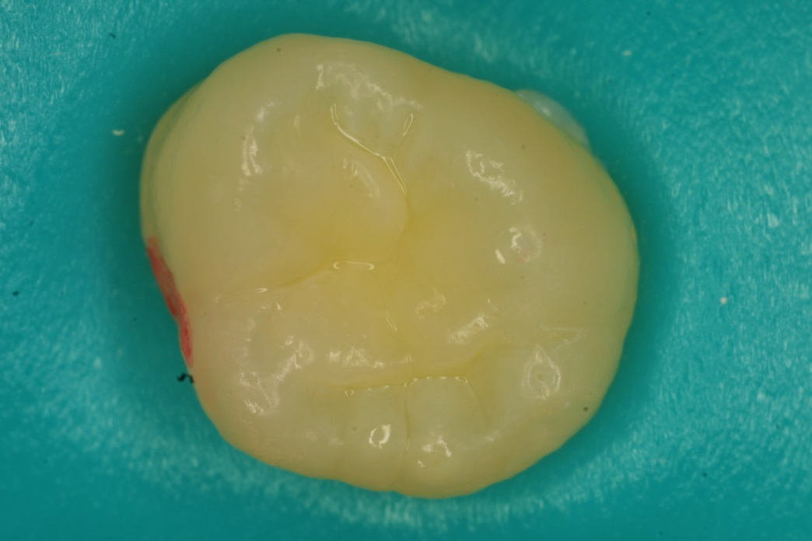
Sound Surfaces - Seal
Magnification 5X

Slide 27
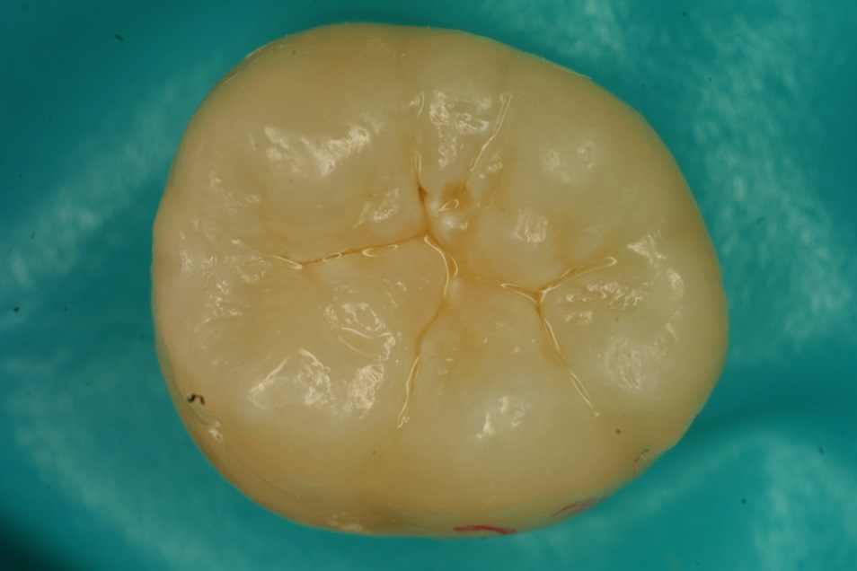
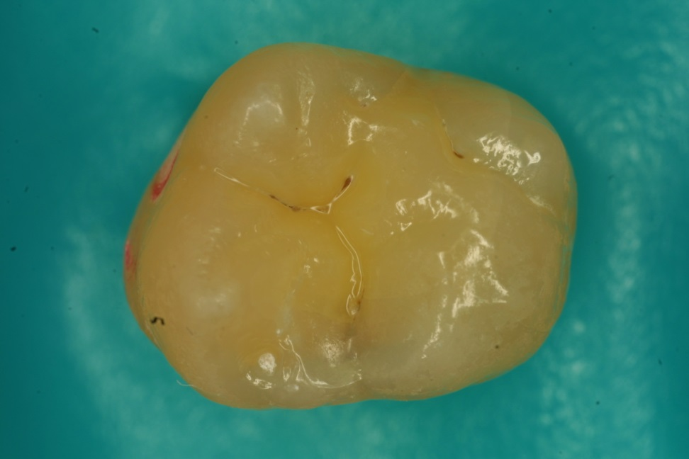
White opacity or brown discoloration confined to fissure and in isolation
Non-Cavitated Lesions - Seal
Notes:
Non-cavitated carious lesion” refers to pits and fissures in fully erupted teeth that may display discoloration not due to extrinsic staining, developmental opacities or fluorosis. The discoloration may be confined to the size of a pit or fissure or may extend to the cusp inclines surrounding a pit or fissure. The tooth surface should have no evidence of a shadow indicating dentinal caries, and, if radiographs are available, they should be evaluated to determine that neither the occlusal nor proximal surfaces have signs of dentinal caries.

Slide 28
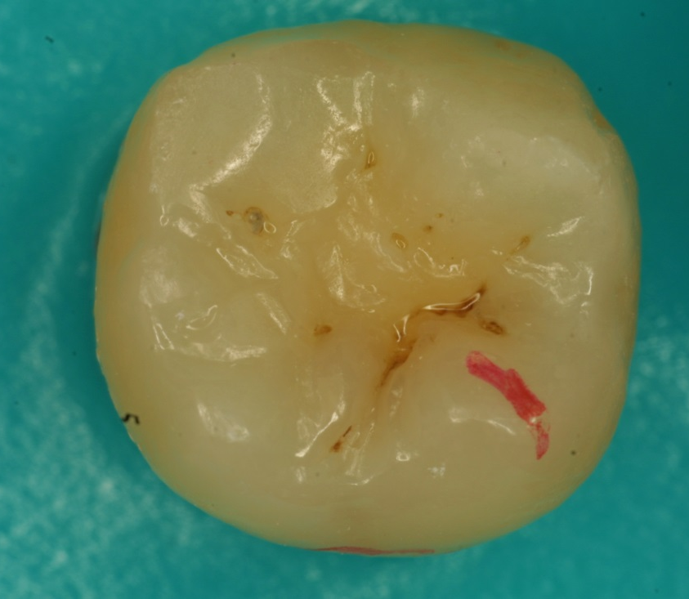
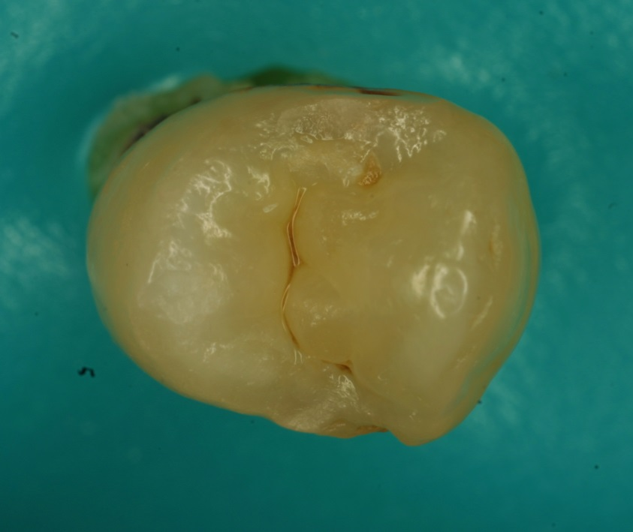
Non-Cavitated Lesions - Seal
The pits of the occlusal surfaces show change in color following the anatomy of the fissure.

Slide 29
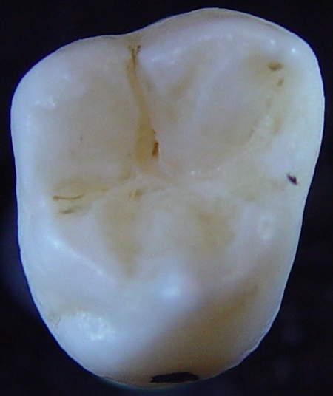
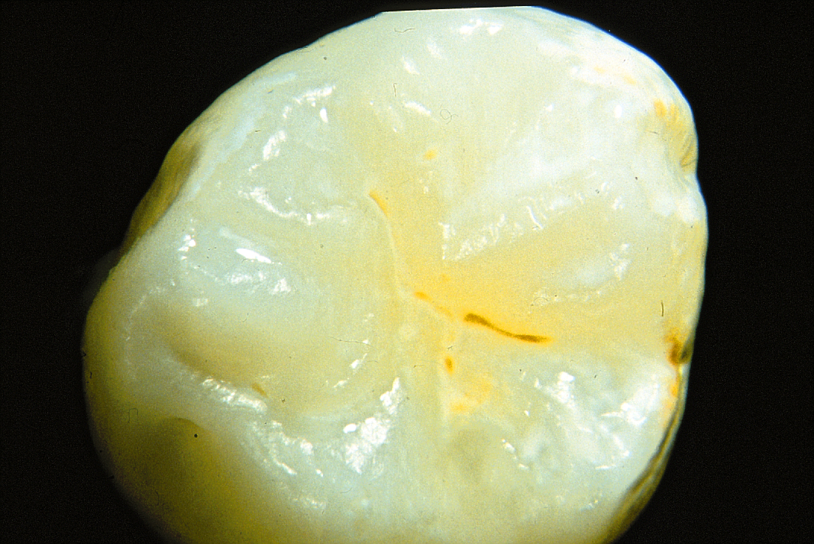
Non-Cavitated Lesions - Seal
These two extracted molars show the same type of non-cavitated lesions in the central fossa

Slide 30
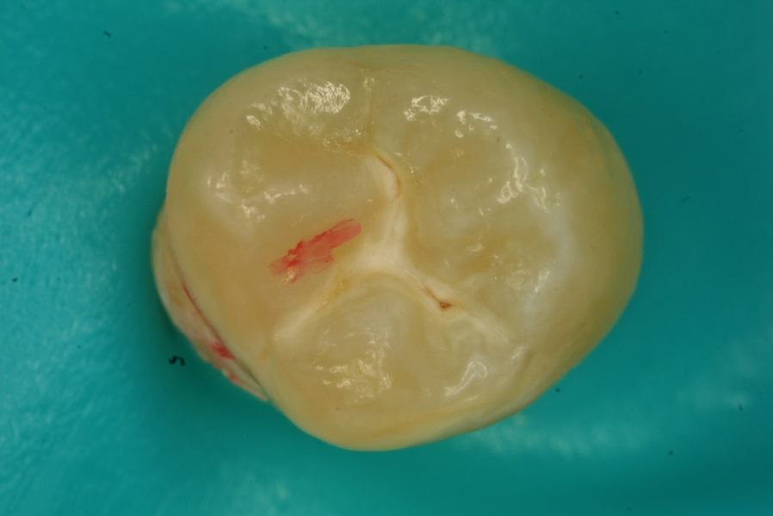
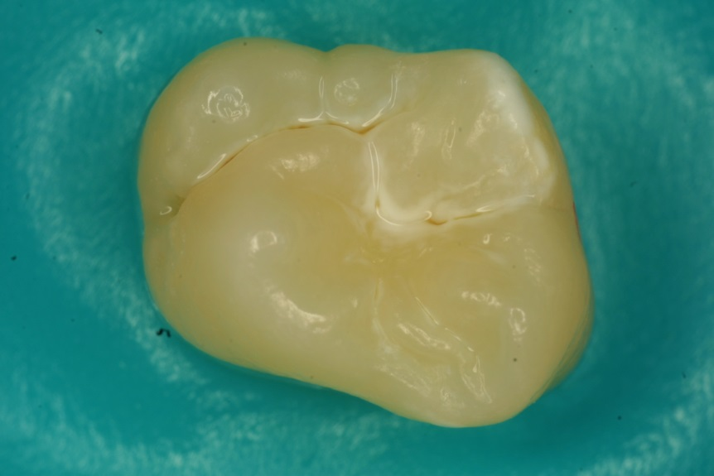
Non-Cavitated Lesions - Seal
Sometimes non-cavitated lesions show as decalcified areas around the pit and fissure which are visible after drying.

Slide 31
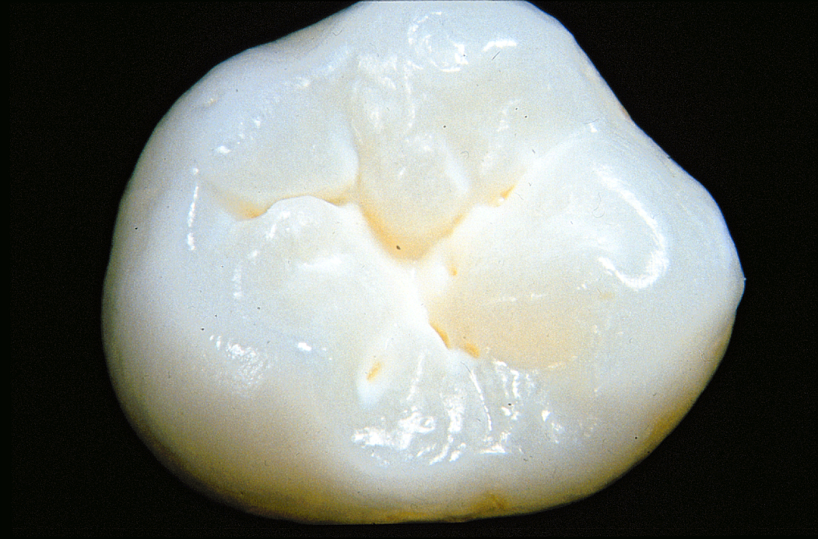
Non-Cavitated Lesions - Seal
Decalcified areas around the pit and fissure which are visible after drying.

Slide 32
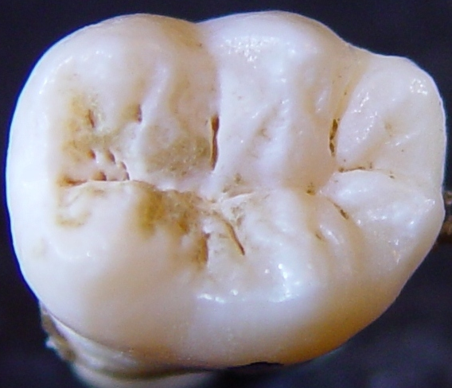
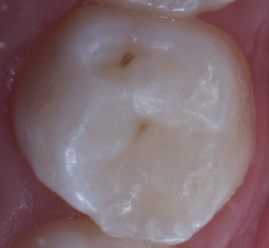
Non-Cavitated Lesions - Seal
The molar on the left has non-cavitated lesions all over its pits and fissures. The molar on the right has non-cavitated lesions restricted to the central and distal fossa.

Slide 33
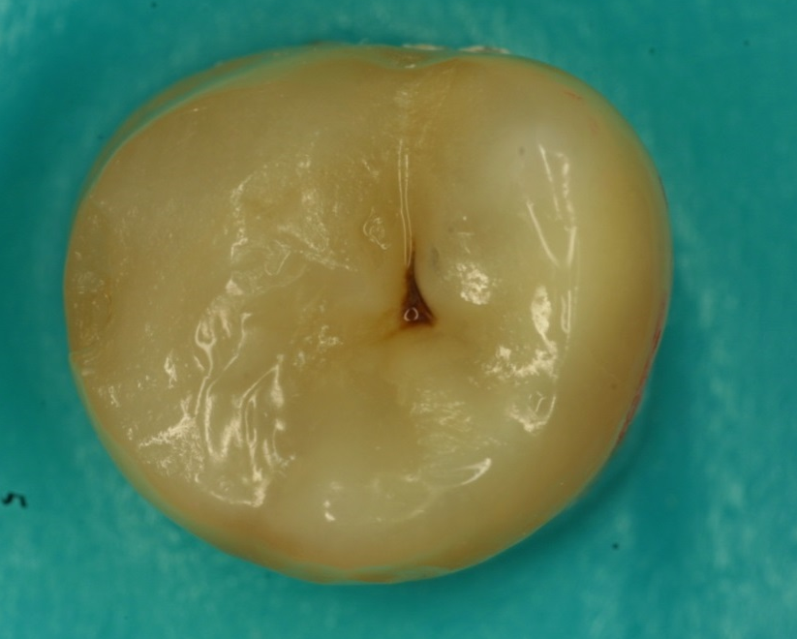
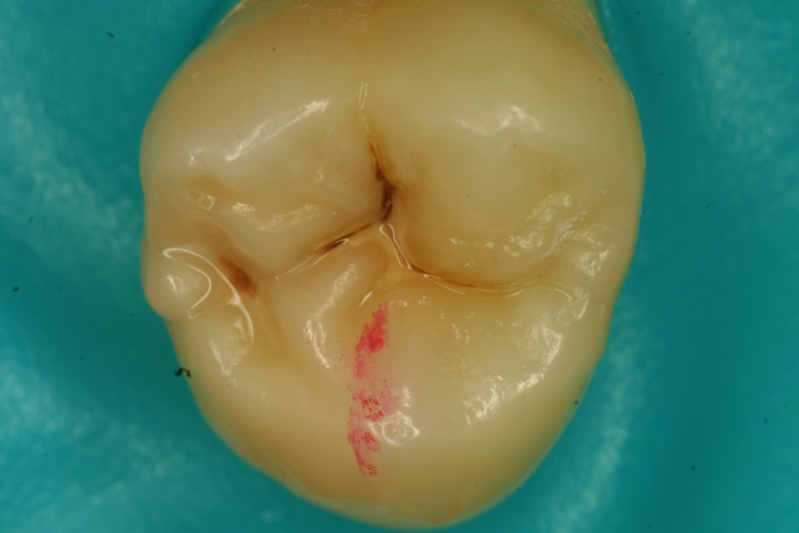
Cavitated Lesions – Don’t Seal –
Refer for Treatment
These two molars have cavitated lesions extending beyond the usual limits of the pit or fissure. These lesions, usually have underlying dentinal lesions which may be visible at examination.

Slide 34
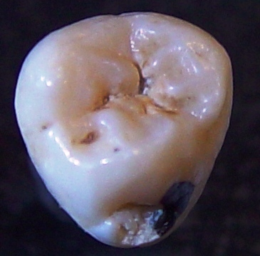
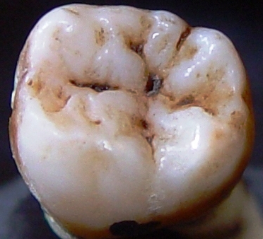
Cavitated Lesions – Don’t Seal –
Refer for Treatment
These two molars have cavitated lesions extending beyond the usual limits of the pit or fissure.

Slide 35
Radiographs
  Improvement in accuracy resulting from addition of radiographs to visual assessment to detect cavitation on pit-and-fissure surfaces cannot be determined (2001 NIH review)
  Low likelihood of caries in newly erupted molars in 2nd and 3rd grade children
  Children in need of treatment referred to clinical settings where range of diagnostic and treatment services are available
Based on slide of M Fontana, DDS, PhD
Notes:
35
Radiographs are unnecessary to detect the presence of cavitation on pit and fissure surfaces.

Slide 36
Recommendations
Differentiate cavitated and non-cavitated lesions
  Visual assessment is appropriate.
  An explorer may be used to confirm cavitation, do not use a sharp explorer under force.
Notes:
36

Slide 37
Key Messages
Evidence supports effectiveness of sealant use in clinical care and school sealant programs.
Caries risk assessment recommended prior to placing sealants on sound surfaces in clinical settings.
Notes:
37

