Slide 1

Using Oral Health Resources on ECLKC to Support DHL Collaboration
DHL Webinar
Presented by:
Michelle Landrum, R.D.H., M.Ed.
Beth Lowe, B.S.D.H., M.P.H.
Gina Sharps, R.D.H., M.P.H.
November 9, 2018

Slide 2

This webinar will be recorded and archived on the ASTDD DHL webpage.
Questions will be addressed after the speakers are finished. Please click on the icon at the top of your screen that looks like a person with their hand in the air. The moderator will recognize and “un-mute” you so you can ask your question.

Slide 3
Objectives
Access oral health resources posted on ECLKC
Recognize how resources produced by NCECHW and others can be used to promote key oral health messages to ECE programs
Use oral health resources on ECLKC to support DHL collaboration and stakeholders
Recognize current NCECHW activities that support year-4 strategies

Slide 4
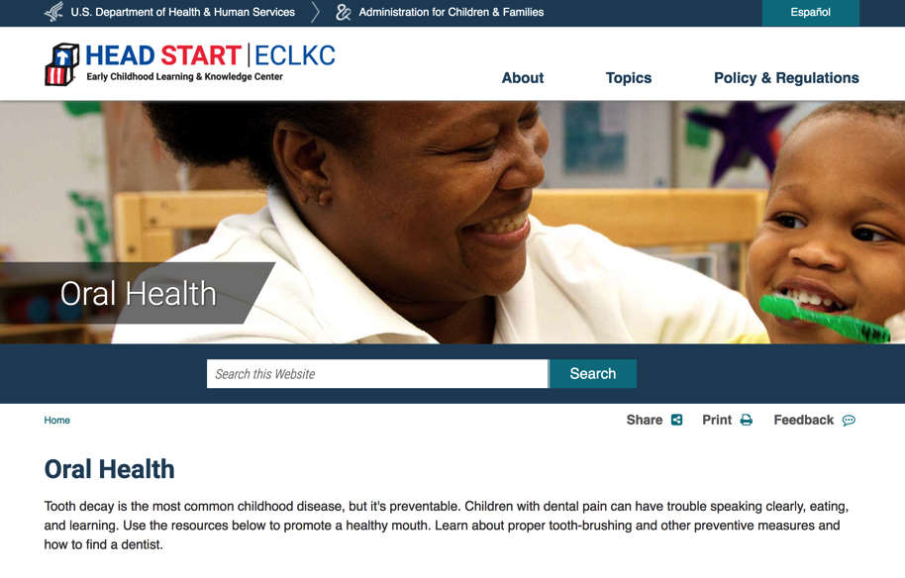
ECLKC Oral Health Pages
Search Tip — Search online for “ECLKC oral health”

Slide 5
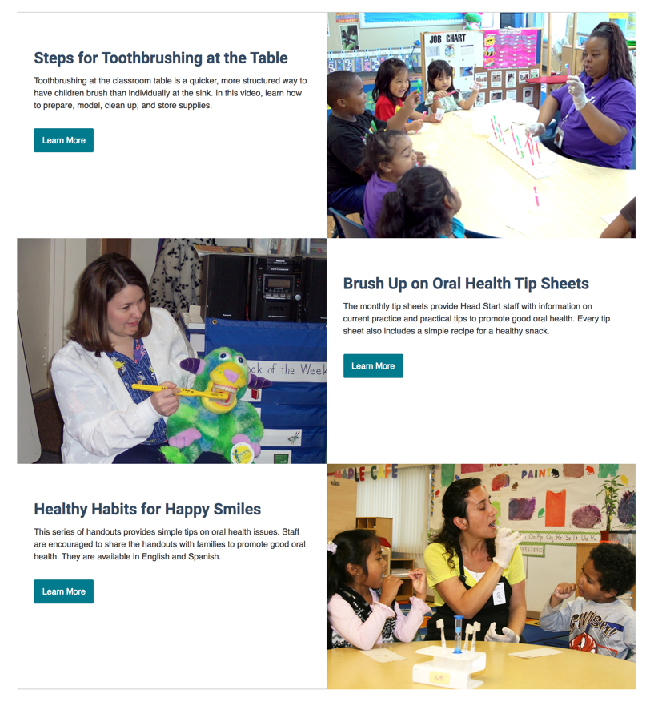
ECLKC Oral Health Pages
Featured Resources
Steps for Toothbrushing at the Table (video)
Brush Up on Oral Health (tip sheets)
Healthy Habits for Happy Smiles (handouts)
Oral Health Forms
Oral Health: Tips for Families
Oral Health: Tips for Health Managers

Slide 6
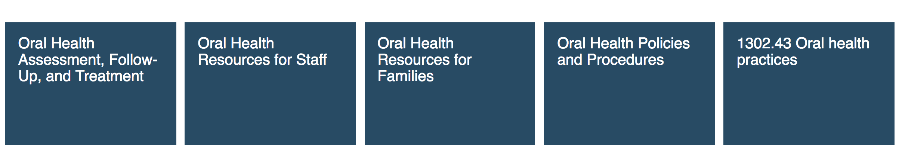
ECLKC Oral Health Pages
  Five secondary pages:
Notes:
Oral Health Assessment, Follow-up, and Treatment — materials and information to

Slide 7
Oral Health Materials for
Head Start Staff

Slide 8
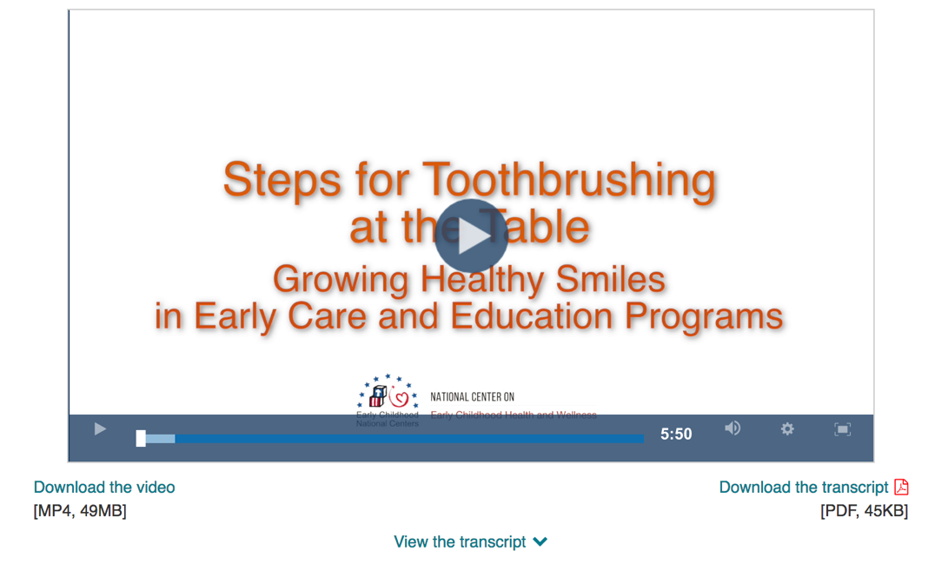
Steps for Brushing at the Table Video
Video for Head Start staff
Provides information and a demonstration on how to implement a daily toothbrushing program in Head Start and child care programs

Slide 9
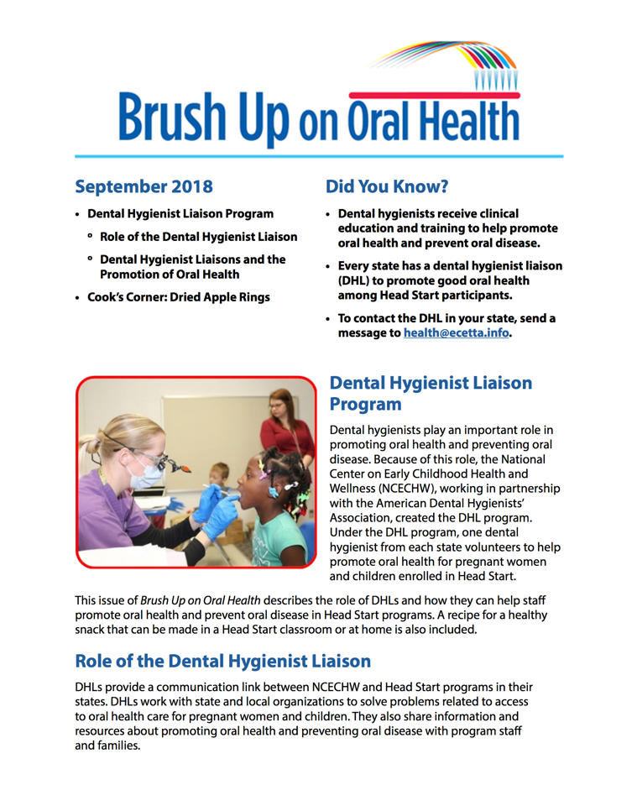
Brush Up on Oral Health Tip Sheet
Monthly tip sheet for Head Start staff and health and social service professionals
Provides information on current practice, practical tips for staff to share with parents for promoting oral health, and recipes for healthy snacks
    Subscribe at https://eclkc.ohs.acf.hhs.gov/subscribe

Slide 10
Brush Up on Oral Health Tip Sheets
  Current and past issues available on ECLKC
  Topics addressed include
  Oral health promotion
  Pregnant women’s and infants’ oral health
  Children’s oral health
  Children with disabilities and oral oral health
  Fluoride toothpaste, toothbrushing, fluoride supplements, and fluoridated water
  Oral health care and dental visits
  Health literacy language and culture

Slide 11
Disseminating Brush Up on Oral Health
Sign up for e-mail updates on oral health (https://eclkc.ohs.acf.hhs.gov/subscribe)
Upon receiving e-blast check ECLKC to see if tip sheet pdf is posted
    Send e-mail to contacts with link to pdf
    Do not send pdf to contacts
    Even better…Encourage contacts to subscribe for e-mail updates on oral health

Slide 12

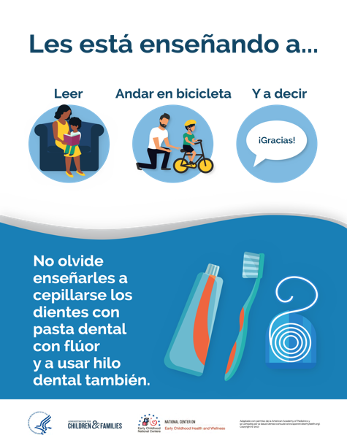
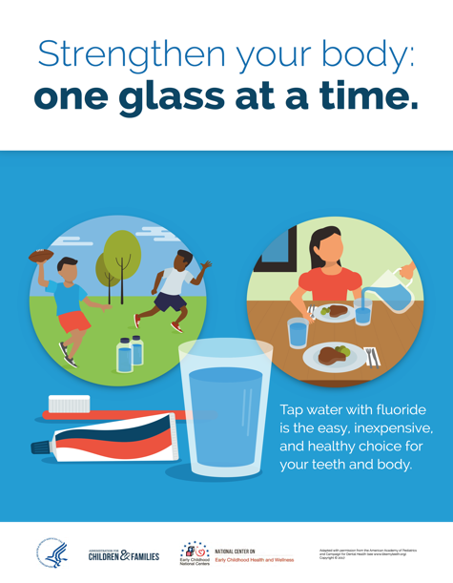
I Like My Teeth Posters
Posters in English and Spanish
Teaching aid for use in Head Start classrooms and at parent events
Offers positive messages about
  Drinking water with fluoride
  Brushing with fluoride toothpaste
  Maintaining children’s oral health
Electronic copies

Slide 13
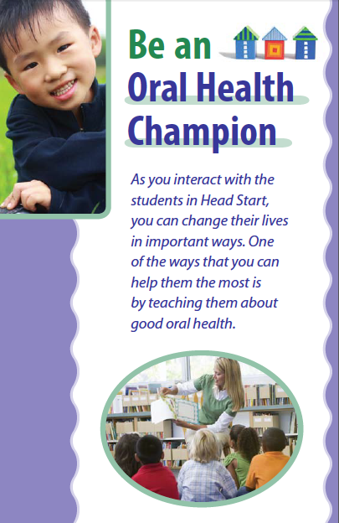

Be an Oral Health Champion
Booklet and Poster
  Promote awareness of problems children with poor oral health may experience
  Ideas for promoting oral health and preventing oral disease in children

Slide 14
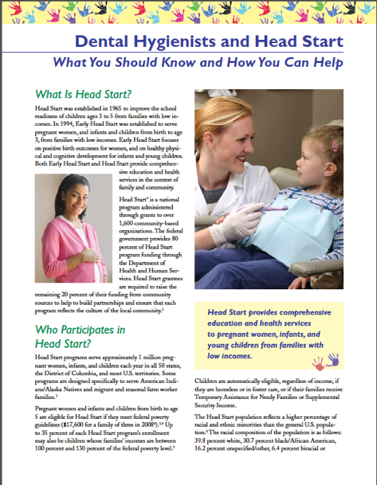
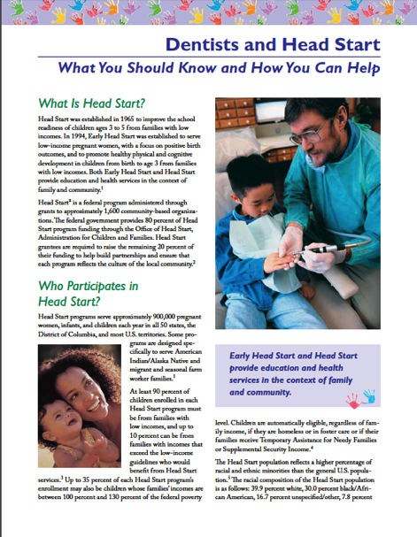
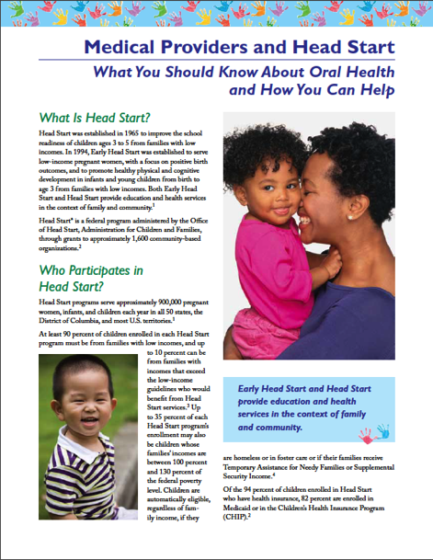
What You Should Know and
How You Can Help Tip Sheet Series
  Tip sheet for dentists, dental hygienists, and medical providers
  Overview of Head Start program
  Oral health status and access to services
  Ways health professionals can provide oral health services to Head Start participants
  Electronic copies

Slide 15
Tip Sheet
  Tip sheet for Head Start health managers
  Part of a series that includes active play, health literacy, healthy breathing, eating, mental health, oral health, safety, and injury prevention
  Provides 10 things health managers should know about oral health that can be shared with families

Slide 16
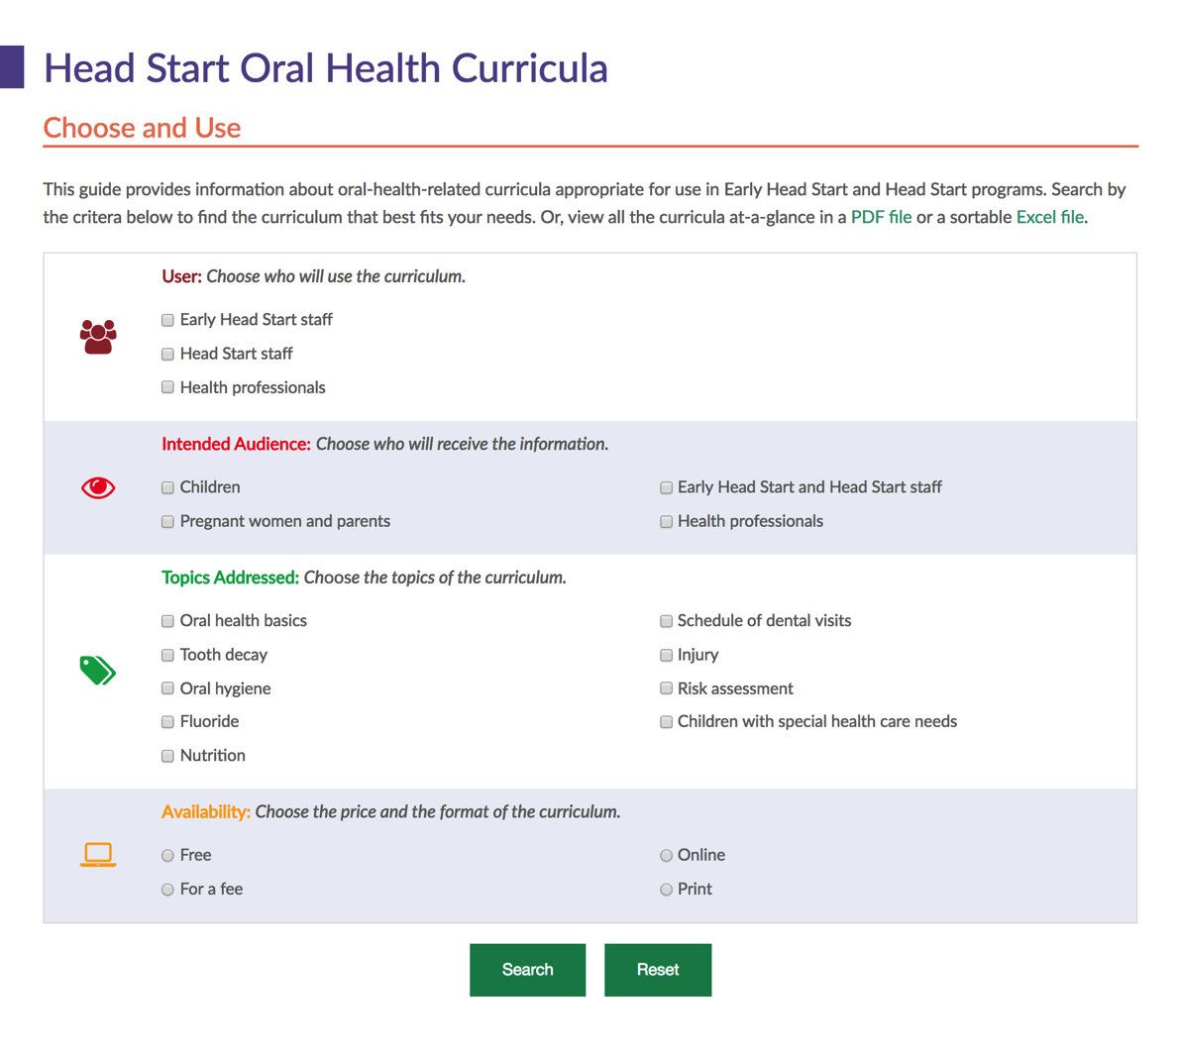
Choose and Use: Head Start
Oral Health Curricula
Oral health-related curricula appropriate for Head Start
Search criteria
  User
  Intended audience
  Topics addressed
  Availability
Available in a pdf file or sortable Excel file
Can access through ECLKC—direct link is www.mchoralhealth.org/headstart/curricula/

Slide 17
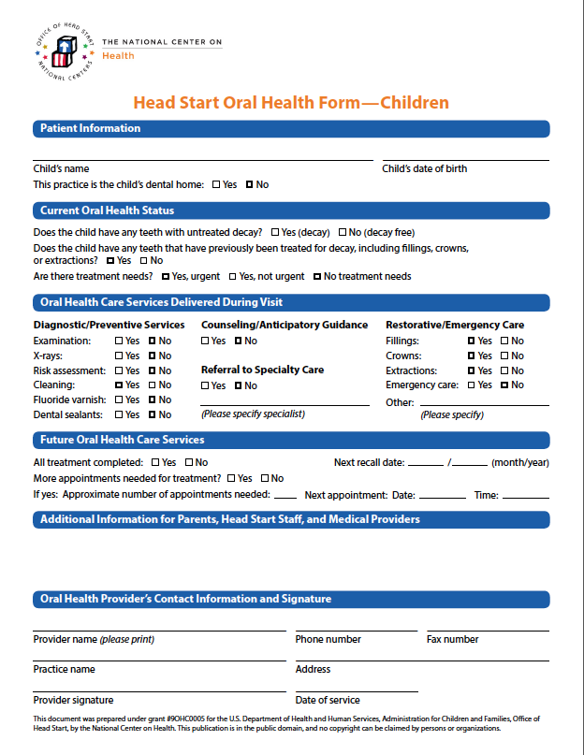
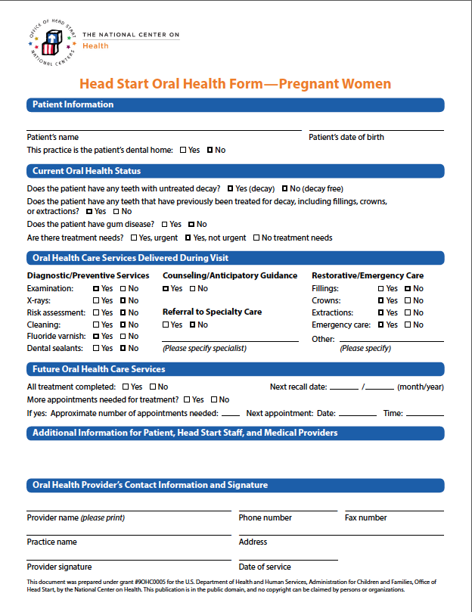
Head Start Oral Health Forms
One combined form (pregnant women and children), a form for pregnant women, and a form for children
Forms collect information on:
  Dental home status
  Current oral health status
  Oral health care services delivered during visit
  Whether all treatment is complete
  If future appointments are needed
Notes:
Michelle,
You can go through the forms with the audience and talk through what’s on the form and how it can help them collect data for their PIR reports.

Slide 18
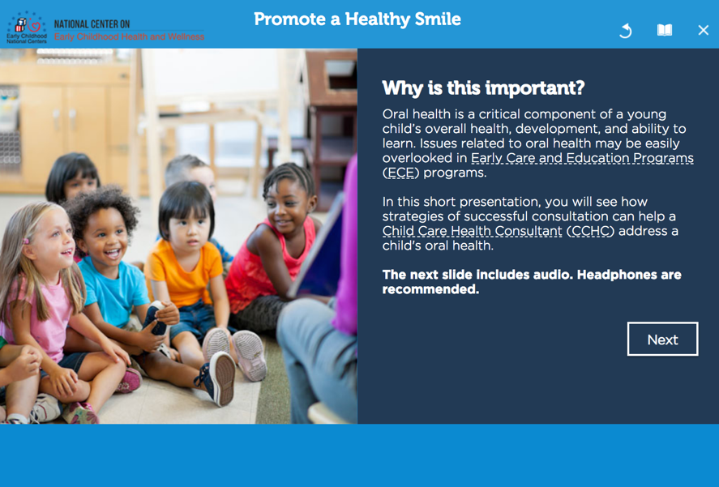
Applying Consultation Skills to Oral Health Promotion
  Part of Child Care Health Consultation: Skill Building Modules
Creating collaborative relationships with programs
Using cultural competence to solve problems
Applying consultation skills to oral health promotion
Identifying and resolving concerns
Improving communication skills
Building trust with programs
https://eclkc.ohs.acf.hhs.gov/health-services-management/article/child-care-health-consultation-skill-building-modules
Notes:
Collaborator National Resource Center for Health and Safety in Child Care developed a series of skill building modules that provide interactive, realistic scenarios to build and enhance consultation skills for child care health consultants. One addresses oral health. However, all 6 are valuable resources to anyone working with the Head Start and child care community. I would highly recommend reviewing all 6 modules

Slide 19
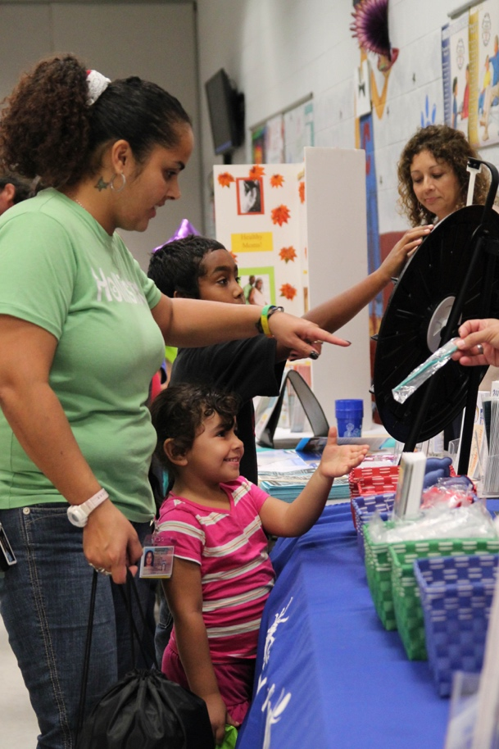
Using Resources to Collaborate with Staff
Introduce and promote resources at health services advisory committee meetings
Offer 1-on-1 education to health specialists
Exhibit at annual state conferences
Present at health managers meetings
Provide in-service and training programs to staff
  How to include oral health in prenatal and perinatal home visits
Notes:
Will email DHLs for stories and pictures to visually demonstrate sample activities

Slide 20
Oral Health Materials for
Head Start Families

Slide 21
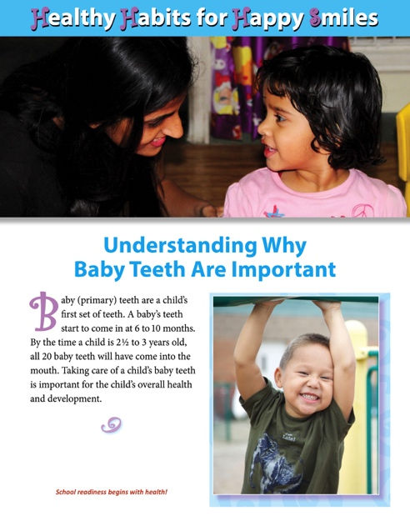
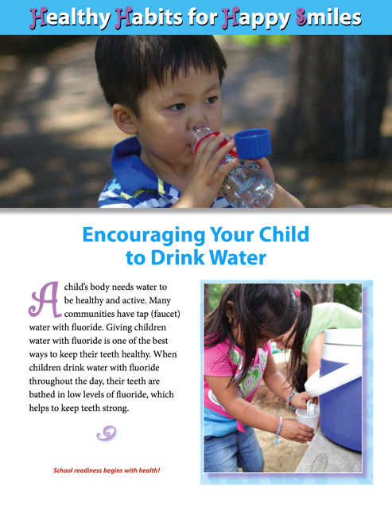
Healthy Habits for Happy Smiles
Handout Series
  Handouts for parents in English and Spanish
  Electronic copies
  Topics addressed:
  Dental Visits
  Fluorides
  Healthy drinks
  Healthy snacks
  Infant oral health
  Oral injuries and first aid
  Pregnancy and oral health
  Primary Teeth
  Teething pain
  Toothbrushing
  Toothbrushing tips for a child with a disability

Slide 22
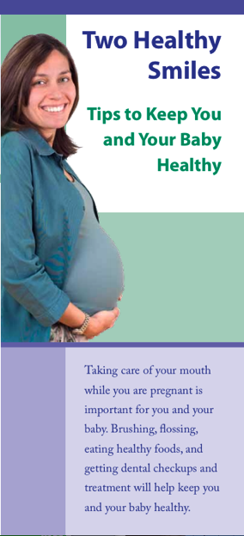
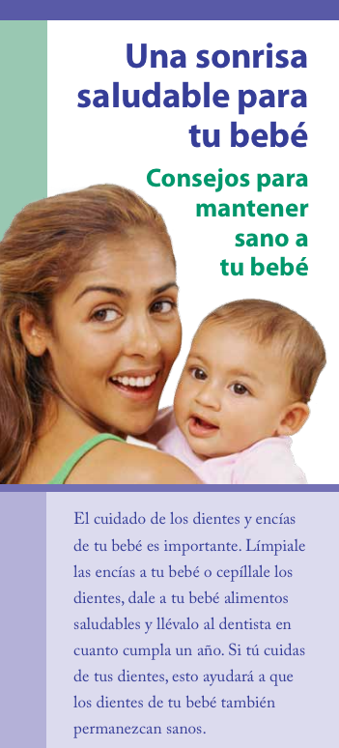

Brochures
  Brochures for pregnant women and parents
  Content includes brushing, eating healthy foods, and regular dental check-ups and treatment
  Written at 4th–6th grade reading level
  In English and Spanish
  Electronic copies

Slide 23
Tip Sheet
Offers tips to help families promote good oral health for their children
Available in multiple languages
  English
  Spanish
  Amharic
  Arabic
  Burmese
  Chinese
  Hmong
  Somali
  Vietnamese

Slide 24

Cook’s Corner: Recipes for Healthy Snacks
2nd edition
Compiled from Brush Up on Oral Health tip sheets published between 2012 and 2017
Available in Spanish
Recipes are low in fat, high in fiber, and do not include added sugar

Slide 25
Questions to Ask When
Looking for a Dental Office
  Handout for parents
  Lists questions to ask when looking for a dental office
  Questions cover
    Type of insurance accepted
    Specialized training of dentist and staff
    Office location and nearby public transportation
    Many other topics

Slide 26

Healthy Smiles: Oral Health Webinar for Spanish-Speaking Parents
  Archived webinar for Spanish-speaking pregnant women and parents
  Provides key oral health messages
  Webinar questions and answers
  Pre- and post-tests
  Evaluation form for participation certificate
  Resources in Spanish
Notes:
Link to Webinar: https://eclkc.ohs.acf.hhs.gov/video/healthy-smiles-oral-health-webinar-spanish-speaking-parents
Link to Resources in Spanish https://eclkc.ohs.acf.hhs.gov/oral-health/fact-sheet/oral-health-resources-spanish-speaking-families

Slide 27


A Healthy Mouth for Your Baby
  National Institute for Dental and Craniofacial Research
  Addresses
    Importance of primary teeth
    Early childhood caries prevention
    Age 1 dental visits
  Available in Spanish
  American Indian and Alaska Native version
Notes:
This easy-to-read brochure produced by NIDCR is for parents of infants or toddlers. It explains why baby teeth are important, gives tips on how to prevent early childhood tooth decay, and promotes the age 1 dental visit.

Slide 28

Healthy Teeth, Healthy Me
  Sesame Workshop oral health initiative
  Bilingual, multimedia
  Targets children ages 2 to 5, parents, and caregivers
  Empowers children to make healthy choices
  Educates parents about benefits of preventive oral health care an establishment of healthy habits early in life
Notes:
Healthy Teeth, Healthy Me is an initiative of Sesame Workshop, the nonprofit educational organization behind Sesame Street, in partnership with Sam’s Club and MetLife Foundation, It’s a bilingual (English/Spanish), multimedia outreach initiative designed to leverage the power of well-known Sesame Street characters to motivate children 2 to 5 years of age, their parents, and their caregivers to care for children’s oral health…early.
The project objectives include
Empowering children to make healthy choices that will have a positive impact on their oral health.
Educating adults about the benefits of young children’s preventive oral care and recommended strategies to establish a foundation for healthy habits early in life.
Project components
The bilingual (English and Spanish) Outreach Kit will include:
An original Sesame Street DVD featuring songs by Elmo and Abby.
A Guide for Families providing useful information and tools to use with children to reinforce important routines that keep teeth healthy and clean.
An online Brushing Teeth game engaging children in brushing all their teeth.
A digital Guide for Providers supporting health practitioners as they create partnerships with families.

Slide 29

Using Resources to Collaborate with Parents
Participate in parent training events
Host oral health baby showers
Arrange “ask a dentist/dental hygienist” events for parents
Participate in Give Kids a Smile Day
Engage in migrant community outreach days
Source: Bread for the World | Flickr | CC BY-NC-ND 2.0
Notes:
Will email DHLs for stories and pictures to visually demonstrate sample activities

Slide 30
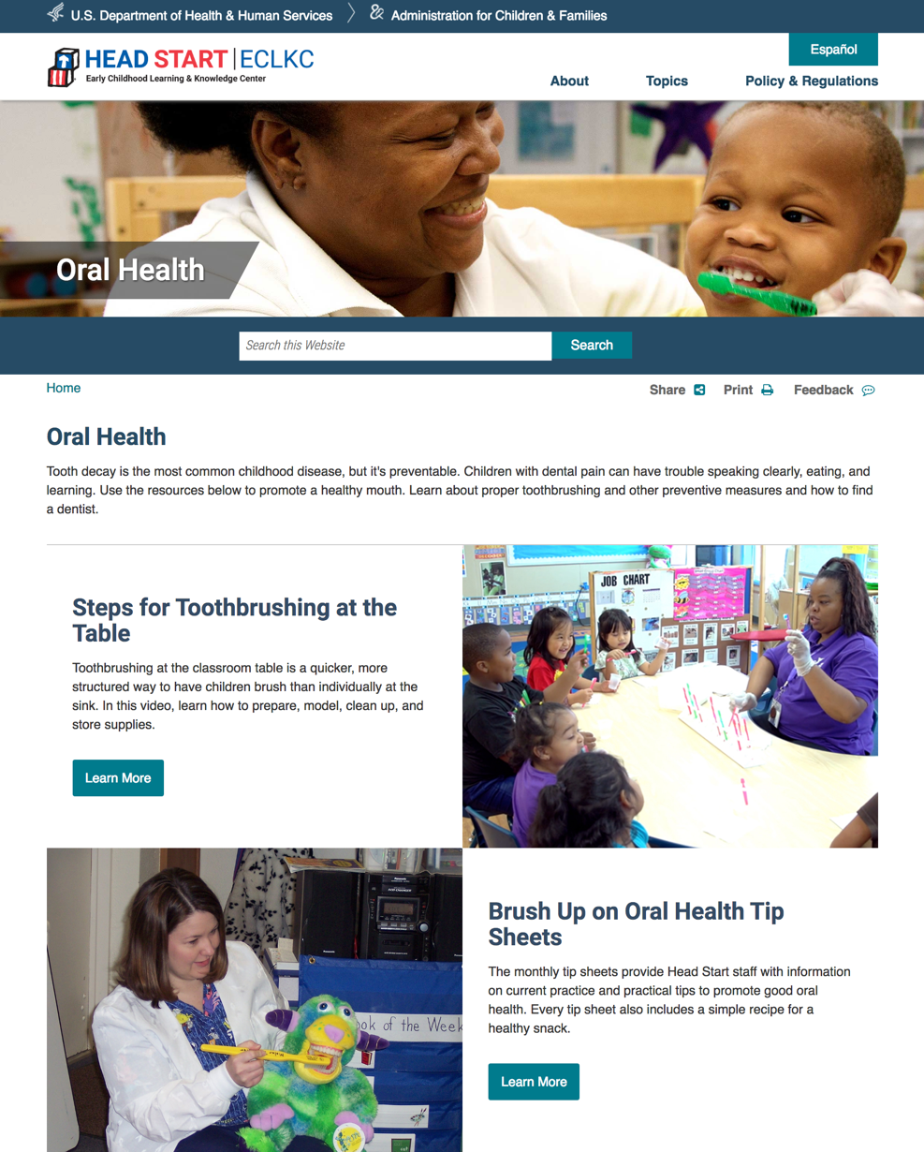
Let’s Take A Tour

Slide 31
Year 4 Priorities for DHL Project
Enhance DHLs’ capacity through training and technical assistance
  e.g., develop an implementation guide that defines “oral exam” vs. “oral health screening” and how to access state’s dental periodicity schedule
Build or enhance DHL relationships at the state level through collaboration with key stakeholders
  e.g., provide DHLs with a letter of introduction to key stakeholders
  host a webinar on utilizing ECKLC oral health resource to increase DHL collaboration with stakeholders

Slide 32
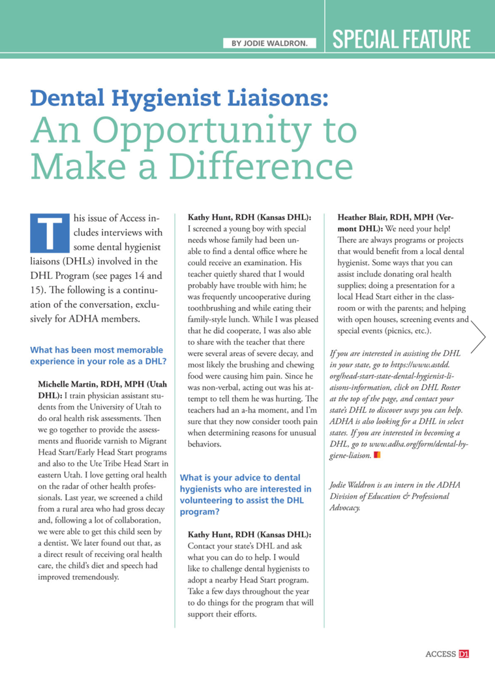
Year 4 Priorities for DHL Project
Improve DHL recruitment and engagement by promoting the DHL project within ADHA
  e.g., publish a follow-up article in Access highlighting DHLS
  host a DHL webinar on strategies to recruit ADHA members to assist state DHLs

Slide 33

Questions?

Slide 34
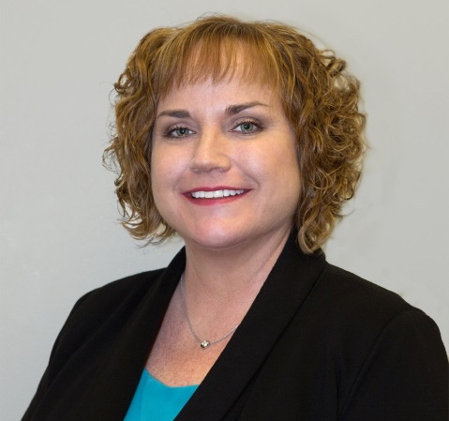
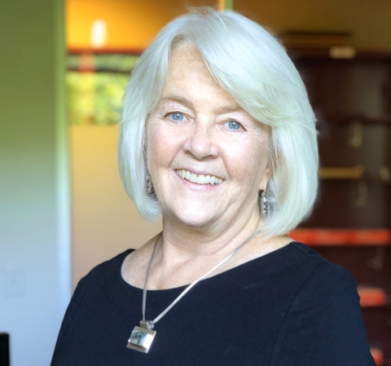
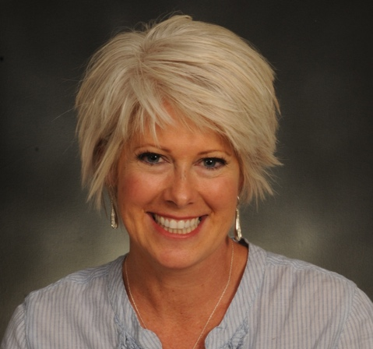
Contact Information
Michelle Landrum, R.D.H., M.Ed. michellelandrum@yahoo.com
Beth Lowe, B.S.D.H., M.P.H.
eal38@Georgetown.edu
Gina Sharps, R.D.H., M.P.H.
sharpsg@marshall.edu
National Center on Early Childhood Health and Wellness
Phone: (866) 763-6481
E-mail: health@ecetta.info
Website: https://eclkc.ohs.acf.hhs.gov/health

