Slide 1
National Center on
Early Childhood
Health and Wellness

Slide 2
General Reminders
This webinar will be recorded and archived on the ASTDD website
Questions will be addressed after the speakers are finished. Please type your question into the “chatbox” that will appear at the end of the webinar, and click on the bubble to the right of where you type your question to send it to the moderator.

Slide 3
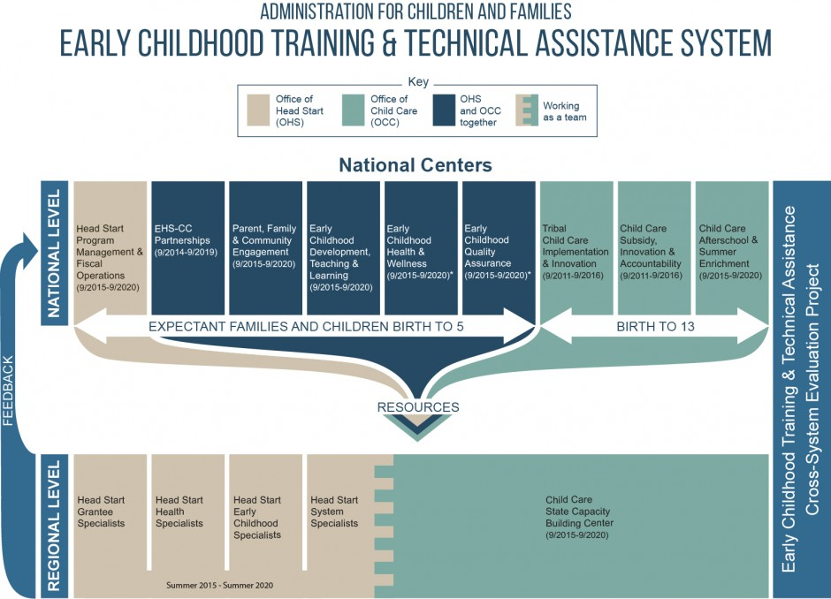

Slide 4
NCECHW—Our Team
American Academy of Pediatrics
University of California, Los Angeles Health Care Institute
Georgetown University’s National Maternal and Child Oral Health Resource Center
Georgetown University’s Center for Child and Human Development
Education Development Center
Child Care Aware of America
Nemours
University of Colorado, Denver, National Resource Center for Health and Safety in Child Care and Early Education
Zero to Three

Slide 5
NCECHW Vision
Provide resources, professional development, and guidance to promote health, safety, and wellness of children from birth to age 5 for families, early childhood education professionals, and health providers

Slide 6
ACF Health and Wellness Goals
Improve the health and safety of ECE settings
Promote positive child health outcomes for children participating in ECE programs
Increase preventive services related to health outcomes.
Promote access to continuous, accessible health services for children and families
Promote mental wellness and resiliency for staff, children, pregnant women, and families
Strengthen networks and coordination of ECE programs and child health professionals

Slide 7
Approaches
Provide research-informed and/or evidence-based resources to the ECE community and families
Provide a continuum of T/TA strategies for professional development
Promote systems of coordination and collaboration in concert with other national centers, regional and state T/TA specialists, and other national initiatives to develop and integrate content

Slide 8
Dissemination Methods
Print and online resources
Workshops
Webinars
Health institutes
Learning collaborates

Slide 9
Desired Outcomes
Increased awareness of
Regulations and requirements to support health and safety of children in care settings
Resources to support health, wellness, and safety in early childhood
Increased knowledge of
Prevention strategies
Family- and community-engagement strategies
Health and wellness practices

Slide 10
Desired Outcomes (continued)
Increased use of specific practices to support
Family and community engagement in supporting children’s health
Children’s health and safety in early childhood education settings
ECE staff and family wellness
Changes in state systems and policies to support
Caring for Our Children (CFOC) Basics
Health and safety recommended best practices

Slide 11
Primary Audiences
Early childhood education staff
Head Start/Early Head Start direct service staff and managers
Child care providers
Home visitors
Family child care providers
OHS Regional T/TA providers
EC specialists
Health specialists
Systems specialists
Grantee specialists
Child care health consultants
CCR&R staff
Child care T/TA provider

Slide 12
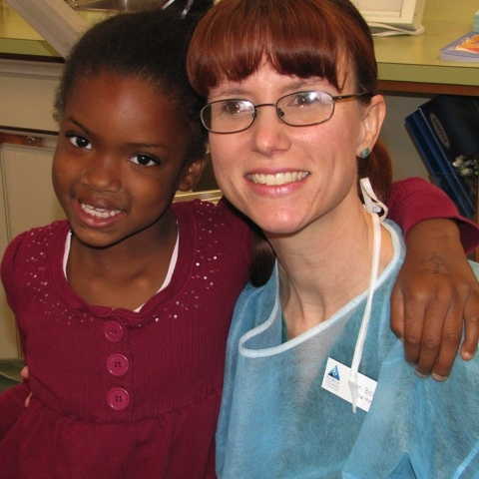
Primary Audiences (continued)
State regulatory and licensing agencies
Federal staff
OHS
OCC
MCHB
Pediatric medical providers
Pediatricians
Family physicians
Nurse practitioners
Dentists
Dental hygienists
Mental health professionals
Photo Source: Sharib4rd | Flickr | CC BY 2.0

Slide 13
Health Specialists
Role
Serve as a resource to other T/TA specialists on comprehensive health services, environmental health and safety, and engaging families in health issues.
Serve as point of dissemination for health data and resources
Aggregate/analyze state and regional health data to identify emerging trends and patterns.
Provide training on health topics
Experience
Minimum of BA in public health, mental health, health education, maternal and child health, or health administration
Minimum 5 years in health services in HS/EHS programs

Slide 14
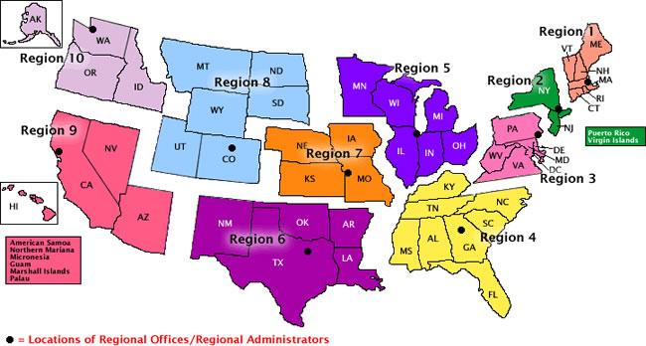
ACF Regions
Region XI —American Indian and Alaska Native (AIAN) Head Start Programs
Region XII—Migrant and Seasonal Head Start Programs (MSHS)

Slide 15
National Center for Early Childhood Health and Wellness Oral Health Team
Association for State and Territorial Dental Directors
Dental Hygienist Liaisons
National Maternal and Child Oral Health Resource Center
Notes:
The oral health team is composed of staff at the National Maternal and Child Oral Health Resource Center (OHRC), which is a federally funded project to support health professionals working in state and communities addressing public oral health issues. The resource center will be working in partnership with the Association of State and Territorial Dental Directors (ASTDD). ASTDD represents directors and staff of oral health programs within state departments of health. ASTDD will coordinate the dental hygienist liaison (DHL) project, which I’ll share more information about in a few minutes.

Slide 16
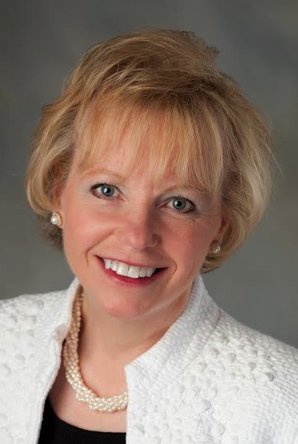
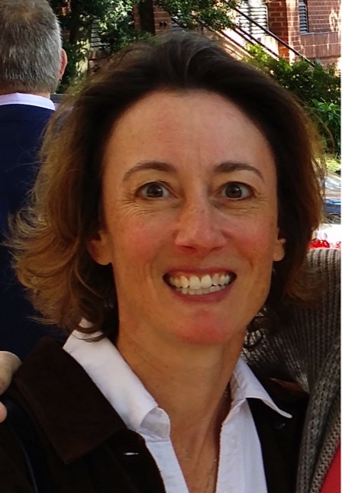
National Maternal and Child Oral Health Resource Center: Who Are We
Katrina Holt
Director
Ruth Barzel
Writer/Editor
Sarah Kolo
Health Communications Specialist
Beth Lowe
Health Education Specialist
Notes:
On the slide, you’ll see the project staff of OHRC, including me; Ruth Barzel, writer/editor; Sarah Kolo, health communications specialist; and Beth Lowe, health education specialist.

Slide 17
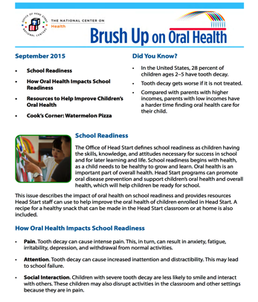
National Maternal and Child Oral Health Resource Center: What Do We Do
Develop and disseminate materials
Brush Up on Oral Health newsletter
Head Start Health Services newsletter
Handouts for staff, pregnant women, and parents
Develop, coordinate, and conduct educational presentations and trainings
Provide information and technical assistance
Review oral health content produced by NCECHW partners and other national centers
Notes:
Resource center staff will be highly involved in developing and disseminating oral-health-educational materials for Head Start and child care staff as well as for pregnant women and parents of young children. We will continue to produce monthly issues of the Brush Up on Oral Health newsletter. The newsletter is designed for staff and provides information on current practice, practical tips to share with pregnant women and parents for promoting good oral health, and a simple, fun recipe for a healthy snack that children can make with staff in the classroom or at home with their parents. We will also continue to produce the Healthy Habits for Happy Smiles consumer handout series. The handouts are written in simple language to make the information easy to understand and put into practice and are available in English and Spanish.
The oral health team has several core messages, such as the importance and safety of oral health for women throughout pregnancy and the importance of brushing children’s teeth with fluoride toothpaste twice a day—one of the best ways to prevent tooth decay. These and other core messages for promoting good oral health will be woven throughout our educational materials, presentations, trainings, and technical assistance.

Slide 18
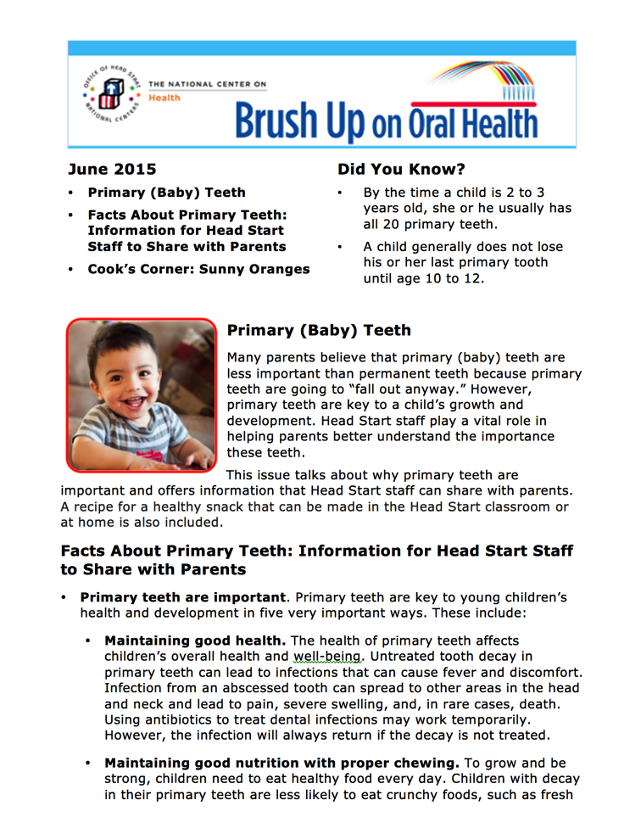
Brush Up on Oral Health Newsletter
Monthly newsletter for Head Start and child care staff
Provides information on current practice, practical tips for staff to share with parents for promoting oral health, and recipes for healthy snacks
Subscribe at https://eclkc.ohs.acf.hhs.gov/ECLKC/customerservice/CMAlerts
Notes:
The Brush Up on Oral Health monthly newsletter is a valuable source of information on current practice, to provide practical tips for staff to share with parents for promoting good oral health, and to offer a simple, fun recipe for a healthy snack that children can make with Head Start and child care staff or at home with their parents.

Slide 19
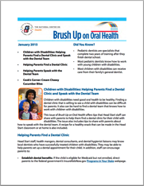
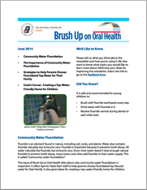
Brush Up on Oral Health Newsletter
Current and past issues available on ECLKC
Topics addressed include
Smoking and oral health
Dental clinic care for children with disabilities
Healthy bedtime habits
Choosing healthy behaviors
Oral injuries
Toothbrushing
Medicaid and CHIP
Notes:
Current issue and all past issues of the newsletter are posted on ECLKC and are available as a ready reference on oral health issues. Topics include finding a dental clinic for children; promoting healthy bedtime habits, including brushing the child’s teeth; helping parents choose healthy behaviors to improve their child’s oral health, treating common oral injuries, toothbrushing.
We also encourage readers to pull information from a newsletter issue to insert into their own newsletter or handout for families

Slide 20
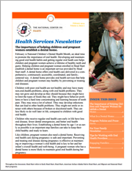
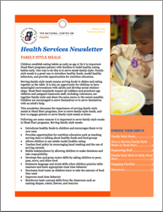
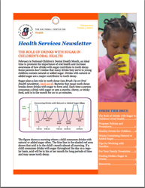
Health Services Newsletter
Monthly newsletter for Head Start and child care staff
Importance of helping children and pregnant women establish a dental home, February 2014
The role of drinks with sugar in children’s oral health, February 2015
Importance of family-style meals, March 2015
Notes:
Another great resource for Head Start staff and child care is the Health Services Newsletter. The newsletter addresses current topical issues and provides information about best practice and tips for engaging families. The February 2014 issue provides information about the importance of establishing a dental home for pregnant women and for children. In this issue, you’ll find information about what is a dental home, ideas for what program staff can do to support the establishment of dental homes, and tips for working with oral health providers. Other newsletter issues have addressed the role that sugar plays in tooth decay and the importance of family-style meals.

Slide 21
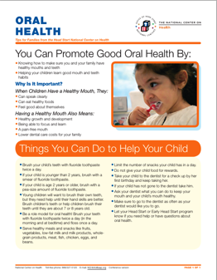
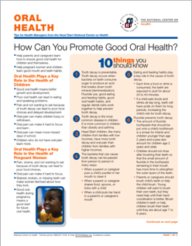
Tip Sheets
Tip sheet for Head Start health managers and tip sheet for families
Tips for promoting good oral health and things parents can do to help their child
Notes:
The series of topical tips sheets provides simple and key messages for Head Start health managers and for families. One of the important topics addressed is oral health. The tip sheets provide information that we want health managers to know (for example, tooth decay is preventable, parents should brush their baby’s teeth, and oral health care is safe during pregnancy), tips for promoting good oral health, and a list of key resources.

Slide 22
Healthy Habits for Happy Smiles Handout Series
Handouts for parents
Oral Health topics addressed:
Dental visits
Children with special needs
Fluoride
Healthy drinks
Oral Injuries
Pregnancy
Teething
Toothbrushing
In English and Spanish
Notes:
The Healthy Habits for Happy Smiles is series of colorful handouts filled with basic tips to help parents keep their children’s teeth and mouths healthy. The handouts are written in simple language to make the information easy to understand and put into practice. The handouts are available in English and Spanish.
Handout topics include taking care of oral health during pregnancy, helping your baby with teething pain, taking care of a baby’s oral health, giving your child healthy snacks, choosing healthy drinks, brushing your child’s teeth, getting fluoride, toothbrushing tips and positions for a child with a disability, preventing oral injuries, giving first aid for common oral injuries, finding a dental clinic, and visiting the dental clinic.

Slide 23
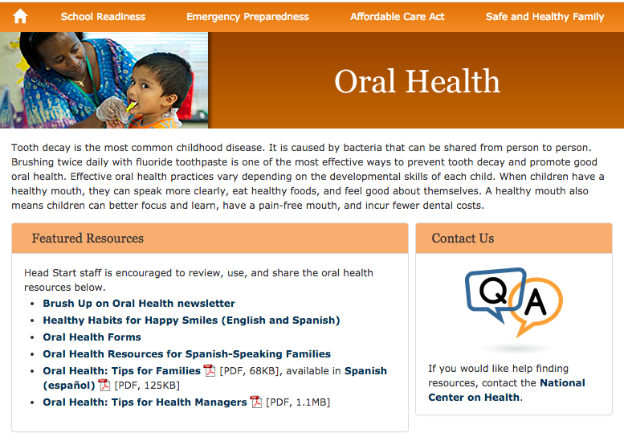
Early Childhood Learning and Knowledge Center Oral Health Pages
Search Tip
Search online for “ECLKC oral health”
Featured Resources
Brush Up on Oral Health newsletter
Healthy Habits for Happy Smiles handouts
Three Secondary Pages
Oral Health Assessment, Follow-up, and Treatment
Oral Health Education Activities
Oral Health Policies and Procedures

Slide 24
The Role of State Dental Hygienist Liaisons (DHLs) and
Regional DHL Coordinators
Presented by: Michelle Landrum, R.D.H., M.Ed.

Slide 25
Role of State DHLs
Serve as communication links between NCECHW and Head Start agencies and state, territory, and tribal child care agencies on topics related to improving the oral health of pregnant women and children enrolled in Head Start and child care
Collaborate with state organizations (e.g., oral health programs, Head Start state collaboration office, child care agencies)
Promote evidence-informed information and materials to Head Start agencies and state, territory, and tribal child care agencies, and offer strategies for accessing oral health care for pregnant women and children enrolled in Head Start and for children enrolled in child care

Slide 26
Role of State DHLs
Present at state Head Start–related and child-care-related meetings, as requested by NCECHW
Attend state and/or local Head Start–related and child-care-related meetings
Share information about NCECHW-produced resources and other OHS-approved resources with Head Start agencies and state, territory, and tribal child care agencies
Prepare quarterly reports on Head Start and child care oral health activities occurring in the state
DHLs will receive $750 in annual stipends based on completion of specific criteria

Slide 27
Role of Regional DHL Coordinators
• Perform DHL duties in their state
• Support DHLs in assigned regions
• Facilitate sharing of NCECHW-produced resources and other OHS-approved resources with DHLs in assigned regions
• Maintain an updated list of DHLs in assigned regions, and recruit new DHLs as needed in the region
• Collaborate with the regional Head Start health specialist on oral-health-related issues

Slide 28
Role of Regional DHL Coordinators
• Present at national and/or regional meetings, as requested by NCECHW
• Participate in evaluation activities, including reviewing Head Start performance information reports and basic screening surveys for states in assigned regions
• Review DHL quarterly reports on Head Start and child care oral health activities occurring in their states from DHLs, and prepare regional reports summarizing activities

Slide 29
Regional DHLs or Point of Contact
Gina Sharps (WV) Region III | Diane Flanagan (WI) Region V | Beth Stewart (TX) Region 6 | Kathy Hunt (KS) Region 7 | Julie Stage (NV) Region 9 | Karen Yoder DHL Project Lead | Michelle Landrum DHL Project Co-Lead
Delaware | Illinois | Arkansas | Iowa | Arizona | Alabama | New Hampshire
D. C. | Indiana | Louisiana | Missouri | California | Alaska | New Jersey
Maryland | Michigan | New Mexico | Nebraska | Hawaii | Colorado | New York
Pennsylvania | Minnesota | Oklahoma |  |  | Connecticut | North Carolina
Virginia | Ohio |  |  |  | Florida | North Dakota
 |  |  |  |  | Georgia | Oregon
 |  |  |  |  | Idaho | Rhode Island
 |  |  |  |  | Kentucky | South Carolina
 |  |  |  |  | Massachusetts | South Dakota
 |  |  |  |  | Mississippi | Tennessee
 |  |  |  |  | Montana | Utah
 |  |  |  |  |  | Vermont
 |  |  |  |  |  | Washington
 |  |  |  |  |  | Wyoming

Slide 30
DHL Quarterly Report and
Stipend Request
Presented by: Michelle Landrum, R.D.H., M.Ed.

Slide 31
DHL Quarterly Report
Now online and easier to complete!
Link (will also be posted on DHL webpage) https://www.surveymonkey.com/r/DHLQuarterlyReport
A new blank form will open each time you go to the link, so please complete your report in one sitting
Your report will be sent to your regional DHL coordinator or point of contact
Due dates
January 7, 2016 (activities from October to December, 2015)
April 7, 2016 (activities from January to March, 2016)
July 7, 2016 (activities from April to June, 2016)
October 7, 2106 (activities from July to September, 2016)

Slide 32
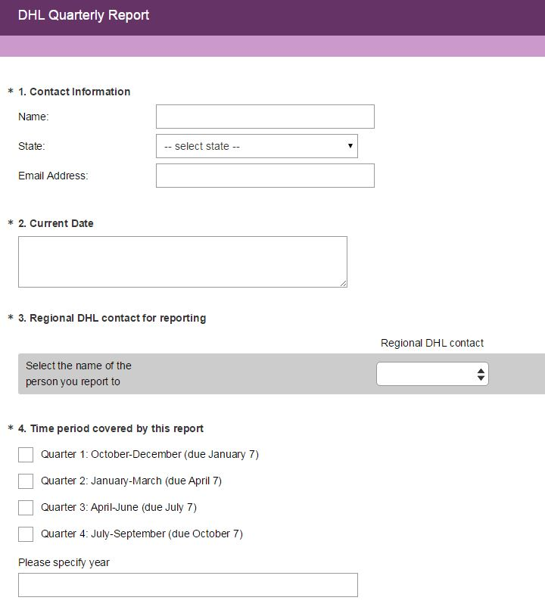

Slide 33
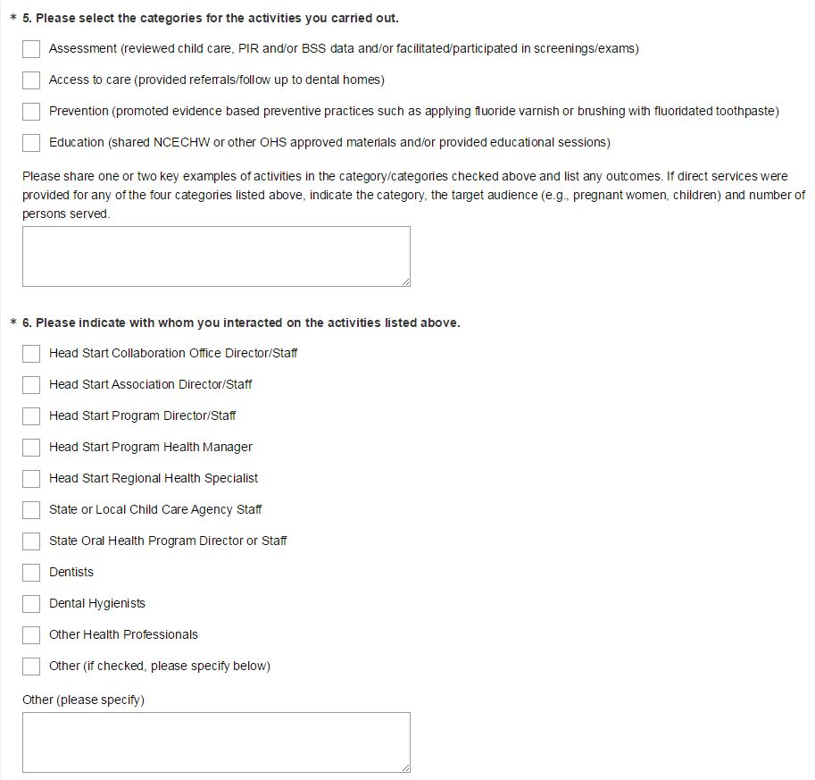
Once you have completed at least 1 activity in 2 of these categories, submit your stipend request

Slide 34
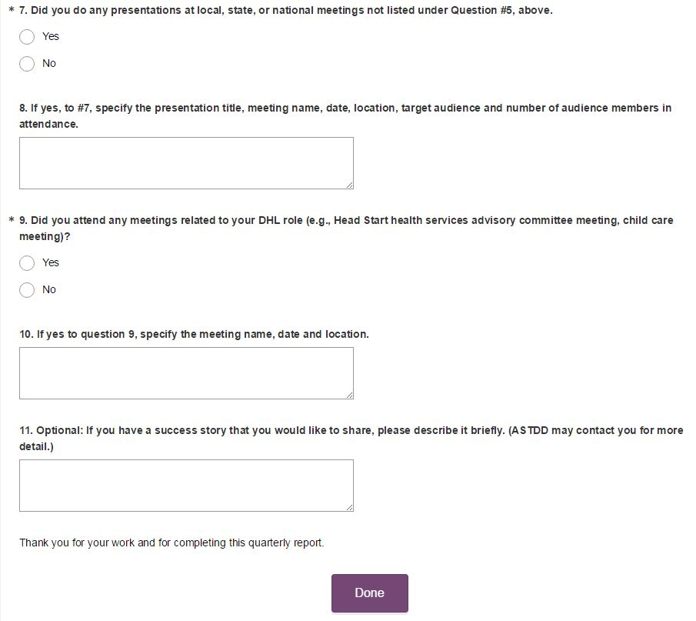

Slide 35
DHL Stipend
$750 annual stipend available
Assist with DHL related activities, such as:
Local travel or supplies to serve programs
Educational resources for programs
Supplement travel expenses to a professional meeting (e.g., ADHA session, NOHC)
Submit when at least one activity is completed under two different categories listed on the quarterly report
E-mail completed form to Bev Isman at bev.isman@comcast.net
Stipend request form will be e-mailed to DHLs and is available on ASTDD’s DHL webpage at http://www.astdd.org/head-start-state-dental-hygienist-liaisons-information

Slide 36
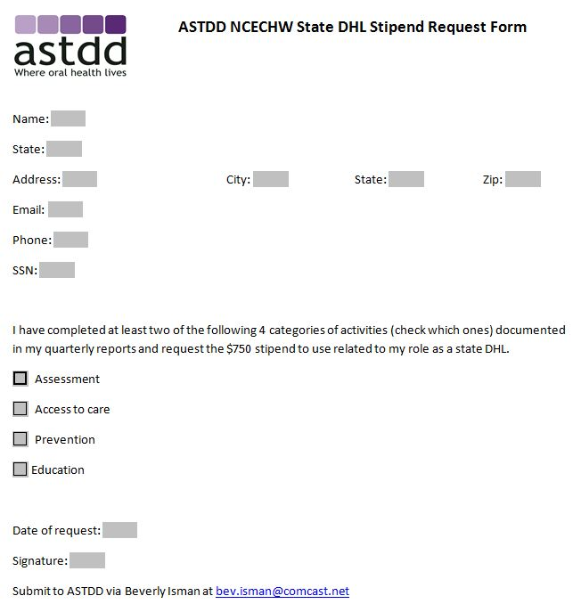
Stipend Request Form

Slide 37
Questions?

