Slide 1
Partnering with Child Care to Improve Oral Health for Children in Early Care and Education Programs
DHL Webinar
Presented by: Linda Satkowiak, ND, RN
Moderated by: Michelle Landrum, RDH, MEd
February 17, 2017

Slide 2
General Reminders
This webinar will be recorded and archived on the ASTDD website
Questions will be addressed after the speakers are finished. Please click on the icon at the top of your screen that looks like a person with their hand in the air. The moderator will recognize and “un-mute” you so you can ask your question.

Slide 3
Learning Objectives
Recognize the various members of the child care landscape, including the National Resource Center (NRC).
Describe the development of the Caring for Our Children health and safety standards and the specialized collections.
Describe Caring for Our Children Basics
Identify how the standards and specifically the Oral Health collection can support the work of the DHL.
Describe the role of the Child Care Health Consultant (CCHC).
Specify ways the DHL and CCHC can partner to improve the oral health of children in early childhood education (ECE).

Slide 4
National Resource Center for Health and Safety in Child Care and Early Education
Mission:
To improve the quality of out-of-home child care and early education programs and support the health and safety of the children they serve.

Slide 5
The Early Care and Education Landscape
Who
Early Care and Education Programs
Child care
Preschool
Before and After School
Summer Day Camps
Family Child Care
Family, Friend and Neighbor Care
Head Start
Early Head Start

Slide 6
The Early Care and Education Landscape
Early Head Start-Child Care Partnerships
This program integrates EHS comprehensive services and resources into the array of traditional child care and family care settings.
Learn more about this partnership…
https://www.acf.hhs.gov/sites/default/files/ecd/ehs_ccp_brochure.pdf
Is your state a part of this grant?
https://www.acf.hhs.gov/ecd/early-learning/ehs-cc-partnerships

Slide 7
The Early Childhood Education Landscape
Who Regulates, Oversees, and Supports
Regulations
State Department of Human Services Child Care Licensing
State Health Department (Sanitation rules)
Head Start Program Performance Standards
Quality Improvement Initiatives
National Association Accreditations, e.g. NAEYC, NAFCC
State Initiatives
National Health and Safety Guidelines−Caring for Our Children, 3rd Edition and Caring for Our Children Basics
Child Care Resource and Referral

Slide 8
An Example
CFOC3 standard concerning the use of Child Care Health Consultants
Standard 1.6.0.1 Child Care Health Consultants
A facility should identify and engage/partner with a child care health consultant (CCHC) who is a licensed health professional with education and experience in child and community health and child care and preferably specialized training in child care health consultation.

Slide 9
An Example
According to Overview of State Child Care Health Consultation Activities and Registries Preliminary Report – February 2017
Only twenty-six states identify CCHCs in their regulation and there is considerable variation in how states utilize child care health consultants.

Slide 10
Caring for Our Children, 3rd Edition National Health and Safety Performance Standards for Early Care and Education Programs
3rd edition revision completed and published in June 2011
10 Technical Panels - 86 panel members
184 stakeholders
686 Standards and 39 Appendices

Slide 11
Caring for Our Children (CFOC) 3rd Ed.
CFOC3 is:
Definitive source on best practice in health and safety in early care and education settings
Evidence-based
Expert consensus
Model for health & safety practices and policies
CFOC3 is not:
Regulations that must be followed by all ECE programs
A substitute for the HS and EHS Program Performance Standards

Slide 12
Tooth Brushing in Head Start
Head Start Program Performance Standards
1302.43 Oral Health Practices
“A program must promote effective oral health hygiene by ensuring all children with teeth are assisted by appropriate staff, or volunteers, if available, in brushing their teeth with toothpaste containing fluoride once daily.”

Slide 13
Tooth Brushing in CFOC3
CFOC3 Standard 3.1.5.1 Routine Oral Hygiene Activities
Caregivers/teachers should promote the habit of regular tooth brushing. All children with teeth should brush or have their teeth brushed with a soft toothbrush of age-appropriate size at least once during the hours the child is in child care. Children under three years of age should have only a small smear (grain of rice) of fluoride toothpaste on the brush when brushing…

Slide 14
Tooth Brushing in CFOC3
CFOC3 Standard 3.1.5.2 Toothbrushes and Toothpaste
In facilities where tooth brushing is an activity, each child should have a personally labeled, soft toothbrush of age-appropriate size. No sharing or borrowing of toothbrushes should be allowed. After use, toothbrushes should be stored on a clean surface with the bristle end of the toothbrush up to air dry in such a way that the toothbrushes cannot contact or drip on each other and the bristles are not in contact with any surface…

Slide 15
Oral Health in Child Care
and Early Education
Applicable Standards From:
Caring for Our Children: National Health and Safety Performance Standards: Guidelines for Early Care and Education Programs, Third Edition.
37 Standards and 1 Appendix

Slide 16
The Best Way to Access CFOC3
The NRC Home Page: http://nrckids.org
Searchable Database
Oral Health Collection

Slide 17
The Best Way to Access CFOC3
The CFOC Database: http://cfoc.nrckids.org

Slide 18
The Best Way to Access CFOC3
The CFOC Database: http://cfoc.nrckids.org

Slide 19
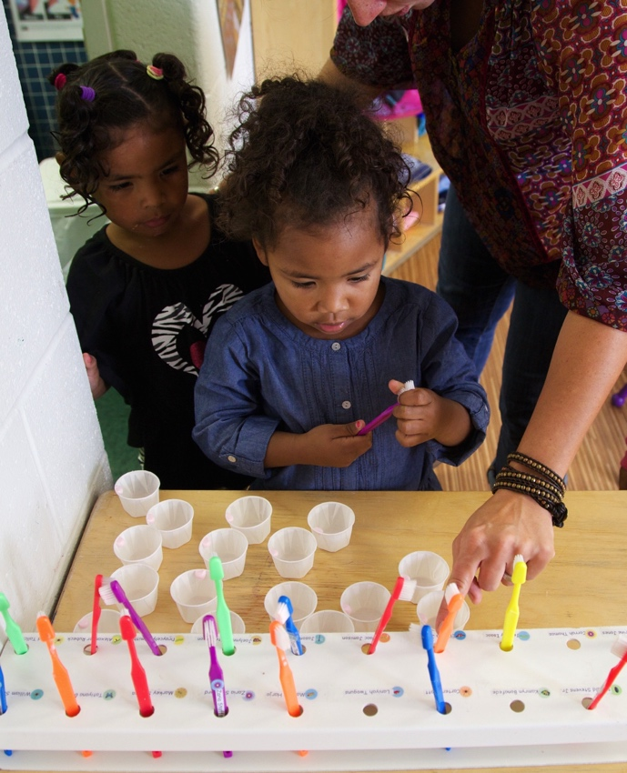
So What? How Does This Help a DHL?
CFOC3 standards can help you guide the Head Start and EHS communities to better understand how and why to integrate oral health hygiene into their programs, and
Provide support to ECE programs that are part of the EHS-CC Partnership.

Slide 20
Scenario
A child care resource and referral office in an Alabama community, participating in the EHS-CC Partnership program, has a request from a child care provider and has contacted you. The provider is trying to integrate oral health hygiene into the daily routine of her large family child care home. She thinks this would be a good idea, but her assistant is reluctant to do this program. She is interested in finding information she could share with her assistant about the importance of this activity…
How could you help?

Slide 21
Another Partner: the Child Care Health Consultant
CFOC3 Standard 1.6.0.1: Child Care Health Consultants
A child care health consultant (CCHC) is a licensed health professional with education and experience in child and community health and child care and preferably specialized training in child care health consultation (1).
The role of the CCHC is to promote the health and development of children, families, and staff and to ensure a healthy and safe child care environment (2).
1. Alkon, A., J. Bernzweig, K. To, M. Wolff, J. F. Mackie. 2009. Child care health consultation improves health and safety policies and practices. Academic Pediatrics 9:366-70.
2. Crowley, A. A. 2001. Child care health consultation: An ecological model. J Society Pediatric Nursing 6:170-81.

Slide 22
Another Partner: the Child Care Health Consultant
CFOC3 Standard 1.6.0.1: Child Care Health Consultants
The child care health consultant should be knowledgeable in the following areas:
m. Oral Health for Children

Slide 23
Scenario
A CCHC has a child care center-based program interested in providing dental screenings for all children in the program. This is not a HS or EHS program and screenings have never been done before. The CCHC reaches out to you to see how to arrange for dental screenings for the children in this center…
How could you help?

Slide 24
Scenario
A CCHC has been asked by a parent if she is aware of any dental providers in the area that will work with young children. The parent has shared that her child may have a cavity and the center staff have seen the child exhibit signs of pain while eating. The CCHC is not sure who in the community provides pediatric dental care and reaches out to you…
How can you help?

Slide 25
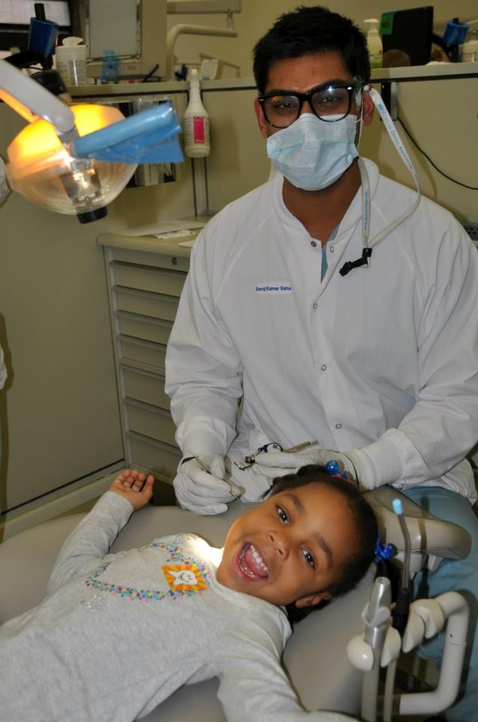
Resources for Finding a Dental Provider
InsureKidsNow.gov
Medicaid and CHIP providers
https://www.insurekidsnow.gov/state/find-a-dentist/index.html
HRSA Federally Qualified Health Centers
Low-income families
https://findahealthcenter.hrsa.gov/
State Oral Health Programs
http://www.astdd.org/state-programs/
Other Resources
Local health department
Local college or university
Local dental or dental hygiene component
Photo Credit: University of Michigan | Foter |CC BY-NC-ND

Slide 26
National Center on Early Childhood Health and Wellness and National Resource Center
NCECHW Toll-Free: 888-227-5125
Email: health@ecetta.info
NCECHW Website: http://eclkc.ohs.acf.hhs.gov/hslc/tta-system/health/center
Linda Satkowiak: linda.satkowiak@ucdenver.edu
NRC Website: http://nrckids.org
CFOC3 Searchable database: http://cfoc.nrckids.org

Slide 27
Questions?
Please click on the icon at the top of your screen that looks like a person with their hand in the air. The moderator will recognize and “un-mute” you so you can ask your question.

