Slide 1
Dental Hygienists Liaison Webinar May 20, 2016
Moderator: Michelle Landrum, RDH, MEd
Presentations:
Health Manager Networks, Steve Shuman
Accessing NCECHW-Approved Oral Health Presentations, Beth Lowe, BSDH, MPH

Slide 2
General Reminders
This webinar will be recorded and archived on the ASTDD website
Everyone except the presenters have been muted.
Questions will be addressed after the speakers are finished. Please “raise your hand” by clicking on the icon at the top of your screen that looks like a person. You will be recognized in turn and unmuted so you may ask your question.

Slide 3
DHL Stipend Reminder
$750 annual stipend available
Assist with DHL related activities, such as:
Local travel or supplies to serve programs
Educational resources for programs
Supplement travel expenses to a professional meeting (e.g., ADHA session, NOHC)
Submit when at least one activity is completed under two different categories listed on the quarterly report
E-mail completed form to Bev Isman at bev.isman@comcast.net
Stipend request form will be e-mailed to DHLs and is available on ASTDD’s DHL webpage at http://www.astdd.org/head-start-state-dental-hygienist-liaisons-information

Slide 4
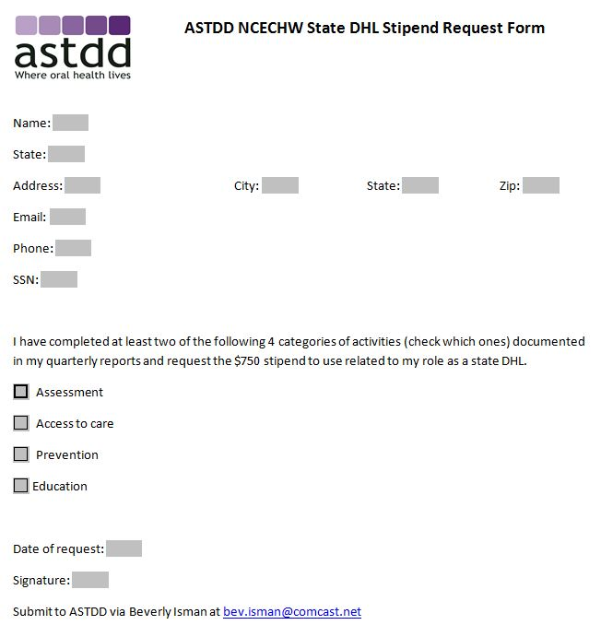
Stipend Request Form

Slide 5
Health Manager Networks: A System for Peer-to-Peer Support
DHL Webinar
Steve Shuman, Senior T/TA Associate
May 20, 2016
Notes:
Health Manager Networks are unique communities of practice made up of Head Start and early childhood health services staff. The National Center on Early Childhood Health and Wellness provides support to states and regions creating, strengthening and sustaining networks of health services staff. Like the DHL model, these peer-to-peer professional support groups allow the national center reach local Head Start providers in ways we normally would not be able to do.

Slide 6
“As health managers, we are our best resource and best support concerning all things health in Head Start and Early Head Start. Together with our community partners, we navigate the difficult water of compliance, quality, policies, and caring to improve the health of the children and families we serve.”
Notes:
Since starting this work in 2012, the National Center on Health and now NCECHW has collected data on health manager network development including quotes and anecdotes. The words of Head Start staff best describe the power of this model. Quotes such as this one are threaded throughout the presentation.

Slide 7
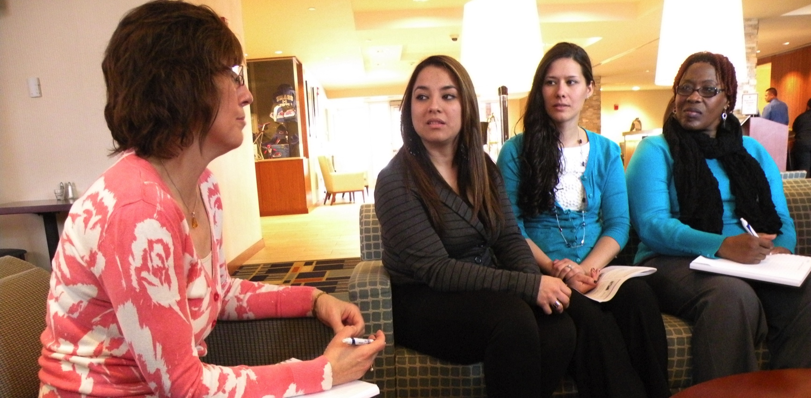
A health manager network (HMN) includes, but is not limited to, a group of three or more managers and staff who work in health, nutrition, mental health, disabilities, and oral health services. The members of this group share a common interest in the work they do and a desire to do it better. They also make a commitment to interacting regularly.
Notes:
Networks have many names such as clusters, affinity groups, communities of practice and quality enrichment circles. To make it easier to discuss the model we have chosen to use the word network to include all groups, regardless of their chosen nomenclature. NCECHW believes that grassroots peer-support networks driven by local needs are most likely to be valued, embraced and sustained by participants. The participants determine the network’s membership and focus.

Slide 8
“New members are thirsty for knowledge! Our more experienced members share information and knowledge together.”
Notes:
Like other communities of practice Health Manager Networks:
Connect people
Provide a shared context
Enable dialogue
Stimulate learning
Capture and diffuse existing knowledge
Introduce collaborative processes
Help people organize, and
Generate new knowledge

Slide 9
Benefits
Decreased feelings of isolation
Reduced staff turnover
Strengthened compliance with HSPPS
Increased awareness of resources
Improved health of children and families during and beyond their involvement in Head Start/Early Head Start
Notes:
Member of health manager networks report a number of benefits to membership for themselves, their programs, and…

Slide 10
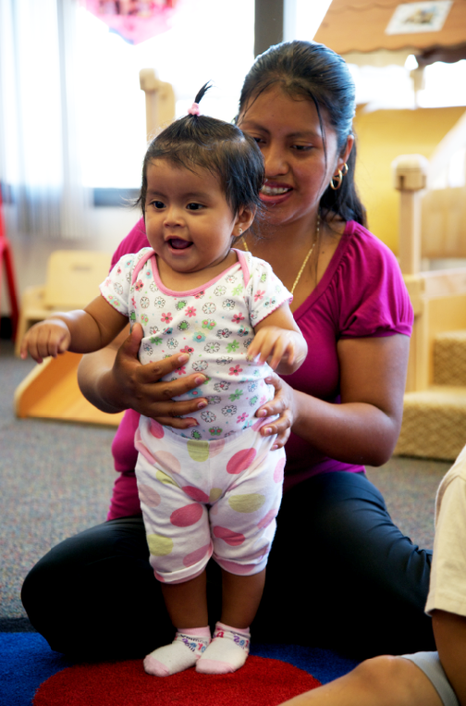
“We are doing this to help the children and families that we serve.”
Notes:
…the families they serve

Slide 11
Current Network Models
Peer led
Head Start Association
Head Start State Collaboration Office
Training & Technical Assistance System
Early Childhood Comprehensive Systems
Notes:
No one person or organization is responsible for the development or maintenance of these networks. Each group is lead and/or supported various entities. The models range from networks solely led by health managers themselves to those that are supported, part of, or led by state associations, collaboration office directors, regional T/TA staff (especially the Health Specialists) and ECCS. Some networks choose to meet only face-to-face, others meet only virtually, most use a combination of meeting formats. The most common model meets once a year face to face and uses virtual meeting technology to connect quarterly.

Slide 12
“The support we get by sharing information and talking about issues at our network meetings has had a positive impact on health services delivery in our programs. We learn from each other, and it makes us stronger.”
Notes:
Agendas are set by each network depending on the issues most pressing for themselves.

Slide 13
Support for Health Manager Networks
Monthly health and wellness resource lists
Quarterly conference calls for leaders
Virtual T/TA for planning and meeting
Identifying participants and interests
Coordination with regional offices
ECLKC
Health Manager Network Tools
Health Manager Networks Fostering Leadership
Getting Started: Health Manager Networks
What Works: Health Manager Networks
Directory of Virtual Meeting Tools
Head Start Health Manager Networks
Notes:
NCECHW supports Health Manager Networks by sending a list of early childhood health and wellness resources each month, hosting conference calls for self-identified network leaders 3 or 4 times each year, and upon request by making NCECHW staff and experts available for both planning and meetings. When someone expresses interest in starting a network, we may help by identifying potential participants and their contact information as well as professional interests. This work is closely coordination with both regional federal and regional T/TA staff. In the past 4 years we have created a number of tools posted on ECLKC. The most recent is a video on fostering leadership. The print materials include briefs on starting a network, what works, a directory of virtual meeting tools and a newsletter.

Slide 14
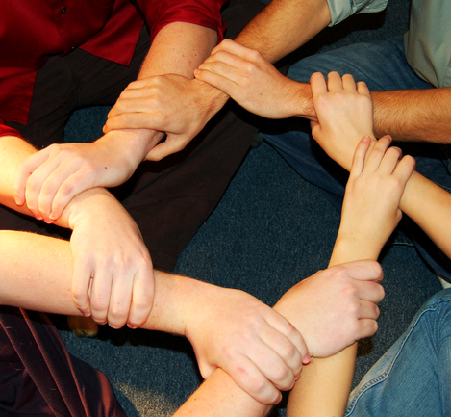
“The impact of our network has been huge, immense! To be able to bounce ideas between people makes my job so much easier.”
Notes:
Our unofficial motto has been work smarter, not harder. Their jobs as health managers, nutritionists, and oral health coordinators are difficult enough.

Slide 15
States with Networks by Region
I | II | III | IV | V | VI
CT | NJ* ** | DC | FL** | IL** | AR*
MA | NY* ** | MD* | GA | MI | OK*
ME | PR | PA | KY | MN**
NH |  | VA | NC** | OH
RI |  |  | SC | WI
VT |  |  | TN
*Network in development
**Multiple clusters
Notes:
There are more than 50 networks currently operating in 38 states, territories, and regions with new ones developing all the time. No one is obligated to report to NCECHW or OHS, so once in a while we discover a group that has been meeting without our knowledge.

Slide 16
States with Networks by Region
VII | VIII | IX | X | XI | XII*
IA | MT | CA** | AK* |  | Facebook Listserv
KS | ND |  | ID
MO | SD* |  | OR
NE* | WY |  | WA
 |  |  |  | Grantees in Regions XI and XII | are invited to join state networks
*Network in development
**Multiple clusters

Slide 17
“It is a time to catch up on the ‘latest and greatest’”
Notes:
The networks allow members to share the newest resources as well as serving as a channel for NCECHW to assess both the most current needs and applicability of new products.

Slide 18
Locating Network Leaders
888-227-5125
health@ecetta.info
Notes:
Leadership is not static and as I said, new networks spring up all the time. If anyone wants to know the name and contact information for networks in their state, contact me at this number or email address

Slide 19
“We can’t do it by ourselves. There is strength in numbers.”
Notes:
Finally, some of the most established networks have been able to influence state policies regarding child and family health.

Slide 20
Accessing National Center on Early Childhood Health and Wellness-Approved Oral Health Presentations
Beth Lowe, B.S.D.H., M.P.H
Dental Hygienist Liaison Program Webinar
May 20, 1026

Slide 21
We couldn’t do it without you!
Notes:
Before we get started. On behalf of the National Center on Early Childhood Health and Wellness, I want to thank you for all you do to improve the oral health of pregnant women, infants, children, and families enrolled in Head Start. We certainly couldn’t do what we have accomplished and what we will accomplish without you.

Slide 22
Objectives
Requesting permission to present
National Center for Early Childhood Health and Wellness (NCECHW)-approved presentations
Accessing presentation folder on Box
Adapting NCECHW-approved presentations
Photo Source: Alien of Earth | Wikimedia Commons | CC-BY-SA-4.0

Slide 23
Requesting Permission to Present
Regional and national meeting requests
Advanced permission required
Abstracts must be approved by the NCECHW federal steering committee
Submit requests and abstracts no later than 5 weeks before the meeting or abstract due date
Submit approval requests for meetings to Beth Lowe at eal38@georgetown.edu
State and local meeting requests
Advanced permission not required
Presentation slides
Must use NCECHW-approved slides at all meetings
Submit new slides 3 weeks before the meeting to Beth at eal38@georgetown.edu
Photo Source: Thinkstock ©

Slide 24
NCECHW-Approved Presentations
Nine (9) presentations available that address:
Effective partnerships
Empowering parents
Engaging parents
Head Start staff’s role in oral health
Motivational interviewing strategies and techniques
Oral health resources for Head Start staff
Oral health messages for home visitors
Promoting oral health during pregnancy
Smiles for life (oral health 101)

Slide 25
Oral Health Presentation Slides
All slides were reviewed and approved by NCECHW advisory committee, including photos
Presentation updates
New template
Updated recommendations for toothpaste amounts
Updated references where relevant
Be sure to delete, throw out, or toss out all National Center on Health presentations
Notes:
We can’t stress enough that it’s important to use only NCECHW-approved slides. Information in these slides contain evidence-based, evidence-informed, and best practices for addressing and preventing oral disease and injury. By using these slides, you are providing a common message and debunking many myths about oral health.
There are a number of updates that have been made to many of the slide presentations. In addition to converting the slides to the new NCECHW template, ADA’s recommendations for toothpaste amounts have been updated as have some of the references supporting data and recommendations stated in the presentations.
Given that, the presentations are non meant to be completely prescriptive. It’s important to use them to best meet the information needs of the meeting planners and the audience. So feel free to remove, reorder, or mix the slides as you see fit. For example, Oklahoma’s state Head Start Association asked for someone to speak at their annual spring meeting in early May 2016 on early childhood caries (or ECC) prevention and oral health during pregnancy.
Instead of providing two separate presentations, Region 6 DHL coordinator Beth Stewart and Oklahoma state DHL Karen Sehorn, used the first half of Smiles for Life to provide an overview of the caries, risk factors for ECC, and strategies for preventing ECC. They deleted the slides on oral injury prevention and first aid from Smiles for Life and replaced them with slides from the NCECHW-Approved presentation on promoting oral health during pregnancy. So by cutting and pasting slides from the two presentations, they created a third presentation using all NCECHW-approved slides. Remember that any new slides cannot be added or used without first being reviewed and approved by the Office of Head Start and it’s NCECHW advisory committee.

Slide 26
Accessing Presentation Folder on Box
Notes:
Gaining access to the updated presentations is easy.
After today’s webinar, you’ll receive an email from me that–when you open it–will look the same or very similar to the screen shot on the slide. This is an invitation to download one or all of the NCECHW-approved oral health presentations.
All you have to do is click on the view folder button and ……

Slide 27
Downloading Presentations
✔
✔
✔
✔
✔
✔
✔
✔
✔
✔
✔
Notes:
You’ll be taken to a screen that looks like this.
Here you will find the files that contain the 9 NCECHW-approved presentations. You can download one presentation at a time or multiple presentations at once. This is done by clicking the small box on the far right of each presentation. In this example I’m going to download 4 presentations at the same time. Once all of my selections are made, I click on the download button in the top left corner of the screen. And the downloading process will begin. If you want to download all of the presentations at once, click on the small box above all the others. This checks all of the files for downloading.
Some of these files are quite large so it may take a few minutes for them to download. That’s especially true if you’re downloading multiple files at once.

Slide 28
Adapting NCECHW-Approved Presentations
Remember that individual NCECHW-approved slides cannot be changed
But …
Approved slides can be removed, reordered, or mixed to meet presentation needs
Selected Slides added
Section deleted
Notes:
Remember that individual NCECHW-approved presentation slides can’t be changed. But you’re welcome to tailor the presentation slide deck to meet the needs of the meeting planners and intended audience. So feel free to remove (delete), reorder, or mix the slides as you see fit. For example, Oklahoma’s state Head Start Association asked for a DHL to speak at its annual spring meeting in early May 2016 on early childhood caries (or ECC) prevention and oral health during pregnancy.
Instead of providing two separate presentations, Region 6 DHL coordinator Beth Stewart and Oklahoma state DHL Karen Sehorn, used the first half of Smiles for Life to provide an overview of dental caries, the risk factors for ECC, and strategies for preventing ECC. They deleted the slides on oral injury prevention and first aid from Smiles for Life and replaced them with slides from the NCECHW-Approved presentation on promoting oral health during pregnancy. So by cutting and pasting slides from the two presentations, they created a third presentation using all NCECHW-approved slides. Remember that any new slides cannot be added or used without being reviewed and approved by NCECHW’s federal steering committee.

Slide 29
National Center on Early Childhood Health and Wellness
Contact for questions about NCECHW oral health presentations
Beth Lowe, B.S.D.H., M.P.H.
Health Education Specialist
National Center on Early Childhood Health and Wellness
E-mail: eal38@georgetown.edu
Phone: (202) 687-1864

Slide 30
National Center on Early Childhood Health and Wellness
Toll-Free: (866) 763-6481
Email: health@ecetta.info
Website: http://eclkc.ohs.acf.hhs.gov/hslc/tta-system/health/center

Slide 31
Questions

