Slide 1

ASTDD Orientation Module
Dental Public Health 101
8-21 version
Notes:
The primary target audience for this module is state health department staff who have little or no dental public health background or experience and little public health experience The hyperlinks in the slides are visible if you look at the slides in normal presentation mode but are not active if you are in the slide notes view.

Slide 2
Acknowledgments
This module was supported by Cooperative Agreement 5U58DP004919-03 and 5 NU58DP006573-02-00 and 03-00 from the Centers for Disease Control and Prevention (CDC), Division of Oral Health (DOH). Its contents are solely the responsibility of the authors and do not necessarily represent the official views of CDC.
Thanks to the American Dental Association (ADA) Council on Access, Prevention, and Interprofessional Collaboration (CAPIR) for permission to adapt material from their Dental Public Health (DPH) Module.

Slide 3
Dental Public Health (DPH) 101
Learning Objectives
Define Dental Public Health and compare DPH practice to clinical dental practice, noting any areas of overlap or controversy.
Describe the various components and work sites of the DPH infrastructure and how they relate to each other.
Compare the missions, members and activities of various national organizations.
Notes:
See the accompanying syllabus and hyperlinks within the slides for additional resources to help you achieve the learning objectives.

Slide 4
Dental Public Health (DPH) 101
Learning Objectives (cont)
List the three core public health functions and the 10 essential public health services to promote oral health.
Define selected key public health concepts and the national prevention agenda.
List some key dental public health/oral health accomplishments.
Discuss some key DPH challenges.
Notes:
See the accompanying syllabus and hyperlinks within the slides for additional resources to help you achieve the learning objectives.

Slide 5
What is Dental Public Health?
One of 10 American Dental Association recognized specialties, established in 1950
Focuses on dental and oral health issues in communities and populations vs. individuals
Described as: “The science and the art of preventing and controlling disease and promoting dental health through organized community efforts”
Notes:
Dental Public Health is a unique dental specialty because its practitioners focus on population health rather than individual health, and thus do not generally provide direct clinical patient services as their primary job function. Competencies for the specialty involve using scientific and evidence-based approaches to create effective programs and policies to prevent oral diseases and improve oral health. The art refers to developing innovative perspectives and adapting approaches to the diverse needs and cultures of different population groups, as well as using effective communication strategies to educate policymakers, other professionals and the public about these strategies.

Slide 6
What is Dental Public Health? (cont)
Dental Public Health is that part of dentistry providing leadership and expertise in population-based dentistry, oral health surveillance, policy development, community-based disease prevention & health promotion, and the maintenance of the dental safety net.

Slide 7
What is Dental Public Health? (cont)
Who is a dental public health professional—a dentist who has successfully completed a DPH residency and passed the specialty boards, a dental professional (dentist or dental hygienist) who has graduated with an MPH degree with or without a concentration in DPH, or any dental professional working in a public health clinical setting? There still is no clear consensus, which creates numerous challenges.
Notes:
Other skills are needed to gather, analyze, interpret and disseminate data and research findings; conduct oral health surveillance; influence policies and systems change; build support through partnerships; manage people and programs; evaluate professional, program and systems’ performance; practice ethical decision-making; use different forms of information technology; and and lead strategically.

Slide 8

Clinical Dental Practice & Public Health Dentistry
Complementary roles
Shared objectives – optimal oral health
Every dental professional can be viewed as part of the DPH infrastructure, but all dental professionals are not dental public health professionals.
Notes:
The next few slides compare the practice of clinical dentistry to dental public health practice. Dental public health professionals graduate from accredited dental or dental hygiene programs and are licensed to practice their respective professions. Their public health credentials or skills are based on additional education, residencies/training or on the job experience. Although many dentists and dental hygienists learn knowledge about population-based approaches during their professional education and participate in public health activities during their careers, they generally do not make this a primary focus of their practices. They do, however, constitute part of the supporting dental public health infrastructure.

Slide 9
Clinician and DPH Practitioner Comparison
Dental Clinician
DPH Practitioner
Focuses on the individual patient
Conducts patient examinations
Focuses on the community, which could be defined by geographic or political boundaries, socio-demographic characteristics, or health status
Implements OH surveillance systems and collects data on community oral health status

Slide 10
Clinician and DPH Practitioner Comparison
Dental Clinician
DPH Practitioner
Establishes patient diagnosis
Discusses findings with patient and develops treatment plan
Analyzes and interprets data from surveillance systems, surveys and other data sources
Engages community partners and forms community OH coalitions; develops a community OH plan to address the findings from OH surveillance; plans community-based prevention and treatment programs; develops policies to address needs

Slide 11
Clinician and DPH Practitioner Comparison
Dental Clinician
DPH Practitioner
Provides treatment to patient
Receives payment for services
Schedules periodic follow-up patient visits
Implements evidence-based, community-based oral health programs, which requires gathering resources in an organized and rational way and preferably with broad-based community support and involvement
Obtains funding to operate programs, which may come from a range of sources including government, private foundations, philanthropic organizations, and commercial or private donors
Conducts program evaluations

Slide 12
The DPH Infrastructure
A broad-based, informal, and diverse network of public and private organizations, as well as individuals, committed to improving oral health through organized community-focused policies and programs
Monitors the oral health status of communities
Oversees community-based oral disease prevention programs
Notes:
The dental public health infrastructure is one component of the larger public health infrastructure. A basic goal is to assure that oral health is recognized as an integral part of overall health. Collaboration and coordination are key to recognizing and reducing oral health disparities and identifying, leveraging and using resources to develop programs for all life stages (lifespan approach).

Slide 13
The DPH Infrastructure (cont)
Establishes policies to maintain and improve oral health and access to care
Involved in research in population health, epidemiology, and disease prevention and control
Assures the safety and effectiveness of the oral health care system for those providing and obtaining oral health care.
Notes:
A challenge for the DPH infrastructure is creating a shared vision of optimal oral health for widely diverse population groups and respecting everyone’s unique skills and perspectives in achieving this goal.

Slide 14
Examples of Public Health Worksites
City, county, tribal, state and territorial health departments
Federal government agencies: Indian Health Service (IHS), Veteran’s Administration (VA), Department of Defense (DOD), Centers for Disease Control and Prevention (CDC), National Institutes of Health (NIH), Health Resources and Services Administration (HRSA), Centers for Medicare and Medicaid Services (CMS), Administration for Children and Families (ACF), Bureau of Prisons (BOP), and the Food and Drug Administration (FDA).
Notes:
Professionals with dental public health skills have several options for applying their skills, in positions as administrators, managers, evaluators, epidemiologists, public health advisors, health educators, faculty, researchers, planners, grantwriters, or project officers.

Slide 15
Examples of Public Health Worksites (cont)
Academia: Health professions schools, schools of public health, public policy institutes, and research centers
Community-based settings: Correctional facilities, long-term care facilities, school-based health programs, mobile and teledentistry programs
Clinics: Federally Qualified Health Centers (FQHCs), which include migrant, homeless, public housing and Native Hawaiian sites; tribal clinics; and non-profit and/or volunteer clinics.
Notes:
Professionals with dental public health skills also often serve on special task forces, advisory committees, grant review panels, local health boards or other groups where their special expertise is valued.

Slide 16
Components of the DPH Infrastructure
Government: State and local health departments, federal agencies (see The Role of Health & Human Services and Its Agencies in Promoting Oral Health)
  Organizations: national (See the ASTDD slideshow on national organizations), state, local, public, private, foundations, and many others
Education: Dental and Dental Hygiene Schools & Graduate/Residency Programs; Schools of Medicine, Nursing, and Allied Health Sciences; Schools of Public Health; Preschool, Primary and Secondary Schools
Workforce: Oral Health Professionals, Physicians, Physician Assistants, Nurse Practitioners, Nurses, Pharmacists, Midwives, Community Health Workers/Promotoras, Community Dental Health Coordinators, Water Plant Operators, Teachers, School Administrators, Parents, Caregivers and others.
Notes:
These are some more specific examples of government agencies, national organizations, educational programs and other members of the broad dental public health infrastructure.

Slide 17
Key Organizations: Association of State and Territorial Dental Directors
Mission: ASTDD provides leadership to: promote and support a governmental oral health presence in each state and territory, increase awareness of oral health as an important and integral part of overall health, address oral health equity, promote evidence-based oral health policies and practices, and assist in the development of initiatives to prevent and control oral diseases.
Members: Primary voting members are the directors of state/territorial public health agency programs for oral health; other interested individuals or groups are associate members; ASTDD is one of 21 affiliates of the Association of State and Territorial Health Officials (ASTHO).
Activities: Co-sponsors the National Oral Health Conference; conducts a peer support program; collects data for annual State Synopses and the National Oral Health Surveillance System; technical assistance and training; provides reports, news updates, guidelines, state oral health program competences, best practice approach reports and other DPH resources.
Notes:
Many national organizations include a focus on oral health and specific population groups. Let’s review some more details about some key national organizations that are most known for their dental public health representation and support for DPH activities and professionals.
ASTDD celebrated its 73rd year as an organization in 2021; some of its original state dental directors also were the organizers of AAPHD in 1950. ASTDD serves as the umbrella organization for state oral health programs but has broadened its membership to include many other professionals from the dental public health infrastructure. Some organizational members represent state dental societies or oral health coalitions, while others are national organizations such as the American Dental Hygienists’ Association. Total membership was 568 at the end of 2020.

Slide 18
Key Organizations: American Association of Public Health Dentistry
Mission: To provide leadership in ensuring optimal oral health for individuals and communities.
Membership: All individuals concerned with improving the oral health of the public; there are several membership categories.
Activities: Sponsors the American Board of Dental Public Health; publishes the Journal of Public Health Dentistry and a newsletter; co-sponsors the National Oral Health Conference; supports student chapters; maintains a speakers’ bureau for curriculum modules; provides information about accredited DPH residency programs; produces white papers and policy statements; the charitable Foundation arm sponsors scholarships and small grants.
Notes:
In 2020 AAPHD had about 578 members among the various membership categories from a broad-based constituency. There now are about 40 Student chapters.

Slide 19
Key Organizations: American Board of Dental Public Health
Serves as the national examining and certifying body for the DPH specialty.
Creates DPH standards of practice and writes DPH Competencies with AAPHD.
Grants and issues DPH certificates to those who pass the specialty boards.
Ensures continuing competency of diplomates.
Notes:
The ABDPH is recognized by the American Dental Association as the certifying body for the DPH specialty. It conducts examinations of Diplomate candidates each April. As of the end of 2019 there were 166 active Diplomates.

Slide 20
Key Organizations: American Association for Community Dental Programs
Purpose: AACDP supports the efforts of those serving the oral health needs of vulnerable populations at the community level.
Members: AACDP is a voluntary membership organization. Members include staff of city, county, and community-based health programs with an interest in oral health issues and access to care.
Activities: Member benefits include an annual meeting and subscription to the Community Oral Health Programs (COHP) discussion list.

Slide 21
Key Organizations: Medicaid/Medicare/CHIP Services Dental Association
Mission: To improve Medicaid, Medicare, and CHIP oral health programs by collaborating with key stakeholders, sharing resources, and disseminating innovative strategies
Membership: State Medicaid and CHIP oral health program directors and staff, Medicaid providers, public and private health insurers, educators, policy makers, and others
Activities: Provide leadership in developing sound Medicaid, Medicare, and CHIP oral health/dental policy; provide a support system to state and national Medicaid/CHIP dental program representatives; encourage innovation and collaboration among state and national Medicaid/CHIP dental program representatives; promote the integration of oral health and primary care in Medicaid/CHIP programs; promote an appropriate balance between the prevention and treatment of oral diseases and conditions.
Notes:
MSDA maintains the Center for State Medicaid-CHIP Oral Health Program
Quality, Policy, & Financing along with several committees, and holds an annual symposium. MSDA surveys all 50 state (and DC) Medicaid and CHIP Oral Health Programs and publishes this resource of national, regional and state program information and data. The collection includes specific program characteristics, policies, administrative practices, provider networks, benefit and payment structures and other key areas of interest.

Slide 22
Key Organizations: National Network for Oral Health Access
Mission: To improve the oral health of underserved populations and contribute to overall health through leadership, advocacy, and support to oral health providers in safety-net systems.
Members: NNOHA is a membership organization of safety-net oral health practitioners, programs and supporters.
Activities: NNOHA provides resources and learning opportunities ranging from the Operations Manual that outlines the best approaches to running an efficient and effective practice, to the Annual Conference which provides both training and networking opportunities for participants.
Notes:
NNOHA is the largest group of safety-net oral health practitioners in the country with more than 3600 members. NNOHA strives to provide relevant and useful resources and information to assist members in leading efficient and effective safety-net oral health programs. Resources fall under the categories of:
NNOHA Operations Manual
Dental Program Management
Clinical Excellence
Access to Care
Advocacy

Slide 23
Key Organizations: American Public Health Association, Oral Health Section
Mission/goals: Promote the importance of oral health; increase access to oral health preventive and treatment services; monitor and disseminate information about the oral health needs of the public
Members: Health professionals who join APHA and indicate their interest in the oral health section
Activities: Promote oral health to a full multidisciplinary audience including during the annual APHA conference; partner with other human service providers; integrate oral health with overall health; have input into environmental and health care delivery issues; disseminate research findings to the broadest possible audience; provide professional and student awards.
Notes:
The Oral Health Section is one of 32 primary sections of the very large American Public Health Association. APHA has been an organization for nearly 150 years and represents all fields of public health. It also is the umbrella organization for state public health associations. There are 53 state and regional public health association affiliates and 25,000 total members. APHA publishes the American Journal of Public Health and The Nation’s Health newsletter that occasionally feature oral health articles. At the end of 2019, the Oral Health Section had 375 members including several students.

Slide 24
Why is DPH Important to State and Territorial Health Departments?
State and territorial oral health programs report oral disease rates and improvements in the state’s population, develop and implement policies and programs to prevent or minimize diseases, and assure that laws and regulations are in place to keep the public safe and healthy.
In 2000 the U.S. Surgeon General reported that “the public health infrastructure for oral health is insufficient to address the needs of disadvantaged groups and integration of oral health and general health programs is lacking.”
ASTDD promotes a strong and effective governmental oral health presence in states and territories to assure optimal oral health for all Americans.
These are some reasons why state oral health programs are important.
Notes:
State and territorial oral health programs (S/TOHPS) are considered a main worksite for dental public health activities. Many S/TOHPs address the broad range of core public health functions and essential services (See slides #26 and 27). They also frequently serve as conveners and main collaborators with other groups.

Slide 25
Public Health Core Functions
Assessment – Regular collection and dissemination of data on health status and community health needs utilizing epidemiologic principles and surveillance systems
Policy Development – Use of scientific knowledge and data in decision making affecting the public’s health and to establish goals
Assurance – Implementing the appropriate programs to achieve the desired goals.
Notes:
The foundation for public health lies within the 3 core functions defined by the Institute of Medicine (IOM). Public health is guided by the Ten Essential Public Health Services that were developed in 1994 and updated in 2020. ASTDD adapted these 10 Essential Services to apply to Oral Health and updated them in 2021 to correspond to the other revisions (see next slides.)

Slide 26
10 Essential Public Health Services to Promote Oral Health in the U.S.
Assessment
Assess and monitor the population’s oral health status, factors that influence oral health, and community needs and assets.
2. Investigate, diagnose and address oral health problems and hazards affecting the population.
Notes:
The core functions and The 10 Essential Public Health Services to Promote Oral Health describe the activities that all public health agencies should undertake and also serve as the framework for the ASTDD Guidelines for State and Territorial Oral Health Programs (see link in the syllabus resources.)

Slide 27
10 Essential Public Health Services to Promote Oral Health in the U.S. (cont)
Policy Development
3. Communicate effectively to inform and educate people about oral health and influencing factors and educate/empower them to achieve and maintain optimal oral health.
4. Mobilize community partners to leverage resources and advocate for/act on oral health issues.
5. Develop, champion and implement policies, laws and systematic plans that support state and community oral health efforts.
6. Review, educate about and enforce laws and regulations that promote oral health and ensure safe oral health practices.

Slide 28
10 Essential Public Health Services to Promote Oral Health in the U.S. (cont)
Assurance
7. Reduce barriers to care and assure to and use of personal and population-based oral health services.
8. Assure an adequate, culturally competent and skilled public and private oral health workforce.
9. Improve and innovate dental public health functions through ongoing evaluation, research and continuous quality improvement.
10. Build and maintain a strong organizational infrastructure for dental public health.

Slide 29
Key Public Health/DPH Concepts
Social determinants of health/oral health: The conditions in which people are born, grow, work, live, and age, and the wider set of forces and systems shaping the conditions of daily life
Common risk factor approach: A method used to create cross-disciplinary health promotion programs sharing common risk factors for disease as many of the behavioral risk factors negatively impacting oral health also have a detrimental effect on overall health
Notes:
To make meaningful contributions to dental public health, professionals should incorporate some key public health concepts defined on the next few slides.

Slide 30
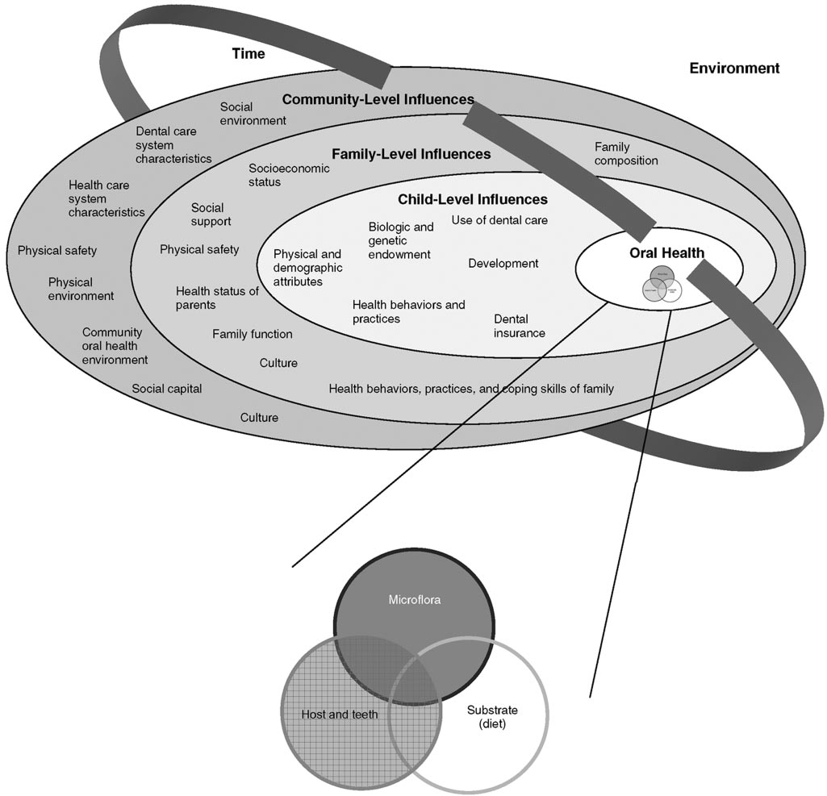
Determinants of Oral Health, Fisher-Owens et al., 2007
Notes:
The social determinants of health don’t just apply to physical health. They apply just as much to oral health. This diagram starts with the traditional way we’ve looked at what determines oral health (actually dental disease, specifically dental caries) as the little Venn diagram at the center of this universe. The diagram expands this universe and views the social determinants impacting on oral health in the context of influences associated with the child, the family and the community.

Slide 31
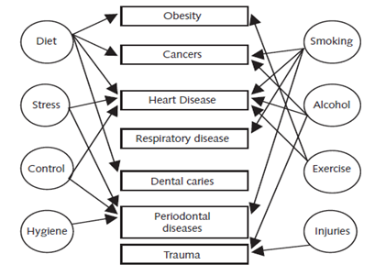
Common Risk Factor Approach
Sheiham and Watt, 2000
Notes:
To highlight oral health as part of general health and to promote inter-professional collaboration, risk factors for oral disease can be viewed as part of a common framework of risk factors for other health problems. Health promotion and disease prevention programs can use a common risk factor approach to address more than one disease at a time.

Slide 32
Key PH/DPH Concepts (cont)
Health disparities: A disproportionate burden or risk of death, disease, disability, and ill health on a particular population or group
Health literacy: Degree to which individuals have the capacity to obtain, process, and understand basic health information and services needed to make appropriate health decisions
Cultural competence: The ability of individuals and systems to relate to people with diverse values, beliefs and behaviors, including tailoring messages and care to meet their social, cultural, and linguistic needs

Slide 33
Key PH/DPH Concepts (cont)
Health equity: When everyone has an opportunity to attain their full potential for health and nobody is disadvantaged because of their social position or other social determinants of health
Health promotion: The process of enabling people and communities to increase their control over various determinants of health and, therefore, to improve their own health

Slide 34
Key PH/DPH Concepts (cont)
Community-clinical linkages: Creating sustainable, effective linkages that connect clinical providers, community organizations, and public health agencies with a common goal of improving the health of people and the communities in which they live
Health systems transformation: Transforming the American health-care delivery system into one that is more patient-centered, value-based, and coordinated.

Slide 35
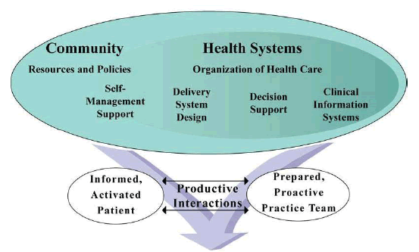
Healthcare Systems Transformation
AHRQ
Notes:
The US health system consists of public health, health and dental care, insurance, and other sectors. With passage of the Affordable Care Act, healthcare systems transformation is an important way to take a comprehensive look at health care and dental care and perform a critical transformation in both financing and service delivery. These changes could improve the efficiency and effectiveness of health organizations and services, as well as increasing connections and collaborations among sectors.

Slide 36
The National Prevention Agenda
  Healthy People Initiative: National prevention agenda for four decades
  HP 2030: 11 national oral conditions objectives
    Oral health is again one of the leading health indicators: OH-08. Increase the proportion of children, adolescents, and adults who use the oral health care system.
    Other oral health objectives are listed under other categories such as public health infrastructure.
    Some states have developed their own HP 2030 state-specific oral health objectives.
Notes:
The Healthy People initiative has served as the nation’s prevention goals since 1979, with 10-year goals for 1990, 2000, 2010, 2020 and 2030. It reflects input from a diverse group of individuals and organizations. Oral conditions is a separate focus area but oral health related objectives are included in other health topics, and for 2020 and 2030 includes one of the leading health indicators. The overall goal for the HP2030 Oral Conditions chapter is to improve oral health by increasing access to oral health care, including preventive services. This seems to move away from a public health focus on population–based primary prevention.eath by increasing access to oral health care, including

Slide 37
National Dental Public Health/Oral Health Accomplishments
National Oral Health Surveillance System
Community water fluoridation
Increased use of dental sealants and topical fluorides in community-based settings
Reductions in dental caries rates in most age groups
Reductions in tobacco use and various tobacco products
Standard infection prevention/control and patient/worker safety precautions in dentistry
Resources for emergency preparedness and response
Notes:
Dental public health professionals have played key roles in the DPH/Oral health national accomplishments noted on the slide.

Slide 38
Dental Public Health Challenges
Improving access to oral health care and insurance coverage
Need for dental public health leaders at all levels of government and all types of worksites
Promoting inter-professional collaboration and coordination that is especially important for ensuring oral health and preventing/managing oral diseases/conditions
Sustaining strong, competent oral health programs despite fluctuating budgets and priorities and an eroding public health infrastructure.
Notes:
Public health in general and dental public health in particular have continuing challenges to address to assure optimal oral health for the US population. Many people still experience oral health disparities and lack access to affordable, easily available, quality oral health care and population-based preventive services. The number of professionals with dental public health skills working in dental public health settings is very limited and often suffers from lack of leadership, retirements and competition from jobs in the private sector.

Slide 39
Dental Public Health Continuing Questions
What will be the makeup of the future dental care workforce, and how will that impact dental public health?
How will access to community-based prevention programs be maintained and enhanced?
What new community-based prevention strategies will be developed to address continuing problems such as early childhood caries and disparities in oral health status?
Notes:
These questions are the frequent focus of discussions across the nation among all sectors.

Slide 40
Dental Public Health Summary
DPH professionals:
  care about population health, health in all policies, health equity and healthy communities
  regularly assess and monitor oral health status
  develop policies and programs to improve oral health for the entire population
  lead, coordinate and evaluate organized efforts to improve oral health
  collaborate with many diverse partners committed to optimal oral health for all people.
Notes:
This slide summarizes some of the key concepts we have learned about dental public health professionals in this module.

