Slide 1
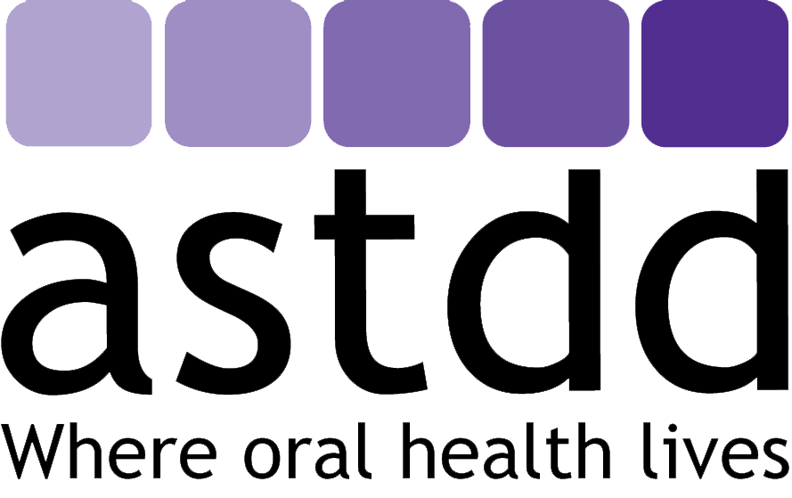
The Role of Health & Human Services (HHS) and Its Agencies in
Promoting Oral Health

Slide 2
Quick Review: US Department of Health and Human Services (HHS)
Secretary – Chief executive officer, political appointee, member of the President’s Cabinet.
Surgeon General – Leader of the US Public Health Service Commissioned Corps, leading spokesperson on matters related to public health, including oral health; appointed by the President, with Senate advice and consent.

Slide 3

Quick Review: US Department of Health and Human Services (HHS)
HHS activities that impact oral health – at the Department level
  develops strategic plans (e.g., Healthy People 2020, HHS strategic plan) that include oral health goals, targets and strategies. OH Strategic Plan has expired.
  develops policies and regulations that impact oral health programs
  conducts public health assessments
  develops and submits budgets to OMB, includes requesting support for programs that impact oral health
  implements programs (grants) authorized by Congress that support oral health

Slide 4
HHS Agencies
*Key Oral Health Agency
Administration for Children and Families (ACF)*
Administration for Community Living (ACL)*
Agency for Healthcare Research and Quality (AHRQ)*
Agency for Toxic Substances and Disease Registry (ASTDR)
Centers for Disease Control and Prevention (CDC)*
Centers for Medicare and
Medicaid Services (CMS)*
Food and Drug Administration (FDA)
Health Resources and Services Administration (HRSA)*
Indian Health Services (IHS)*
National Institutes of Health (NIH)*
Substance Abuse and Mental Health Services Administration (SAMHSA)

Slide 5
Administration for Children and Families
Promotes the economic and social well-being of families, children, individuals and communities
Programs with oral health impact
  Temporary Assistance for Needy Families (TANF) – Promotes health professions training through Health Professions Opportunity Grants (dental lab tech, dental assistant, dental hygienists)
  Head Start - Promotes dental homes for Early Head Start and Head Start children
    In 2011-2012, 85% of pre-school children received preventive dental care and 87% received a professional dental exam

Slide 6
Administration for Community Living
Programs for older adults and people with disabilities
  Encourages the Aging Services Network to engage in oral health promotion and disease prevention interventions for older adults and people with disabilities
  Community Guide to Adult Dental Program Implementation – resources, innovative programs, environmental scan

Slide 7
Agency for Healthcare Research and Quality
Invests in research to make health care safer and improve quality, generates measures and data used by providers and policy makers.
Consumer Assessment of Healthcare Providers and Systems (CAHPS) Dental Plan Survey
  Standardized questionnaire that asks adult enrollees in dental plans to report on their experiences with care and services from a dental plan, the dentists, and their staff
  Was developed for the TRICARE dental plan, but has been adapted for other uses.
  It is available to States, purchasers, and other organizations interested in assessing, improving, and reporting on the quality and value offered by dental plans.

Slide 8
Centers for Disease Control and Prevention (CDC)
Division of Oral Health – works to improve the oral health of the nation and reduce inequalities in oral health
  Helps states improve their oral health programs by:
    Developing a state oral health plan
    Training and resource development (Oral Health Resources Web site)
  Surveillance - enhancing efforts to monitor oral diseases (dental caries and periodontal infections)
  Contributing to the scientific knowledge-base regarding oral health and disease

Slide 9
CDC (cont.)
  Supporting Oral Health Promotion and Disease Prevention through these strategic priorities:
    School-based dental sealant programs (including adherence to infection prevention guidelines)
    Community water fluoridation
    Surveillance systems
    Integrating oral health with chronic disease

Slide 10
CDC (cont.)
Division of Oral Health – works to improve the oral health of the nation and reduce inequalities in oral health
  Helps states improve their oral health programs by:
    Developing a state oral health plan
    Training and resource development (Oral Health Resources Web site)
  Surveillance - enhancing efforts to monitor oral diseases (dental caries and periodontal infections)
  Contributing to the scientific knowledge-base regarding oral health and disease

Slide 11
Centers for Medicare and Medicaid Services (CMS)
Oral Health Efforts:
  Works to improve the collection and analysis of data and quality measures related to the delivery of Medicaid and CHIP oral health services.
  Sponsors the Oral Health Initiative, asked each state to increase the proportion of Medicaid children receiving preventive dental services.

Slide 12
CMS (cont.)
  Annually reports state progress on the oral health quality measures in the child core set of health-care quality measures
    PDENT: proportion of children ages 1 – 20 enrolled in Medicaid/CHIP who received a preventive dental service.
    SEAL: Proportion of children ages 6 – 9 enrolled in Medicaid/CHIP who received a sealant on a permanent molar.
  Oral Health Efforts:
    Maintains and promotes the use of the national Insure Kids Now Medicaid/CHIP dentist locator.
    Provides technical support to States testing value-based payment approaches to oral health services in Medicaid.
    Supports the validation of two dental measures (sealants and continuity of care) for inclusion in electronic health records.

Slide 13
Health Resources and Services Administration (HRSA)
Health center program (more than 1,400 Federally Qualified Health Centers) increases access to quality primary health care services, including oral health services, for medically underserved populations.
  Most health centers provide dental services on-site, or by paid referral
  In 2016 – health centers provided more than 14 million dental visits, an increase of 56% since 2010
  Supports school-based oral health care
Supports oral health care for people living with HIV/AIDS through the Ryan White/HIV/AIDS Bureau

Slide 14
HRSA (cont.)
Supports maternal and child health programs that promote oral health – Title V (state block grant)
  Perinatal and Infant Oral Health Quality Improvement Initiative (PIOHQI)– reduce the prevalence of oral disease in pregnant women and infants through improved access to high quality care.
    16 state projects
    Learning collaborative coordinated by the Center for Oral Health Integration and Improvement, includes the National Maternal and Child Oral Health Resource Center, ASTDD and FrameShift Group

Slide 15
HRSA (cont.)
Engages other providers in oral health workforce development
  Supports the Integrating Oral Health and Primary Care Practice Initiative – oral health core clinical competencies for primary care providers
  Supports the National Center for Interprofessional Practice and Education – promotes interprofessional practice and team-based care
  Supports the National Network for Oral Health Access
  Supported the development of oral health clinical competencies for primary care providers

Slide 16
HRSA (cont.)
Designates Dental HPSAs (health professions shortage areas)
Supports other policy work, such as National Academy of Medicine studies
Supports an Oral Health Workforce Research Center (SUNY-Albany)
Supports dental workforce development grants (Title VII)
  general dentistry
  pediatric dentistry
  dental faculty loan repayment
  dental hygiene
  dental public health
  State Oral Health Workforce grants

Slide 17
HRSA (cont.)
National Health Service Corps (loan repayment in exchange for service) for dental providers who work in underserved areas
Area Health Education Centers –support for health professionals training, includes dental providers
Federal Office of Rural Health Policy
  Rural Health Care Services Outreach and Rural Health Network Development grant programs address unmet oral health needs in rural communities
  Rural Oral Health Toolkit (RHIhub)
For more information about HRSA:
  https://www.hrsa.gov/oral-health/index.html

Slide 18
Indian Health Service (IHS)
Oral Health Activities
  Provides oral health assessment and fluoride varnish application training to primary care providers and other staff
  Supports an Early Childhood Caries Collaborative, promotes childhood oral health and the application of dental sealants
  Provides direct care to American Indian/Alaska Native patients or contracts with tribal organizations to provide dental care
  IHS – Division of Oral Health (Rockville, MD central office, and regional offices)

Slide 19
National Institutes of Health
NIH – conducts oral health and dental research through the National Institute of Dental and Craniofacial Research (NIDCR)
Other NIH Institutes that Address Oral Health
  National Institute of Child Health and Human Development
  National Institute on Minority Health and Health Disparities
  National Cancer Institute

Slide 20
Additional Resources
Learning more about the HHS regional offices: https://hhs.gov/about/agencies/iea/regional-offices/index.html
Finding out about grants: https://www.hhs.gov/grants/index.html
Oral health workforce research center: http://www.oralhealthworkforce.org/
For more information about HRSA’s oral health programs: https://www.hrsa.gov/oral-health/index.html
ACL’s Oral Health Community Guide: https://www.acl.gov/programs/health-wellness/oral-health

