Slide 1
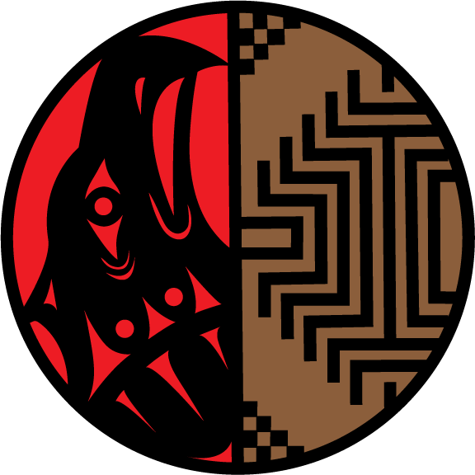
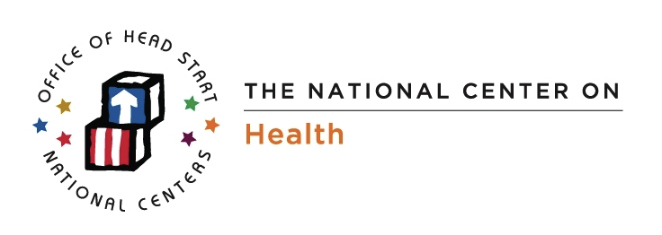
Navigating AIAN Healthcare systems for head start children
Bonnie Bruerd, DrPHHealth Policy Consultant

Slide 2
General Reminders
This webinar will be recorded and archived on the ASTDD website;
Questions will be addressed after the speakers are finished. Please type your question into the “chatbox” that will appear at the end of the webinar and then click on the bubble to the right of where you type your question to send it to the moderator;
Please respond to the polling questions at the conclusion of the webinar.

Slide 3
Navigating AIAN Healthcare systems for head start children
Bonnie Bruerd, DrPHHealth Policy Consultant

Slide 4
Region XI Head Start (2013-14 PIR summary)
One of 2 non-geographic regions
205 programs serving 22,302 (24,405 cumulative enrollment) children/families
1,359 classrooms
Head Start and Early Head Start (148 HS, 57 EHS)
About 13,000 income eligible.
Vast majority have a medical and dental home (IHS/Tribal Clinic)
Most HS programs are administered by the Tribe (194)

Slide 5
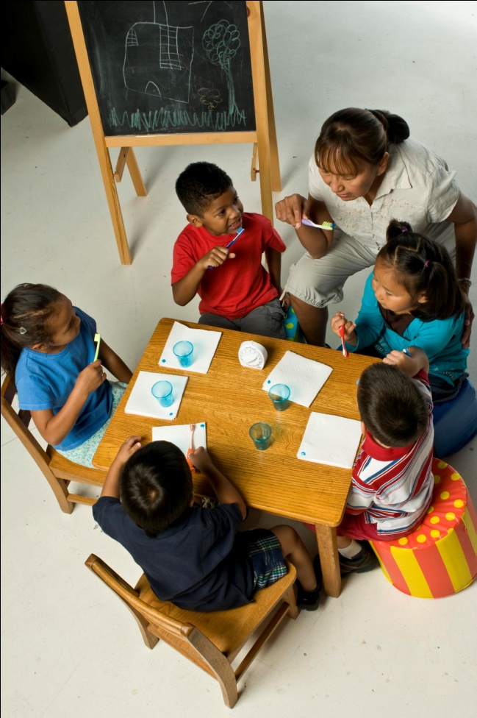
Region XI Head Start Programs
Great variation in education level of Directors and all other staff
Most staff is AIAN and may have been HS parents or even graduates
Mostly rural programs, some extremely isolated

Slide 6
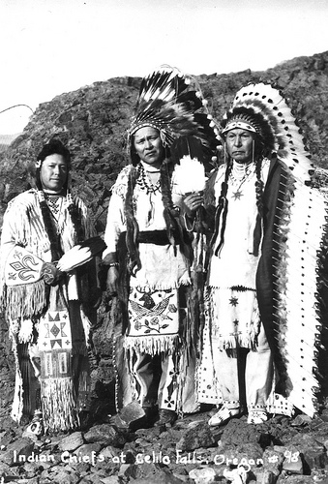
Tribal Sovereignty
The inherent authority of indigenous tribes to govern themselves within the borders of the U.S.
This legal and political relationship was established in 1787, based on Article I, Section 8 of the Constitution, and has been given form and substance by numerous treaties, laws, Supreme Court decisions, and Executive Orders.
Notes:
While tribal sovereignty is limited today by the United States under treaties, acts of Congress, Executive Orders, federal administrative agreements and court decisions, what remains is nevertheless protected and maintained by the federally recognized tribes against further encroachment by other sovereigns, such as the states. Tribal sovereignty ensures that any decisions about the tribes with regard to their property and citizens are made with their participation and consent.

Slide 7
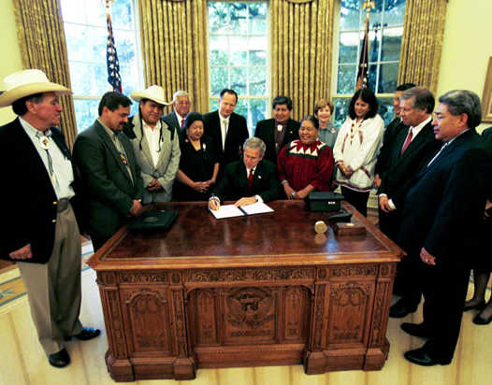
A Little History
The provision of health services to members of federally-recognized tribes grew out of the special government-to-government relationship between the federal government and Indian tribes.
Notes:
Health care is a treaty right of all AIAN people

Slide 8
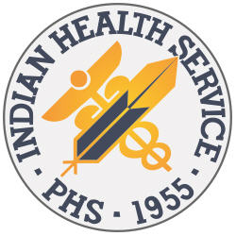
Indian Health Service (IHS)
Officially established in 1955
Agency under the Department of Health and Human Services.
Serve 2.1 million AIAN people who live on or near reservations and are members of 566 federally recognized tribes.
Notes:
Previously, health care was provided by the BIA.

Slide 9
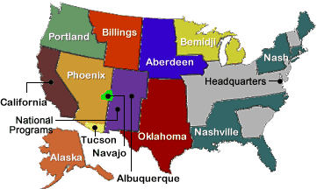
www.ihs.gov
Notes:
This is a map of the 12 IHS “Areas”, or geographical groupings of states. This gets confusing when the name of the area is a city or state, like “Portland Area” that encompasses Oregon, Washington, and Idaho. Oklahoma Area includes Kansas, Nashville Area includes many eastern and southern states. The only reason you might need to know this information is if you want to contact someone at Area Office for assistance. Each IHS Area has a central office with key administrative staff like an “Area Medical Director” and “Area Dental Officer”. Example: If a local program does not currently have a dentist, you could contact the ADO to see if one will be coming soon. You might also contact an IHS Area Dental Support Center to see if they could provide training on fluoride varnish or help you set up a better system for dental treatment. There are descriptions and contacts for each IHS Area on the IHS webpage listed on this slide.

Slide 10
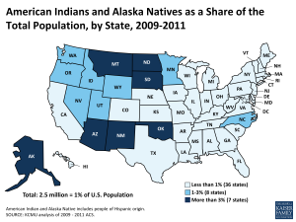
Where do most AIAN people live?
http://kff.org/report-section/health-coverage-and-care-for-american-indians-and-alaska-natives-issue-brief/
Notes:
54% of AIAN population reside in 7 states

Slide 11
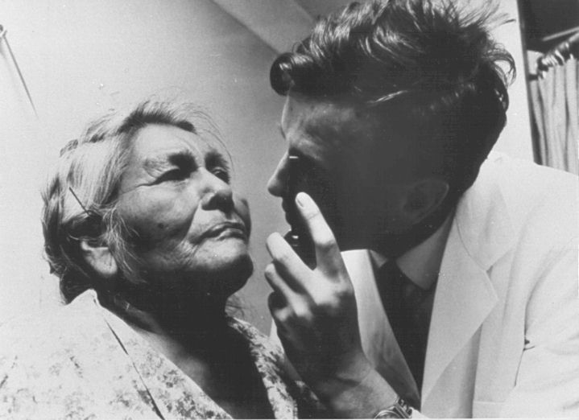
The Indian Healthcare System
Indian Health Service (IHS) direct health care services
IHS services are administered through a system of 12 Area offices and 168 IHS and tribally managed service units.
Tribally-operated health care services
Today, over half of the IHS appropriation is administered by Tribes through self-determination contracts or self-governance compacts.
Urban Indian health care services
There are 33 urban programs
Notes:
Therefore, all of these options are actually funded and administered through the Indian Health Service. Often, HS will blame IHS, when the healthcare program is actually run by the tribe. You’ll want to find out if the dental program is IHS or tribally run. I’ll talk more about that later.

Slide 12
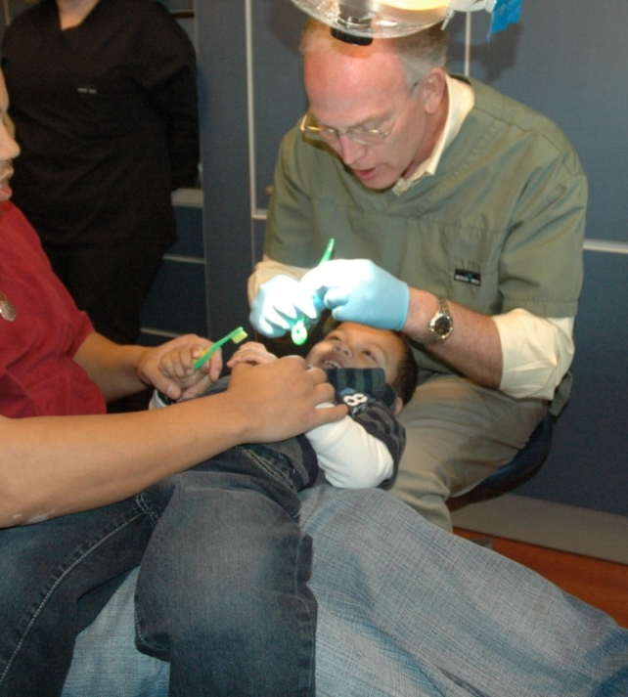
Healthcare Providers
Healthcare providers who work in direct IHS and tribal programs can be employed as officers in the USPHS (uniformed), civil servants, tribal employees, or under contract with the tribes.
Notes:
A tribal facility might still have a Commissioned Officer as a doctor or dentist and an IHS facility could have a health professional that is a tribal hire or contracted. In other words, you can’t tell which system the employees are working under based on whether the program is IHS or tribal. The good news is that it really doesn’t matter to Head Start.

Slide 13
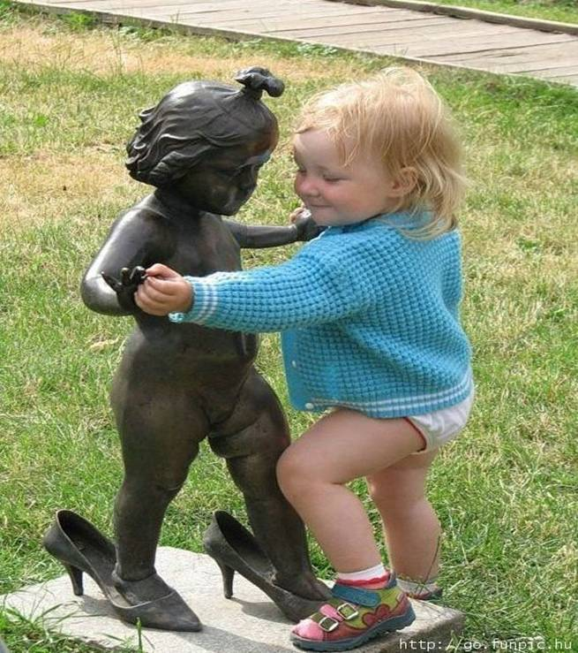
The Cross-Cultural Dance

Slide 14
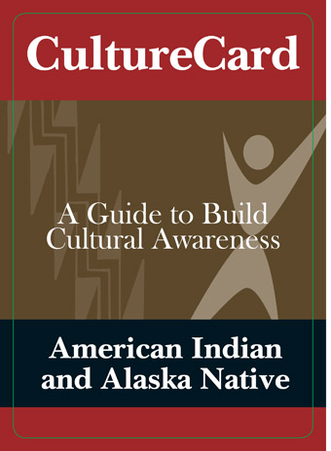
The Culture Card
http://store.samhsa.gov/product/American-Indian-and-Alaska-Native-Culture-Card/SMA08-4354

Slide 15
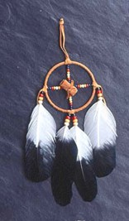
The Culture Card: Some Highlights
Handhugs instead of handshakes
Humor (laugh at yourself)
Respect for elders and veterans
Strong kinship and extended family systems
Shared sense of collective community responsibility vs. individual competition

Slide 16
The Cross Cultural Dance…
Retention and reclamation of traditional language/culture
Following” instead of directing children. Letting children learn through experience and observation.
Value of Storytelling
Relationships are everything! Trust is built slowly.

Slide 17
Region XI Head Start and Healthcare
Notes:
So now let’s take the information about IHS and Tribal healthcare and see how it can help you unravel problems that you encounter in Head Start and Early Head Start

Slide 18
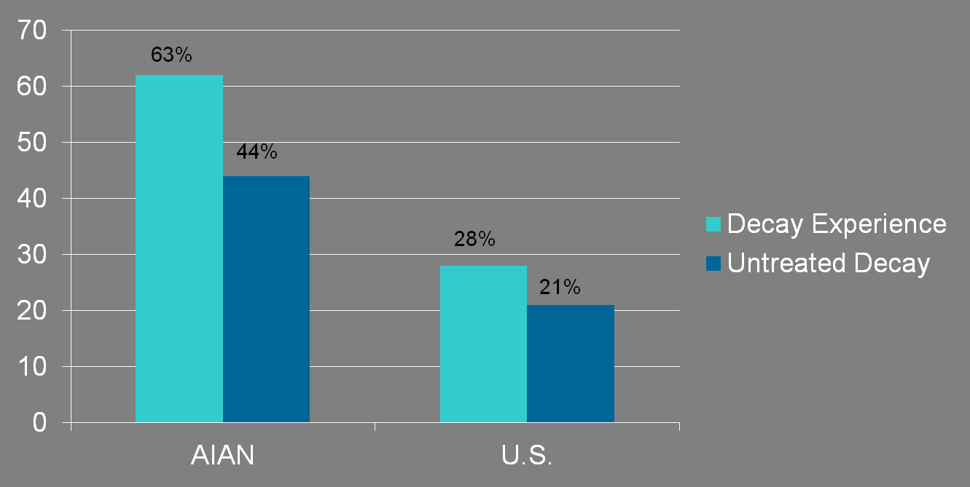
Health Disparity or Health Disaster?
Notes:
Over 8,000 children 2010, Basic Screening Survey. AIAN children 1-5 years of age have more than twice the decay experience of the general US population and twice as much untreated decay as the general US population. (54% and 37% 2014 1-5 year olds)
Death rate of 1-4 year olds is 3 times the US all populations, with preventable accidents being the leading cause of death (52%) As the children get older, the rate of death is about twice the US all populations with motor vehicle accidents, pedestrian accidents, and suicide leading the causes, much of it identified as alcohol related.
Twice as likely to be overweight and 3 times as likely to be obese.

Slide 19
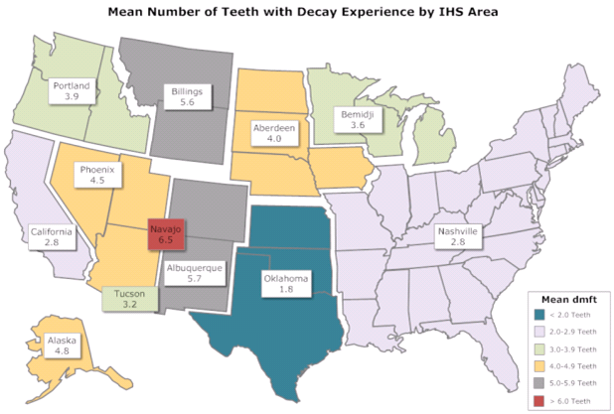
Variation by IHS Area
Notes:
There is considerable regional variation in caries experience

Slide 20
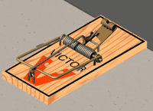
Head Start and IHS/Tribal Healthcare
Question #1: Is the healthcare in this community provided directly by an IHS program or is it administered by the tribe, either through a contract or a compacted agreement?
Trap: If you ask the HS staff/parents,
they will say “IHS” regardless of which system it is.
Facts: You can look it up online or you can talk to the Health Director or other health professionals
Notes:
When problem solving, you’ll want to know which system (direct IHS or Tribal) the dental services are provided under

Slide 21
Who Cares Which System it is?
IHS has a fairly structured list of services, and often difficult policies for getting an appointment. Head Start may have little influence with these programs.
If the Tribe has compacted health and dental care, they have great flexibility in the level of services and appointment policies.
Note: It is in the best interest of the Tribe to provide efficient health and dental services to Head Start children if they are also the HS grantee.
Notes:
You really want to understand which system you are dealing with. Believe it or not, the Head Start Director might not fully understand the significance of the three different healthcare systems, but if you unravel this puzzle, it can really help you along the way and you can teach the HS staff how to better navigate the healthcare system.

Slide 22
Resources
www.ihs.gov
Dental Support Centers
You can google tribes and most have great websites listing their health programs and usually the name/number for the Health Director and often the full healthcare staff.

Slide 23

What if nothing is working?
Define the problem: Find out what the problem is and determine if the problem lies with the healthcare system, Head Start staff, or with parents who are not following through.
Get a second opinion
Notes:
Define the problem and then talk to one of the healthcare providers involved or a tribal health board member, or parents, to see if you get the same definition of the problem.

Slide 24
What Would Work?
Before you draw in tribal members or health professionals to solve the problem, be sure to formulate exactly what you want/need from them.
Be prepared to tell them what HS requirements are.
This can be supplemented with brainstorming during upcoming sessions about what others think would work.
Notes:
(provide examples of improving access or treatment outcomes in other tribes)

Slide 25
Who can help you?
Health Director
Health Professionals
  Local health professionals
  IHS Area Office
  Dental Support Centers
Members of the Tribal Health Board
Parents
Others?
Notes:
(talk about how these different people can help solve health care issues)

Slide 26
Encourage Flexibility and Vision
Be prepared with models that work in other places.
Be prepared with ideas for working both within and outside of the Indian Healthcare System.
Develop at least one backup plan.

Slide 27
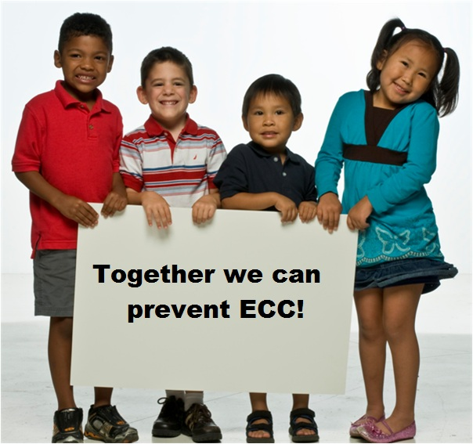
Don’t forget about Prevention!
IHS ECC Collaborative promoted access for 0-5 year olds, FV, sealants on primary teeth
Minimally invasive dentistry including ITRs
Notes:
Prevention is a primary objective of Head Start, the Indian Health Service, and the Tribes.

Slide 28
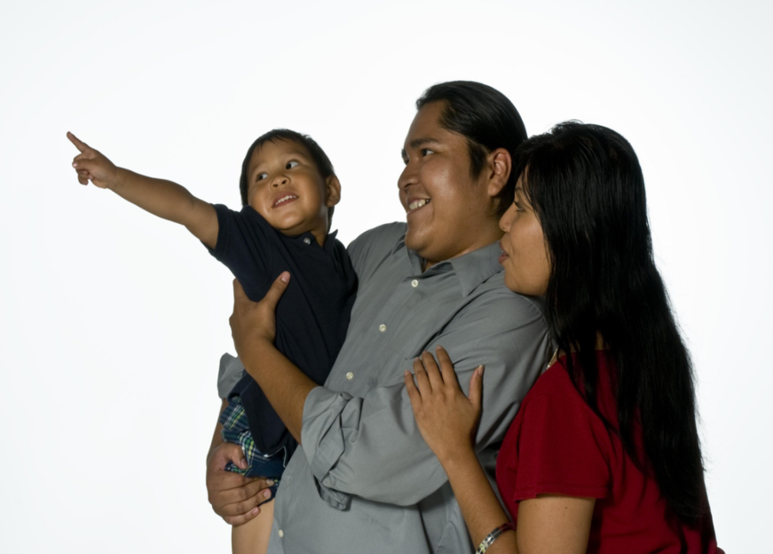
Healthy Children, Healthy Families!
National Center on Health
Phone: (888) 227-5125 E-mail: nchinfo@aap.org

