Slide 1
IT TAKES A VILLAGE! CNMI: Oral Health Programs, Partnerships, Strategies, Challenges & Its Future
National Oral Health Conference 2022
Fort Worth, Texas
April 11-13, 2022
Angelica Sabino, DDS
Chief Dentist, Oral Health Clinic
Commonwealth Healthcare Corporation
Saipan, MP 96950
angelica.sabino@chcc.health
This presentation was supported in part by ASTDD
HRSA Grants to States to Support Oral Health Workforce Activities
Grant No. T12HP31858
Notes:
<number>

Slide 2
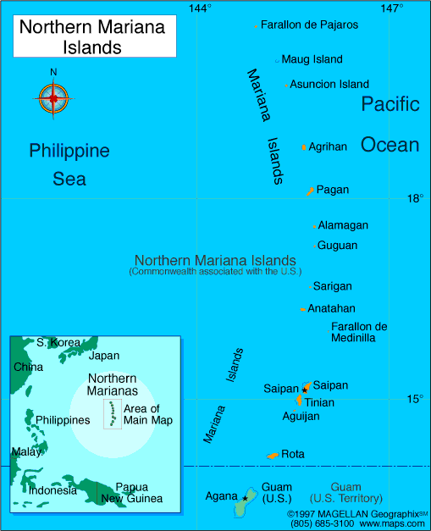
Commonwealth of the Northern Mariana Islands
(CNMI)
Composed of 14 islands with a land mass of 183.5 square miles
3 islands are inhabited: Saipan, Rota and Tinian
Capitol is Capitol Hill located on Saipan
Population: 47,329 (2020 US Census)

Slide 3
CNMI Dental Facilities & Workforce
SAIPAN:
6 Private Dental Clinics
1 Public Health Dental Clinic (Commonwealth Healthcare Corp- CHCC)
11 Dentists
ROTA:
1 Public Health Dental Clinic (Rota Health Center – satellite clinic of CHCC)
1 Traveling Dentist, 1 Traveling Hygienist, 1 Traveling EDDA* (3x per month)
1 Resident DA (OHWF grant 2018)
TINIAN:
1 Public Health Dental Clinic (Tinian Health Center – satellite clinic of CHCC)
1 Traveling Dentist, 1 Traveling Hygienist, 1 Traveling EDDA* (3x per month)
1 Resident DA (OHWF grant 2018)
*EDDA – Expanded Duty Dental Assistant
Notes:
EDDA vs Dental Therapist
DT- can administer anesthetics, can diagnose, can do simple extractions, sub-gingival prophylaxis and fillings unlike EDDA

Slide 4
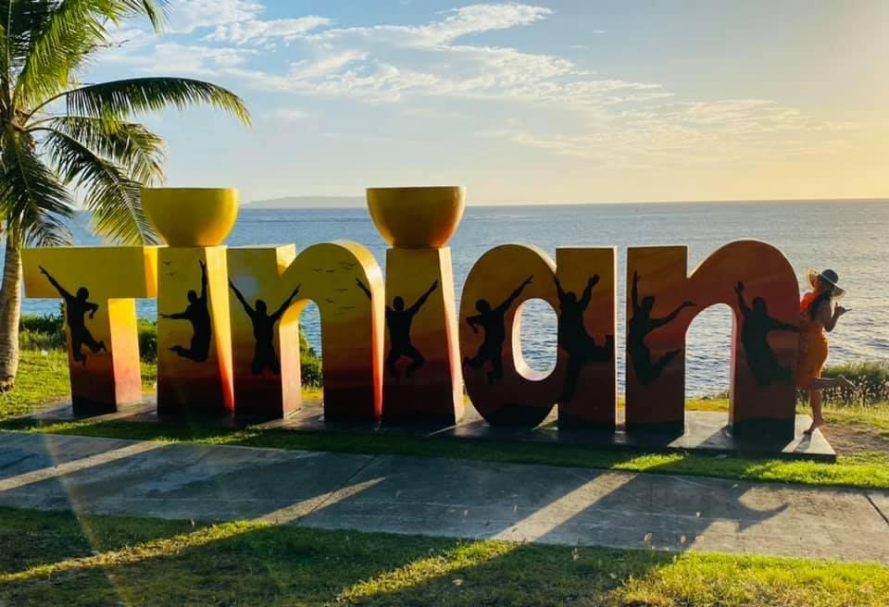
Oral Diseases in the CNMI
Oral Diseases in the CNMI: Saipan, Rota & Tinian
Tooth Decay
Oral Cancer
Health issues that stem from dental diseases
Prenatal Population
Diabetes

Slide 5
Significant Challenges in the CNMI
Socio-economic:
63% of the CNMI population are on Medicaid
56% below poverty according to US Census 2015
CDC report (2015-2018) illustrated the correlation between poverty levels and untreated tooth decay (18.7% in Black/African Americans in poverty below 100) Prevalence of tooth decay in the CNMI is 3x that at 68%.
Health Provider Shortage Area
26 - highest attainable; there are 11 dentist on Saipan to serve the island population of 43,000; only 1 dentist from CHCC to provide dental services on the island of Tinian (pop 2044) and Rota (pop 1893) 3 days out of the month each.
ROTA
No access to dental services prior to 2017; school program began in 2018
Decayed permanent molars in 96% of 2nd graders in 2018.
Notes:
Socio-Economic: The COVID 19 pandemic has exacerbated the poverty levels. The islands depend on tourism for income and the pandemic caused border closure and limited entry which dried up all activities related to tourism. The number of Medicaid recipients increased with the Medicaid Pandemic Eligibility that does not require a US citizenship. Strict entry requirements also prevented dental specialists like oral surgeons and endodontists from providing services on Saipan
<number>

Slide 6
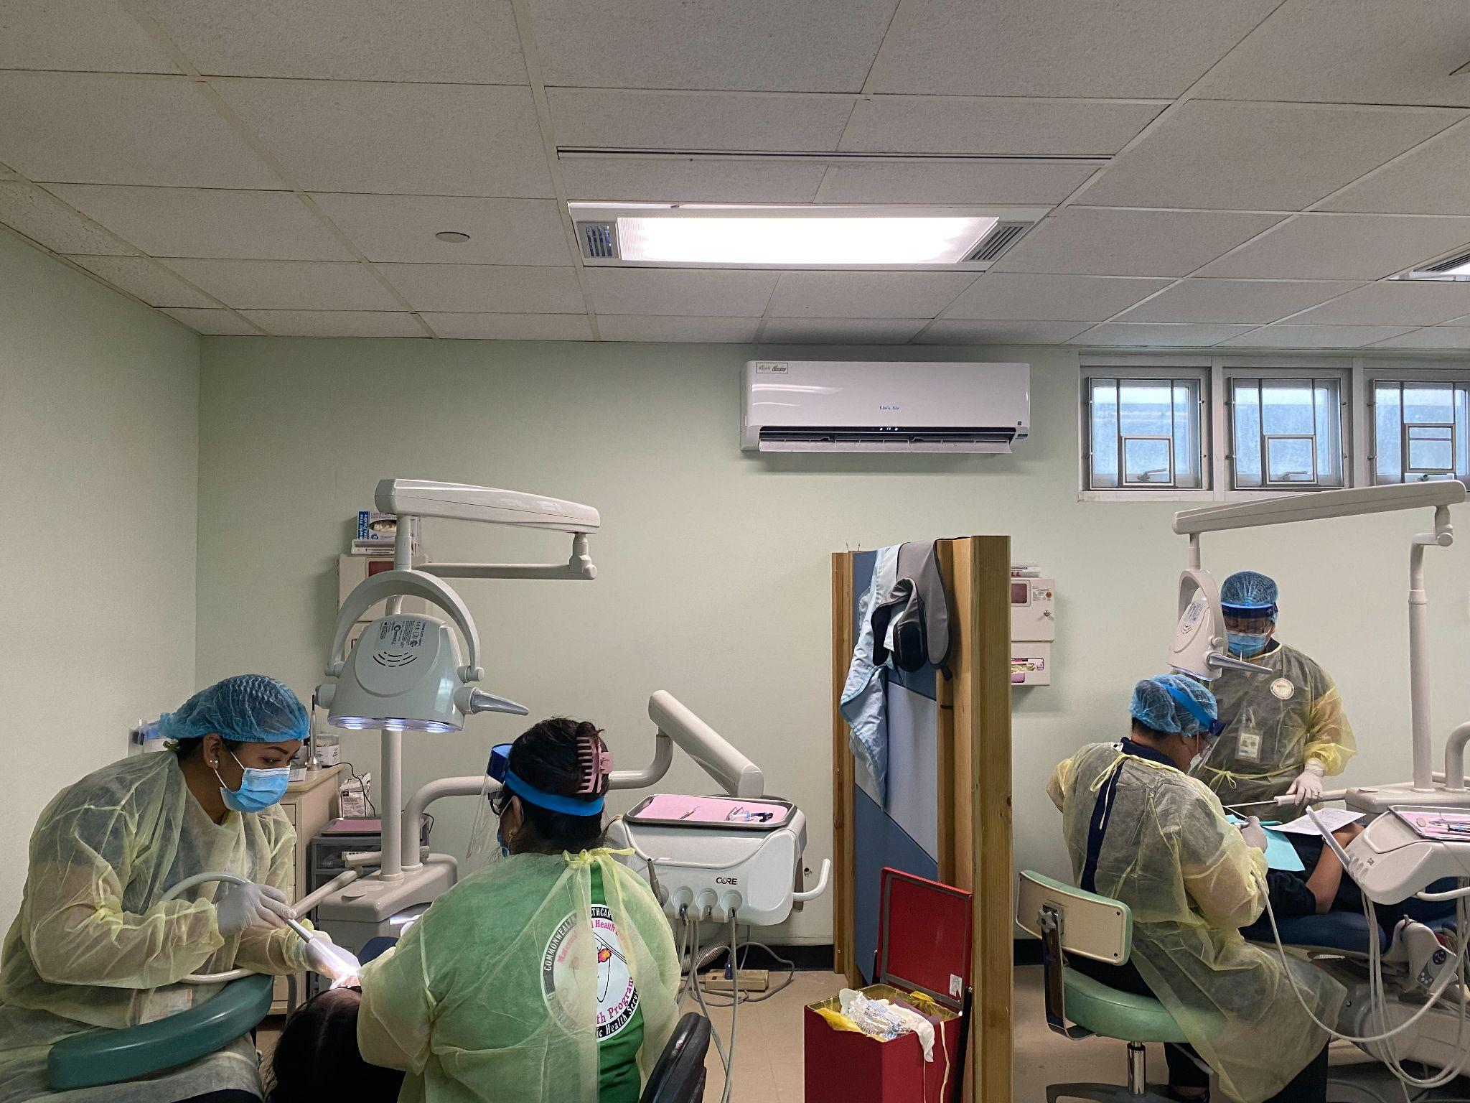
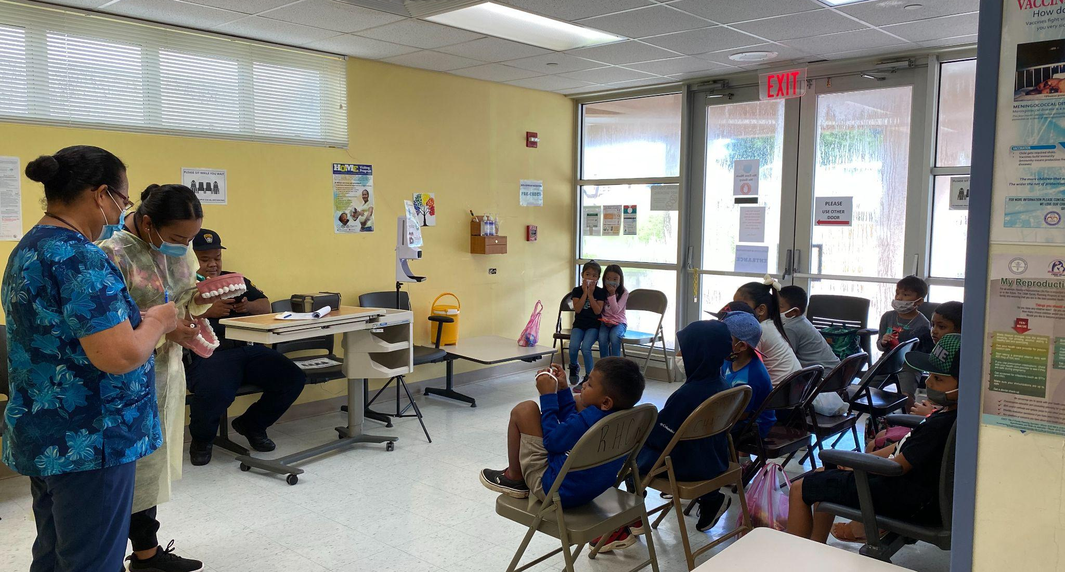
Battling Tooth Decay - Preventive Programs Partnership with Public School System (PSS)
HEAD START/EARLY HEAD START FLUORIDE VARNISH PROGRAM
Application of Fluoride Varnish to 0-5 year old kids enrolled in the Head Start Program at 3 intervals/year.
SCHOOL SEALANT PROGRAM
Public School System Saipan: 2nd and 6th grade
Expanded to include the students on Rota and Tinian (OHWF 2018)
Added 1st graders after 96% of 2nd graders had decayed permanent 1st molars (2019)
Added “Wrap Around Program” to Rota and Tinian for application of FV during well baby visits
Notes:
<number>

Slide 7
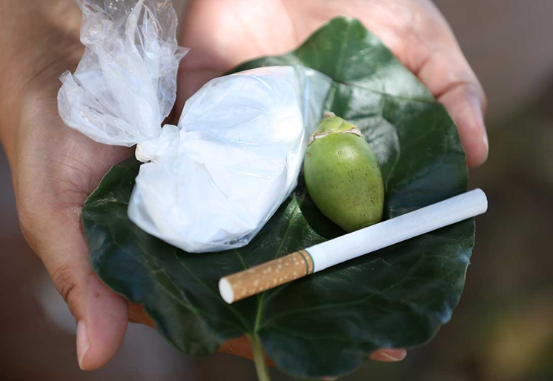
Prevalence of Oral Cancer in the CNMI
(5th leading cause of cancer mortality in CNMI) *
Cancer of the Head & Neck
* Risk factors: Betel nut quid, alcohol and HPV
* Majority of oral cancer in CNMI is from chewing betel nut quid (areca nut, pepper leaf, limestone and a form of tobacco)
45% Morbidity rate due to late stage screening
Average age: 48 years old (stark contrast to report by American Cancer Society of age over 60 diagnosed).
5 year survival: 49.5% due to late stage screening
Types: squamous cell (90%) verrucous (5%)
Most patients are unaware of the presence of oral lesions. Commonly found when assessing a toothache.
Notes:
*SAGE Journal June 16, 2020. https://journals.sagepub.com/doi/abs/10.1177/0003489420934846.
Due to our robust immunization program, unlike the U.S. where most of the oral cancer is from HPV, we have no oral cancer from HPV.
Ave age is 48 though the youngest patient with oral cancer is 29; diagnosed in 2019 and died 2020. CNMI Oncologist, Dr. Brett and ENT Dr. Moss noted that oral cancer from betel nut chewing is very aggressive and does not respond well to conventional treatment of radiation. These type of cancer are more responsive to immunotherapy
<number>

Slide 8
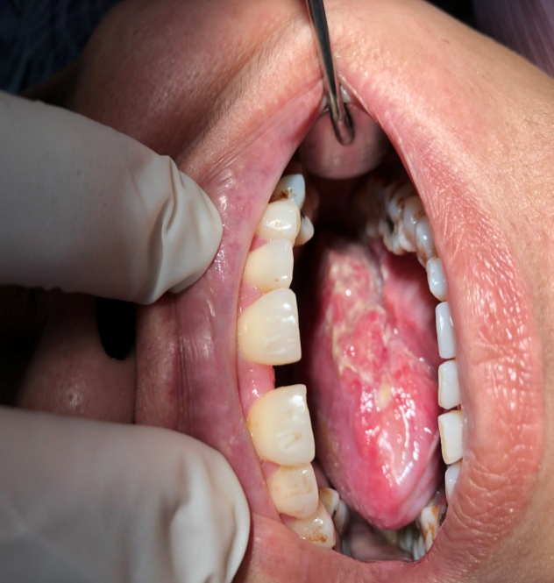
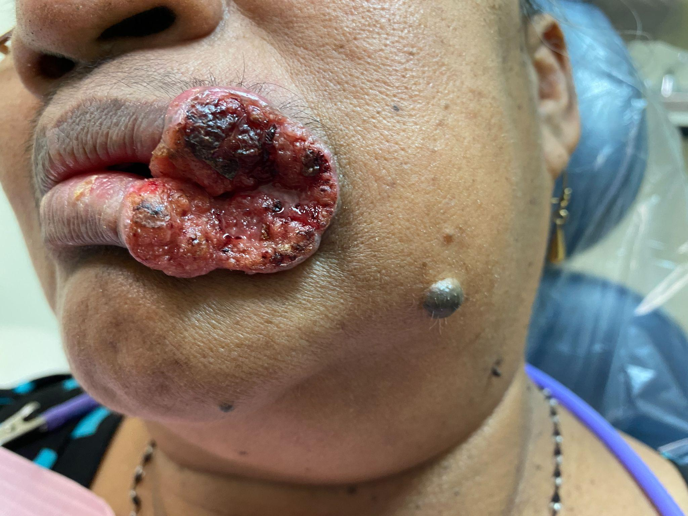
Suspect oral cancer? What next?
Collaboration between Medical Providers, NCD and Dental
ORAL CANCER SCREENING
Visual inspection and manual manipulation
FREE at ALL dental clinics in CNMI
BIOPSY
Punch Biopsy-Oral Health Clinic (CHCC) or Seven Day Adventist (SDA) Dental Clinic
Other types of Biopsy – CHCC Family Clinic (ENT)
MEDICAL REFERRAL FOR TREATMENT
Collaboration between Oncology, ENT & OHC
Dental Referral of Head/Neck Cancer Patient
Dental prophylaxis and treatment pre-referral
POST TREATMENT
Collaboration between Oncology, ENT & OHC
Dental Referral of Head/Neck Cancer Patient
Dental prophylaxis POST referral
Notes:
2018-2020 # of patients screened (112) biopsied (21) confirmed squamous cell ca (11)
2021-2022 # patients screened (67), biopsied (11), confirmed w/squamous cell ca (2)
<number>

Slide 9
IT TAKES A VILLAGE TO FIGHT ORAL CANCER CHCC Oncology & ENT, NCD, Dental Clinics, Public School System, Commonwealth Cancer Association
Oral Cancer School Outreach
Coordination with the Public School System
Primary Target: Middle and High School Students
Presentation and Oral Cancer Screening
Oral Cancer Community Outreach (CCA, NCD)
Businesses – Presentation & Oral Cancer Screening
Community Fair – Oral Cancer Screening
Head/Neck Dental Referral Policy
Referral of OC patients to dental for preventative dental treatment prior to medical referral for medical treatment (ENT/Oncology)
Betel Nut Cessation Program (NCD)
Oral Cancer Screening – CNMI Dental Community and CHCC Oncology Department
FREE Oral Cancer Screening at ALL Dental Clinics in the CNMI
Lobby for a stricter guidelines in the purchase and usage of betel nut **
Notes:
Oral Cancer is a huge problem in the CNMI, it is an concerted effort by the community to address this problem. **Cultural norm so to ‘ban” its usage has no support in the CNMI
Again, Angie: My previous comment:
“According to the American Cancer Society oropharyngeal cancers are diagnosed in folks over 60 years. Now if this occurs at much younger ages and with greater prevalence than in the US overall, this is significant. So even if you don’t have hard data, you can refer to your clinical observations and experience and that of your public health colleagues. This is important to share.”
Any additional comment???

Slide 10
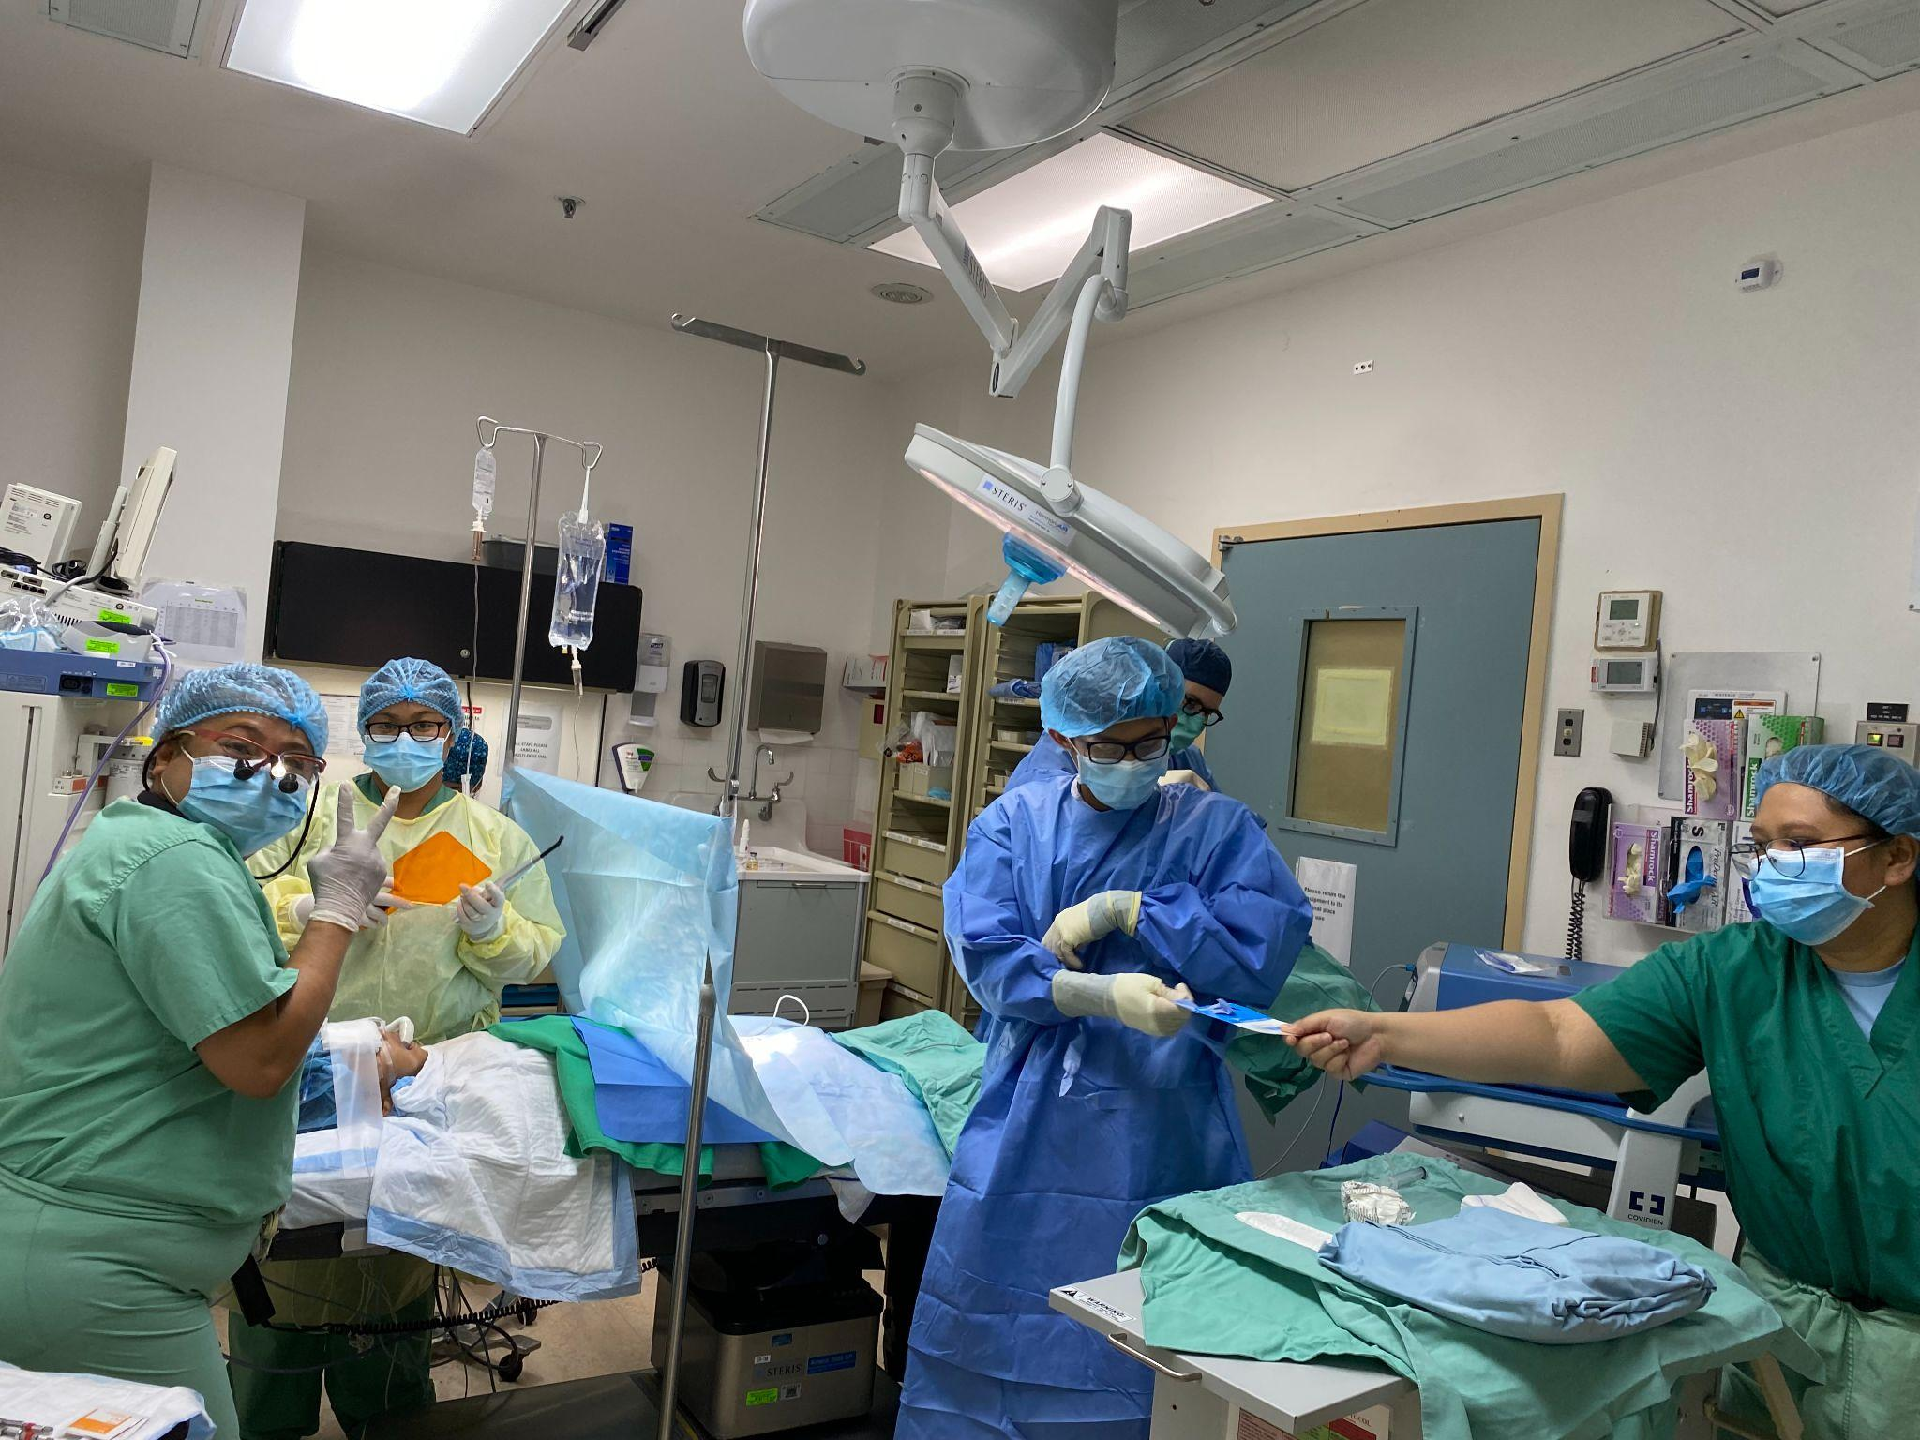
Integrated Medical-Dental Partnerships
Understanding the implication of good oral health to the overall health of an individual stresses the need for medical-dental integrated programs especially in areas with a shortage of oral health workforce.
The following are examples of the medical-dental integrated programs within CHCC.
Prenatal Program
Women’s Clinic/Providers at THC/RHC
MCH Centering Program
Well Child - Fluoride Varnish Program
Children’s Clinic - training by dental staff
THC/RHC Health Providers
Dental Referral for Head/Neck Cancer Patients
Oncology
ENT
Non-Communicable Disease (NCD)
Tobacco Cessation Program (Betel Nut)
NCD
Dental & Medical Surgical Team in the OR
Notes:
<number>

Slide 11
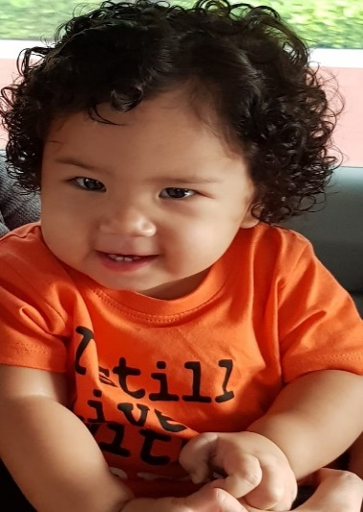
Prenatal/Dental Program:
Prenatal patients referred for Preventive Services (Women’s Clinic, MCH Centering Program, OHC)
Oral Health Instructions – How to keep teeth clean for self and the baby
Prophylaxis or Cleaning – To minimize gingival inflammation
Radiographs – To assess conditions of the teeth; need for extractions or fillings
Fluoride – to strengthen tooth structures
Baby’s 1st Program: (2020)
Child of recipient of the Prenatal Program
1st Dental Visit
Fluoride Varnish
Notes:
MCH Centering Program: Implemented in 2015 to address the need for prenatal support, primarily in the 1st trimester to decrease preterm delivery. Participants: not income based, prenatal patients in 1st/2nd trimester. Support Group led by trained health professional – discuss nutrition, breast feeding, oral hygiene, mental health, family planning, baby care, labor and delivery etc. Prenatal patient medical care provided by medical providers.
PRENATAL: 141 (2018-2020) 42 (2021-22) BABY FIRST: 28(2020)

Slide 12
CNMI Oral Disease Education, Prevention & Promotion
Encouraging healthy eating habits and oral hygiene habits
Media – Newspaper/Ads at movie theaters
Social Media – Facebook
Involved in Policy Development as it pertains to oral health diseases
To be involved in policies related to oral health issues (ex: promoting the requirement of having warning labels on betel nuts as a carcinogen or higher taxes on betelnut and tobacco products
Dental Surveillance
Tooth Decay – School Program BSS (Training by ASTDD in 2020)
Prenatal Program & Baby 1st (#of patient who were treated)
Oral Cancer Screening (# of patient requesting to be screened, #patient biopsied and #patients confirmed)
Notes:
Dental Surveillance – Data are kept at the CHCC Oral Health Clinic specifically for School Programs, Prenatal Program (# of prenatal visits/Baby 1st) and Oral Cancer
Angie: As a public health official not sure you want to use “advocating” in the 3rd bullet. Maybe “promoting”, especially most in the audience is in a similar position.

Slide 13
STRATEGIC ACTION PLAN IN PAST 2 YEARS TO ADDRESS ORAL HEALTH ISSUES IN CNMI
PREVENTIVE SERVICES
Expanded School Sealant Program (SSP) to include 1st graders
Addition of Silver Diamine Fluoride in the SSP
Addition of Dental Prophylaxis, as time permits in the SSP
Incorporating application of fluoride varnish into the well baby clinics
(addition of FV check list onto the IMMUNIZATION cards at CHCC)
WORKFORCE
Expansion of workforce (2018 OHWF)
Assumption of workforce in local budget (2022)
Expansion of scope of work for Dental Therapist
Inclusion of Dental Therapists in the CNMI
Utilizing other health providers to apply FV in the health clinics
* 1 dental therapist – Saipan, hired but waiting for immigration paperwork
(foreign educated dentist-required to possess an H1b visa or CW to work in the CNMI)
** 2 dental therapist; 1 per island (Rota and Tinian) – recruiting
Notes:
Policy changes made in the CNMI HPLB (Health Professional Licensing Board) to expand scope of work for Dental The distance from the US mainland makes it more difficult to (recruit,) hire (and retain) dentists to work on Saipan, therefore using dental therapists increases oral care access for the CNMI population which includes the island of Saipan.
CRITERIA to be licensed as a dental therapist in CNMI: FOREIGN LICENSED DENTISTS OR US EDUCATED DENTAL THERAPIST
Repeat 3/17 NOTE - ANGIE: Do you currently have any dental therapists? Where/who will train(s) your dental therapists? And do you have sufficient FTE slots and resources for new/additional DTs?
<number>

Slide 14
COVID-19: It’s Effect on CNMI Oral Health Programs
SCHOOL PROGRAMS:
Head Start Fluoride Varnish Program - ceased in February 2020 due to school closures; reinstated in January 2022 in modified format.
School Sealant Program - continuous for Rota and Tinian but modified; parents brought children into clinic, ceased for Saipan due to instability of school’s mode of teaching. Reinstated on Saipan for the 2nd graders only in February 2022.
School Outreach - ceased in February 2020 and has not been reinstated.
MEDICAL-DENTAL INTEGRATED PROGRAMS:
Uninterrupted services - The pandemic slowed the process to access these programs but it remained uninterrupted.
CLINICAL SERVICES AT THE DENTAL FACILITY:
Due to the COVID 19 pandemic, safety measures were implemented which slowed the process of encountering and treating patients. However, due to the availability of Medicaid Presumptive Eligibility, the number of patients seeking treatment had increased tremendously.
Notes:
COVID 19 pandemic caused school closures which made it difficult to implement the school programs. We were only able to continue with the school sealant programs on Rota and Tinian which have a smaller population and smaller land mass, 1st, 2nd and 6th graders were brought into the dental facility by their parents for application of sealants, Silver Diamine Fluoride, Fluoride varnish and dental prophylaxis. Unfortunately we were unable to continue with our school outreach, that stemmed out of concern of students safety. To continue with clinical services and programs, a modified standard of operation was adopted in the midst of the pandemic. This allowed for uninterrupted services, though it was a slower process. There was a large influx of patients that were seen and mostly had taken advantage of the availability of the Medicaid presumptive eligibility.
<number>

Slide 15
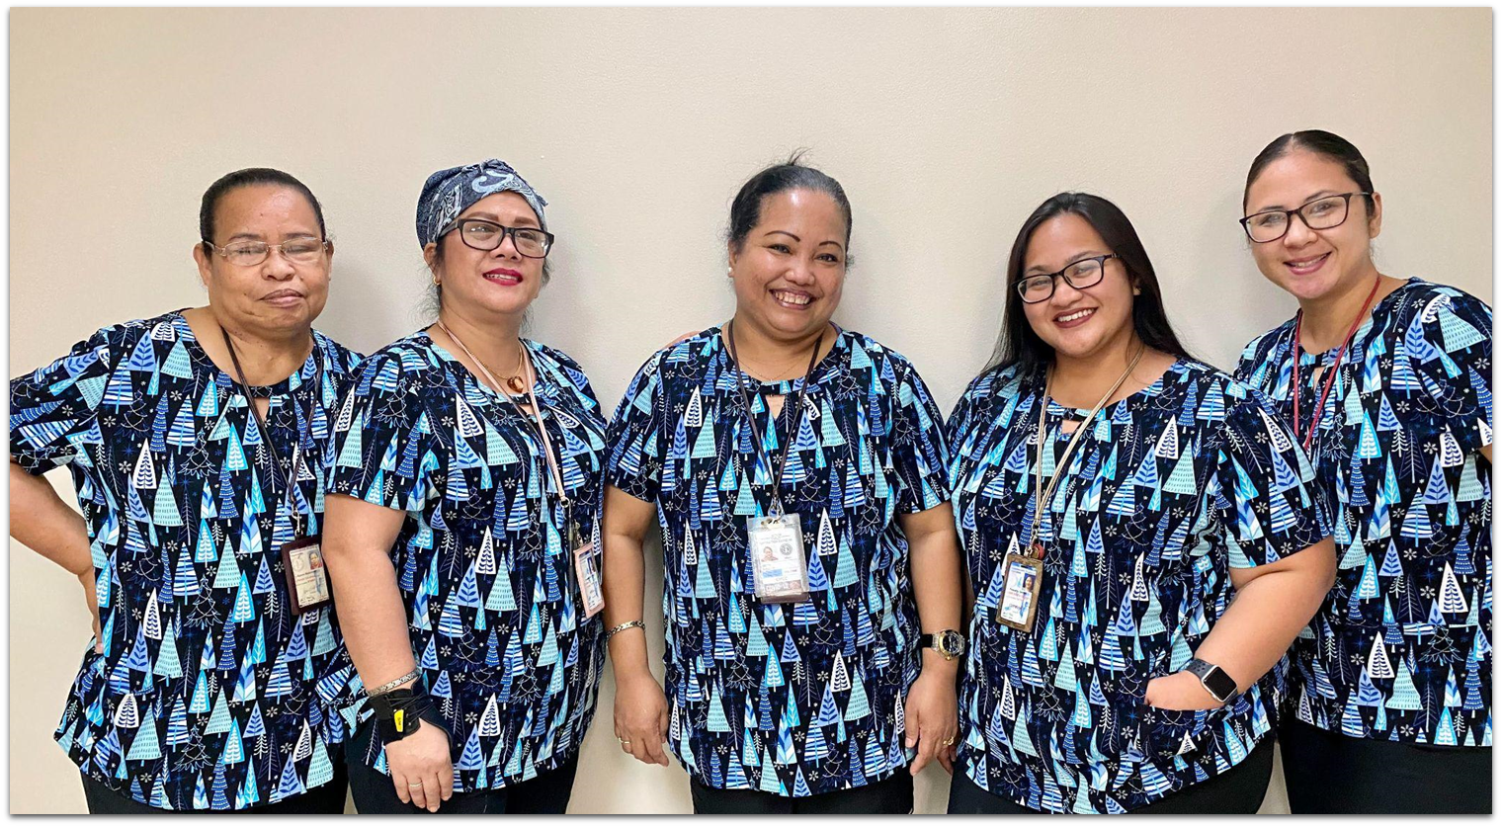
CHALLENGES & PROPOSED SOLUTIONS Oral Health Workforce in the CNMI
CHALLENGES WITH ORAL HEALTH WORKFORCE
Aging Dental Staff:
a) 1 certified dental hygienist – 60 years old
b) average age of EDDA (3) – 57 years old
Lack of educational/training program in the CNMI
a) no training program or educational program for oral
health workforce
Lack of mid-level professional to provide continuous access to oral care on Rota & Tinian
PROPOSED SOLUTION
Application for HRSA’s Grants to States to Support Oral Health Workforce Activities 2022
a. Hire dental therapist for islands of Rota and Tinian for continuous access to oral health services
b. Partner with Northern Marianas Technical Institute for a training program
c. Partner with Northern Marianas College for a curriculum to support a post
education in the field of dentistry, dental hygiene or dental therapy
Teledentistry
Notes:
<number>

Slide 16
What’s in our future?
TELEDENTISTRY
Hub: Saipan Satellite Clinics: Rota & Tinian
2. Equipment (February 2022) a) iPads b) Intraoral Camera c) Computer (workstation laptops)
3. Standard Operating Procedure (March 2022)
4. Scope of Practice (CNMI HPLB) (February 2021)
5. Remote supervision by Dentist (Saipan) for Resident DA (March 2022)
Notes:
Teledentistry in the CNMI is not a billable service but its primary importance for the CNMI is that it allows for an increase in access to oral health services on the islands of Rota and Tinian. Through teledentistry, the dentist can remotely supervise work being done by dental assistants and dental therapists.

Slide 17
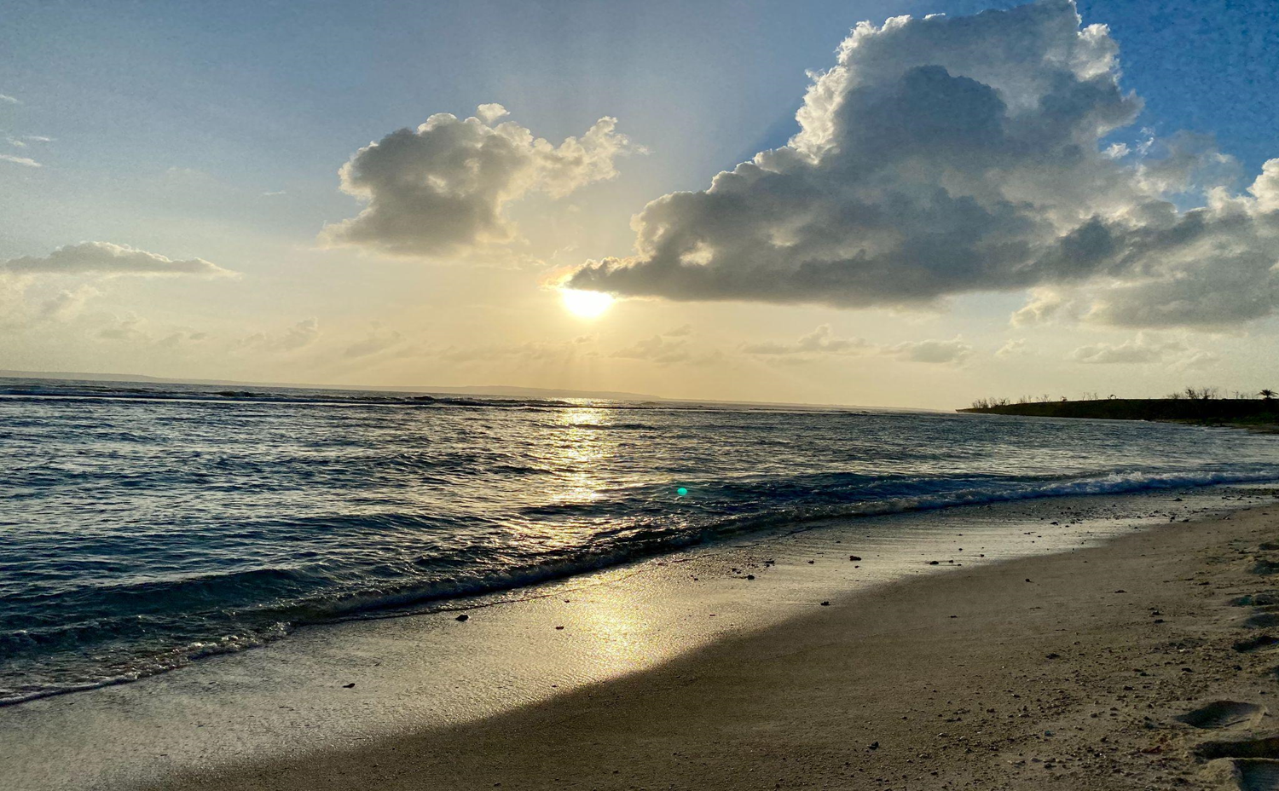
Thank you,
Si Yu’us Ma’ase, Oloomwaay!
Notes:
<number>

