Slide 1

USAPI Oral Health Program Needs Assessment
and
Two Case Studies from the COVID Pandemic
National Oral Health Conference, 2022
Ft. Worth, Texas
Reg Louie, DDS, MPH
Ohnmar Tut BDS, MPhil
Oral Health Consultants
Association of State and Territorial Dental Directors
www.astdd.org
Notes:
1

Slide 2
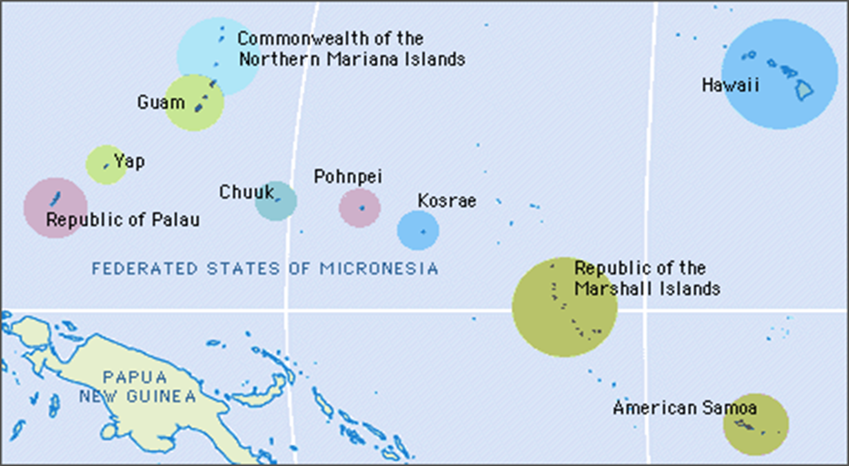
U.S. Affiliated Pacific Islands, USAPI

Slide 3
USAPI Oral Health Program Needs Assessment
CDC Division of Oral Health funded ASTDD to assess and report on territorial oral health program infrastructure and capacity, identifying strengths, gaps and needs in 2018
Key collaborations:
  ASTDD provided management through its ED Chris Wood, coordination and communication through the CDC Cooperative Agreement Manager Beverly Isman
  Technical expertise through ASTDD consultants; Reg Louie, Ohnmar Tut, Kathy Phipps, and Mike Manz
  PIHOA, PBDA, PIPCA, ASTHO, HRSA MCHB, NACDD
  Dental chiefs of all USAPI

Slide 4
Meetings/Workshop: ASTDD and USAPI representatives
In late 2018, met with USAPI ministers/directors of public health. Shared proposed project plans/objectives/strategies/potential outcomes. Assured them that findings/recommendations are vetted by them before completion of final report to CDC
In 2019, USAPI dental chiefs and representatives of MCH, CHC, PIHOA and PIPCA worked with ASTDD consultants to:
  present descriptions of their current programs and existing data
  discuss best approaches and a plan to promote support for and implement the needs assessment
  decide on an oral health surveillance plan for the USAPI
  identify a key oral health contact person in each USAPI
Subsequently, each USAPI completed a draft of the Characteristics of the Oral Health Environment table

Slide 5
Needs Assessment Approach
Reviewed existing reports and literature
Used an ethnographic approach structured around the respective territory’s perceptions of their needs and cultural influences
ASTDD consultants developed assessment tools and table templates for each territory to collect information on strengths, challenges and opportunities for:
  Components of the oral health environment
  Service delivery sites and programs
  Funding
  Workforce
  Policy mandates
  Partnerships

Slide 6
USAPI Findings – A. Oral Health Needs
Significant oral health problems exist in each territory:
  high dental caries prevalence, especially among children
  high prevalence of diabetes, CVD, and obesity
  In most USAPI, high prevalence of oral cancer associated with betel nut use.
Community water fluoridation is not feasible for USAPI
Consensus that establishing a common oral health surveillance system be explored – e.g., ASTDD Basic Screening Survey

Slide 7
USAPI Findings –
B. Public Oral Health Care Delivery Sites
Delivery sites range from fixed facilities in main hospitals and in CHCs, to extramural/community sites, most using portable dental equipment. Also, outreach/off-site care is provided with other health care disciplines, and capacity for telehealth and distance training/learning is evolving
Dental clinics have limited clinical facilities & equipment. Serious challenges due to expense, remote locations from vendors, and equipment maintenance

Slide 8
USAPI Findings
C. Funding for Public Oral Health Care Programs and Services
All have established PH infrastructure for oral health, funded primarily by general government funds.
Each USAPI receives HRSA CHC funding and all have an oral health component.
Some have Medicaid (AS, CNMI, Guam) and others have other health insurance/financing programs with dental benefits. Patient fees collected go to the general hospital/clinic funds.
To date, USAPI have not been eligible for CDC funding, e.g., infrastructure development, surveillance or preventive services.
All OH programs have insufficient funds to meet the needs of their populations.

Slide 9
USAPI Findings
D. Current Staffing and Pipeline
Established pipeline for training: Department of Oral Health, Fiji National University
Some USAPI have a limited ability to hire dentists from other countries
US federal dental “loan repayment” opportunities exist in 3 USAPI
Limited number of providers (up to 1:10,000) in some USAPI
Minimal Dental CE opportunities/training for all staff on or off-island

Slide 10
USAPI Findings
E. Policy Mandates
All have US Territory/Commonwealth status that gives opportunities for US federal aid, e.g., MCH block grants that mandate needs assessments.
Some have local OH mandates for children, e.g., dental exam prior school entry and dental services to young children. FSM has a state law against selling betel nut and tobacco to children. Problems exist for actualizing policy mandates into public health practice.
Some are constrained by policies, e.g., scope of practice and boards of licensure.
Limited dental public health leadership/representation, e.g., no FSM national dental director.

Slide 11
USAPI Findings
F. Partnerships and Collaborations
Collaborations with “sister programs”, e.g., Head Start & DOE, CHC, Non-communicable Diseases, and MCH. Challenges exist to effective communication and partnering
Consensus about benefits of revitalizing the Pacific Basin Dental Association and recreating leadership in oral health for USAPI
Partnership with regional health associations and US national dental associations

Slide 12
Development of Report to CDC for USAPI
Compiled and summarized information from each USAPI table into an Oral Health Environment report for each island which was vetted by their oral health leaders
PIHOA provided an overview of the USAPI general demographics, geography, socioeconomic determinants of health, and health services for each territory
A draft final report with project overview, key findings and recommendations was sent to representatives of national organizations and federal agency partners for additional review and comment. Subsequently, the final report was completed and submitted to the DOH/CDC.
An Executive Summary is posted on the ASTDD website and shared with ASTHO online newsletter Insular Areas Update
  usapi-executive-summary.pdf (astdd.org)

Slide 13
USAPI – Opportunities and Next Steps [1]
CDC and HRSA: seek funding for BSS training and development & maintenance of common OH surveillance system across the USAPI
Collect, analyze and use data to identify/target priority populations and to promote a more robust integration of oral health with other health/social programs
PBDA, PIHOA and PIPCA can work with ASTDD and other partners to enhance infrastructure and capacity
Respond to appropriate NOFOs that support OH programs and their integration with “sister public health programs”

Slide 14
USAPI – Opportunities and Next Steps [2]
Promote more substantial/effective NCD collaboration, e.g., promote inclusion/enhancement OH protocols for clinical patients, especially for populations with diabetes, obesity, cardiovascular diseases and engage other partners. Seek assistance from PIHOA and the NACDD Pacific Chronic Disease Council.
Build upon the revitalization of the PBDA and explore establishing a Community of Practice.
Examine existing policies that might interfere with eligibility to pursue/receive funding or other types of assistance.

Slide 15
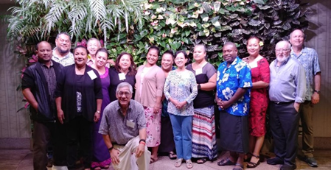
ASTDD Consultants and USAPI representatives
And Thank You!

