Slide 1

American Samoa Case Study
COVID Pandemic
National Oral Health Conference, 2022
Ohnmar Tut BDS, MPhil
Oral Health Consultant for USAPI
Association of State and Territorial
Dental Directors www.astdd.org
Christina Pola-Willis BDS, PGDPH
Dentist, Early Childhood Education
LBJ Tropical Medical Center
American Samoa
christina.pola@lbj.as
Notes:
1

Slide 2
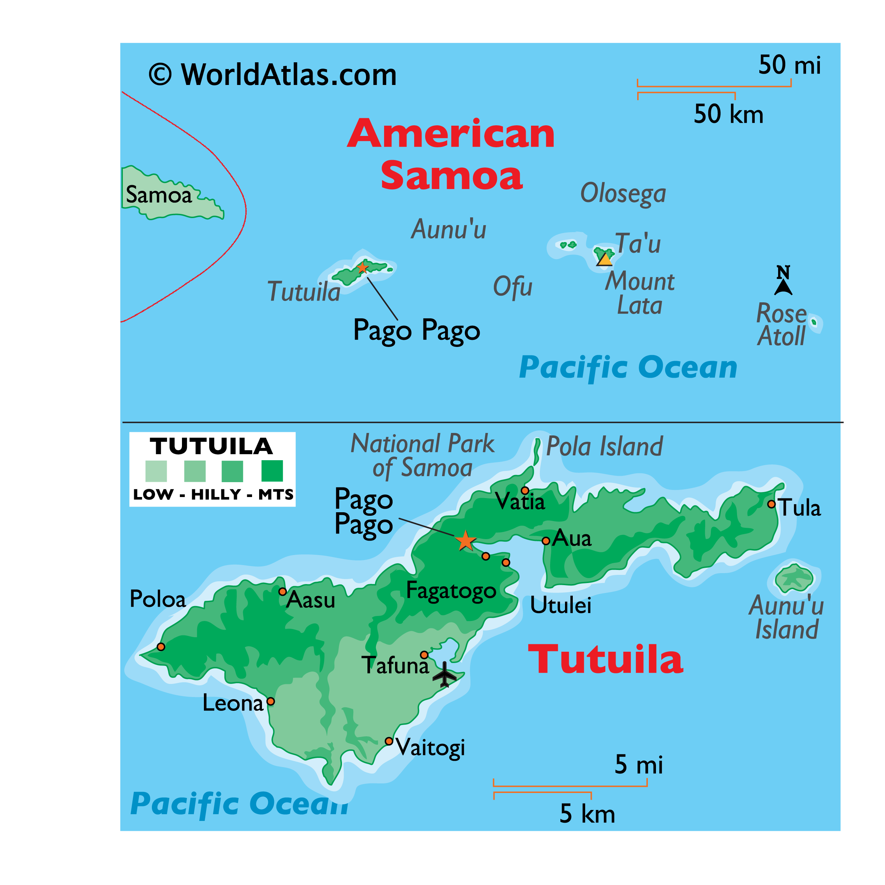
Group of 7 Islands:
5 VOLCANIC ISLANDS
2 ATOLLS
Population: 54,719
Notes:
2

Slide 3

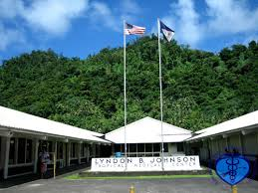

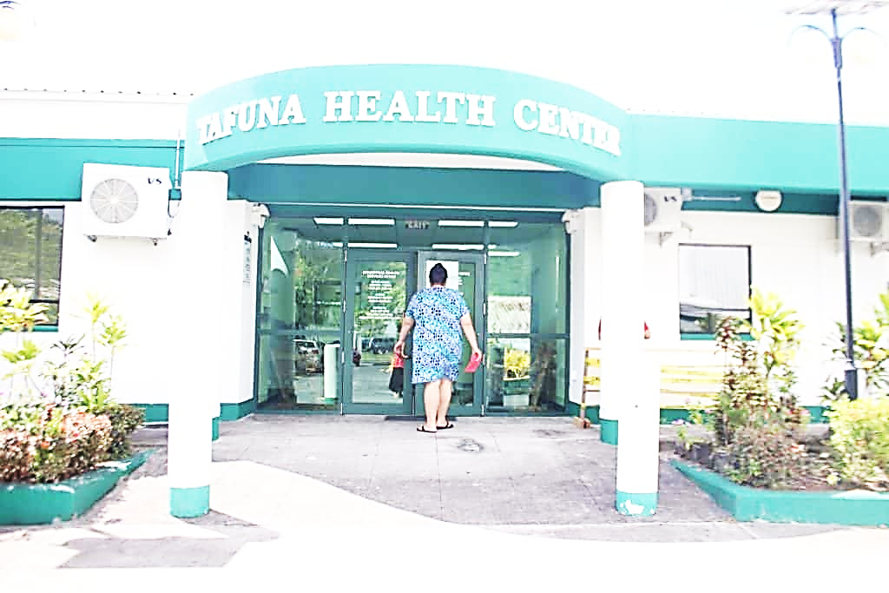

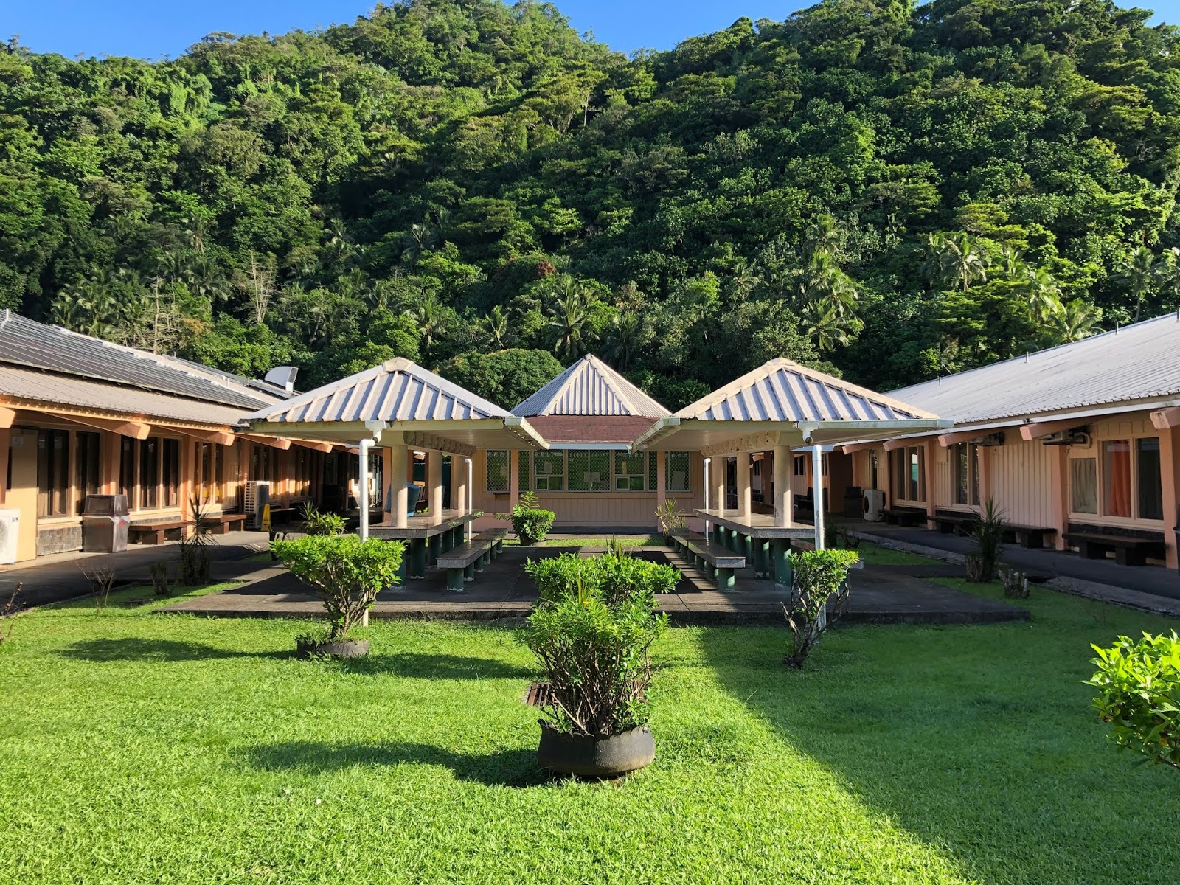
A.S. HEALTH SERVICE DELIVERY SYSTEMS
One main hospital
Five Community Health Centers (CHC)
Maternal Child Health (MCH)
A.S. DENTAL WORKFORCE
CHC 07 GDPs
  03 Locals FSM (01 MPH)
  04 Expatriate (Philippines)
03 CDA (USA)
04 Training DA’s
LBJ 09 GDPs
07 Local (06 FSM 01 USA)
02 Expatriate FSM
03 Cert – Prosth USA
01 Post Grad Surgery Certified FJ
01 Post Grad Dental Public Health FJ
01 Undergoing Post Grad MPH FJ
11 CDA (USA)
02 DA Trainees
Private 01
GDP (FSM)
Prosth (NZ)
Ortho (USA)
02 Training DA
Notes:
3

Slide 4

BASIC SCREENING SURVEY
2020 AS PUBLIC SCHOOL CHILDREN
Main Ds Burden
Dental Caries and
Periodontal Ds
Source for US data: National Health and Nutrition Examination Survey (NHANES), 2011-2013

Slide 5
BASIC SCREENING SURVEY
2020 AS PRIVATE SCHOOL CHILDREN
Main Ds Burden
Dental Caries and
Periodontal Ds
Source for US data: National Health and Nutrition Examination Survey (NHANES), 2011-2013

Slide 6
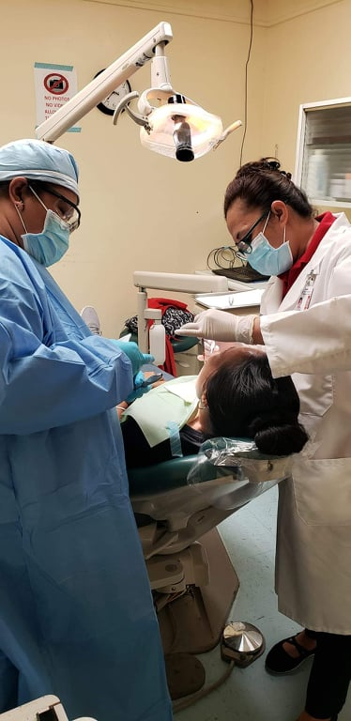
Diabetes and Periodontal Disease
in American Samoa
LBJ Dental Patients seen in the year 2019.
  Total of 10,952 patients seen at the LBJ Dental Clinic.
  4,377 patients have Diabetes.
DECAY EXPERIENCE
42% (1,852 Patients with Diabetes)
PERIODONTAL DISEASE
58% (2,555 Patients with Diabetes)
DENTAL EXTRACTIONS DUE TO DENTAL CARIES
42% (678 Patients with Diabetes)
DENTAL EXTRACTIONS DUE TO PERIODONTAL DISEASE
58% (916 Patients with Diabetes)
ORAL HEALTH DISPARITIES
Adults with Diabetes in American Samoa are substantially more likely to have dental tooth extraction treatment due to Periodontal Disease.
Notes:
6

Slide 7
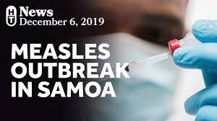
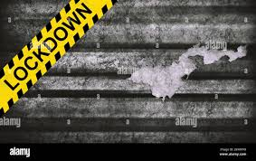
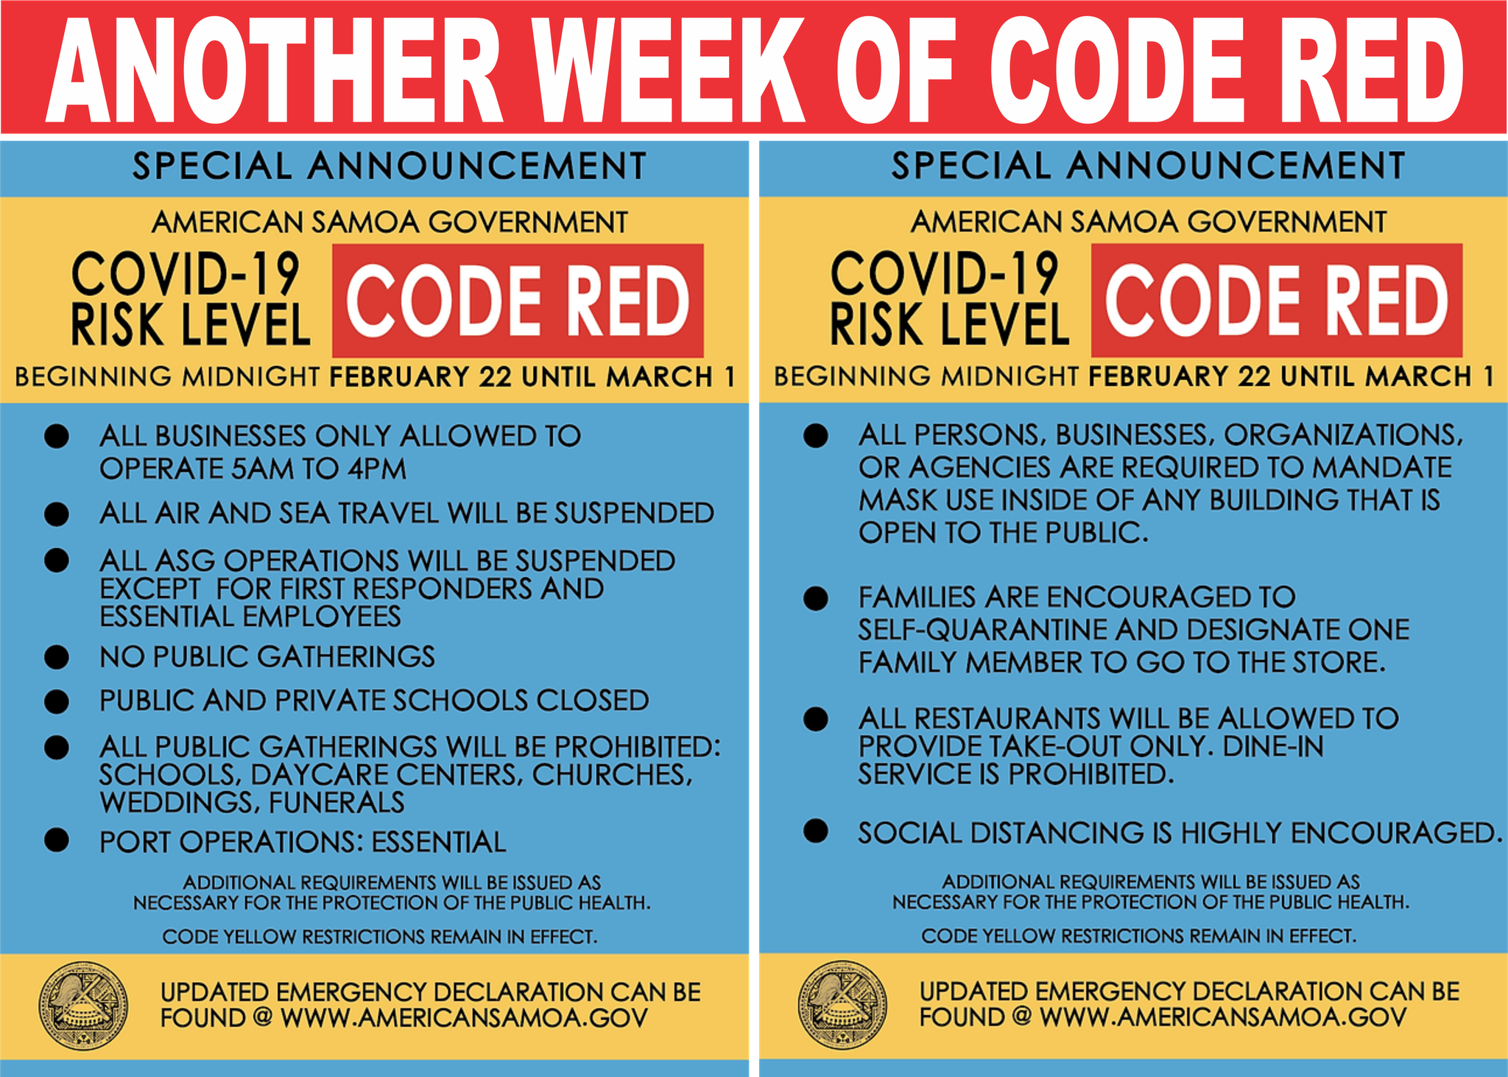
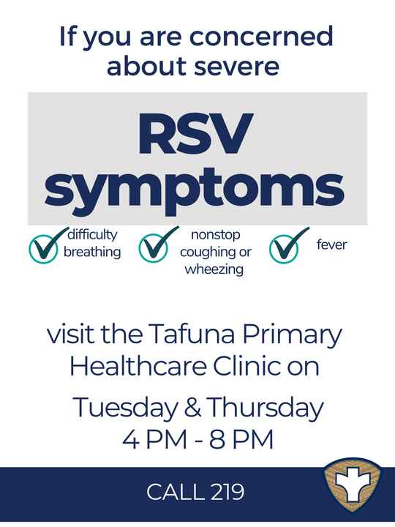
SIGNIFICANT CHALLENGES
Measles Outbreak (2019)
Pre-Covid (2020)
RSV-Resp. Syncytial Virus (2021)
COVID Code Red (2022)
Notes:
7

Slide 8
Oral Health Programs in American Samoa
Community Health Center (CHC) Oral Program in American Samoa
  Federally funded to increase access to quality oral health care
  HRSA’s initiative “Integrating Oral Health and Primary Care Practice (IOHPCP) to improve the knowledge and skills of primary care clinicians and promote collaboration across health professions (HRSA, 2014).
  CHC oral health program in American Samoa identified five key oral health domains and associated core clinical competencies:
    (1) Risk Assessment (e.g.,Basic Screening Survey)
    (2) Oral Health Evaluation (Sealant evaluation)
    (3) Preventive Intervention
    (4) Communication and Education (CDEs & Professional development) and
    (5) Interprofessional collaborative practice (patient referral & Team Building etc).
Maternal and Child Health Program(MCH)
  serves pregnant women and children, including children and youth with special health care needs.
  Child 9mos-3 years old receive a dental check up and fluoride treatment. (Well-baby clinics three times a year)
    Works closely with ECE Dental team (CBDP), CHC & LBJ for dental referrals and treatments.
  Mother’s receive dental check up and referral if need.
LBJ Tropical Medical Center- Dental Services
  funded by American Samoa Government (Local/General funds), Medicaid.
  Main dental clinic/ On Call Dentist and Assistant 24/7.
  School-Based Dental Program (Public/ Private/ ECE Schools), DHSS Child Care.

Slide 9
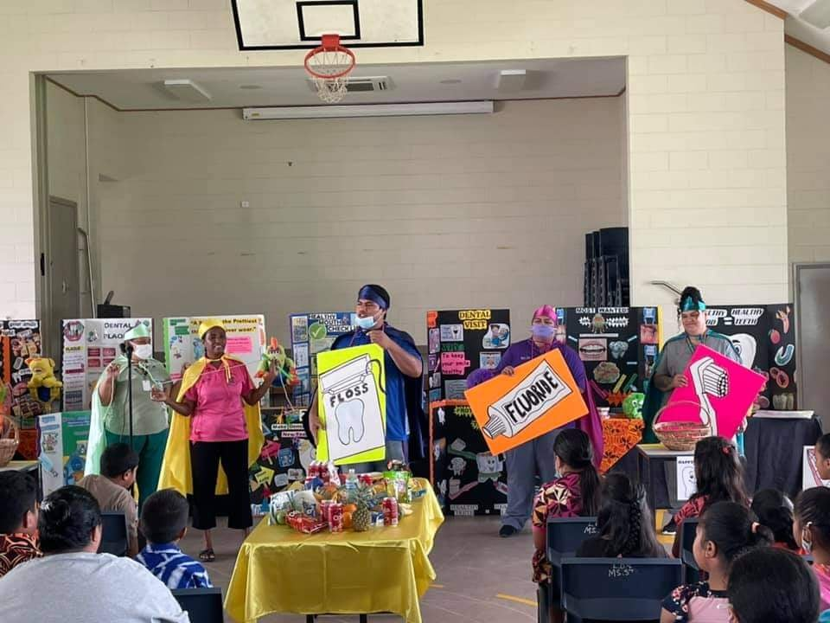
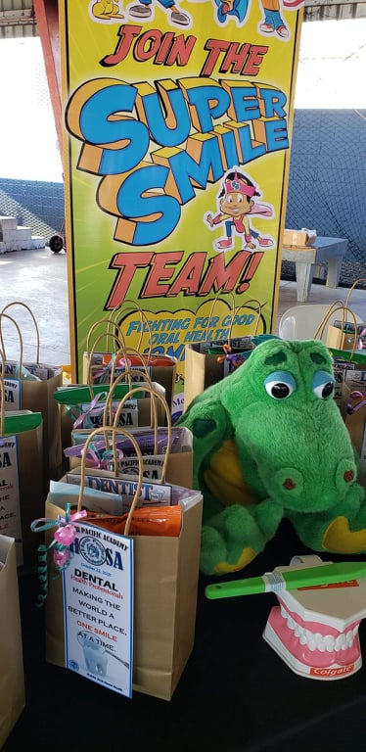
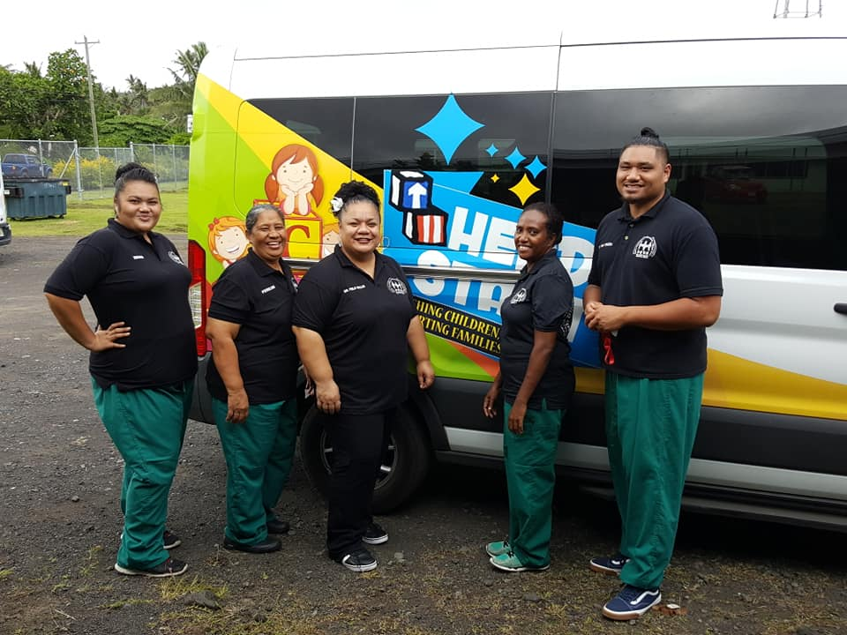
COMMUNTIY BASED DENTAL PROGRAM (CBDP)
Partner Programs | Number of Centers and Schools | Students Served | Dental Care
Child Care Centers | 42 | 1,500 | Dental Health Ed., BSS, Fluoride Varnish Tx.
Maternal Child Health (MCH) | Child Care Centers Children with Special Needs |  | DHE, BSS, Fluoride Varnish Tx
Early Childhood Education (ECE) | 53 | 1,348 | DHE Lesson plans, Classroom Toothbrushing, FL Tablets ECE Health Requirement: 45 days – Dental Exam & BSS 90 Days- Curative Treatment
Elementary Schools | 23 Public 13 Private | 9, 716 2,151
Summer Program (May - July) | Set up and move in 3 different locations. (West, Central and East)
Basic Screening Survey (BSS)
Dental Health Education
Preventive Treatment
Sealants : 2nd & 5th graders
Curative Treatment
Referrals to CHC and LBJ
Referrals to LBJ for Gen. Anesthesia

Slide 10
Accomplishments
Decentralizing of dental services among dental partners in American Samoa.
LBJ-CBDP Outreach provides BSS, Preventive (fluoride, Sealants), and Curative Tx.
Basic Survey Screening (BSS) Training in Am. Samoa Completed. (ASTDD, NNOHA)
Dentist Post Gradates and Certification Dental Assistant Program (World Health Organization)
New Dental operatories- funded by ECE (AS Dept. of Education)
Dental Visits Free of Charge

Slide 11
Challenges and Limitations in American Samoa 2019-2022
Main Oral Disease Burdens: Dental Caries and Periodontal Disease.
Measles Outbreak (2019), Pre-Covid (2020), RSV-Resp. Syncytial Virus (2021), COVID Code Red (2022) = Schools, Child Care Centers and CHC Dental Clinics Close except LBJ Dental main clinic.
Dental staff directed to help other medical services during COVID-Code-Red Status. (Vaccinations, Covid testing etc.)
Bad Weather/Natural Disasters (Hurricane/ Tsunami): CBDP closed
Equipment Maintenance & Mechanical problems – transport
Shortage of dental staff (Resignations/ Migrations/ COVID +ve)

Slide 12
Triumphs Over Challenges
LBJ Main Dental Clinic remains open:
  Limited to Emergency Dental Tx Only
  Dentist on call 24/7 and Phone Consultations avail.
Measles Outbreak (2019), RSV outbreak (2021) =
  DOH/ECE health team updates child’s immunization
  Home Visits to children who were immunized and consented by parents/guardians for Tx.
Use of Personal automobile if program transport is unavailable.
Use of Dental Portables, when units are down.

Slide 13
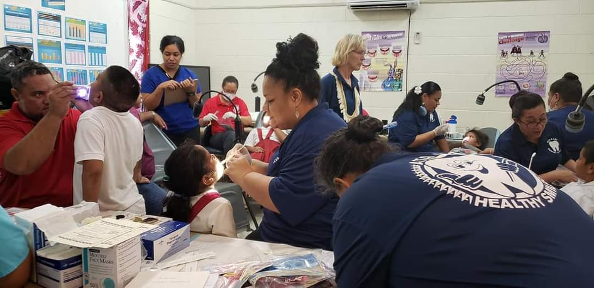
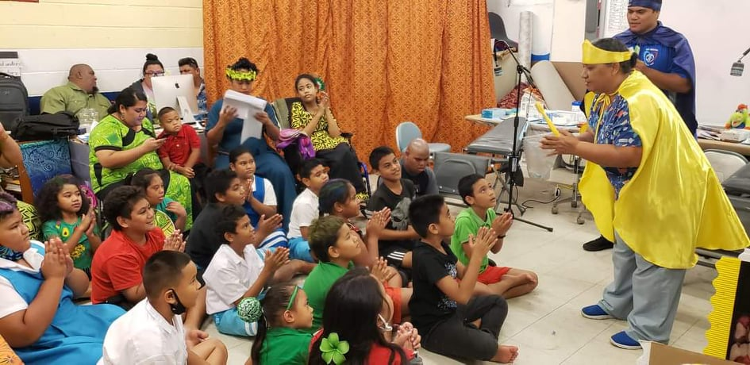
Partnerships
Partners and stakeholders i.e LBJ Hospital Dental Team, MCH, American Samoa- Dept. of Education (ASDOE) ECE dental Team, ASDOE Elementary division and Child Care (DHSS- Social Service).
  ASDOE – Early Childhood Education houses their own children’s dental clinic. (Manpowered by LBJ Dental –MOU) and is building another 2 dental operatories in the central district.
  Provisional of FREE Dental services and Programs. (Children’s Dental Month)
  Providing funds for dental materials, supplies and equipment’s for SBDP Outreach.
  CME Dental Conference Trips
External partners include the NNOHA & ASTDDs, WHO, and the Pacific Basin Dental Association and PIHOA. Providing professional development and the Basic Screening Survey.
  Latest Modern Dental Development, Technology and Information.
  Federal assistance ie. Grants, funds
  Dental Assistant Certification Program
Basic Screening Survey Training
Children with Special Needs
Notes:
13

Slide 14
Retrospect
Years ago CHC and LBJ both had CBDP outreach teams, we currently have one CBDP team serving our school age population. Increasing number of outreach teams would allow CHC and LBJ to concentrate in serving our older age population.
Additional CDBP teams would be ideal to focus fully on Preventive Dentistry.
Strengthening Medical-Dental integration.
Goals
Reinforce Strengthening Medical and Dental Integration.
Dental Personnel Increase for more Community- SBDP Outreach.
Dental Unit Van(s) (Digital scanning and screening equipment's)
  Mobilizing community dental outreach even more.
Notes:
14

Slide 15
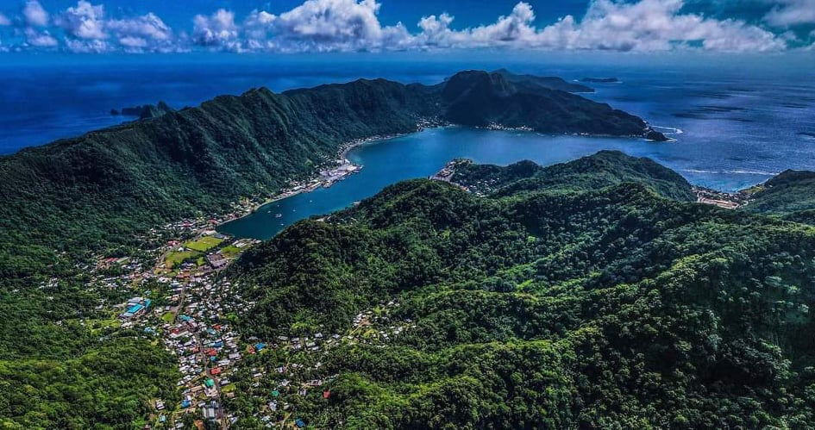
FA’AFETAI / THANK YOU
from
AMERICAN SAMOA
Notes:
15

