Slide 1

ASTDD Healthy Aging Committee
&
Data Committee Present
Data Sources: Where to Uncover Oral Health Information for Older Adults
March 22, 2017
Mike Manz, DDS, MPH, DrPH
Kathy Phipps, DrPH
Diane Brunson, RDH, MPH

Slide 2
General Reminders
This webinar will be recorded and archived on the ASTDD website;
We would like to hold any questions until the end, so if you have questions, please make a note of them. When we are ready for questions, if you wish to ask one, please click on the Set Status icon which is the little man with his arm raised on either the upper left or the top of your screen. Click on “raise hand.” We will then call on you to ask your question over the phone;
Please respond to the polling questions at the conclusion of the webinar.

Slide 3

This presentation was supported by Cooperative Agreement NU58DP004919-04-00 from CDC, Division of Oral Health. Its contents are solely the responsibility of the authors and do not necessarily represent the official views of CDC.

Slide 4
Educational Objectives
Identify relevant data sources for older adult oral health data at various levels: state, community, national
Empower states to find older adult oral health data specific to their state
Appreciate the impact data can have on advocating for older adult oral health
Demonstrate how data can be used to populate an infographic template and shared with targeted advocacy groups

Slide 5
Filling in the Tables – Appropriate Quotes
Got Data? – California Milk Processor Board
Spare Me the Details, Just Give Me the Data – The Offspring (the first part, anyway)
Just the data, Ma’am – Joe Friday (Dragnet, but actually not)
He Must Be Hopped Up on Goofballs – me today? but inspired by Dragnet
Notes:
Stan Freburg in Dragnet parody – Little Blue Riding Hood
Joe Frieday said, “All we want are the facts, maam” and “all we know are the facts, maam”

Slide 6
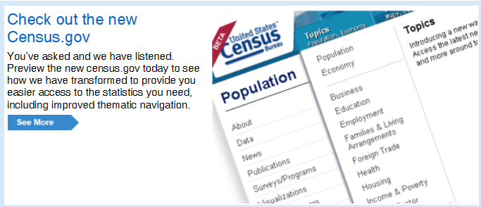
Oral Health Status of Older Adults
Start with demographic data to find out about your state population
www.census.gov

Slide 7
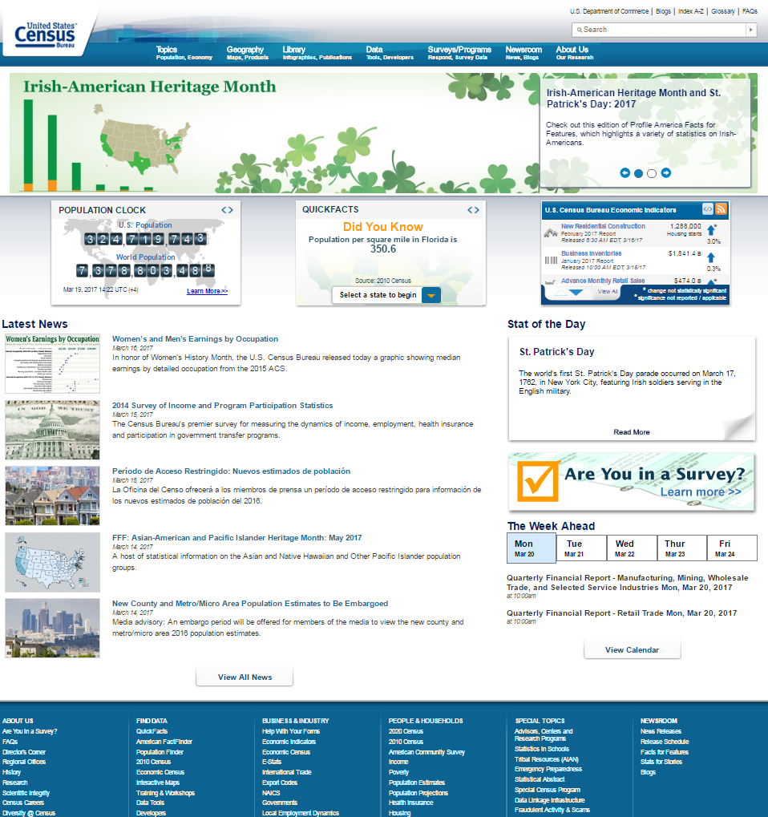

Slide 8
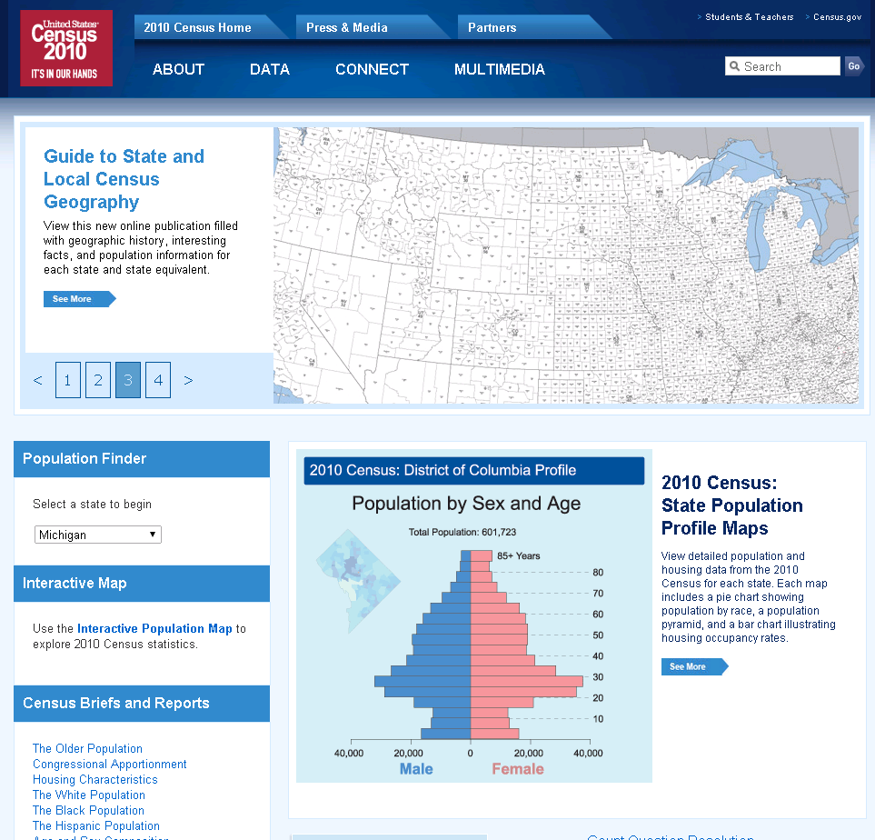

Slide 9
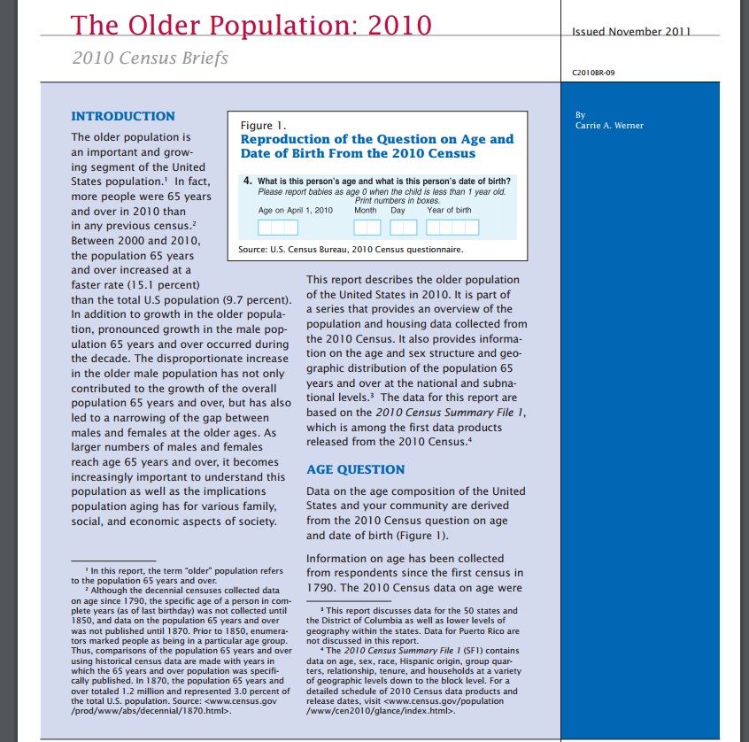
Notes:
“The Older Population” is a link to a census document pdf that provides detailed information on the older adult US population including distributions, maps, trends and breakdowns by state and even some county/community level information.

Slide 10
Notes:
Select your state for info on your state

Slide 11
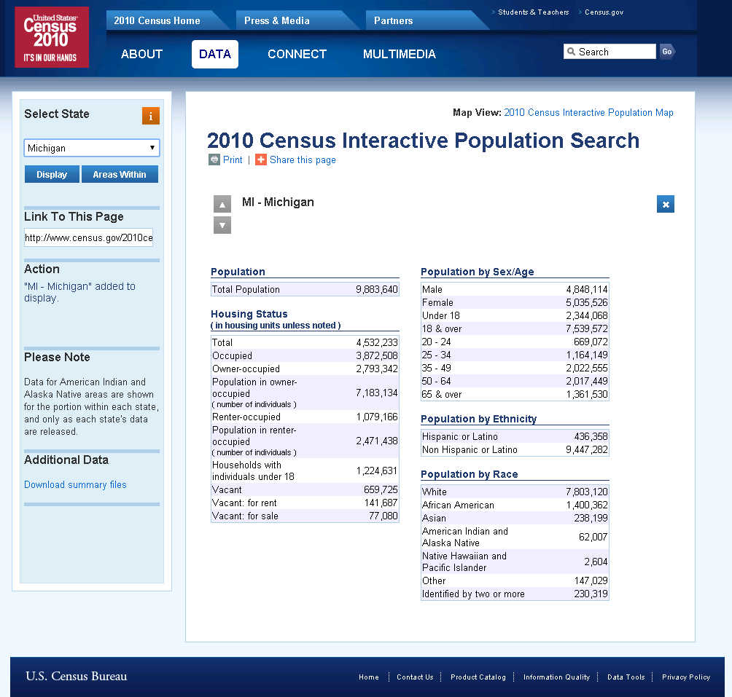
13.8%

Slide 12
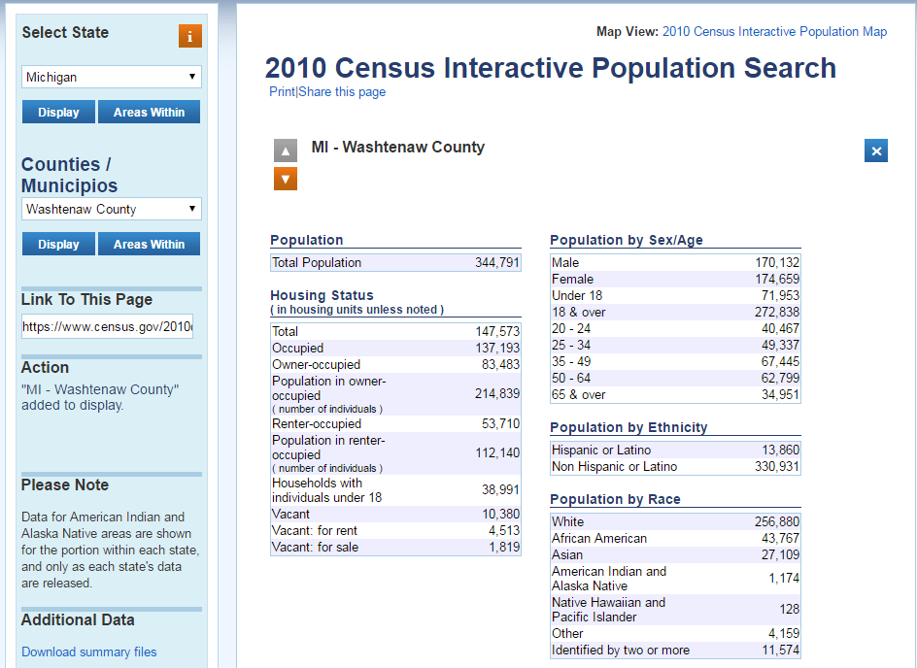
10.1%

Slide 14
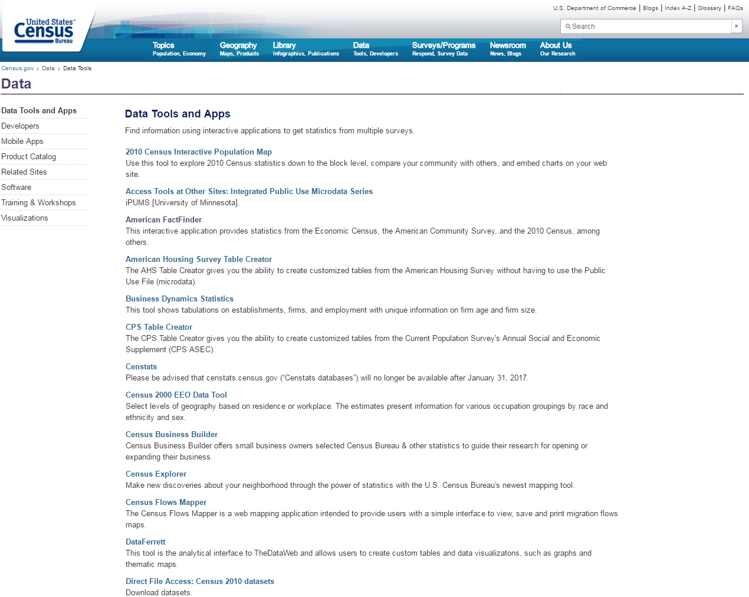

Slide 15
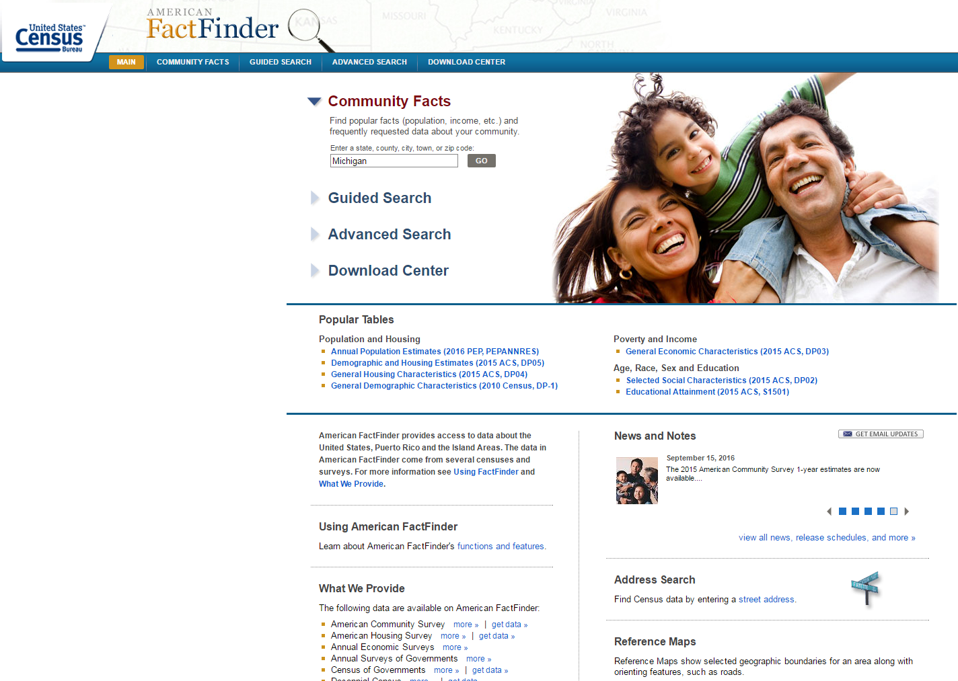

Slide 16
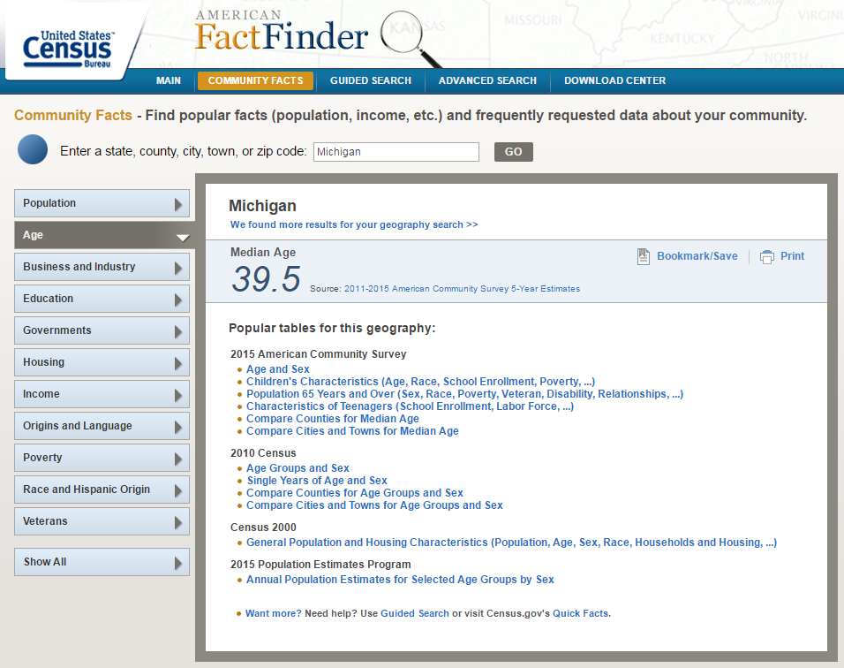

Slide 17
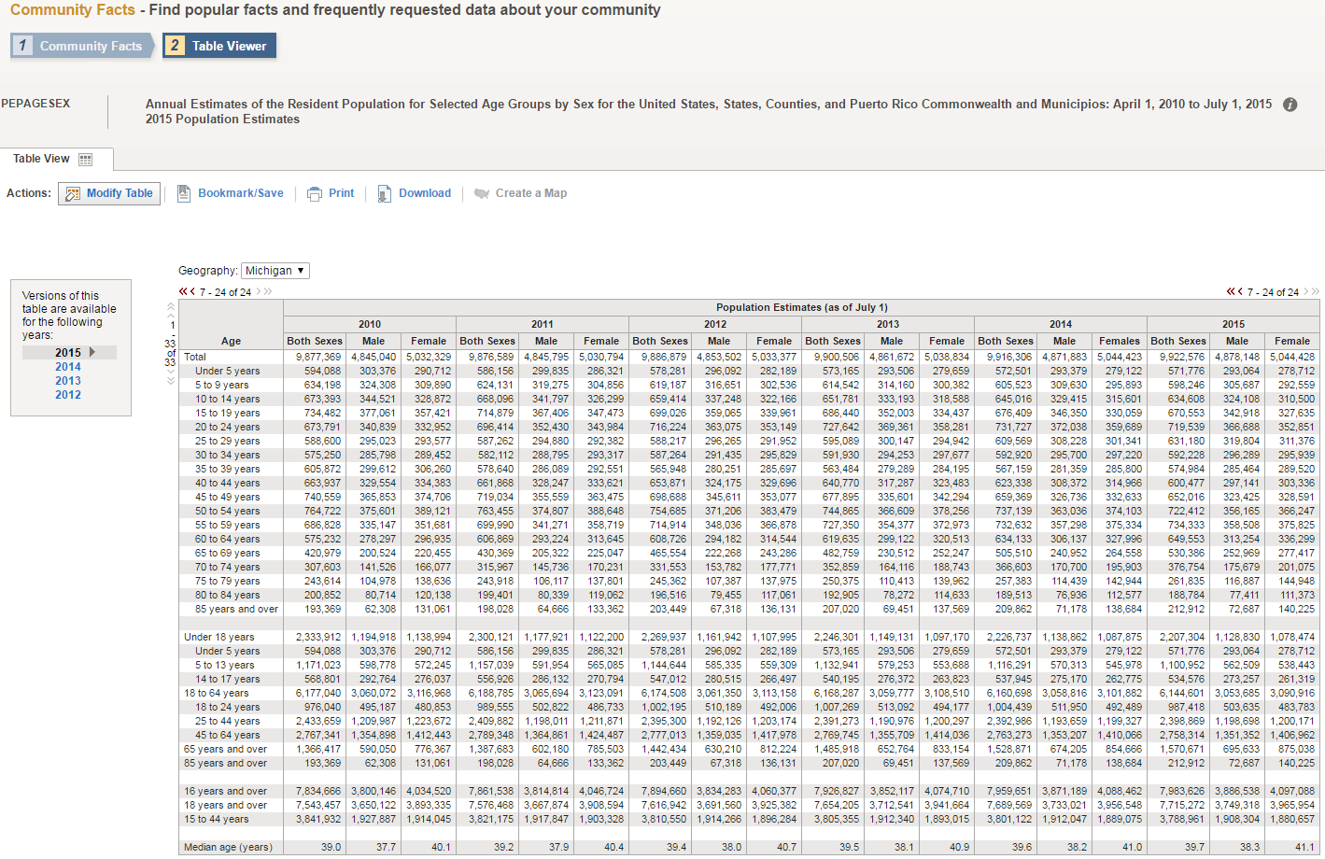

Slide 19
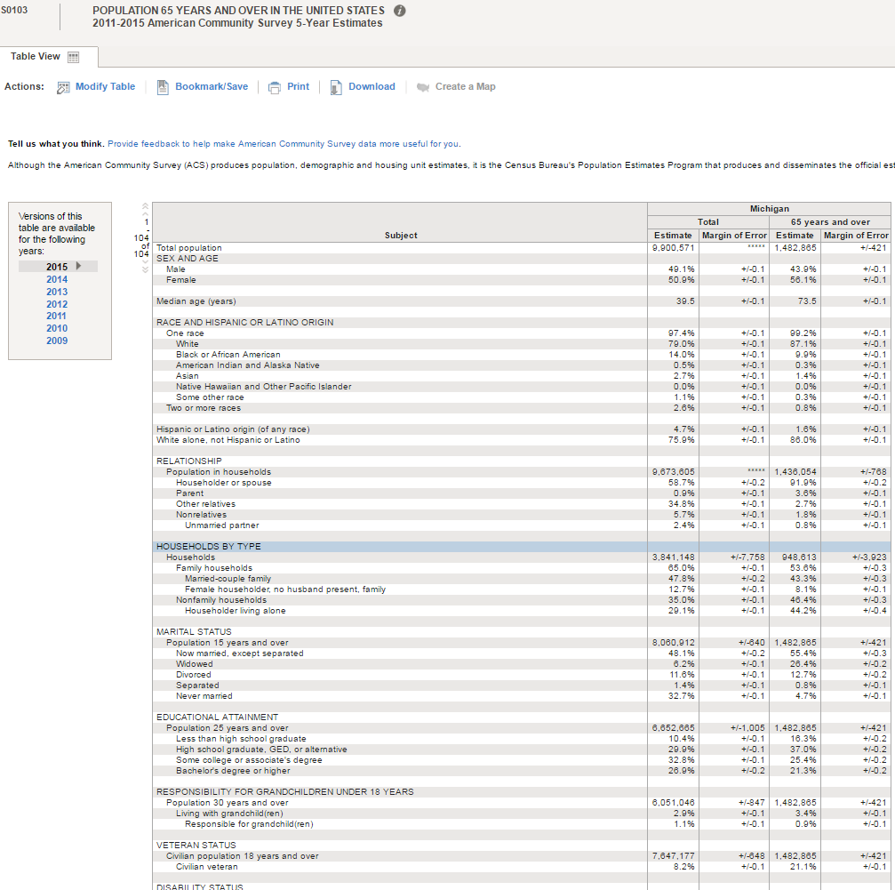

Slide 20

Behavioral Risk Factor Surveillance System (BRFSS)
www.cdc.gov/brfss
Oral Health data collected in “even” years
Starting in 2012 - new methods (cellular phone sampling)
Trends to 2010 or 2012 forward?

Slide 21
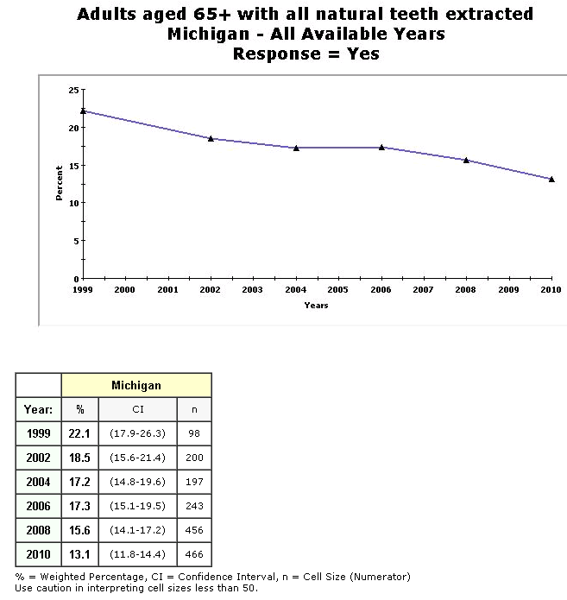
Trend Charting

Slide 22
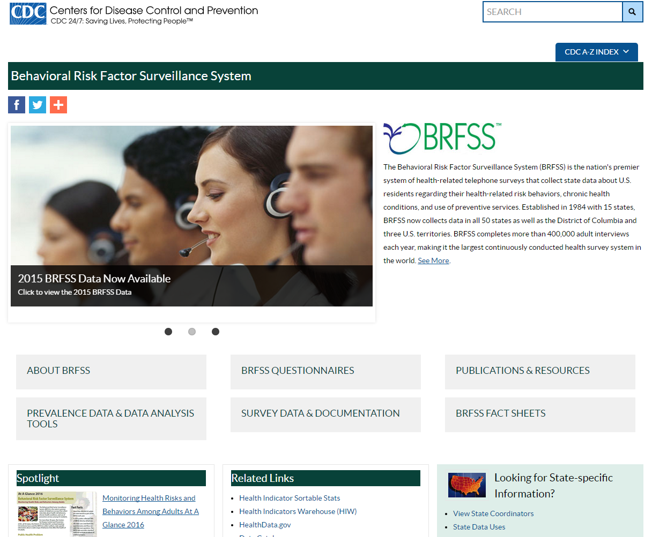

Slide 23
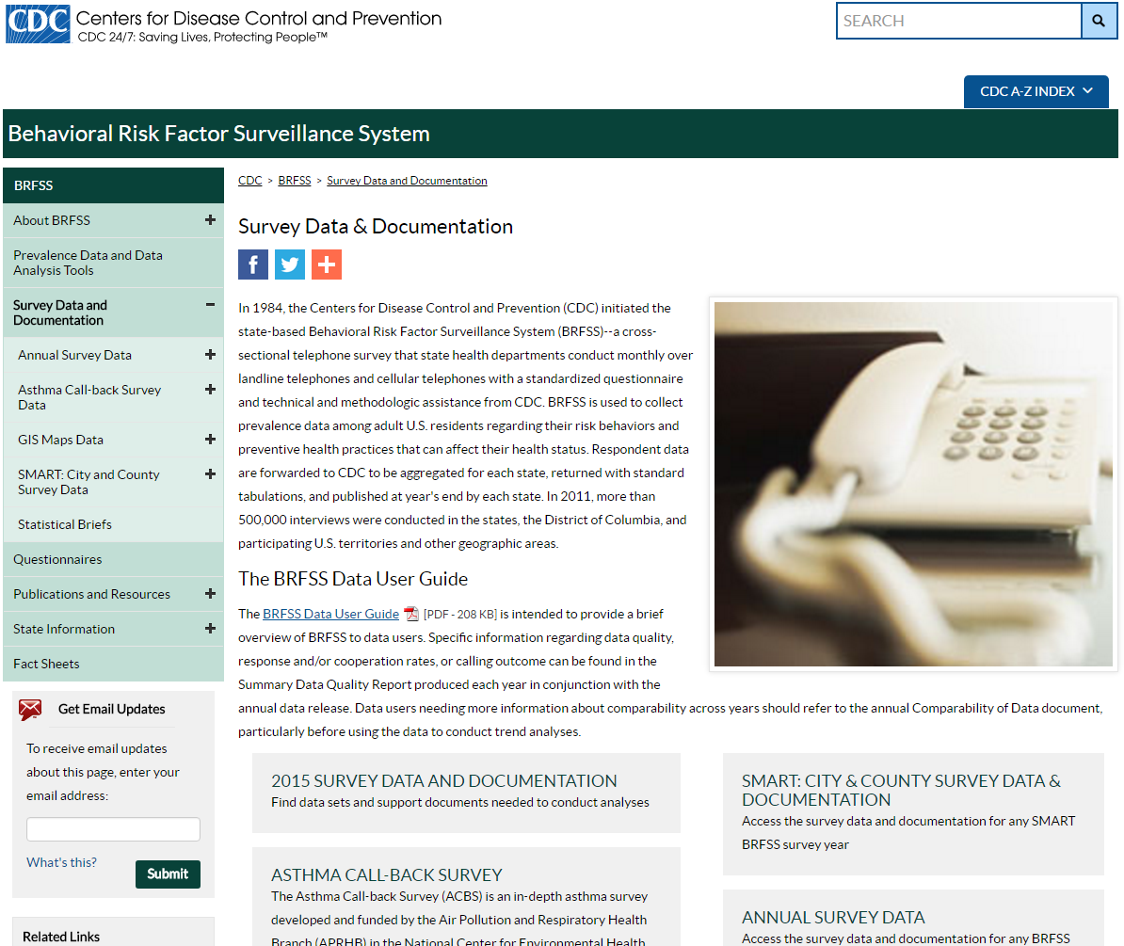

Slide 24
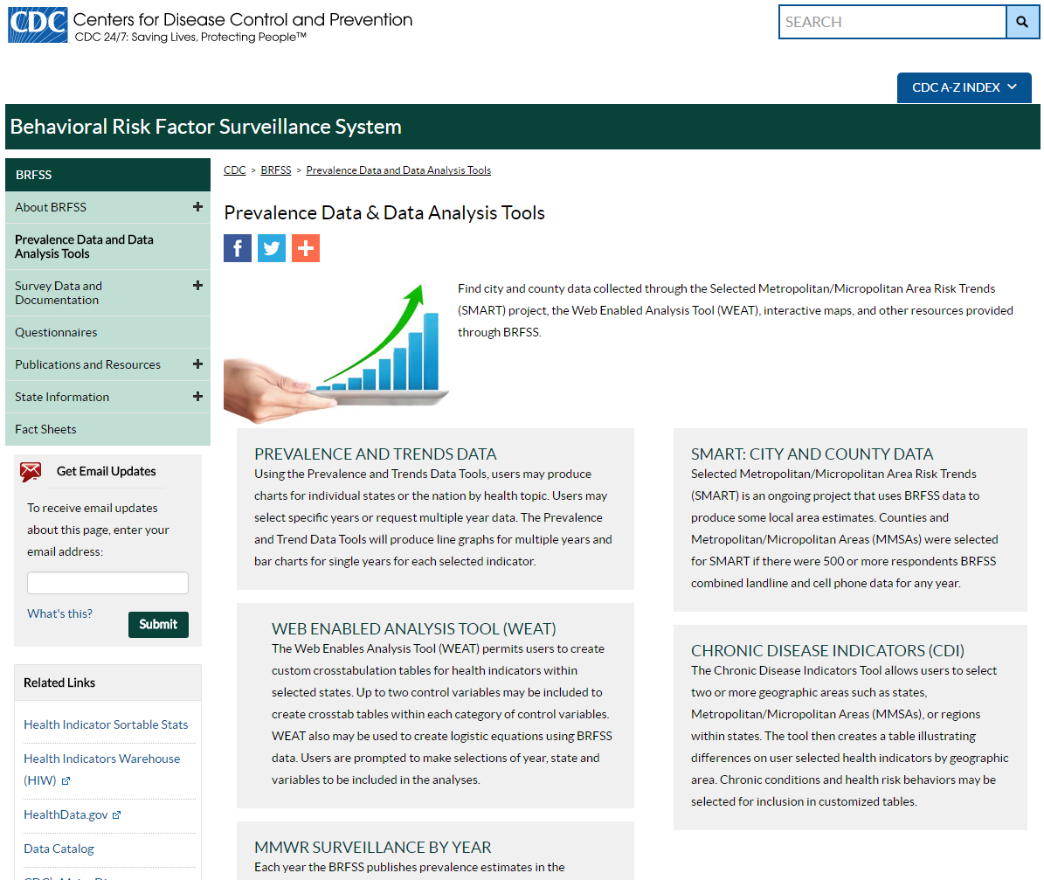

Slide 25
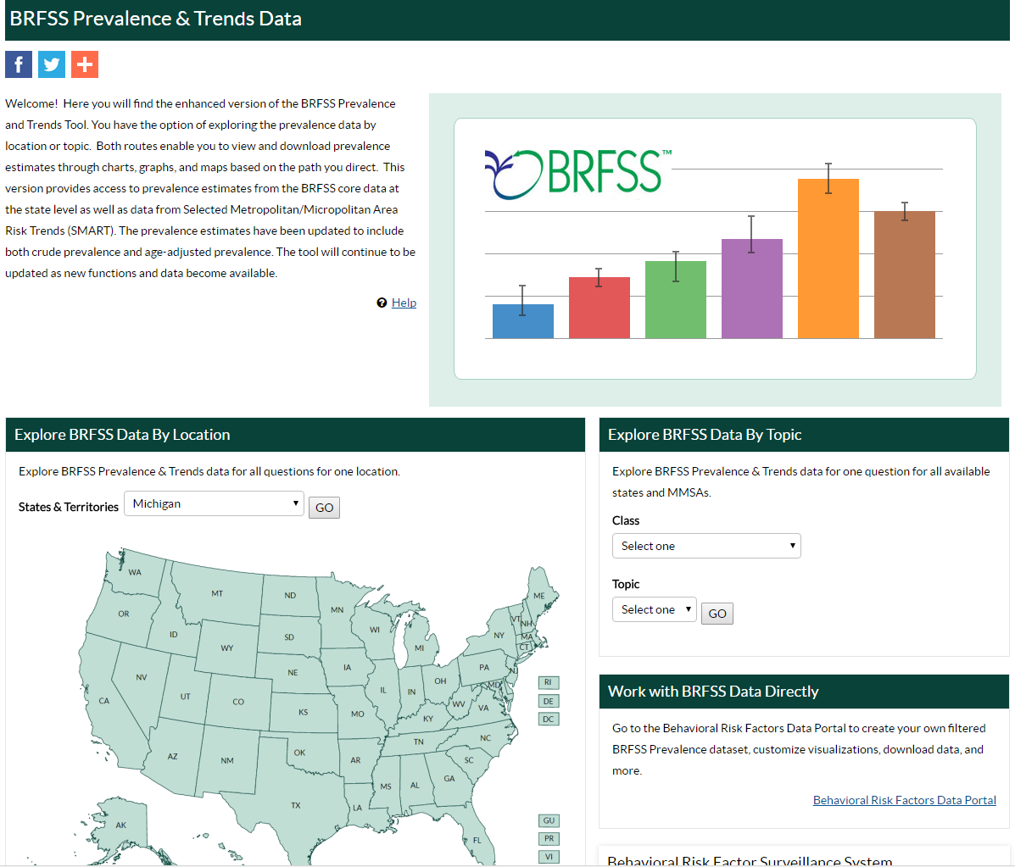

Slide 26
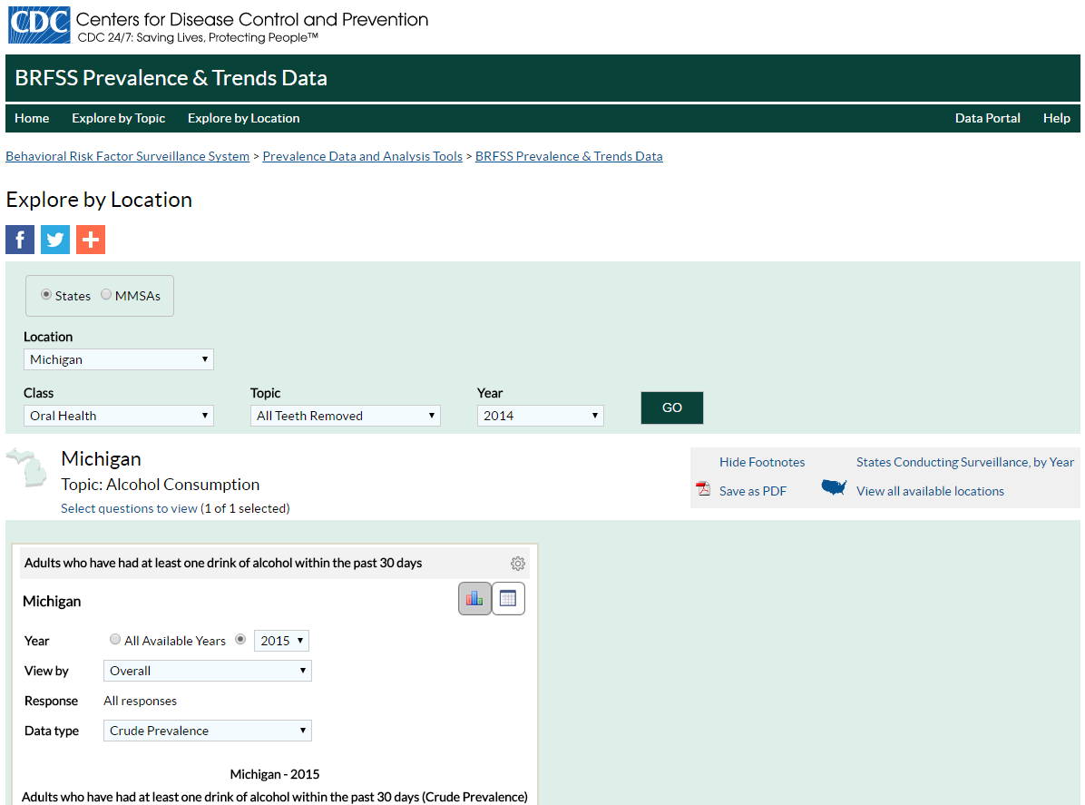
Notes:
Then select Class = oral health, Topic = (All teeth removed, Teeth Removed (any vs. 6+ in Oral Health Data), or Dental Visit; and Year ---- GO
(Check with Kathy on Teeth Removed)

Slide 27
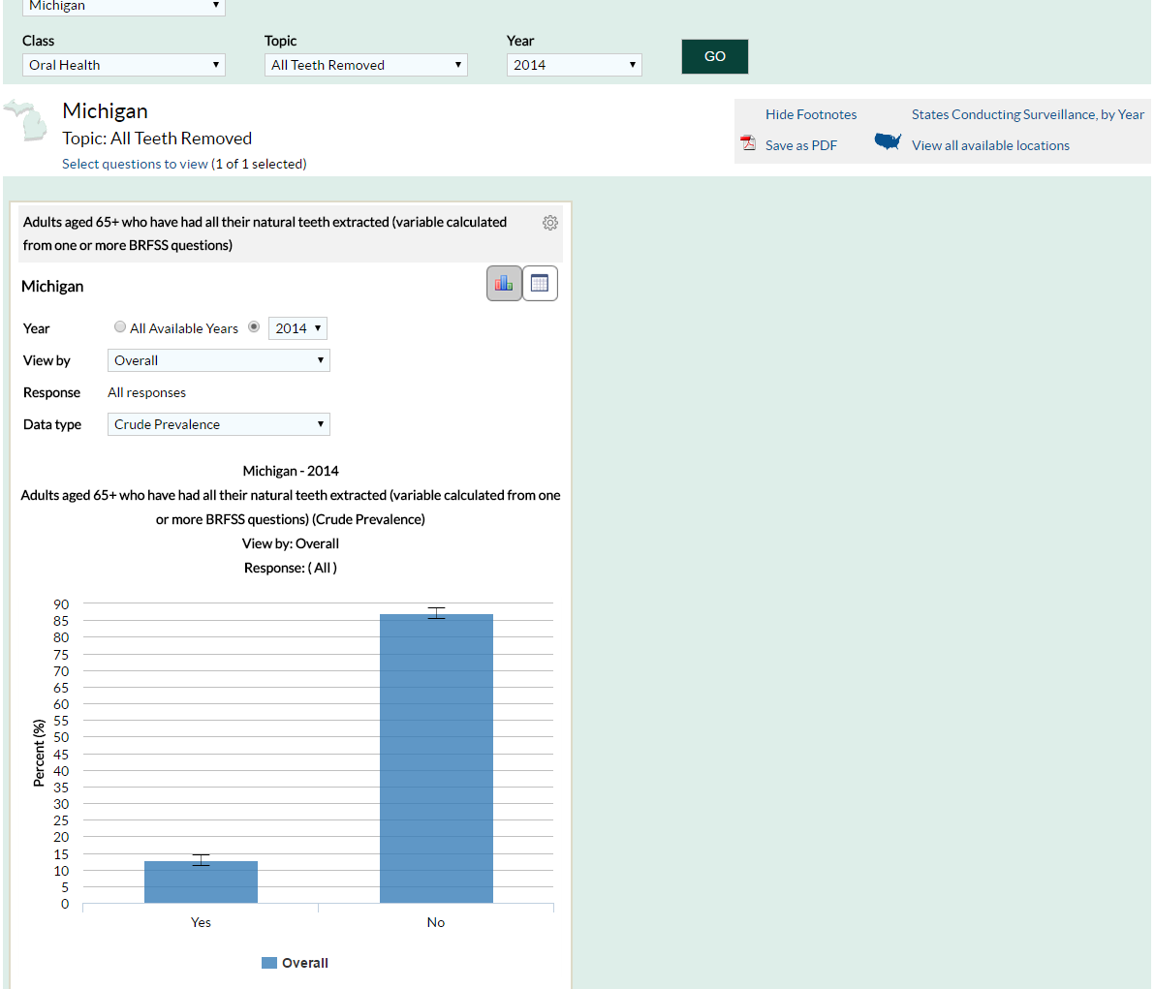

Slide 28
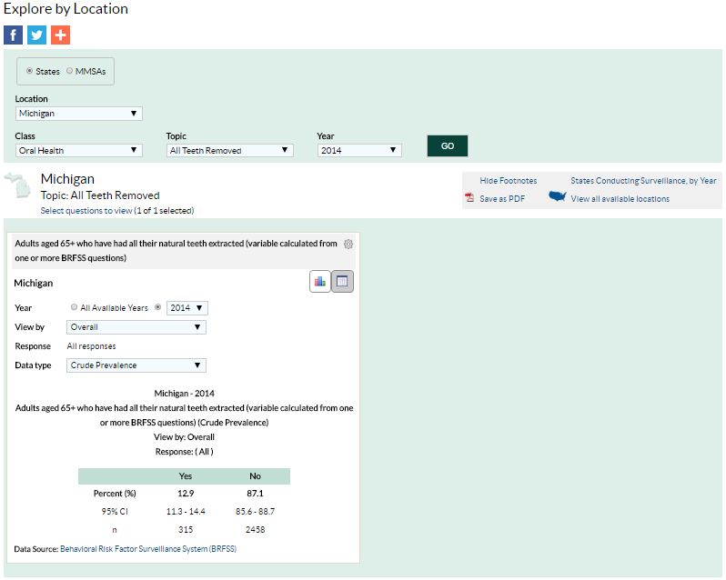

Slide 29
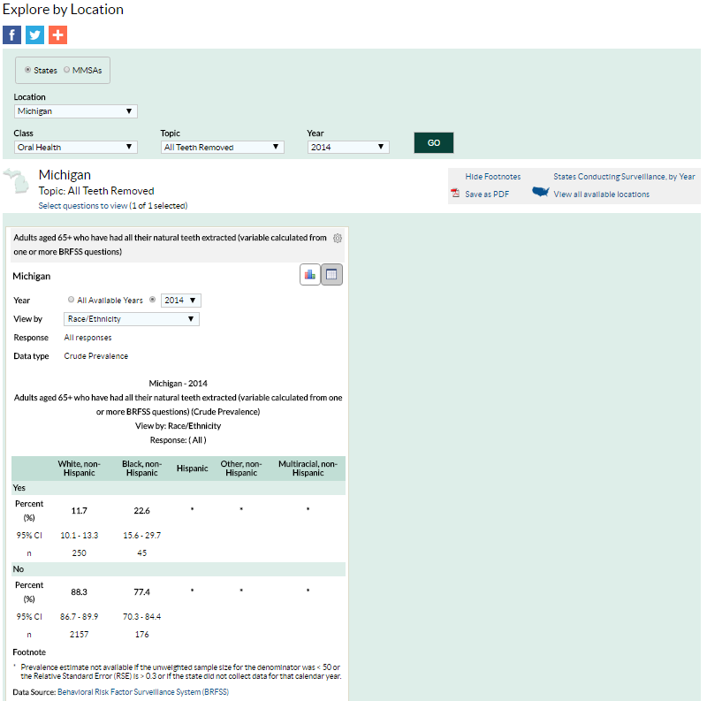

Slide 30
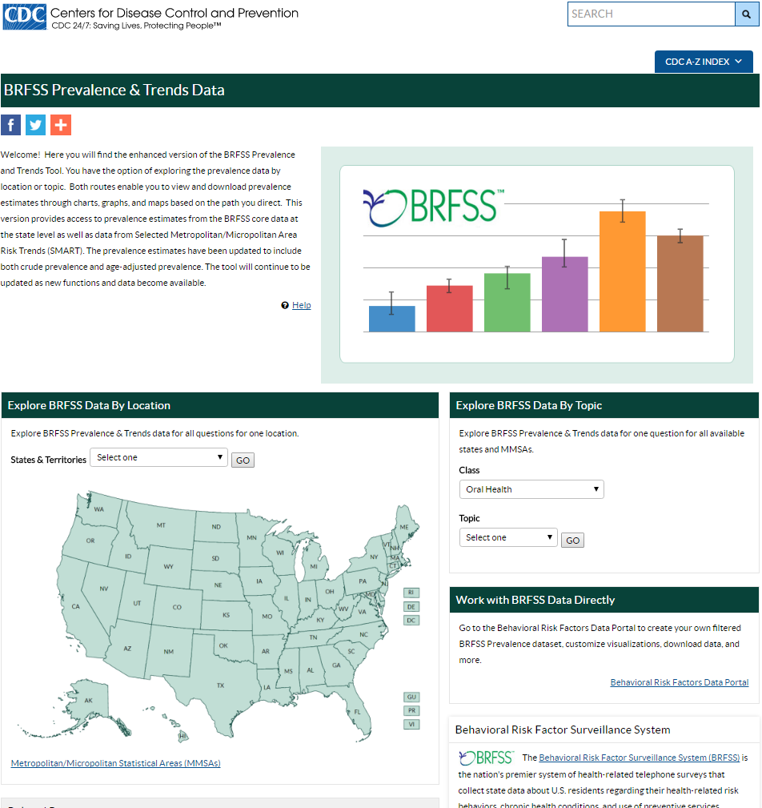
Notes:
Select Oral Health, and then select Topic = “Dental Visit”, “Teeth Removed”, or “All Teeth Removed”

Slide 31
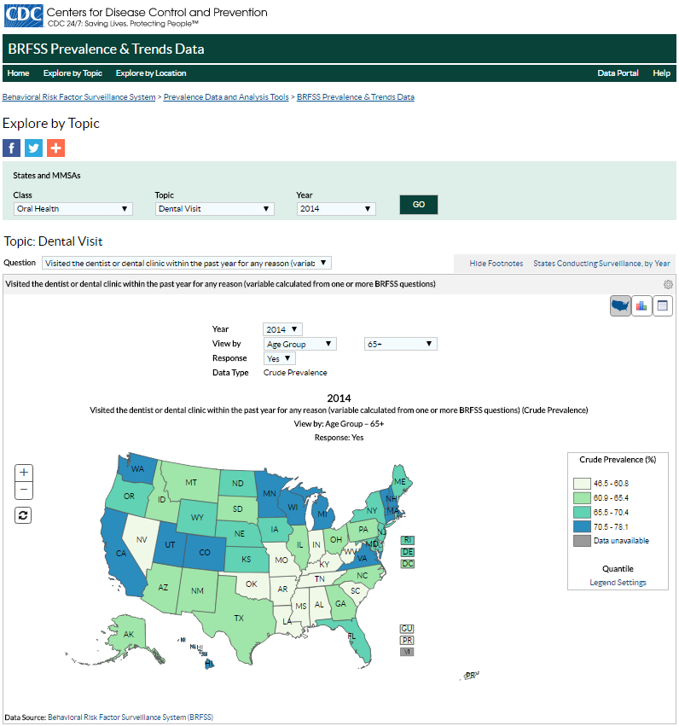
Notes:
Can then look by age group.

Slide 32
Notes:
Click your state will give you state estimate and CI. Will also give you option to look at all indicators for your state. Can then look by age group. If you select to look at all indicators for your state, you can then look at individual indicators.

Slide 33
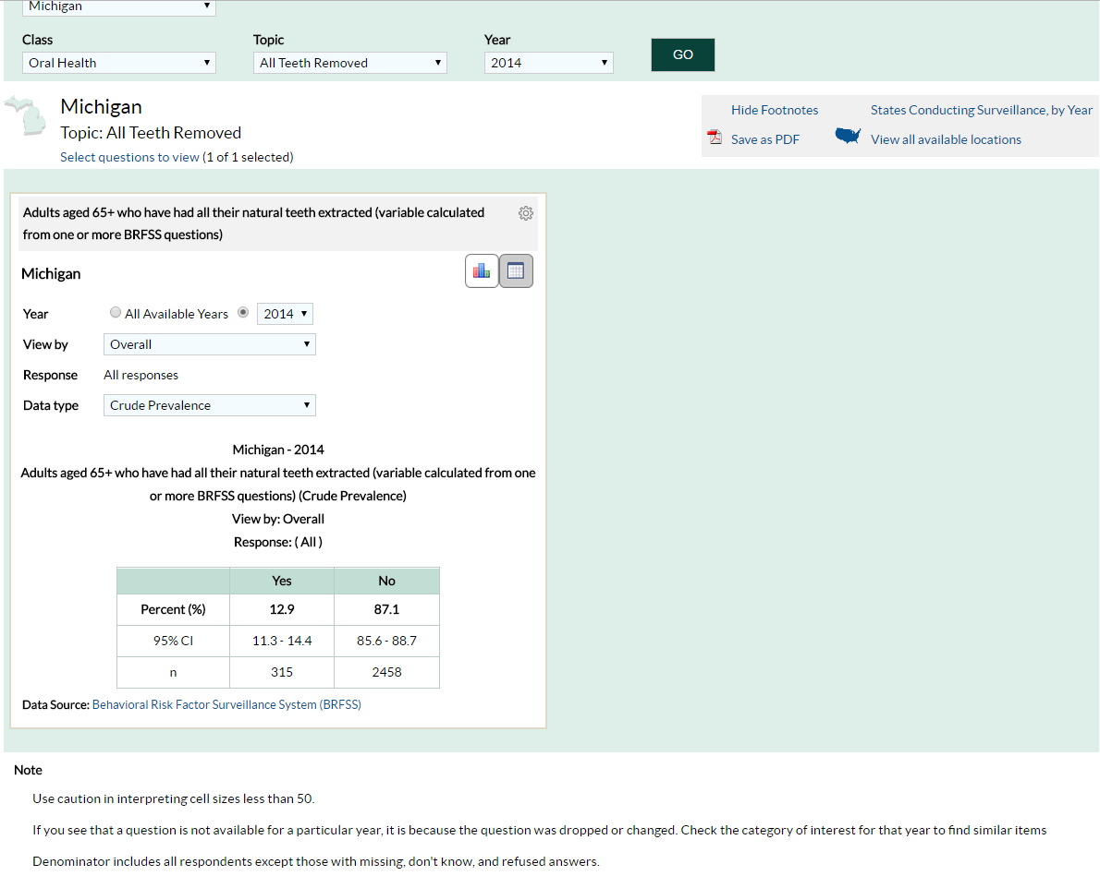
Notes:
Can also look by gender, age group, race/ethnicity, education attained, and household income.

Slide 34
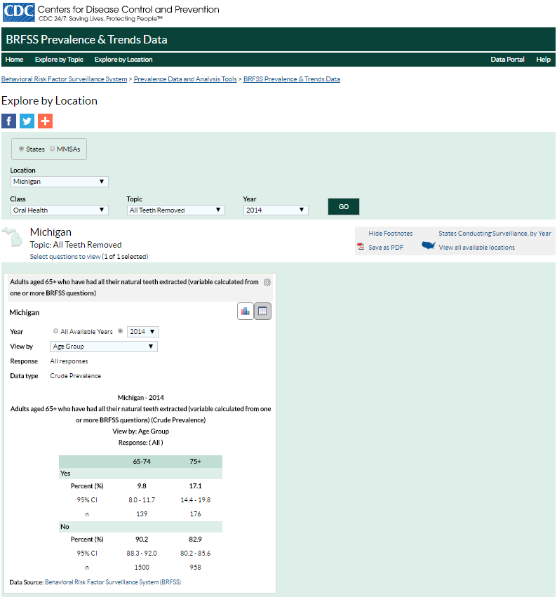

Slide 35
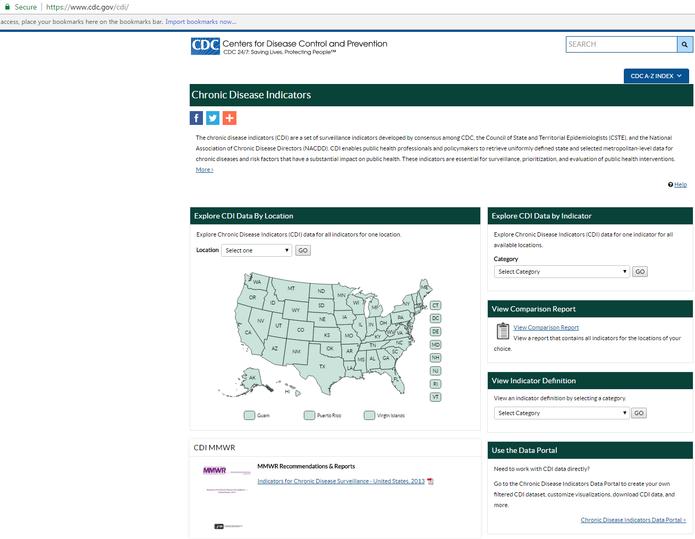

Slide 36
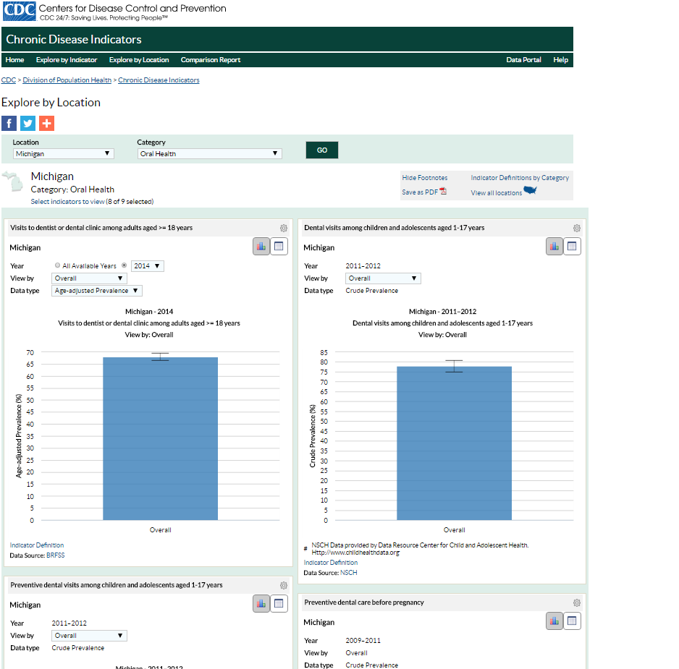

Slide 38
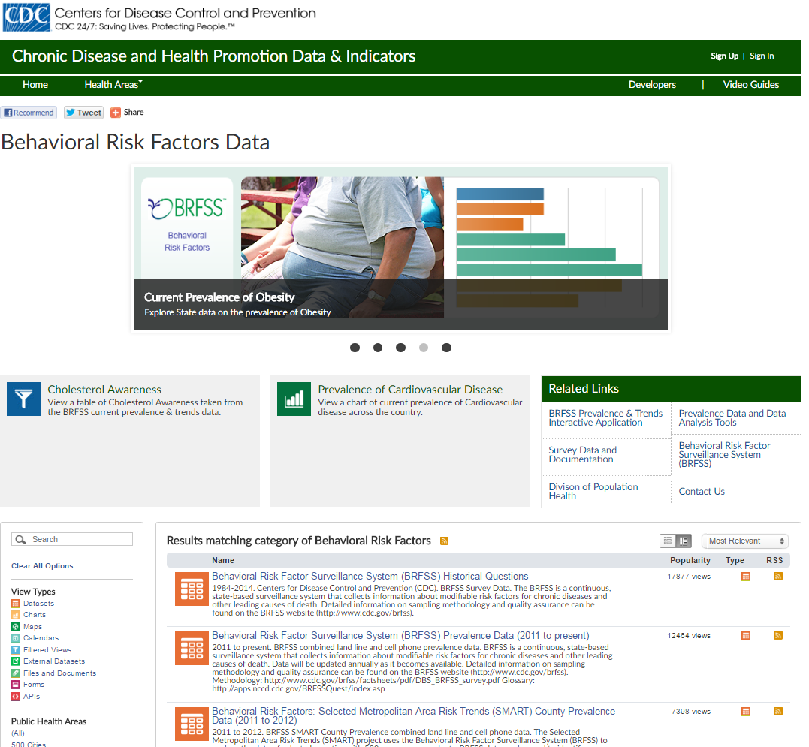

Slide 39
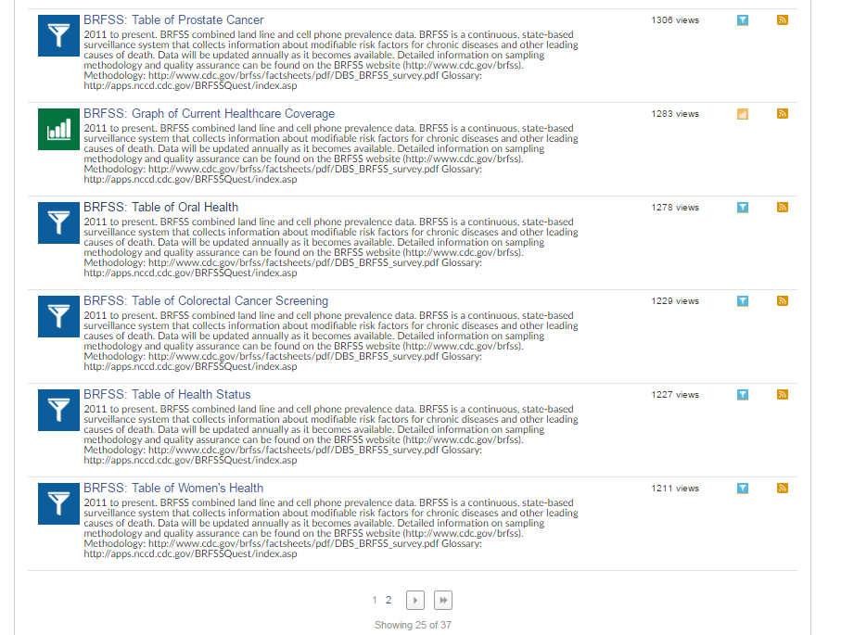

Slide 40
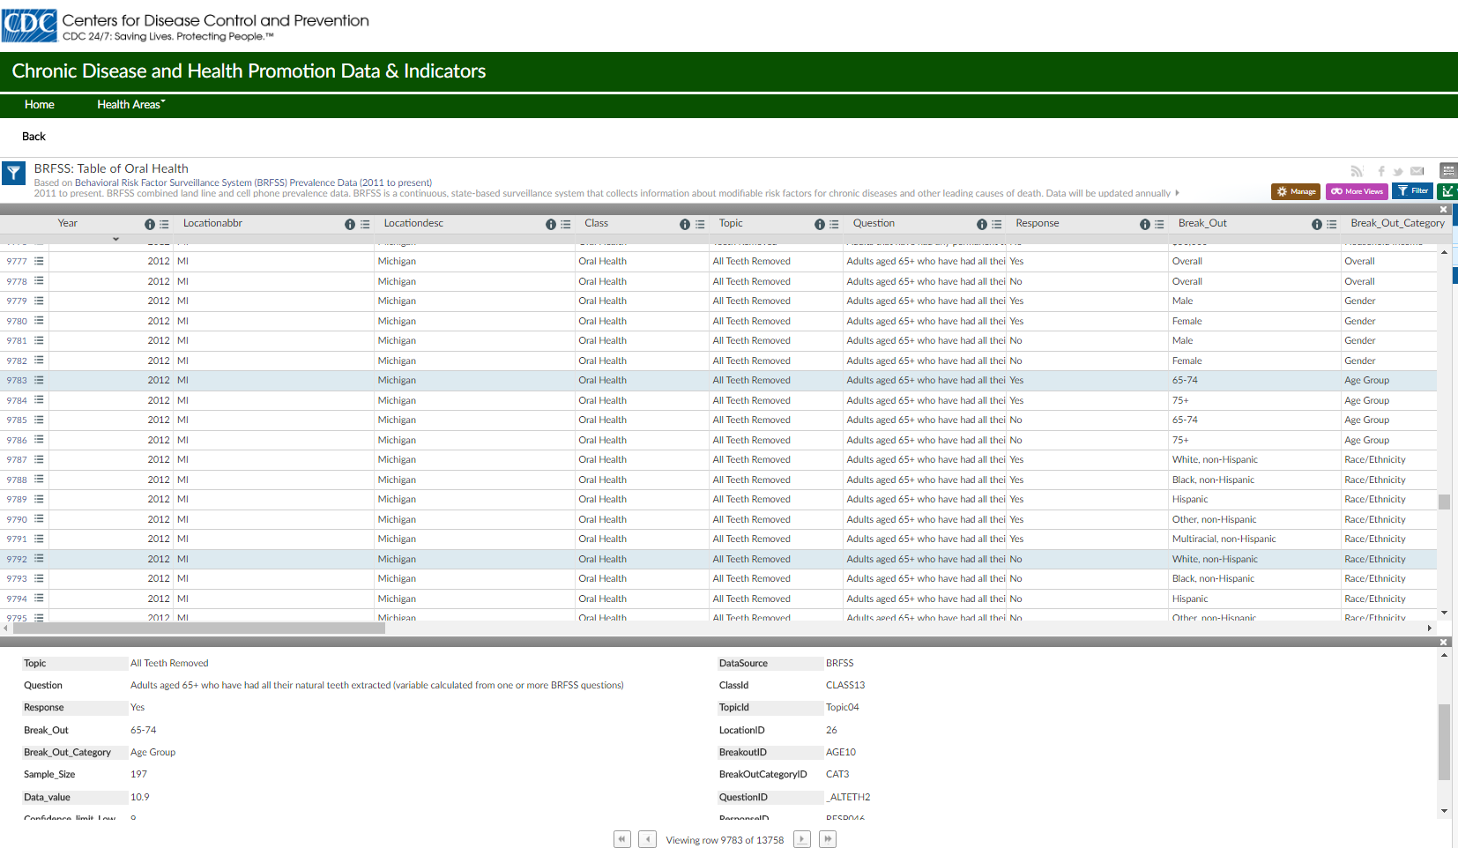

Slide 41
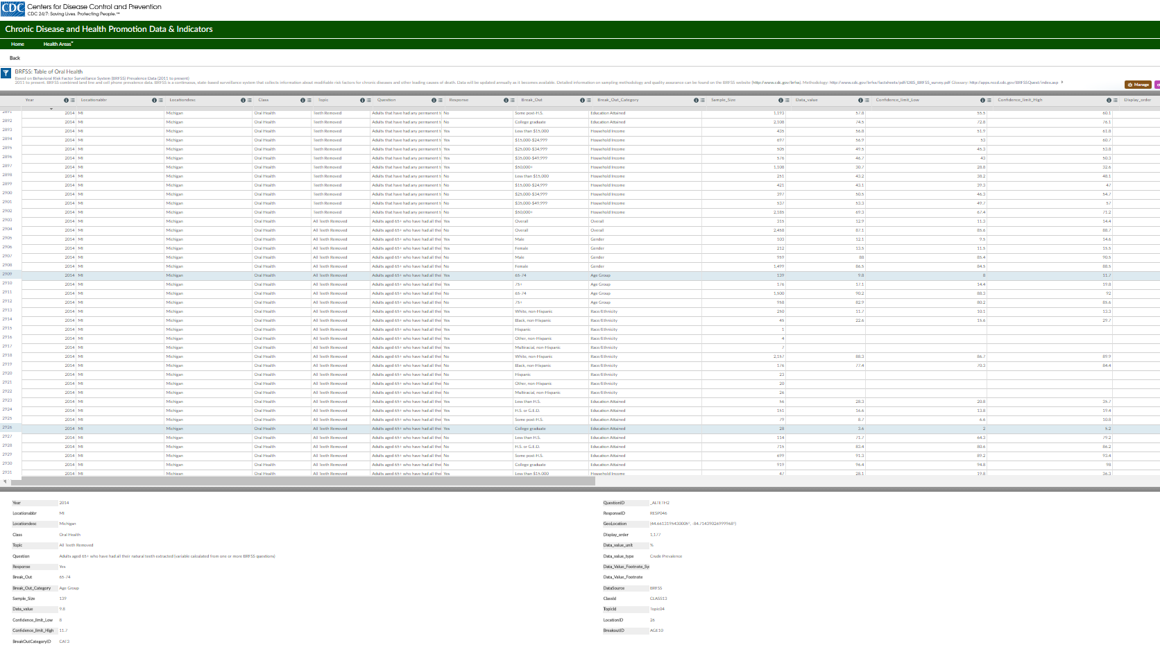

Slide 42
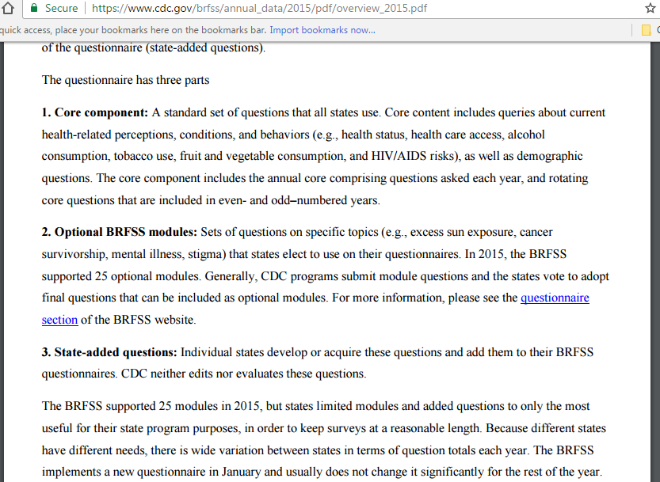

Slide 43
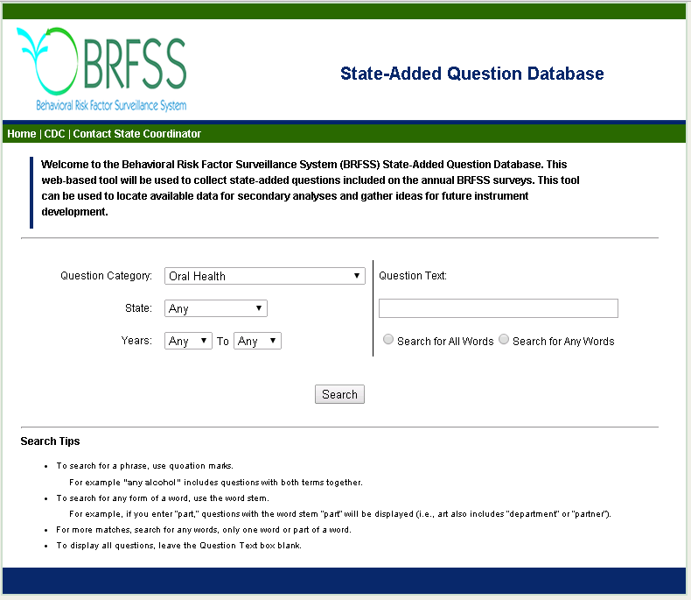
State Added Questions: https://www.ark.org/brfss_questions/default.aspx

Slide 44
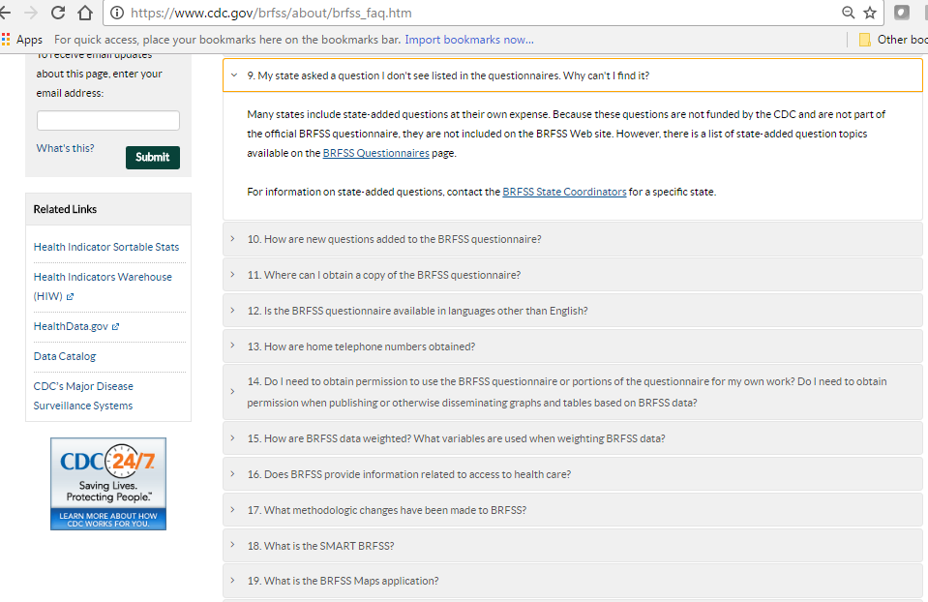

Slide 45

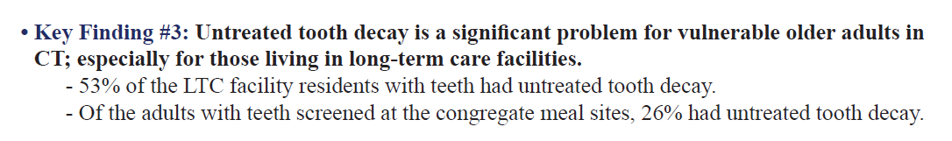
State Older Adult Surveillance Activities
ASTDD - Older Adults
www.astdd.org
Members section or links on the home screen
CDC website

Slide 46
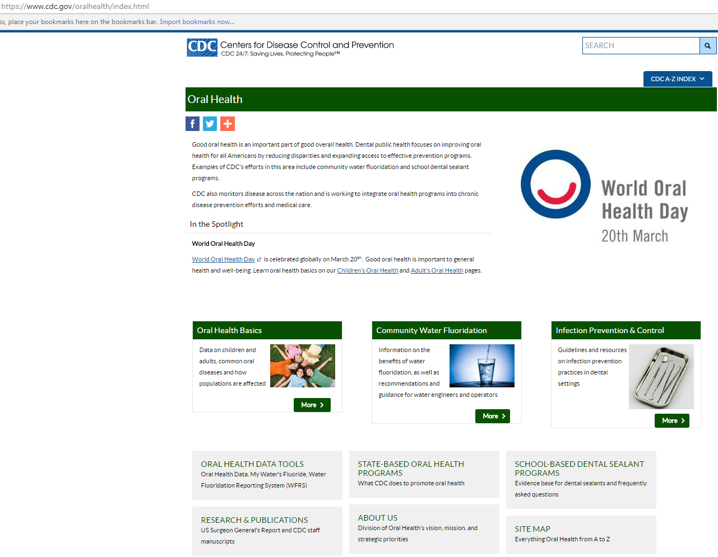

Slide 47
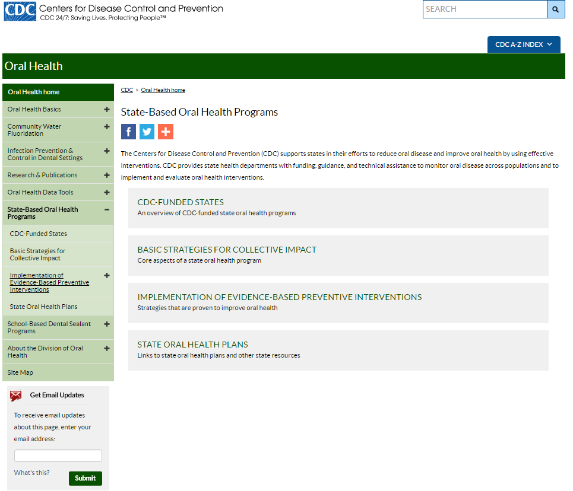

Slide 48
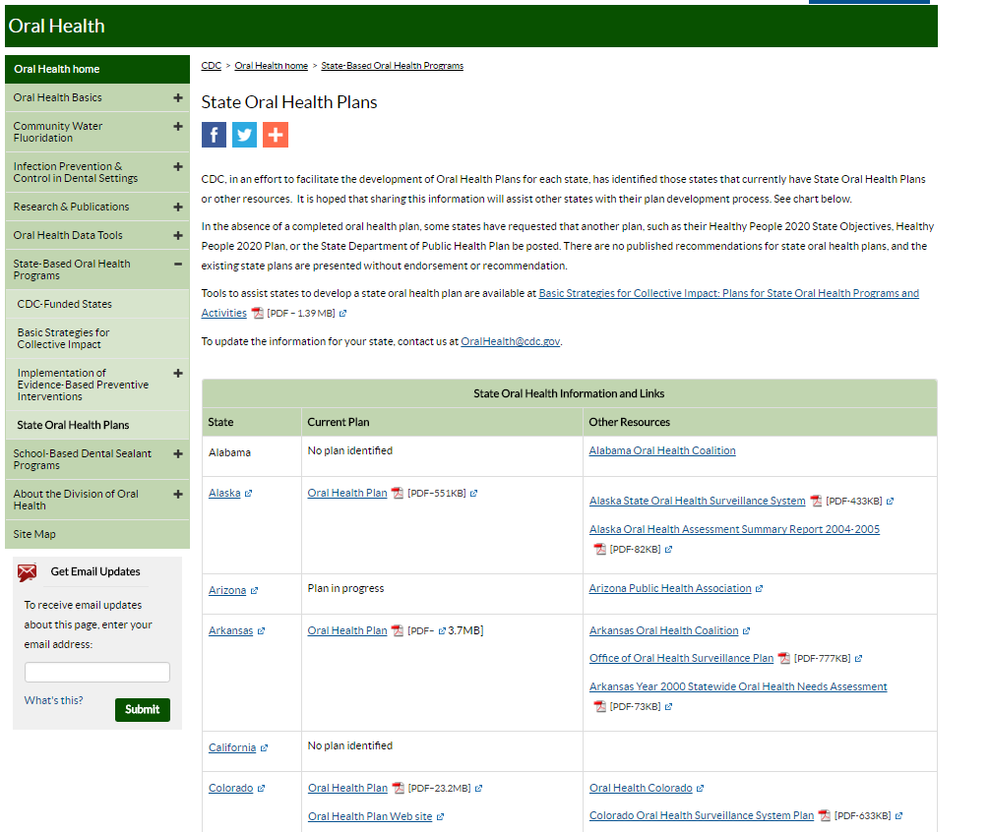

Slide 49
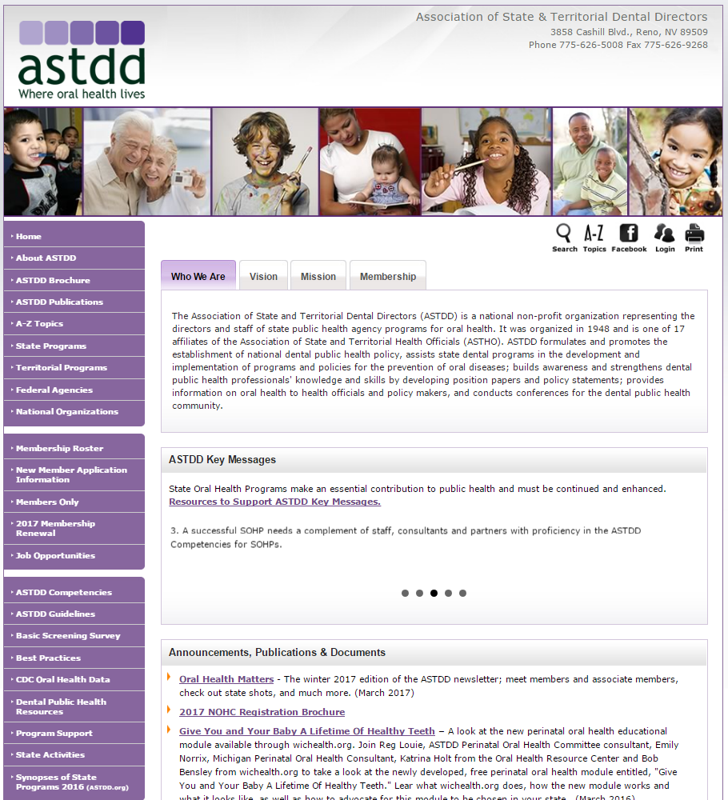
Notes:
Here are relevant links on the ASTDD website. There is a link to the CDC Oral Health Data website and the link to state activities is a place to look to see if states have done or are doing surveillance activities for older adults. We’ll take a closer look at the State Programs and Basic Screening Survey links.

Slide 50
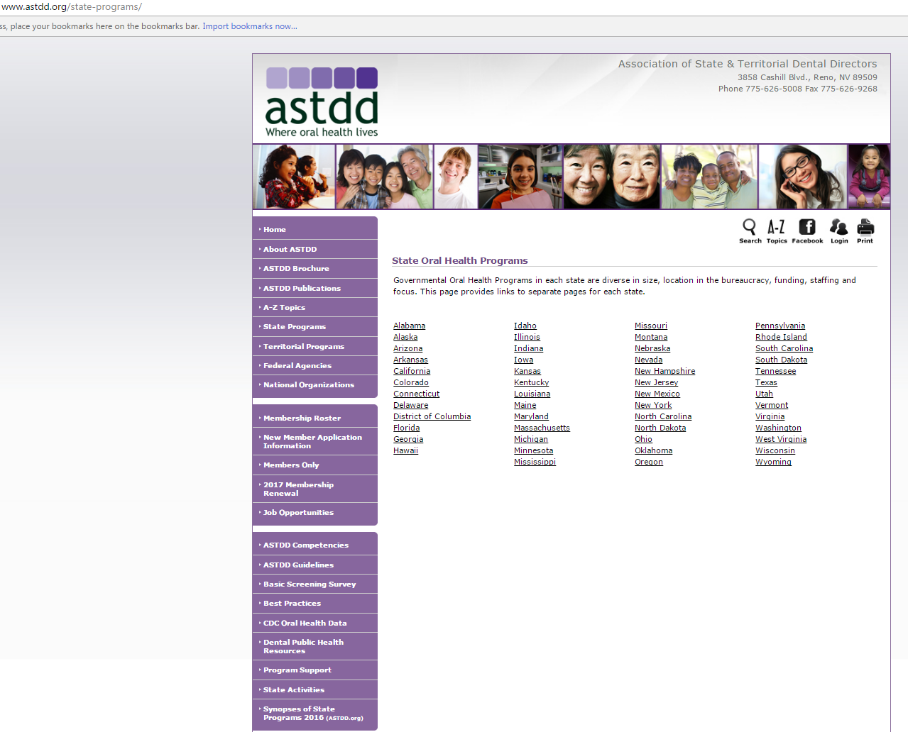

Slide 51
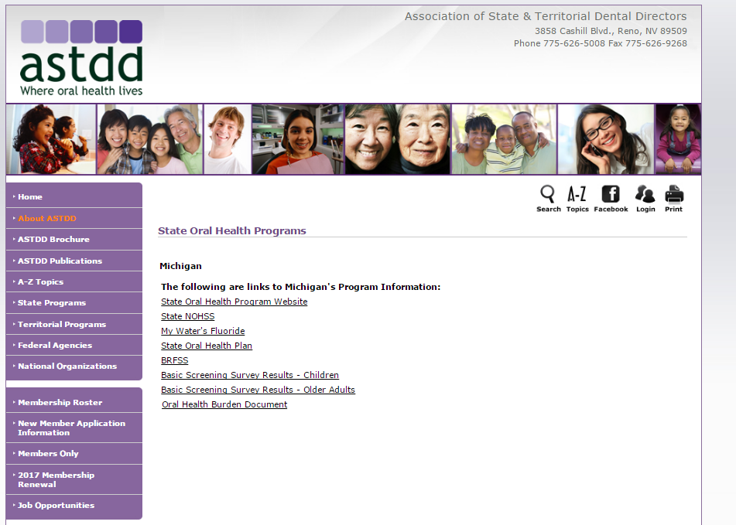

Slide 52


Slide 53
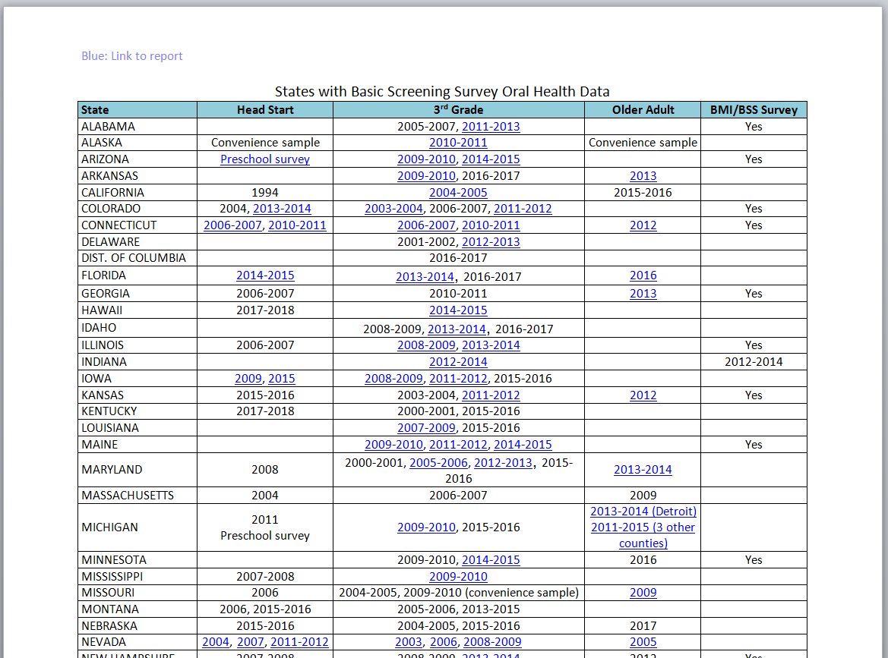

Slide 54
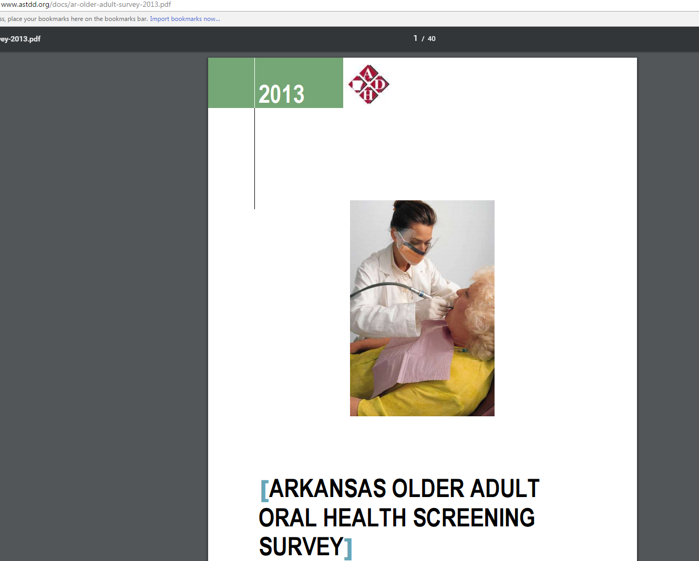

Slide 55
NOHSS
(National Oral Health Surveillance System)
http://www.cdc.gov/nohss/

Slide 56
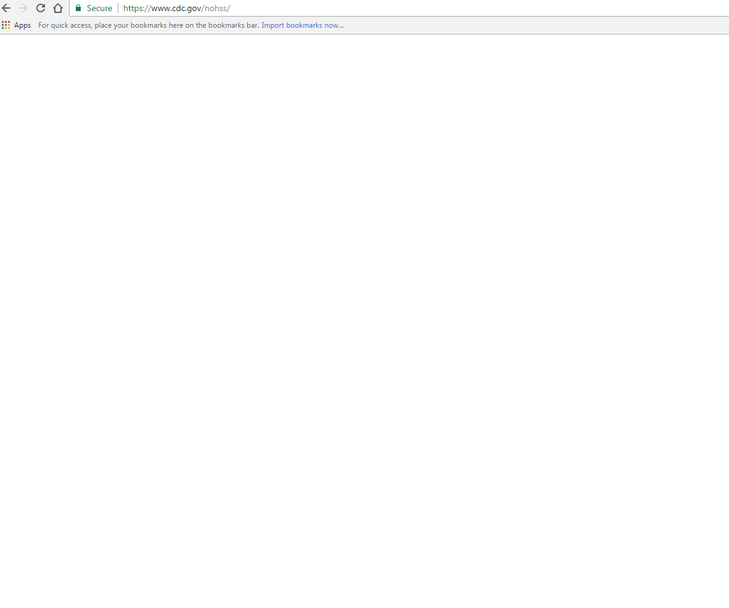

Slide 57
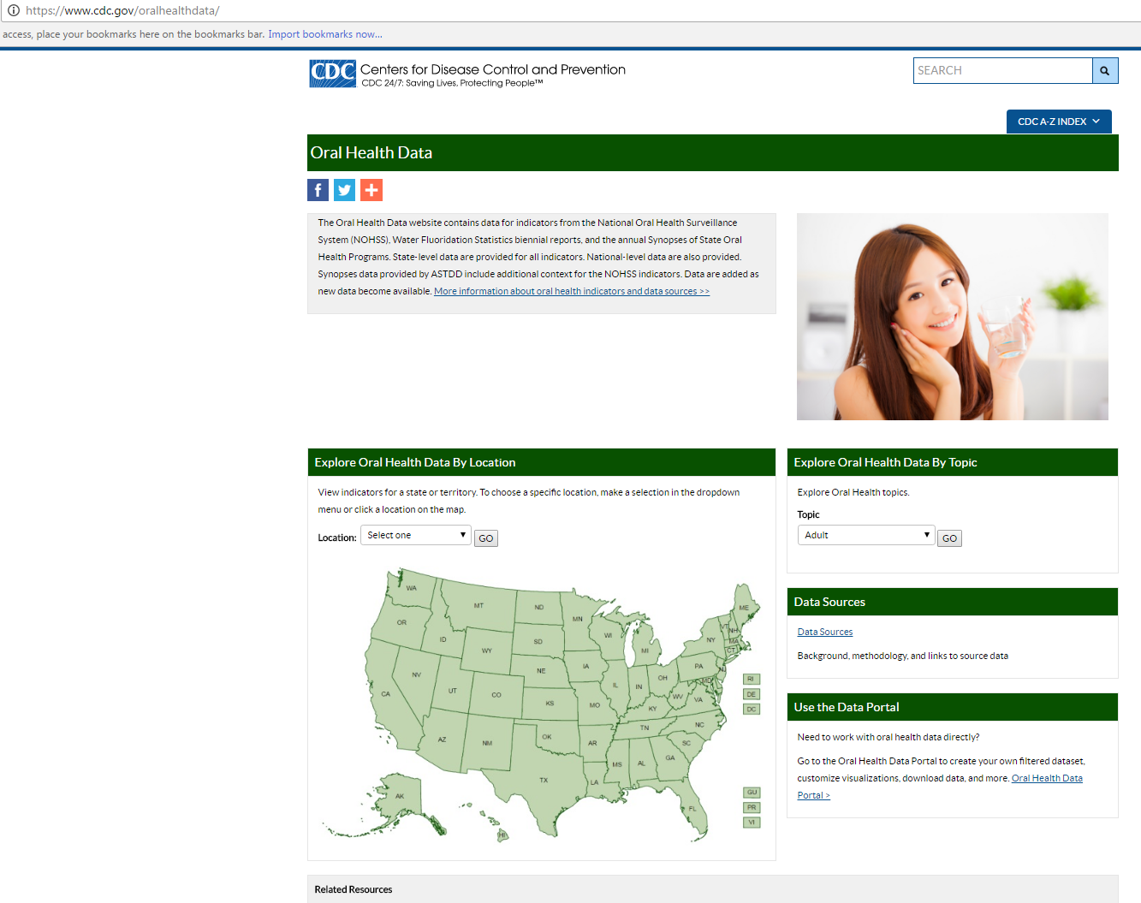

Slide 58
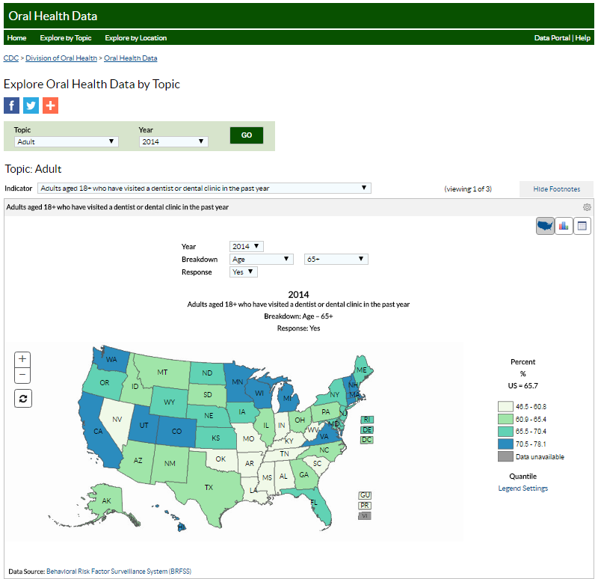
Notes:
Can again select 65+ with 6 or more teeth lost, 65+ with all teeth lost, or dental visit (and then do an age breakdown and select 65+,
Same options of map, chart, or table for data display
And can click on state in map to get state estimate and CI, and option to look at all oral indicators for your state.

Slide 59
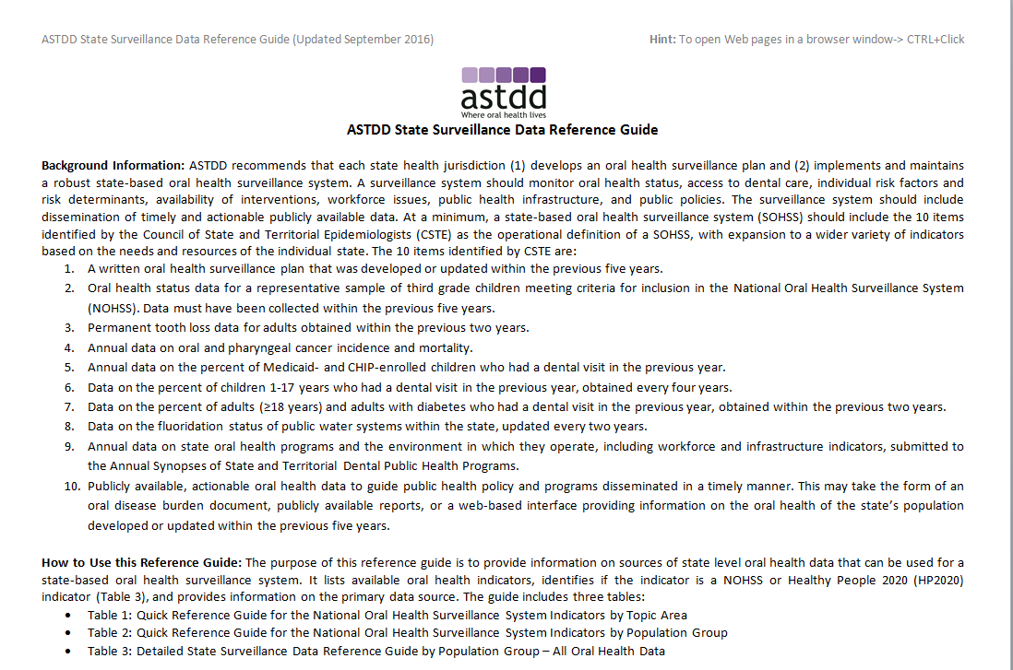
A-Z Topics – Oral Health Data and Surveillance – download link

Slide 60
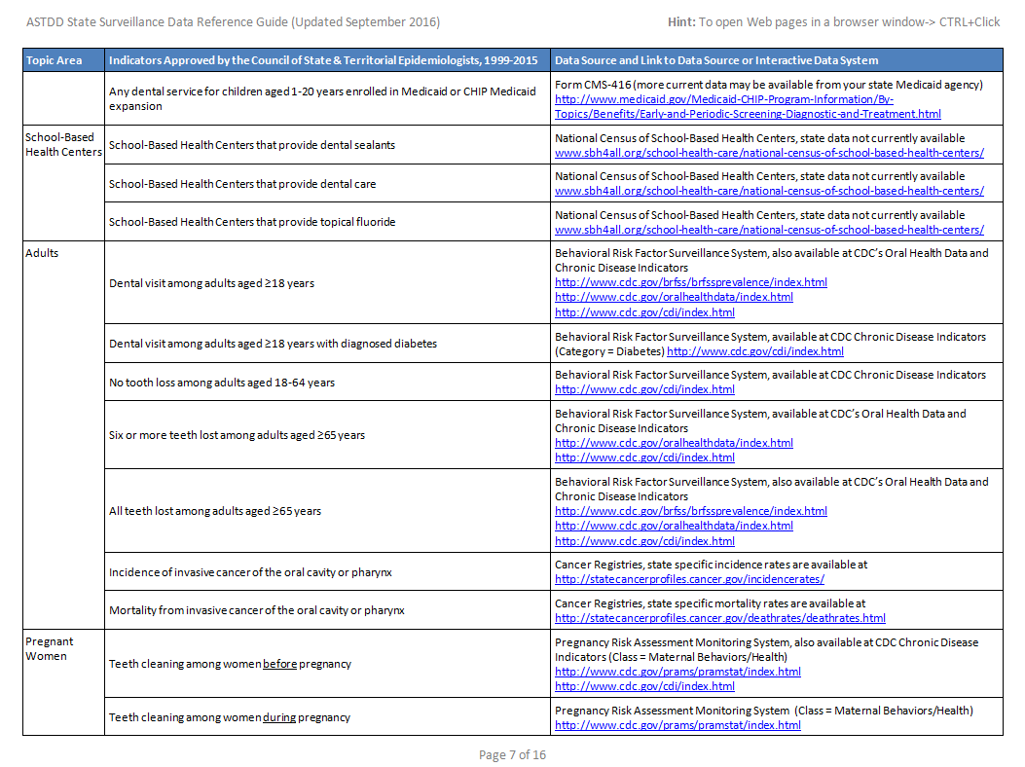

Slide 61
Oral Cancer Data
American Cancer Society
NIH National Cancer Institute
CDC National Program of Cancer Registries
U.S. Cancer Statistics
State contact and state vital statistics
(links in the State Surveillance Data Reference Guide)

Slide 62
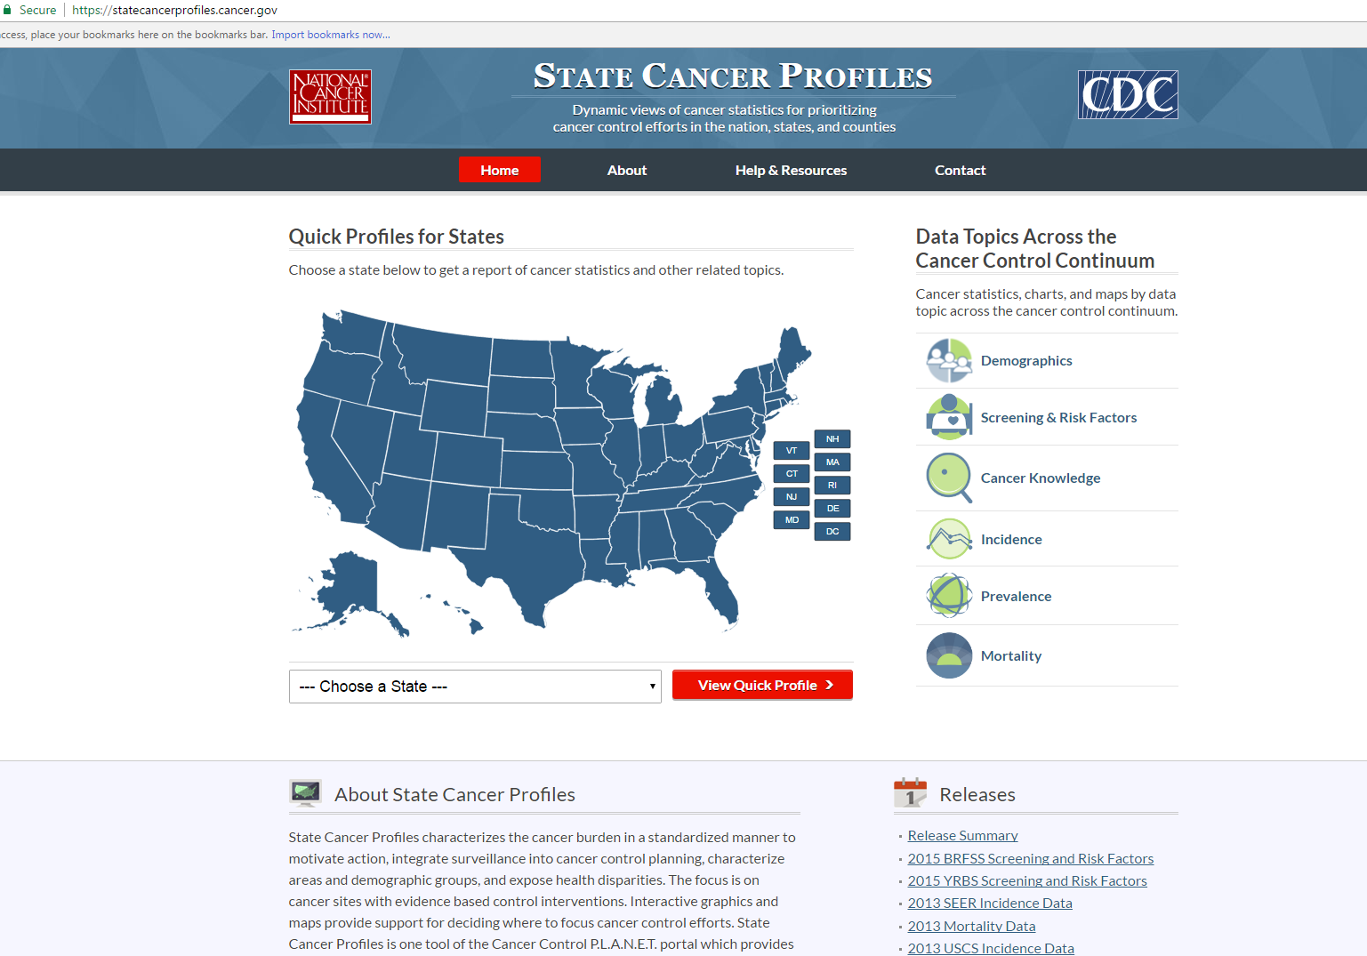

Slide 63
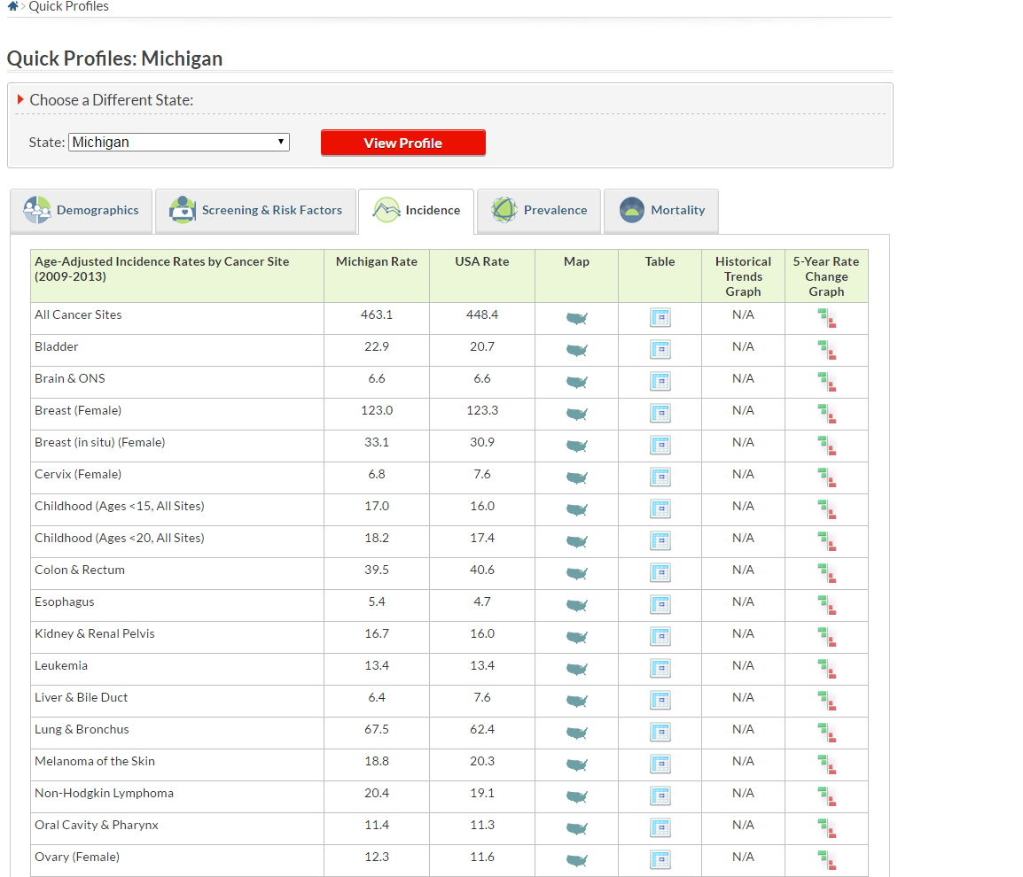

Slide 64
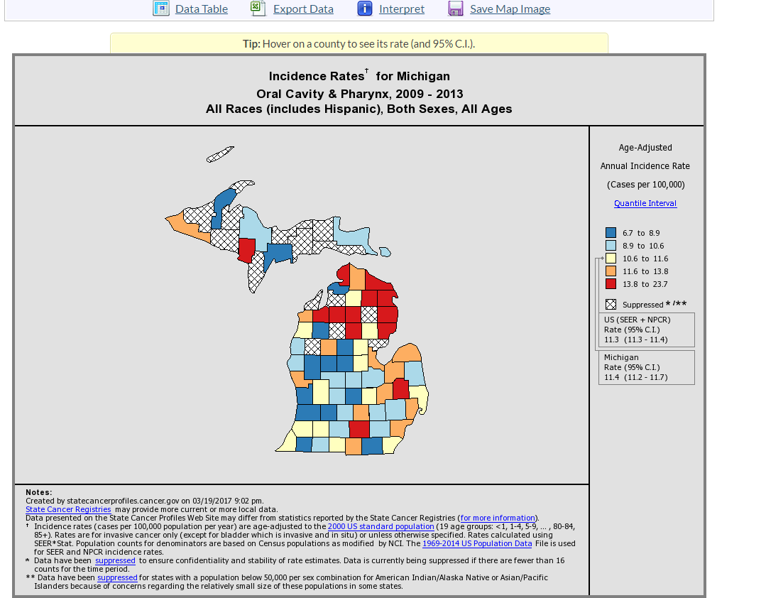

Slide 65


Slide 66


Slide 67


Slide 68


Slide 69


Slide 70


Slide 71

Nursing Homes/Residents
American Health Care Association
www.ahcancal.org
Research and Data tab, LTC Stats (OSCAR data), Nursing Facility Operational and Patient reports
The Henry J. Kaiser Family Foundation: http://kff.org/other/state-indicator/number-of-nursing-facility-beds/
Check your state (e.g. Michigan report updated March 2014 on MI DCH website)

Slide 72

Nursing Facility Data

Slide 73


Slide 74


Slide 75
Dental Insurance Data (Medicaid)
(Nat’l Academy for State Health Policy)
http://www.nashp.org/category/oral_health/
ADA
Individual state data
SOHP
State Medicaid
State Health Institute report?

Slide 76


Slide 77


Slide 78


Slide 79


Slide 80


Slide 81

Data in Context

Slide 82

ASTDD Resource
http://www.astdd.org/docs/oral-health-data-used-for-policy-05-12-2012.pdf

Slide 83

BRFSS Deep Dive
Kathy Phipps

Slide 84

Usual Presentation of BRFSS Data

Slide 85
BRFSS Deep Dive
Used publicly available BRFSS data sets
Analysis funded by private non-profit
Washington State BRFSS 2014

Slide 86
Washington BRFSS 2014
Core oral health questions
  Time since last dental visit
  Number of permanent teeth removed
State added questions
  Dental insurance
  Frequency of mouth pain during last year

Slide 87
Washington BRFSS 2014
Risk factors of interest
  Education, income, gender, race/ethnicity
  Smoking
  Overall health status
  Activity limitation due to health problems
  Health problems requiring special equipment
  Diabetes, pre-diabetes, coronary heart disease

Slide 88

Measure of Association: Odds Ratio

Slide 89
Odds Ratio (OR)
A measure of association between an exposure & outcome
Represents the odds that an outcome will occur given an exposure, compared to the odds of the outcome occurring in the absence of the exposure
OR = 1.0 = no association
The bigger the OR the stronger the association

Slide 90

Severe Tooth Loss
Adults 45+ Years of Age

Slide 91
Severe Tooth Loss
Adults 45+ Years of Age
Severe tooth loss = 6+ teeth lost
Variables with high association (Odds Ratio > 2.0)
  Age
  Education
  Income
  Smoking
Variables with lower association (OR >1.0 and < 2.0)
  Overall health status
  Disability
  Diabetes, coronary heart disease
  Dental insurance

Slide 92
Severe Tooth Loss
Adults 45+ Years of Age
Age Group | Odds Ratio
Age 45 to 54 (reference)
Age 55 to 64 | 1.8
Age 65 or older | 3.9
Education
Graduated from College (reference)
Attended College | 1.8
Graduated High School | 2.1
Did not graduate High School | 3.8
Income
$50,000 or more (reference)
$35,000 to less than $50,000 | 2.4
$25,000 to less than $35,000 | 2.3
$15,000 to less than $25,000 | 2.8
Less than $15,000 | 3.7
Smoking Status
Never smoked (reference)
Former smoker | 1.8
Current smoker | 4.6

Slide 93

Total Tooth Loss
Adults 65+ Years of Age

Slide 94
Total Tooth Loss
Adults 65+ Years of Age
Variables with high association (Odds Ratio > 2.0)
  Education
  Income
  Smoking
Variables with lower association (OR >1.0 and < 2.0)
  Race/ethnicity
  Overall health status
  Disability
  Diabetes
  Dental insurance

Slide 95
Total Tooth Loss
Adults 65+ Years of Age
Education | Odds Ratio
Graduated from College (reference)
Attended College | 1.9
Graduated High School | 2.4
Did not graduate High School | 4.8
Income
$50,000 or more (reference)
$35,000 to less than $50,000 | 2.1
$25,000 to less than $35,000 | 2.2
$15,000 to less than $25,000 | 2.3
Less than $15,000 | 3.4
Smoking Status
Never smoked (reference)
Former smoker | 1.6
Current smoker | 3.2

Slide 96

YOU HAVE DATA! Now what?!
Assessment “…is the regular and systematic collection, assemblage, analysis, and communication on the health of the community.”
- IOM: The Future of Public Health, 1988

Slide 97
Public Health Core Functions and 10 Essential Services
Evaluate and improve programs
Monitor health status and
understand health issues
facing the community
Maintain a competent
public health workforce
Protect people from
health problems and
health hazards
Research for new insights and innovative solutions to health problems
Give people the information they need to make healthy choices
Help people receive
health services
Engage the community to identify and solve health problems
Enforce public health
laws and regulations
Develop public health policies and plans

Slide 98

Communication
Brochure (template on ASTDD.org)
Fact sheet/Infographic
SOHP or Health Data website – briefs?
Messages: other chronic disease advocates
Communication strategy – depends on targeted audience (legislators, public, providers)
Senior Summit
Public Will building – awareness, funds to conduct specific data collection
Incorporate strategies in state oral health plan
Evaluate efforts using data as baseline data

Slide 99



Slide 100
Logo, picture
Here
Title of Fact Sheet Here
• Insert key data facts here
•
•
•
•
•
•
Insert graph/chart here
Insert photo/graph here
Insert here text on why issue is important

Slide 101

Next Steps
Best Practice Approach Reports (BPAR)
A Best Practice Approach is defined as a public health strategy that is supported by evidence for its impact and effectiveness. Evidence includes research, expert opinion, field lessons, and theoretical rationale.
A Best Practice Approach Report captures key information that describes the public health strategy, determines the strength of evidence, and illustrates implementation with current practice examples. The report serves as a resource to share ideas and promote best practices for state and community oral health programs.

Slide 102
Questions?
Contact information
Mike Manz: mmanz@umich.edu
Kathy Phipps: kathyphipps1234@gmail.com
Diane Brunson: diane.brunson@ucdenver.edu
Lori Kepler Cofano: lkcofano@gmail.com

