Slide 1
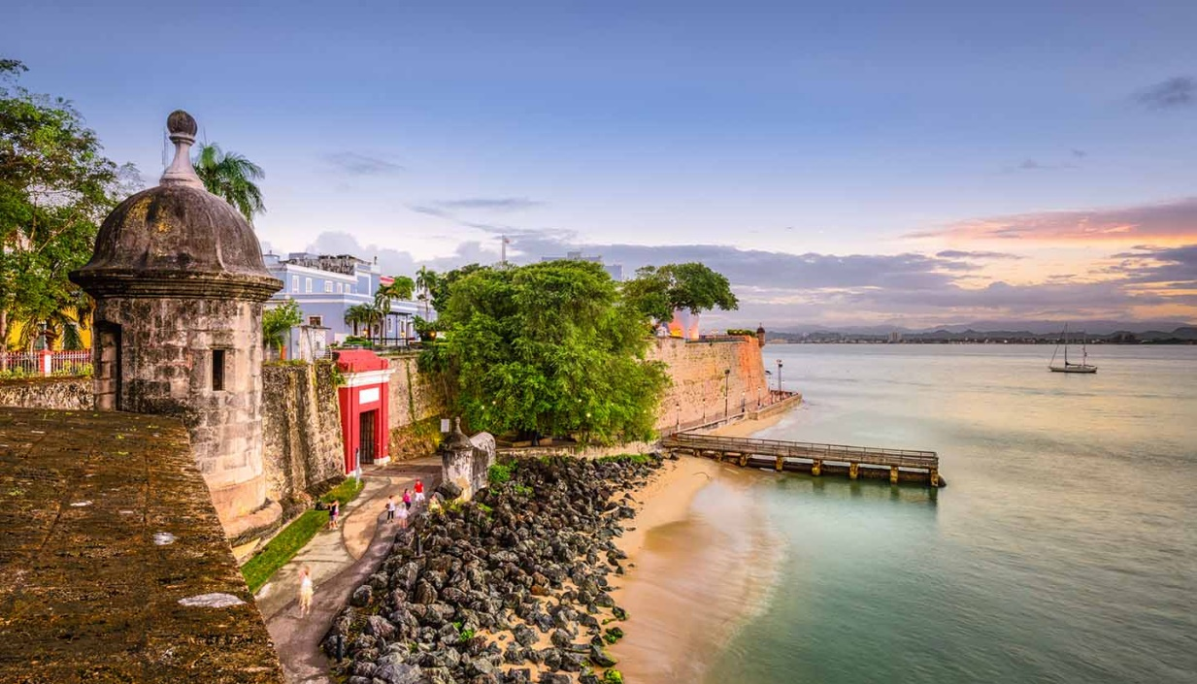
Public Health Challenges and Oral Health Successes Post Hurricane Maria’s Devastation
Elaine M. Pag$á$n,DMD,MS
Puerto Rico State Dental Officer
University of Puerto Rico Professor
Board Certified Pediatric Dentist

Slide 2
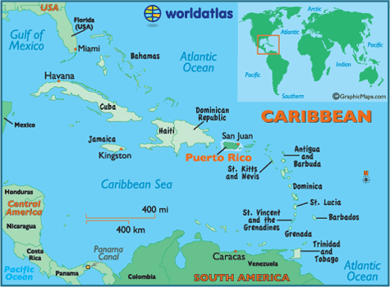
Unincorporated territory of the United States located in the northeast Caribbean Sea

Slide 3
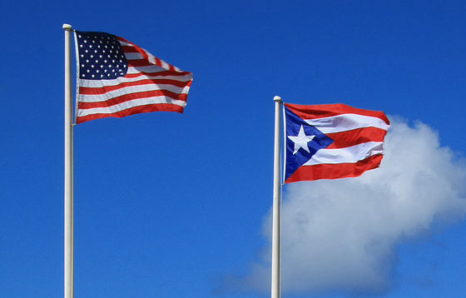
Introduction
US Citizens since 1917
Non voting member in House or Senate, but has a non voting Resident Comissioner
Financial challenges- since US financial crisis in 2006, has not recovered: migration, unemployment, schools merge
Since 2017 is ruled by a US Financial Board – restructuring debt
Languages – English and Spanish. Only 20% are fully proficient in English
Estimated population of Puerto Rico -3,195,153 a 14.24% decrease since the 2010 United States Census.

Slide 4
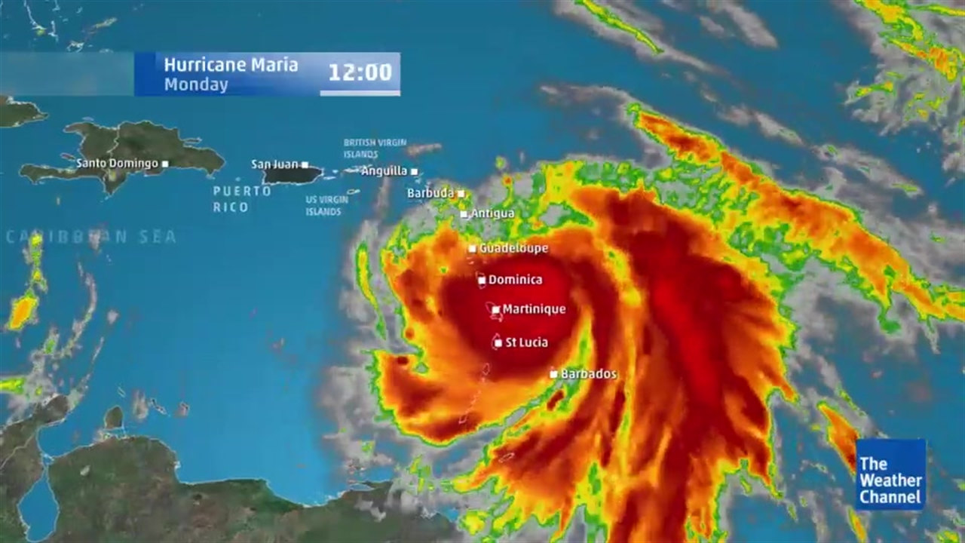
Background
YEAR | NAME | CATEGORY
1928 | San Felipe | 5
1935 | San Ciprián | 2
1989 | Hugo | 3
1998 | George | 1
2017 | Maria | 4-5

Slide 5
Oral health in Puerto Rico
ORALHEALTH PROGRAM DEPARTMENT OF HEALTH
YEAR | EVENTS
1954-1993 | Dual health system: private and public
1993 | Health reform – privatization of oral health services
2008 | Dental Director of DOHOHP retired and not replaced
2012 | State Dental Director Position – HRSA Grant. Expansion of DOHOHP. Oral Health Coalition and collaborative work `initiatives started.
2015 | Grant discontinued. State Dental Officer , educational program remained. Special projects started (School Based Program), collaborations remained.
2017 | USFBoard implemented in Puerto Rico – Hurricane Maria
2018 | Merge of DOH Programs – reorganization

Slide 6
ORAL HEALTH IN PUERTO RICO
Gingivitis - 2016 | Gingivitis prevalence is higher among 12-year-old Puerto Ricans compared to data reported for U.S. adolescents. Public schoolchildren presented significantly higher prevalence of gingivitis compared to private schoolchildren. Boys presented a significantly higher total and supragingival calculus prevalence than girls. Studies suggest that exists oral health disparities related to gender and school type.
Dental caries - 2016 | Early childhood caries studies- high prevalence 47 – 62 % Between 1997 and 2011, reductions were observed in caries prevalence (81 to 69 %), mean DMFT scores (3.8 to 2.5), mean DMFS scores (6.5 to 3.9), and mean SiC index (7.3 to 5.6) in both private and public schools, with a more prominent decrease in private schools. Between 1997 and 2011, overall the filled component increased (50 to 67 %), while decayed and missing component decreased (42 to 30 %) and (8 to 3 %), respectively.
Dental sealants | Comparable results of 1997 & 2011 establish that Prevalence of Sealed First Molars on public schools increased from 3.4% to 15.5% and in private schools form 11% to 28.0% There exist a disparity related to school type
Periodontal disease | The prevalence of moderate and severe periodontitis of Puerto Ricans was 44.5% compared to 20.7% in the NHANES 1999-2004 survey among 75 years and older
Oral cancer | Oral cavity and pharynx cancer was the fifth most commonly diagnosed cancer among men and the fifteenth in women of PR. Apparently, disparity exists in the early detection of Oral cancer in PR related to the US.
Dental insurance | Puerto Rico has one of the highest rate of health insurance coverage in the US at 92.5% Lowest rate of private health insurance at 40.8% and well below the US average of 60.8 percent Low dental insurance utilization rates : 40%

Slide 7
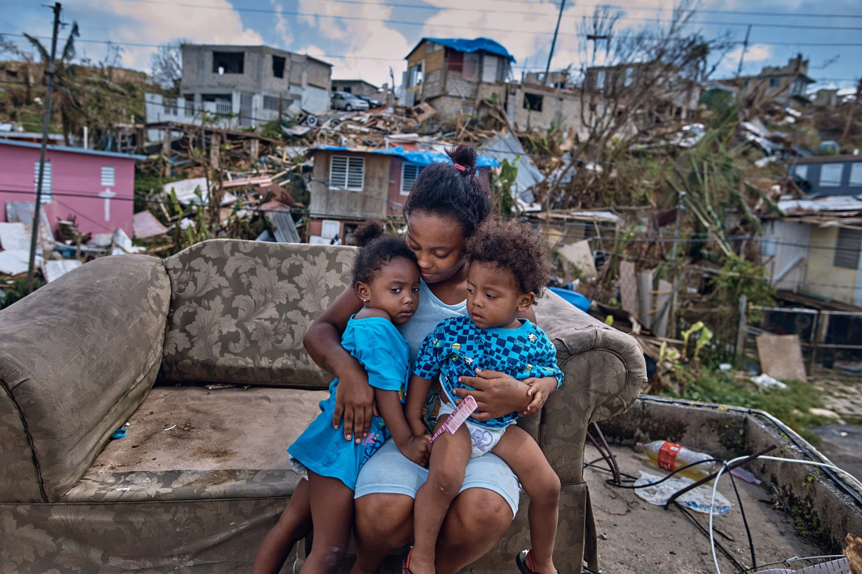
Hurricaine Maria September,2017
Severe damage to homes, other buildings and infrastructure
Migration to US (financial and medical reasons)
4,600 estimated deaths
1/3 of the recorded deaths- by interruption of medical services

Slide 8
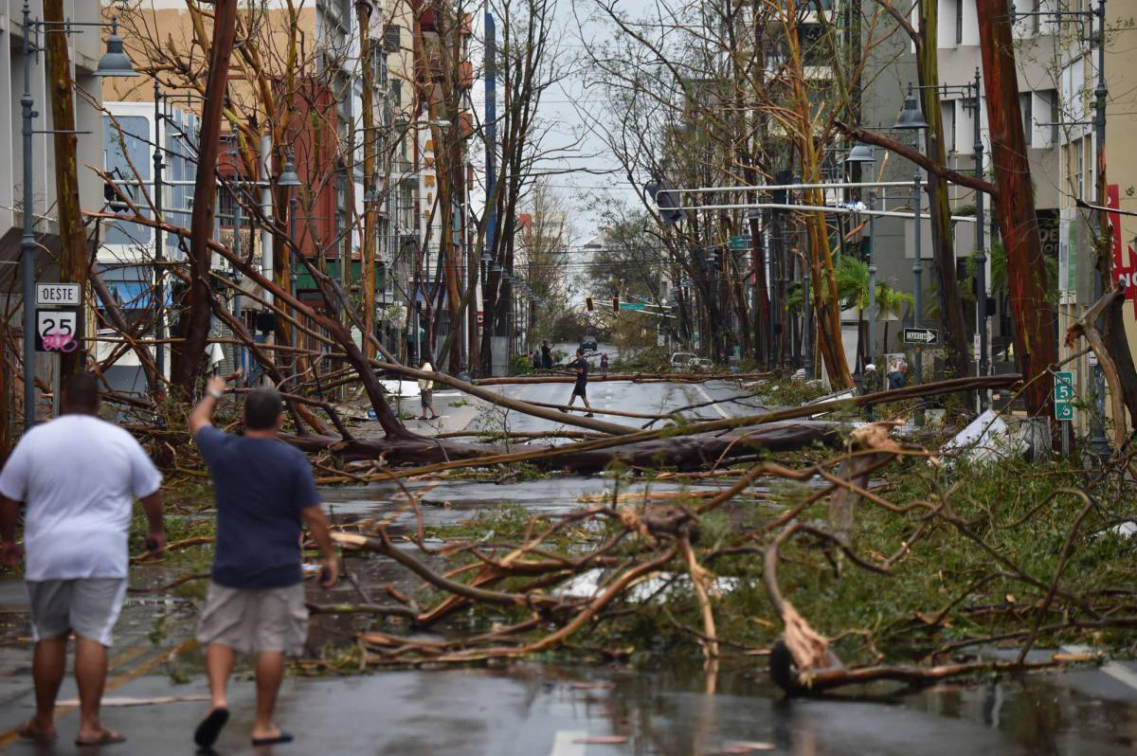
Immediate challenges after Maria hit…
Infrastructure damages
Equipment not working
Asepsia and infection control awareness
Barriers
Roads blocked, no access or difficult
Financial – no ATMs working, cash has to be saved.
Delayed support
Food
Emotional status
No utilities
Providers facing difficulties to work
Patient, providers and population
Patients and population without appropriate shelter or recovering
Worsens medical dental conditions
Electronic systems not working (EHR)
Materials
Fuel (generators, transportation)

Slide 9
Challenges
CHALLENGE #1. DECREASE IN THE NUMBER OF PRACTICING DENTISTS
2014 | 2016 | AFTER MARIA |  |  | ACTIONS
1495 | 1293 | 800 |  |  | 14 Law for retention of Medical Professionals, originally for specialists, is being reviewed to include GP Dentists
CHALLENGE #2. MANDATORY ORAL HEALTH CERTIFICATE IN SCHOOLS
2017 BEFORE MARIA |  |  | 2017 AFTER MARIA |  |  | 2018
#63 Law approved , implementation tasks started |  |  | #63 Implementation in place (moratory) |  |  | Process running
CHALLENGE #3. ACCESS TO TREATMENT / AWARENESS ACTIVITIES/ PUBLIC POLICY
2017 BEFORE MARIA |  |  |  | 2017 AFTER MARIA
Collaboration initiatives started |  |  |  | Collaborative work was clue in access to dental services

Slide 10
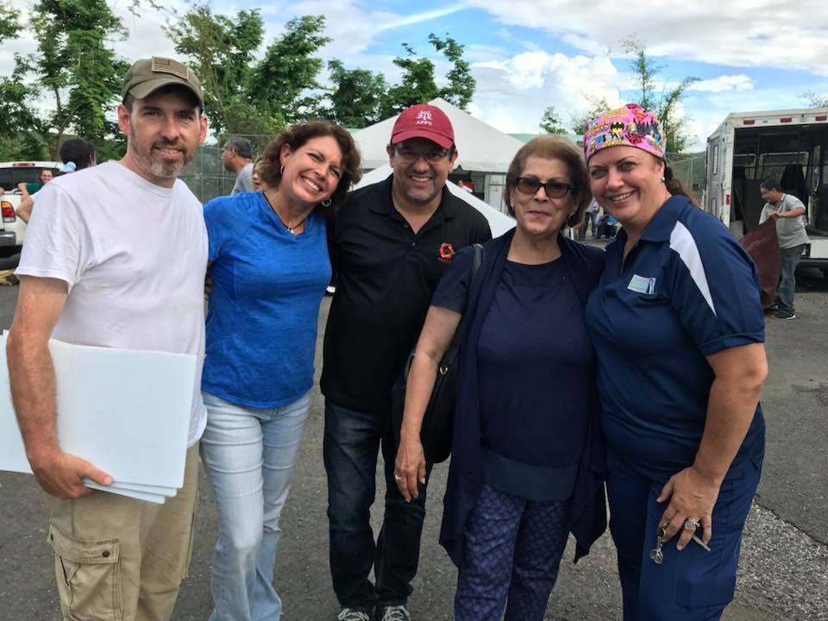
STRATEGIES
Asses
Plan and develop
Action
Communicate

Slide 11
María made us stronger……
STRATEGY | TIMELINE | ENTITY/INDIVIDUAL | INITIATIVE
ASSESMENT ACTION | 1 year | UPR Medical Sciences Campus/ DOH/ Private volunteers/ Government | Assessment brigades in remote areas, first response support
COMMUNICATE | First 2 months | Oral Health Coalition /DOH | Daily update and (radio/social media) inform the population of the dental professionals providing services
PLAN AND DEVELOP COMMUNICATE ACTION | 4 months | Puerto Rico Dental Society | Support to dental providers and family – economic, share office spaces
ACTION | From 1 month to present | UPR School of Dental Medicine | Provision of service for all population that comes for dental service in the Medical Center. Emergency services on call before, during and after the hurricane
ASSESSMENT PLAN AND DEVELOP COMMUNICATE ACTION | From 1month to present | Missionary Dentists of Puerto Rico Puerto Rico Dental Society UPR School of Dental Medicine Volunteer dentists Oral Health Coalition /DOH | Direct dental services to areas of difficult access or with no working providers

Slide 12
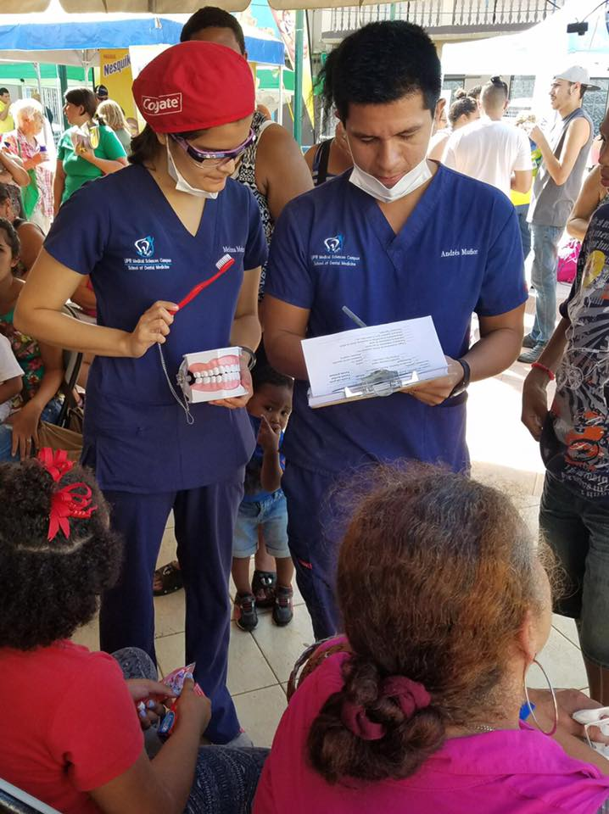
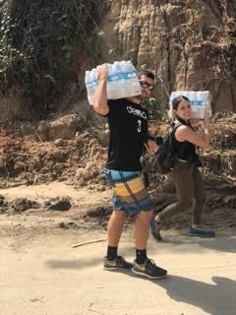

Slide 13
Future plans
Grant writing
Efficiency
Strengthening of collaborations
Oral Health State Plan – Water Fluoridation/sealants
HRSA States Oral Health Workforce
Other
Merge of personnel , integration of efforts
Continue joint initiatives
Collaborative grants and projects
Public policy
Law # 14 to include primary dental providers
Monitoring of compliance Law #63,
Strengthen relations of school-provider

Slide 14
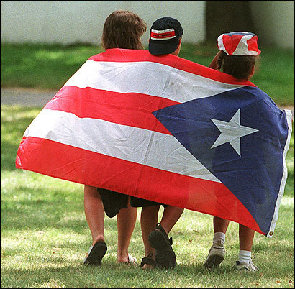
Conclusion
Crisis can bring good changes
Initiatives are better in collaborative work
Oral health improvement in Puerto Rico is key

Slide 15
