Slide 1
Standardization Testing Quiz

Slide 2
Testing Instructions
Ask each provider to:
1) Take out a piece of paper and number 1 - 13.
2) Record a response for each number after viewing clinical image on slides.
3) Response Choices:
YES – Seal tooth
NO – Do not seal tooth
4) Compare participant’s responses to answer key.
* this quiz can be used as a pretest and/or post test

Slide 3
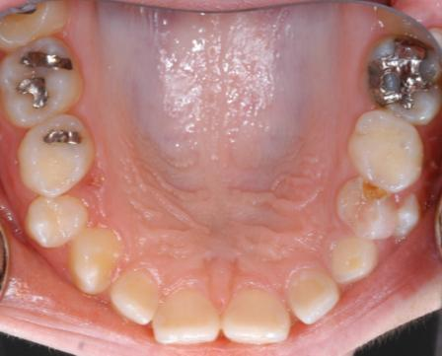
#1: SEAL or NOT SEAL?

Slide 4
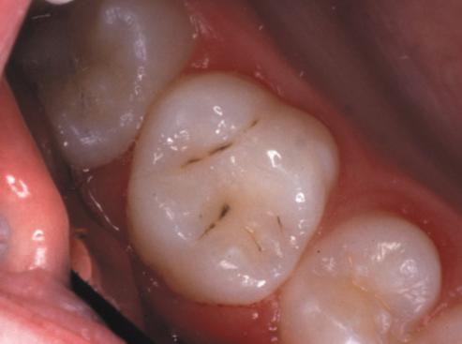
#2: SEAL or NOT SEAL?

Slide 5
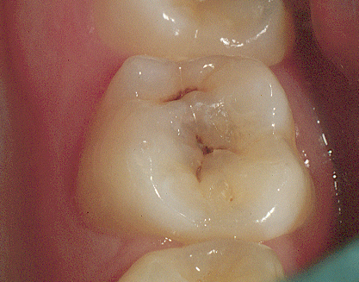
#3: SEAL or NOT SEAL?

Slide 6
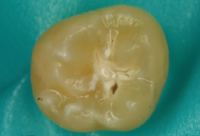
#4: SEAL or NOT SEAL?

Slide 7
#5 and #6: SEAL or NOT SEAL?
#6
#5

Slide 8
#7 - #10: SEAL or NOT SEAL?
7
8
9
10

Slide 9
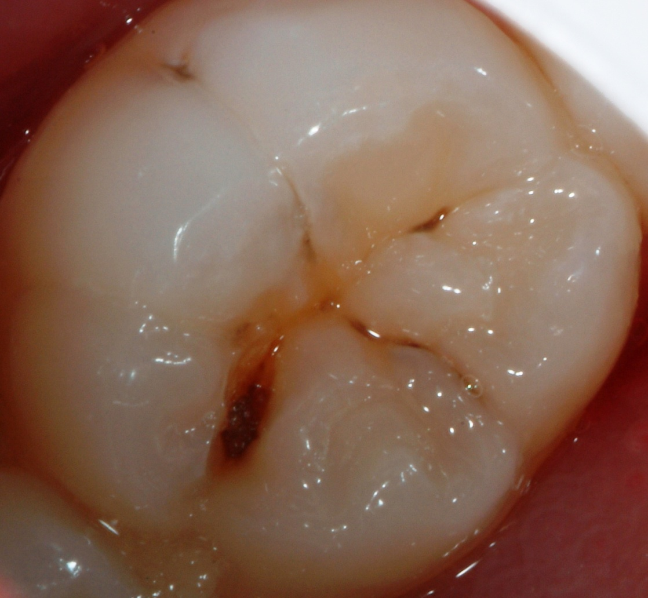
#11: SEAL or NOT SEAL?

Slide 10
#12: SEAL or NOT SEAL?

Slide 11
#13: SEAL or NOT SEAL?

Slide 12
Answer Key
1: No – interproximal decay
2: Yes – sound tooth surface
3: No – untreated decay
4: No – cavitated lesion
5: Yes – non-cavitated lesion
6: Yes - non-cavitated lesion
7: Yes – non-cavitated lesion/stain
8: Yes - sound tooth surface/stain
9: Yes - sound tooth surface
10: No - cavitated lesions
11: No - untreated decay
12: Yes - etched/dried tooth surface
13: Yes - non-cavitated lesion/stain

