Slide 1
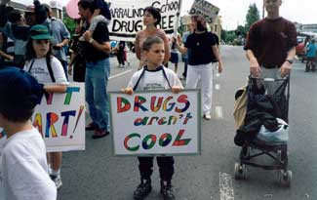
Connecting for Social Good
Using Social Marketing to Improve Oral Health
Linda Orgain, MPH Health Communications Specialist, Division of Oral Health
National Center for Chronic Disease Prevention and
Health Promotion, CDC

Slide 2
What is Social Marketing?
“The application of commercial marketing technologies to the analysis, planning, execution, and evaluation of programs designed to influence the voluntary behavior or target audiences in order to improve their personal welfare and that of their society.”
Alan Andreasen, 1995
Marketing Social Change
Notes:
Social marketing is a social or behavior change strategy.
It’s most effective
When it activates people
When it’s targeted to those who have a reason to care and who are ready for change

Slide 3
Key Principles
Target Audience
Desired Behavior
Benefits and Exchange Concept
Barriers
4 Ps
Price
Product
Place
Promotion
Sometimes Policy
Competition
Notes:
Policy – This is those laws and regulations that influence the desired behavior.
Examples – requiring sidewalks to make communities more walkable
-- Prohibiting smoking in shared public spaces

Slide 4
Social Marketing Model
The Social Change Program
HEALTH
PROBLEM
PRICE (Exchange)
What you do to impact why the audience will want or not want to do the behavior
NET PRICE = Benefits - Barriers
PRODUCT
The combination or bundle of price, place that you offer the target audience in order to enact the behavior
TARGET
AUDIENCE
BEHAVIOR
PLACE
What you do to impact where or how the audience can easily access the behavior or product (not message)
PROMOTION
How the offering is communicated to the target audiences: tone, feel, placement, spokesperson
Continuous evaluation/modification as needed
D. Kirby. 2004. Social marketing model to facilitate social change.

Slide 5
Enhances Existing Health Planning Models
Social Marketing is different
Audience Segmentation/Analysis
Exchange concept in behavior change
Marketing research (e.g., Epi) data
Potential competition
Social Marketing has some similarities
Interventions with multiple elements
Intermediate outcomes prior to behavior
Behavior change is the long-term goal
Can enhance existing health planning models

Slide 6
Target Audience
Recommended to segment the audience on a factor relevant to the desired behavior
Define as detailed as possible
Demographics
Geographics
Psychographics
Knowledge, attitudes, behaviors
Involve partners in developing the description of the target audience

Slide 7
Desired Behavior
Must be specific to the target audience
Must be something you can do
Be as precise as possible
Easier to link an evaluation to behavior if you are specific
Try to make the behavior measurable
Types of behavior change
New behaviors
Substitute behaviors
Avoidance behaviors
Think in terms of shaping behaviors
Suggesting change in small steps

Slide 8
Benefits/Exchange
What are the benefits to the target audience of doing the desired behavior
Benefits of doing the behavior must be greater than the barriers
Exchange: If you do X you will get Y
Tangible and intangible
Are there some non-health benefits associated with the desired behavior?

Slide 9
Barriers
What would hinder the target audience from doing the desired behavior?
Internal, e.g. skills, beliefs
External, availability of facilities
Related to the Ps:
Part of the Price – the cost of adopting a behavior
Part of Place – location of where to perform the behavior may not be close to home/work/school

Slide 10
4 Ps
Price:
The net price offered the target audience based on research
Place
How the behavior is made more convenient and accessible
Product
The bundle of Price and Place that is offered
Promotion
How you communicate with them about the other 3 Ps

Slide 11
Competition
The behaviors and related benefits the target audience is accustomed to – or may prefer – over the behavior you are promoting.

Slide 12
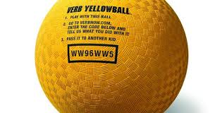
VERB^{tm} Campaign
VERB in a nutshell…
Target Audience
Desired Behavior
Benefits and Exchange Concept
Barriers
4 Ps
Competition
Notes:
VERB™ was a national, multicultural, social marketing campaign coordinated by the U.S. Department of Health and Human Services’ Centers for Disease Control and Prevention (CDC). The campaign had a simple mission:
Increase and maintain physical activity among youth ages 9-13, an age group known as tweens.
The VERB™ campaign owes much of its success to social marketing theory and the four Ps — product, price, place and promotion. Much like anti-smoking campaigns, the campaign combined paid advertising, marketing strategies and partnerships to reach a wide audience.
After just 1 year of advertising, 74% of tweens were aware of the VERB™ campaign. After 2 years, 68% of children exposed to the campaign reported increasing their physical activity.
Unfortunately, the campaign ended in 2006.

Slide 13
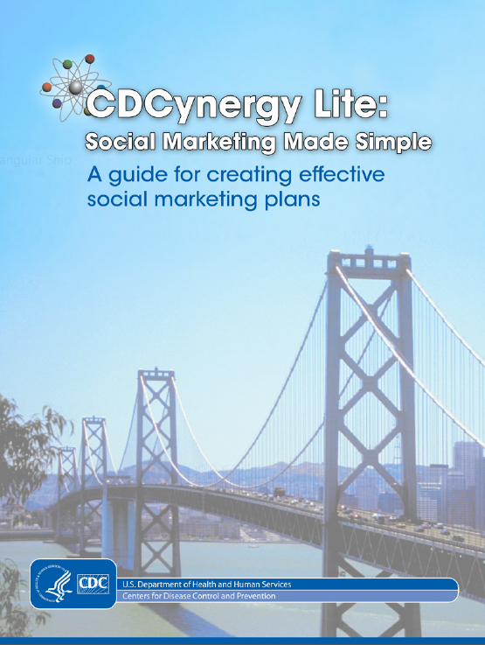
Resources
CDC’s Communication & Social Marketing portal
http://intranet.cdc.gov/oadc/tools/communication-social-marketing/
CDCynergy Social Marketing edition
M. Siegel & L.D. Lotenberg. Marketing Public Health: Strategies to Promote Social Change, 2nd ed. Sudbury, MA: Jones & Bartlett.

Slide 14
Thank you
Linda S. Orgain, MPH
LBO6@cdc.gov

