Slide 1

Oral Health is Health
Why State Oral Health Programs Matter
Notes:
State instruction: Add your program or health department logo top left

Slide 2
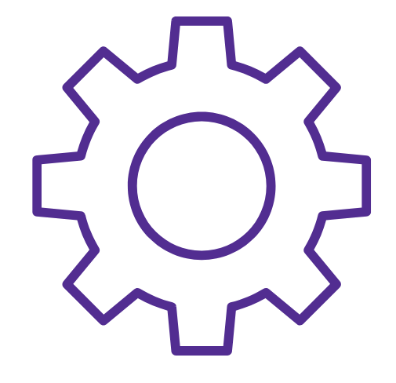
Why Oral Health Matters
Oral health = overall health, equity and opportunity
Impacts learning, nutrition, employment, self-esteem

Slide 3

The Personal Side of Oral Health
Notes:
State instruction: Short vignette or real-life example (child in pain, adult missing work, etc.) from your state to humanize the issue of oral health beyond the mouth.

Slide 4
The Challenge: Personal Burden in the U.S.
Education
Quality of Life
Overall Health
34 million
school hours
lost on average each year
23% of low income adults avoid social activities
ADA Health Policy Institute
Gum disease linked strongly with heart disease and diabetes.
due to unplanned or emergency dental care.
CDC, 2024
due to the condition of their mouth and teeth.
Oral health is critical
to overall health.
CDC, 2019
Notes:
Note to presenter:
For an alternative statistic related to school absences, consider the following North Carolina study, which found that children with recent dental pain were nearly three-times more likely to be absent from school
Citation: Jackson SL, Vann WF Jr, Kotch JB, Pahel BT, Lee JY. Impact of poor oral health on children's school attendance and performance. Am J Public Health. 2011 Oct;101(10):1900-6. doi: 10.2105/AJPH.2010.200915.
Link to the study manuscript: https://pmc.ncbi.nlm.nih.gov/articles/PMC3222359/

Slide 5


The Challenge: Personal Burden in [STATE]
Risk Behaviors, Chronic Disease, and Oral Health
Risk Behaviors, Chronic Disease, and Oral Health
Notes:
State instruction: Add your data points around cardiovascular disease, diabetes, etc.

Slide 6
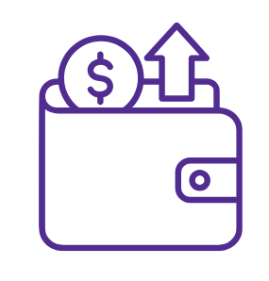
The Challenge: A Hefty Price Tag
Dental spending accounts for $139.7 annually, making it the second-highest healthcare spending category among all healthcare payers.
Source: Dieleman JL, Beauchamp M, Crosby SW, et al. Tracking US Health Care Spending by Health Condition and County. JAMA. Published online February 14, 2025. doi:10.1001/jama.2024.26790

Slide 7
From Medicaid to Military: The Cost of Inaction
In [your state], Medicaid/CHIP spent $XXXX on dental care
in 2024.
Dentists are the second-most frequent prescribers of opioids, contributing to $78.5 billion in annual costs. ASTDD, 2021
Annual costs of $3.4 billion to treat non-traumatic dental visits in emergency rooms. CareQuest Institute for Oral Health, 2022
Poor oral health among potential military recruits contributes to disqualification or requires expensive treatment. NIH, 2021
Notes:
State instruction: Add your state specific data/information where indicated.
Additional details re: bullets #2 and #3 above:
Dentists are the second-most frequent prescribers of opioids, contributing to $78.5 billion in annual costs related to health care, lost productivity, treatment, and criminal justice (ASTDD, 2021)
In 2019, there were 1.8 million hospital emergency department (ED) visits for non-traumatic dental conditions (NTDCs), which cost $3.4 billion to treat (CareQuest Institute for Oral Health, 2022)

Slide 8

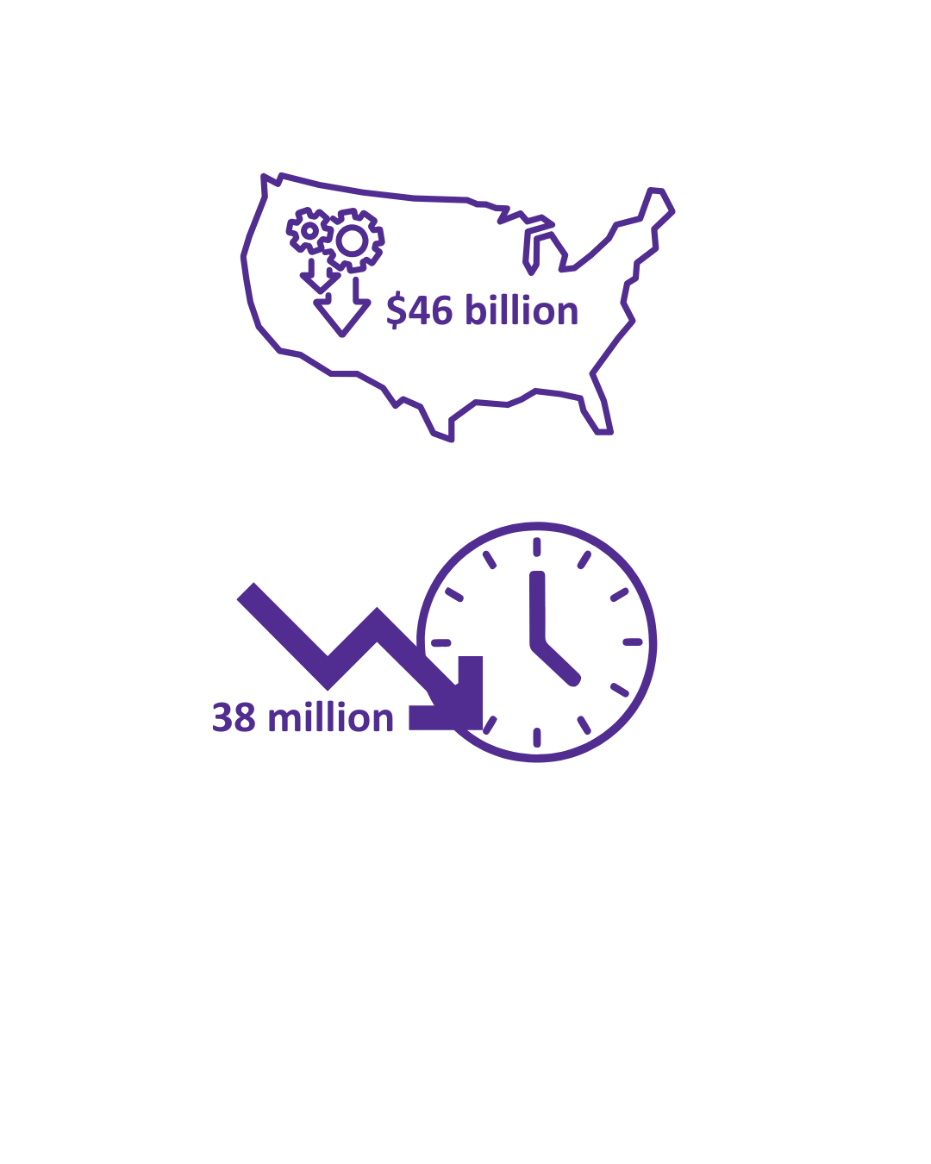
Oral Disease Reduces Employment and Productivity
29%
29% of low-income
adults say the appearance of their mouth affects their ability to interview for a job.
ADA Health Policy Institute
Untreated oral disease leads to $46 billion in lost productivity in the
U.S. each year.
CDC, 2024
Parents/caregivers lose 38 million productive hours annually due to children’s oral pain or unplanned dental visits.
CareQuest Institute for Oral Health, 2024

Slide 9
Impact on Employment and Productivity in [STATE]
Copy
Copy
Copy
Copy
Notes:
State instruction: Add your data about employment and productivity here.

Slide 10
Prevention Pays Off: Proven and Cost-Effective
Access to Care
Fluoridated Water
Dental Sealants
Medicaid enrollees with no preventive dental visits are
School sealant programs could save up to $300M by providing sealants to low-income children.
Providing one year of fluoridated water in the U.S.
8x more likely
to have an ER visit for a dental condition.
saves an estimated
$6.5 billion
in averted dental treatment costs.
CareQuest Institute for Oral Health, 2022
CDC, 2024
CDC, 2024
Notes:
Note: If you would like to replace any of the above with data related to dental disease prevention and pregnant women, or to offer this data verbally, consider this CDC resource.

Slide 11
Prevention Pays Off in [STATE]
Copy
Copy
Copy
Copy
Notes:
State instruction: Add your prevention data here.

Slide 12
State Oral
Health Programs (SOHPs)
Notes:
State instruction: Add a picture of your state health department or other state-identifying image in the gray area.

Slide 13

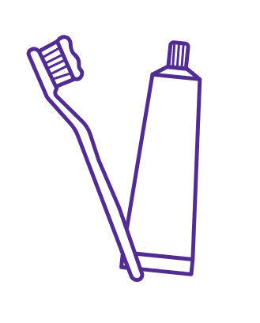
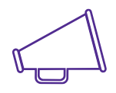
State Oral Health Programs (SOHPs)
Surveillance &
planning
Prevention
programs
Policy &
regulation
Convening cross-
sector partnerships
Workforce
development
Public health education
Community based dental public health programs
Notes:
SOHPs are the only entity positioned to lead this work statewide.
Note: Dental public health programs include integrating SDF application as part of medical care, integrating oral health into SUD treatment, pop-up dental clinics, etc.

Slide 14
Proof of Impact (Story)
Add a “human” story: family or community benefiting from SOHP services in your state
Notes:
State instruction: Add a story

Slide 15
Proof of Impact (Data)
Add state examples of improved oral health outcomes, especially among low-income and other at-risk populations
Add other metrics: sealant rates, fluoridation coverage, workforce placements
Notes:
State instruction: Add a state specific data

Slide 16

Partnerships Amplify Results

Slide 17
SOHPs Convene Broad Networks
Coalitions
Health centers and
hospitals
Schools and universities
Dental and medical associations
Insurers
and policymakers
Other governmental agencies
Notes:
State instruction: Name and describe the specific organizations that are part of your SOHP’s network. You can add additional circles and lines to the network graphic if needed.

Slide 18
Leveraged impact
State funding for SOHPs leverages impact by unlocking federal grants, foundation funding, and in-kind
partner contributions.
Enables SOHPs to convene coalitions and align
efforts across health systems, schools, insurers, and community organizations.
Modest cost of SOPH translates to statewide prevention programs that improve overall health and save dollars in treatment costs.
Notes:
State instruction: Add state-specific figures for bullet #3.

Slide 19

Partner Voices
Add quote here
Add quote here
Notes:
State instruction: Add partner quotes or testimonials, plus logos of trusted collaborators

Slide 20
[STATE] Partners and Funders
Add logos here
Notes:
State instruction: Add logos of your partners and funders on this slide.

Slide 21


Accountability to Funders
Notes:
Explain how you report to your funders and track program success, and if you have limitations or requirements.

Slide 22

Using Data for Impact
Demonstrate accountability
to funders and policymakers
Highlight disparities and target equity strategies
Guide program design
and policy
Share transparent results with partners and the public
Notes:
State instruction: Share any state-specific examples.

Slide 23

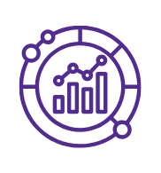
What it Takes for SOHPs to Succeed
Skilled leadership
and staff
Stable or increased funding
Policy support for prevention and workforce initiatives
Partnerships to expand reach and sustainability
Access to valid data
Notes:
State instruction:
For item #2, reference the state-specific budget and how that may have changed over time. Also consider referencing any current threats to funding (either on the slide or verbally).
For items #3 and #4, mention state-specific initiatives and partnerships.

Slide 24

The Vision
All people and communities in Vermont have equitable opportunities to achieve their highest level of health and well-being. This will not be possible without the work of a strong state
oral health program.
Notes:
State instruction: Update photo and copy for your state vision and imagery.

Slide 25

Together, we can make it happen.

Slide 26
Thank you!

